Slide 1
Final Present
Online Book Store Group 107 (CSC13002 – Introduction to Software Engineering)

Slide 2
Member of group
Trịnh Hoàng An _ 21127577 _ Leader ( PA0 -> PA6)
Ngô Nguyễn Thanh Thanh _ 21127690 _ Member ( PA0 -> PA6)
Trương Diệu Đạt _ 19127359 _ Member ( PA0 -> PA4)
Nguyễn Hoàng Quốc Tuấn – 21127198 _Member ( PA0 - > PA4)

Slide 3
Agenda
Introduction and Project Overview
Problem Statement and User Pain Points
Product Positioning and Unique Selling Proposition
Target Audience and Market Analysis
Project Management and Team Structure
Software Requirements: Use-Case Model and Non-Functional Requirements
Analysis and Design: Architecture and Technologies Used
Software Testing: Test Environment, Test Plan, and Results
Live Demo: Key Scenario of the Online Book Store
Conclusion and Key Takeaways
Q&A Session
Contact Information for Follow-Up
Thank You and Closing Remarks

Slide 4

Problem Overview
.Challenges in Online Book Buying:
Overwhelming selection.
Limited discoverability.
Lack of physical interaction.
Privacy concerns.
Growing Demand for Online Bookstores:
Accessibility and convenience.
Personalized recommendations.
Multiple book formats (e-books, audiobooks).
Global reach and diverse options.
Social features and community engagement.

Slide 5

User Pain Points
Common Pain Points in Online Book Shopping:
Difficulty in Finding Specific Books: Customers often struggle to locate specific books amidst the vast online catalog, especially when searching for rare or niche titles.
Lack of User Reviews: Shoppers rely on user reviews to gauge a book's quality, relevance, and readability. The absence of genuine, unbiased reviews can be frustrating.
Shipping Delays: Slow shipping or unexpected delivery delays can disrupt reading plans, particularly for those who want a book quickly.
Uncertainty in Book Quality: Online shoppers miss the tactile experience of physically inspecting a book. There's uncertainty about the book's condition, cover, and paper quality.
Privacy Concerns: Customers may hesitate to share personal information or financial details online due to data privacy and security concerns.

Slide 6
Advanced of my website
Advanced Search and Filtering: Our online bookstore offers a robust search and filtering system. Customers can refine their searches by genre, author, publication date, and more. We also employ AI-driven recommendations to help users discover books aligned with their interests.
Verified User Reviews: We ensure the authenticity of user reviews through a stringent verification process. Only users who have purchased and read the book can leave a review, reducing the likelihood of biased or fake feedback.
Fast and Reliable Shipping: We prioritize prompt delivery by partnering with trusted shipping carriers. Customers can track their orders in real-time, minimizing surprises and delays.
Book Quality Assurance: We provide detailed book descriptions, including information on cover materials, paper quality, and edition details. High-resolution images allow customers to inspect the book virtually.
Privacy and Security: Our website employs state-of-the-art encryption and security protocols to safeguard customer data. We also offer anonymous checkout options, reducing the need for extensive personal information.
Satisfaction Guarantee: We offer a hassle-free return policy, allowing customers to return books if they are not satisfied with their purchase for any reason.

Slide 7

Vision Statement
The problem of : +You can't find the book you're looking for in a bookstore ? +You can’t go to the book store because some problem such as the store’s very far ? +The store can reach for more reader ?
Affects : Bookstore owner and reader
The impact of which is : That reader can’t find type of book or that book buy at store has much more money than real value of that book That the bookstore owner can’t find the way to attract the customer so that the bookstore is increasingly sluggish
A successful solution would be : That the book will be able to the reader faster and the bookstore maybe increase the revenue

Slide 8

Product Position Statement
For : Bookstore onwers and Readers
Who : Sell and buy books
The (product name) : Online Book Store
That : Allows bookstore to sell the book fasters and the readers can buy the book with good Price
Unlike : Tiki, shopee, Lazada
Our product : Can guarantee the book are real and reach to the reader most accurately

Slide 9

Target Audience
Insights about their Needs and Preferences in Online Book Shopping:
Avid Readers: These individuals seek a wide variety of genres and enjoy discovering new authors. They value personalized recommendations and user reviews to make informed choices.
Students: They often require textbooks and academic materials, emphasizing affordability, fast delivery, and digital format options for convenience in study.
Professionals: This group may be interested in professional development books, industry-specific titles, or business literature. They prioritize efficient search features and reliable delivery for timely access to relevant material.
Parents: Parents look for children's books, educational resources, and age-appropriate content. They appreciate curated selections and content tailored to different age groups.
Niche Interest Groups: Some readers have specific niche interests (e.g., history buffs, sci-fi fans). They value easy access to specialized books and communities of like-minded enthusiasts.

Slide 10
Market Analysis
Market Size: The global online book market is substantial, with sales reaching hundreds of billions of dollars annually.
Growth Potential: The market continues to expand, driven by the increasing adoption of online buying book , and growing internet penetration. Emerging markets represent significant growth opportunities.
Current Trends:
Personalization: Online bookstores are utilizing AI and machine learning to offer personalized book recommendations, enhancing the user experience.
Promotion of new and popular books: In the context of fierce competition, online bookstores regularly update and promote new and popular books to attract customers' attention.
Better customer care: Online book selling websites are focusing on creating a better experience for customers. This includes online support, quick responses to customer questions, and improved returns and refunds processes.
Fast Delivery Services: To compete with physical stores, some online booksellers are increasing their delivery services to meet customer demand, including same-day delivery or expedited delivery fast.
Quality and Care: Online book stores are concerned with providing books with good quality and good care to ensure that the books are delivered to customers intact and undamaged.

Slide 11
Project Management : Team Structure
Trịnh Hoàng An : Project Report, Vision Document, Usecase_Spec, Testing, Powerpoint, …
Ngô Nguyễn Thanh Thanh : Backend development, Frontend development, report …
Trịnh Hoàng An | Ngô Nguyễn Thanh thanh
Quality Assurance (QA) Project Manager Business Systems Analyst | 1.Test Automation Engineer 2.Quality Assurance (QA) 3.Development

Slide 12
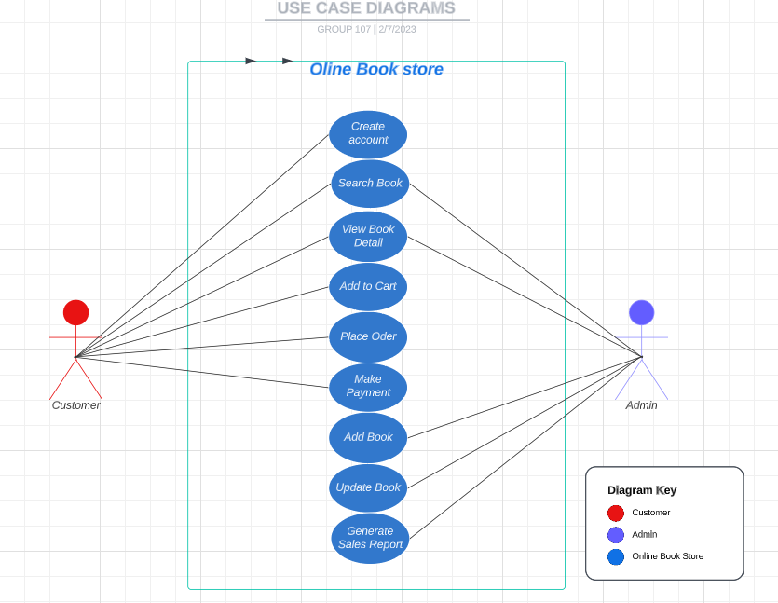
Software Requirements

Slide 13

Non-Functional Requirements
Security:
Data encryption to protect personal information and user accounts.
Secure login sessions to maintain user account integrity.
Protection against DDOS and SQL injection attacks to ensure website availability.
User Experience Standards:
User-friendly and intuitive user interface to create an easy and comfortable shopping experience.
Optimization of the checkout and ordering process to minimize shopping

Slide 14
Architecture
Architecture of Our Online Book Store
Front-end Components: + User Interface (UI): This is the customer-facing part of our website, designed to be user-friendly and responsive. It includes product pages, search, and the shopping cart. + User Experience (UX): Our UX design focuses on making the website intuitive and visually appealing. It ensures smooth navigation and a seamless shopping experience.
Back-end Components: + Server: We employ a robust server to handle incoming requests, manage user sessions, and serve content. Our server is capable of handling high traffic loads efficiently. + Application Logic: This layer manages the core functionalities of the platform, including user authentication, product management, and order processing. + Database: We use a relational database management system (SQLlite3) to store user data, product information, and transaction records securely.

Slide 15
Technologies Used
Technologies and Tools Utilized in Developing Our Online Book Store
Front-end Technologies: + Tailwindcss: For structuring and styling web pages, providing a visually appealing interface. + Typescript: Used for client-side scripting, providing interactive features and enhancing user experience. + React.js: A JavaScript library for building user interfaces, ensuring high performance and responsiveness.
Back-end Technologies: + Python: As our primary back-end programming language, we use Python for server-side logic and data processing. + Django: Python web frameworks used for building the back-end server, handling routing, database operations, and more. + Database: SQL Lite3, a powerful open-source relational database management system, ensures data security and scalability.

Slide 16
Software Testing : Test Environment
Testing Environments Used: Katalon
Local Development :We use Katalon for unit testing and initial development.
Development Staging: Integration and system testing are conducted here using Katalon.
Security Testing: Katalon conducts penetration testing and vulnerability assessments.
Test Data Generation: Katalon generates test data for different scenarios.

Slide 17
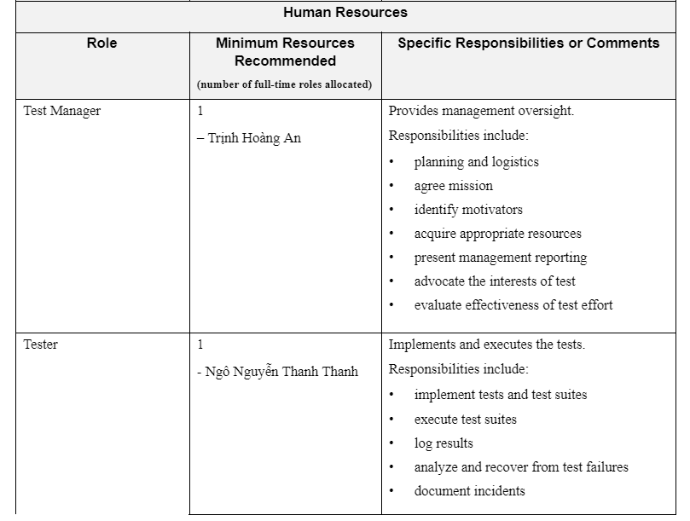
Software Testing : Test Plan

Slide 18
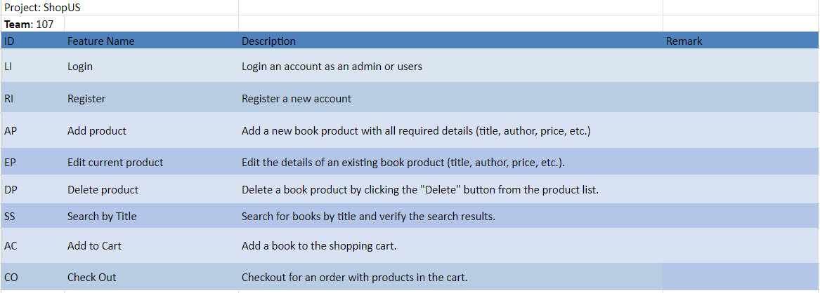
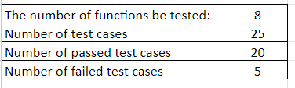
Test Results

Slide 19
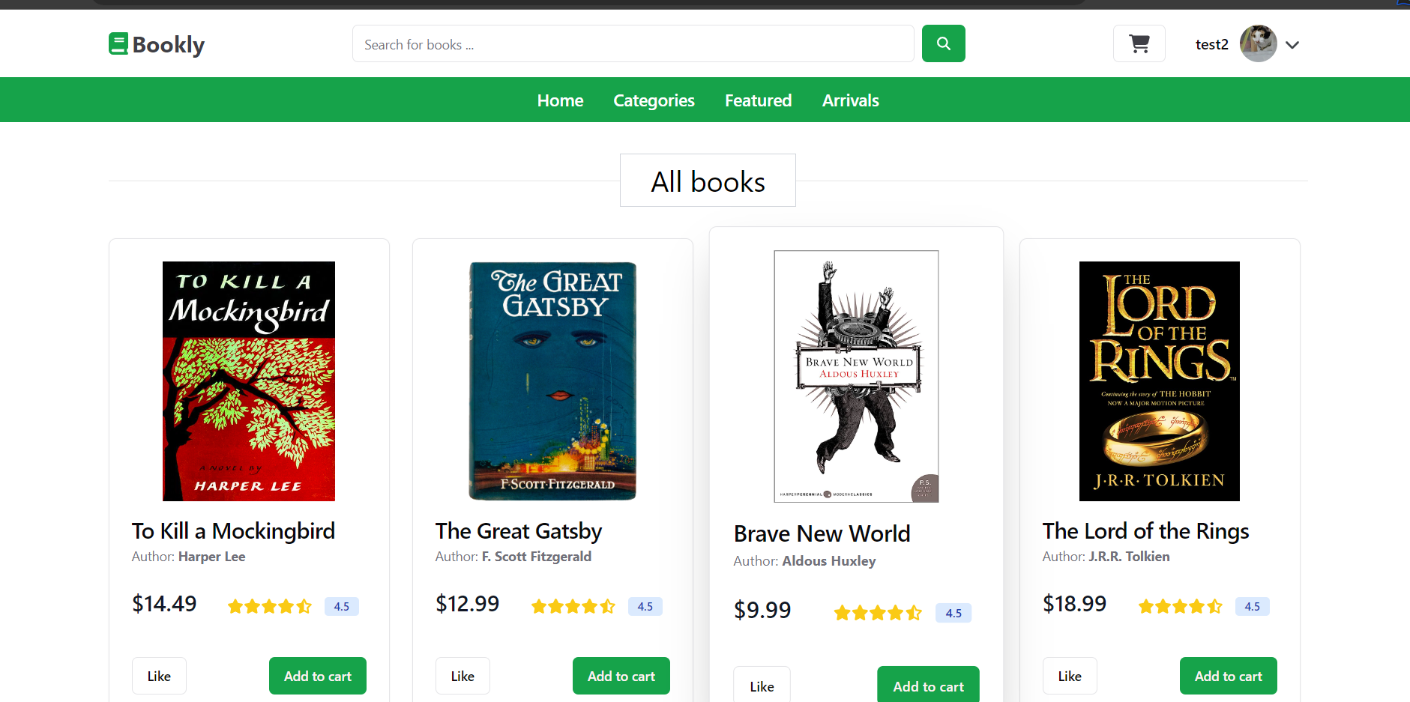
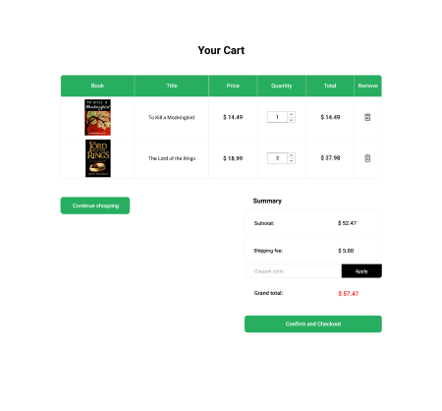
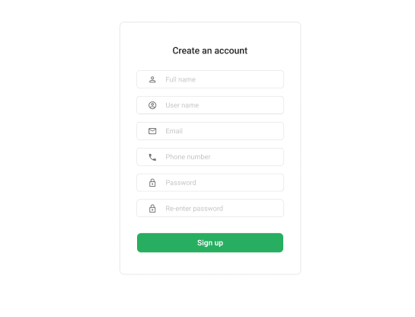
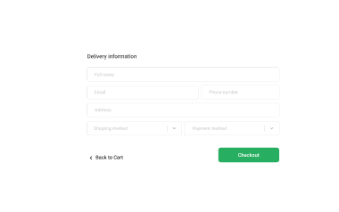
Some of my website
This is some page of User Page : + Register + Login + Home + Search/ Info book

Slide 20
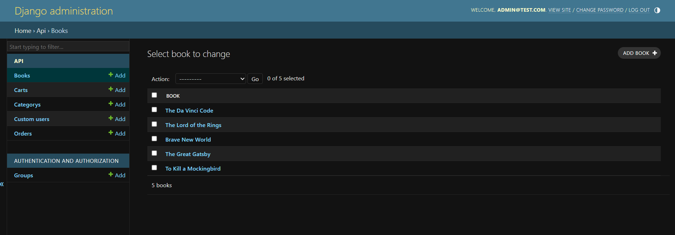
Some of my website
This is some page of admin page: + Home admin + Addbook + DeleteBook

Slide 21
Demo
Link video demo
https://youtu.be/aSkgJFnfQRE

Slide 22
Conclusion:
In conclusion, our presentation has highlighted the development and quality assurance aspects of our online book store. We've discussed key components of our architecture, the technologies utilized, our testing strategy, and the findings from our testing phases.
Key Points: + Our online book store prioritizes user-friendliness and a seamless shopping experience. + Findings confirm our platform's reliability and readiness for deployment.
Addressing Challenges: + Shipping and Delivery: Swift and reliable delivery services minimize delays. + Quality Assurance: Rigorous testing guarantees security, scalability, and user-friendliness + Making sale-report for admin

Slide 23
Q&A
Ask some question for us

Slide 24
Thank you everyone for listening to our presentation
If you have a confidential question or want to cooperate with us please contact us via this email : than21@clc.fitus.edu.vn

