Slide 1
Practice Day 1
Basic of Python, Regression

Slide 2
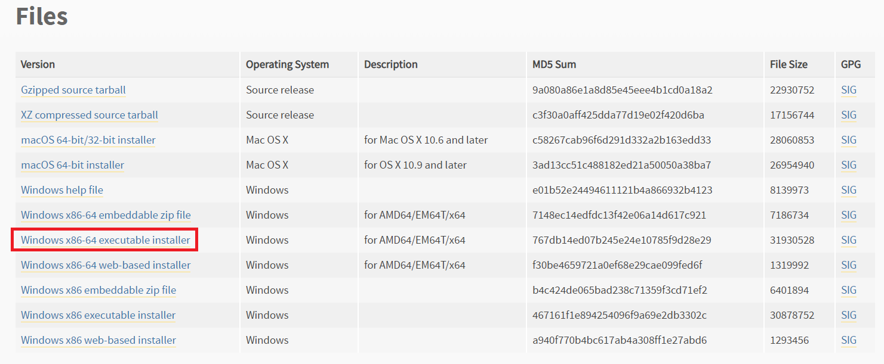
Install Python
Python 3.6.6
https://www.python.org/downloads/release/python-366/
Download Windows x86-64 executable installer and install it.
Timothy Ha (ECE, SNU)
RLLAB (http://rllab.snu.ac.kr)
<숫자>

Slide 3
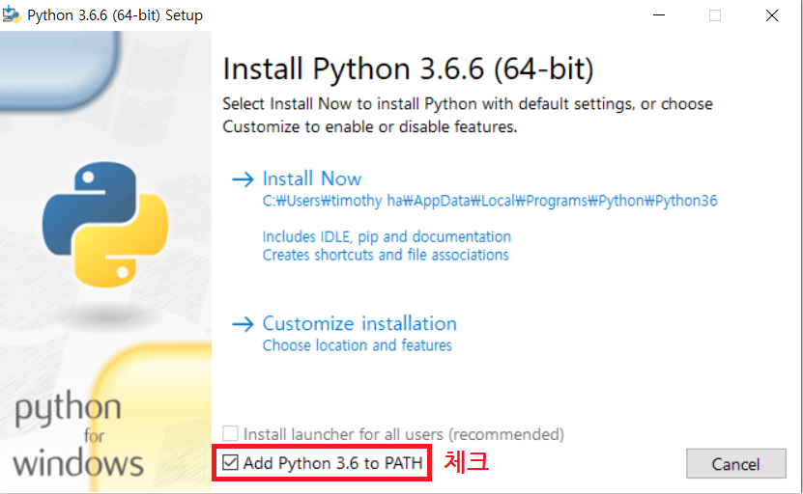
Install Python
Python 3.6.6
Add Python 3.6 to Environment Variable Path
Timothy Ha (ECE, SNU)
RLLAB (http://rllab.snu.ac.kr)
<숫자>

Slide 4
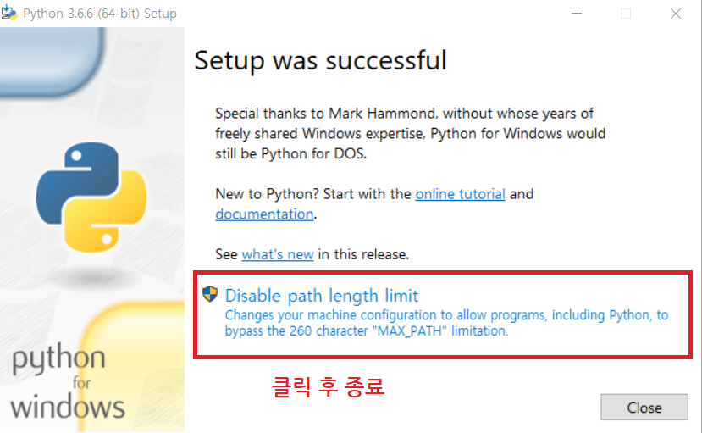
Install Python
Python 3.6.6
설치 후
Timothy Ha (ECE, SNU)
RLLAB (http://rllab.snu.ac.kr)
<숫자>

Slide 5
Other Installations
cmd 창 열기
Windows 검색 -> cmd (명령 프롬프트) -> 관리자 권한으로 실행
cmd 창에서 명령어 입력
pip3 install tensorflow
pip3 install jupyter
pip3 install matplotlib
설치 확인
cmd 창
py
import tensorflow
Import matplotlib
exit()
Timothy Ha (ECE, SNU)
RLLAB (http://rllab.snu.ac.kr)
<숫자>

Slide 6
Other Installations
Git 설치
https://git-scm.com/download/win
Download 64-bit version Git
Install Git
실습파일 download
cmd 창
cd c:\Users\<User name>\Documents
git clone https://github.com/bareblackfoot/deep_learning_tutorial.git
Jupyter notebook 실행
cmd 창
cd c:\Users\<User name>\Documents
jupyter notebook
Timothy Ha (ECE, SNU)
RLLAB (http://rllab.snu.ac.kr)
<숫자>

Slide 7
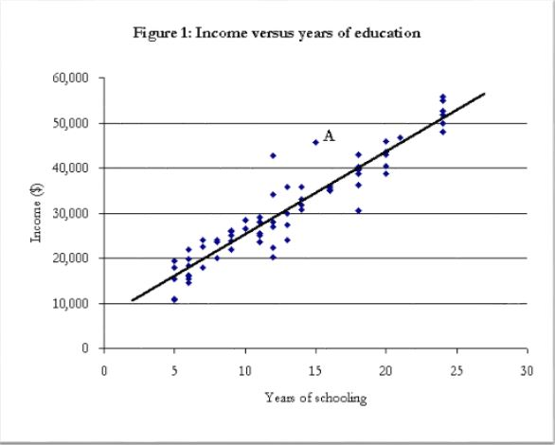
Regression
주어진 데이터가 있을 때 변수들 간의 인과 관계를 찾는 것
Ex) “Year of schooling” vs “Income”
Timothy Ha (ECE, SNU)
RLLAB (http://rllab.snu.ac.kr)
<숫자>

Slide 8
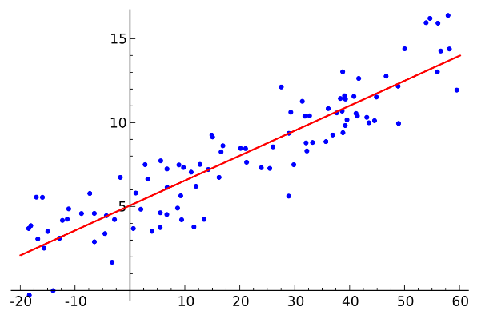
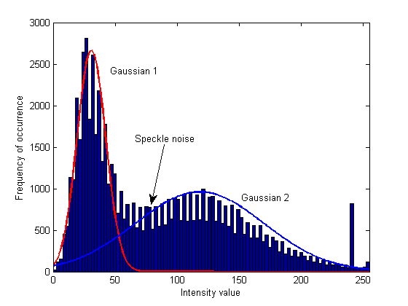
Regression
종류
Linear Regression
Gaussian Mixture Model
Kernel Regression
Gaussian Process Regression
Etc…
Timothy Ha (ECE, SNU)
RLLAB (http://rllab.snu.ac.kr)
<숫자>

Slide 9
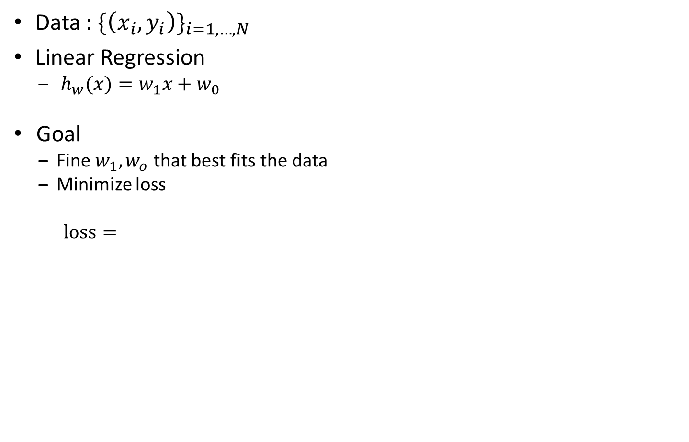
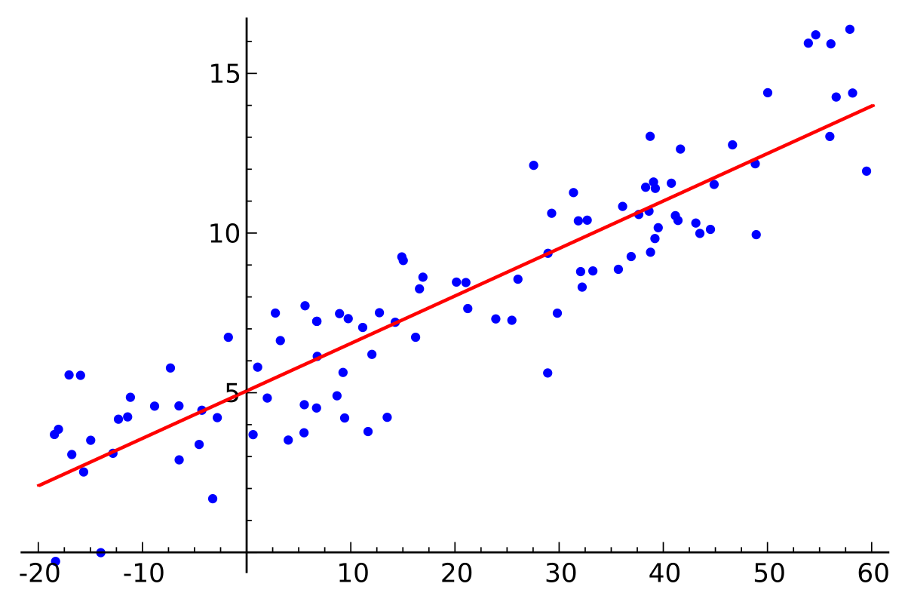

Linear Regression
Data :
Linear Regression
Goal
Fine that best fits the data
Minimize loss
Timothy Ha (ECE, SNU)
RLLAB (http://rllab.snu.ac.kr)
<숫자>

Slide 10
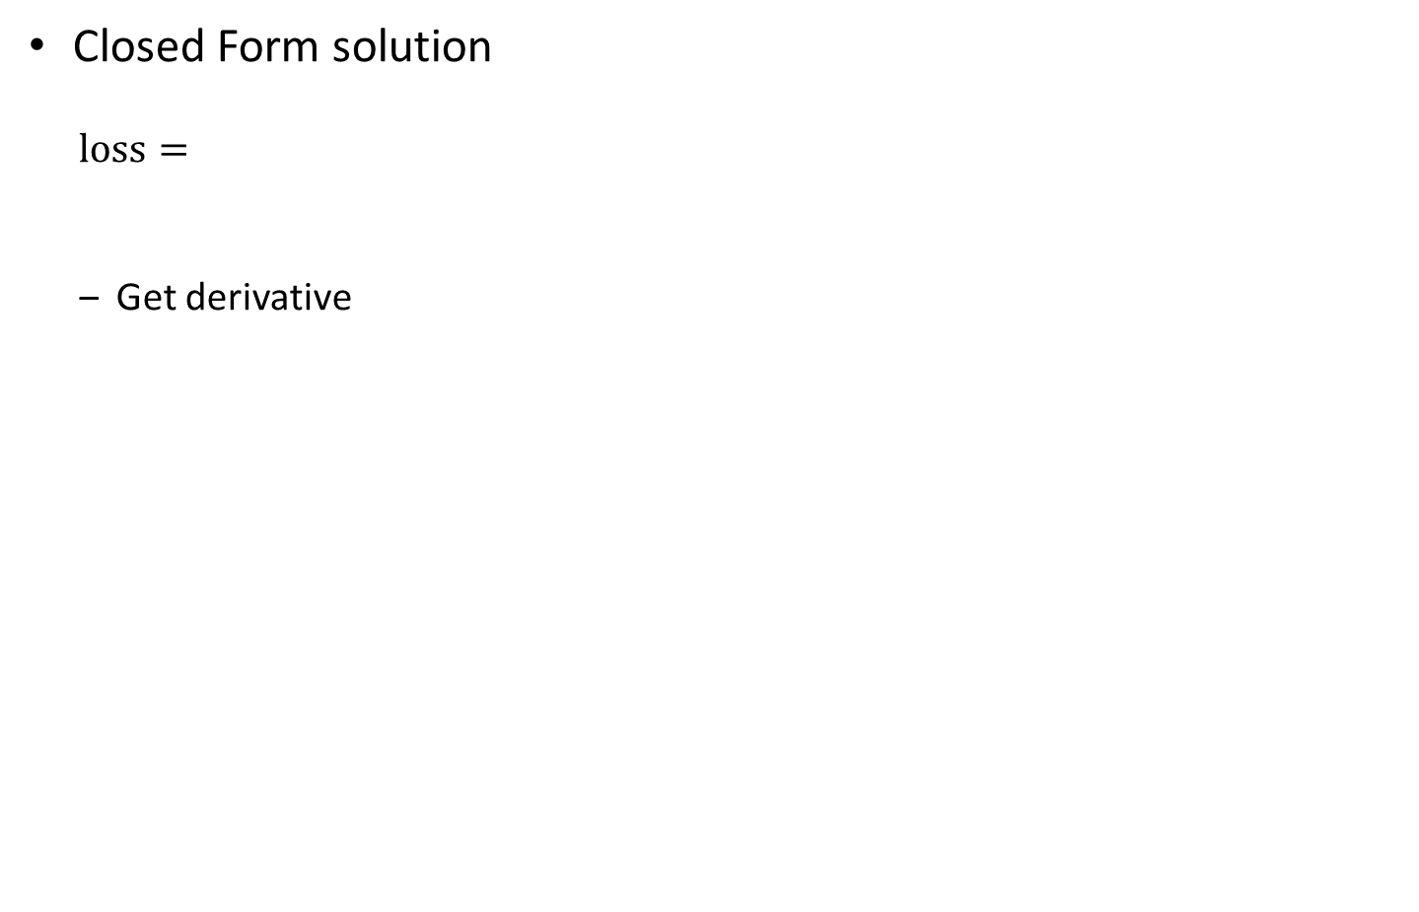
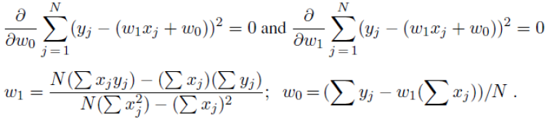
Linear Regression
Closed Form solution
Get derivative
Timothy Ha (ECE, SNU)
RLLAB (http://rllab.snu.ac.kr)
<숫자>

Slide 11
Practice Contents
Learn Python and Tensorflow
Basic Python Expressions
File I/O
Numpy
Pyplot
tensorflow
Linear Regression
Closed form solution
Gradient descent
Timothy Ha (ECE, SNU)
RLLAB (http://rllab.snu.ac.kr)
<숫자>

Slide 12
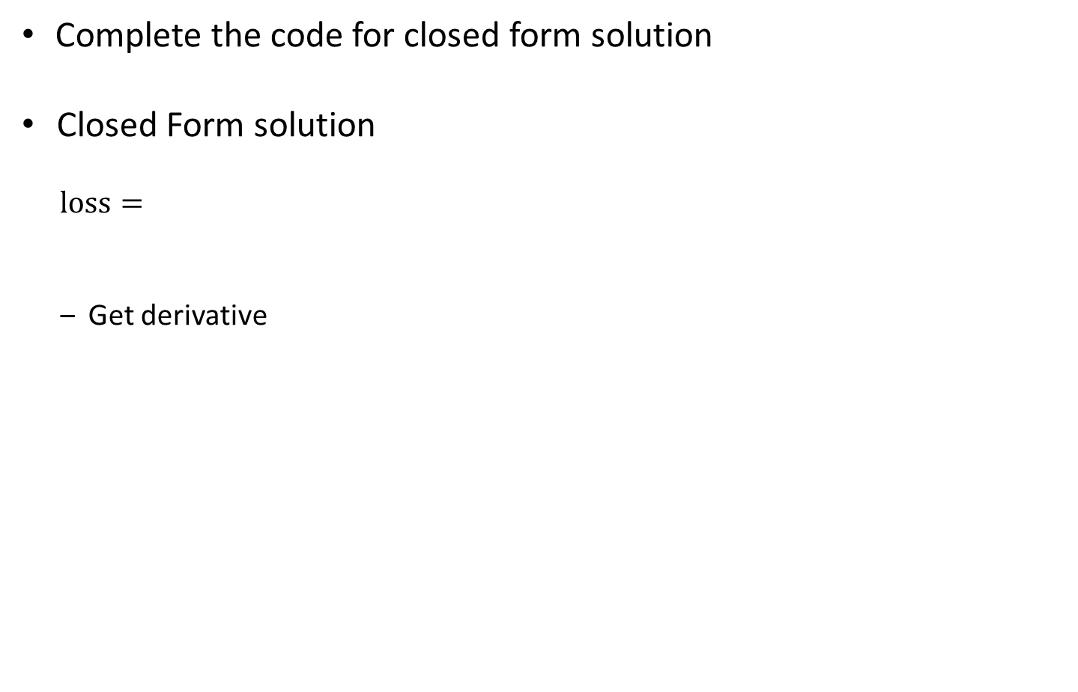
Todo 1
Complete the code for closed form solution
Closed Form solution
Get derivative
Timothy Ha (ECE, SNU)
RLLAB (http://rllab.snu.ac.kr)
<숫자>

Slide 13

Tensorflow
What is Tensorflow?
An Open-source Library for Deep Learning
Widely used among Machine Learning researchers
Timothy Ha (ECE, SNU)
RLLAB (http://rllab.snu.ac.kr)
<숫자>

Slide 14
Tensorflow
Steps of Tensorflow
Build a graph
어떤 network 를 사용할 것인지?
어떤 loss function 을 사용할 것인지?
어떤 optimization method 를 사용할 것인지?
Open a session
실질적으로 graph 안의 내용물들을 실행시키는 곳
sess.run()
Graph 안에서 define 된 operator 들을 실행시킴
혹은 variable 들의 값들을 출력함
Timothy Ha (ECE, SNU)
RLLAB (http://rllab.snu.ac.kr)
<숫자>

Slide 15
Tensorflow
Build a graph
Tensor
Initial variables
네트워크가 가지는 초기값들
Placeholder
유저가 input 값들을 넣어주는 곳
주로 데이터 들이 해당
Constants
Loss
Operators
Optimizer
Variable initializer
Etc…
Timothy Ha (ECE, SNU)
RLLAB (http://rllab.snu.ac.kr)
<숫자>

Slide 16
Tensorflow
Open tf.Session
sess = tf.Session()
이제 graph 안에서 define 된 값들을 실제로 사용 가능
sess.run()
Arguments : Anything defined in the graph
sess.run([something], feed_dict={placeholder:my_data})
Tensor, variables
해당하는 현재 값들을 출력
Operator
해당하는 Operator 를 실행
실행한 결과를 출력할 때도 있음
Timothy Ha (ECE, SNU)
RLLAB (http://rllab.snu.ac.kr)
<숫자>

Slide 17
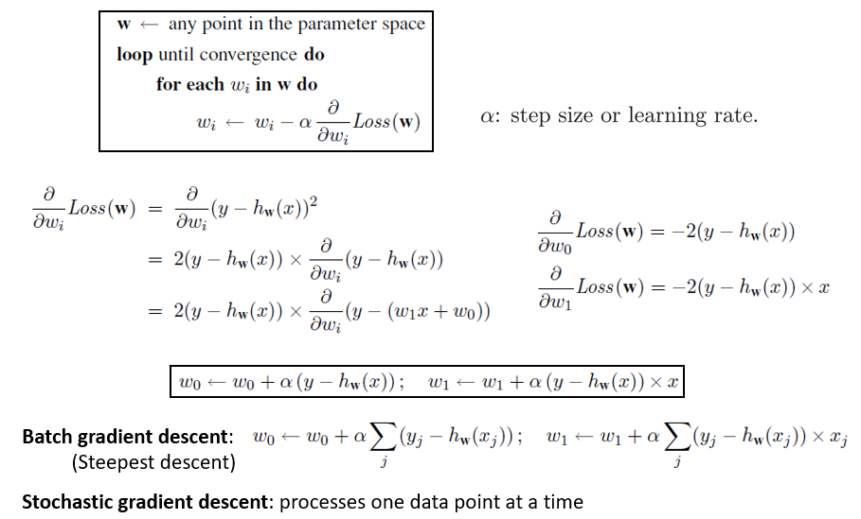
Gradient Descent Optimization
Nuri Kim (ECE, SNU)
RLLAB (http://rllab.snu.ac.kr)
<숫자>

Slide 18
Tensorflow Graph
mean, square
(loss)
Optimizer,
minimize
Add, multiply operator (y_regression)
global variable
initializer
Variable w, b
x_data
place_holder
y_data
place_holder
Nuri Kim (ECE, SNU)
RLLAB (http://rllab.snu.ac.kr)
<숫자>

Slide 19
Todo 2
Complete the code for sess.run()
Change the parameters
Initial variables
Learning rate
Optimizer
The number of training steps
Timothy Ha (ECE, SNU)
RLLAB (http://rllab.snu.ac.kr)
<숫자>

Slide 20

Timothy Ha (ECE, SNU)
RLLAB (http://rllab.snu.ac.kr)
<숫자>

