Slide 1
QoS-enabled job scheduling
George Barelas
ΔΠΜΣ-ΣΕΣΕ
Notes:
Theme created by
Sakari Koivunen and Henrik Omma
Released under the LGPL license.

Slide 2
Grid
  Resources
  Users → Tasks
QoS-enabled job scheduling
  Scheduling algorithms
  Simulator
  Experimental results

Slide 3
Scheduling problem
“assign n tasks to m machines, optimizing some metric”
On-line: Tasks keep arriving as time passes.
Task characteristics are unknown.

Slide 4
Quality of Service
  QoS: necessary for users demanding Service Level Agreement (SLA)
  Gain user trust → success of Grid system

Slide 5
Quality of Service
2 types of QoS for a Grid:
  Percentage of tasks/workload that a Grid accepts for scheduling.
  If a task is accepted, what is the probability to miss deadline?

Slide 6
Scheduling
Can be broken down to 2 phases:
Select next task to be scheduled.
Then select node for the task to be assigned to.
First phase becomes somewhat irrelevant for an on-line Grid scheduler.

Slide 7
Earliest Completion Time (ECT)
“Assign task to the node where it will be completed the soonest.”
As far as the current information tell us.

Slide 8
Earliest Completion Time 2 (ECT')
“Assign task to the node where it will be completed the soonest, without causing any of the already assigned tasks to miss their deadline.”
Better second level QoS: if the scheduler accepts a task, it will be completed before the deadline.

Slide 9
ECT – ECT' experimental comparison
Using our simulator, which will be described later.
Experiment characteristics:stable nodeset consisting of 100 fully-interconnected computational nodes. Each node has a computational power of 1000 cu/epoch (computational units per epoch).Each network link has a network capacity of 100 du/epoch (data units per epoch).
Tasks are all the same: workload: 10⁴ cu, desirable completion time: 30 epochs, deadline: 45 epochs, input data: 10³ du, output data: 10³ du. Task distribution: Poisson with rate λ tasks per epoch.

Slide 10
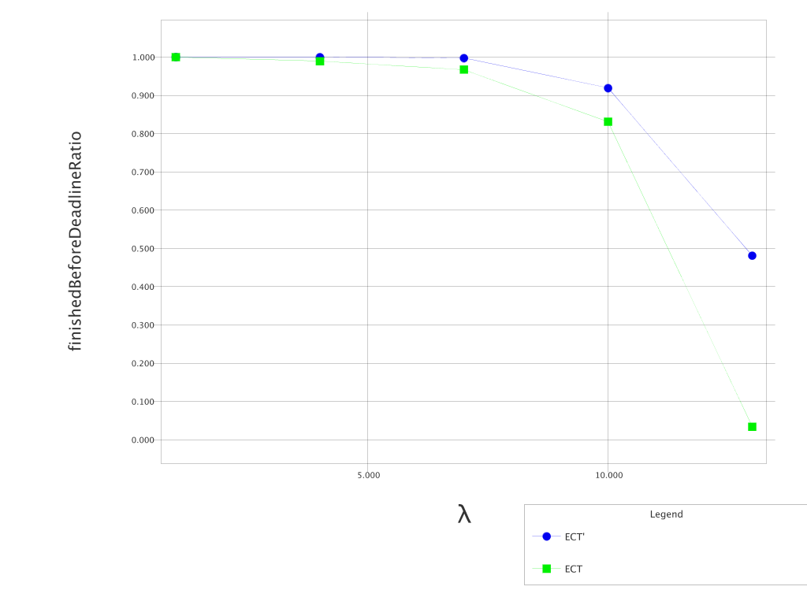
ECT – ECT' experimental comparison

Slide 11
(ρ,σ) bounded user
Problem: ill-behaving users, submitting workload with a rate, much greater than the mean submission rate.
These users must be contained, for the increase of the total user fairness and satisfaction.
Idea: contain them, using a linear function to bound their rate. (like the token-bucket congestion prevention technique used by data networks)

Slide 12
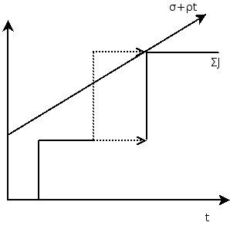
(ρ,σ) bounded user
The rate limit may be applied for the sum of user submissions to the system, or per computational node.

Slide 13
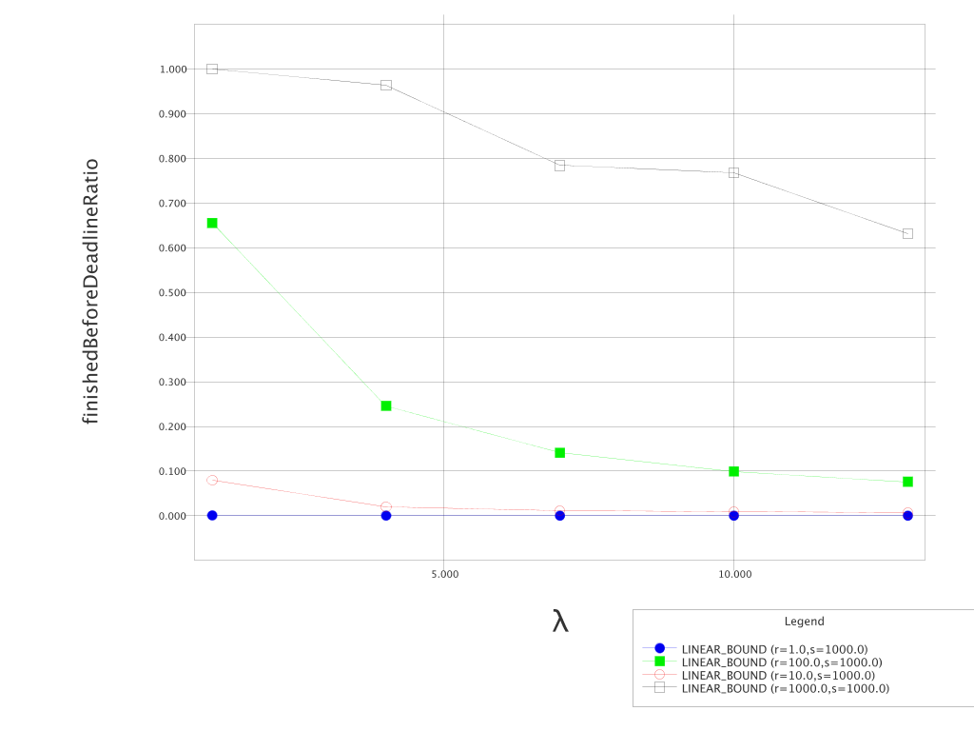
ρ=?

Slide 14
ρ=?
→ user's i workload submission ratio Ri
while time passes.

Slide 15
ρ=?
if all ρi equal
System stability constraint:
We want to use all of the system computational capacity:

Slide 16
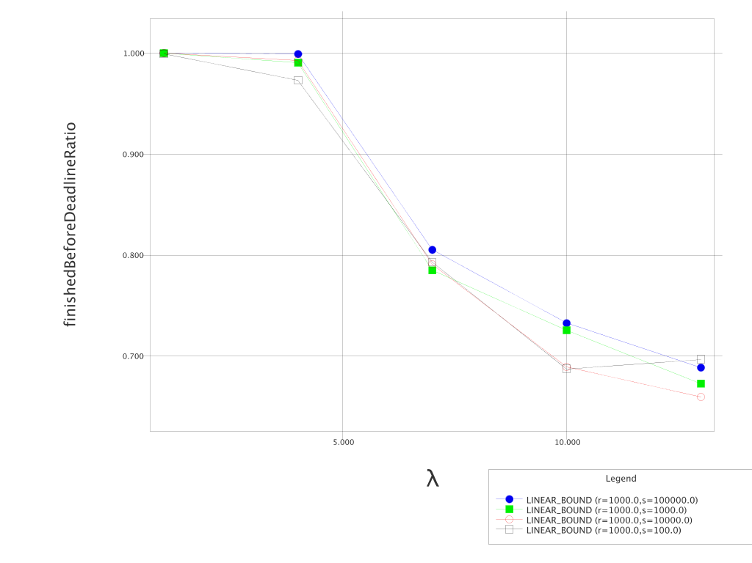
σ=?
σ value does not affect perfomance

Slide 17
team scheduling
users not all equal
different user categories exist
Solution: Split nodes in teams. Each team handles a specific user category.
Simulation:
User category 1: 80%
User category 2: 20%

Slide 18
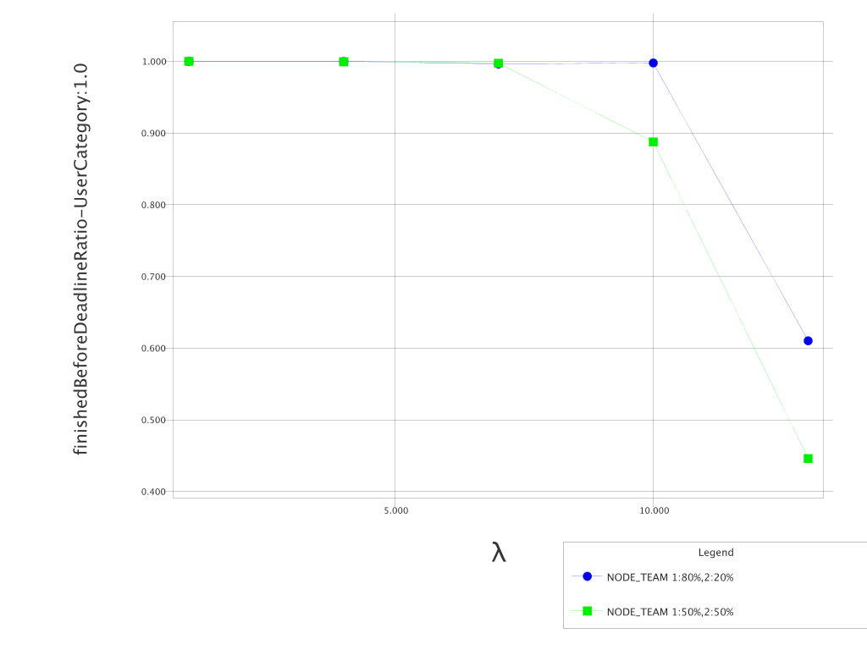
team scheduling

Slide 19
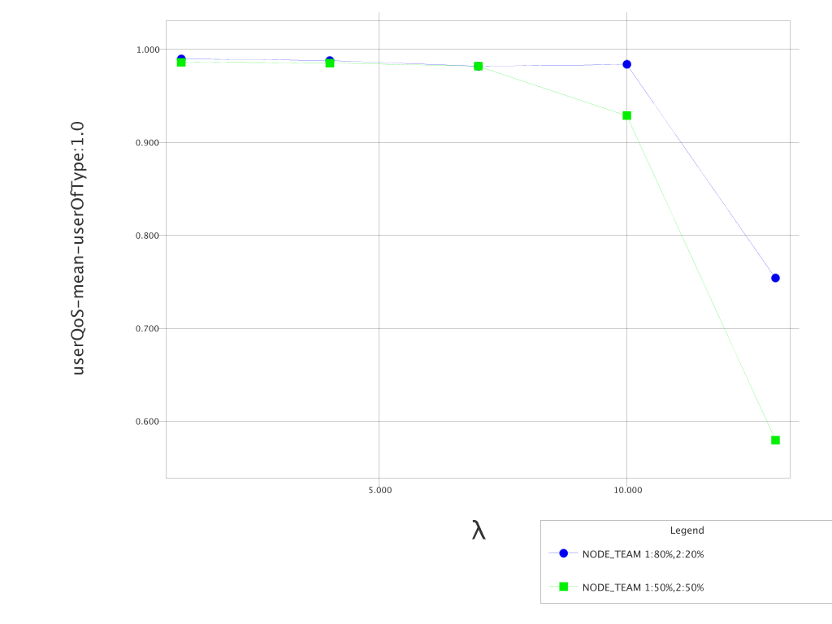
team scheduling

Slide 20
2-level scheduling
With team scheduling, we can give more resources to user categories that deserve it (maybe they are paying users or they offer their resources to the system)
But inside a user category, users may still behave incorrectly and have a large workload submission rate.

Slide 21
2-level scheduling
Solution: use a different “(ρ,σ) bounded” scheduler instance, for each node team. Thus, create a 2 level scheduler:
  level one: Manage node teams. For a task, determine the user category and submit it to the scheduler instance, responsible for the specific category.
  level two: the corresponding (ρ,σ) bounding scheduling instance, schedules the task to the node subset it controls.

Slide 22
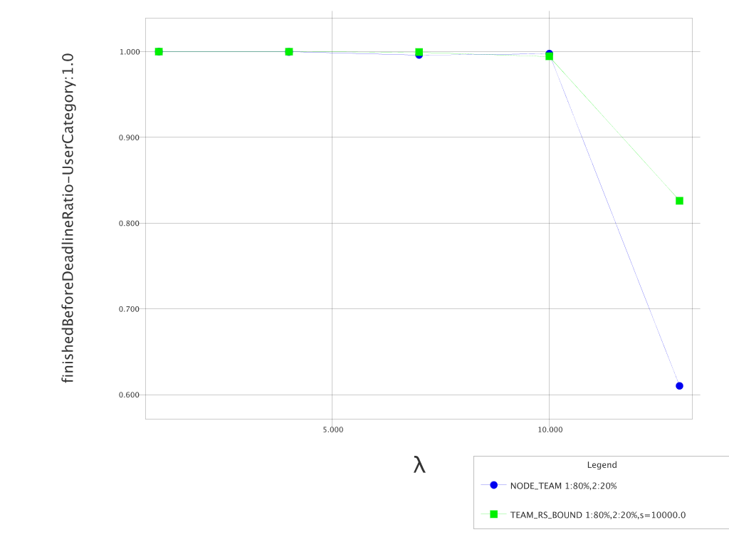
2-level scheduling

Slide 23
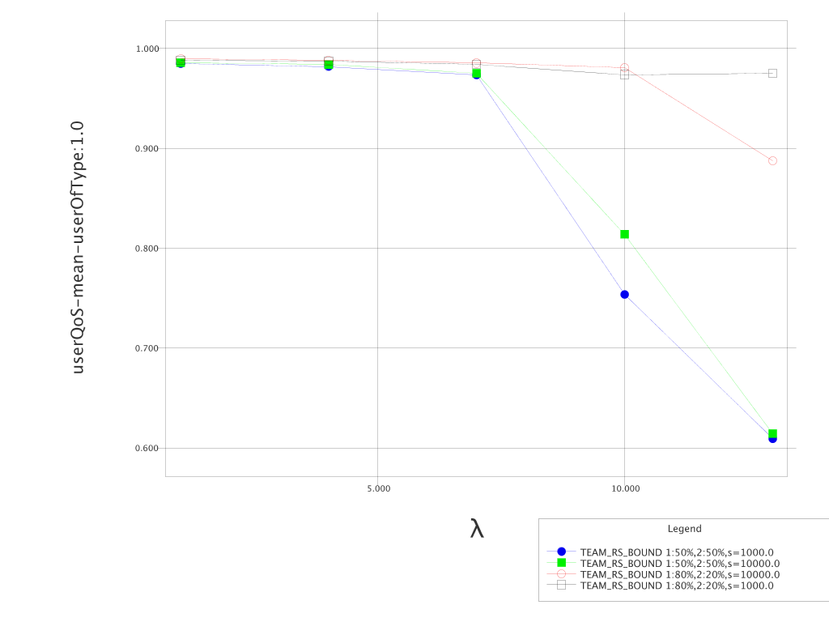
2-level scheduling

Slide 24
Simulation
Invaluable tool for scheduling algorithm designers/engineers
Analysis is difficult and maybe impossible
Worst case analysis does not help, because real-world workloads never exhibit the specific structure that will cause a bad case.

Slide 25
GEMU: A Grid Simulator
Desirable characteristics of a simulator:
  simple (simple model of simulation)
  flexible (easily combine entities to form new experiments)
  extendible (easy development and addition of new entities, metrics, etc)
  utilities (simulate by parameter,graph generation, result combination)

Slide 26
Model of simulation
non-preemptible, indivisible tasks
fully interconnected computational nodes
node:
  infinite storage capacity
  network frontend
  network links are not shared, meaning task data queue up and sent sequentially

Slide 27
Model of simulation
Each Grid entity consist of:
  TaskProducer
  NodeProducer
  Scheduler
  statsAggregators
  vatious data structures holding completed tasks, on-line nodes, failed tasks, etc
API Javadoc: http://students.ceid.upatras.gr/~barelas/gemu-api/

Slide 28
Model of Simulation
discrete time simulation.
epoch → system's heart-beat
In every epoch:
  nodeProducer.generateNodes()
  taskProducer.generateTasks()
  scheduler.schedule()
  foreach online node:
    node.nextEpoch() (calculate, send/receive data)
  foreach statsAggregator:
    collect stat values

Slide 29
Node
Main node attributes:
computationalCapacity
tasksToCompute
tasksReceiving
connectedNodes
transmitLists
departureSchema → entity that desides when the node will depart from system (e.g. Never, FixedTime)
...

Slide 30
NodeProducer
A nodeProducer entity must implement the NodeProducer interface.
generateNodes() method. It is called once per epoch. May introduce new nodes to the system.
A nodeProducer encapsulates other entities modeling node behavior:
  linkProducer
  departureSchema
  weightProducer

Slide 31
Task
Main task attributes:
initialWorkload
workloadLeft
input/outputData
desirableCompletionTime
absolutCompletionTime
taskCategory
status
...

Slide 32
TaskProducer
A taskProducer entity must implement the TaskProducer interface.
generateTasks() is the method that is called in every epoch and it may return new tasks.
The taskProducer implementation constitutes system workload behavior
  Poisson and normal distributions for arrival times and attributes implemented

Slide 33
Metrics - statsAggregators
The desired metrics are the output of the experimental simulation.
Each data-collecting entity must implement the StatsAggregator interface.
Multiple StatsAggregator entities per experiment.
aggregate() method: collect statistics, if you want to.
The StatsAggregator objects are serialized and saved to disk. The graph generator deserializes them and plots PNG graphs on command. Any tool can read them.

Slide 34
experiment example
<?xml version="1.0"?>
<experiments>
<experiment>
<nodeProducer class="gr.upatras.gemu.node.producer.TestNodeProducer">
<departureSchema class="gr.upatras.gemu.node.departure.NeverDepartSchema">
<attr name="countdown" value="1e4"></attr></departureSchema>
<linkProducer class="gr.upatras.gemu.node.producer.NormalLinkProducer">
<statsChars class="gr.upatras.gemu.util.StatisticalCharacteristics">
<attr name="bandwidthMean" value="1e3"></attr>
<attr name="bandwidthDeviation" value="1e3"></attr>
</statsChars></linkProducer></nodeProducer>
<taskProducer class="gr.upatras.gemu.task.producer.TestTaskProducer"/>
<statsAggregator class="gr.upatras.gemu.stats.SimpleStatsAggregator">
<attr name="aggregationInterval" value="1e3"></attr></statsAggregator>
<scheduler class="gr.upatras.gemu.scheduler.SimpleFCFSqueueECTassignScheduler">
</scheduler>
<attr name="finishTime" value="1000"></attr>
</experiment>
</experiments>

Slide 35
future work...
algorithms:
  clever (ρ,σ) bound: accept marked tasks over bound and drop them on congestion
  auto node team formation (AI?, neural network?)
simulator:
  scripting language integration (python)
  full network simulation with routing entities
  GUI/Web

Slide 36
Thank you!!!

