Slide 1
5-Apr-14 Ocean Shield signals: what can we learn from videos
1. 37.5 kHz signal WAS in fact detected
2. Modulated, 33.3 kHz peak is lower sideband
3. Second detection 1.3 times further from source than the first

Slide 2
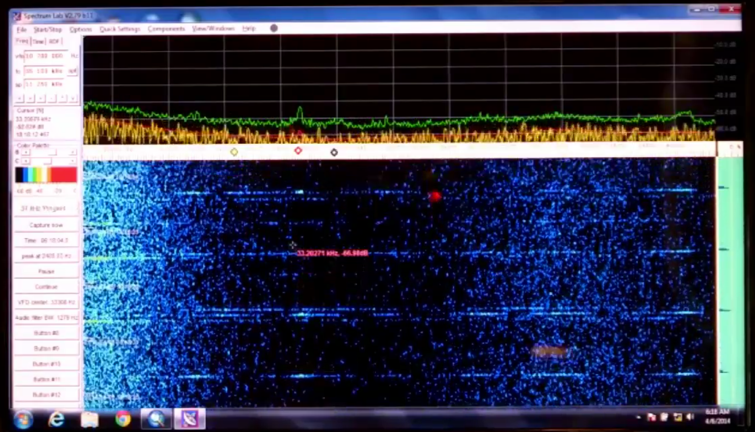
So I was once watching the two videos showing replay of 5-Apr-14 TPL detections onboard ADV Ocean Shield released by Australian DoD.
Hm, this is not right, the 10ms pulse makes for ~200 Hz bandwidth – here the signal is like several kHz across

Slide 3
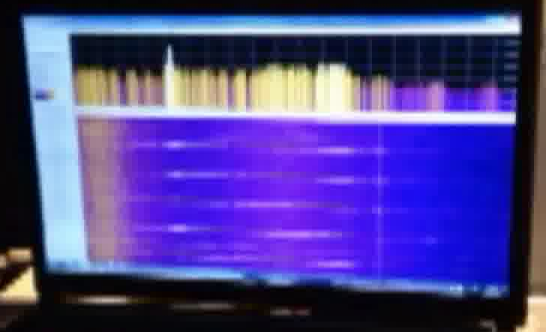
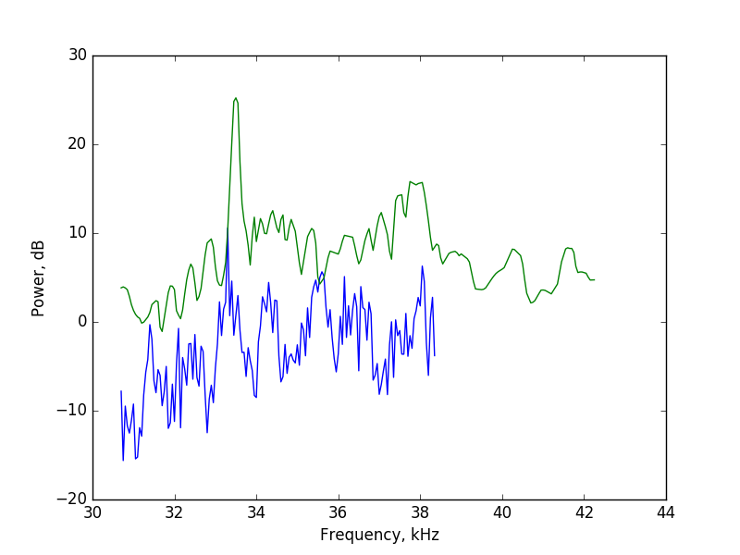
Better digitize spectral graphs for both pulse and background noise for both movies and see what’s going on.
Blue is signal-background for one of the pings in the first video,
Green is same for the second video. Second video has bigger bandwidth of 12 kHz across spectrum shown.
Central 37.5kHz peak visible. If the infamous 33.3kHz peak is then a sideband, there are should be another one at same frequency offset (4.15 kHz) above the pinger – and there is! The amplitudes should be same at origin, but due to frequency-dependent absorption will get progressively different away from source

Slide 4
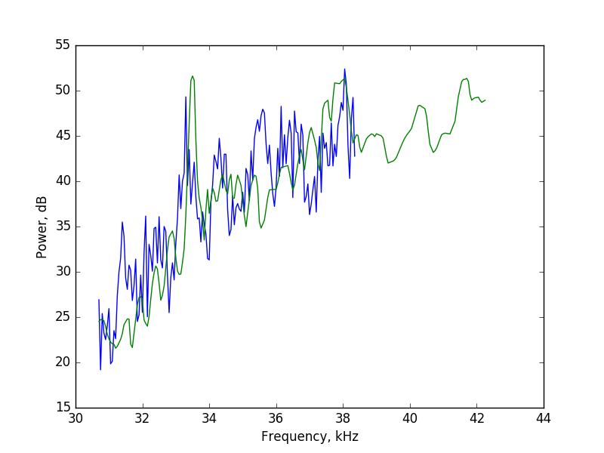
Needed slope is linearly related to distance from source (absorption dependency taken from: http://resource.npl.co.uk/acoustics/techguides/seaabsorption/
It turns out 37.5kHz peak is of same amplitude as sidebands once they equalled out. We can use this to also adjust PSD from first video, the distance turns out to be 1.3 times less

Slide 5
So if the source is an ULB, what can cause frequency (or amplitude) modulation of its signal? I have two suggestions:
1. Pinger mechanically coupled to a decent quality resonator with a strong mode at 4 kHz (like a sheet of aluminum). The resonator is e.g. parametrically excited by pinger and is always moving. Every time pinger fires, movement of its base appears as Doppler. Pinger draws around 1W when firing. This is similar in concept to laser Doppler vibrometry.
2. As 37.5 is 9th harmonic of 4.15 kHz, something within pinger circuitry creates modulation due to electrical/mechanical damage maybe.

Slide 6
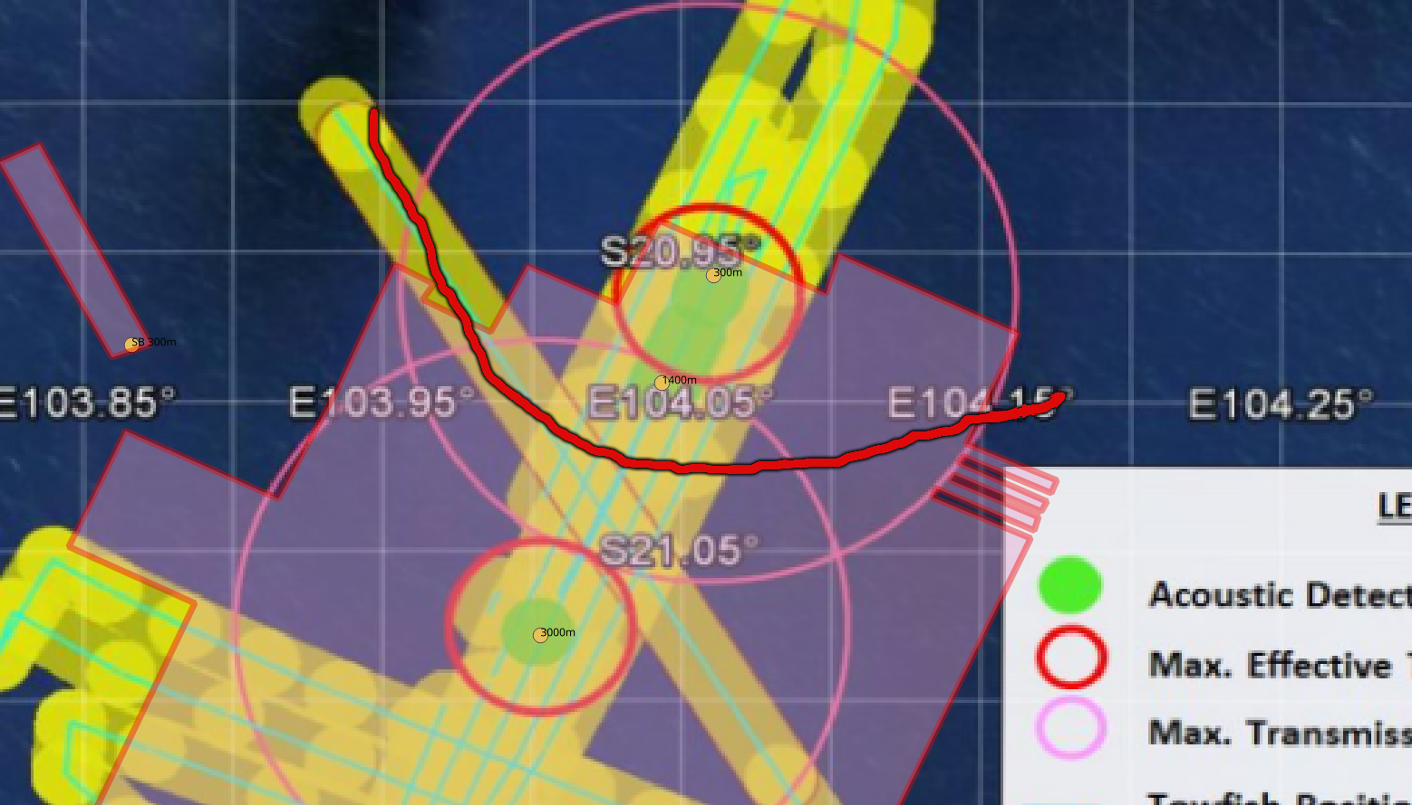
The relevant source locations will be on a hyperbola-like curve. Actually once adsorption is properly calibrated, only two points will be left on this curve

