Slide 1
Linux: File System
In this document we'll cover:
Why the Linux File System is important?
File System Explained
Why the Linux File System is important?
Understanding the Linux File System will clear out a lot of questions.
What is a socket file?
'myfile' vs. 'myFile' ( Case Sensitivity )
No C: or D: drive?
Deleting an open file?
In Linux everything is a file
External Drives
Network Traffic
CPU Performance
SWAP configuration
● ...
NO CONTROL PANEL NO USER MANAGEMENT NO REGISTRY
There is tools that could help with the above but all these still is edits a file.
File System Explained
Here is a list of the most commonly used directories in the Linux File System. There are a few which we'll not cover as it is optional or distribution specific.

Slide 2
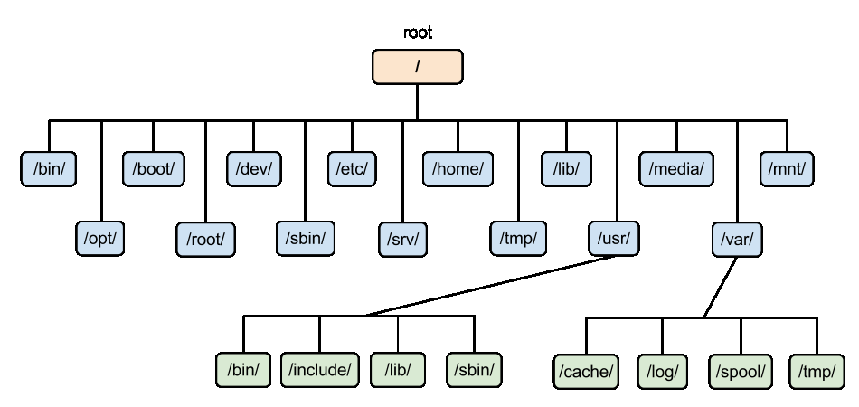
/ – The Root Directory
Everything on your Linux system is located under the / directory, known as the root directory.
/bin – Essential User Binaries
The /bin directory contains the essential user binaries (programs) that must be present when the system is mounted in single-user mode. Programs which a user install will be under /usr/bin but system programs will be located in /bin.
/boot – Static Boot Files
The files in the /boot directory is needed to boot the system.
/dev – Device Files
Remember everything is a file, including devices. Examples would be CPU, Keyboard and Memory.
/etc – Configuration Files
The /etc directory contains configuration files, which can generally be edited by hand in a text editor.
/home – Home Folders
The /home directory contains a home folder for each user.
/lib – Essential Shared Libraries
The /lib directory contains libraries needed by the essential binaries in the /bin and /sbin folder.

Slide 3
/media – Removable Media
The /media directory contains subdirectories where removable media devices inserted into the computer are mounted.
/opt – Optional Packages
The /opt directory contains subdirectories for optional software packages.
/proc – Kernel & Process Files
The /proc directory similar to the /dev directory because it doesn’t contain standard files.
/root – Root Home Directory
The /root directory is the home directory of the root user.
/run – Application State Files
The /run directory is fairly new, and gives applications a standard place to store transient files they require like sockets and process IDs.
/sbin – System Administration Binaries
The /sbin directory is similar to the /bin directory. It contains essential binaries that are generally intended to be run by the root user for system administration.
/srv – Service Data
The /srv directory contains “data for services provided by the system.”
/tmp – Temporary Files
Applications store temporary files in the /tmp directory. These files are generally deleted whenever your system is restarted.
/usr – User Binaries & Read-Only Data
The /usr directory contains applications and files used by users, as opposed to applications and files used by the system.
/var – Variable Data Files
The /var directory is the writable counterpart to the /usr directory, which must be read-only in normal operation.

