Slide 1
Node: Introduction
Cape Town
Barend Erasmus
May 2017

Slide 2
Node: EveNt Loop
In this presentation we’ll cover
What is Node?
When to use Node?
When not to use Node?

Slide 3
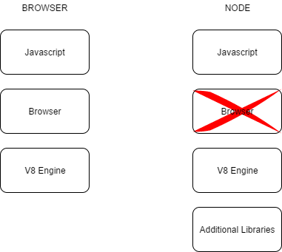
NODE: Introduction
What is Node?
Node is a JavaScript environment built on the same JavaScript engine used in Google’s Chrome web browser

Slide 4
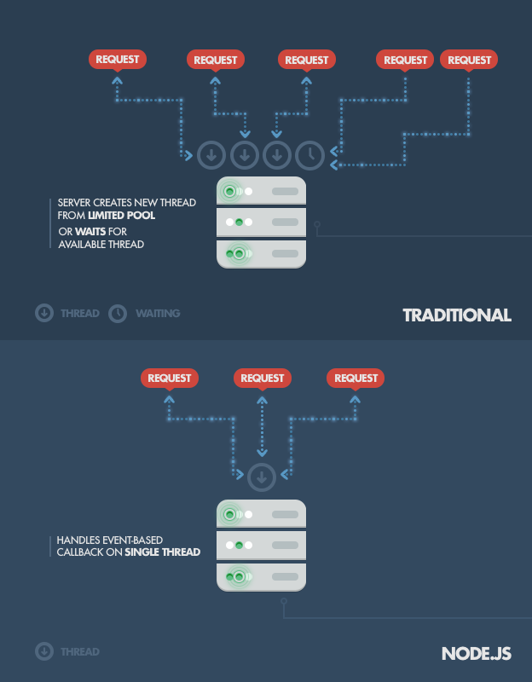
NODE: introduction
When to use Node?
Use Node when you have a DIRT-y application.
D - Data
I - Intensive
R - Real
T - Time

Slide 5
Node: INtroduction
When not to use Node?
Node does not perform well when executing CPU intensive tasks.
Such as computing Averages, Standard Deviations...

Slide 6
Node: introdution
Questions?

