Slide 1

Progressive Web App
Improving the user experience

Slide 2

What is a Progressive Web App (PWA)?
Progressive Web Apps (PWAs) are web applications that load like regular web pages or websites but can offer the user functionality such as working offline, push notifications, and device hardware access traditionally available only to native mobile applications.

Slide 3
Characteristics
Progressive - Work for every user, regardless of browser choice because they’re built with progressive enhancement as a core tenet.
Responsive - Fit any form factor, desktop, mobile, tablet, or whatever is next.
Connectivity independent - Enhanced with service workers to work offline or on low quality networks.
App-like - Use the app-shell model to provide app-style navigation and interactions

Slide 4
Characteristics
Fresh - Always up-to-date thanks to the service worker update process.
Safe - Served via HTTPS to prevent snooping and ensure content has not been tampered with.
Discoverable - Are identifiable as “applications” thanks to W3C manifests and service worker registration scope allowing search engines to find them.
Re-engageable - Make re-engagement easy through features like push notifications.

Slide 5
Characteristics
Installable - Allow users to “keep” apps they find most useful on their home screen without the hassle of an app store.
Linkable - Easily share via URL and not require complex installation.

Slide 6
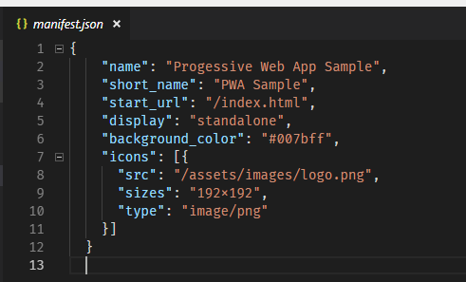
The Web App Manifest
The web app manifest is a simple JSON file that tells the browser about your web application and how it should behave when 'installed' on the users mobile device or desktop.

Slide 7
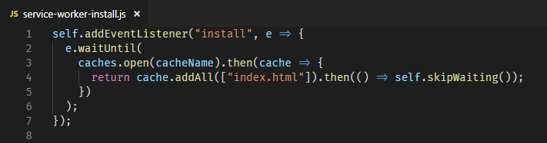
The Service Worker
A service worker is a script that your browser runs in the background, separate from a web page, opening the door to features that don't need a web page or user interaction.

Slide 8
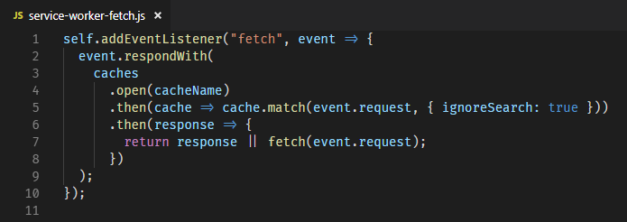
The Service Worker
A service worker is a script that your browser runs in the background, separate from a web page, opening the door to features that don't need a web page or user interaction.

Slide 9
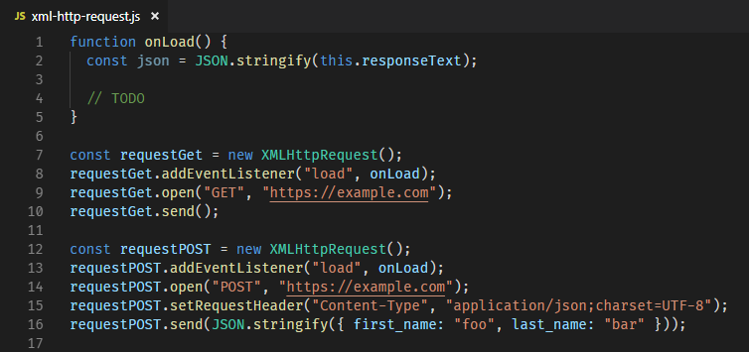
XMLHttpRequest API
You can retrieve data from a URL without having to do a full page refresh. This enables a Web page to update just part of a page without disrupting what the user is doing.

Slide 10
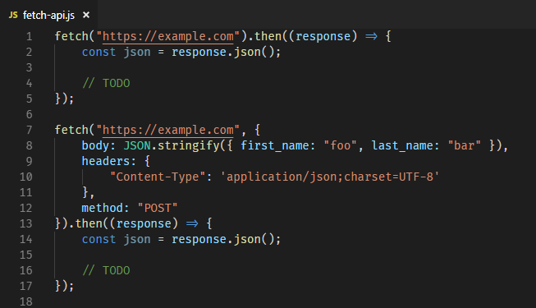
Fetch API
The Fetch API provides an interface for fetching resources (including across the network). It will seem familiar to anyone who has used XMLHttpRequest, but the new API provides a more powerful and flexible feature set.

Slide 11
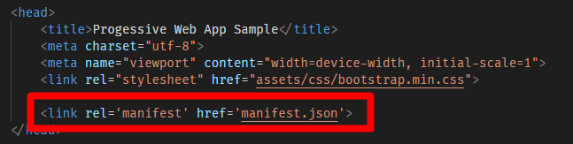
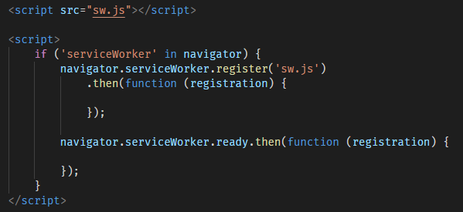
Integrating

Slide 12
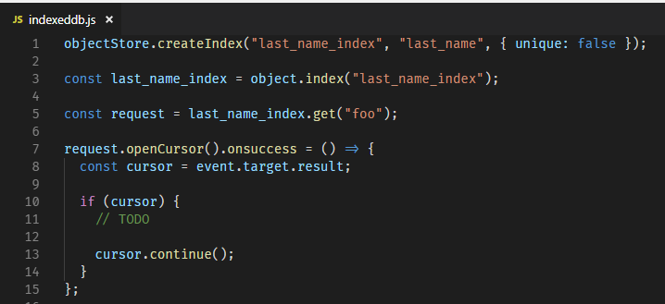
SQLite??
localStorage – Key-Value Store
IndexedDB - IndexedDB is a low-level API for client-side storage of significant amounts of structured data, including files/blobs.

Slide 13

Single-Threaded JavaScript
Web Workers - Web Workers is a simple means for web content to run scripts in background threads.

Slide 14
Hardware??
http://bit.ly/2NG0s7l

Slide 15
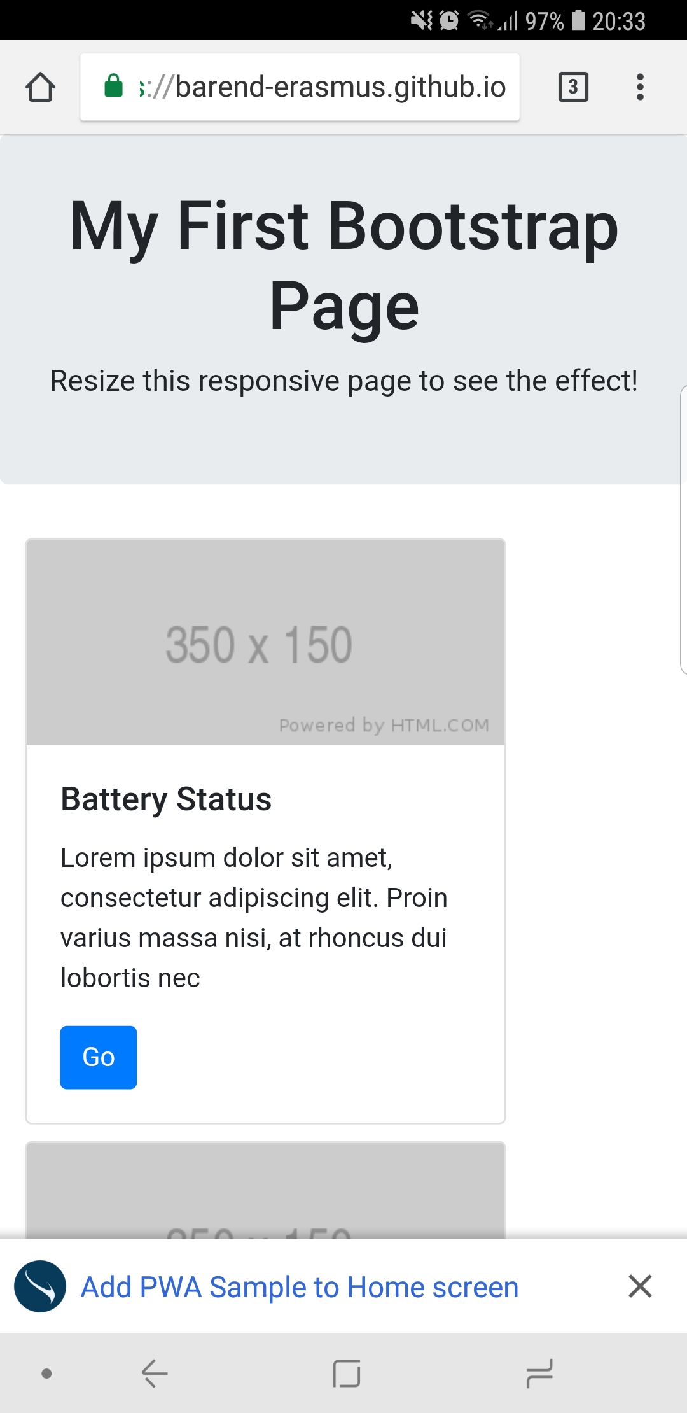

Slide 16
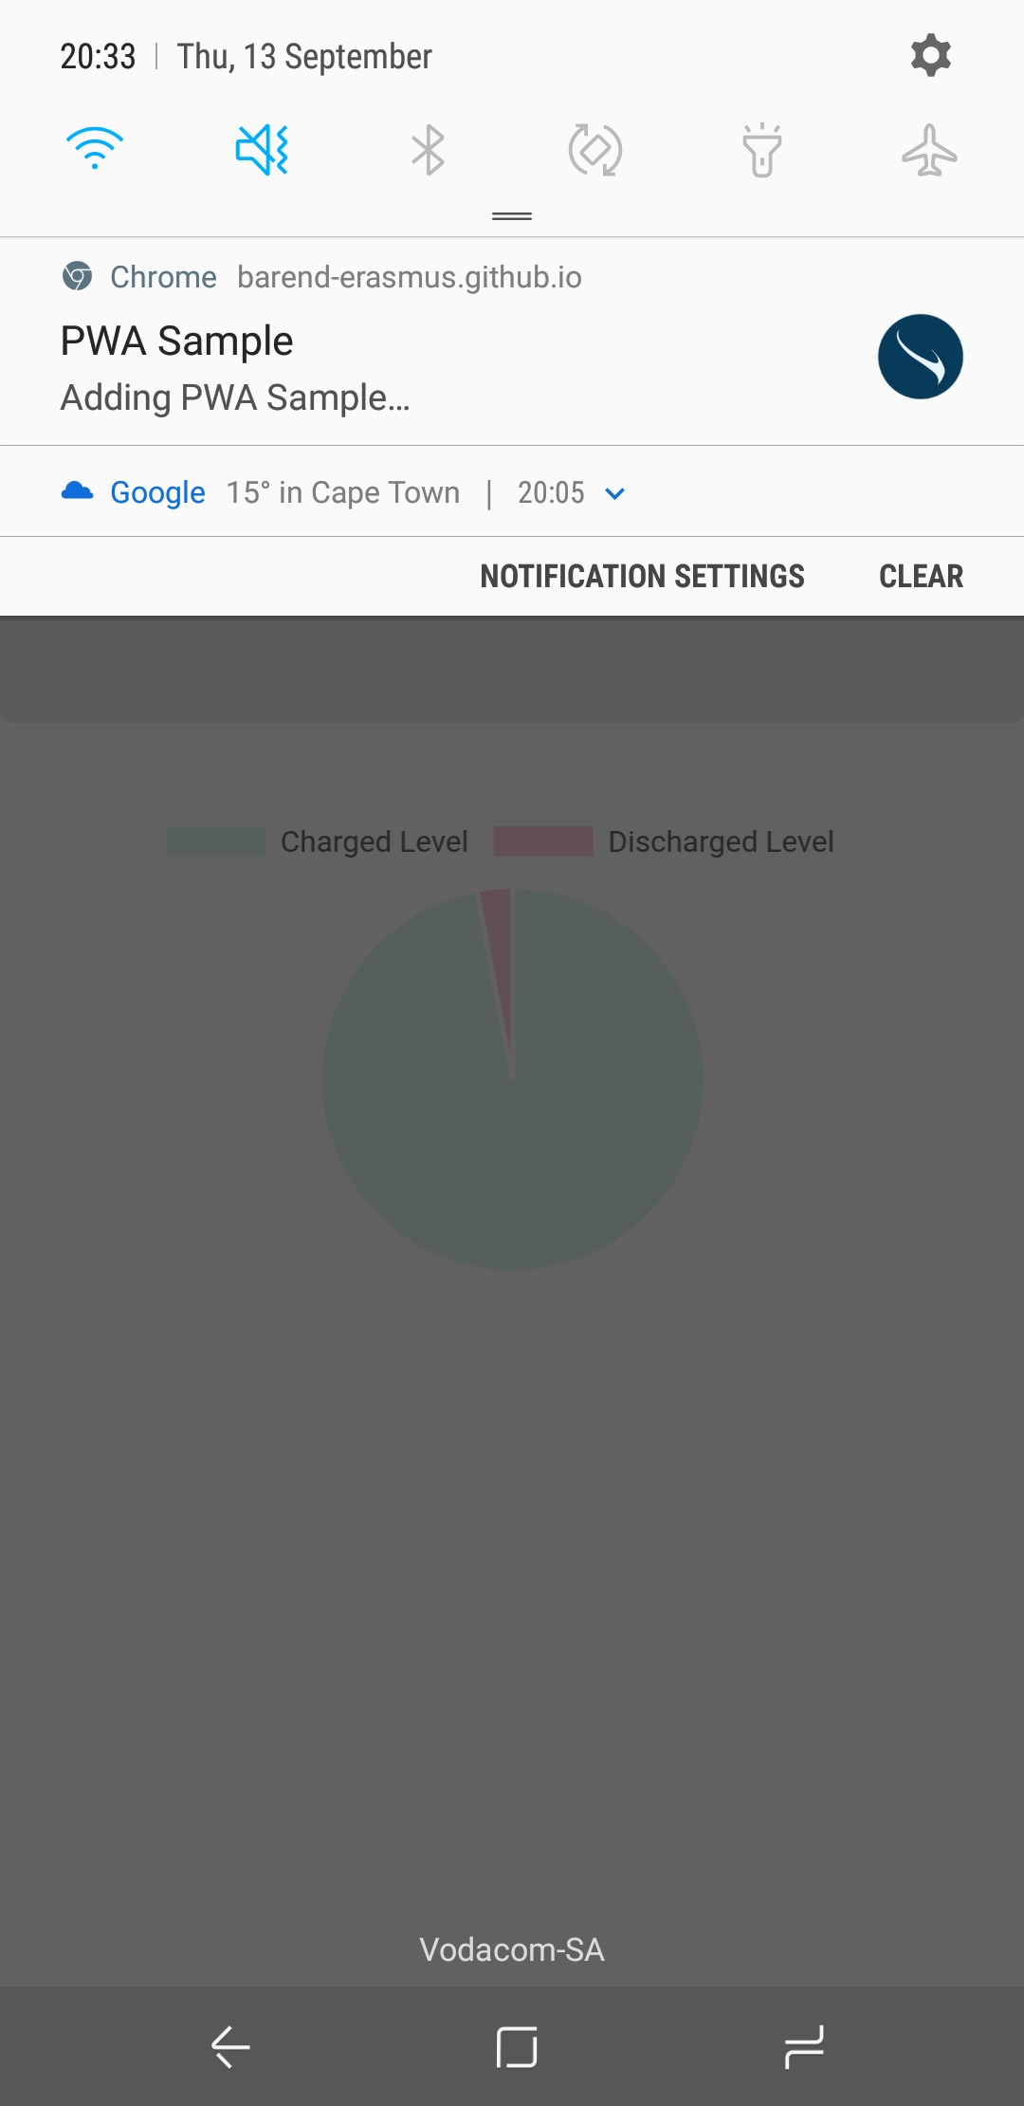

Slide 17
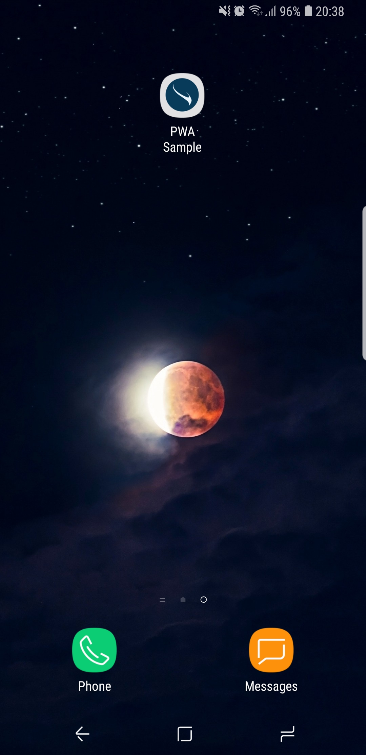

Slide 18
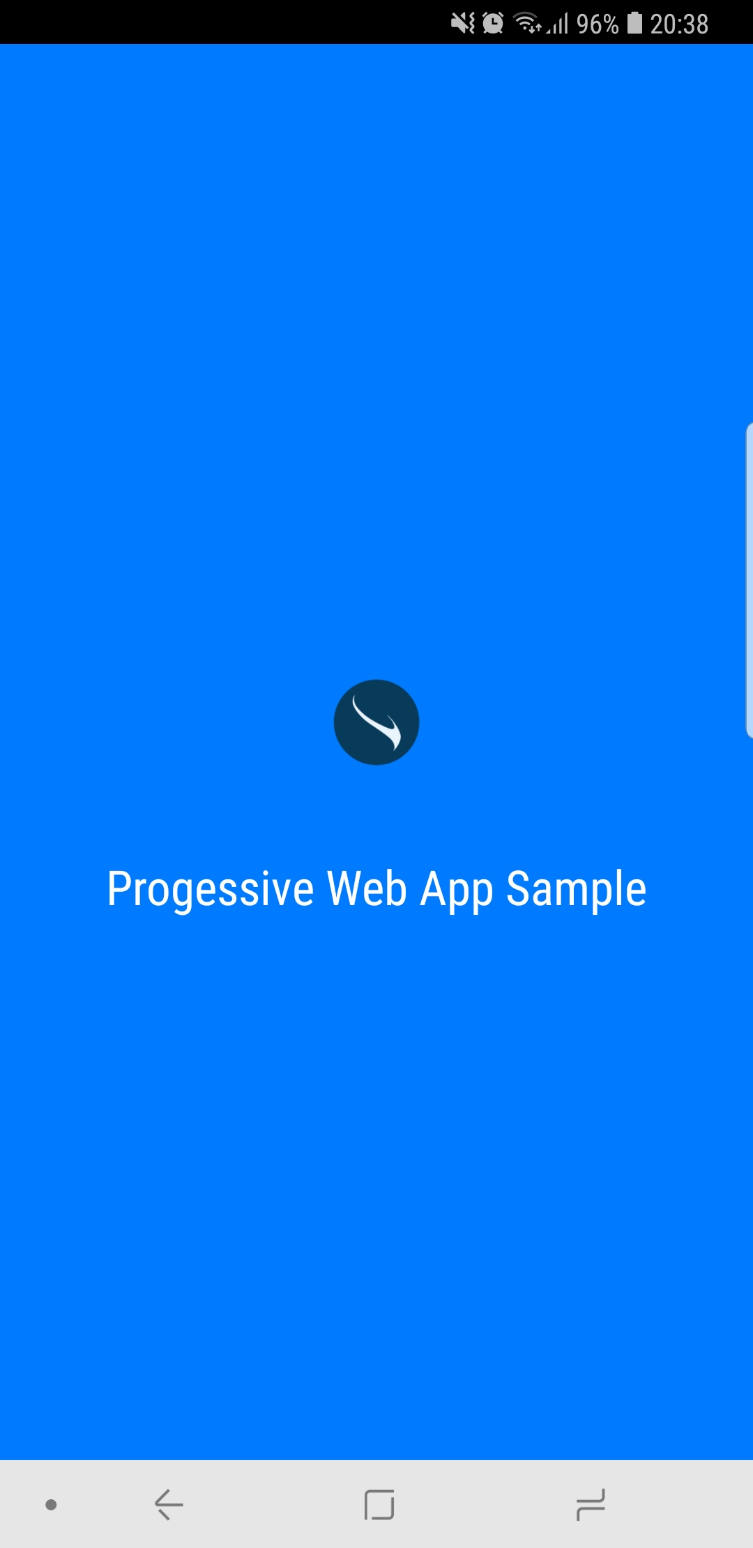

Slide 19
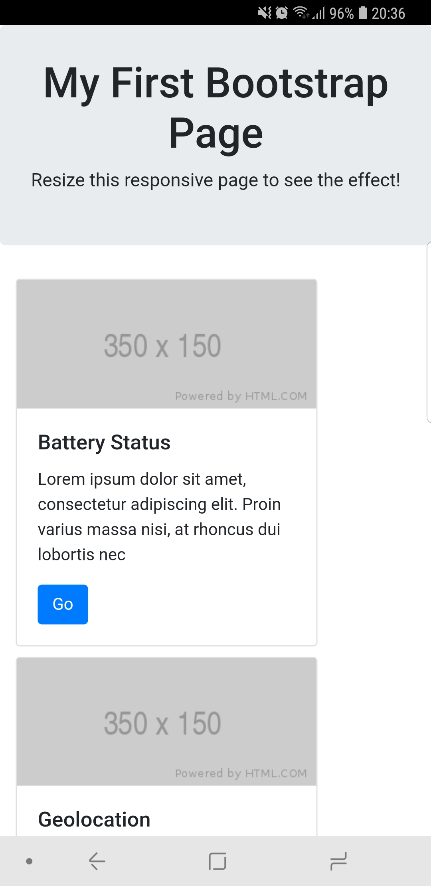

Slide 20
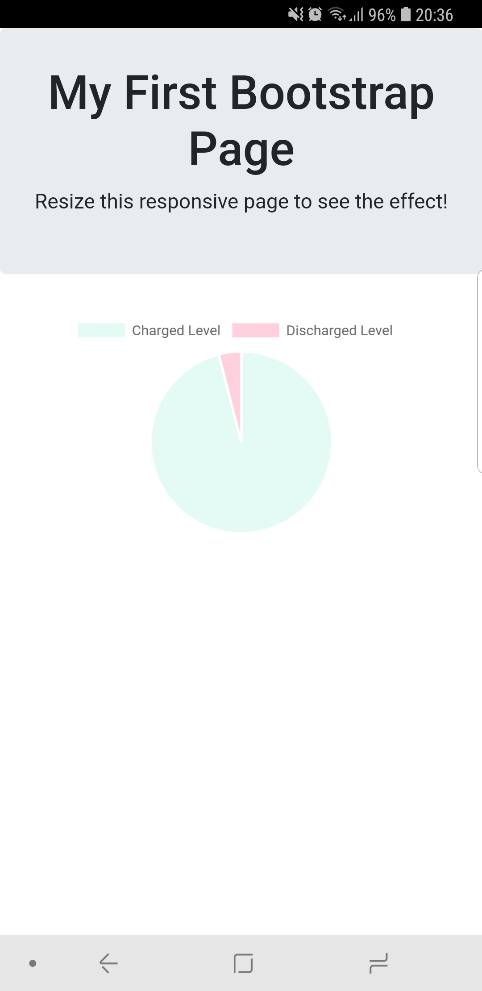

Slide 21
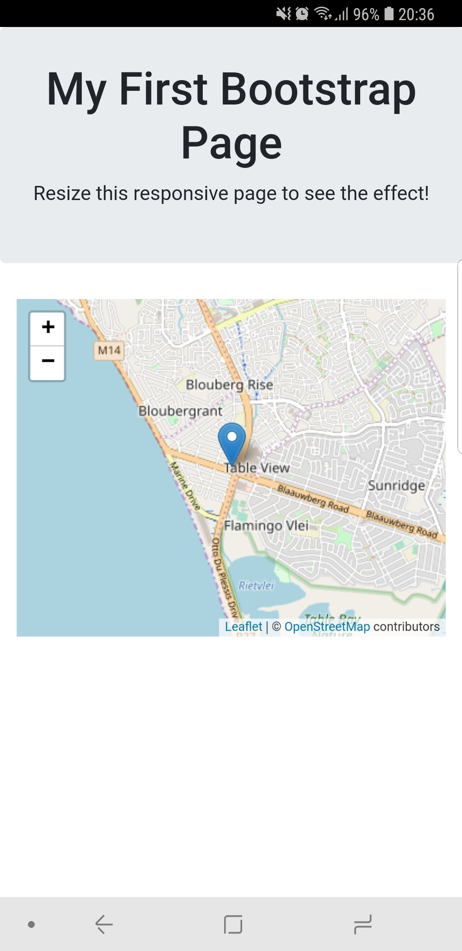

Slide 22
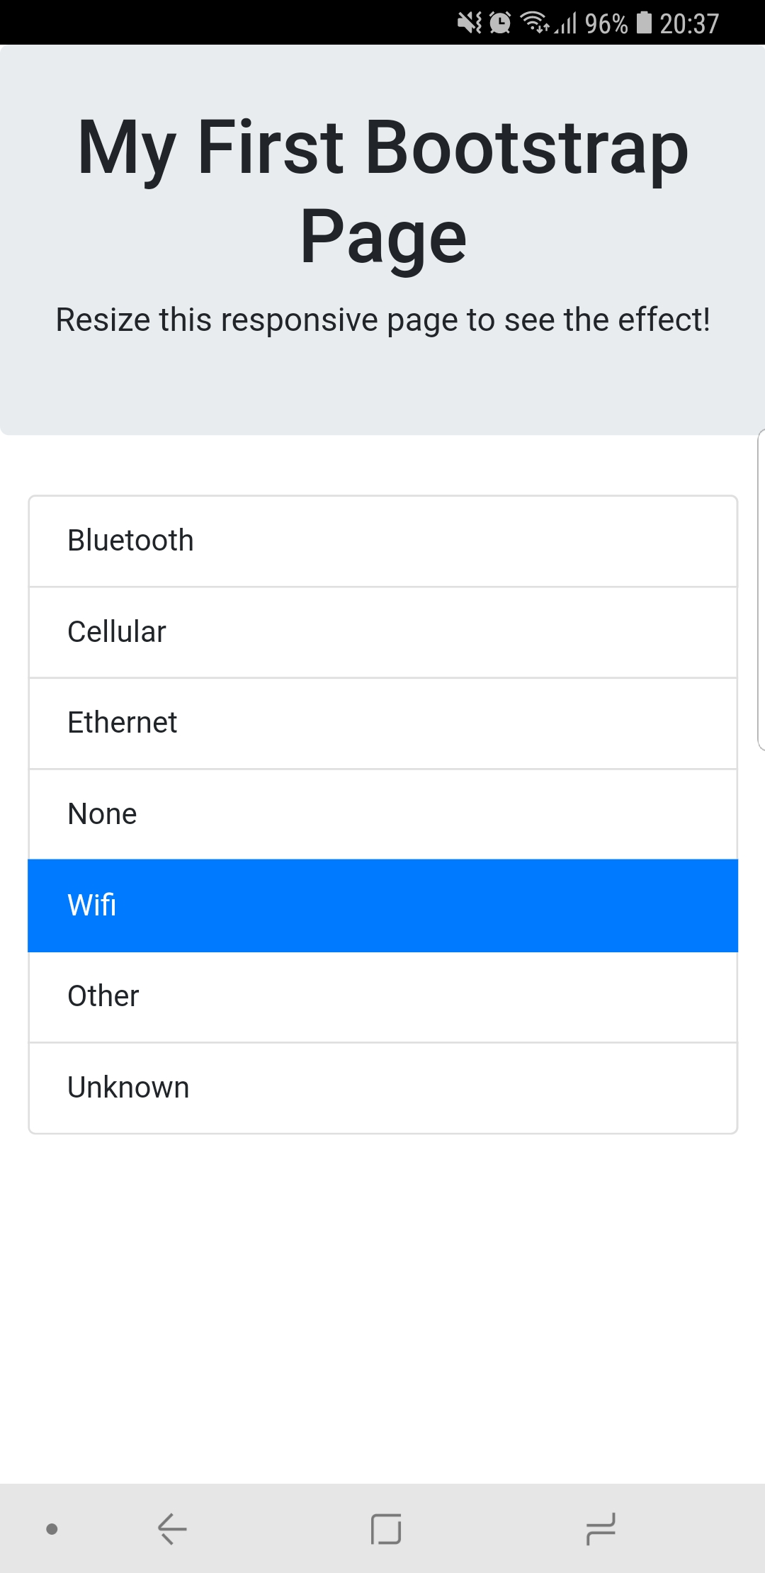

Slide 23
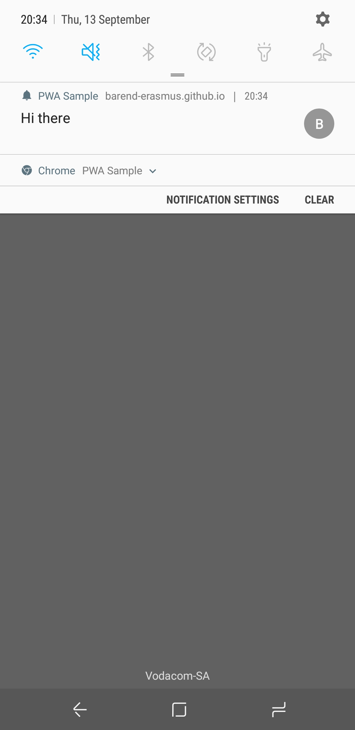

Slide 24
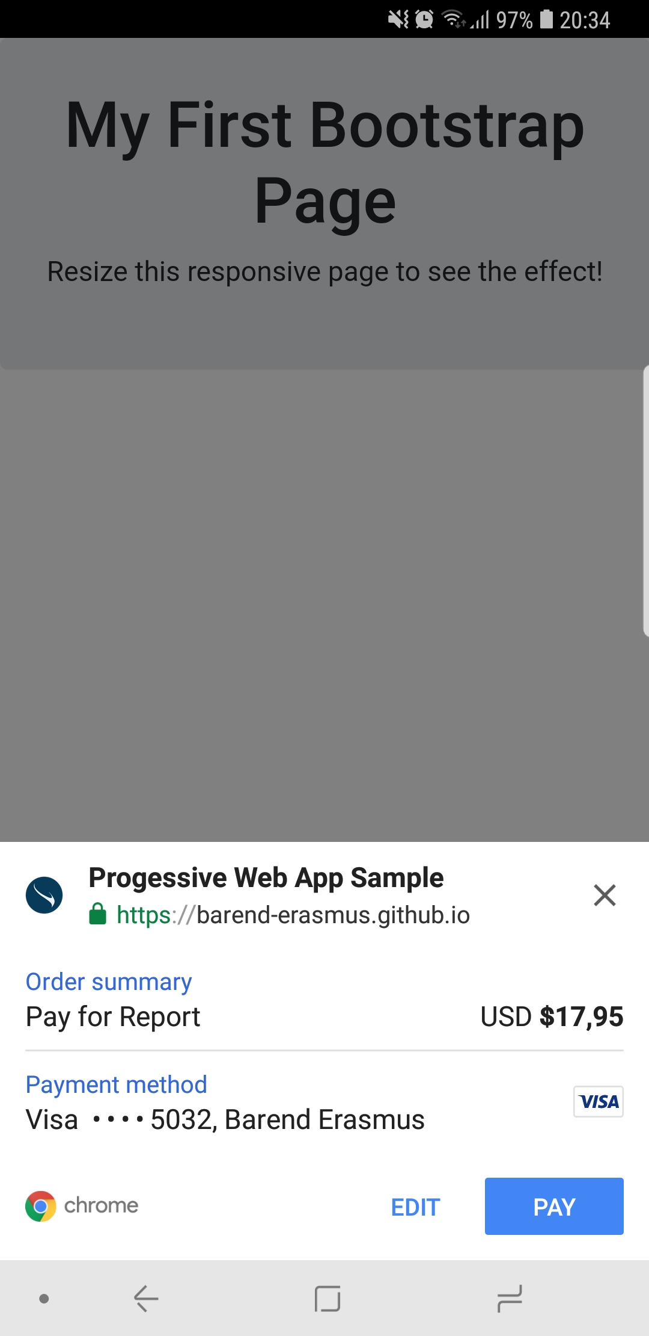

Slide 25
