Slide 1

JSON TO CSV ELT PIPELINE PRACTICE
Renruo Ba

Slide 2
Task description
Apply "JSON to CSVs" transformation to those files (each JSON is a single record in the resulting CSV table) in a script.
Instead of resulting tables in CSV format, store them in a database system. (Optional)
Wrap the entire pipeline into a docker image. (Optional)
Use Python to construct your pipeline, save your functions or other necessary in the Python scripts (not Jupyter notebook).
Attach your GitHub repository or gist once you are finished.

Slide 3
1."JSON to CSVs" transformation in a script
Partial transformation of data ELT pipelines. EL(T): EXTRACTION - LOADING – TRANSFORMATION(may be partial according to requirements)
My solution programmed by python:
(1)find newly updated .json file which needs to be loaded: three ways/modes
(2)perform normalization and extract information from .json file to Pandas Dataframe.
(3)edit the data in dataframe, make sure the .csv file generated will be readable from Mysql side(for further importing).
(4)transform dataframe object into .csv file with the same name.
(5)save codes in a .py file

Slide 4
Find newly updated .json file which needs to be loaded
Pipelines should be able to identify new .json files and transform them automatically. .
However, people can also input the file path of the .json file after selecting the “single file transform” mode, and transform this file to target folder.
Json Folder
CSV Folder
To identify a newly uploaded .json file, the function loop over all .json and .csv files in a certain folders, and find .json files which have no maching .csv files with the same name
A.JSONF
A.CSV
B.JSONF
B.CSV
No maching .csv file, need transformation
C.JSON

Slide 5
Extract information from .json file to Dataframe
Json files structures:
1. A collection of key/value pairs, known as object or dictionary
2. An ordered list of values known as list or array
dict
dict: { … }
keys
values
list
JSON
Null
dict
list:[ … ]
values
list:[ … ]

Slide 6
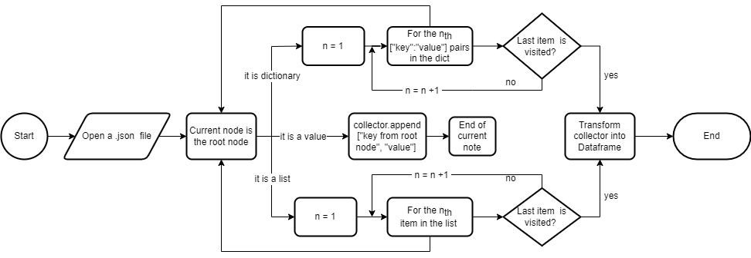
Extract information from .json file to Dataframe
In order to extract information from nested .json files, a recursive process is introduced as follows:

Slide 7
Extract information from .json file to Dataframe
Problems in this part:
1.I tried to normalize the json file horizontally, which enable all json files share common table after transformation:
 | Column 1 | Column 2 | … | Column N
A.json | Value_a_1 | Value_a_2 | … | Value_b_N
B.Json | Value_b_1 | Value_b_2 | … | Value_b_N
However, these json files has different number of keys and some keys share the same name, which needs more time to sort and structured. Generally, I need more time to think and understand the raw data.

Slide 8
Extract information from .json file to Dataframe
Solution:
1.Instead, I normalize them vertically, making two columns to store normalized data.
2.Thus I have to create for each json file a new csv file with the same name.
3.Also when Import them into database, I will create new tables for new json file to store.
A.json
B.json
Recordname | Recordvalues
Key_a_1 | Value_a_1
Key_a_2 | Value_a_2
… | …
Key_a_N | Value_a_N
Record name | Record values
Key_b_1 | Value_b_1
Key_b_2 | Value_b_2
… | …
Key_b_M | Value_b_M

Slide 9
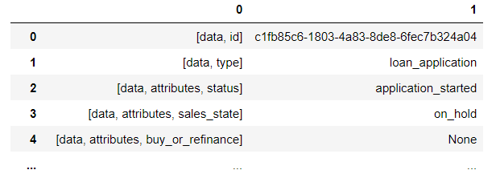
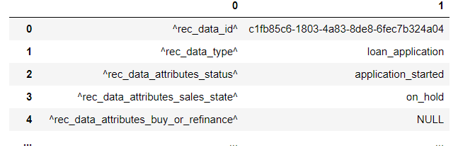
Some edit to the data in Dataframe
The keys I extracted from .json files are in the form at right :
However, in order not to confuse Mysql when I command “terminate one column by ‘,’” at csv importing process, I make the keys look like:
In the next step, I replace .json with .csv and create csv files using Dataframe.to_csv() function in python.

Slide 10
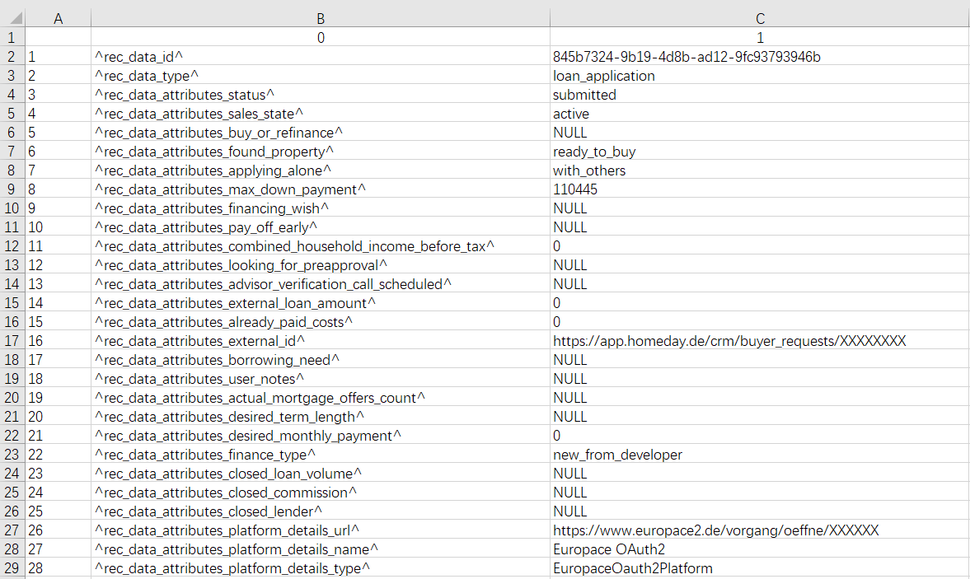
The .csv files after transformation shown as follows

Slide 11
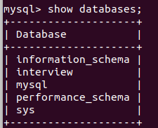
2. Store .json files in a database system
The DBMS I select is MySQL database, and I create a new database named “interview”
2. For manual importing .csv files to database with Sql command, it works well:
3. For importing .csv files automatically, I import mysql.connector to connect database using python. Then I execute inserting command with cursor.execute().

Slide 12
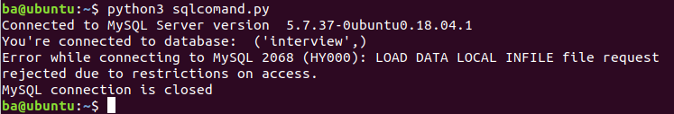
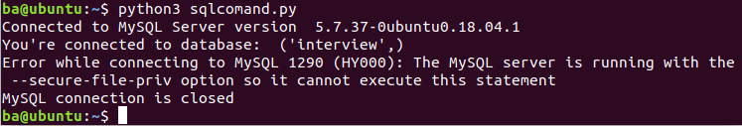
Store .json files in a database system
Problem in this part:
1. When I tried to execute ("LOAD DATA local INFILE ‘…’) with cursor.execute, it shows
When I delete “local” and execute ("LOAD DATA INFILE ‘…’) with cursor.execute, it shows
My solution:
Instead of importing data as csv, insert them as arguments in a loop

Slide 13
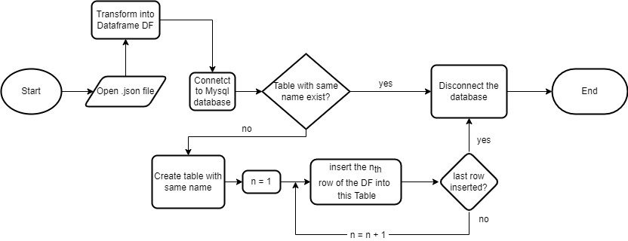
Store .json files in a database system
The workflow of inserting data into database:

Slide 14
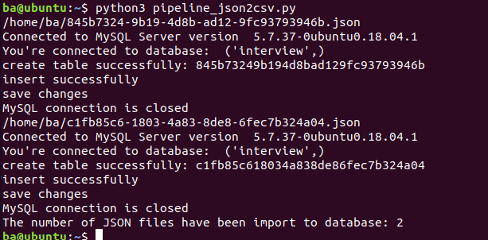
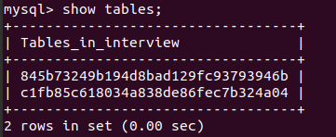
Display of the code running in Ubuntu

Slide 15
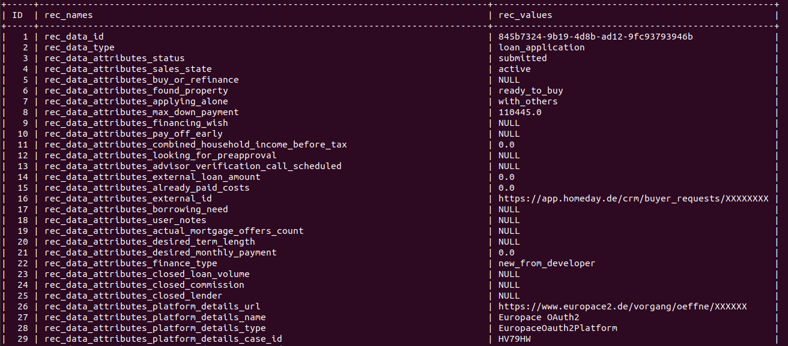
The storage in table is in the following form:

Slide 16
Improvement in the future
1. Complete the data structure modeling for the loans data. Store them in one table in the database.
2. Test some queries according to some requirements, create new tables with specific aims automatically.
3. Filter the data, not all the information is needed.
4. Test the script and data in Docker containers, create Docker image for others to check and run in the same environment.

Slide 17

Thank You

