Slide 1


Bacula
The Network Backup Solution
Presented by Kern Sibbald at FOSDEM
25 February 2007 in Brussels
Bacula – the Network Backup Tool for Linux, Mac, Unix and Windows
It comes by night and sucks the vital essence from your computers.

Slide 2

Introduction
Do you do backups?
  No
  Yes, I did one last month
  Yes, tarballs every week
  Sometimes I rsync ...
  Yes, CDs every week
Problems with the above that Bacula solves by:
  Finding the files you need to restore (GUI)
  Restoring to a point in time
  Knowing what was backed up when
  Scaling to handle 2000 machines
  Providing a bare-metal recovery (non-trivial)

Slide 3
Introduction
Bacula is a network backup solution, designed for Linux, Mac OS, Unix and Windows systems.
Project goals are to:
  backup any client from a Palm to a mainframe computer
  provide “Enterprise” features similar to the largest commercial applications
  assure data compatibility for 30 years (providing you have the appropriate hardware)
  use a Free and Open Source (GPL v2 + clarifications) license

Slide 4

Project History and Statistics
  Bacula = Backup + Dracula
  January 2000 – Project started
  14 April 2002 – First release to Source Forge (version 1.16)
  29 June 2006 – Release 1.38.11
  January 2007 – Release 2.0.0 (current 2.0.2)
  41 Source Forge project members
  13 (35) developers with subversion write access
  656 bugs.bacula.org
  1,444 bacula-users@lists.sourceforge.net
  712 bacula-announce@lists.sourceforge.net
  Downloads
    74 version 1.16
    10,919 version 1.36
    12,408 version 1.38.11

Slide 5

The Six Bacula Components
1. Director (DIR)
  Control and administration for everything is centralized
  Basic unit is a Job (one client, one set of files, ...)
  Schedules, initiates and supervises all Jobs
  Maintains the catalog
  Typically one Director except in very large shops

Slide 6
The Six Bacula Components
  2. File daemon or Client (FD)
  Does file backup, restore and verification as requested by Director
  Installed on each machine as a service (daemon)
  Communicates over network with Director and Storage daemon
  Needs access to all files to be backed up (root)
  Common code but adapted specifically to each OS
  Typically multiple File daemons per Director; one for each machine

Slide 7
The Six Bacula Components
  3. Storage daemon (SD)
  Reads and writes data to the physical medium
    Disk
    Tape
    DVD
    USB
  Accepts orders and authorization from the Director
  Accepts and returns data to/from File daemons (FD)
  Sends file storage location to Director -> Catalog
  Typically one per Director

Slide 8
The Six Bacula Components
  4. Console
  Allows user or administrator to control Bacula
  Communicates with Director via network
  Start jobs, review Job output, query/modify catalog
  Consoles available
    TTY (bconsole)
    wxWidgets (GUI) – Linux, Unix, Win32
    Gnome (GUI)
    Several web interfaces
    Comprehensive Qt 4 console being developed (bat)
  Restricted consoles (ACL) for security

Slide 9
The Six Bacula Components
  5. Catalog database
  Only component not written by Bacula team
  SQL database (MySQL, PostgreSQL, or SQLite) - unique
  Tracks Jobs run, Volumes used, File locations, ...
  Permits rapid restores
  Allows inquiry of when and where files were backed up
  Old data automatically pruned by Director
  Supports multiple databases of same vendor - scaling

Slide 10
The Six Bacula Components
  6. Tray Monitor
  Gnome/KDE/Win32 GUI tray applet
  Monitors Director, File daemons, Storage daemon
  Near real-time display of activity

Slide 11
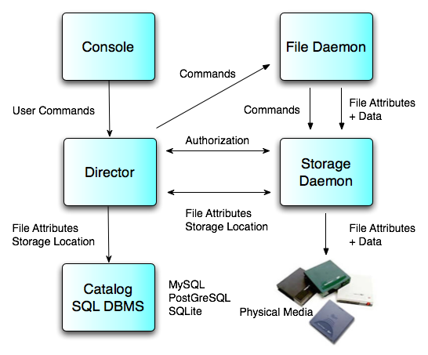
Main Components

Slide 12
Features
  A central server and catalog with distributed backup
  All components communicate via the network and are deployed separately.
  Internal scheduler for automatic and simultaneous job execution with priorities.
  Interactive restore of one or more files from:
    current backup
    prior backup of time and date
    list of files/directories to restore
    restore by JobId
    ...
  Simple administration with consoles (command line, GUI, and web)

Slide 13
Features (cont.)
  Labeled Volumes, to prevent accidental overwriting
  Support for ANSI / IBM labels
  Machine independent Volume data format - extensible
  Support for Unicode on Win32; UTF-8 on Unix
  Python interpreter for user “event” (job start, end, ...) scripting
  Rescue CDROM for “bare metal” recovery.

Slide 14
Bacula – Hardware Features
  Backups can span multiple volumes
  Multiple backups (jobs, clients, OSes) per volume
  Supports most tape drives with configurable Device resources
  Support for multiple drive autochangers (libraries)
  Supports tape barcode readers
  Extensive Pool and Volume library management
  Rapid restoration of individual files (one user reported 4 to 6 hours with tar and 3 to 4 minutes with Bacula!).

Slide 15
Bacula – Security Features
  Daemon authorization with CRAM-MD5
  Director and Storage daemon can be run non-root
  MD5, SHA1, ... signatures for each file
  CRC checksum for each Volume block
  Restricted consoles and tray-monitors
  Communications (TLS) encryption
  Data (PKI) encryption
  Tripwire like intrusion detection (Verify)

Slide 16
Technical Highlights
  OS support : Linux (all versions including the zSeries), Win32, Solaris, *BSD, Mac OS X, Irix, Tru64, AIX, HP-UX
  Backup has disk spooling capability to avoid “shoe-shine” on tapes
  Backup/restore of POSIX Access Control Lists (ACL), Mac resource forks, Win32 permissions
  Support for large files (>2GB) and 64 bit architectures
  Multi-thread implementation
  Originally written in C, now converted to a subset of C++

Slide 17
Bacula – Director Configuration File
Director {
Name = bacula-dir
Query File = “/usr/local/etc/query.sql”
Working Directory = “/var/bacula”
PID Directory = “/var/run”
Maximum Concurrent Jobs = 20
Password = “secret”
Messages = Standard
}
Console {
Name = Monitor
Password = “monitor-secret”
CommandACL = status, .status
CatalogACL = BackupDB
}

Slide 18
Bacula Configuration - Job
Jobs are the basic unifying structure
  Name – unique name
  Type – what to do: backup, Backup, Migrate, Admin, Restore
  Level – level of detail of type: Full, Differential, Incremental
  FileSet – what to files to backup
  Client – where to get the files (machine name)
  Storage – where to put the files (which hardware)
  Pool – which set of Volumes (tapes, disk) to use
  Schedule – when to do it

Slide 19
Bacula – Director Configuration File
Job {
Name = “Laptop”
Type = Backup
Client = laptop-fd
FileSet = “Full Set”
Schedule = “Weekly Cycle”
Storage = File
Messages = Standard
Pool = Standard
Write Bootstrap = “/var/bacula/laptop.bsr”
Priority = 10
}

Slide 20
Bacula – Director Configuration File
Client {
Name = laptop-fd
Address = laptop.example.org
Catalog = MyCatalog
Password = “secret-fd”
File Retention = 30 days
Job Retention = 6 months
AutoPrune = yes
Maximum Concurrent Jobs = 20
}

Slide 21
Bacula Configuration – FileSet
  Include/Exclude files and/or directories
  Regex or wildcard for file/directory name selection
  Compression using similar selection criteria
  Which filesystem types to backup
  ACL support
  Sparse file handling
  Signature (MD5, SHA1, ...)

Slide 22
Bacula – Director Configuration File (cont)
FileSet {
Name = “Full Set”
Include {
Options {
signature=SHA1; sparse = yes
regex = ".*\.c$"; wild = "*.txt"
exclude = yes
}
File = /
File = /usr
File = /var
}
Exclude {
File = /proc; File = /tmp; File = /sys; File = /.journal
}
}

Slide 23
Bacula – Director Configuration File (cont)
Schedule {
Name = “Weekly Cycle”
Run = Level=Full 1st sun at 2:05
Run = Level=Differential 2nd-5st sun at 2:05
Run = Level=Incremental mon-sat at 2:05
}

Slide 24
Bacula – File daemon Configuration File
FileDaemon {
Name = laptop-fd
Working Directory = /var/bacula
PID Directory = /var/run
}
Director {
Name = bacula-dir
Password = “secret-fd”
}

Slide 25
Bacula – Storage Configuration File
Storage {
Name = bacula-sd
Working Directory = /var/bacula
PID Directory = /var/run
}
Director {
Name = bacula-dir
Password = “secret-sd”
}

Slide 26
Bacula – Storage Configuration File (cont)
Device {
Name = File
Archive Device = /var/bacula/backups
Device Type = File # DVD, FIFO, Tape
Media Type = File
Label Media = yes
Random Access = yes
...
}

Slide 27
Bacula – Storage Configuration File (cont)
AutoChanger {
Name = LTO-Changer
Device = Drive-0, Drive-1
Changer Device = /dev/sg0
...
}
Device {
Name = Drive-0
Archive Device = /dev/nst0
Device Type = Tape # DVD, File, FIFO
Media Type = LTO-2
Autochanger = yes
...
}

Slide 28
Developers
Most developers believe that backup programs are not very “sexy”. Perhaps, but they are extremely complicated:
  Database – SQL
  GUI
  Web
  Networking
  OS (every bit must be restored)
  Restore
    Full, Diff, Inc
    Find Volumes
    Directory tree (100 million records, 5 million files)
    where is the file?
  Job resource allocation (drives, Volumes)

Slide 29
Project development
Site : http://www.bacula.org/
Development style:
  SourceForge project
  Developer's guide with code style guidelines
  Developer SVN access. Currently 13 developers may commit
  Patches and commits reviewed by K. Sibbald
  All code tested using a regression test suite
  Email list for developers (bacula-devel)
License:
  GPL 2 (+ clarifications) copyright assigned to FSFE.
  Freedom Task Force (FTF)

Slide 30
Resources
For users and system administrators
  Manual: http://www.bacula.org/rel-manual/index.html
  OS and Hardware compatibility lists (in manual)
  Bugs reports: http://bugs.bacula.org/
  Email support list: bacula-users@lists.sourceforge.net
For developers
  Docs: http://www.bacula.org/developers/index.html
  Email list: bacula-devel@lists.sourceforge.net,
  bacula-commits@lists.sourceforge.net
  SVN at Source Forge

Slide 31

Credits
Thanks
  Dan Langille who created the original presentation
  Karl Cunningham who updated it
  This presentation draws heavily on their work
  A .pdf copy of this presentation can be found at:
  http://www.bacula.org -> Presentations -> ...

Slide 32
Live Demo
The following slides are not part of this slide show but are screenshots of the live demo that will be presented after the slide show.

Slide 33
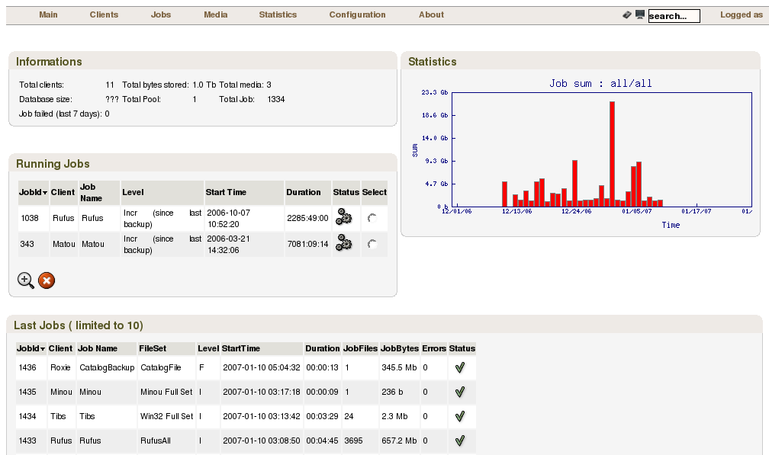

Slide 34
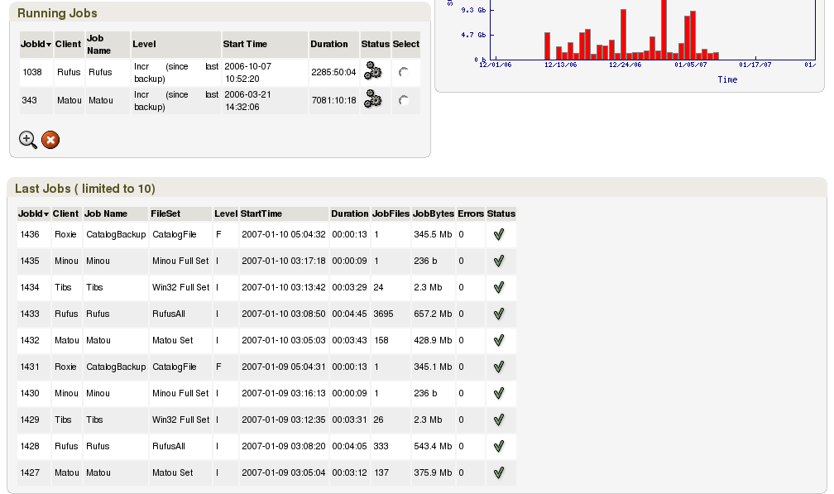

Slide 35
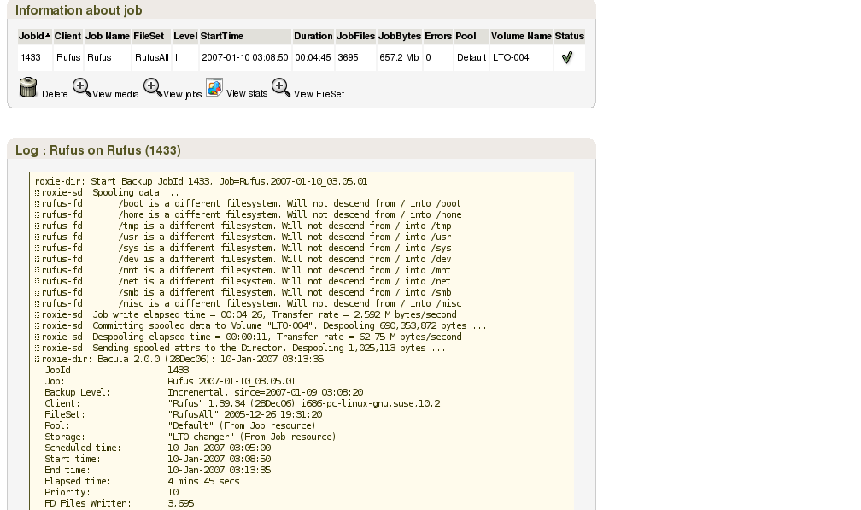

Slide 36
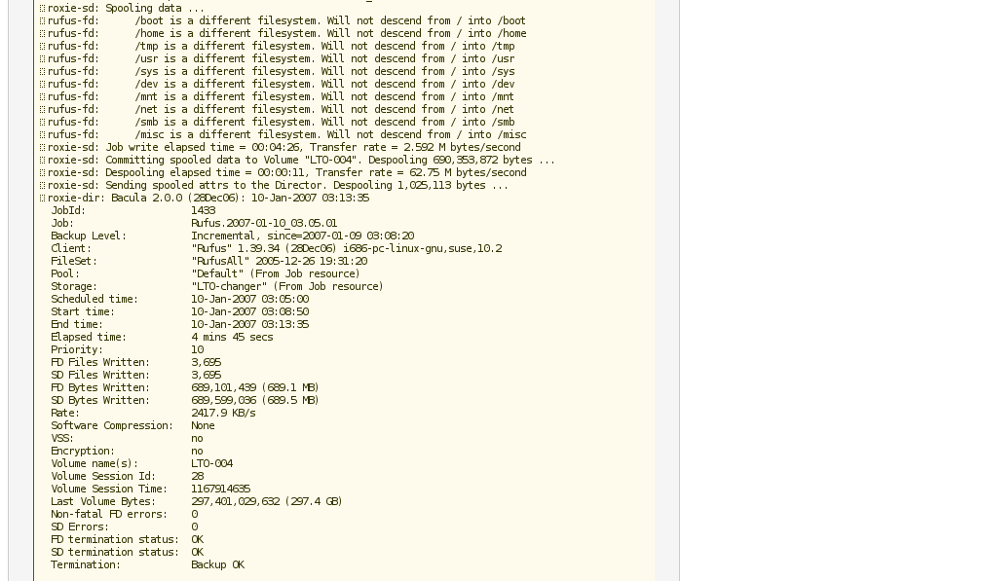

Slide 37
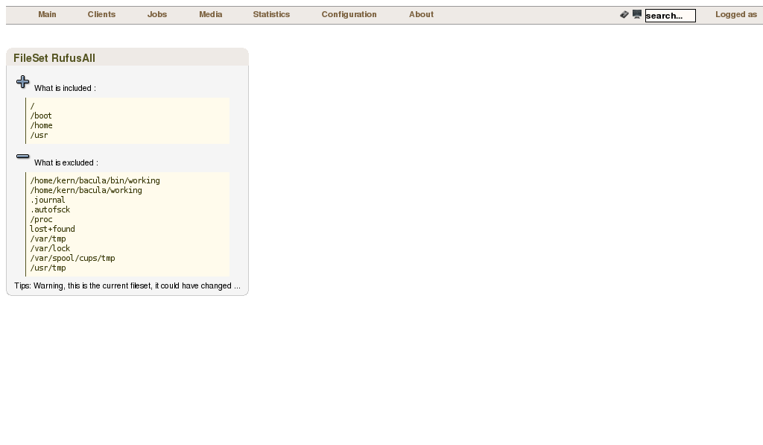

Slide 38
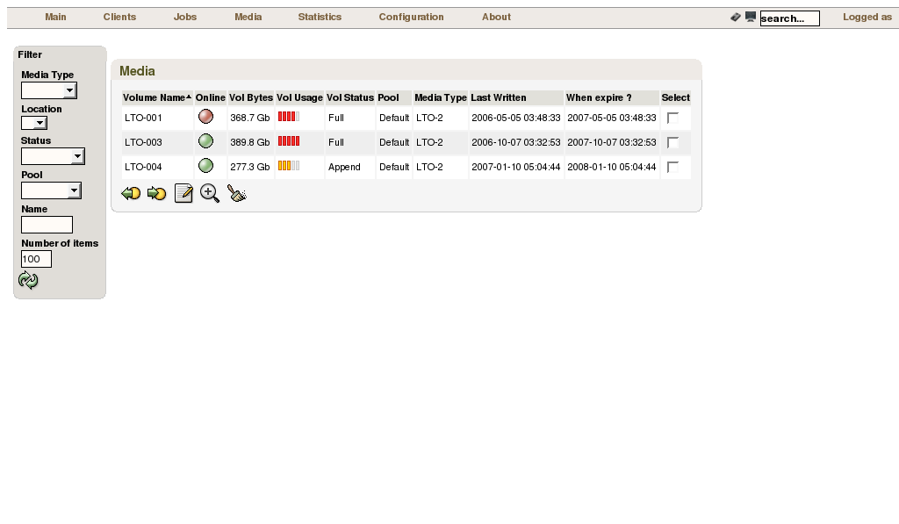

Slide 39
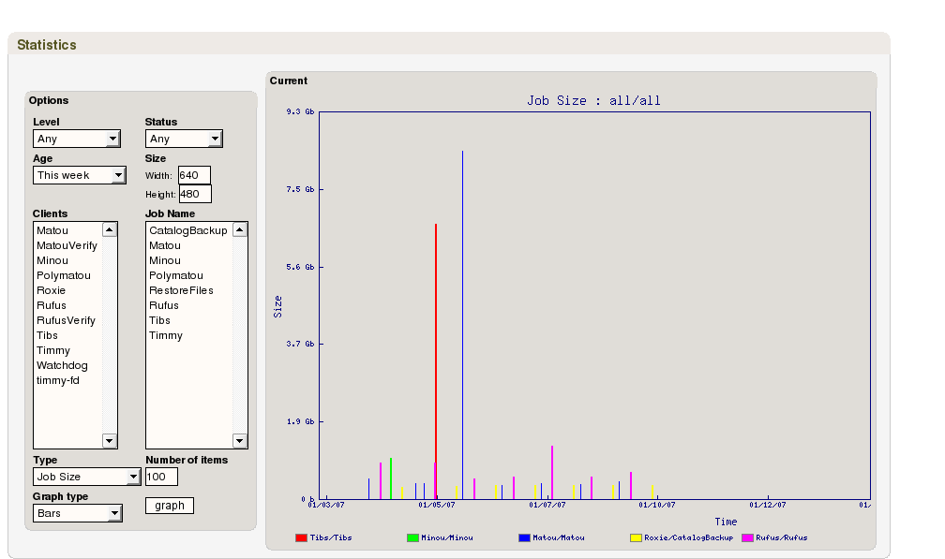

Slide 40
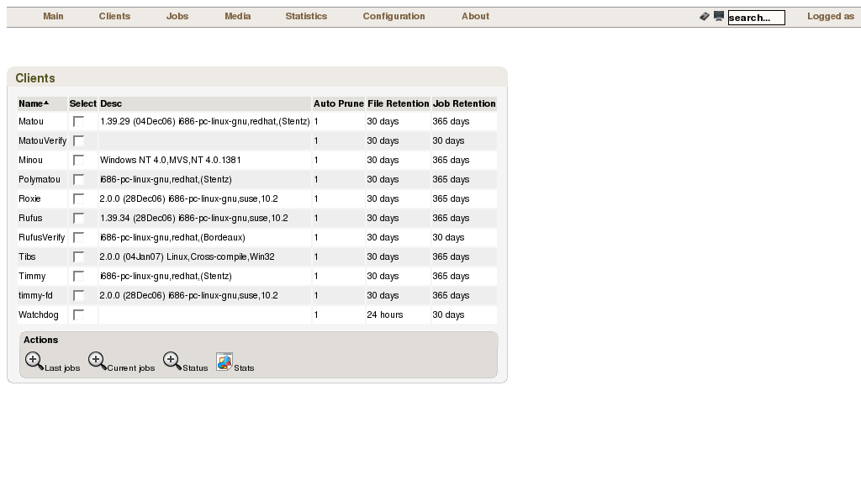

Slide 41
