Slide 1
Bacula
The Network Backup Solution
Presented on 12th of May 2005 in Paris
Bacula – the Network Backup Tool for Linux, Unix, Mac and Windows

Slide 2
Introduction
Bacula is a network backup solution, designed for Linux, Unix, Mac OS and Windows systems.
Project goals:
  To be able to backup any client from a Palm to a mainframe computer with the same software
  To have “Enterprise” features similar to what are available in the largest commercial applications.
  To assure compatibility of your data for at least 30 years (providing you have the appropriate hardware).
  An Open Source (modified GPL) license.

Slide 3
Features
  Distributed backup with a central server and catalog: all components communicate via the network and can be deployed separately.
  Internal scheduler for automatic and simultaneous job execution with priorities.
  Restore of one or more files selected interactively either for current backup or a backup prior to a specified time and date (many more options).
  Pool and library volume management.
  Multi-volume saves and multiple saves per volume with checksum and hash code for data security.
  Rescue CDROM for “bare metal” recovery.
  Simple administration with several consoles (command line, GUI, and a web version in development)
  Rapid restoration of individual files (one user reported 4 to 6 hours with tar and 3 to 4 minutes with Bacula!).

Slide 4
Bacula components
  Bacula Director : service is the program that initiates and supervises all backup, restore, verify and archive operations.
  Bacula Console : allows the administrator to control Bacula through the Director using the network to communicate; currently three consoles are available (TTY, wxWidgets (GUI), and Gnome (GUI)). Several web interfaces also exist.
  Bacula File Daemon : a client program that does file backup and restore; installed on each system to be backed up; adapted specifically to each OS.
  Bacula Storage : assures the storage (read/write) of data on the physical medium – on disk or tape.
  Bacula Catalog : services that maintain the indexes and Volume databases to permit rapid restores.
  Bacula Monitor : a Gnome/KDE GUI tray applet to monitor daemon operation.

Slide 5
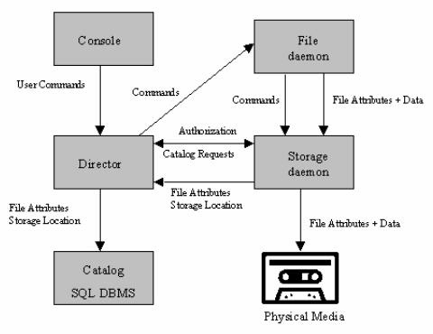
Main Components

Slide 6
Technical Highlights
  Multi-OS support : Linux (all versions including the zSeries), Win32, Solaris, *BSD, Mac OS X, Irix, Tru64, AIX, HP-UX
  Catalog : support for MySQL, PostgreSQL or SQLite
  Backup to disk or tape with spooling capability to avoid “shoe-shine” on tapes
  Wide hardware support with configurable Device resources, including support for multiple drive autochangers (libraries).
  Backup/restore of POSIX Access Control Lists (ACL)
  Support for backup/restore of raw devices
  Support for large files (>2GB) and 64 bit architechtures
  Secured communication between components with CRAM-MD5 authentication and optional encryption
  Multi-thread implementation

Slide 7
Project development
Site : http://www.bacula.org/
Development style:
  Open with SourceForge project
  Patches and commits reviewed, and releases planned by K. Sibbald
  Developer CVS access. Currently 24 developers may commit.
  Comprehensive developer's guide with code style guidelines, design documents and a test suite.
  Email list for developers (bacula-devel).
Release organization:
  Development code in CVS HEAD
  Releases are maintained/updated via stable branches

Slide 8
Features Planned for the Next Release
Release 1.38.0 (July – August 2005)
  Support for ANSI / IBM labels
  Support for multiple drive autochangers (libraries)
  Support for Unicode/Win32
  Secured communications with built-in TLS (SSL) between components
  Support for direct writing on DVD
  Integrated Python interpreter for “event” (job start, end, ...) scripting
  Specification of multiple possible devices with automatic selection of a free device
  Multiple simultaneous copies of the same backup on different volumes

Slide 9
Resources
Downloads : http://download.sourceforge.net/bacula
For IT professionals and system administrators
  Manual: http://www.bacula.org/rel-manual/index.html
  OS and Hardware compatibility lists (in manual)
  Bugs reports: http://bugs.bacula.org/
  Email support list : bacula-users@lists.sf.net
For developers
  Docs : http://www.bacula.org/developers/index.html
  Email list : bacula-devel@lists.sf.net
  CVS at Source Forge
Interview with K. Sibbald : http://www.linuxdevcenter.com/pub/a/linux/2005/04/07/bacula.html

