Slide 1
Newtonian Program Analysis via Tensor Product
Thomas Reps
Univ. of Wisconsin
and GrammaTech
Emma Turetsky
GrammaTech
Prathmesh Prabhu
Google
Notes:
First of all, thank you for coming to this event, and thank you Mooly, Reinhard, Aws, Somesh, and Ramalingam for organizing it. I’ll have more to say in the way of thanks at the end of the day, but first I will kick off the technical talks with something that I hope you’ll find interesting. When Ramalingam sent me e-mail asking if I wanted to give a talk, I immediately thought of this material because it can be viewed as kind of a capstone on two main threads of things that I’ve worked on during my career – algorithms that involve incrementality or differencing, and program analysis – which get combined here to create a new algorithm for solving certain types of program-analysis problems.

Slide 2
Big Picture: Dataflow Analysis
Program
Abstraction engine
System of Dataflow Equations
We combine two methods for solving equations to create an improved equation solver
Equation solver
Solution (= dataflow facts)
Notes:
In terms of a typical system for program analysis, which has the pipeline shown on this slide, the algorithm plays the role of the equation solver. It takes as input the equation system that abstracts the actions of the program, and produces as output the solution to the equation system. That solution is then used to identify possible program flaws, or to establish the correctness of the program’s behavior.
<CLICK>
In essence, what we did was to combine two known techniques to create an improved equation solver.

Slide 3
Story in a Nutshell
In 1981, Tarjan found a fast way to solve intraprocedural dataflow equations
Solves a linear system of equations
In 2008, Esparza et al. used inspiration from Newton’s Method to solve interprocedural dataflow equations
Repeatedly: create and solve a linear system of equations
Esparza et al. and Tarjan do not create the same type of linear system
Cannot apply Tarjan’s algorithm to Esparza et al.’s linear systems
We found a way to transform Esparza et al.’s linear systems so that Tarjan’s algorithm can be applied
Surprising because a reasonable-sounding sanity check suggests that is not possible to do so!
Notes:
. . . Our result is surprising because, as I hope to convince you in the remainder of the talk, a reasonable-sounding sanity check suggest that what we were trying to do was impossible! But the moral is that sometimes a sanity check is only a plausible argument, and does not actually reflect reality.

Slide 4
Outline of talk
Newtonian Program Analysis (Esparza et al. [JACM10])
A misconception on my part
A promising step: Pairing
Pairing fails to deliver
A different kind of pairing
Experimental results
Wrap-up

Slide 5
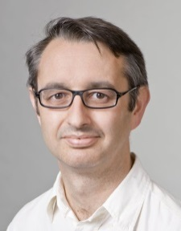


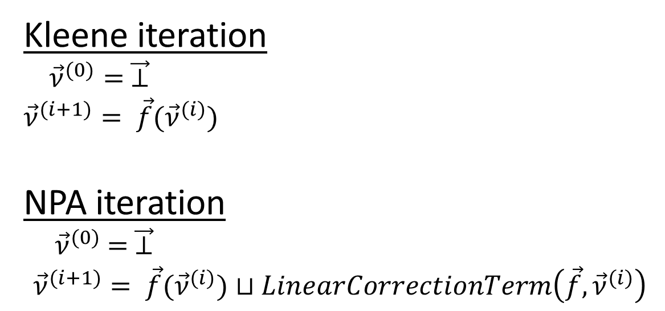

Newton’s Method for Programs [Esparza et al.]
Kleene iteration
${\vec{ν}}^{(0)}= \vec{⊥}$
$${\vec{ν}}^{(i+1)}= \vec{f}({\vec{ν}}^{(i)})$$
NPA iteration
${ \vec{ν}}^{(0)} = \vec{⊥}$
$${\vec{ν}}^{(i+1)}= \vec{f}({\vec{ν}}^{(i)})⊔LinearCorrectionTerm\left(\vec{f}, {\vec{ν}}^{(i)}\right)$$
$$⊥$$
Javier
Esparza
Michael
Luttenberger
Stefan
Kiefer
Notes:
In program analysis, we typically use iterative algorithms, such as Kleene iteration, which works up a lattice to find a fixed point. The so-called Newtonian Program Analysis of Esparza, Luttenberger, and Kiefer is based on the observation that numerical analysts also use iterative algorithms, but instead of something like Kleene iteration, they use Newton’s method. I’ll say more about this over the next few slides, but the high-level picture is that NPA is quite similar to Kleene iteration, except that there is an adjustment made each round in the form of some linear correction term, which has the effect of reducing the number of iterative rounds that need to be performed.

Slide 6
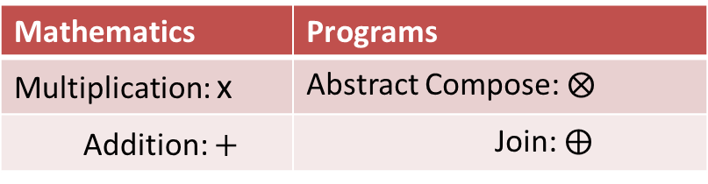
Newton’s Method for Programs [Esparza et al.]
Esparza et al. had to finesse certain differences
Real-valued equations → Algebraic semiring
Each semiring element is an abstract transformer
the usual kind of value in interprocedural dataflow analysis
Initial value x₀ →⊥
Mathematics | Programs
Multiplication: x | Abstract Compose: $⨂$
Addition: + | Join: $⨁$
Notes:
To bring out the analogy, we’ll use the semiring formulation of dataflow-analysis problems.
This formulation is really just a change in nomenclature: dataflow problems are equations over a formal multiplication operator and a formal sum operator. The semiring values are abstract transformers of exactly the kind used in interprocedural dataflow analysis, namely abstractions of the program’s transition functions: multiplication is just an abstraction of function composition; and plus is
what is more commonly called join.

Slide 7


Running Example
proc X₁
proc X₂
x₁() {
a;
x₂();
}
x₂() {
if (*) d;
else{
b;
x₂();
x₂();
c;
}
}
a
b
X₂
X₂
d
X₂
c
Equation System
$$X_{1}=a ⨂ X_{2}$$
$X_{2}=d ⨁$ $b ⨂ X_{2}⨂X_{2}⨂c_{ }$
Notes:
Here is a program that I’ll use as a running example.
Each summand represents a path in the (acyclic) control-flow graph.
Esparza et al. handle loops by assuming that all loops have been converted to calls on tail-recursive procedures. In general, they have a precise method for solving systems of recursive, loop-free equations. One of the contributions of our paper that I will not talk about in this presentation is a different method for handling loops that does not rely on such a normalizing transformation.

Slide 8
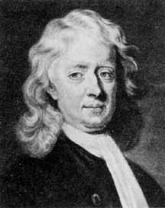
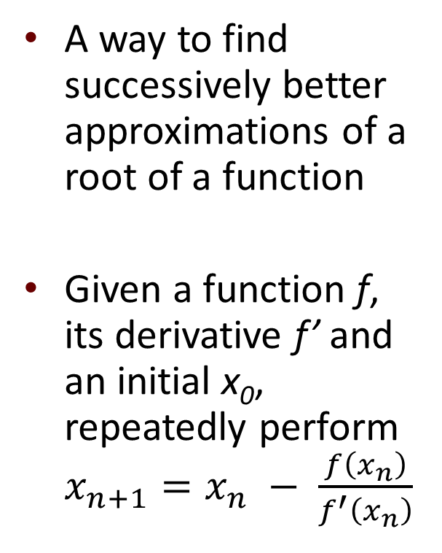
Newton’s Method for Finding Roots
y
A way to find successively better approximations of a root of a function
Given a function f, its derivative f’ and an initial x₀, repeatedly perform $x_{n+1}=x_{n} − \frac{f\left(x_{n}\right)}{f^{′}\left(x_{n}\right)}$
f(x₀)
f(x₁)
x
x₂
x₁
x₀
Esparza et al.: The same general idea—repeatedly create and solve a linear model—can be applied to programs, too
Create a linear model of the function and use it to find a better approximation of the solution
Isaac
Newton
Notes:
Brief overview of Newton’s method – for Calculus. (Motivates why it is proper to call the method of Esparza et al. a variation on Newton’s method.)

Slide 9
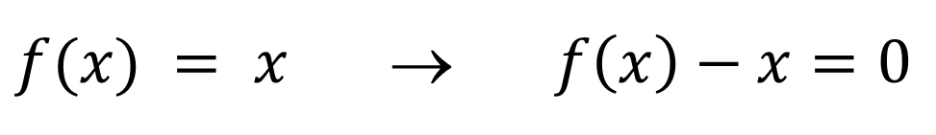
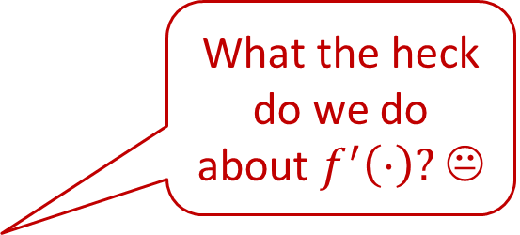
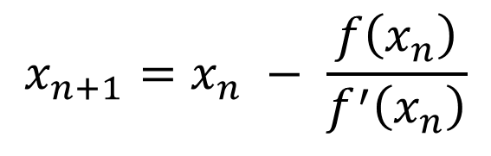
From Fixed Points to Roots
We have no minus operation in dataflow analysis ☹
$f(x) = x$ → $f\left(x\right)−x=0$
What the heck do we do about $f^{′}\left(⋅\right)?$ 😐
$$x_{n+1}=x_{n} − \frac{f\left(x_{n}\right)}{f^{′}\left(x_{n}\right)}$$
Notes:
Esparza et al. had to finesse a couple of problems.
We might try to reduce our fixed-point problem to a root-finding problem merely by subtracting x from both sides;
however, this approach is a non-starter because we have no minus operation in dataflow analysis
Then if you look at the iteration step, it has a derivative in it. What the heck do we do about that?

Slide 10
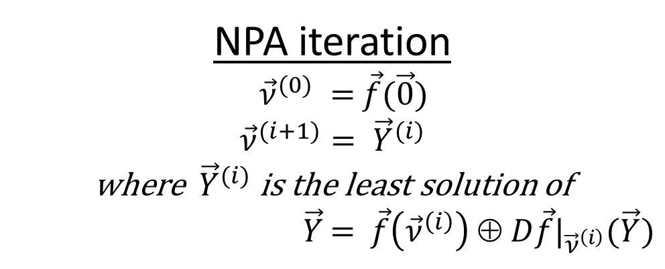
Newton’s Method for Programs [Esparza et al.]
Finesse the derivative question by fiat:
D (f ⊕ g) = Df ⊕ Dg
D (f ⊗ g) = (Df ⊗ g) ⊕ (f ⊗ Dg)
NPA iteration
${\vec{ν}}^{(0)} =$ $\vec{f}(\vec{0})$
$${\vec{ν}}^{(i+1)}= {\vec{Y}}^{(i)}$$
where ${\vec{Y}}^{(i)}$ is the least solution of
$\vec{Y}$ = $\vec{f}\left({\vec{ν}}^{\left(i\right)}\right) ⊕ D\vec{f}|_{{\vec{ν}}^{\left(i\right)}}(\vec{Y})$
Linear correction term

Slide 11

Running Example
proc X₁
proc X₂
x₁() {
a;
x₂();
}
x₂() {
if (*) d;
else{
b;
x₂();
x₂();
c;
}
}
a
b
X₂
X₂
d
X₂
c
Equation System
This term is quadratic
$$X_{1}=a ⨂ X_{2}$$
$X_{2}=d ⨁$ $b ⨂ X_{2}⨂X_{2}⨂c_{ }$
Notes:
If we go back to the running example, we see that we have a quadratic equation system because of the two calls along one branch of procedure X₂

Slide 12






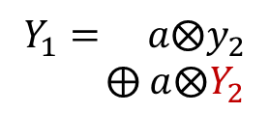
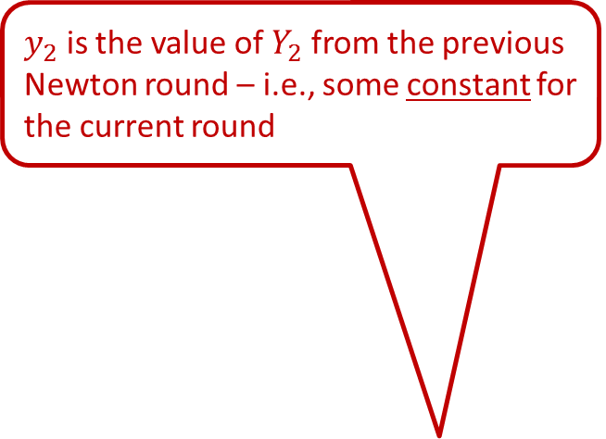
Running Example
$y_{2}$ is the value of $Y_{2}$ from the previous Newton round – i.e., some constant for the current round
Differentiated Equations
Original equations
Apply the
linearization
operator
$$Y_{1}= a⨂y_{2}$$
$⨁$ $a⨂Y_{2}$
$$X_{1}=a ⨂ X_{2}$$
y
$Y_{2}= d$
$X_{2}=d ⨁$ $b ⨂ X_{2}⨂X_{2}⨂c_{ }$
$$⨁ b⨂y_{2}⨂ y_{2}⨂ c$$
$$⨁ b⨂y_{2}⨂ Y_{2}⨂ c$$
Each summand now only has one variable; this system of equations is now linear!
$$⨁ b⨂Y_{2}⨂ y_{2}⨂ c$$
proc X₁
proc X₂
proc Y₁
proc Y₂
f(x₀)
a
b
a
a
b
b
b
X₂
X₂
y₂
Y₂
y₂
Y₂
y₂
x
d
d
x₂
x₁
x₀
X₂
y₂
y₂
Y₂
c
c
c
c

Slide 13
A Misconception on My Part
On each Newton round, use a fast intraprocedural solver, such as Tarjan’s path-expression method!
Polynomial → Linear
Interprocedural Analysis → Intraprocedural Analysis
Notes:
This work got started due to a misconception on my part. We tried out Newtonian Program Analysis, and found that although it was true that there were very few rounds, each round took quite a long time performing Kleene iteration on each linear problem. I suggested that we try a fast intraprocedural method, namely, Tarjan’s path-expression method. I was surprised by my student’s answer, which was that there was an essential mismatch that prevented us from applying Tarjan’s method.

Slide 14

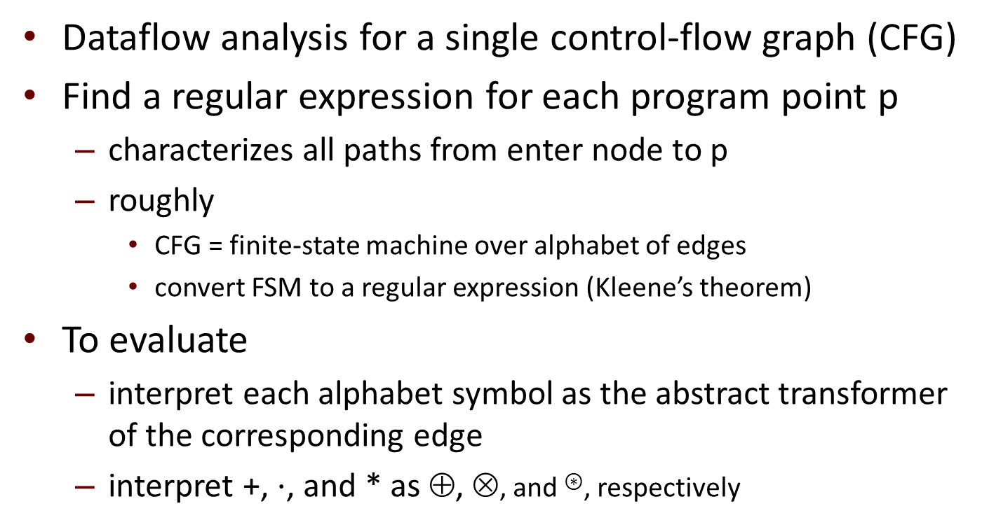
Tarjan’s Path-Expression Method
Dataflow analysis for a single control-flow graph (CFG)
Find a regular expression for each program point p
characterizes all paths from enter node to p
roughly
CFG = finite-state machine over alphabet of edges
convert FSM to a regular expression (Kleene’s theorem)
To evaluate
interpret each alphabet symbol as the abstract transformer of the corresponding edge
interpret +, $⋅$, and * as ⊕, ⊗, and ⊛, respectively
Robert
Tarjan

Slide 15

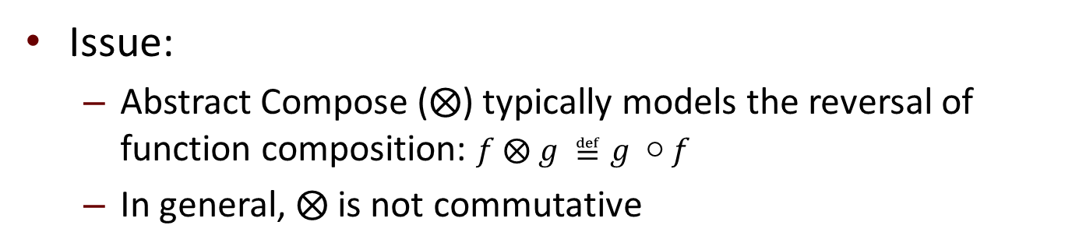
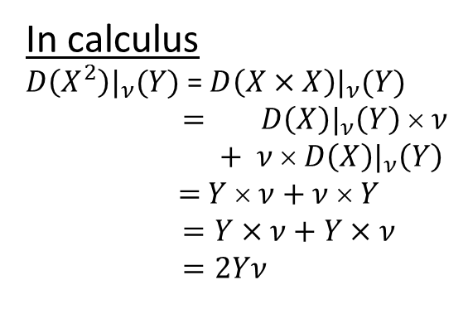
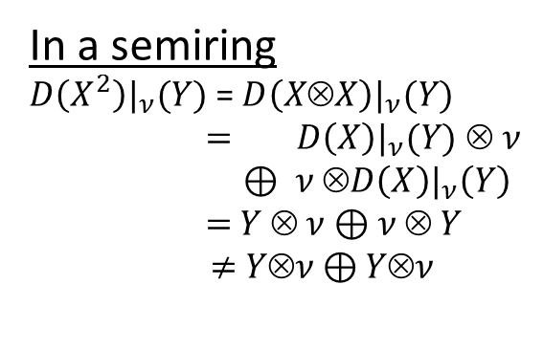

A Misconception on My Part
Issue:
Abstract Compose ($⨂$) typically models the reversal of function composition: $f ⨂ g ≝g ○f$
In general, $⨂$is not commutative
In a semiring
$D\left(X^{2}\right)|_{ν}(Y)$ = $D\left(X⊗X\right)|_{ν}(Y)$
$=$ $D\left(X\right)|_{ν}(Y)$ $ ν$
$⊕$ $ν ⊗D\left(X\right)|_{ν}\left(Y\right)$
$=$ $Y  ν⊕$ $ν  Y$
$≠$ $Yν$⊕ $Yν$
In calculus
$D\left(X^{2}\right)|_{ν}(Y)$ = $D\left(X×X\right)|_{ν}(Y)$
$=$ $D\left(X\right)|_{ν}\left(Y\right) × ν$
$+$ $ν × D\left(X\right)|_{ν}\left(Y\right)$
$=$ $Y  ν+$ $ν  Y$
$=Y×ν+Y×ν$
$=2Yν$
$$b⨂y_{2}⨂Y_{2}⨂c ≠ Y_{2}⨂b⨂y_{2}⨂c$$
Esparza’s linear equations are not left-linear or right-linear, which Tarjan requires
$$≠b⨂y_{2}⨂c⨂Y_{2}$$

Slide 16
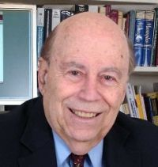



Doesn’t the Pumping Lemma Imply . . . Fuggedaboutit?
If we represent the Esparza linearized system as a grammar, we obtain a linear context-free grammar
$$Y_{1} ∷=ay2 | aY_{2}$$
$$Y_{2} ∷=d | by_{2}y_{2}c \left| bY_{2}y_{2}c \right| by_{2}Y_{2}c$$
One learns early on in a formal-language course that not all languages defined by a linear context-free grammar are regular
In particular, { a^{i}b^{i} | i ∈N } is the canonical example of an LCFL language that is not regular: X ::= a X b | ε
Suggests that we are barking up the wrong tree . . . ☹
But we aren’t!
We are not abstracting the program to a grammar
We can sidestep the issue with some “magic”
from algebra ☺
Michael
Rabin
Dana
Scott
Notes:
. . . <Mirrored Symmetry> . . .

Slide 17
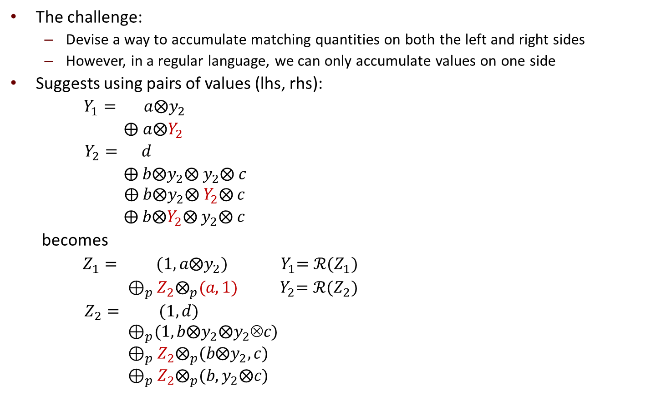
Converting to Tarjan
The challenge:
Devise a way to accumulate matching quantities on both the left and right sides
However, in a regular language, we can only accumulate values on one side
Suggests using pairs of values (lhs, rhs):
$Y_{1}= a⨂y_{2}$
$⨁$ $a⨂Y_{2}$
$Y_{2}= d$
$⨁ b⨂y_{2}⨂ y_{2}⨂ c$
$$⨁ b⨂y_{2}⨂ Y_{2}⨂ c$$
$⨁ b⨂Y_{2}⨂ y_{2}⨂ c$
becomes
$Z_{1}= (1,a⨂y_{2})$ ${ Y}_{1}=ℛ(Z_{1})$
$⊕_{p}Z_{2}⨂_{p}(a,1)$ ${ Y}_{2}=ℛ(Z_{2})$
$Z_{2}= (1,d)$
$${ ⊕}_{p}(1,b⨂y_{2}⨂y_{2}c)$$
$$⊕_{p}Z_{2}⨂_{p}(b⨂y_{2},c)$$
$$⊕_{p}Z_{2}⨂_{p}(b,y_{2}⨂c)$$
LCFL
Each variable occurrence is now leftmost in its summand; this system of equations is left-linear!
Left-recursive = Regular

Slide 18
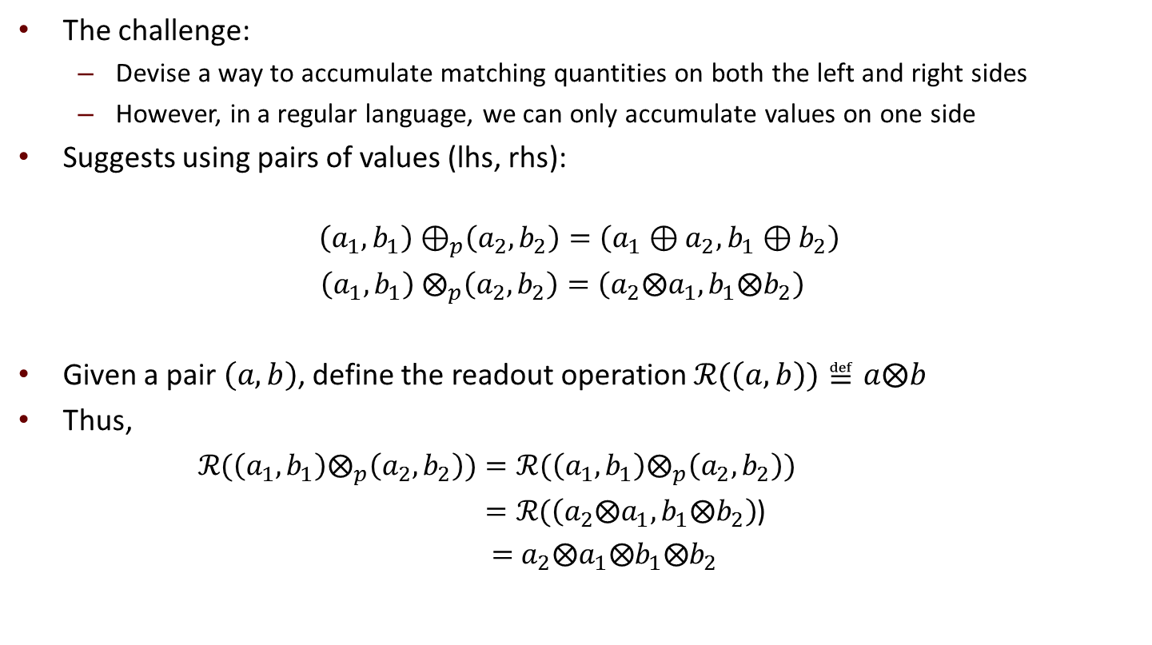
Converting to Tarjan
The challenge:
Devise a way to accumulate matching quantities on both the left and right sides
However, in a regular language, we can only accumulate values on one side
Suggests using pairs of values (lhs, rhs):
$$\left(a_{1},b_{1}\right){ ⊕}_{p}\left(a_{2},b_{2}\right)=\left(a_{1}⊕a_{2},b_{1}⊕b_{2}\right)$$
$\left(a_{1},b_{1}\right){ ⨂}_{p}\left(a_{2},b_{2}\right)=\left(a_{2}⨂a_{1},b_{1}⨂b_{2}\right)$
Given a pair $\left(a,b\right)$, define the readout operation ℛ($\left(a,b\right))≝a⨂b$
Thus,
ℛ$(\left(a_{1},b_{1}\right)⨂_{p}\left(a_{2},b_{2}\right))=\text{ℛ}(\left(a_{1},b_{1}\right)⨂_{p}\left(a_{2},b_{2}\right))$
$=\text{ℛ}\text{(}\left(a_{2}⨂a_{1},b_{1}⨂b_{2}\right)$)
$=$ $a_{2}⨂a_{1}⨂b_{1}⨂b_{2}$
Notes:
. . . <Reversal in the paired multiplication operator> . . .
. . . <Mirrored Symmetry> . . .

Slide 19
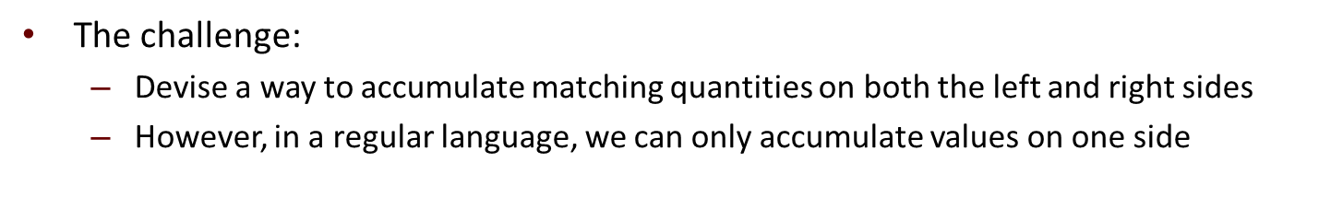
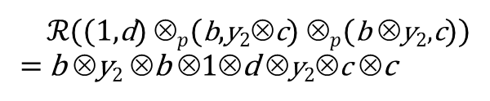
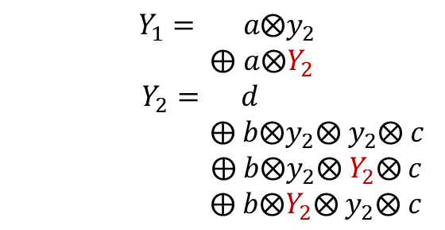
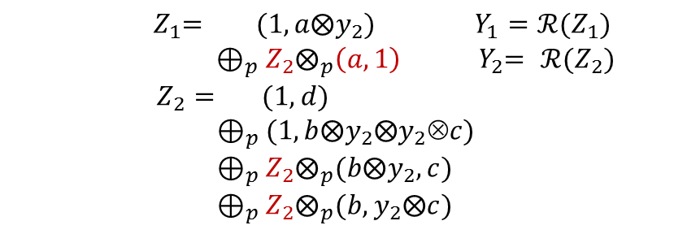
Converting to Tarjan
The challenge:
Devise a way to accumulate matching quantities on both the left and right sides
However, in a regular language, we can only accumulate values on one side
$Y_{1}= a⨂y_{2}$
$⨁$ $a⨂Y_{2}$
$Y_{2}= d$
$⨁ b⨂y_{2}⨂ y_{2}⨂ c$
$$⨁ b⨂y_{2}⨂ Y_{2}⨂ c$$
$⨁ b⨂Y_{2}⨂ y_{2}⨂ c$
${ Z}_{1}= (1,a⨂y_{2})$ $Y_{1}=ℛ(Z_{1})$
${ ⊕}_{p}{ Z}_{2}⨂_{p}\left(a,1\right)$ ${ Y}_{2}= ℛ(Z_{2})$
$Z_{2}= (1,d)$
$${ ⊕}_{p} (1,b⨂y_{2}⨂y_{2}c)$$
$$⊕_{p}Z_{2}⨂_{p}(b⨂y_{2},c)$$
$$⊕_{p}Z_{2}⨂_{p}(b,y_{2}⨂c)$$
(3)
(3)
(2)
(2)
(1)
(1)
b
b
d
(1,d)
(b⊗y₂, c)
(b, y₂⊗c)
y₂
y₂
ℛ((1,d) ⊗$p$(b,y₂⊗c) ⊗$p$(b ⊗y₂,c))
= b ⊗y₂ ⊗b ⊗1⊗d ⊗y₂⊗c ⊗c
c
c
Notes:
This slide shows how the paired system simulates the computations of the original system

Slide 20
Pairing Fails to Deliver . . .
X₁ = 1 X₂ = a₁⊗X₁⊗b₁ ⊕ a₂⊗X₁⊗b₂
Z₁ = (1, 1) Z₂ = Z₁ ⊗_{p}((a₁, b₁)⊕_{p}(a₂, b₂))
proc X₁
proc X₂
proc Z₁
proc X₂
1
a₁
a₂
(1,1)
Z₁
Z₁
X₁
X₁
(a₁, b₁)
(a₂,b₂)
b₁
b₂
Least solution (⊕_{p} of the two paths):
Z₂ = (a₁, b₁)⊕_{p}(a₂, b₂)
ℛ((a₁, b₁)⊕_{p}(a₂, b₂)) = ℛ((a₁⊕a₂, b₁⊕b₂))
= (a₁⊕a₂)⊗ (b₁⊕b₂)
= a₁b₁⊕a₂b₁⊕a₁b₂⊕a₂b₂
⊒ a₁b₁⊕a₂b₂
Conservative, but loses precision . . . ☹
Least solution (⊕ of the two paths):
X₂ = a₁⊗1⊗b₁ ⊕ a₂⊗1⊗b₂
= a₁b₁ ⊕ a₂b₂

Slide 21



Doesn’t the Pumping Lemma Imply . . . Fuggedaboutit?
If we represent the Esparza linearized system as a grammar, we obtain a linear context-free grammar
$$Y_{1} ∷=ay2 | aY_{2}$$
$$Y_{2} ∷=d | by_{2}y_{2}c \left| bY_{2}y_{2}c \right| by_{2}Y_{2}c$$
Fuggedaboutit?
One learns early on in a formal-language course that not all languages defined by a linear context-free grammar are regular
In particular, { a^{i}b^{i} | i ∈N } is the canonical example of an LCFL language that is not regular: X ::= a X b | ε
Easily shown via the pumping lemma
Suggests that we are barking up the wrong tree . . . ☹
Michael
Rabin
Dana
Scott
Notes:
Thus, the formal-languages perspective suggests that we are barking up the wrong tree.
As I’ll now show, it turns out that there is a way to finesse the problem, so this is what I meant when I said that “our result is surprising because a reasonable-sounding sanity check suggests that what we are trying to do is impossible.”

Slide 22
A Glimmer of Hope . . .
A transformation of the linearized problem to left-linear form is not actually forced to use pairing
Given a “coupled value” c = couple(a, b), we never need to recover from c the value of a or b alone
We only need to be able to obtain the value a⊗b
Notes:
So what saves us? Well, there is one glimmer of hope. We are not actually forced to use pairing per se. We need to produce some kind of coupled value; however, the property of pairing is that one can recover each individual argument from the pair, and we never have to do that.
You can think of a coupled value c as some kind of blending of a and b. It just has to be a blending from which we can recover “a extend b” later, if we so choose. One analogy is RSA public keys: the public key is a blending of two primes. In that case, you can extract the arguments, but not without doing a lot of work.

Slide 23
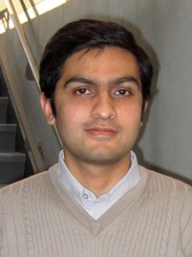
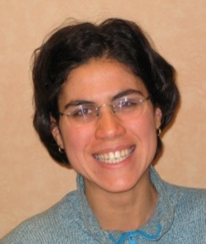
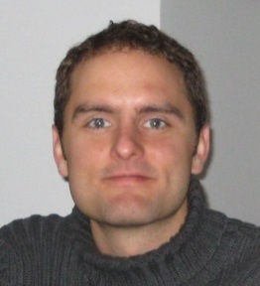

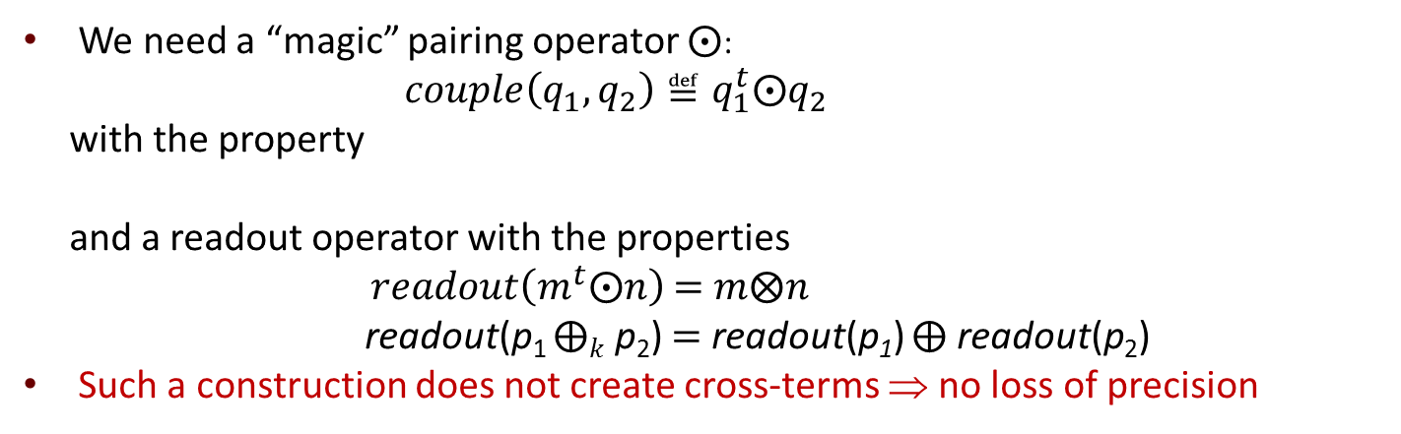
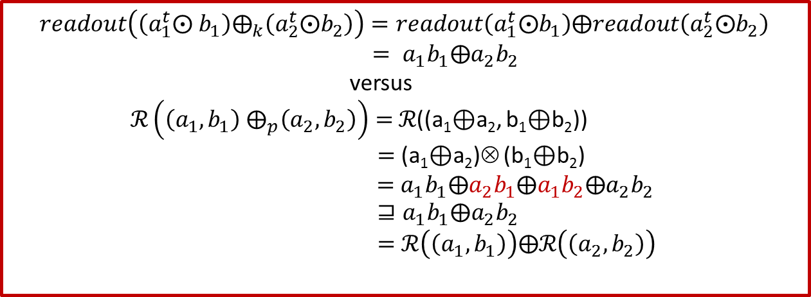
Converting to Tarjan
We need a “magic” pairing operator ⨀:
$couple\left(q_{1},q_{2}\right)≝q_{1}^{t}\text{⨀}q_{2}$
with the property
and a readout operator with the properties
$readout\left(m^{t}\text{⨀}n\right)$ $=$ $m⨂n$
readout(p₁ $⨁k$ p₂) $=$ readout(p₁) $⨁$ readout(p₂)
Such a construction does not create cross-terms ⇒ no loss of precision
$\left(m_{1}^{t}⨀m_{2}\right) ⨂k \left(n_{1}^{t}⨀n_{2}\right)={\left(n_{1}⨂m_{1}\right)}^{t}⨀\left(m_{2}⨂n_{2}\right)$ (†)
$readout\left(\left(a_{1}^{t}\text{⨀} b_{1}\right)⨁_{k}\left(a_{2}^{t}\text{⨀}b_{2}\right)\right)=readout\left(a_{1}^{t}\text{⨀}b_{1}\right)⨁readout\left(a_{2}^{t}\text{⨀}b_{2}\right)$
$= a_{1}b_{1}⨁a_{2}b_{2}$
versus
$ℛ\left(\left(a_{1},b_{1}\right){ ⨁}_{p}\left(a_{2},b_{2}\right)\right)=$ℛ((a₁⊕a₂, b₁⊕b₂))
$=$ (a₁⊕a₂)⊗ (b₁⊕b₂)
= $a_{1}b_{1}⨁a_{2}b_{1}⨁a_{1}b_{2}⨁a_{2}b_{2}$
$⊒a_{1}b_{1}⨁a_{2}b_{2}$
$=$ $ℛ\left(\left(a_{1},b_{1}\right)\right)⨁ℛ\left(\left(a_{2},b_{2}\right)\right)$
Akash
Lal
Tayssir
Touili
Nick
Kidd
Thomas
Reps

Slide 24

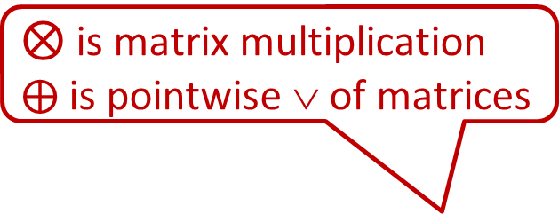
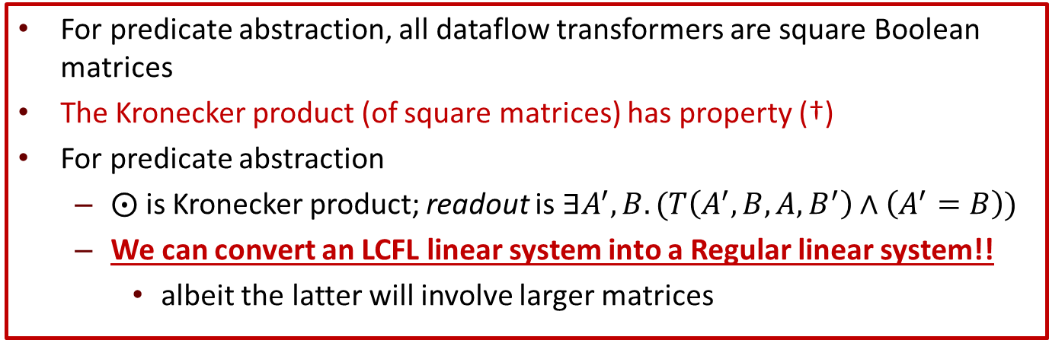
Converting to Tarjan
We need a “magic” pairing operator ⨀:
$couple\left(q_{1},q_{2}\right)≝q_{1}^{t}\text{⨀}q_{2}$
with the property
and a readout operator with the properties
$readout\left(m^{t}\text{⨀}n\right)$ = $m⨂n$
readout(p₁ $⨁k$ p₂) = readout(p₁) $⨁$ readout(p₂)
Such a construction does not create cross-terms ⇒ no loss of precision
$\left(m_{1}^{t}⨀m_{2}\right) ⨂k \left(n_{1}^{t}⨀n_{2}\right)={\left(n_{1}⨂m_{1}\right)}^{t}⨀\left(m_{2}⨂n_{2}\right)$ (†)
$⨂$ is matrix multiplication
$⨁$ is pointwise ∨ of matrices
For predicate abstraction, all dataflow transformers are square Boolean matrices
The Kronecker product (of square matrices) has property (†)
For predicate abstraction
⨀ is Kronecker product; readout is $∃A^{′},B. (T\left(A^{′},B,A,B^{′}\right)∧\left(A^{′}=B\right))$
We can convert an LCFL linear system into a Regular linear system!!
albeit the latter will involve larger matrices

Slide 25
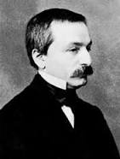
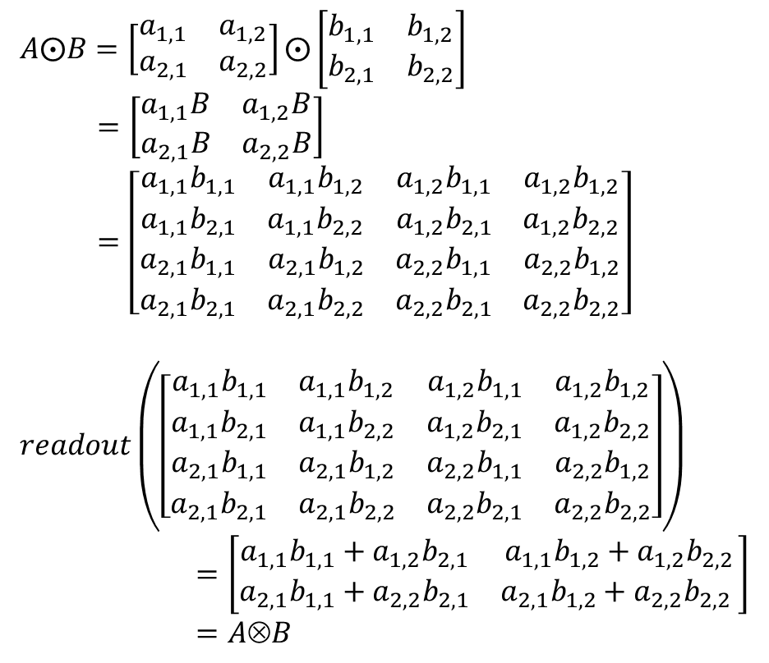
Some Intuition About Kronecker Product
$A⨀B=\left[\begin{matrix}a_{1,1} & a_{1,2} \\ a_{2,1} & a_{2,2}\end{matrix}\right]⨀\left[\begin{matrix}b_{1,1} & b_{1,2} \\ b_{2,1} & b_{2,2}\end{matrix}\right]$
$=\left[\begin{matrix}a_{1,1}B & a_{1,2}B \\ a_{2,1}B & a_{2,2}B\end{matrix}\right]$
$=\left[\begin{matrix}\begin{matrix}a_{1,1}b_{1,1} & a_{1,1}b_{1,2} \\ a_{1,1}b_{2,1} & a_{1,1}b_{2,2}\end{matrix} & \begin{matrix}a_{1,2}b_{1,1} & a_{1,2}b_{1,2} \\ {a_{1,2}b}_{2,1} & a_{1,2}b_{2,2}\end{matrix} \\ \begin{matrix}a_{2,1}b_{1,1} & a_{2,1}b_{1,2} \\ a_{2,1}b_{2,1} & a_{2,1}b_{2,2}\end{matrix} & \begin{matrix}a_{2,2}b_{1,1} & a_{2,2}b_{1,2} \\ a_{2,2}b_{2,1} & a_{2,2}b_{2,2}\end{matrix}\end{matrix}\right]$
$readout\left(\left[\begin{matrix}\begin{matrix}a_{1,1}b_{1,1} & a_{1,1}b_{1,2} \\ a_{1,1}b_{2,1} & a_{1,1}b_{2,2}\end{matrix} & \begin{matrix}a_{1,2}b_{1,1} & a_{1,2}b_{1,2} \\ {a_{1,2}b}_{2,1} & a_{1,2}b_{2,2}\end{matrix} \\ \begin{matrix}a_{2,1}b_{1,1} & a_{2,1}b_{1,2} \\ a_{2,1}b_{2,1} & a_{2,1}b_{2,2}\end{matrix} & \begin{matrix}a_{2,2}b_{1,1} & a_{2,2}b_{1,2} \\ a_{2,2}b_{2,1} & a_{2,2}b_{2,2}\end{matrix}\end{matrix}\right]\right)$
$=\left[\begin{matrix}a_{1,1}b_{1,1}+a_{1,2}b_{2,1} & a_{1,1}b_{1,2}+a_{1,2}b_{2,2} \\ a_{2,1}b_{1,1}+a_{2,2}b_{2,1} & a_{2,1}b_{1,2}+a_{2,2}b_{2,2} \end{matrix}\right]$
$=AB$
Leopold
Kronecker

Slide 26

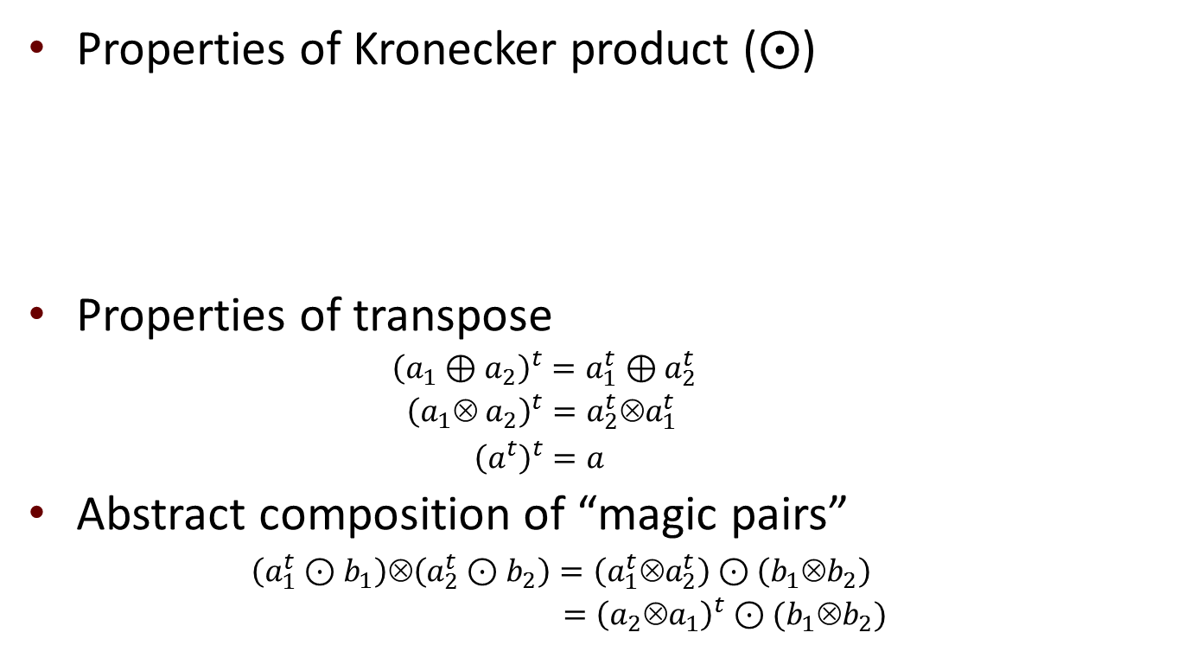
Converting to Tarjan
Properties of Kronecker product (⨀)
Properties of transpose
${\left(a_{1}⊕a_{2}\right)}^{t}=a_{1}^{t}⊕a_{2}^{t}$
${\left(a_{1}⊗ a_{2}\right)}^{t}=a_{2}^{t}⊗a_{1}^{t}$
${\left(a^{t}\right)}^{t}=a$
Abstract composition of “magic pairs”
$\left(a_{1}^{t}⊙b_{1}\right)⊗\left(a_{2}^{t}⊙b_{2}\right)=\left(a_{1}^{t}⊗a_{2}^{t}\right)⊙\left(b_{1}⊗b_{2}\right)$
$={\left(a_{2}⊗a_{1}\right)}^{t}⊙(b_{1}⊗b_{2})$
$$0 ⨀ a=a ⨀0 =0$$
$$a_{1}⨀ \left(b_{2} ⨁ c_{2}\right) = \left(a_{1}⨀ b_{2}\right) ⨁k \left(a_{1} ⨀ c_{2}\right)$$
$$\left(b_{1} ⨁ c_{1}\right) ⨀{ a}_{2} = \left(b_{1}⨀ a_{2}\right) ⨁k \left(c_{1} ⨀ a_{2}\right)$$
$$\left(m_{1}⨀m_{2}\right)⨂k\left(n_{1}⨀n_{2}\right)= \left(m_{1}⨂n_{1}\right)⨀\left(m_{2}⨂n_{2}\right)$$
Leopold
Kronecker

Slide 27
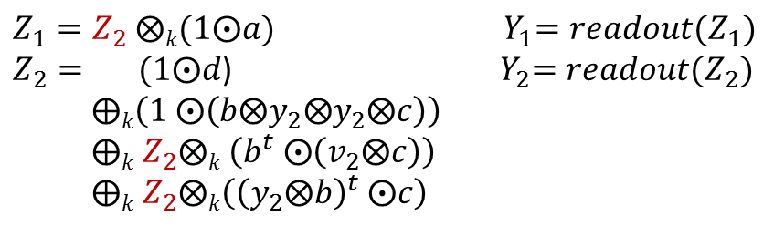
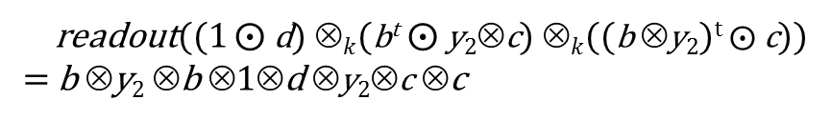



Why Does This Trick Work?
This system is left- linear and Tarjan can be applied, which returns the ⊕-over-all-paths solution COAP
Because readout distributes over ⊕, we have this equality for each path in the COAP solution!
No loss of precision!
The challenge:
Devise a way to accumulate matching quantities on both the left and right sides
However, in a regular language, we can only accumulate values on one side
$Y_{1}= a⨂y_{2}$
$⨁$ $a⨂Y_{2}$
$Y_{2}= d$
$⨁ b⨂y_{2}⨂ y_{2}⨂ c$
$$⨁ b⨂y_{2}⨂ Y_{2}⨂ c$$
$⨁ b⨂Y_{2}⨂ y_{2}⨂ c$
$Z_{1}=Z_{2} ⨂k(1⨀a)$ ${ Y}_{1}=readout(Z_{1})$
$Z_{2}= (1⨀d$) ${ Y}_{2}=readout(Z_{2})$
$⨁k{\left(1^{ }⨀\left(b⨂y_{2}⨂y_{2}⨂c\right)\right)}^{ }$
$⨁k Z_{2}⨂k {\left({b^{t}}^{ }⨀\left(v_{2}⨂c\right)\right)}_{ }$
$⨁k Z_{2}⨂k\left({{\left(y_{2}⨂b\right)}^{t}}^{ }⨀c\right)$
(3)
(3)
(2)
(2)
(1)
(1)
b
b
d
(1⨀d)
(${\left(b⊗y_{2}\right)}^{t}$⨀ c)
($b^{t}$⨀ y₂⊗c)
y₂
y₂
readout((1 $⨀$d) ⊗$k$(b^{t} $⨀$y₂⊗c) ⊗$k$((b ⊗y₂)^{t} $⨀$c))
= b ⊗y₂ ⊗b ⊗1⊗d ⊗y₂⊗c ⊗c
c
c

Slide 28
Revised Story in a Nutshell
In 1981, Tarjan found a fast way to solve intraprocedural dataflow equations
In 2008, Esparza et al. used inspiration from Newton’s Method to solve interprocedural dataflow equations
Esparza and Tarjan do not create the same type of linear system
Cannot apply Tarjan’s algorithm to Esparza’s system

Slide 29
Revised Story in a Nutshell
For predicate abstraction, we found a way to convert from a linear system of equations to a left-linear system of equations without a loss of precision
Use Kronecker products of dataflow transformers
Tarjan’s algorithm can be used to find the least solution of the left-linear system on each Newton round
The answer is in Kronecker-form (a “coupled” value)
To finish a Newton round, apply “readout” to convert – without loss of precision – the Kronecker-form answer back into an ordinary value, which is what Esparza et al. need for the next Newton round

Slide 30
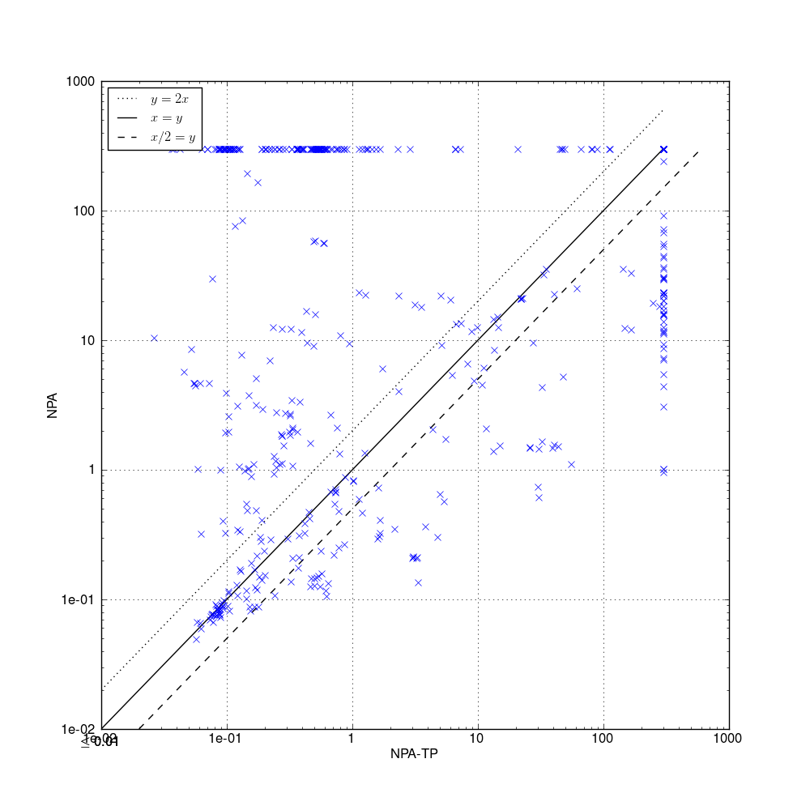
Experimental Results (The Good News)
NPA-TP better than NPA
Geometric mean: 1.62
NPA
NPA via Tensor Product
Notes:
On the roughly 500 hardest examples in the Static Driver Verifier test suite of Boolean programs

Slide 31
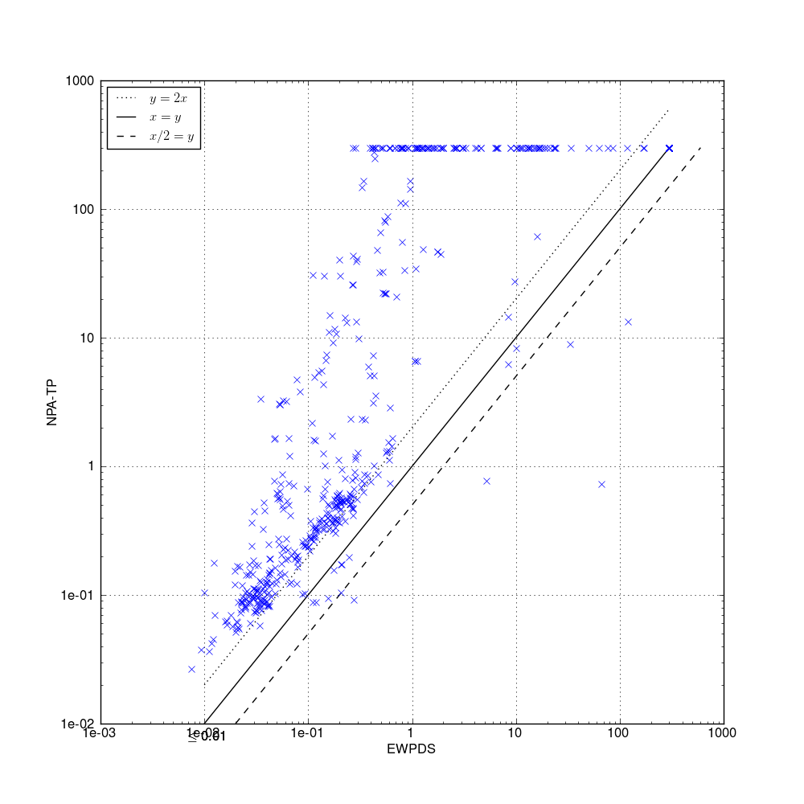
Experimental Results (The Bad News)
Chaotic iteration better
than NPA-TP
Geometric mean: 5.20
NPA via
Tensor Product
Chaotic iteration

Slide 32
Related Work
One previous use of Kronecker product + readout [Lal et al. TACAS 2008]
The tensor-product principle
Tensor products—plus an appropriate readout operation—allow computations to be rearranged in certain ways; they can be used to delay performing every multiplication in a sequence of multiplications, which is useful if either
(a) a value that is only obtainable at a later time needs to be
placed in the middle of the sequence, or
(b) a subsequence of values in the middle of the sequence
needs to be adjusted in certain ways before contributing to the
overall product
Notes:
As for related work, we made use of the algebraic magic that we used in a TACAS paper in 2008
about context-bounded model checking of concurrent programs.
Because the idea has only been used in one paper from my group in 2008, I took the opportunity
to articulate the high-level principle we are

Slide 33
Future Work
NPA via Tensor Product for abstract domains other than predicate abstraction
with exact ⨀, readout
with overapproximate ⨀, readout

Slide 34
Wrap-Up
Goal:
Use Tarjan’s algorithm for each Newton round of Esparza et al.
Obstacle:
Esparza’s linear system not compatible with Tarjan’s algorithm
Overcoming the obstacle:
Chief technical challenge: “turn LCFL path problem into a regular-language path problem”
Some algebraic magic (Kronecker product + transpose)
Evaluation (for predicate-abstraction of device drivers)
NPA via Tensor Product is faster than NPA
Chaotic iteration the method of choice overall
See the paper for several additional contributions
Alternative way to handle loops
Merge functions (for local variables)

Slide 35

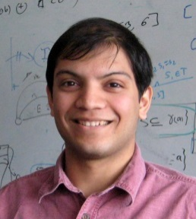
Javier
Esparza
Michael
Luttenberger
Stefan
Kiefer
Leopold
Kronecker
Akash
Lal
Tayssir
Touili
Nick
Kidd
Thomas
Reps
Thomas
Reps
Emma
Turetsky
Prathmesh
Prabhu
Isaac
Newton
Robert
Tarjan
Michael
Rabin
Dana
Scott
Notes:
That brings me to the end of our story – from Esparza et al. to Newton to Tarjan,
an attempt to use formal-language theory as a sanity check, which suggested
that we give up. And how a little algebra magic rescued us.
I like this result very much, and hope that you enjoyed hearing about it.
Thank you for your attention, and I’m happy to take questions.

