Slide 1
Differential program verification: Verifying properties of differences (instead of programs)
Shuvendu Lahiri
Research in Software Engineering (RiSE),
Microsoft Research, Redmond
Reps at 60
September 11, 2016

Slide 2
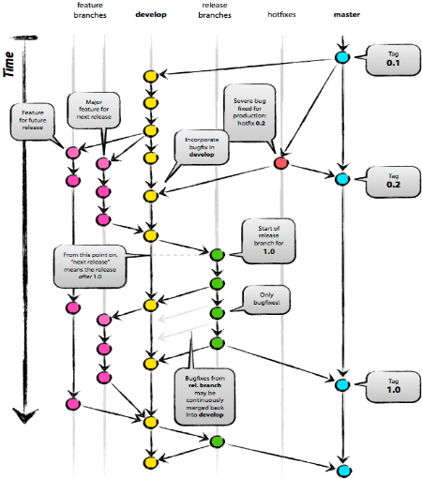
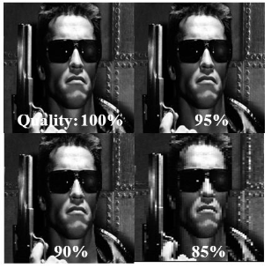
Sources of program differences
f() { Print(foo);
g(); }
g() { ...
Print(foo); }
g() { ...
Print(foo);
Print(bar); }
Most differences may not be equivalence preserving
Bug fixes
Refactoring
New features
Library API
changes
Version control
Approximate compilers

Slide 3
Two-fold motivation for diff verification
Natural way to specify regression-freedom
Equivalence
Preserves
Memory safety
Termination
Performance
Call chains
…
Verification failures ➔ semantic diff
High domain-specific upfront investment for static assertion verification (not for masses yet)
Need for assertions and ghost state
Model environment
Infer program-specific invariants
Scalability
Correctness of production code is not feasible worthwhile, but perhaps preserving “quality” of code with newly written code may be feasible worthwhile

Slide 4
Research questions
Can some software engineering tasks leverage differential verification?
Change impact analysis, conflict-freedom, debugging regressions, …
What differential specifications distinguish intended from unintended semantic differences
Equivalence, Assertion safety, Termination safety, …
How to leverage/extend program specification and verification advances for differential verification?
SMT, abstract interpretation, predicate abstraction, CEGAR, interpolants, …

Slide 5
Progress
Applications
Differential assertion checking (DAC) [FSE’13]
Verification modulo versions (VMV) [PLDI’14]
Safety of approximate transformations [NFM’16]
Cross-version compiler validation for CLR [FSE’13, CAV’15]
Partition changesets for more efficient reviewing [ICSE’15]
Conflict-freedom of 3-way merge
Semantic change impact analysis
Semantic diff of concurrent programs
SymDiff
Framework for differential program verification and invariant inference [CAV’12]
Differential specifications and proof system [CADE’13]
mutual summaries and (relative) termination conditions
Ongoing work

Slide 6
Overview
Assertion specific
Differential assertion checking
Generic properties of differences
Conflict-freedom of 3-way merge
Semantic change impact analysis
Starting point for me
Roots in Reps’
Wisconsin Program
Integration project
[late ‘80s]

Slide 7
Differential assertion checking

Slide 8
Verifying a bug fix
void StringCopy1
(char* dst, char*src, int size)
{
int i=0;
for(;*src &&
i<size-1; i++)
*dst++ = *src++;
*dst = 0;
}
void StringCopy2
(char* dst, char*src, int size)
{
int i=0;
for(;i<size-1 &&
*src; i++)
*dst++ = *src++;
*dst = 0;
}
}
Does the difference introduce any invalid pointer access?

Slide 9
Option: verify the fixed program directly
Need precondition relating dst,src, size, null-terminated
void StringCopy2
(char* dst, char*src, int size)
{
int i=0;
for(;i<size-1 &&
*src; i++)
*dst++ = *src++;
*dst = 0;
}
}
Need a program-specific ∀ loop invariant
Add ghost variables to define buffer bounds and their quantified updates at malloc and postconditions
Check all dereferences are in bound

Slide 10
False alarms from no preconditions
void StringCopy2
(char* dst, char*src, int size)
{
int i=0;
for(;i<size-1 &&
*src; i++)
*dst++ = *src++;
*dst = 0;
}
}
size ==2, !Valid(src)
size ==2, !Valid(dst)
size ==1, !Valid(dst)
assert(Valid(x)) before every *x

Slide 11
Differential assertion checking (DAC)
[Joshi, Lahiri, Lal POPL’12] [Lahiri et al. FSE’13]
Correctness → Relative correctness
An input that can* satisfy P, cannot fail P’.
Note: asymmetric check
How?
Replace assert A with ok := ok && A;
Express it as a mutual summary specification: (i₁==i₂ && ok₁’) ==> ok₂’)

Slide 12
Weaker check: verify absence of regressions
void StringCopy1
(char* dst, char*src, int size)
{
int i=0;
for(;*src &&
i<size-1; i++)
*dst++ = *src++;
*dst = 0;
}
void StringCopy2
(char* dst, char*src, int size)
{
int i=0;
for(;i<size-1 &&
*src; i++)
*dst++ = *src++;
*dst = 0;
}
}
Does the difference introduce any invalid pointer access?
==
Is there any input that passes StringCopy1 but fails StringCopy2?

Slide 13

Diff verification ➔ Relative correctness
void StringCopy1
(char* dst, char*src, int size)
{
int i=0;
for(;*src &&
i<size-1; i++)
*dst++ = *src++;
*dst = 0;
}
void StringCopy2
(char* dst, char*src, int size)
{
int i=0;
for(;i<size-1 &&
*src; i++)
*dst++ = *src++;
*dst = 0;
}
}
No need for any preconditions
Mutual loop invariants:
src.1=src.2, dst.1=dst.2, size.1=size.2, i.1=i.2, Mem_char.1 == Mem_char.2, ok1 ➔ ok2
Notes:
Conversely, if the old version was the buggy version and we fixed the bug, by putting the order of predicates right,
then our checker can prove the relative memory safety. Now I am sure that I have not inadvertently not introduced any new illegal memory dereferences. Looking closer, the invariants used to prove the relative memory safety by our tool, are much simpler than what are required for proving the memory safety and hence seem possible to infer automatically rather than being manually provided by the user. They are just correspondence between variables of the two programs. Note that these correspondences are generally simple but might not always be symmetrical or just simple equalities.

Slide 14
Verifying real-world bug fixes and regressions
Does a fix inadvertently introduce new bugs (wrt given assertions)?
Verisec suite
“snippets of open source programs which contain buffer overflow vulnerabilities, and corresponding patched versions.”
Relative memory safety (e.g. buffer overflow) checking
Snippets from apache, madwifi, sendmail etc.
Verified several bug fixes automatically using SymDiff [FSE’13]
Verification modulo versions (VMV) [Logozzo, Lahiri, Blackshear, Fahndrich PLDI’14]
Another approach using abstract interpretation in Clousot
10k+ LOC of C# projects, verified fixes, verified regressions
Notes:
First, let us talk about verifying bug fixes. We are interested in answering the question whether a bug fix can inadvertently introduce new errors. For this case study we use the Verisec benchmark suite. This suite has buggy and patched versions of snippets of open source software. Since the bugs are buffer overflow errors, we validate relative buffer overflows in the patched version w.r.t. the buggy version.
Our tool is able to automatically prove the relative correctness of these snippets thus ensuring that a new buffer overflow vulnerability was not introduced during the fix. For more details please refer to the paper but to give an idea of these patches, I will show an example.

Slide 15
Similar problem in approximations
Strcpy() {
i := 0;
while(src[i] != 0) {
dst[i] := src[i];
i := i + 1;
}
dst[i] := 0;
}
StrcpyApprox() {
i := 0; j := 0;
while(src[i] != 0) {
dst[j] := src[i];
i := i + 1; j := j + 1;
if (src[i] == 0) {break;}
i := i + 1;
}
dst[j] := 0;
}
Termination preservation does not even need a ranking function
Show that StrcpyApprox preserves memory safety and termination
[He, Lahiri, Rakamaric NFM’16]
Notes:
Here is an example: (what string copy does and when it terminates)
Right-hand side: first show naïve approximation (ask the audience) => show if statement => our approach can prove relative memory safety and termination with minimal manual efforts (in an automate fashion).
Say why relative properties are amenable to prove => (requires precondition/loop invariant etc.)
SKL: What is the assertion? What is the approximation at a high level? Why does one need precondition/loop invariants?

Slide 16
Takeaway from DAC
Relative correctness proofs have a better chance of automation
Weaker guarantees
Tolerates environment imprecision
Often a small space of proof works across domains

Slide 17
Conflict-freedom in 3-way merge

Slide 18
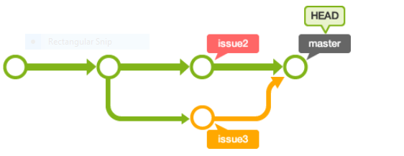
Conflict-freedom for 3-way merge
Base
A
M
B
(Informally) A merge is conflict-free if
changes from both branches A and B are preserved in merge
unchanged behaviors in both branches over Base are preserved in merge
Popular merge are based on textual (semantics-unaware) diffs (e.g. diff3)
False positives: Spurious merge-conflicts due to overlapping textual diffs
False negatives: Silently admit merges that do not preserve conflict-freedom

Slide 19
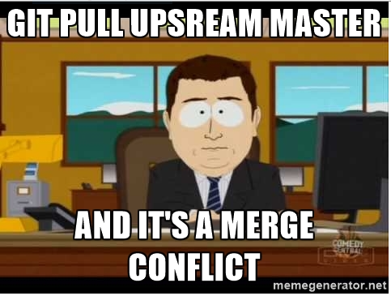
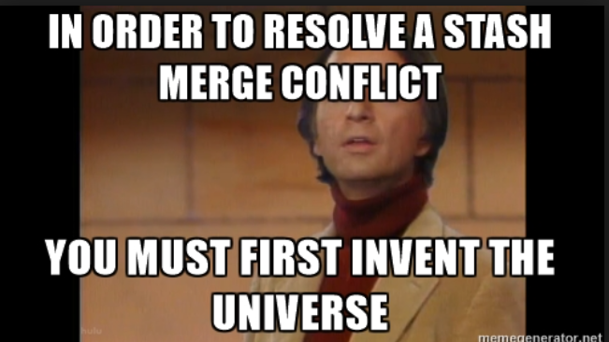
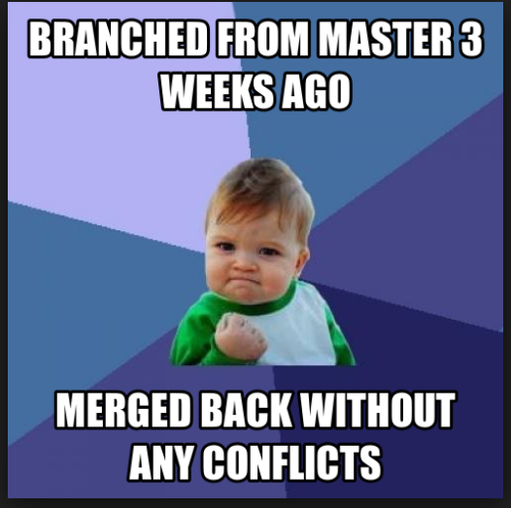
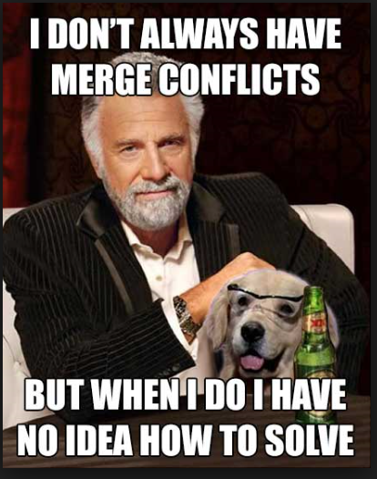
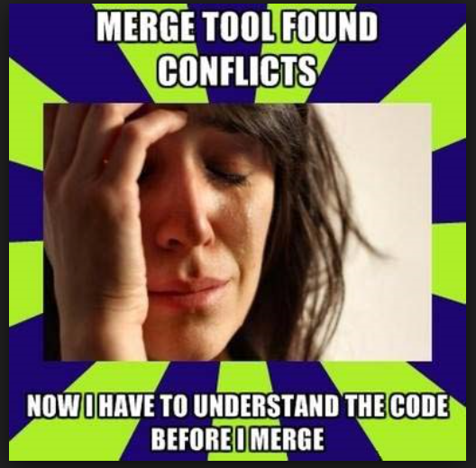
False alarms ➔ dev frustration

Slide 20
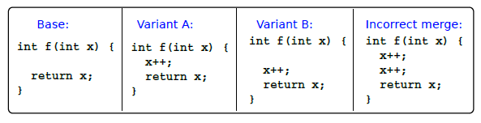
False negatives ➔ regressions
Inconsistency can be introduced silently by (text-based) git merge
Blamed for Apple SSL/TLS Goto Bug 2014 (led to widely publicized security exploits)
Questions
Can we have a semantic formulation of conflict-freedom?
Can we check such a property automatically?

Slide 21

Wisconsin Program Integration project
Seminal work of Horwitz, Reps et al.
[POPL’88, ESOP’88, TAPSOFT’89, SCM’89, TOPLAS’89, SDE’90, ESOP’90, TAPSOFT’91,AMAST’91, SCP’91, TOSEM’92]
Formalism
If value of a variable x differs in A (respectively B) from Base, then M should concur with A (respectively B). Otherwise x should have identical values in all 4 programs
Synthesizing merges
Use of program dependence graphs (PDGs) and program slicing to merge programs [SCP’91]
Merge: Union of slices of changed behavior of A, B and the preserved behavior:
Test for interference: (a) change slices are preserved, (b) graph is a feasible PDG

Slide 22
Conflict-freedom as program verification
[Dillig, Sousa, Lahiri, Cheung, Vytiniotis] (ongoing)
Proof-of-concept tool to verify conflict-freedom for (Base, A, B, M)
Uses advances in program verification (SMT, product programs, Horn-clause based invariant generation, …)
Requires manually specifying the “edits”
Current work
End-to-end automated tool for Java/C
Synthesize conflict-free merges using program synthesis (verifier as an oracle)

Slide 23

Conflict-freedom verification sketch
Verify Conflict-freedom(Base, A, B, M)
Come up with sound edit scripts eA, eB, eM
Maps a node in Base to an edit
s.t. Apply(Base,eA) == A etc.
Create a 4-way product program
Uses a 4-way mini-product for each edited node n in Base
Add conflict-freedom assertion as postcondition
Verification
Infer invariant (simulation relations) on the product program using Horn-clause solver (Duality)

Slide 24
Semantic change impact

Slide 25
Semantic change impact
Which statements are impacted by a change (soundly)?
Useful in code review
Hard to localize change (even for refactoring parts)
Foo(x, z) {
y = x + x 2x ;
Bar(y);
Complex(z);
}
Problem with existing approaches
CIA is not change-semantics aware
Bar(y) {
Baz(y+1);
….
}
Spurious impacts in unchanged procedures makes code review ineffective
Baz(z) {
…
Foo(.., z);
….
}

Slide 26
Semantic change impact
Which statements are impacted by a change (soundly)?
Useful in code review
Hard to localize change (even for refactoring parts)
Solution
Incorporate change semantics by inferring equivalences when they hold (SymDiff)
More subtle than checking two procedures are equal
Novel combination of data-flow and differential invariant inference
Bar’s arguments are identical in two versions
Foo(x, z) {
y = x + x 2x ;
Bar(y);
Complex(z);
}
Bar(y) {
Baz(y+1);
….
}
Baz(z) {
…
Foo(.., z);
….
}

Slide 27
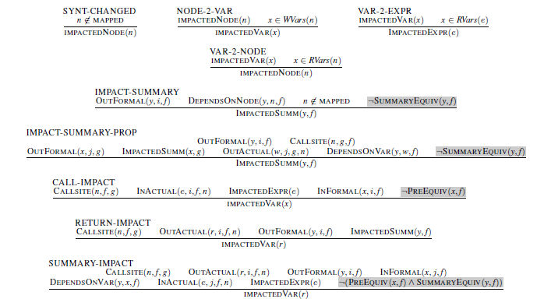


Refining change impact analysis with equivalences

Slide 28
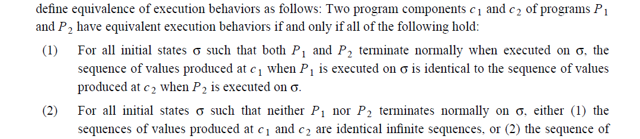
Formalizing semantic impact and PreEquiv
Formulation
Impacted statement: A (mapped) statement is impacted if there exists an initial state (from main) that results in difference sequence of read values in the two versions.
PreEquiv(x, f, f’): parameter x has the same sequence of values in both f and f’ for executions starting at an identical state
The idea of comparing “sequence of vaues” appears in [Wang,Horwitz,Reps TOSEM’92], Intraprocedural setting

Slide 29
Semantic CIA
Prototype
Use SymDiff to infer equivalence relations SummaryEquiv and PreEquiv
An algorithm to incrementally apply expensive eq uiv-inference over (1 program) data-flow analysis to refine the precision
Evaluation
Applied to 164 real changes on 5 Github projects
Reduces impacted statements by 35% on average

Slide 30
Research questions
Can some software engineering tasks leverage differential verification?
Change impact analysis, conflict-freedom, debugging regressions, …
What differential specifications distinguish intended from unintended semantic differences
Equivalence, Assertion safety, Termination safety,
How to leverage/extend program specification and verification advances for differential verification?
SMT, abstract interpretation, predicate abstraction, CEGAR, interpolants, …

Slide 31
Progress
Applications
Differential assertion checking (DAC) [FSE’13]
Verification modulo versions (VMV) [PLDI’14]
Safety of approximate transformations [NFM’16]
Cross-version compiler validation for CLR [FSE’13, CAV’15]
Partition changesets for more efficient reviewing [ICSE’15]
Conflict-freedom of 3-way merge
Semantic change impact analysis
Semantic diff of concurrent programs
SymDiff
Tool for differential program verification and invariant inference [CAV’12]
Differential specifications and proof system [CADE’13]
mutual summaries and (relative) termination conditions
Chicken and Egg problem for difference verification
Industry needs well-studied problems to build production quality tools
Academia needs a well-defined problem to study the problem
Reps’ Program Integration problem is a great example
Are there others?

Slide 32
Backup

Slide 33

Apple SSL bug

