Slide 1
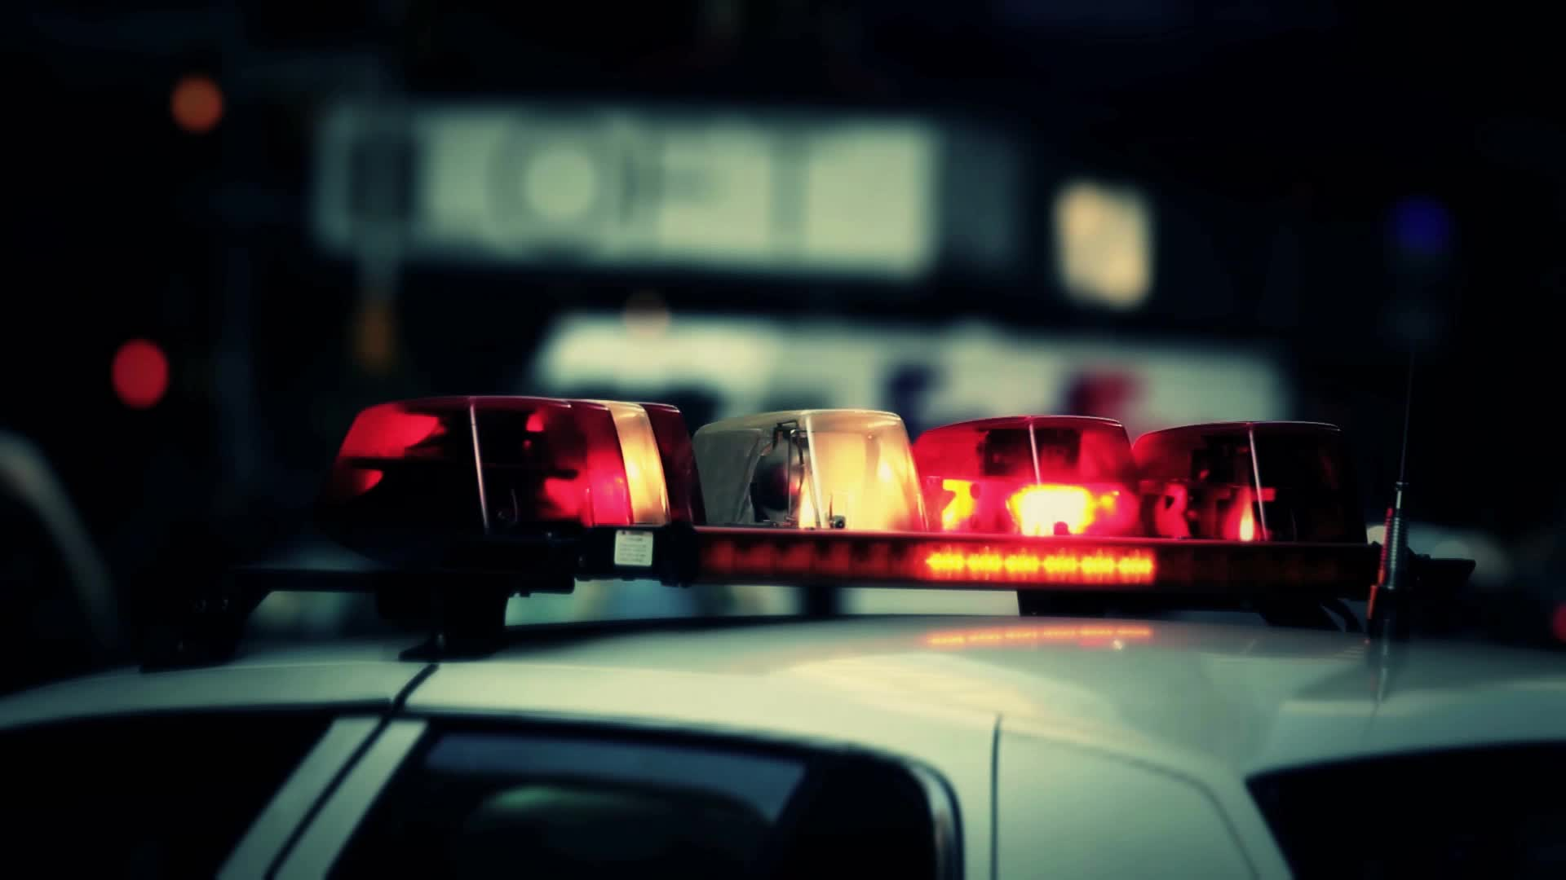
Crash Detectives

Slide 2



STARTING POINT
More traffic on the roads
Opening of offices
Season of summer
End of pandemic
Back to normal phase
GIT HUB :
https://github.com/barharding/Crash-Detectives

Slide 3

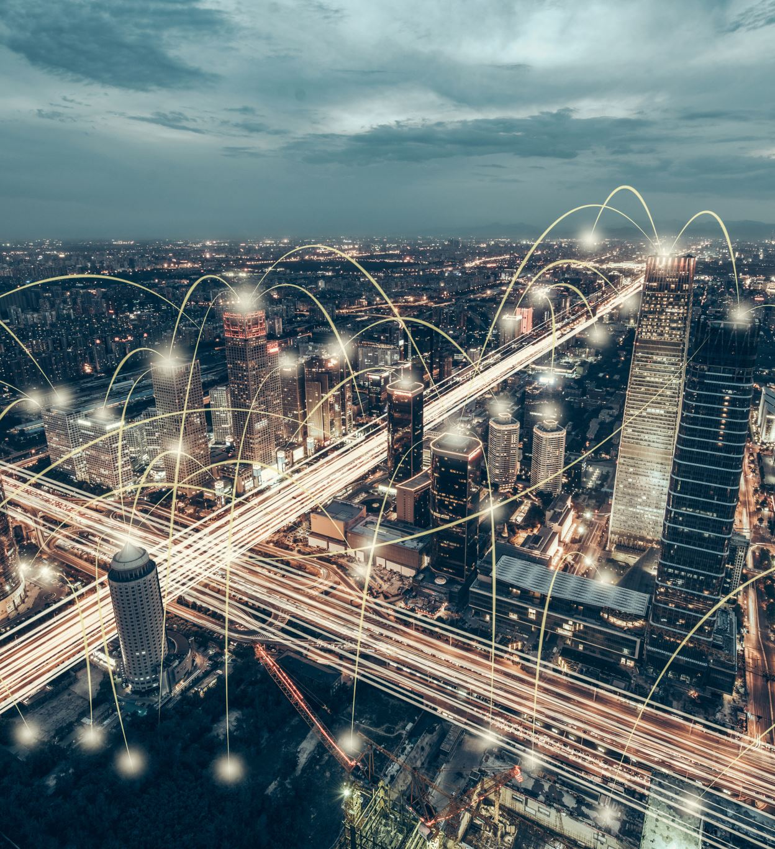

DATASET SOURCE
City of Toronto's Open Data Portal- Link to portal
On Git hub - Link

Slide 4
Datasets
Seriously injured/killed collisions data : Dataset 1
Red light cameras data : Dataset 2
Traffic collision data : Dataset 3

Slide 5


Questions to be answered
Factors affecting Accident severity
Red light camera installation correlation with incidents
Predicting if an incident will be fatal/non-fatal on a location?

Slide 6


What’s in the data?
Accident Number
Road Class
Collector
Time stamp
Accident Location
Intersection
Location
Visibility
Expressway and ramps
Lane
Local
Major + minor arterials with ramps
Latitude
Longitude
Driveway
Overpass or bridge
Underpass or tunnel
Trail
Private driveway…
Year
Date
Time
Clear
Fog, mist, smoke and dust
Freezing rain
Snow and Drifting snow
Strong wind…
Light
Daylight or dark
Dawn or dusk
Artificial lights…
Accident class
Vehicle type
Fatal
Non-fatal injury
Property damage
Manoeuvre
Automobile and station wagon
Motorcycle
Bicycle
Driver Action
Pick up truck
Street Car
School bus…
Turning left or right
Failed to yield right of way
Disobeyed traffic control
Lost control
Improper lane change
Speed too slow
Speed too fast for condition…
Stopped
Making U-turn
Overtaking
Changing lanes
Reversing …
Age of the involved
10 to 14
25 to 29
Over 95
15 to 19
20 to 24
……
Driver condition
Ability impaired, alcohol
Normal
Inattentive
Medical/physical disability
Fatigue
Ability impaired, drugs…

Slide 7


Deep exploration of data
Coming up soon!

Slide 8
Analysis
Coming up soon!

Slide 9

Technologies used
Data cleaning and exploratory analysis:
Pandas, numpy, seaborn
Database storage: PostgreSQL
Machine learning models: Decision tree,
Random forest,
Balance random forest and Gradient boosting
Dashboard:
Tableau public

Slide 10
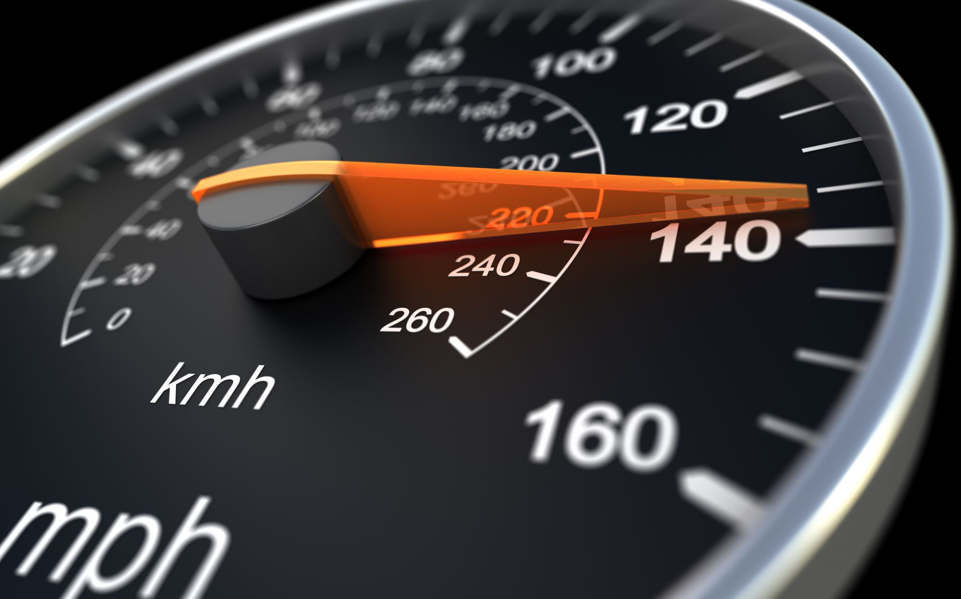
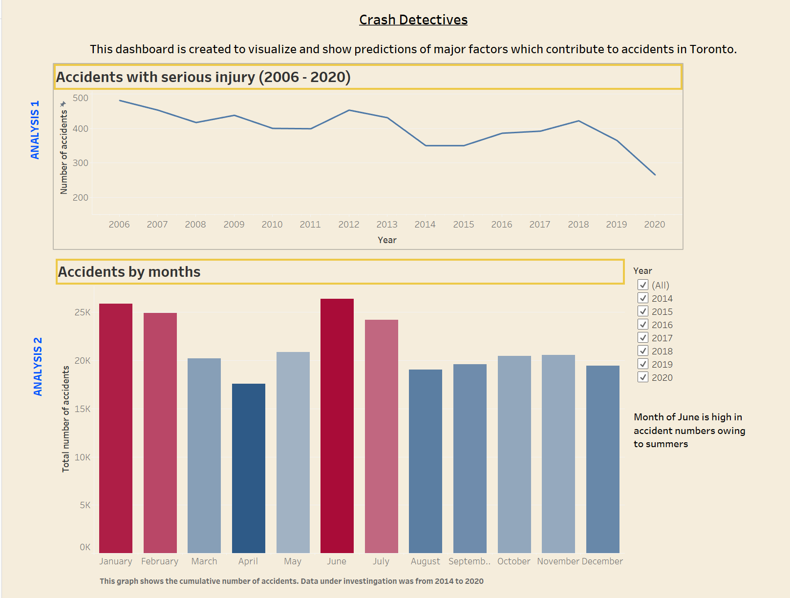
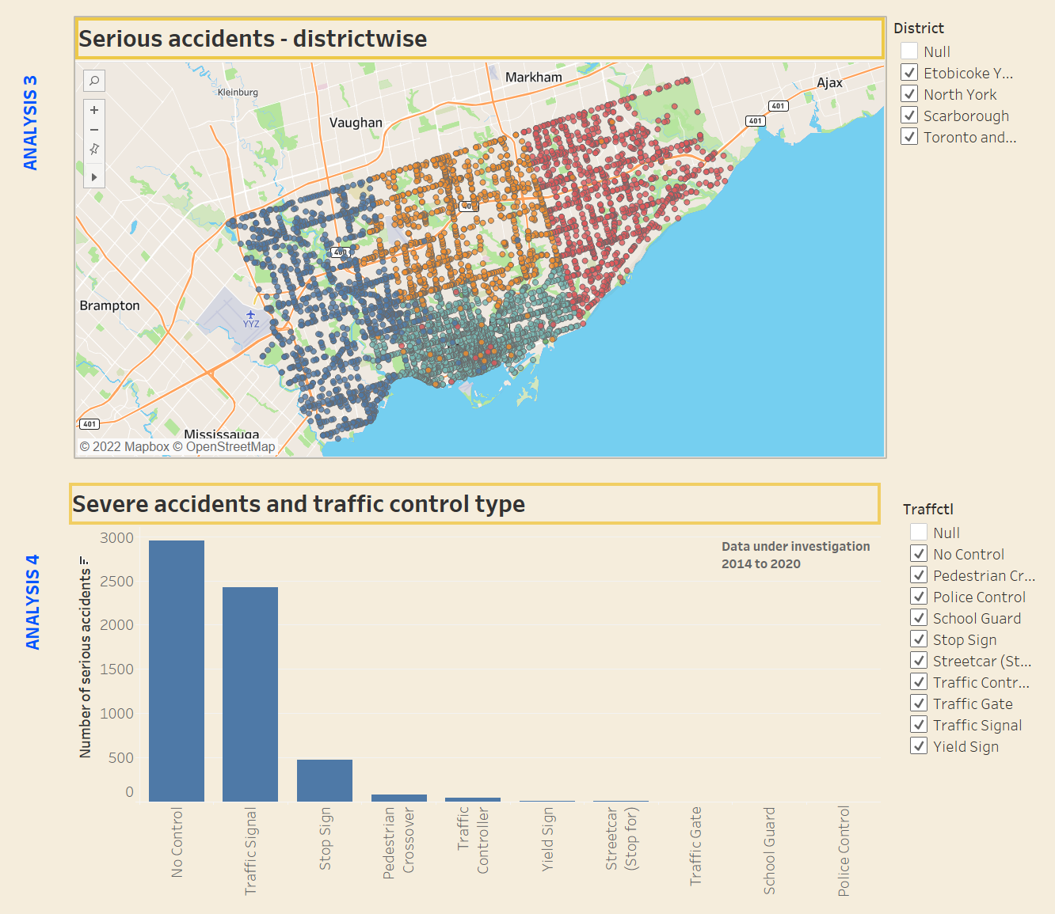
A glimpse of the Dashboard

Slide 11
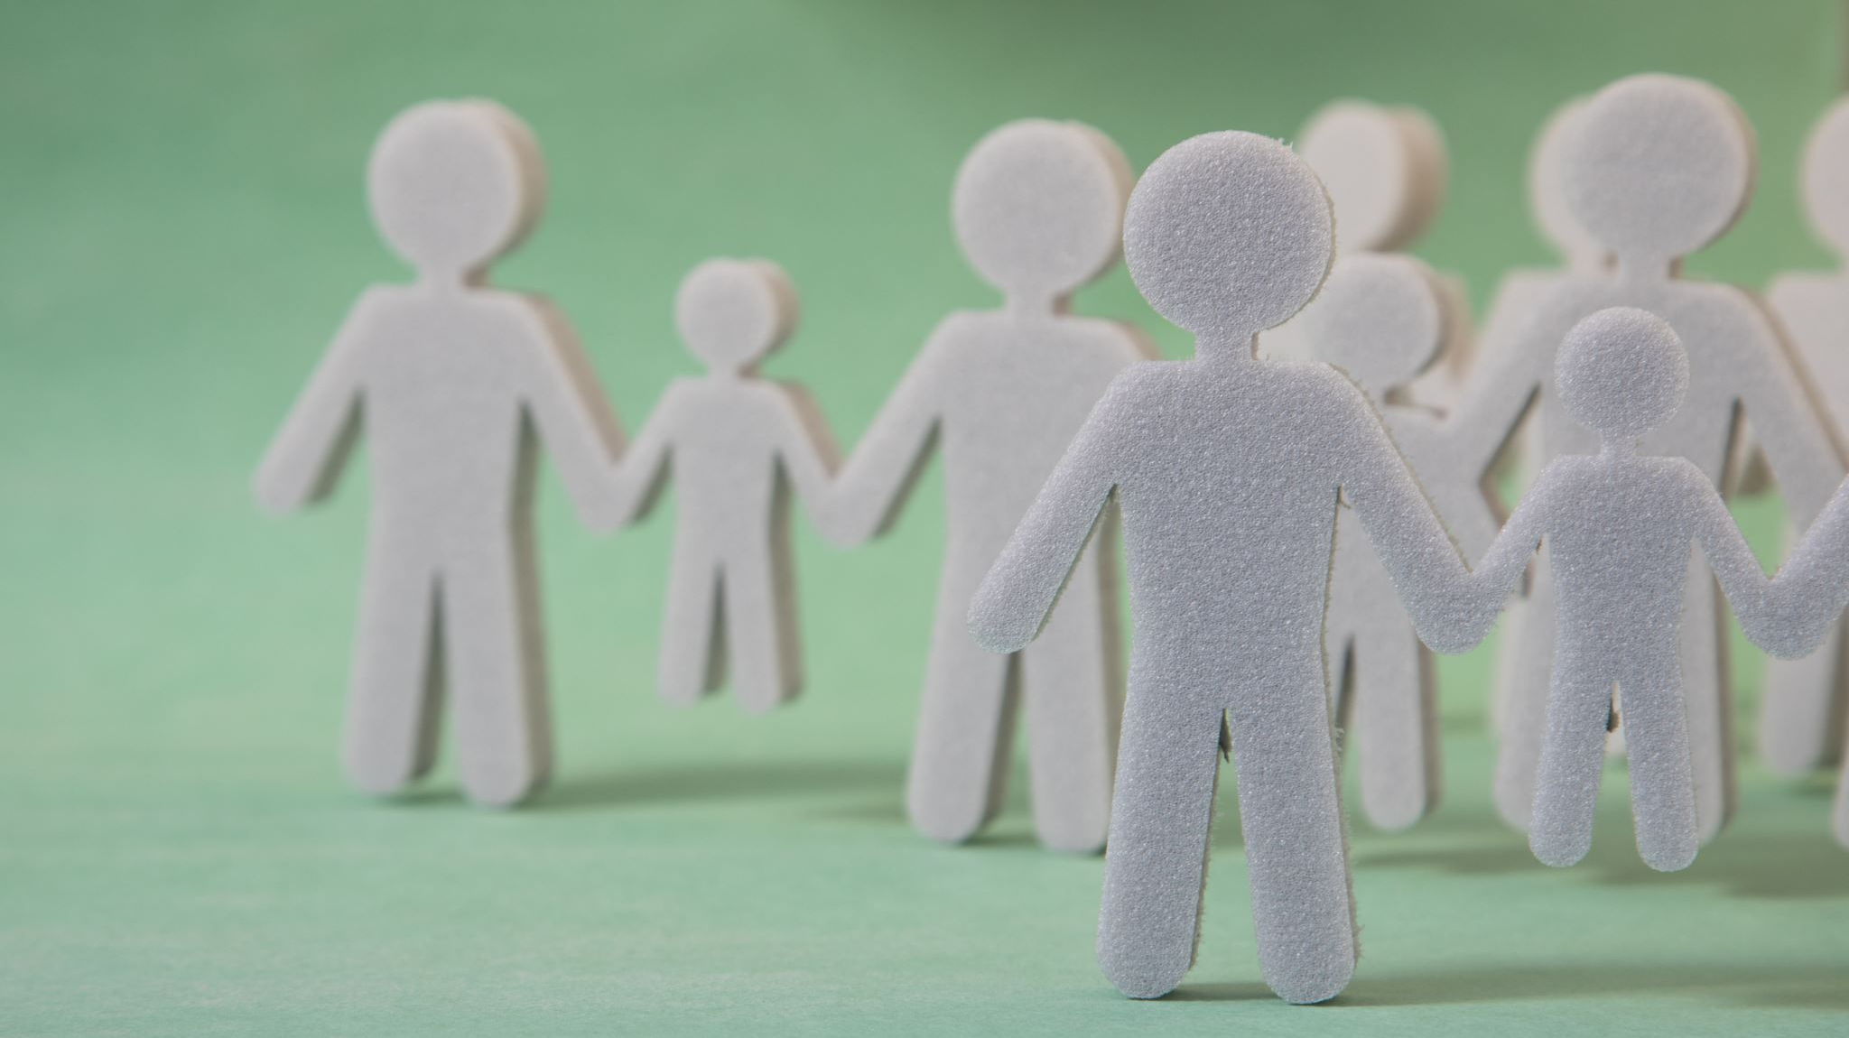

The Team
ADITI
BARDHONIA
KRITIKA
RICHELLE

Slide 12
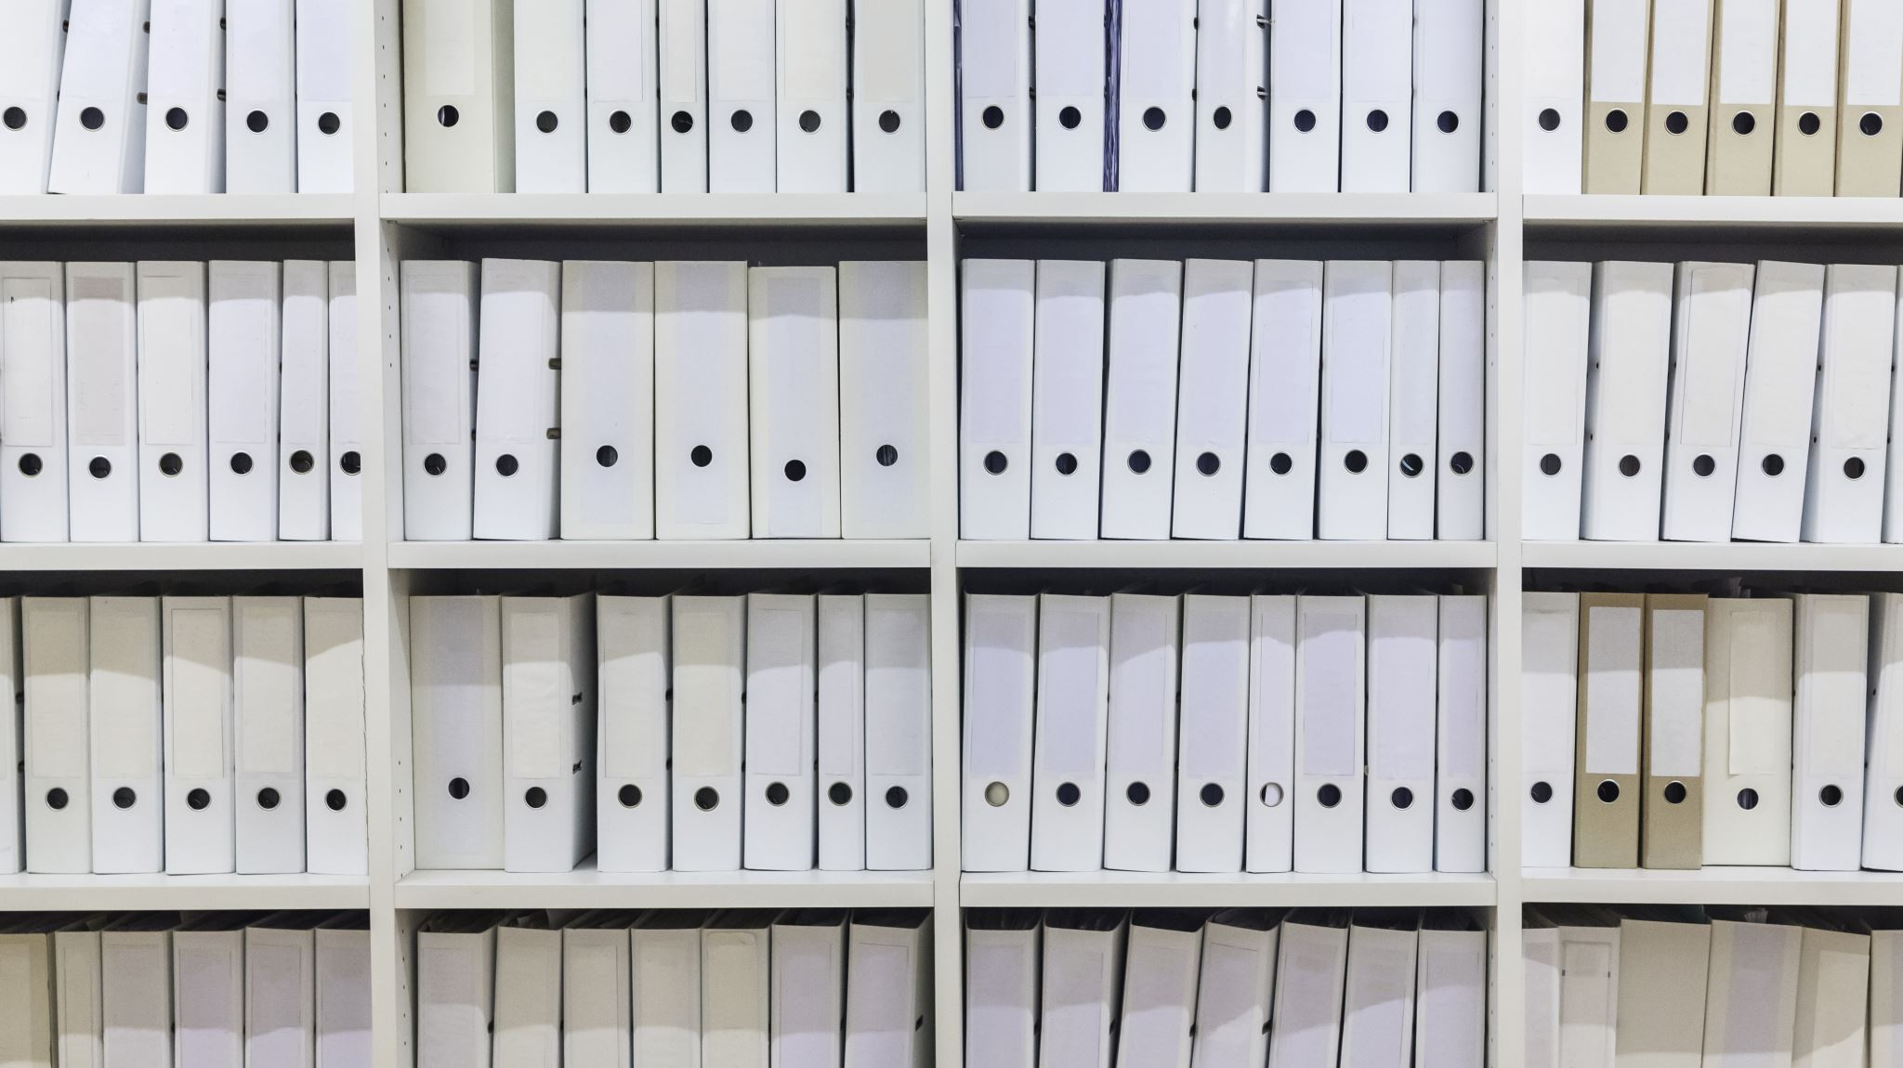
References
City of Toronto open data portal - Link to portal

