Slide 1
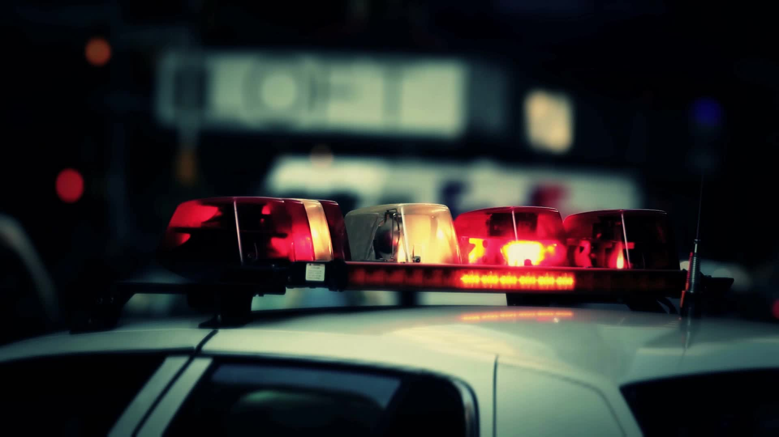
Crash Detectives

Slide 2
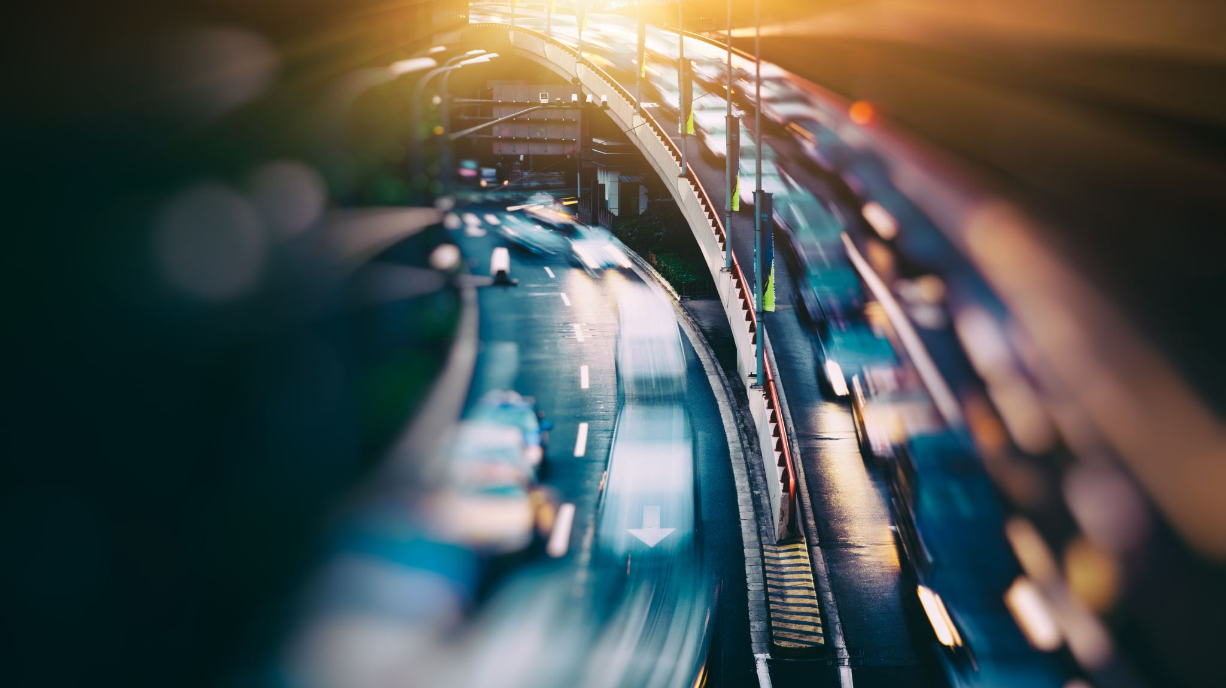

STARTING POINT
More traffic on the roads
Opening of offices
Season of summer
End of pandemic
Back to normal phase

Slide 3
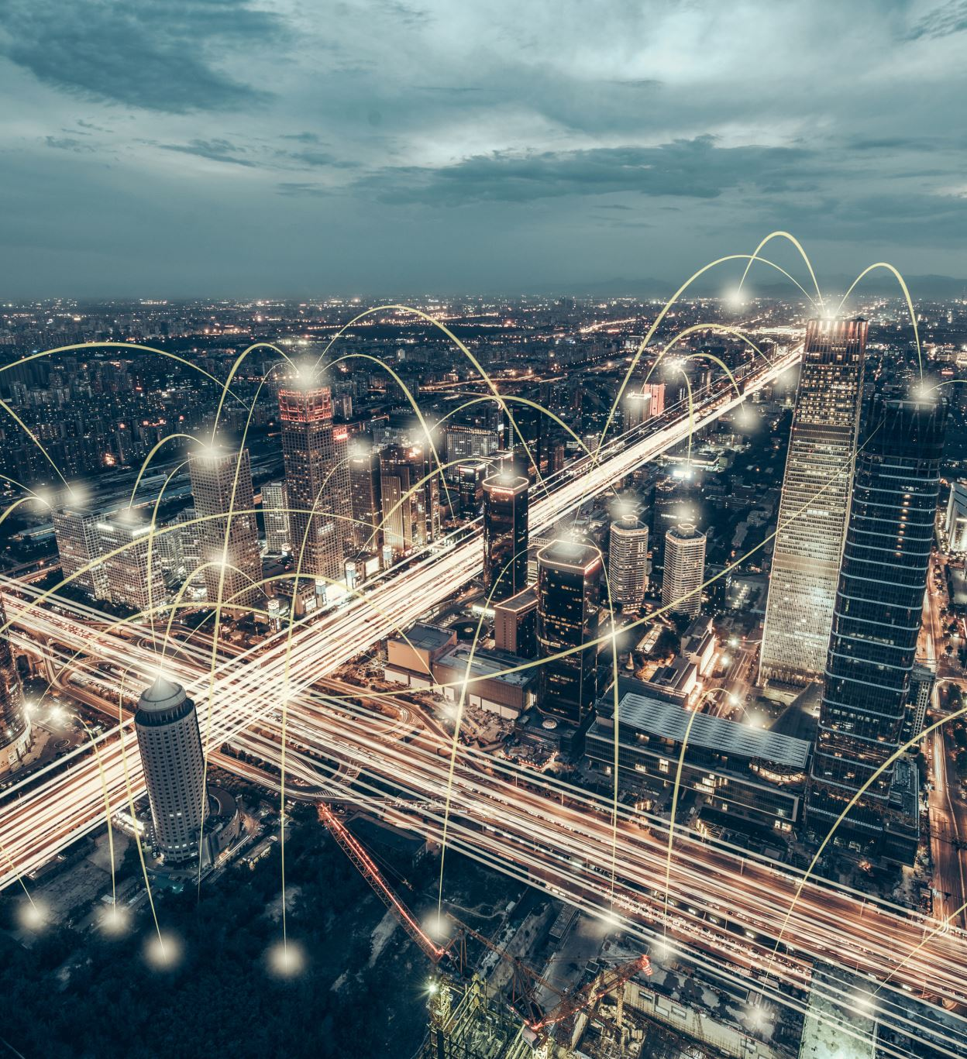

DATASET SOURCE
City of Toronto's Open Data Portal

Slide 5

What’s in the data?

Slide 6
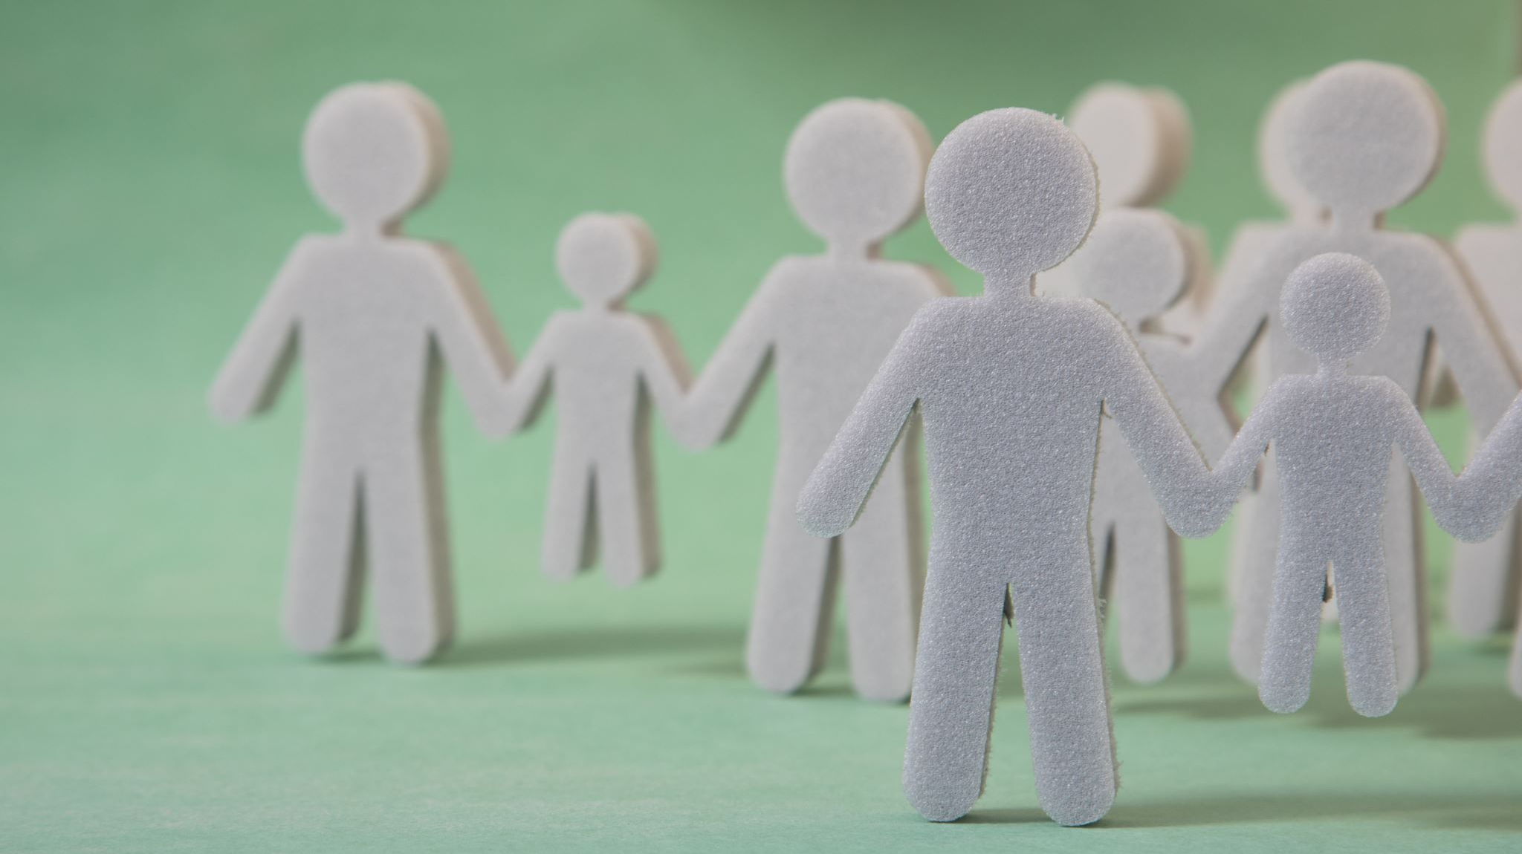
The Team
ADITI
BARDHONIA
KRITIKA
RICHELLE

