Slide 1



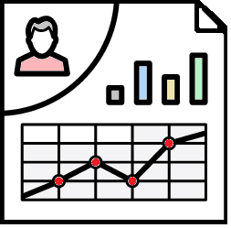
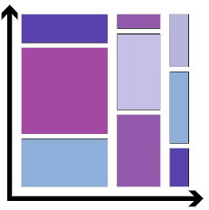
EXPLORATORY DATA ANALYSIS
Data Cleaning
Visualization
Removing Redundant variables
Variable Selection, Data Types
Remove outlier
Creating Charts, Graphs
IMPORT
Correlation
Algorithm Model
Import Libraries. Load data in data frames
Finding Relationship between variables
Use information from EDA for your Model

Slide 2


Slide 3
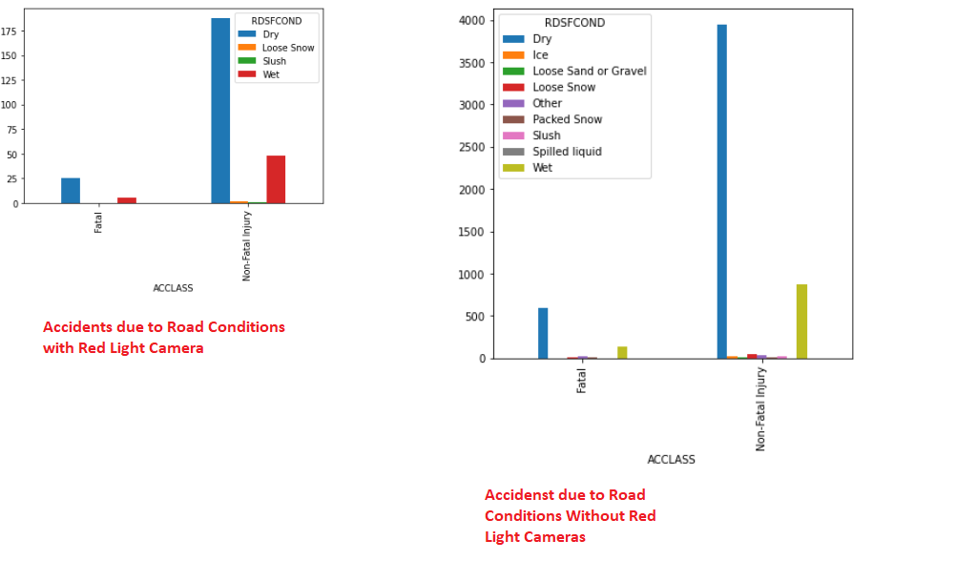
ROAD CONDITION
Template editing instructions
and feedback

Slide 4
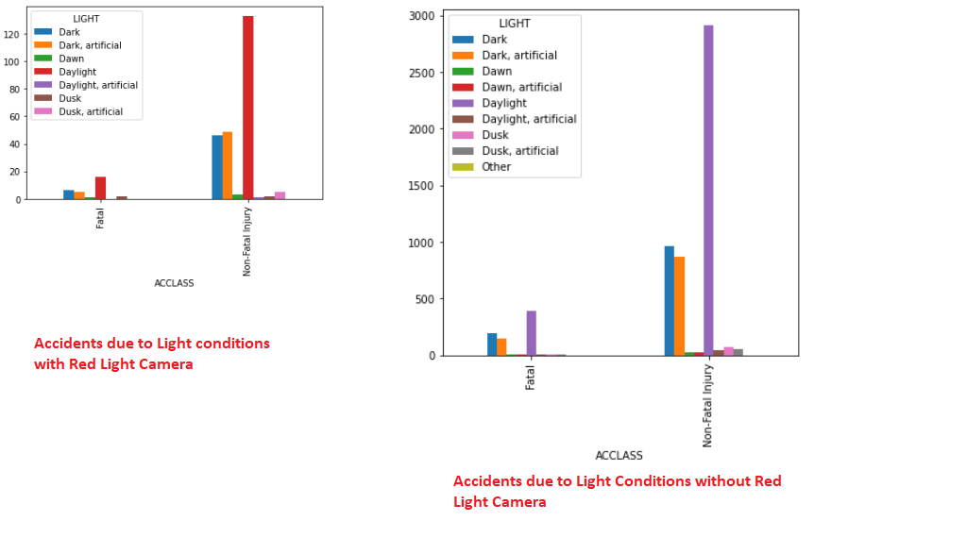
LIGHT

Slide 5
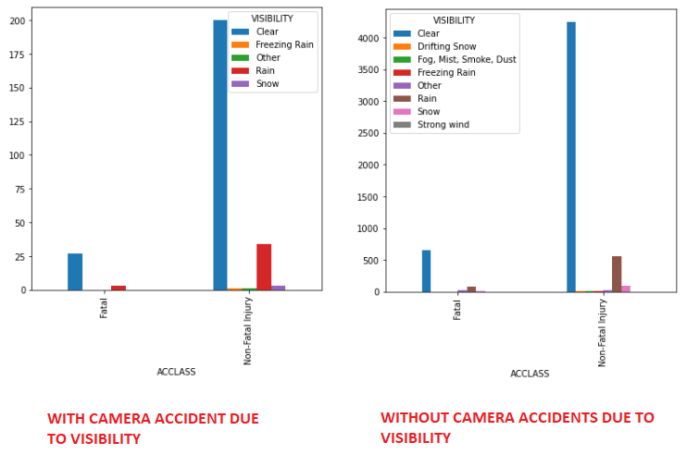
VISIBILITY

Slide 6
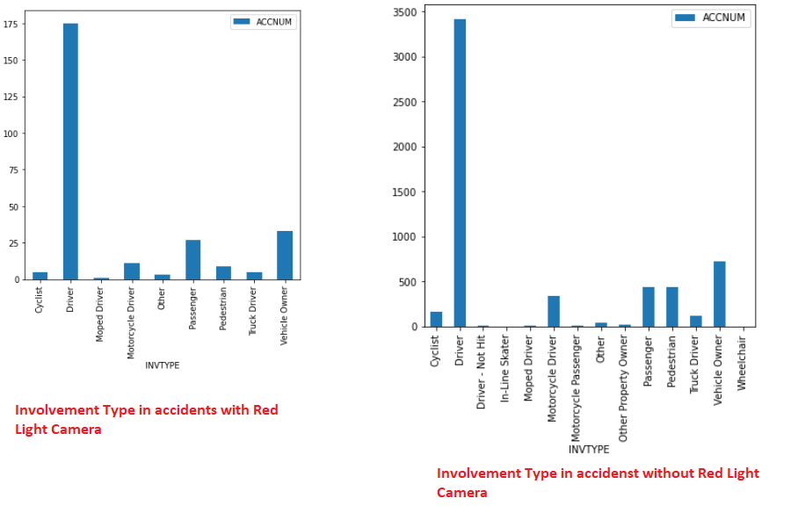
INVOLVEMENT TYPE

Slide 7
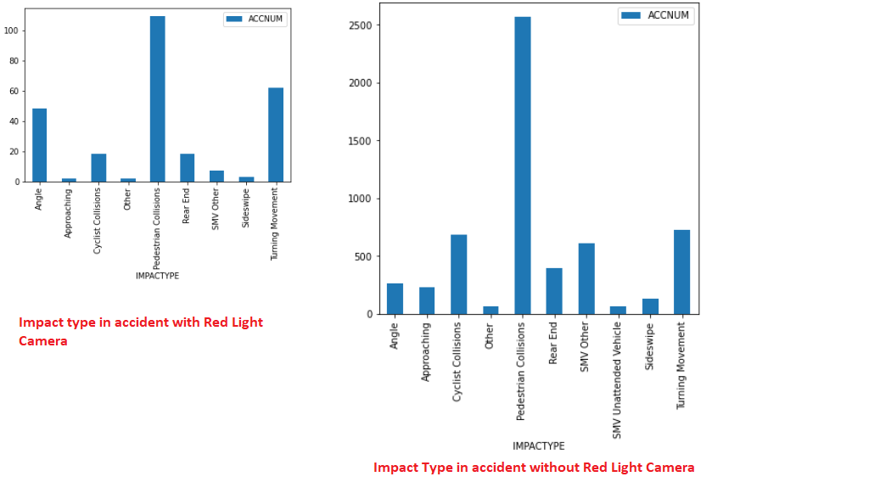
IMPACT TYPE

Slide 8
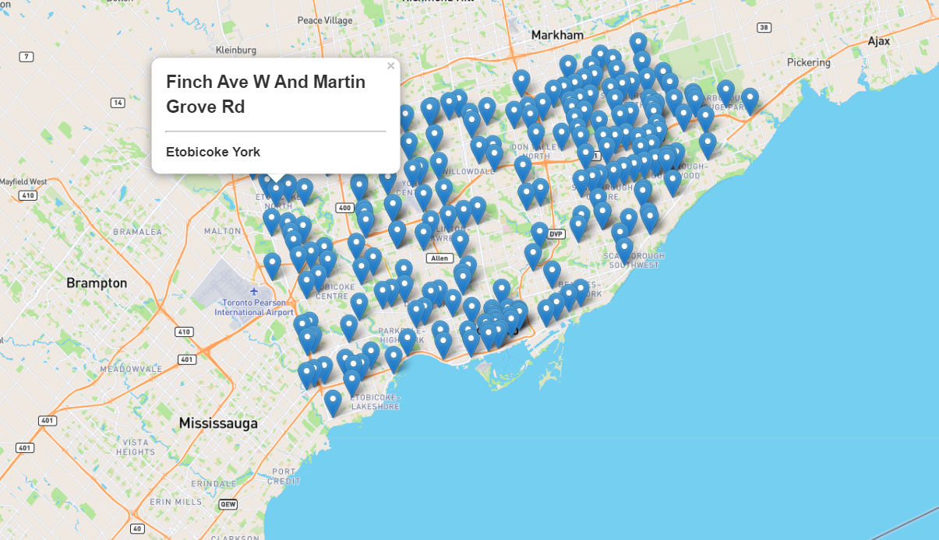
RED LIGHT CAMERA LOCATIONS

Slide 9
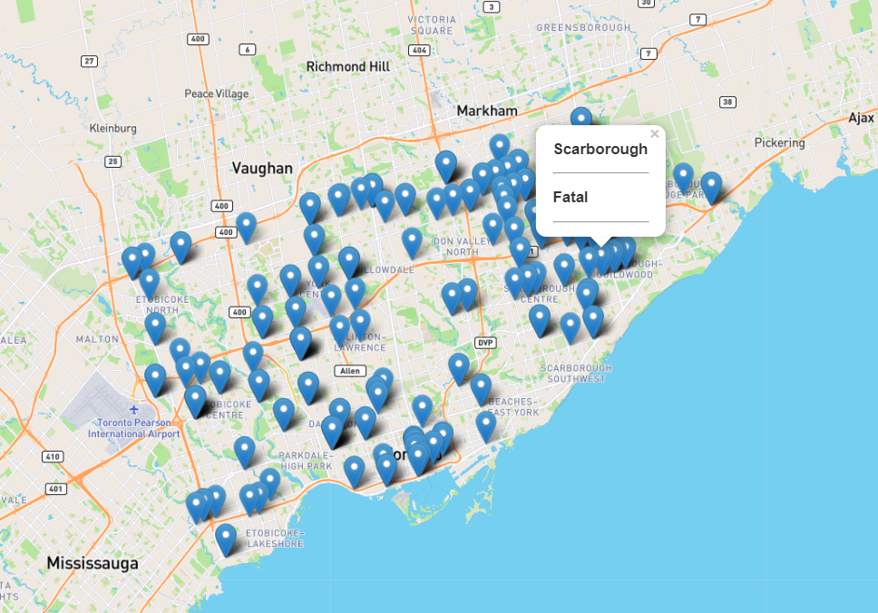
ACCIDENTS WITH RED LIGHT CAMERA

Slide 10
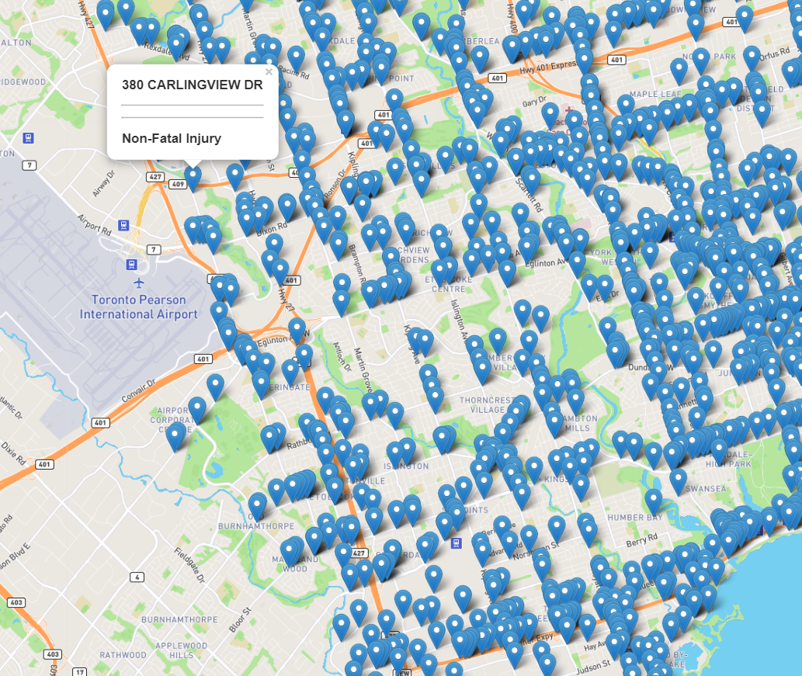
ACCIDENTS WITHOUT RED LIGHT CAMERAS

Slide 11
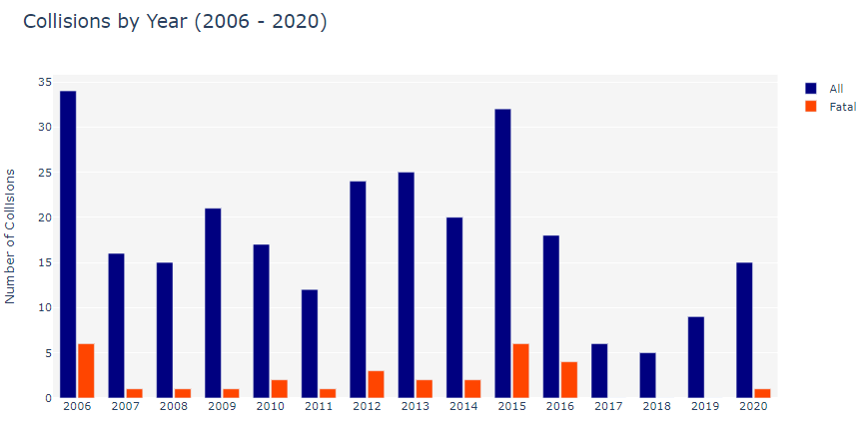
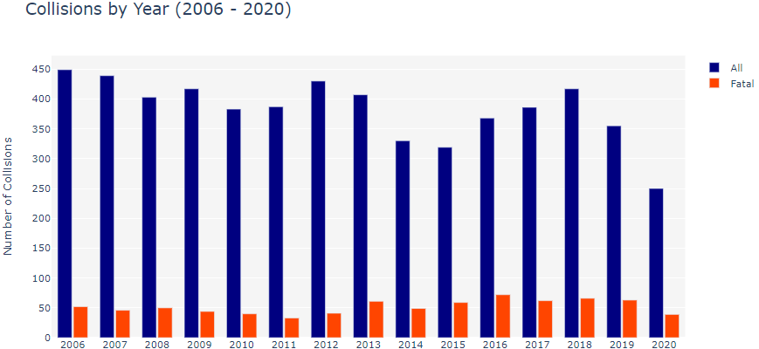
COLLISIONS BY YEAR
Red Light Camera
No Red Light Camera

Slide 12
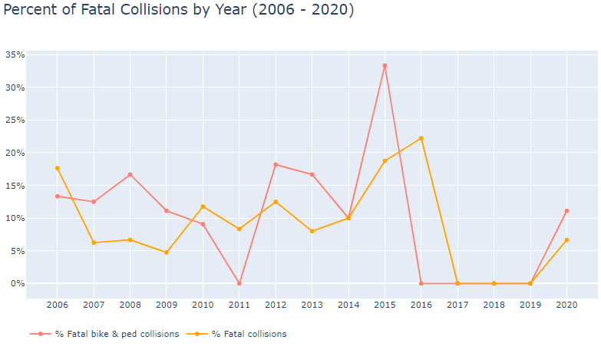
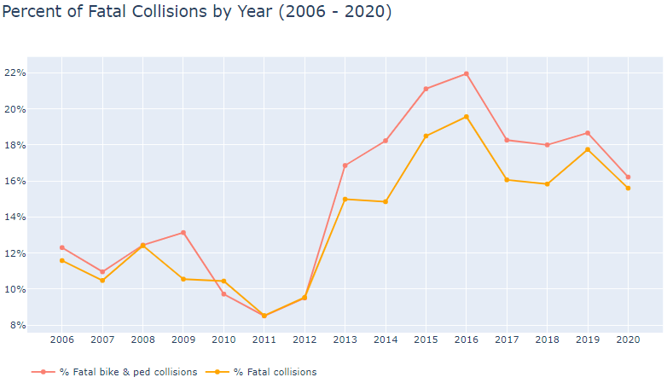
PERCENT OF SEVERE COLLISIONS BY YEAR
Red Light Camera
NO Red Light Camera

Slide 13
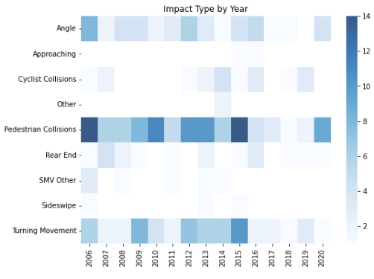
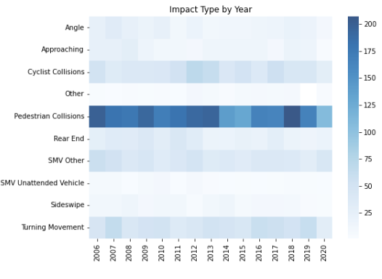
IMPACT TYPE BY YEAR
Red Light Camera
No Red Light Camera

Slide 14
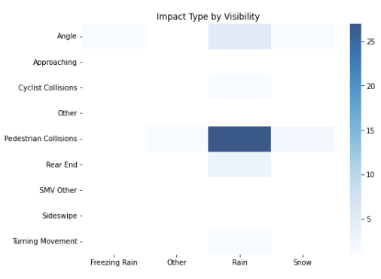
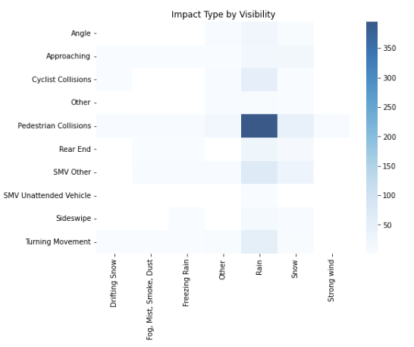
IMPACT TYPE BY VISIBILITY
Red Light Camera
No Red Light Camera

Slide 15
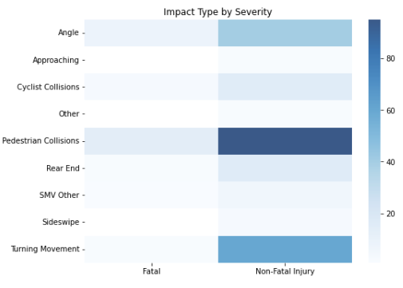
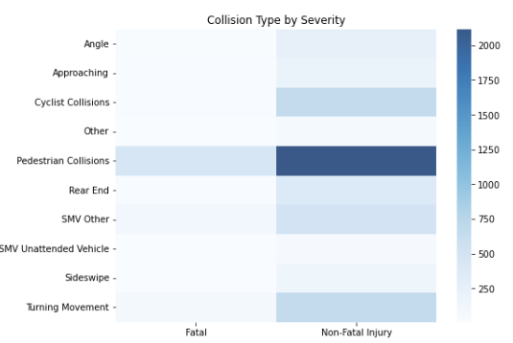
IMPACT TYPE BY SEVERITY
Red Light Camera
No Red Light Camera

Slide 16
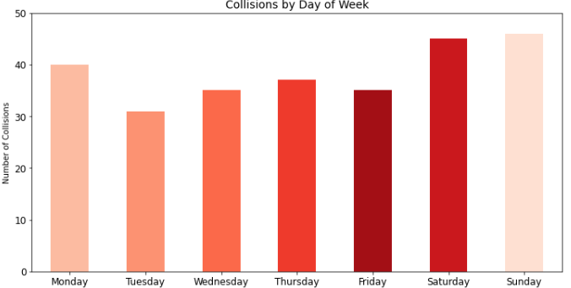
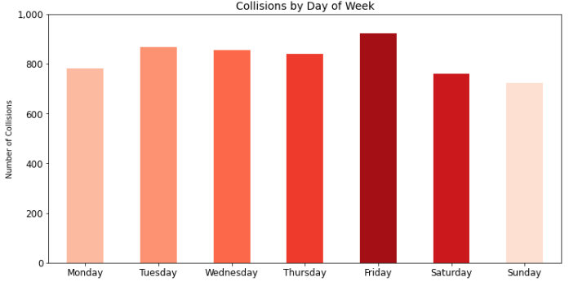
COLLISIONS BY DAY OF WEEK
RED LIGHT CAMERA
NO RED LIGHT CAMERA

Slide 17
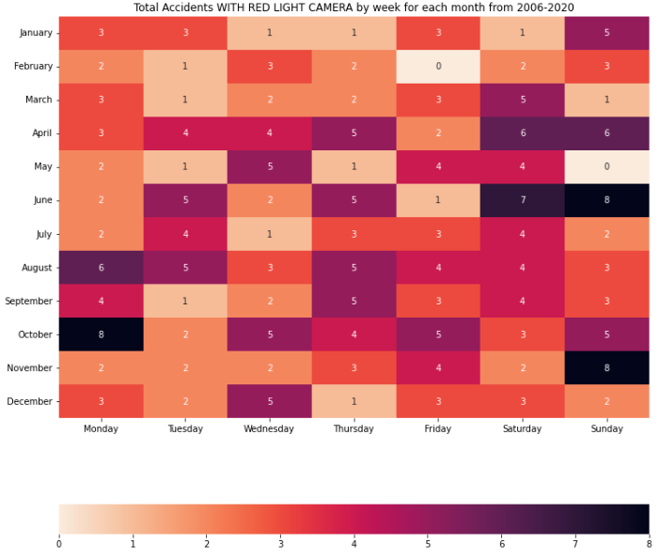
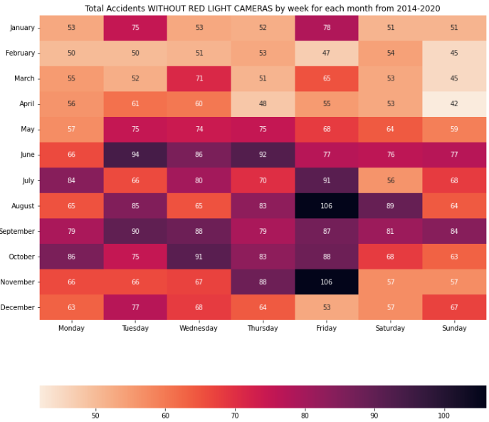
Heat Map Total Accidents by Week of Each Month 2006-2020
Red Light Camera
No Red Light Camera

Slide 18
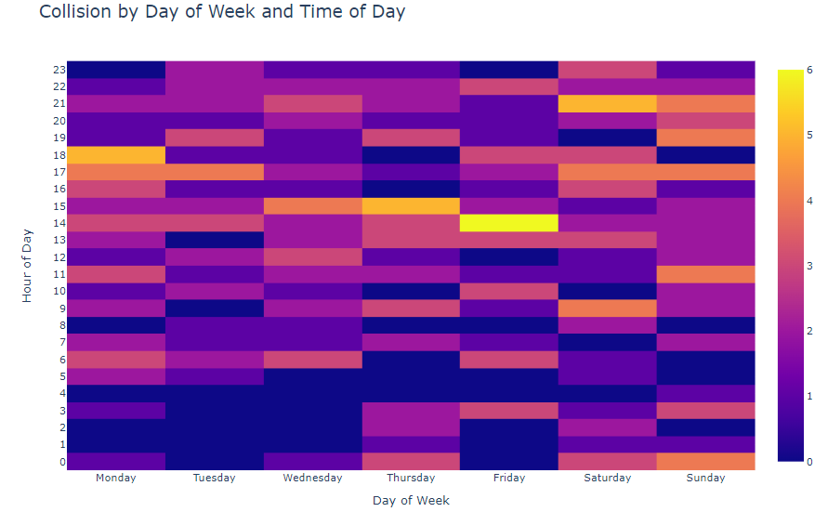
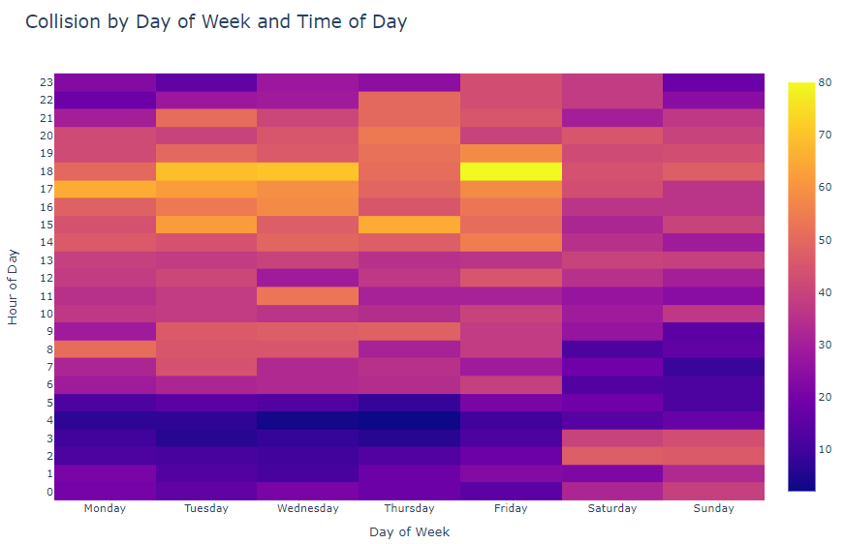
COLLISION BY DAY OF WEEK AND TIME OF DAY
Red Light Camera
No Red Light Camera

Slide 19
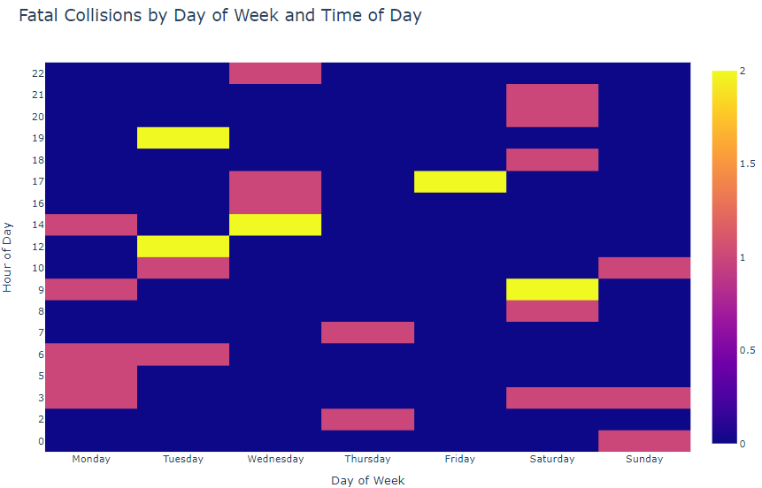
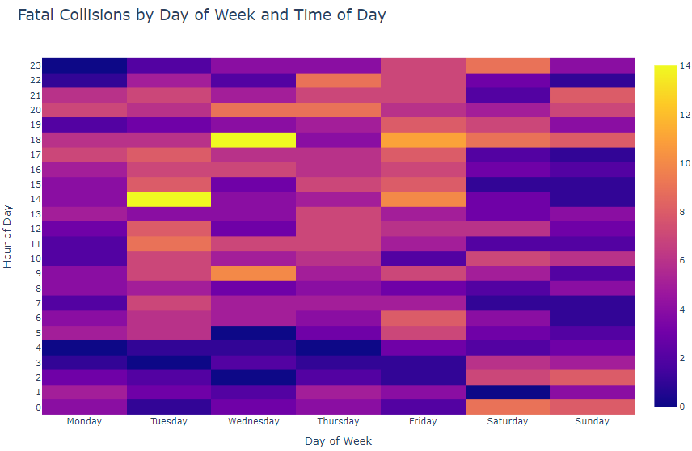
FATAL COLLISIONS BY DAY OF WEEK & TIME OF DAY
Red Light Camera
No Red Light Camera

Slide 20
VISUALIZATION SUMMARY NON-RED LIGHT CAMERAS AREAS
WE HAVE OBSERVED THAT THERE ARE MORE FATAL AND NON-FATAL ACCIDENTS IN NON-REDLIGHT CAMERAS AREA.
THERE ARE MORE PEDESTRAINS INVOLVED IN COLLISIONS
MORE ACCIDENST HAPPEN IN CLEAR VISIBILITY WHICH MEANS PEOPLE DRIVE CAREFULLY WHEN THERE IS VISIBILITIES ISSUES.
MORE ACCIDENST IN MONTH OF AUGUST AND NOVEMBER AND ON FRIDAYS.

Slide 21
IMPORTANCE OFTHIS ANALYSIS
Accurately analyzing accidents can help governments to better the safety of their roads and highways.
Identifying high areas of accidents and high areas of accident severity can highlight areas of concern.
It can also be beneficial to insurance companies looking to change their rates in different areas.

