Slide 1
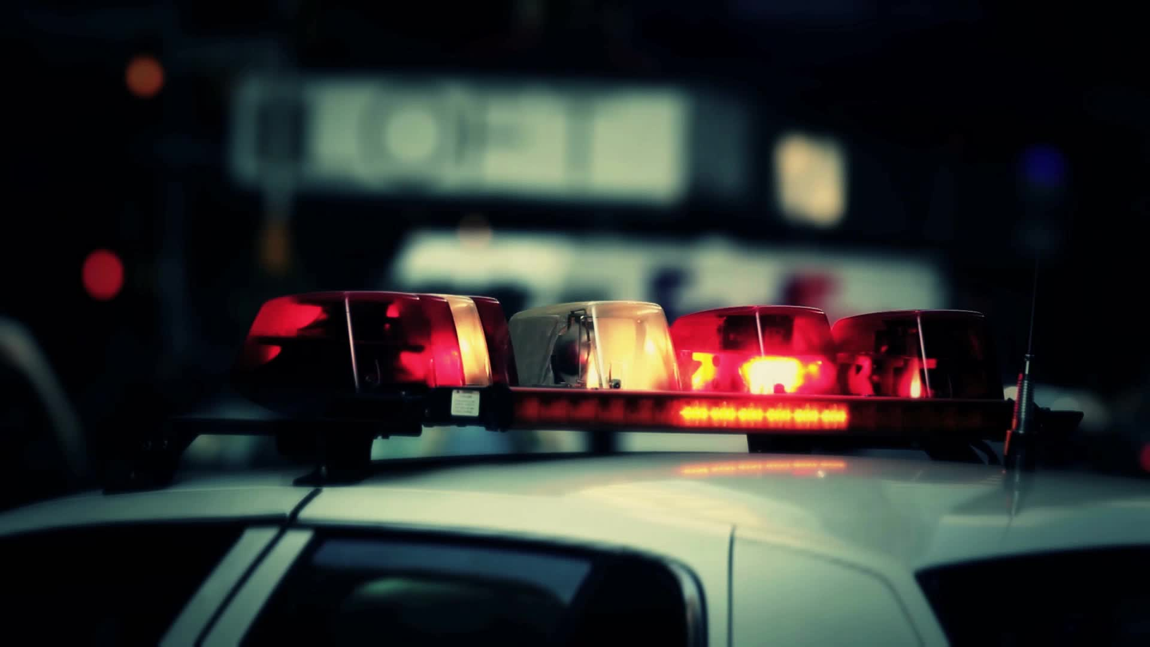
Crash Detectives

Slide 2



STARTING POINT
More traffic on the roads
Opening of offices
Season of summer
End of pandemic
Back to normal phase
GIT HUB :
https://github.com/barharding/Crash-Detectives

Slide 3

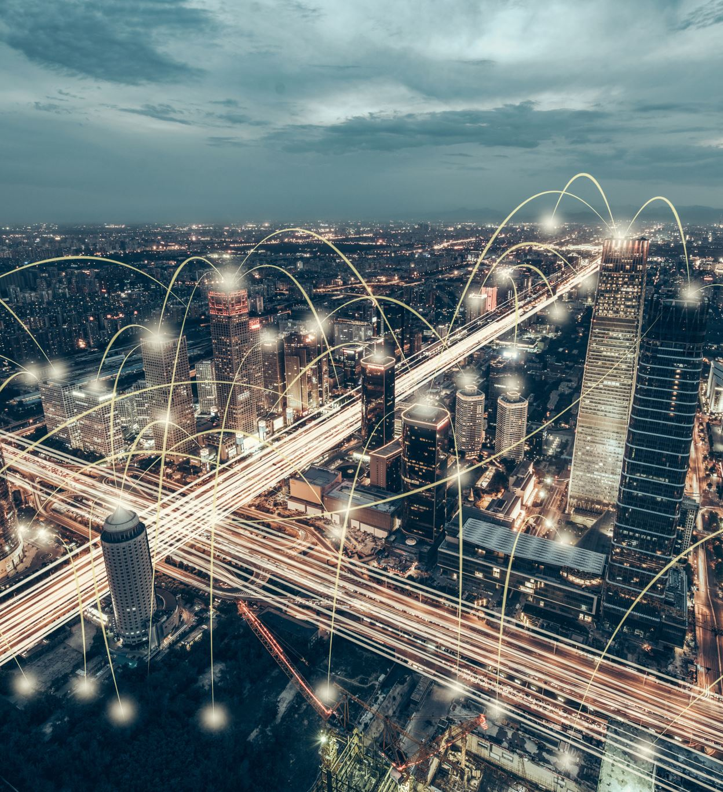

DATASET SOURCE
City of Toronto's Open Data Portal (https://open.toronto.ca/dataset/motor-vehicle-collisions-involving-killed-or-seriously-injured-persons/)
On Git hub - https://github.com/barharding/Crash-Detectives/tree/main/Dataset

Slide 4
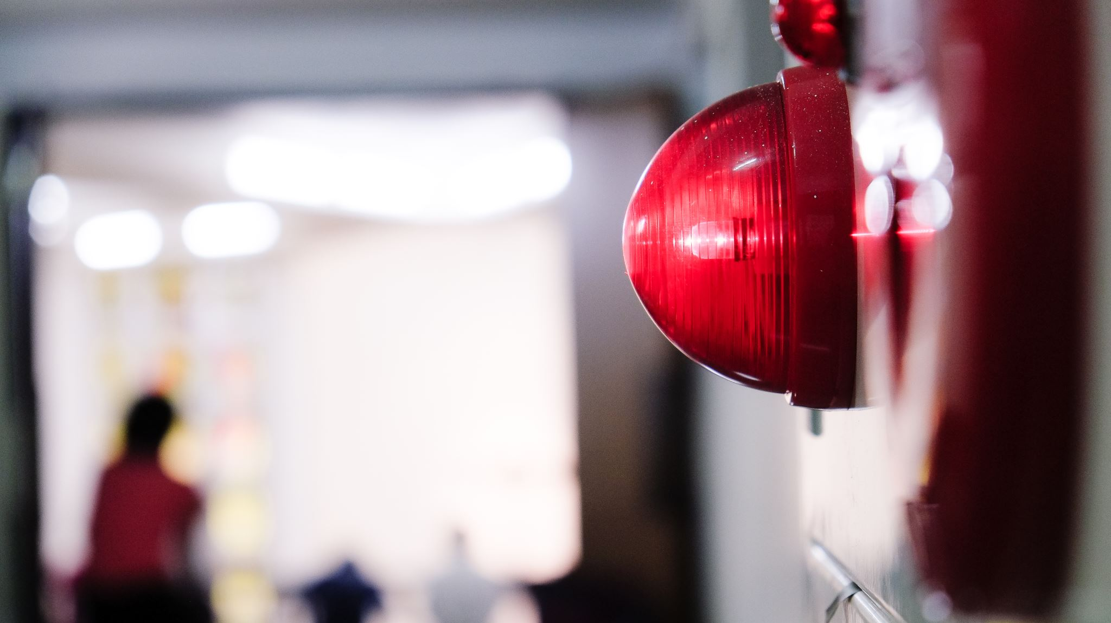
Questions to be answered
Factors affecting Accident severity
Red light camera installation correlation with incidents
Predicting if an incident will be fatal/non-fatal on a location?

Slide 5

What’s in the data?
Accident Number
Road Class
Collector
Time stamp
Accident Location
Intersection
Location
Visibility
Expressway and ramps
Lane
Local
Major + minor arterials with ramps
Latitude
Longitude
Driveway
Overpass or bridge
Underpass or tunnel
Trail
Private driveway
Year
Date
Time
Clear
Fog, mist, smoke and dust
Freezing rain
Snow and Drifting snow
Strong wind
Light
Daylight or dark
Dawn or dusk
Artificial lights
Accident class
Fatal
Non-fatal injury
Property damage

Slide 7
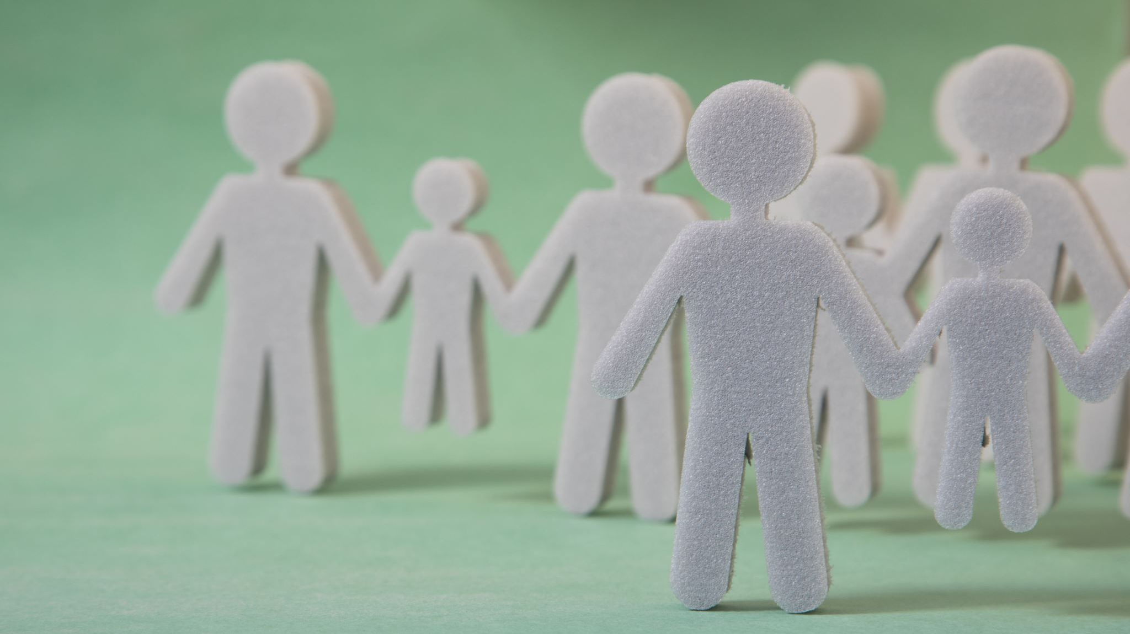
The Team
ADITI
BARDHONIA
KRITIKA
RICHELLE

