Slide 1




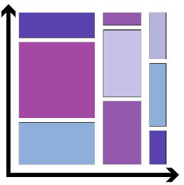
EXPLORATORY DATA ANALYSIS
Data Cleaning
Visualization
Removing Redundant variables
Variable Selection, Data Types
Remove outlier
Creating Charts, Graphs
IMPORT
Correlation
Algorithm Model
Import Libraries. Load data in data frames
Finding Relationship between variables
Use information from EDA for your Model

Slide 2


Slide 3
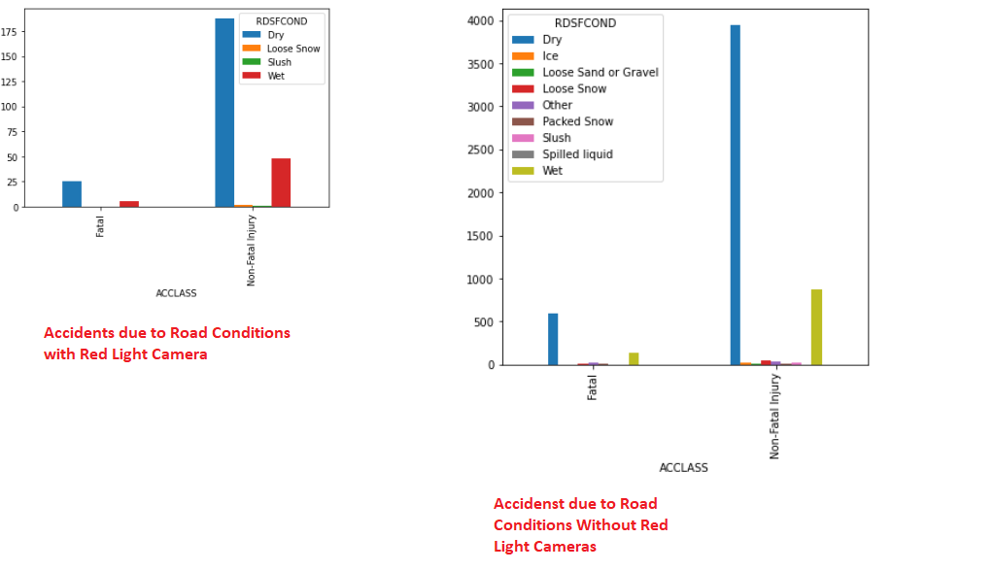
ROAD CONDITION
Template editing instructions
and feedback

Slide 4
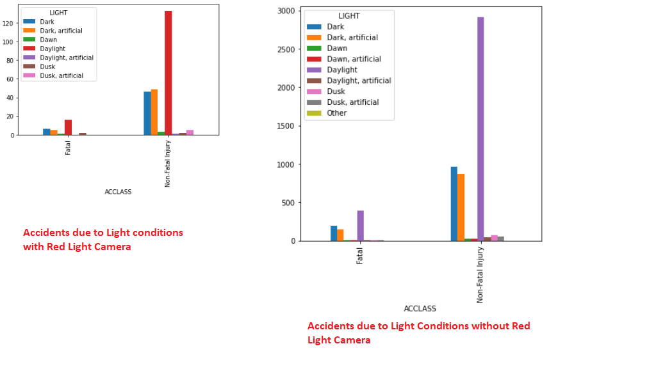
LIGHT

Slide 5
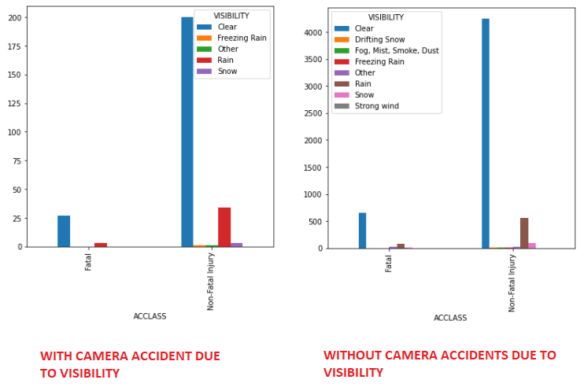
VISIBILITY

Slide 6
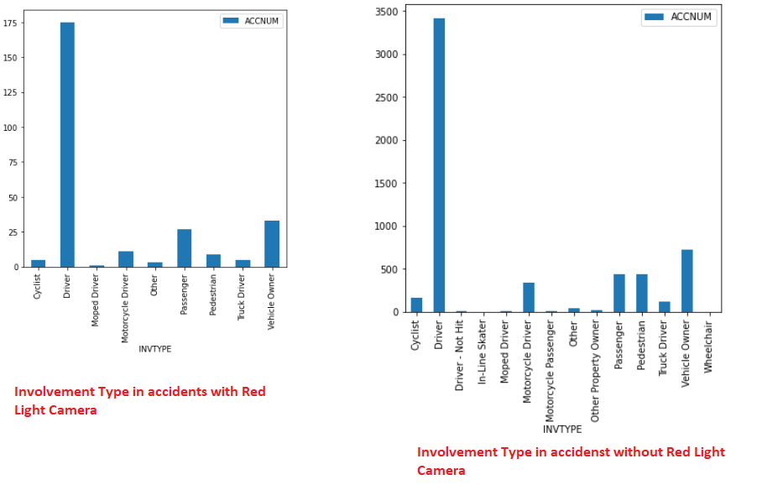
INVOLVEMENT TYPE

Slide 7
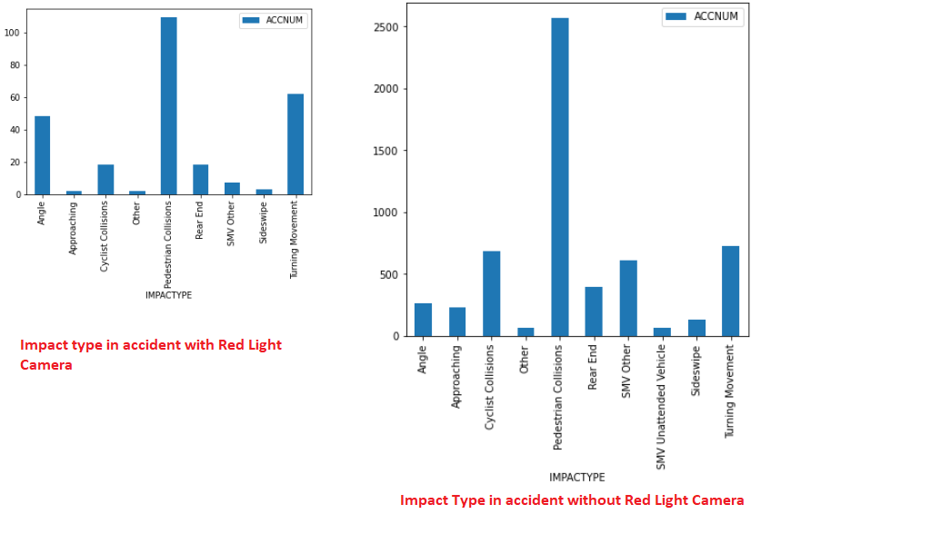
IMPACT TYPE

Slide 8
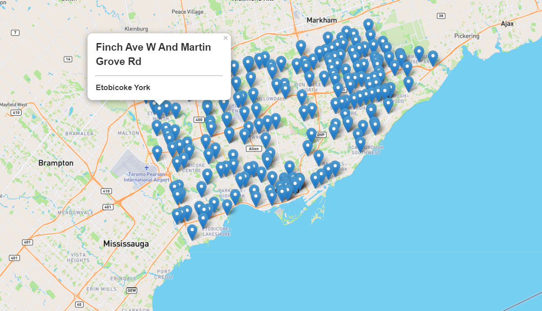
RED LIGHT CAMERA LOCATIONS

Slide 9
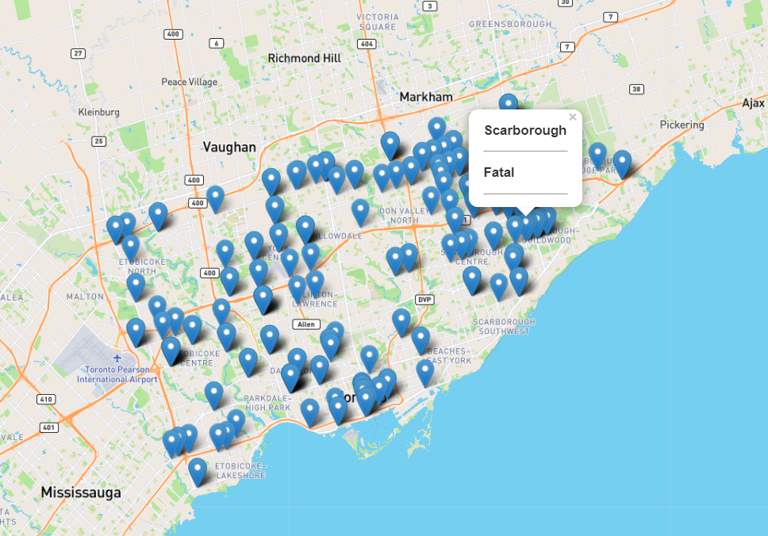
ACCIDENTS WITH RED LIGHT CAMERA

Slide 10
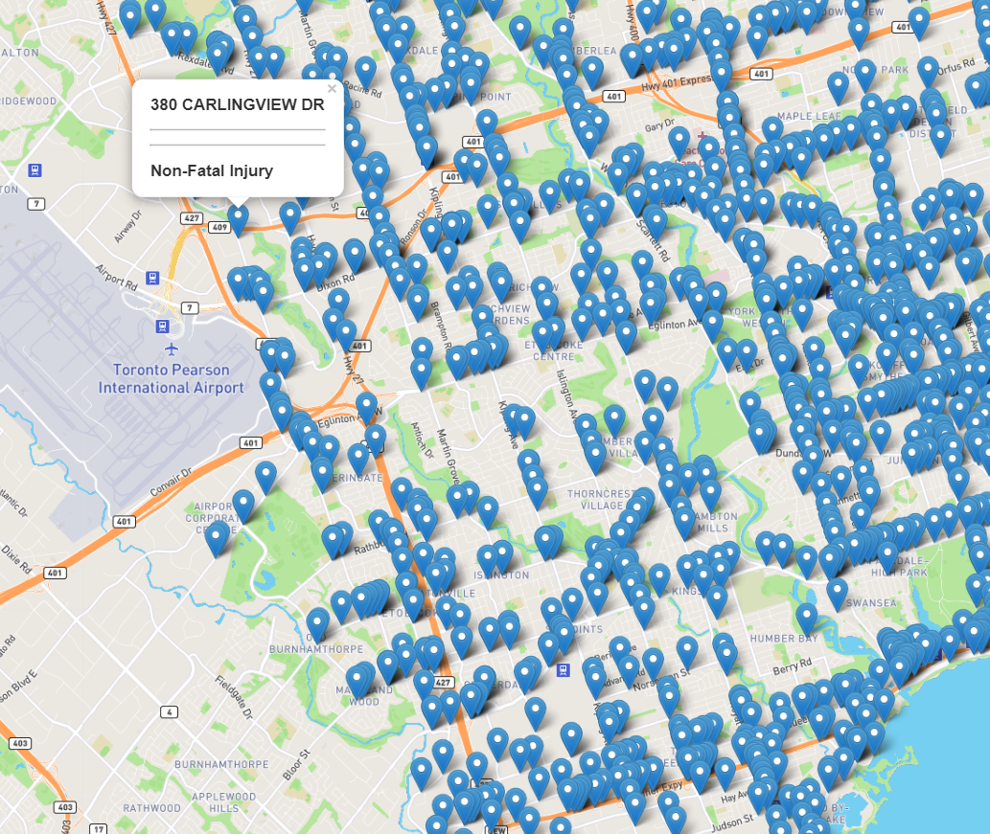
ACCIDENTS WITHOUT RED LIGHT CAMERAS

Slide 11
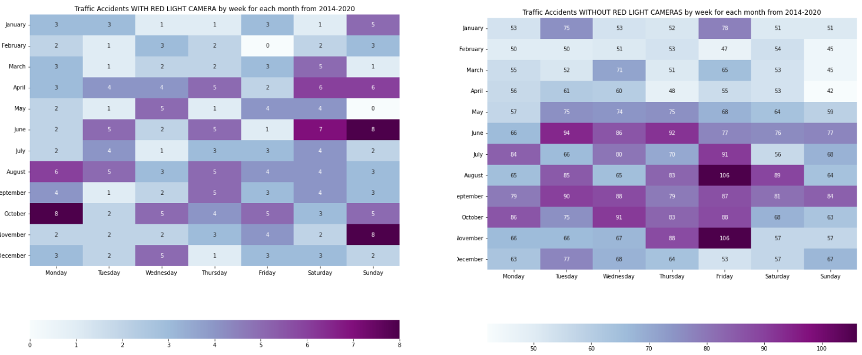
HEAT MAP BY WEEK FOR EACH MONTH 2014-2020

Slide 12
VISUALIZATION SUMMARY NON-RED LIGHT CAMERAS AREAS
WE HAVE OBSERVED THAT THERE ARE MORE FATAL AND NON-FATAL ACCIDENTS IN NON-REDLIGHT CAMERAS AREA.
THERE ARE MORE PEDESTRAINS INVOLVED IN COLLISIONS
MORE ACCIDENST HAPPEN IN CLEAR VISIBILITY WHICH MEANS PEOPLE DRIVE CAREFULLY WHEN THERE IS VISIBILITIES ISSUES.
MORE ACCIDENST IN MONTH OF AUGUST AND NOVEMBER AND ON FRIDAYS.

Slide 13
IMPORTANCE OFTHIS ANALYSIS
Accurately analyzing accidents can help governments to better the safety of their roads and highways.
Identifying high areas of accidents and high areas of accident severity can highlight areas of concern.
It can also be beneficial to insurance companies looking to change their rates in different areas.

Slide 14
To be Continued……

