Slide 1

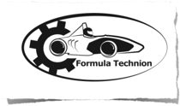

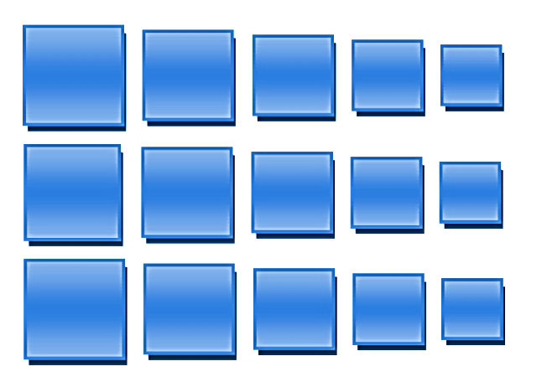
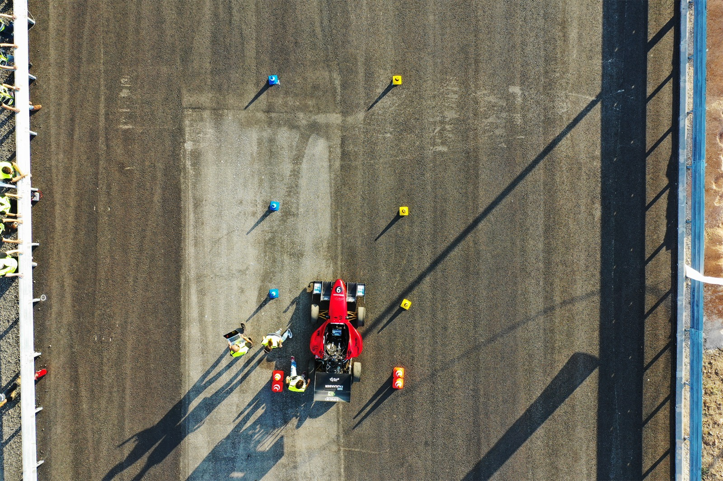
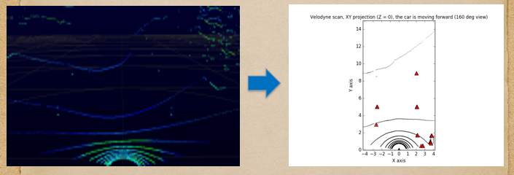
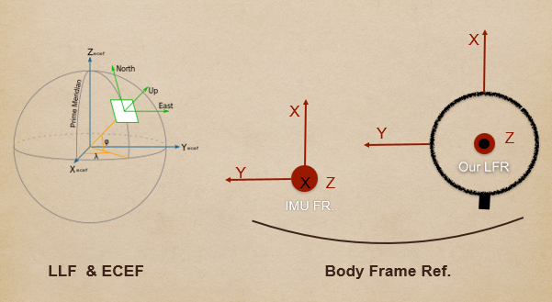
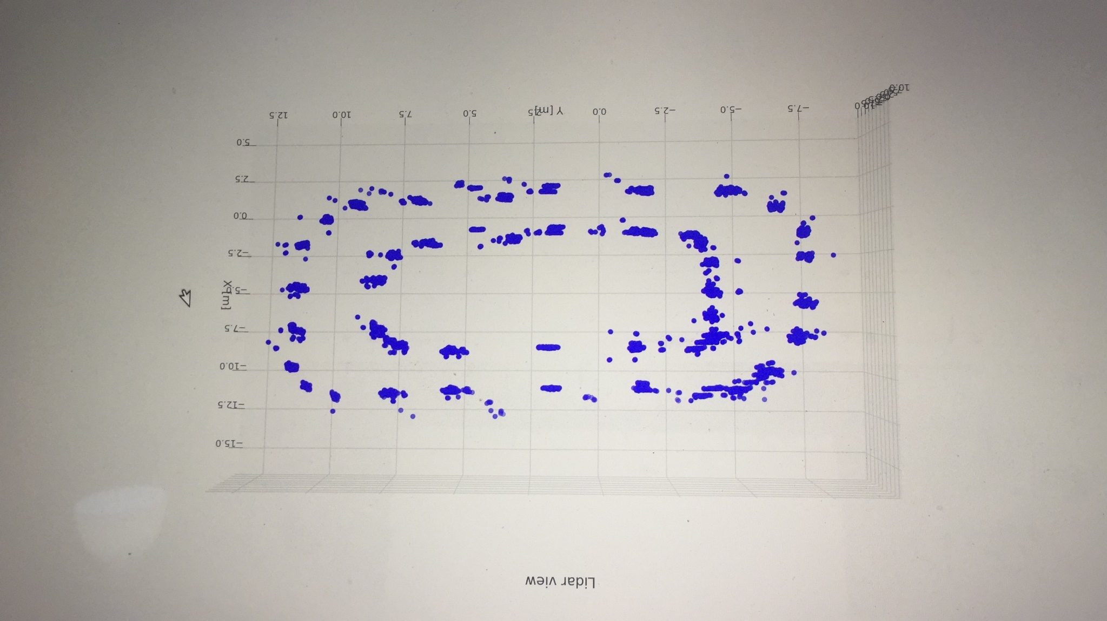
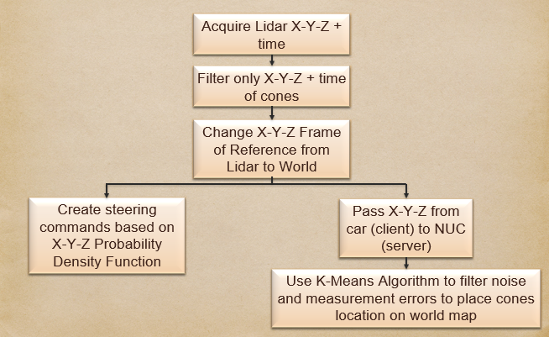
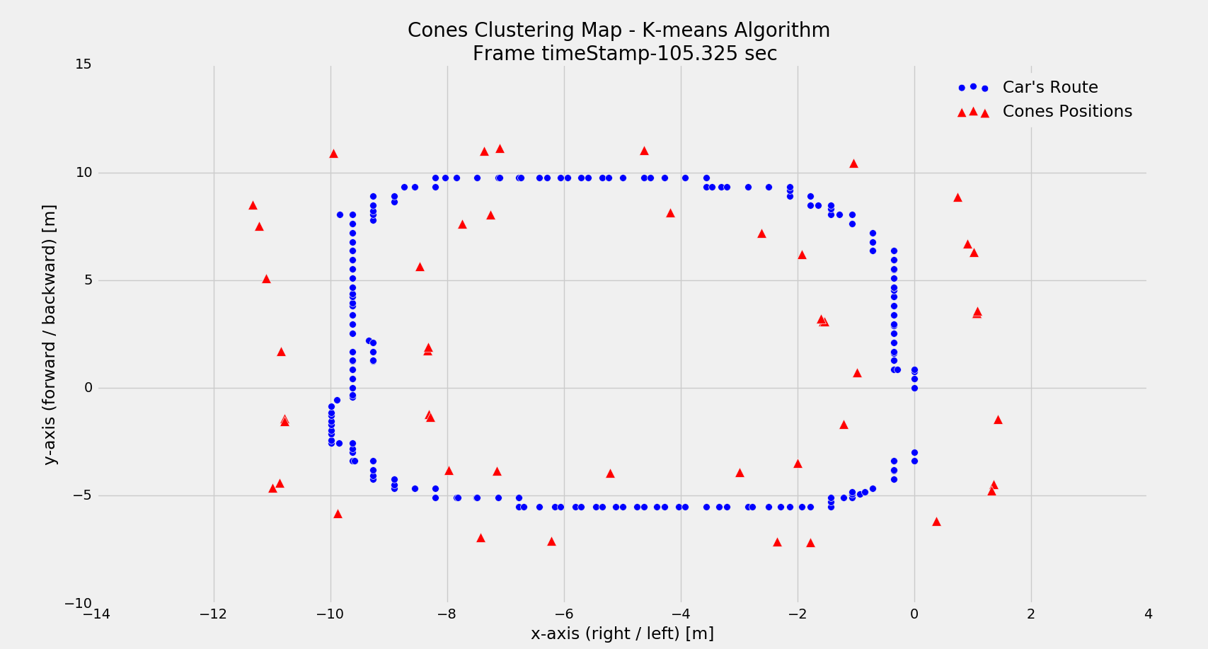
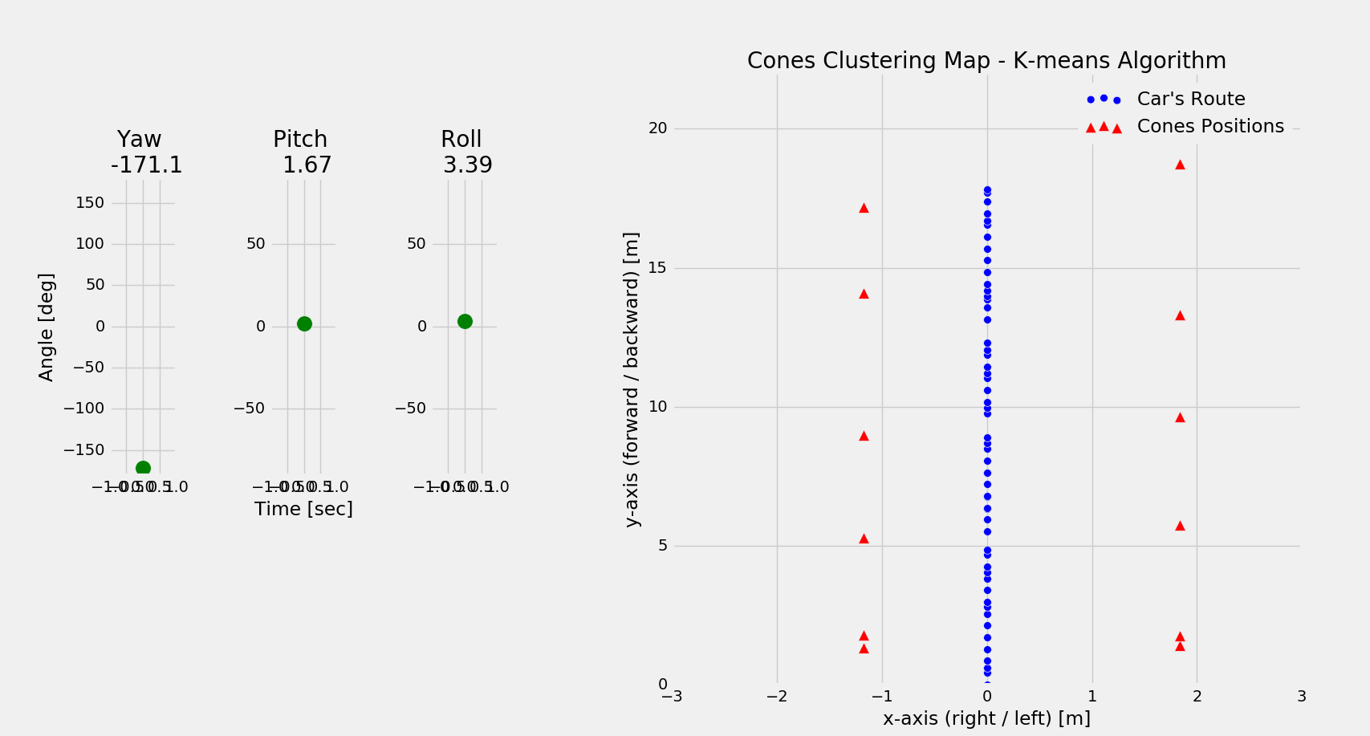
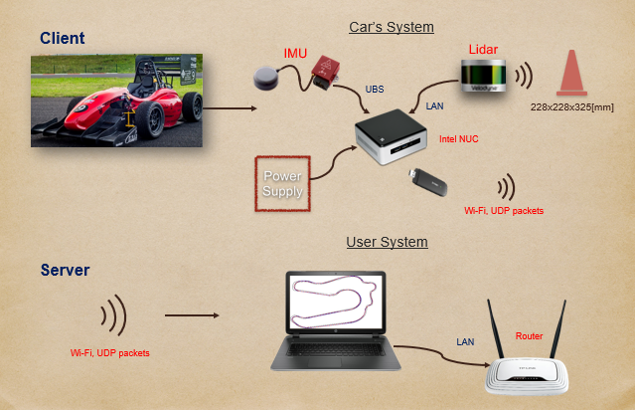
The Andrew & Erna Viterbi Faculty of
Electrical Engineering
Electronics
Computers
Communications
Real-time track detection via LiDAR technology for an autonomous formula car
Aviv Regev & Avinoam Barhom, supervised by: Danny Veikherman
Project main goal
Real time track detection and mapping of an unknown track using LiDAR, IMU and GPS in order to achieve full path planning.
First Stage- Receiving suspect points
Second Stage- IMU/Lidar integration
Solution flow
Third Stage- K-means clustering
Error Measurements
System Structure
Final results
Real time cone detection and mapping solution using LiDAR & IMU integration.
Full operating software with online and offline capabilities.
Server/Client WIFI communication, with 3D plotting in real time.
Notes:
להגיד במילים שהגענו לדיוק גבוה מאוד (סנטימטרים בודדים) בשיערוך המקום

