Slide 1





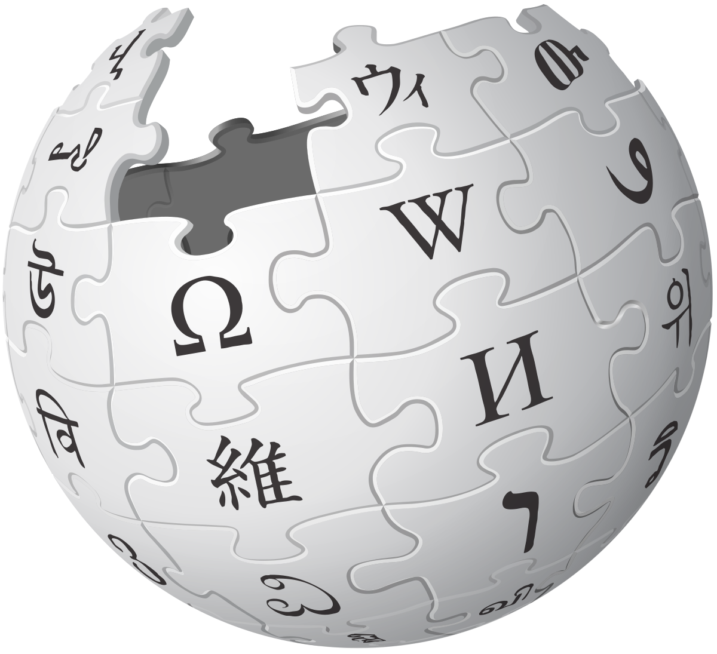

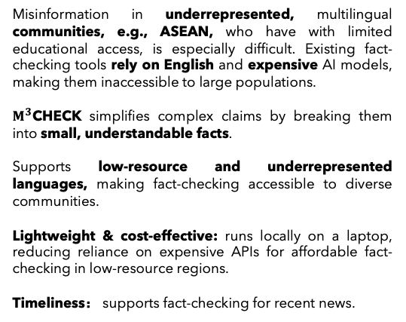
$M^{3}$CHECK
A Demonstration System for Multilingual Multi-clue Multi-Hop Fact-Checking
Barid Xi Ai, Xinyuan Lu, Liangming Pan, Tianyi Zhu, Sahej Agarwal, Mahardika Krisna Ihsani, Min-Yen Kan
Introduction
System Architecture
Multilingual Use Cases
Misinformation in underrepresented, multilingual communities, e.g., ASEAN, who have with limited educational access, is especially difficult. Existing fact-checking tools rely on English and expensive AI models, making them inaccessible to large populations.
$M^{3}$CHECK simplifies complex claims by breaking them into small, understandable facts.
Supports low-resource and underrepresented languages, making fact-checking accessible to diverse communities.
Lightweight & cost-effective: runs locally on a laptop, reducing reliance on expensive APIs for affordable fact-checking in low-resource regions.
Timeliness： supports fact-checking for recent news.
Claim · 断言 · tuntutan · கூற்று.
🤔 Sunlight can reach the bottom of the Black Sea.
👎
I’ve got the following clues:
1️⃣ Sunlight can penetrate up to 200 meters in clear ocean water
2️⃣ The Black Sea is over 2,000 meters deep.
3️⃣ In general, sunlight cannot penetrate water beyond a depth of 1,500 meters (4,921 feet).
👍
🗂️ DECOMPOSER
🐕 RETRIEVER
👍
I am going to verify the above clues one by one:
1️⃣ Sunlight can penetrate up to 200 meters in clear ocean water.
➡️ TRUE 2️⃣ The Black Sea is over 2,000 meters deep. ➡️ TRUE
3️⃣ In general, sunlight cannot penetrate water beyond a depth of 1,500 meters (4,921 feet). ➡️ TRUE
Break down the claim into clues
Retrieve relevant articles
👍
💡 FACT-CHECKER
👍
Verify each clue based on articles
Your claim is False ❌. The bottom lies far beyond the depth where sunlight can penetrate (>2000 meters).
Key Design
🤔太阳光线可以到达黑海底部
Multi-clue Generation: break down complex claims into simpler clues to improve interpretability and fact-checking accuracy.
Evidence-based Checking: verify each clue to facilitate verification from trusted documents, supporting evidence-based verification.
Multi-Hop Reasoning: zip verified clues into a structured and supervised chain of clues for inference with multi-hop deductive reasoning.
✅ FACT REASONER
I’ve generated the following clue:
1️⃣ 阳光可以穿透水的深度大约为200米。
2️⃣ 黑海的最大深度超过2,000 米。
3️⃣ 一般来说，阳光无法穿透深度超过 1,500 米的水。
Conclude, check, and reason claims based on structured, supervised, and verified chain of clues
I am going to verify above clues one by one
1️⃣阳光可以穿透水的深度大约为200米。➡️ TRUE
2️⃣黑海的最大深度超过2,000米。➡️ TRUE
3️⃣一般来说，阳光无法穿透深度超过 1,500 米的水。 ➡️ TRUE
Label
Conclusion
✔️ ❌ ❓
📝
Your claim is False ❌. 海底的深度远远超出了阳光可以穿透的深度（>2000米）。

Slide 2
Major Update
Remove Questioner.
Not very robust.
It does not make sense right now.
Change the fact verification to NLI or entailment verification task.
Question: given the following premises, is the hypothesis correct?
Premises: structured, supervised, and verified chain of clues
Hypothesis: claim
Zip all verified clues into a structured, supervised, and verified chain of clues (in contrast to unsupervised COT)
More robust and consistent to the negative.
Easy to fine-tune.

