Slide 1




Fuse: A Reproducible, Extendable, Internet-scale Corpus of Spreadsheets
go.ncsu.edu/fuse
@barik
Titus Barik, Kevin Lubick, Justin Smith, John Slankas, Emerson Murphy-Hill
Notes:
Hi, my name is Titus. Today I’m going to tell you about a dataset called Fuse, which is a reproducible, extendable, internet-scale corpus of spreadsheets.

Slide 2
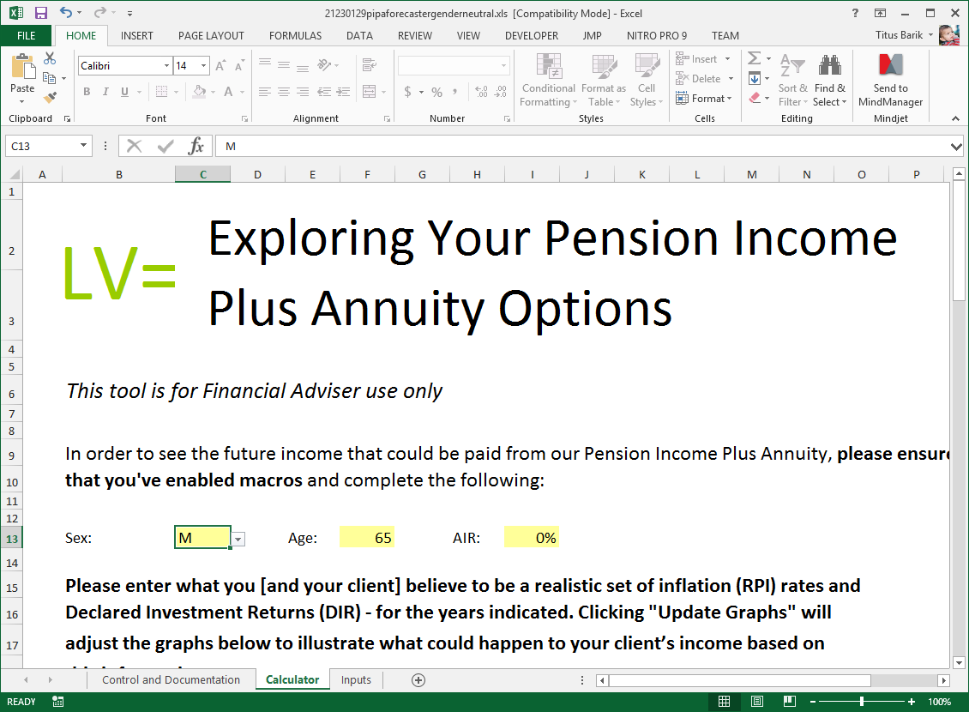
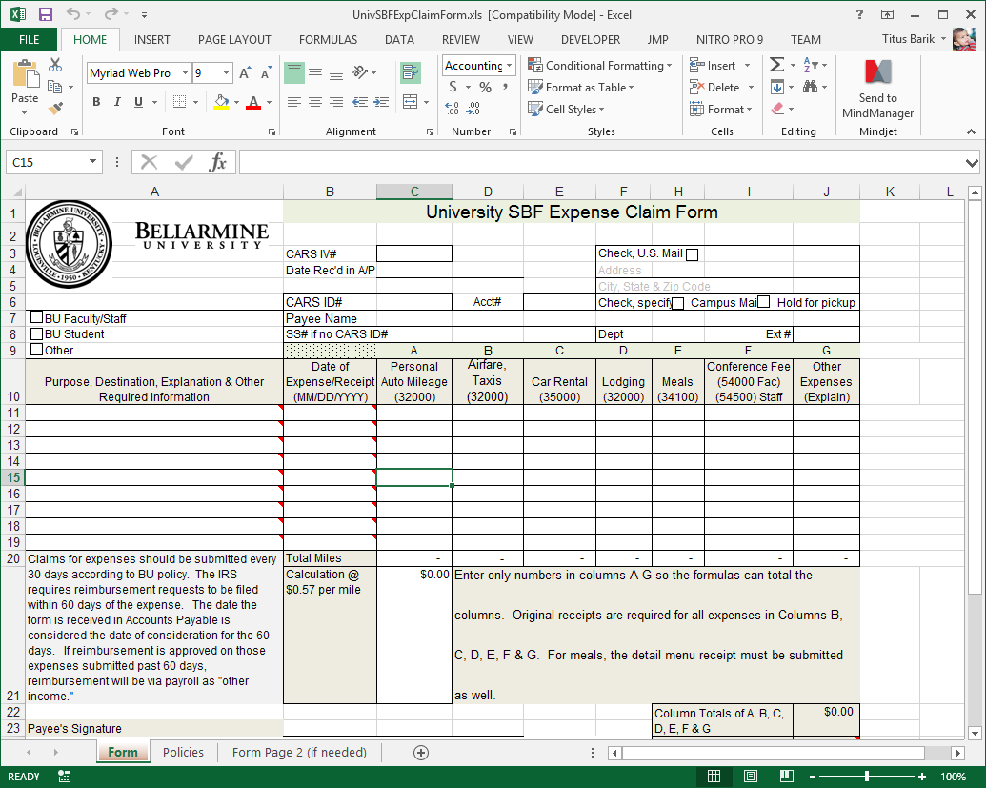
Why Spreadsheets?
a681834d-a309-43eb-b2a2-56f81b61a495
Spreadsheets are perhaps the most ubiquitous form of end-user programming software.
01a66242-e3f3-4471-a32c-b8bf49aa369a
db.spreadsheets.find( { "LingPipe.Tokens":
{$all : ["travel", "request", "university",
"reimbursement"]} } )
Notes:
Spreadsheets are most well known and most used form of end user programming software
Where end user programmers typically don’t have formal programming experience, but still have a need to perform programming activities
Example: financial planner. Example: administrator. travel reimbursement form.
Researchers are interested in the types of software that these end-users create and how they go about doing so

Slide 3
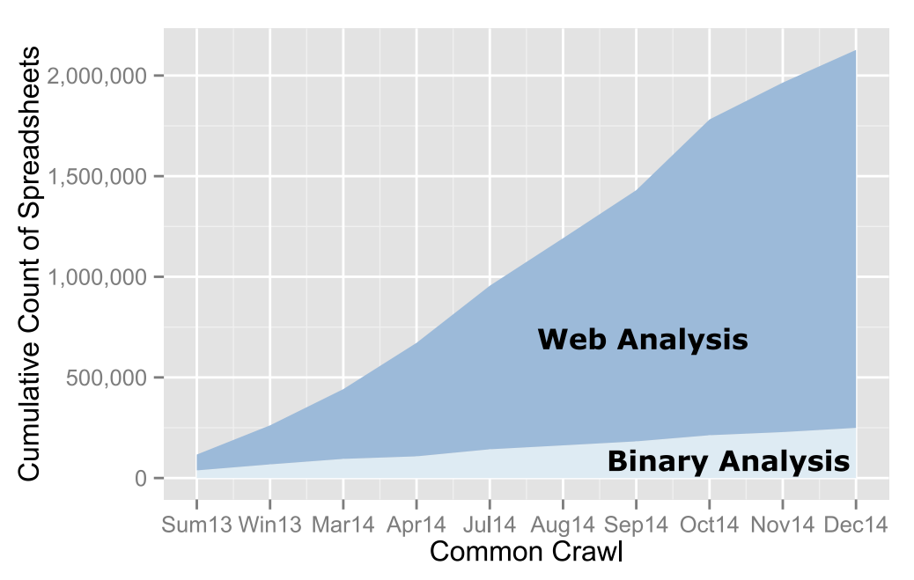
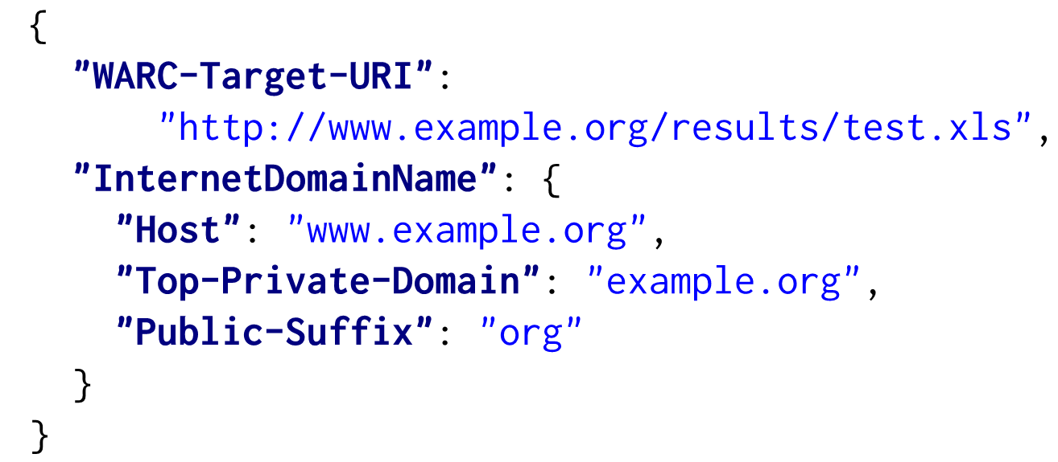
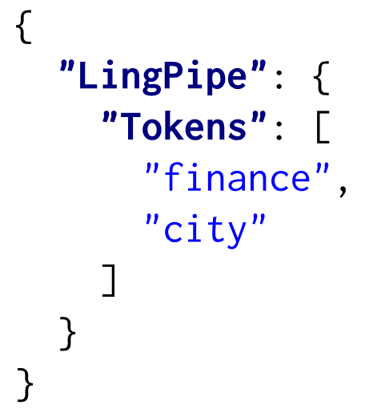
Description of Fuse
Extracted from Common Crawl archive of 26 billion web pages.
Over 2 million URLs that return spreadsheets.
Over 249 thousand unique spreadsheets.
JSON metadata for each spreadsheet.
Notes:
Mention that this is also much larger than existing corpus – 4500.
Apache POI metrics: types of functions, whether the spreadsheet has charts, or worksheets – over 450 such metrics

Slide 4


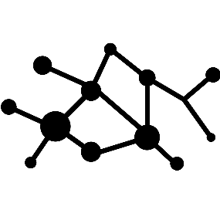
Fuse Benefits
Reproducible.
Independently obtain identical corpus.
Extendable.
Common Crawl archives released monthly.
Internet-scale.
Contains spreadsheets from diverse domains.

Slide 5
Thanks!
Fuse is unencumbered by any license agreements, available to all, and intended for wide usage by researchers.
go.ncsu.edu/fuse
@barik

