Slide 1



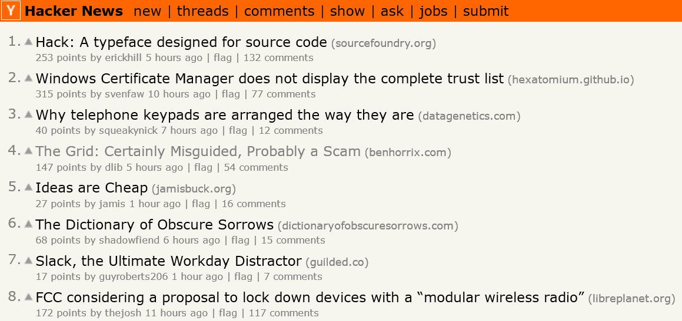
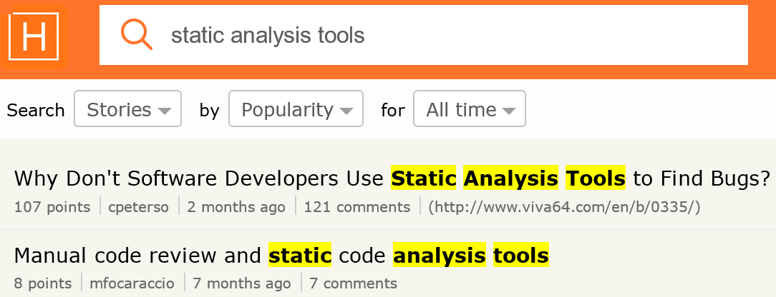
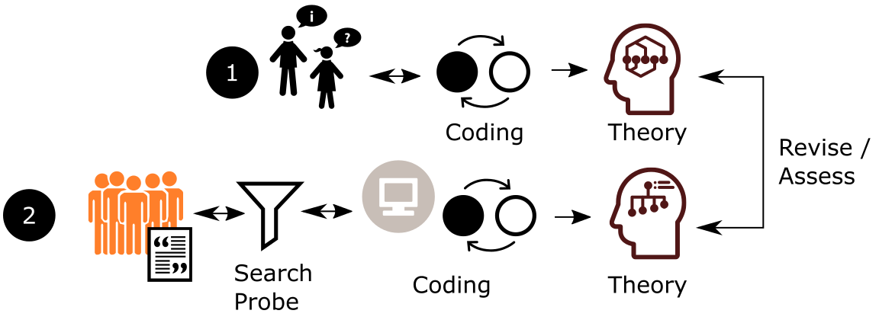




I ♥ Hacker News
Expanding Qualitative Research Findings by Analyzing Social News Websites
Titus Barik, Brittany Johnson, Emerson Murphy-Hill
ABB Corporate Research and North Carolina State University
tbarik@ncsu.edu
@barik
Introduction
Hacker News
The qualitative research method of grounded theory is time consuming and complex. Our approach makes this method more efficient by using social news websites as a triangulation source of knowledge.
Potential to capture a broad range of software engineering experiences.
Method
Case Study: Static Analysis Tools (Johnson and colleagues, 2013)
Expanded Challenges
Tool Output*
Collaboration*
Customization*
Awareness
Cost
Ego
Management
Maintenance
Performance
Security
* Identified in original study.
[Tool Output] “I hated every attempt at static analysis until I started programming with Xcode. In my usage, Build and Analyze is always right — that's the difference. Other tools (lint, FXCop) are too noisy.” (HN 4849800)
[Collaboration] “Where a static analysis tool can help is … it's a way to enforce … practices without requiring one of your senior developers to be able and willing to read over your junior devs' code.” (HN 305395)
Proposal: Filtering and topic analysis of user comments are automatically or semi-automatically performed, using techniques from knowledge discovery and databases (KDD).
Contribution: New tools, incorporating social news websites, for qualitative researchers.
[Cost] “Pretty much SonarQube is the only tool I have found and it's somewhat annoying as a few plugins are commercial and very expensive.” (HN 8568574)
[Ego] “Unfortunately, the decision to use static analysis tools would have to come from developers who are comfortable admitting they make mistakes sometimes.” (HN 7283205)

