Slide 1
Machine Learning
House Price Prediction

Slide 2
Outline
EDA
Sale Price Analysis(descriptive Summary)
Numerical Feature
Catagorical Feature
Data Engineering
Feature Engineering
Feature Selection
Pre-Processing Data Import/Cleaning and Imputation

Slide 3
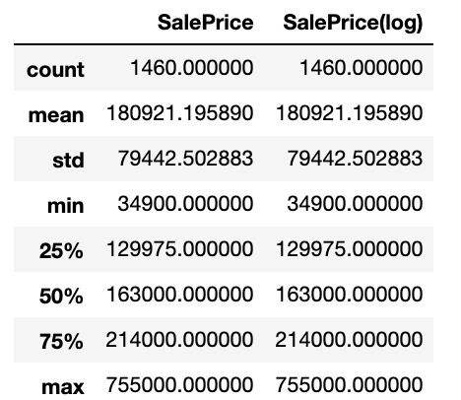
Sale Price Analysis Descriptive Summary
.

Slide 4
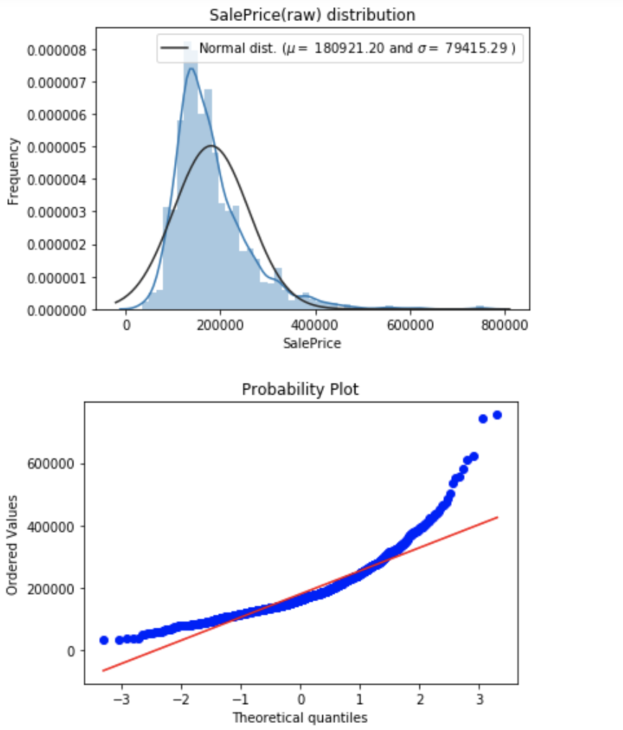
Histogram and Distribution
.

Slide 5
Histogram and Distribution
With this information we can see that the prices are skewed right and some outliers lies above ~500,000. We will eventually want to get rid of the them to get a normal distribution of the independent variable (SalePrice) for machine learning

Slide 6
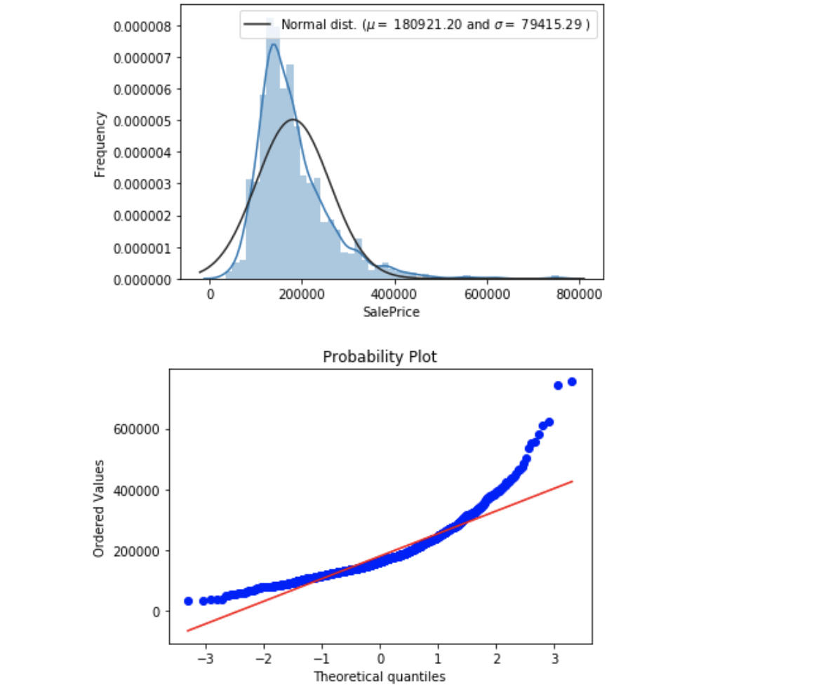
Log normal SalePrice Distribution
.

Slide 7
Numerical Data Exploration
Numerical data
is information that is measurable,
data represented as numbers and not words or text.

Slide 8
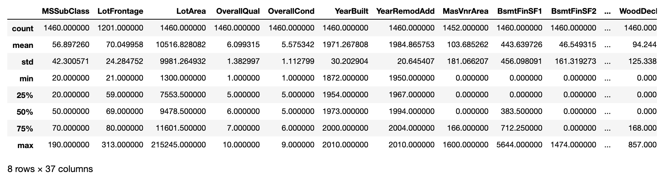
Numerical Data Exploration
.

Slide 9
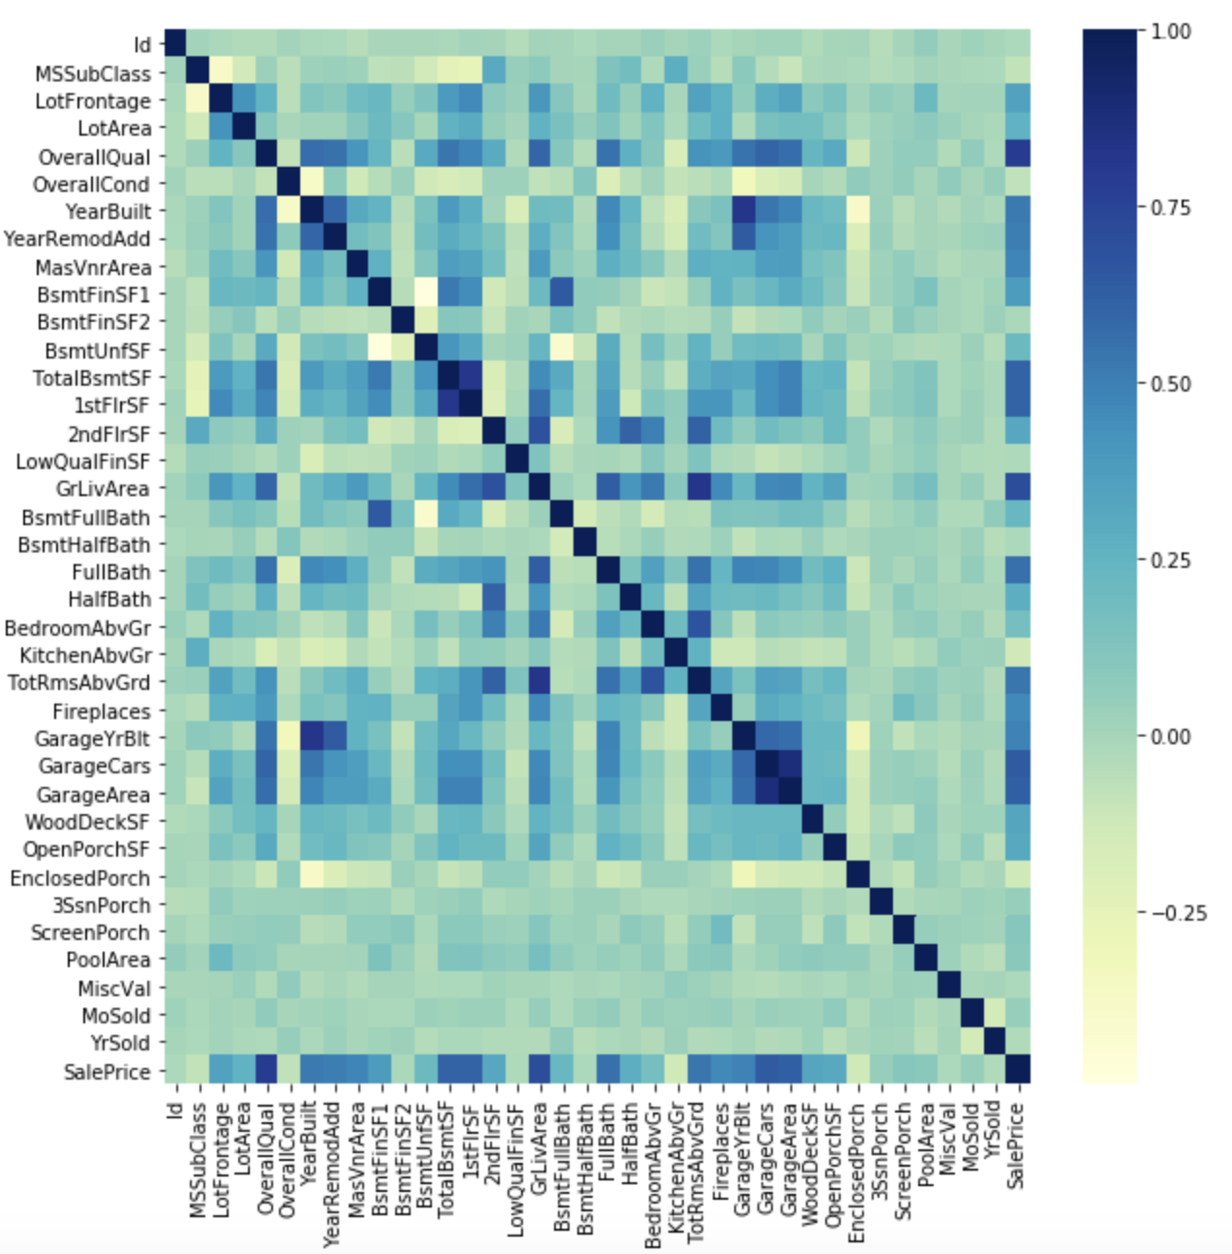
Numeric Correlation Matrix
.

Slide 10
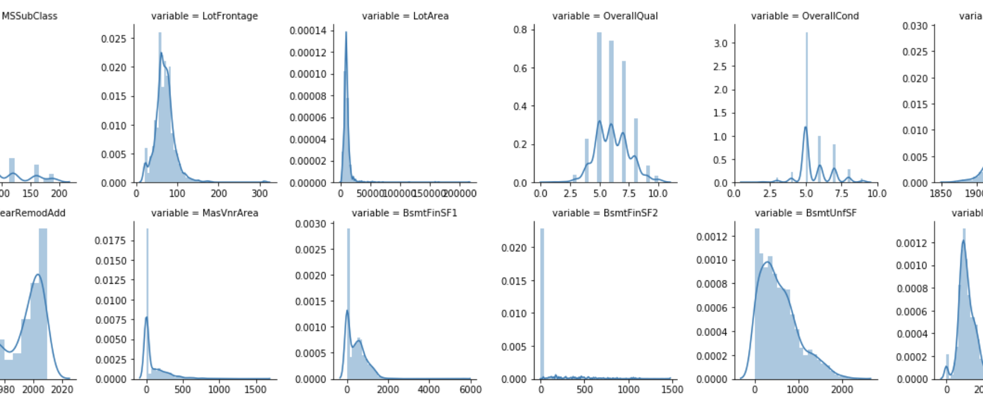
Numerical Data Explore
.

Slide 11
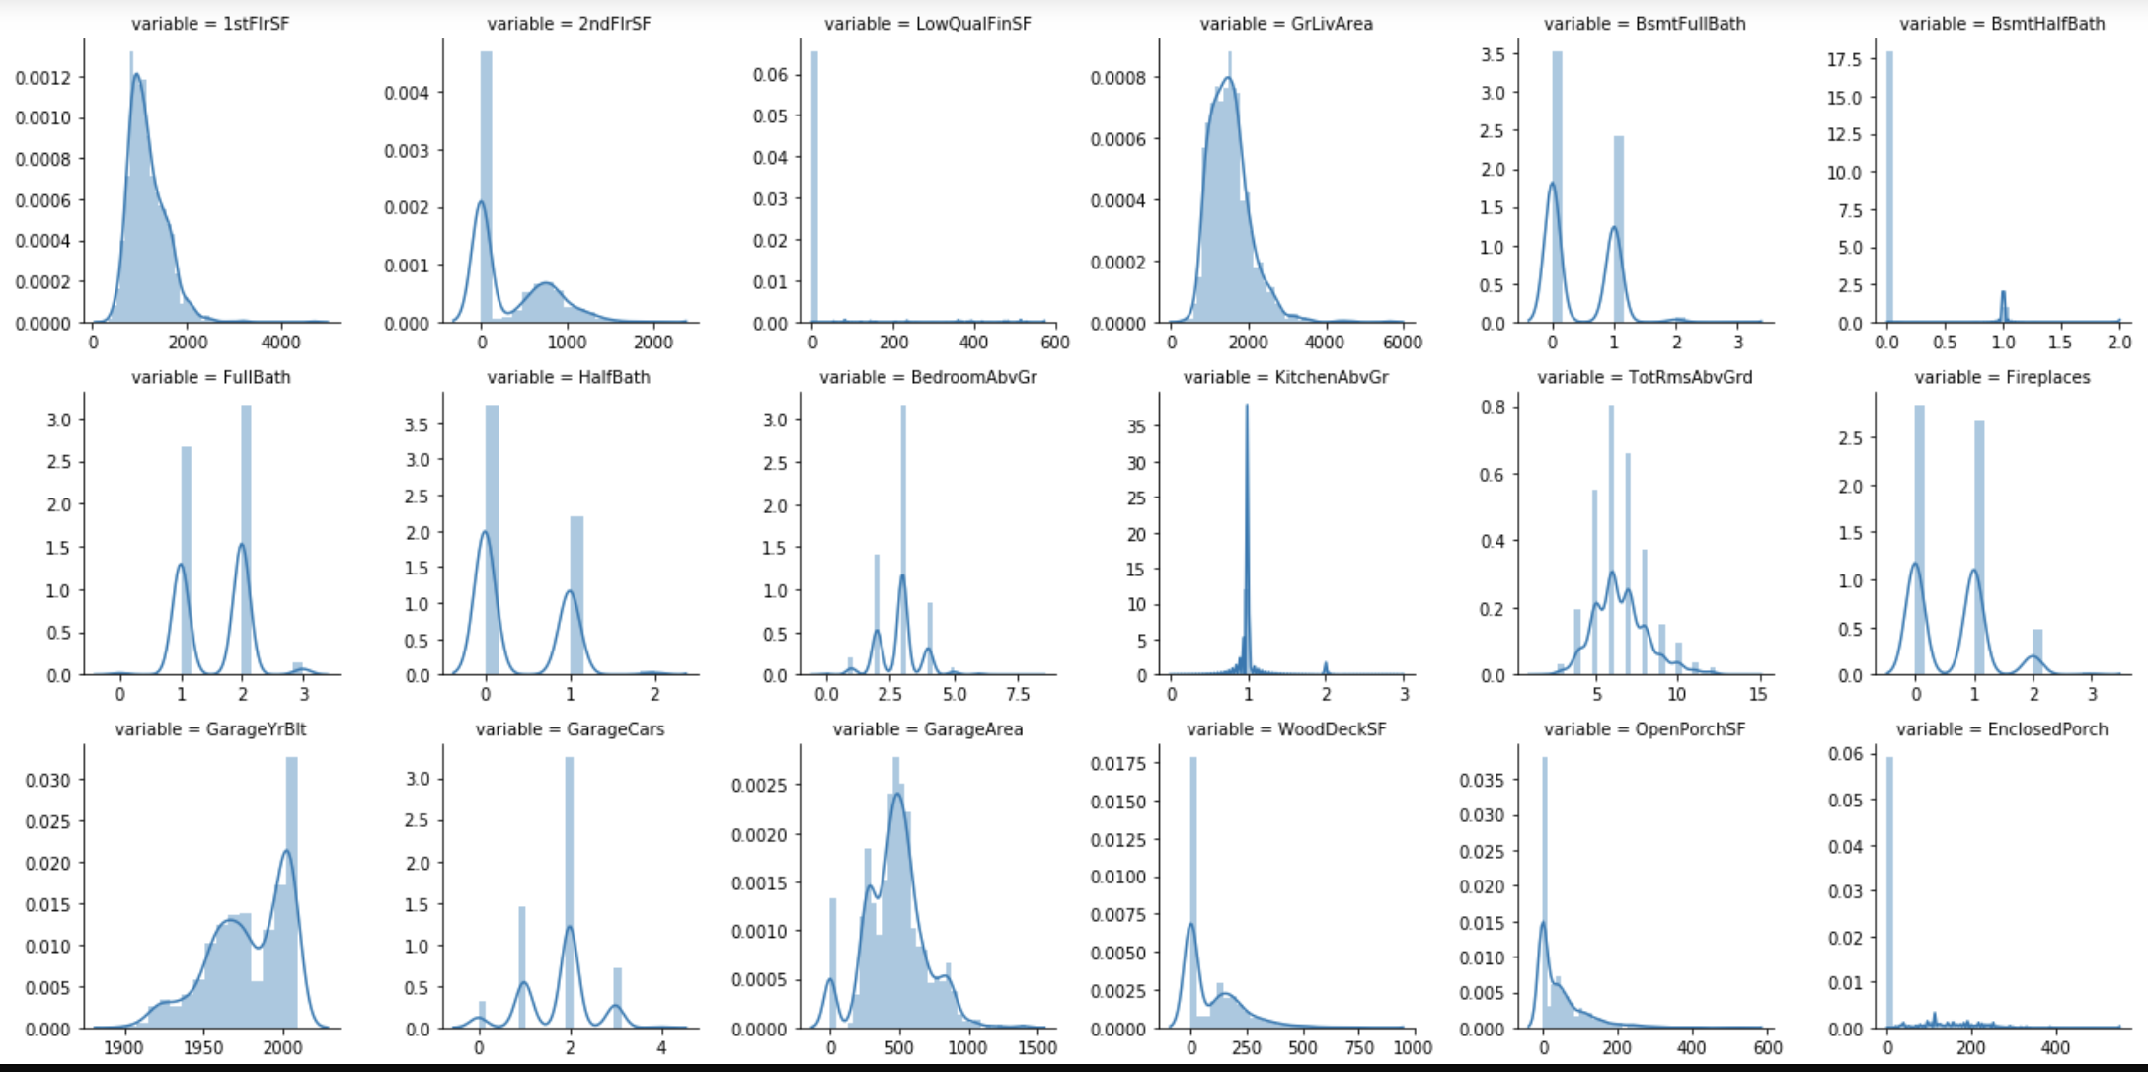
Numerical Data Explore Conti..
.

Slide 12
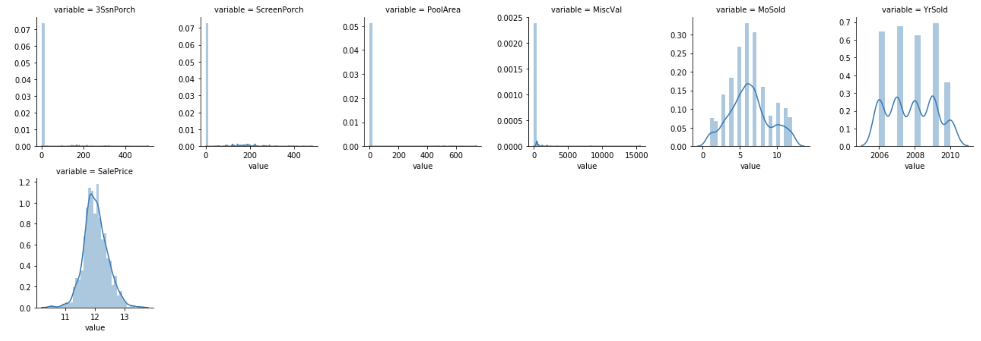
Numerical Data Explore Conti..
.

Slide 13
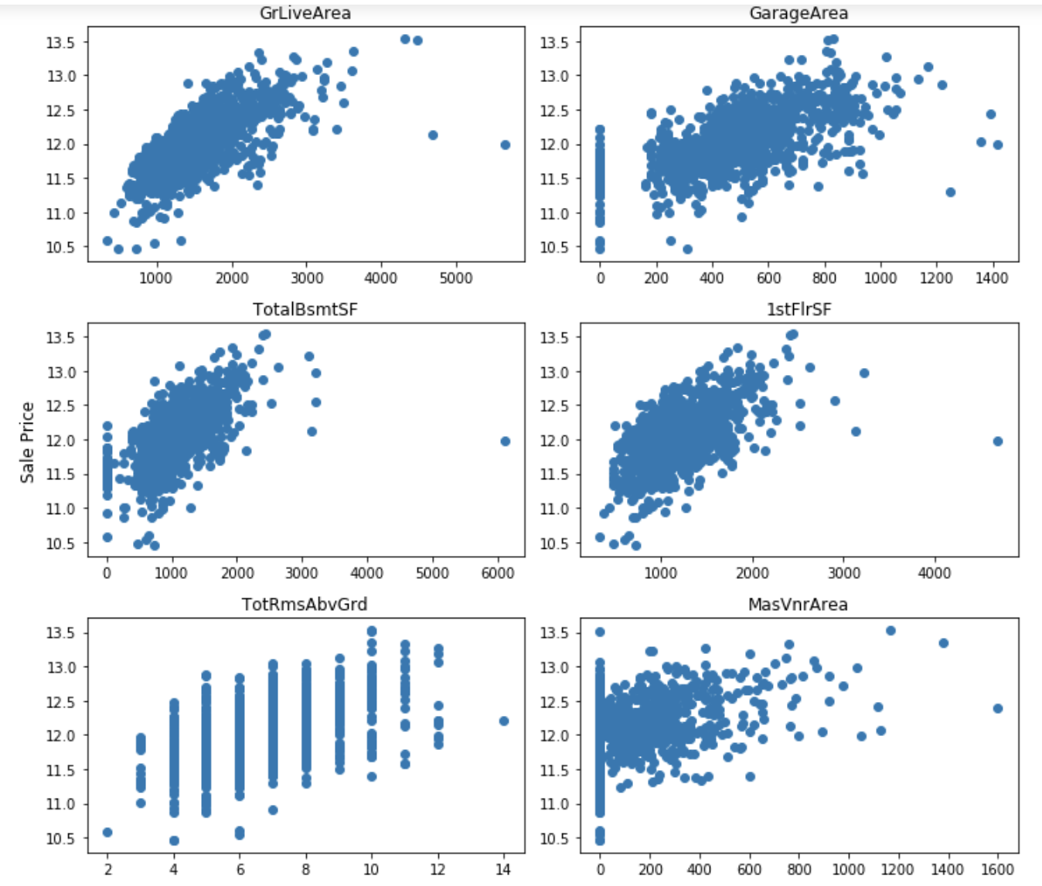
Numerical Data on Sale Price
.

Slide 14
Categorical Data Exploration
categorical data:
any data that isn’t a number, which can mean a string of text or date.
These variables can be broken down into nominal and ordinal values, though you won’t often see this done..

Slide 15
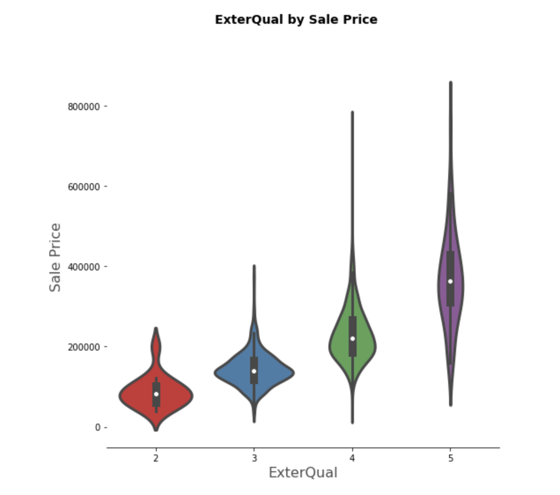
Categorical Data Exploration continue..
.

Slide 16
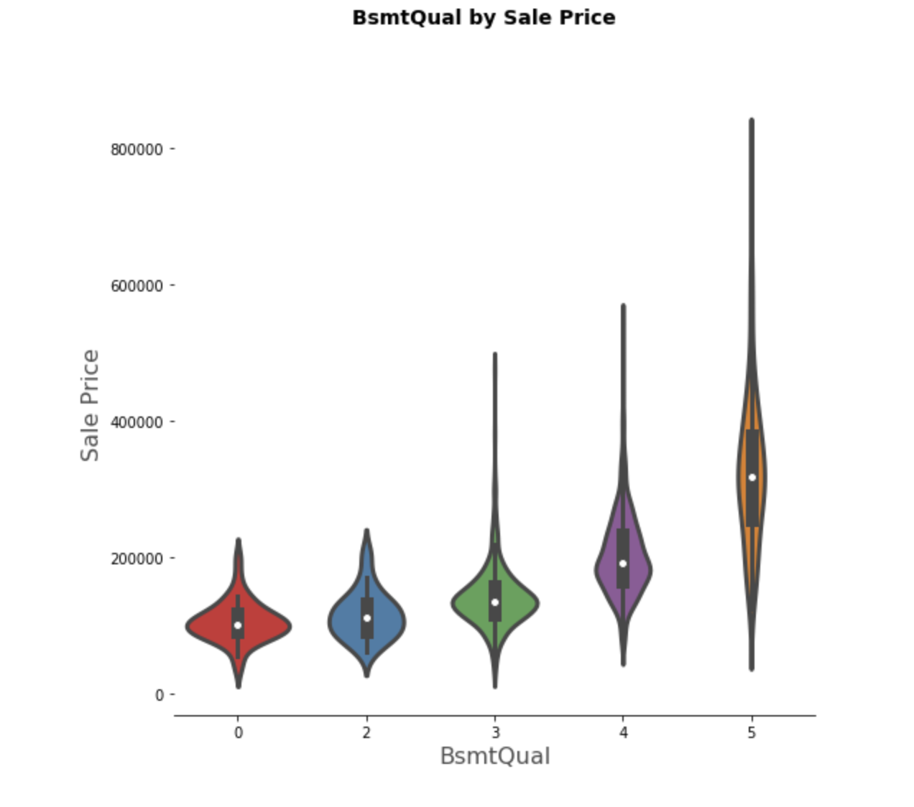
Categorical Data Exploration continue..
.

Slide 17
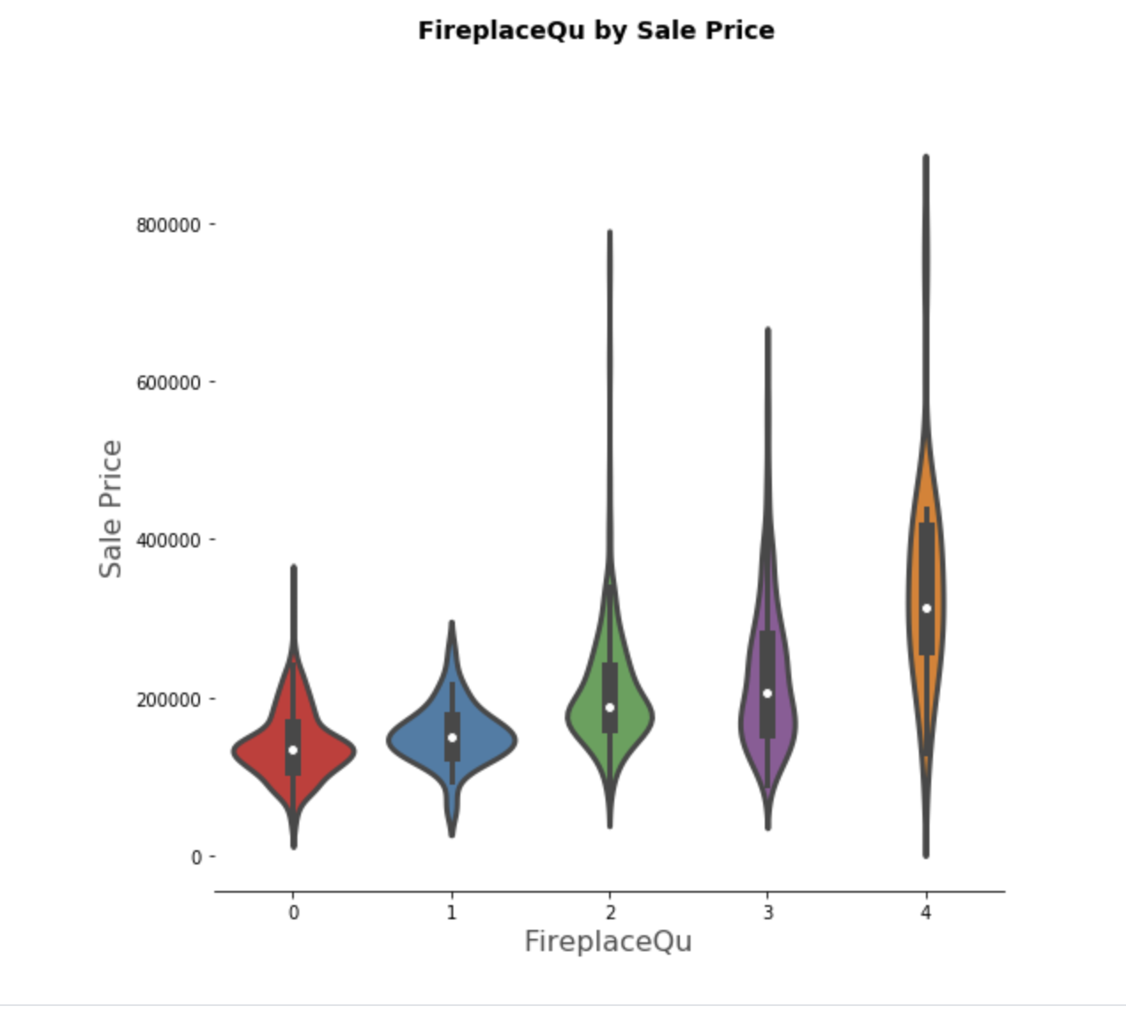
Categorical Data Continue...
.

Slide 18
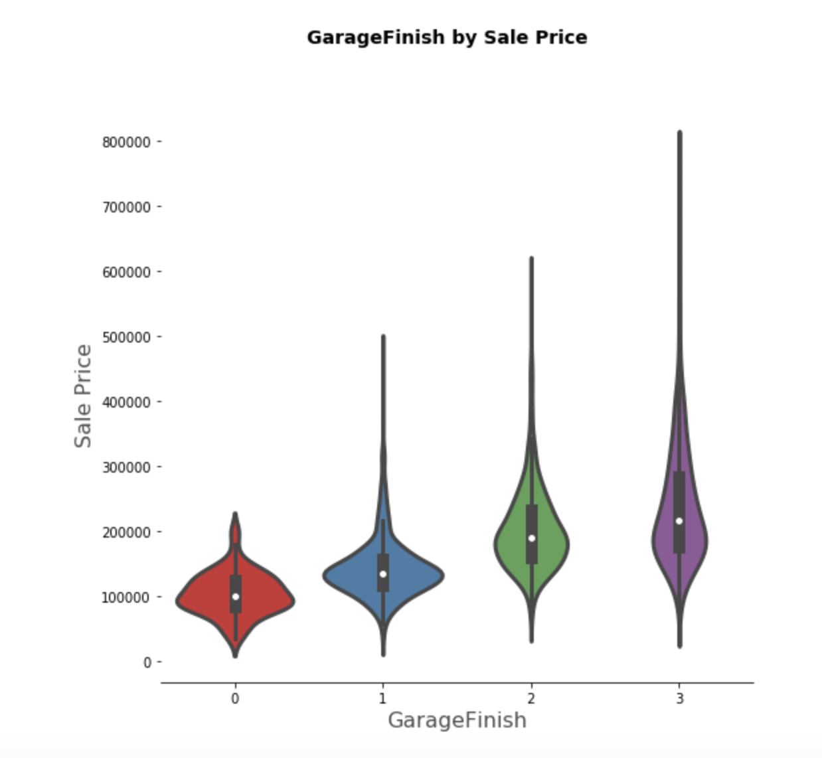
Categorical Data
.

Slide 19
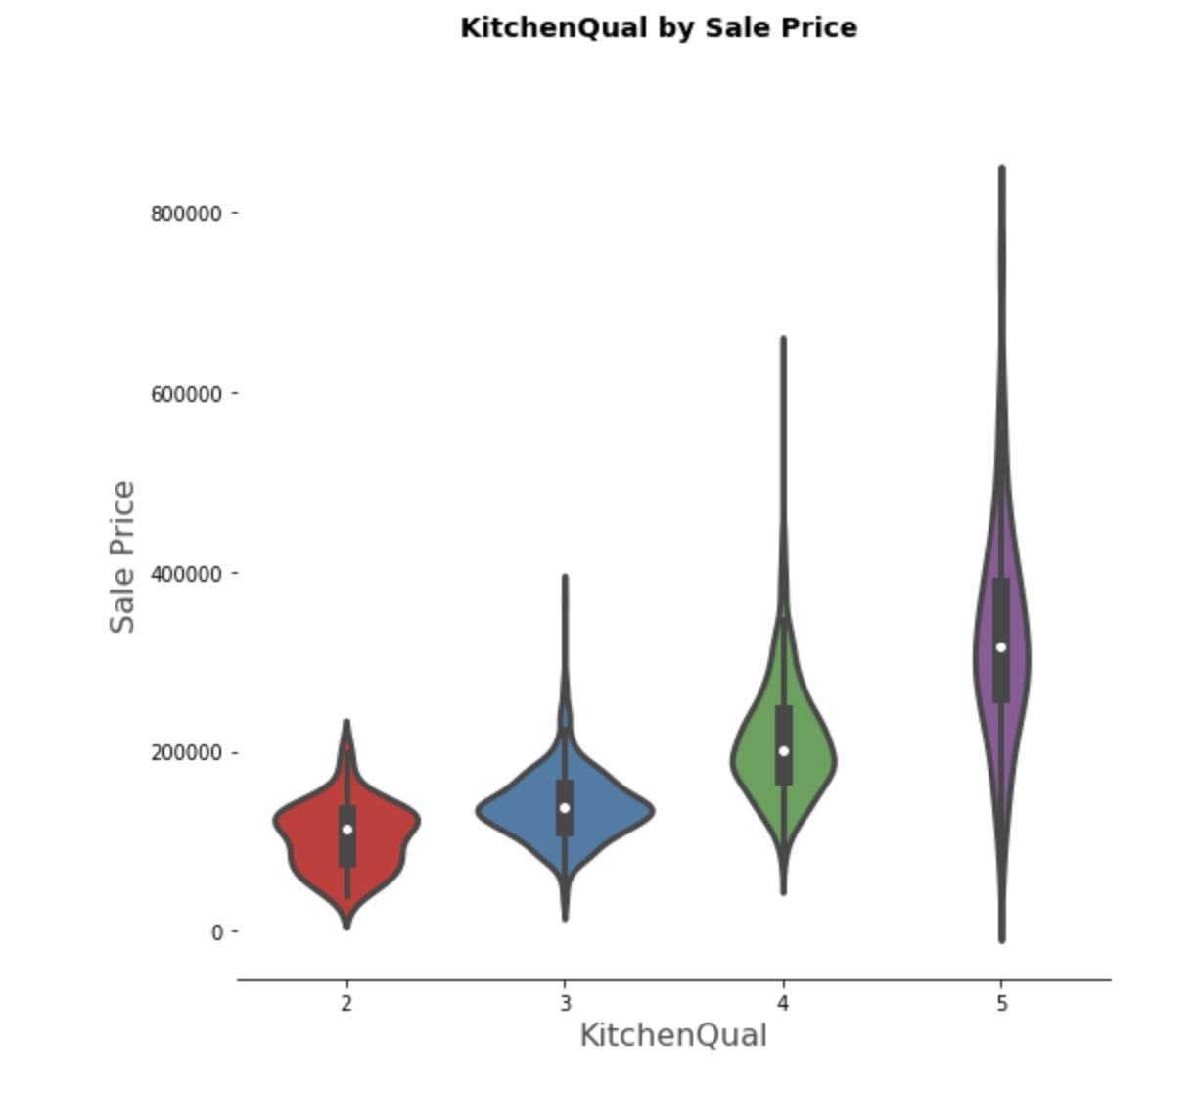
Categorical Data
.

Slide 20
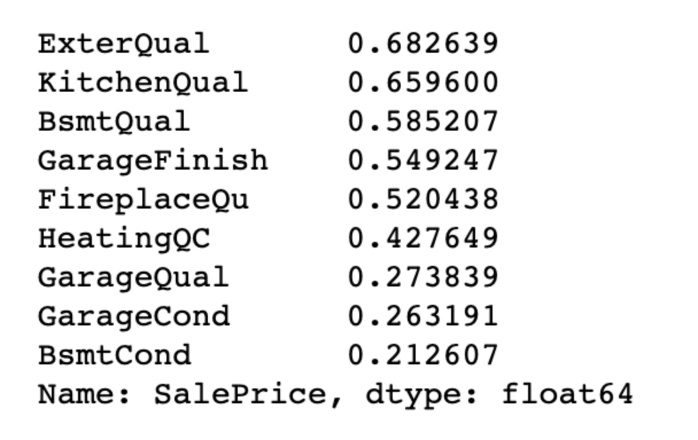
Categorical Data -Correlation
.

Slide 21
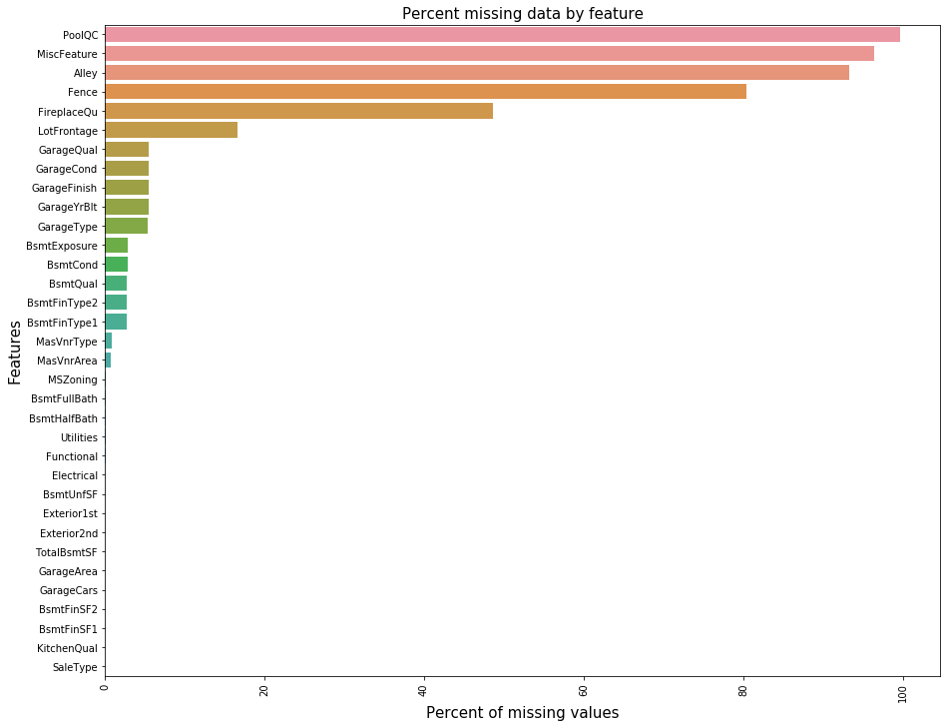
ANALYZE MISSING VALUE
PoolQC | 99.657417
MiscFeature | 96.402878
Alley | 93.216855
Fence | 80.438506
FireplaceQu | 48.646797
LotFrontage | 16.649538
GarageQual | 5.447071
GarageCond | 5.447071
GarageFinish | 5.447071
GarageYrBlt | 5.447071
GarageType | 5.378554
BsmtExposure | 2.809181
BsmtCond | 2.809181
BsmtQual | 2.774923
BsmtFinType2 | 2.740665
BsmtFinType1 | 2.706406

Slide 22

ARE DATA REALY MISSING?
PoolQC
MiscFeature
Alley
Fence
FireplaceQu
GarageQual
GarageCond
GarageFinish
GarageType
NA = Not exist, Refers to “data_description.txt”

Slide 23

IMPUTATION METHODS
Median Imputation For ‘LotFrontage’ due to outlier
Mode Imputation For Categorical Variables
Zero Imputation Logical reasoning

Slide 24
Model Analysis
Prediction Models
Linear Regression
Gradient Boosting
Random Forests

Slide 25
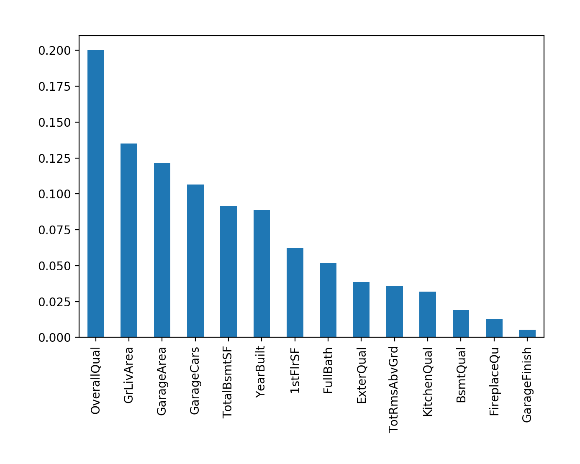
Feature Importance After Modeling

Slide 26
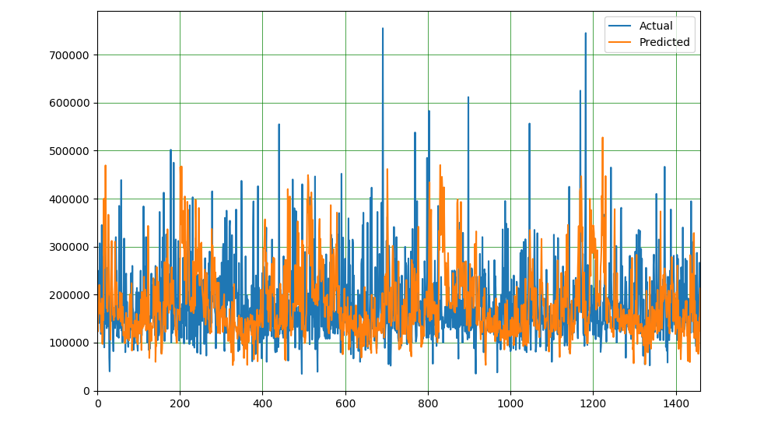
Plotting Training Data Prediction

Slide 27
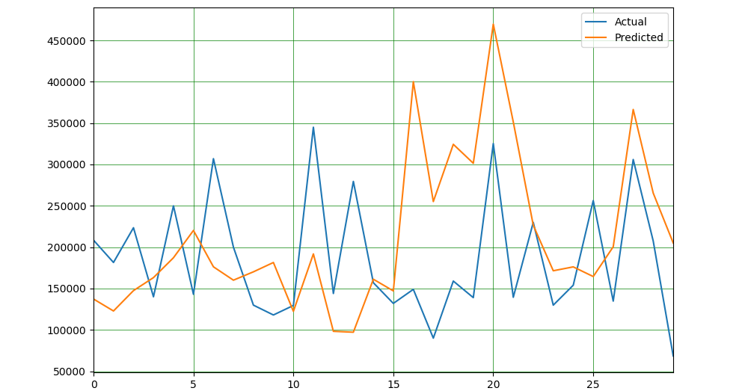
Line Graph Showing Training Data Prediction (Head)

Slide 28
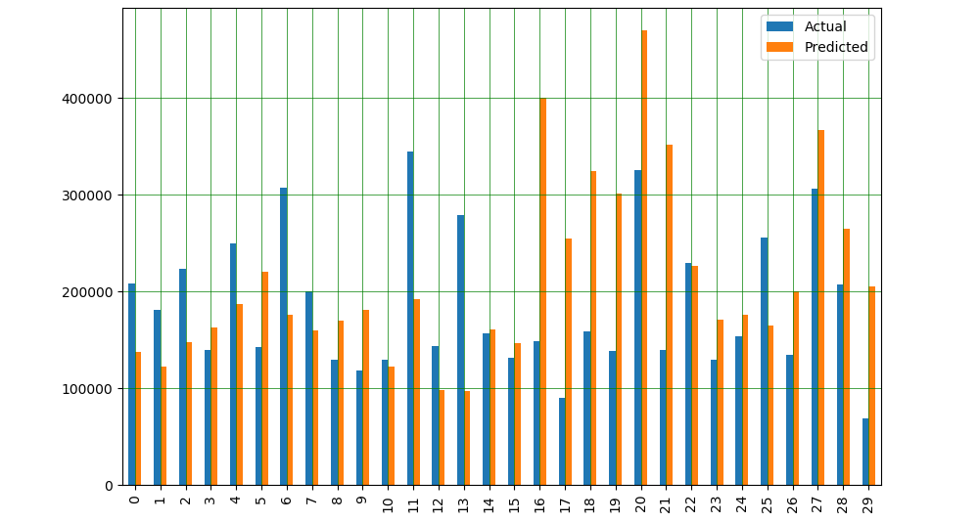
Bar Graph Showing Training Data Prediction (Head)

Slide 29
Models Tested
model | Train Score(R2)
Linear Regression | 0.802041
Lasso | 0.802041
Random Forest | 0.976609
Gradient Boostrap | 0.935683

Slide 30
Selected Model Metrics
Random Forest Was Selected For Prediction Among All the Reviewed Models
Mean Absolute Error | 72766.25441891294
Mean Squared Error | 9890321936.463663
Mean Squared Error | 99450.09771972908

Slide 31
That’s All For Now, Thank You.

