Slide 1


cesium.agi.com
Patrick Cozzi
@pjcozzi
Notes:
I’m Patrick. I’m a developer at Analytical Graphics, Inc. We’re using WebGL to develop an open-source virtual globe and map named Cesium. I’m going to show a few demos today.

Slide 2






Cesium
A WebGL virtual globe and map engine
Open source - Apache 2.0 license

Slide 3
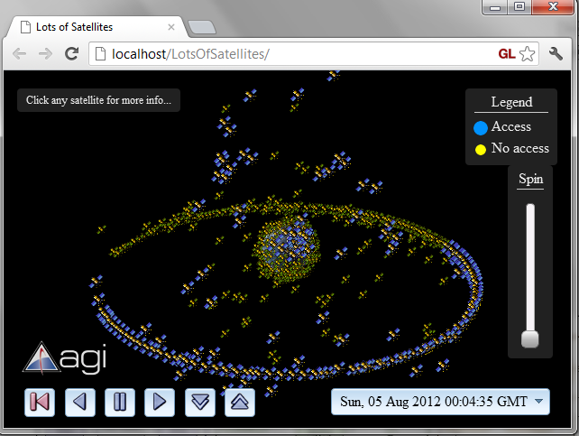
Streaming Analysis
Demo
Notes:
All the active unclassified satellites in our database, ~900 satellites and 70 sensors. The blue ones have line-of-sight to the ground station.
SGP4 propagate server-side and Lagrange interpolate client-side to reduce overall traffic.
Buffer and prefetch like streaming video. We send CZML over the wire – A JSON schema for dynamic streams, think dynamic KML.
WebGL
Billboards are batched together and rendered in a single draw call. Expanded in vertex shader.
Sensor intersection with the Earth is done in a fragment shader.
Picking with the color buffer.

Slide 4
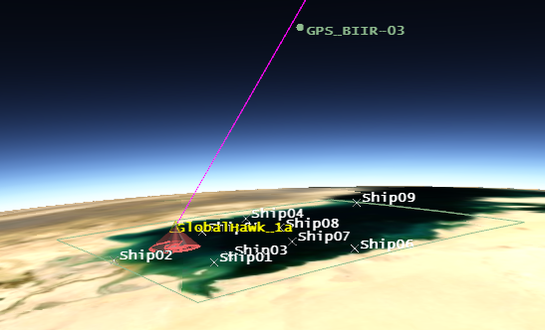
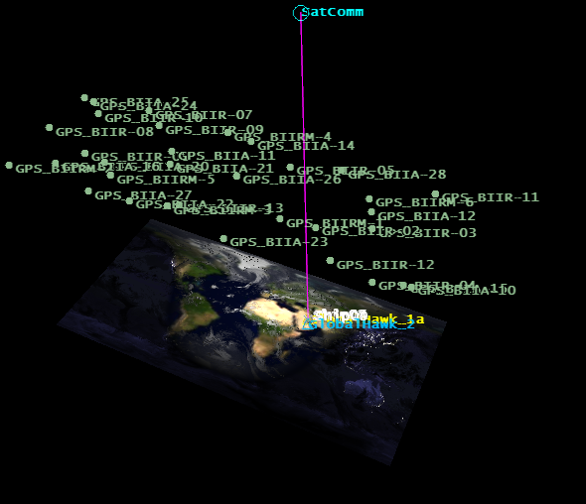
3D, 2D, Columbus View
Demo
Notes:
A reconnaissance UAV mission over the Persian Gulf. GlobalHawk_2 is changing color based on its GPS signal quality. "GlobalHawk 1a" is maintaining a down link from the satellite (which is relaying video and comms to a unseen ground facility in the US).
Cesium is one API that allows both 3D, 2D, and Columbus view (2.5D). Under the hood, this is simple morphing in the vertex shader. This is not render-to-texture; we actually animate during the morph.
WebGL is great for 3D and 2D.

Slide 5
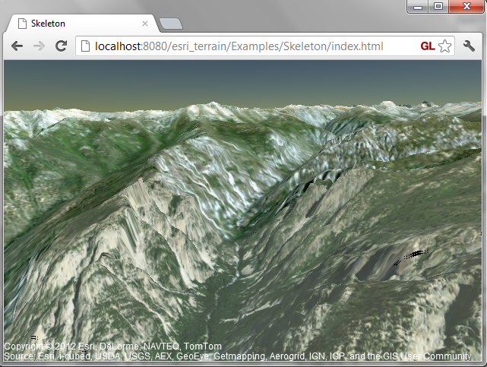
Terrain and Imagery
Video
Notes:
I’ll be streaming lots of data over the wireless connection, so if anything crashes, I assure you it is part of the show.
Here is our terrain engine in progress. We are rendering terrain and imagery from Esri servers.
The terrain is 90m for world, and up to 3.1m in the US. Imagery for our initial view is 1m.
Height fields are streamed as images. In a web worker, we reproject from web-mercator to WGS84, and compute a mesh with positions and texture coordinates.
We use hierarchical level of detail (HLOD), view frustum culling, and occlusion culling to select tiles to render.
Here, we render the terrain with 42 draw calls, each just under 32K triangles, and reusing the same index buffer for a total of over 1.3 million triangles at 25-30 FPS on my GeForce 260M, which is like a desktop GeForce 9. This view is reading from 336 256x256 textures, which I think is way too many, but we haven’t started tuning this yet.
There are two imagery layers: one base layer and a road layer that is alpha blended.

Slide 6
WebGL Wish List
Excellent mobile support
Fast shader compiler or shader binaries
Shared context in web workers
Fast JavaScript property getter/setters
WebGL tee-shirts
Notes:
56% of the time of our unit tests are spent in compiling/linking shaders. We use to spend the bulk of our time in context creation, but we fixed that. ☺
Let’s throw in GLSL debugger and Direct State Access (DSA).
To become a first-class API, we need first-class tools.

Slide 7
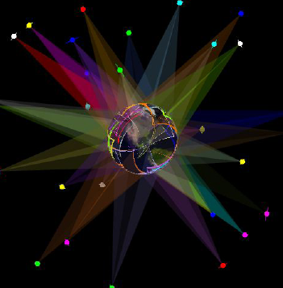
Check us Out
Demos
cesium.agi.com
Code
github.com/AnalyticalGraphicsInc/cesium
Contributors
Matt Amato @matt_amato
Dan Bagnell
Kristian Calhoun @KristianCalhoun
Patrick Cozzi @pjcozzi
Tom Fili
Matt Ford
Scott Hunter
Ian Lilley
Ed Mackey @emackey
Kevin Ring
Frank Stoner
Notes:
Apache 2.0 License – Free for commercial and non-commercial use.
Very active on github and mailing list. Contributions welcome.

