Slide 1
Final Project Presentation
by Baris Top
Notes:
test

Slide 2
Contents
Overview of the App
Architecture Diagram
Tech Stack
Infrastructure Provisioning
How to deploy dev & prod
CI/CD Pipeline & DevSecOps
Resilience & Disaster Recovery

Slide 3
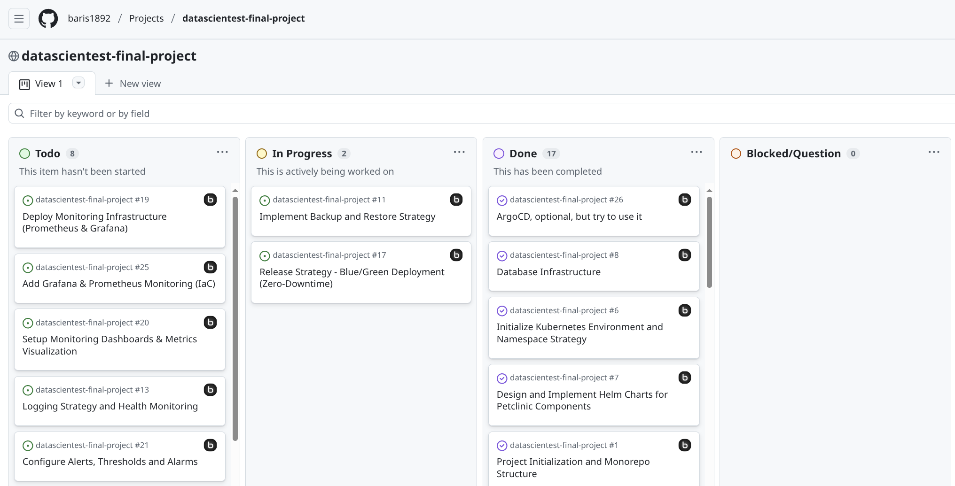
1. Overview of the App
Foundation: Utilizing the Spring Petclinic as a baseline.
Core Components: Separation of Angular Frontend, Spring Boot REST API, and a persistent PostgreSQL Database.
Key Objectives: Operational efficiency, independent scalability, and full automation via CI/CD pipelines.
Project Management: Managed with Agile/Kanban methodology using GitHub Issues and Project Boards.

Slide 4
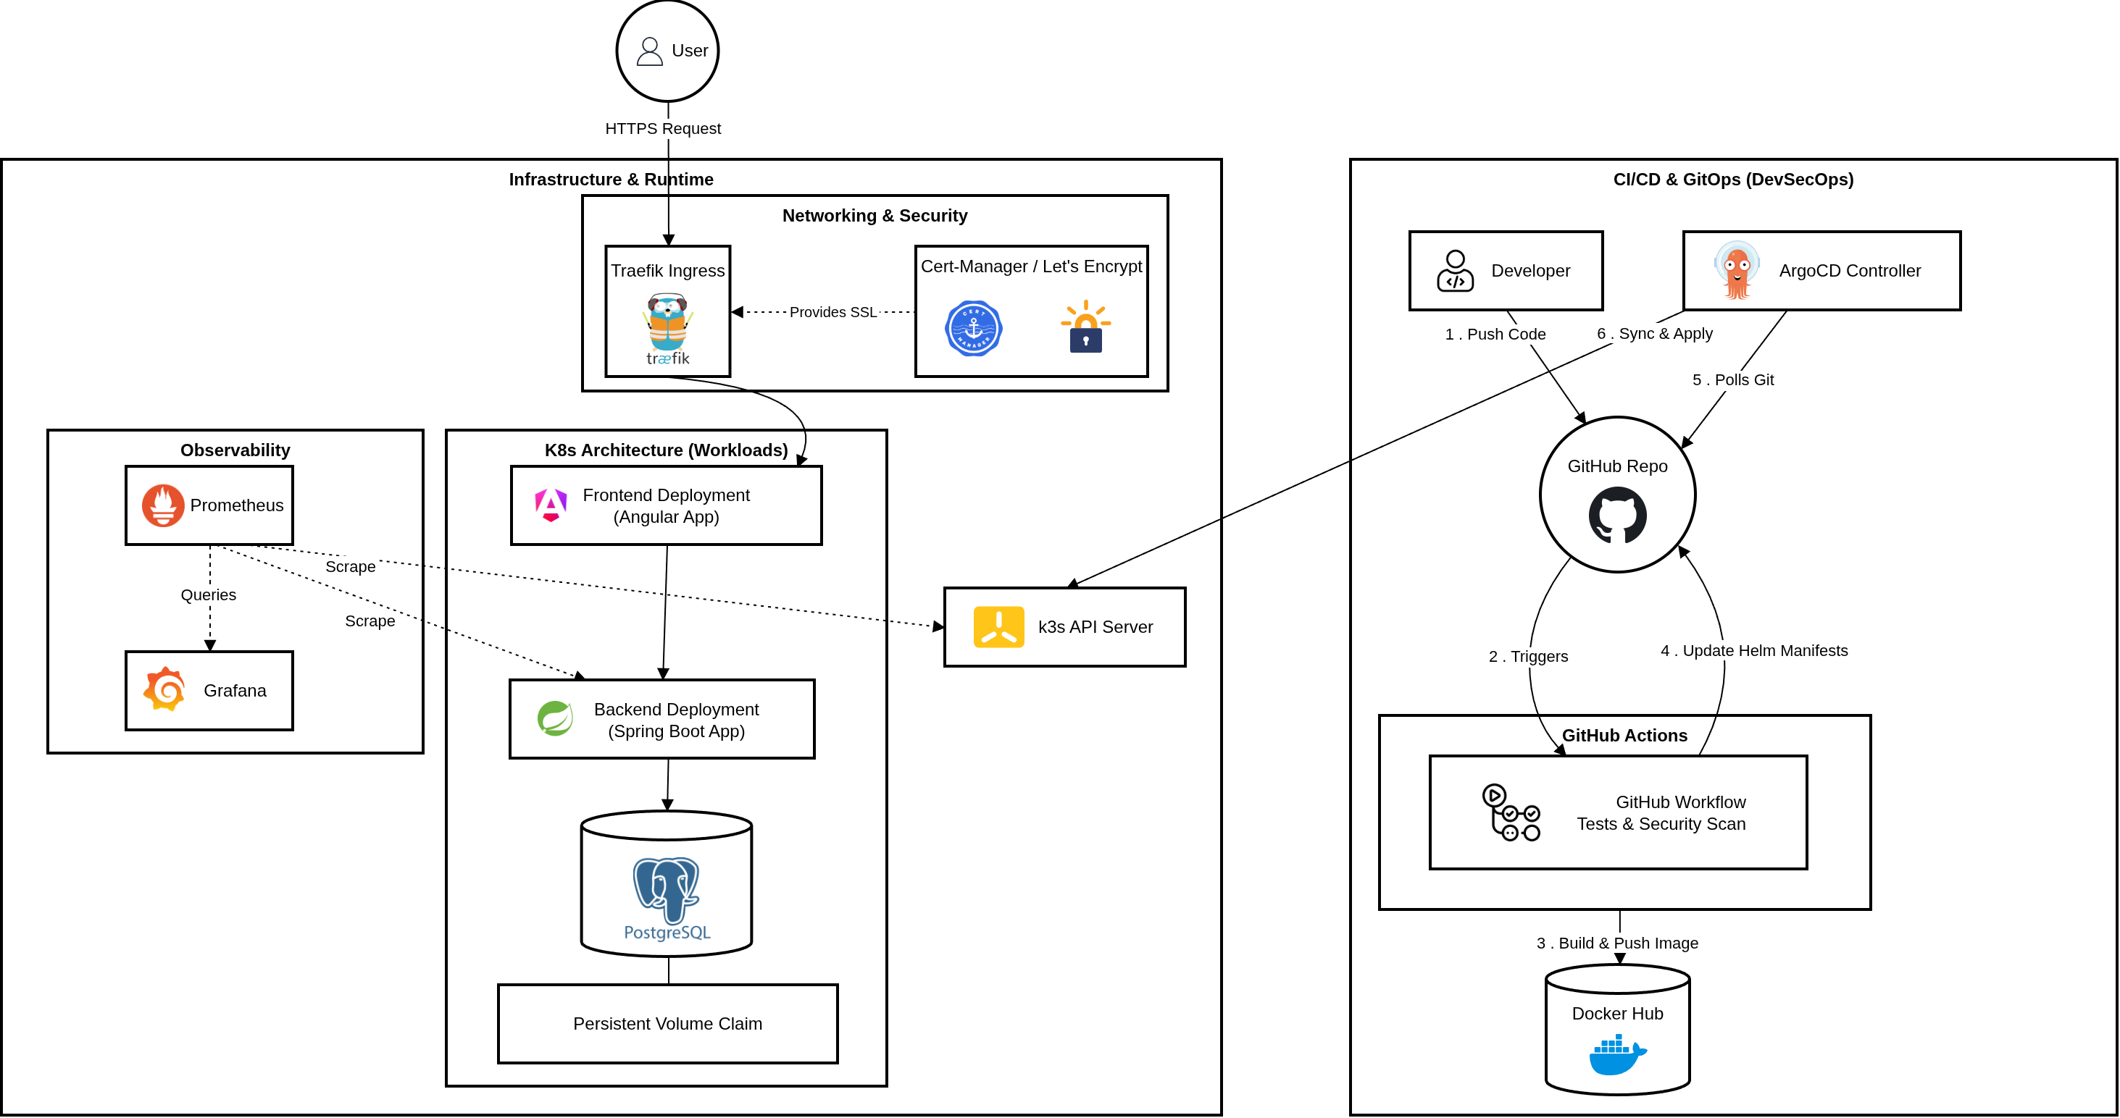
2. Architecture Diagram

Slide 5


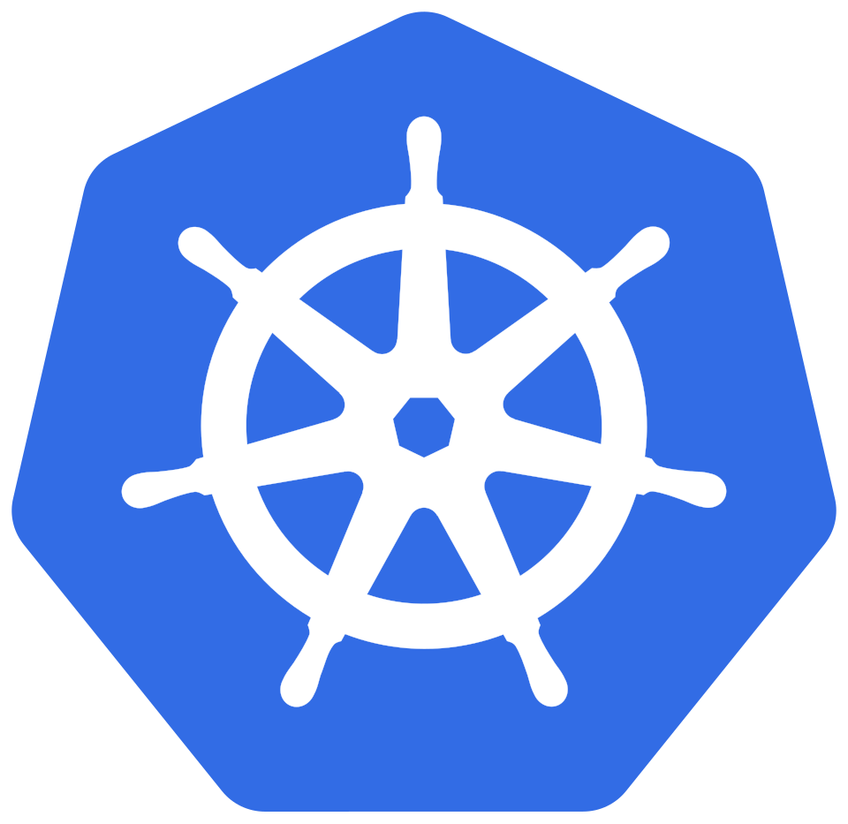
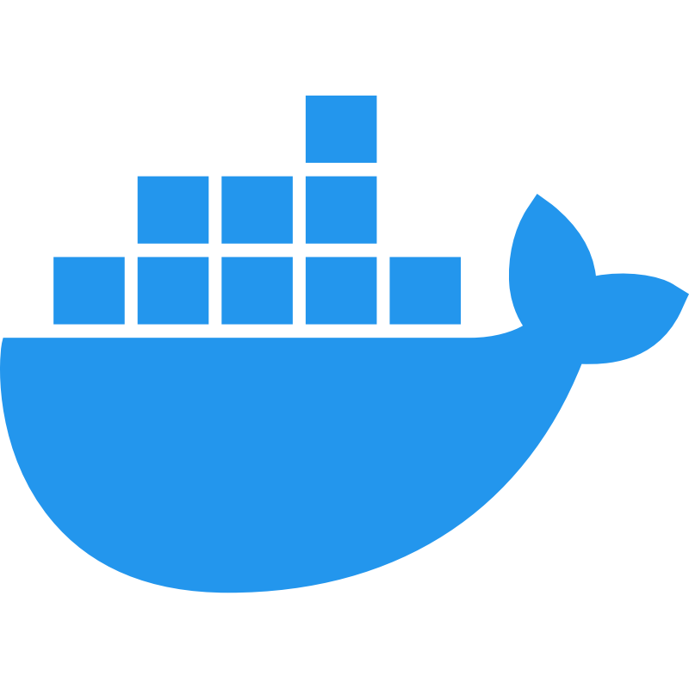





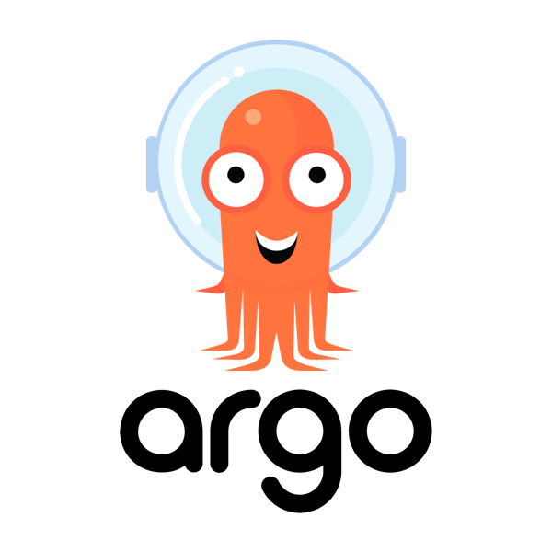
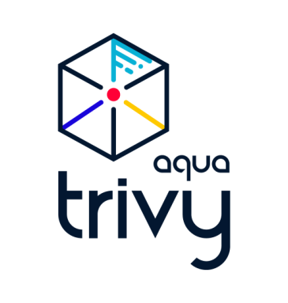




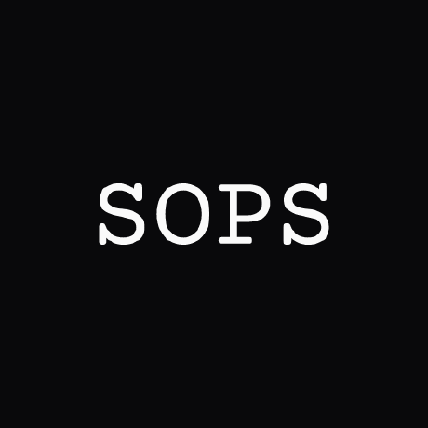
3. Tech Stack
Application & Persistence:
Infrastructure & IaC:
Deployment & GitOps:
Observability & Security:

Slide 6
4. Infrastructure Provisioning
Automated Foundations: Infrastructure as Code via Terraform for global services (Ingress, SSL, Monitoring).
Environment Setup: Isolated namespaces and persistent databases for Dev & Prod.
GitOps (ArgoCD) Bootstrap: Using the App-of-Apps pattern to trigger automatic synchronization of all services.
# 1. Global Cluster Services (Ingress, SSL, GitOps) cd infra && terraform init && terraform apply # 2. Environment Setup (Namespaces, Databases, Secrets) cd ../environments/dev && terraform apply cd ../environments/prod && terraform apply # 3. Trigger Application Sync kubectl apply -f argocd/app-of-apps.yaml

Slide 7
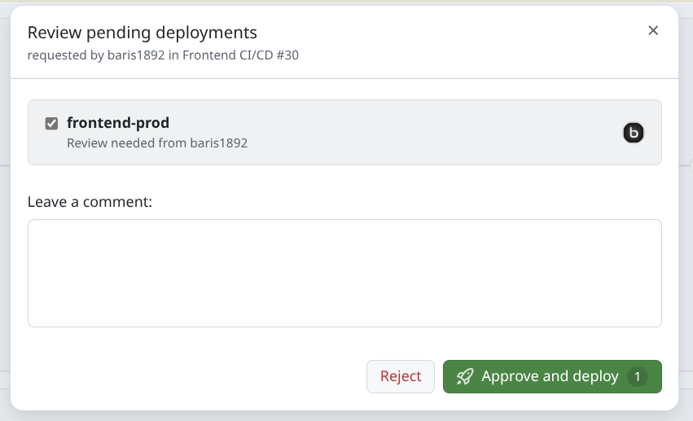
5. How to deploy dev & prod
Environment Isolation: Strictly separated via Kubernetes Namespaces (dev & prod).
Dev Workflow (values-dev.yaml): Continuous Deployment triggered by every push to the develop branch.
Prod Workflow (values-prod.yaml): Continuous Delivery via Git Tags (e.g., v1.0.2) and Manual Approval.
Dynamic Config (FE, Angular): Runtime API-URL injection via ConfigMaps (No re-builds required).

Slide 8
5. How to deploy dev & prod
Environment Isolation: Strictly separated via Kubernetes Namespaces (dev & prod).
Dev Workflow (values-dev.yaml): Continuous Deployment triggered by every push to the develop branch.
Prod Workflow (values-prod.yaml): Continuous Delivery via Git Tags (e.g., v1.0.2) and Manual Approval.
Dynamic Config (FE, Angular): Runtime API-URL injection via ConfigMaps (No re-builds required).
apiVersion: v1 kind: ConfigMap metadata: name: {{ include "frontend.fullname" . }}-config data: env.js: | window.__env = { REST_API_URL: "{{ .Values.env.REST_API_URL }}", ENV_NAME: "{{ .Values.env.ENV_NAME }}" };
# usage in deployment.yaml
spec: containers: - name: {{ .Chart.Name }} volumeMounts: - name: frontend-config mountPath: /usr/share/nginx/html/assets/env.js subPath: env.js volumes: - name: frontend-config configMap: name: {{ include "frontend.fullname" . }}-config

Slide 9
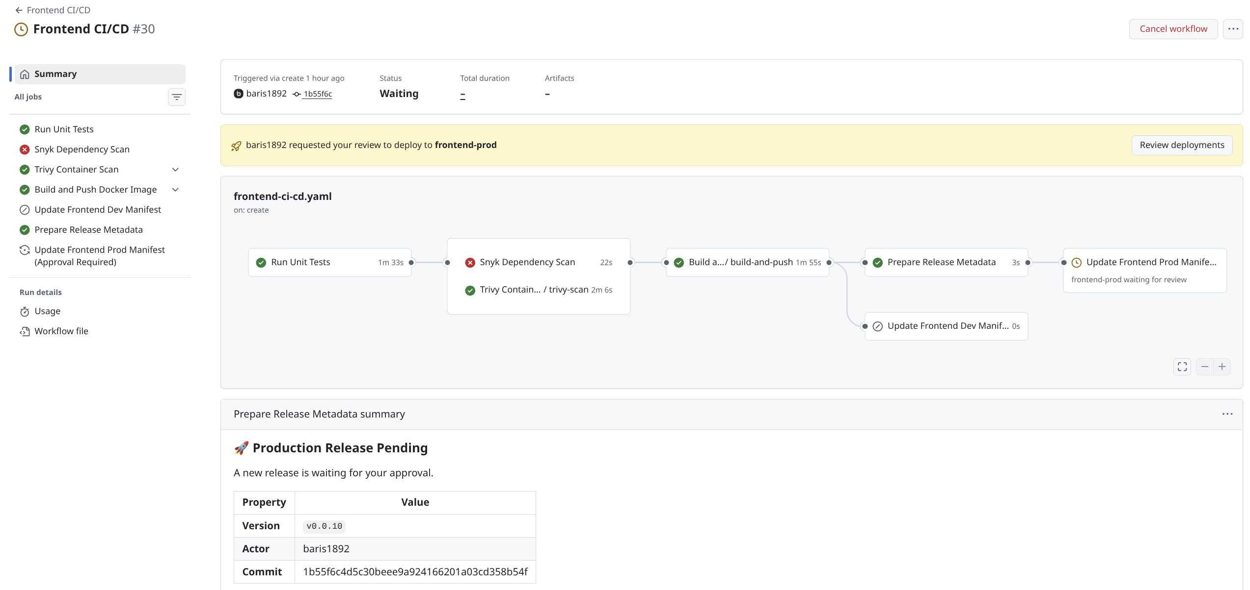
6. CI/CD Pipeline & DevSecOps

Slide 10
7. Resilience & Disaster Recovery
Self-Healing: Automatic container recovery via Liveness & Readiness probes.
Database Backups: Daily automated pg_dump via Kubernetes CronJobs.
Infrastructure Recovery: Full reconstruction using the layered Terraform & GitOps approach.
GitOps Rollback: Instant version reversal by adjusting helm values.yaml file

Slide 11
Demo
Pipeline in Action
Adjust FE text
Adjust BE logs
After Deployment
Check ArgoCD UI
Check Grafana Logs for adjusted BE logs
Demonstrate Fault Tolerance & Alerting

