Slide 1

Università degli studi di Genova
MSc Robotics Engineering
Ambient Intelligence
Intelligent System Design – 2nd Assignment
Barış Aker | S5430437

Slide 2
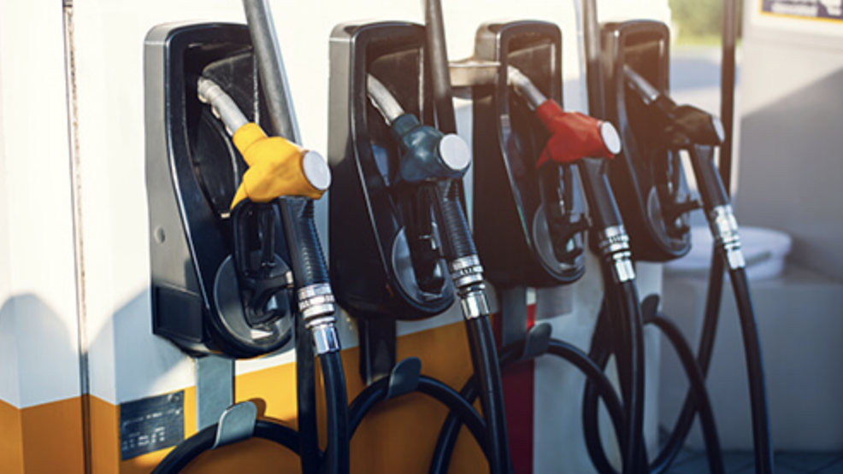
State of the Art
People can take wrong pump
Drivers can spend lots of time

Slide 3

What is Baritto Energies ?
Energy Station which supplies;
Electric Plugs
Gasoline Pumps
Diesel Pumps
Provides;
Special Discount for Registered Vehicles
Free water filling of the windshield wiper for EVs

Slide 4
How the system works?
While driver entering the Baritto Energies station vehicle detecting by it’s plate and some informations already known;
Is the vehicle registred or not ?
Type of the vehicle as; Electric, Diesel or Gasoline
Vehicle size as; Big, Medium or Small
Driver just needs to select how amount of energy they would like to purchase.

Slide 5
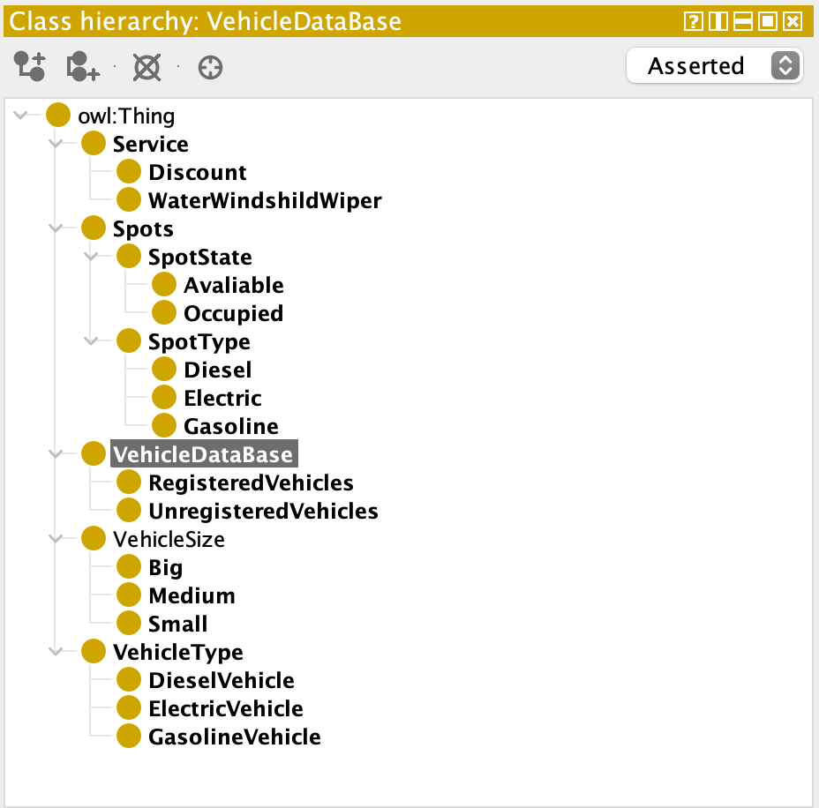
General Structure
VehicleDataBase Class includes all the vehicles, it has two sub-classes;
RegisteredVehicles, they have discount
UnregisteredVehicles, they don’t have discount

Slide 6
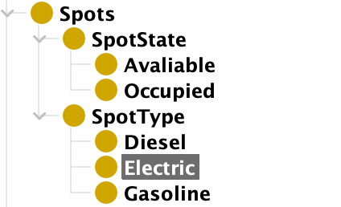
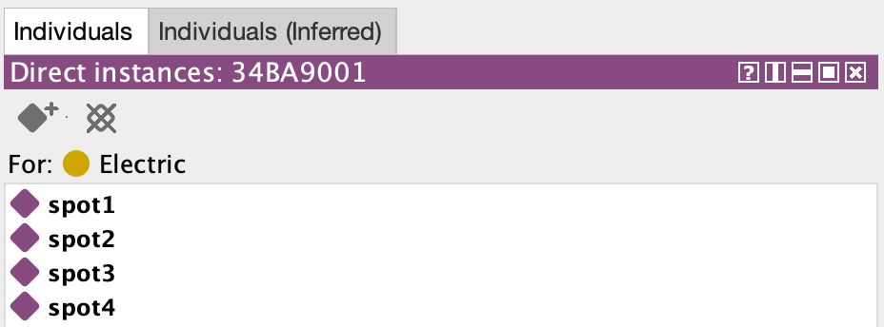
Spots & Station Environment
Spots Class has two sub-classes;
SpotState defines the availability of the spots
SpotType defines the type of the spots;
Every each spot type has own individuals, four for each energy type, total 12 spots.

Slide 7
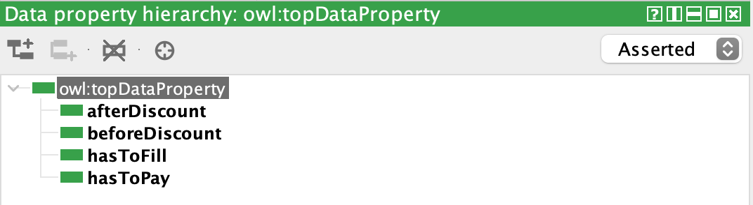
Data Properties
afterDiscount: Calculates the discounted price for registered vehicle
beforeDiscount: Calculates the not discounted price for registered vehicle
hasToFill: User’s input defines how amount of energy they need
hasToPay: Calculates the price for unregistered vehicle

Slide 8
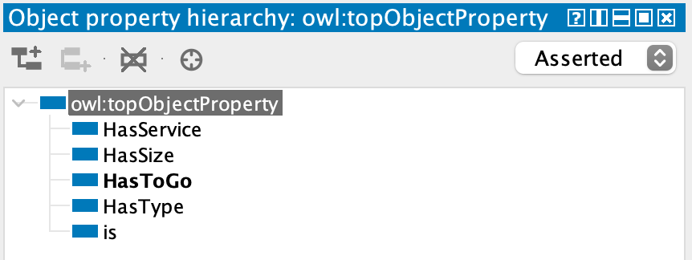
Object Properties
HasService: defines the services, which are discount and water filling depends on the vehicle type and registered situation
HasSize: defines the vehicle size
HasToGo: Informs the user, proper and available slots depends on to the vehicle type
HasType: Defines vehicle type; Electric Diesel or Gasoline

Slide 9
Working Logic
Diesel Vehicles;
Big Diesel Vehicles has approximately 71 L storage (Volvo XC90)
Medium Diesel Vehicles has approximately 66 L storage (Volkswagen Passat)
Small Diesel Vehicles has approximately 45 L storage (Volkswagen Polo)
Calculation had been done depends on;
Energy Prices in Italy
Size of the vehicle
How much amount is the user wants to purchase
Same steps had been followed for Gasoline and Electric vehicles, for electric vehicles calculation made depends on kW.
Notes:
If vehicle is registered then the system spplies %10 discount to the user, if the vehicle is unregistered then the system will not apply any discount and the user need to pay the normal price.

Slide 10
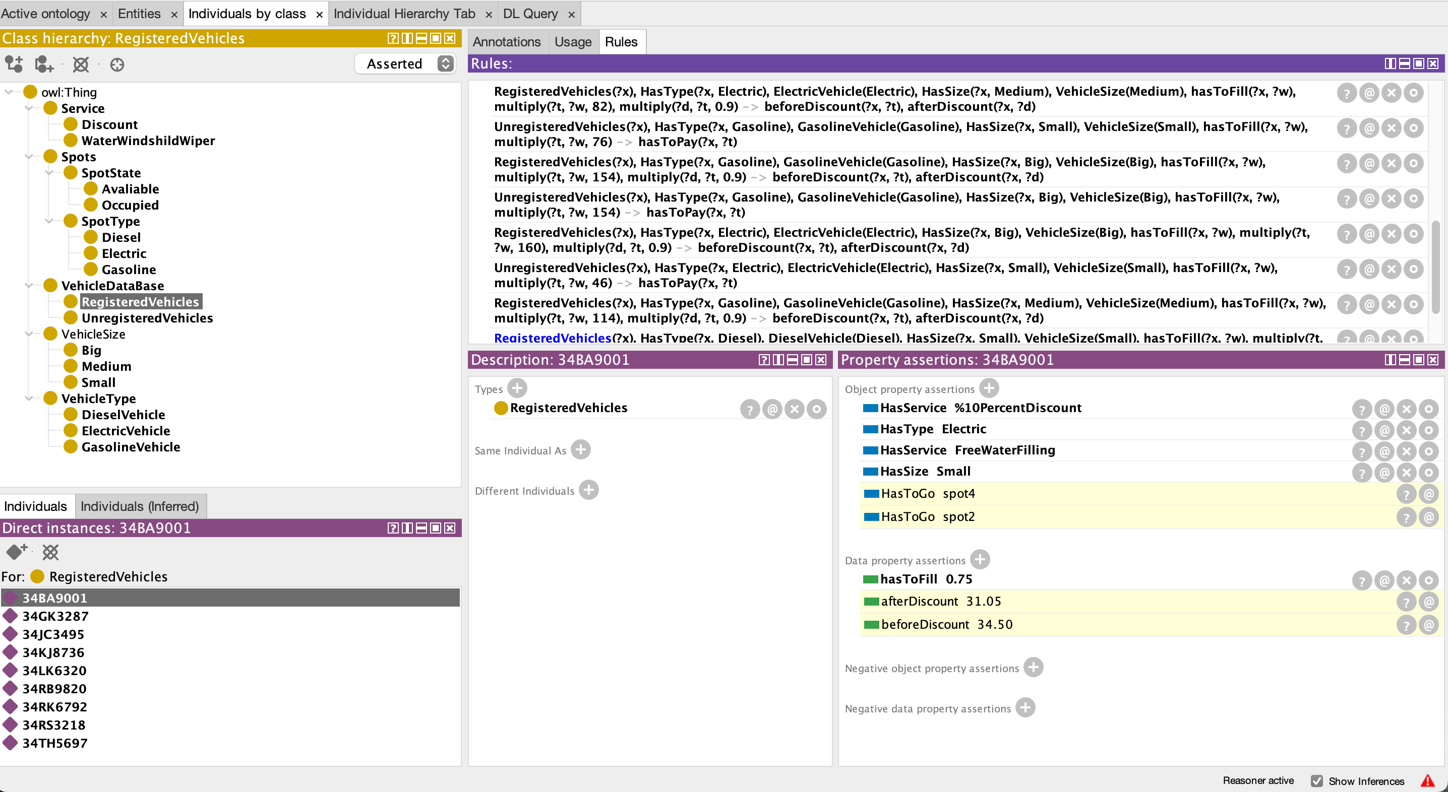
Out Put ?
Registered small electric vehicle owner wants to take %75 amount of energy
System applies discount and shows discounted and normal price
Provides free water filling service
Tells the proper and available spots

Slide 11
Do Not Forget To Fasten Your Seatbelts Thanks For Listening

