Slide 1
Reinforcement Learning
COMP438/538 · Fall 2026
Nuts and bolts
Barış Akgün
Koç University
Notes:
Suggested delivery: 0:15
Welcome students. Introduce the course organization before starting RL formulation.
Source: course/syllabus/syllabusFall26.docx (instructor-frozen September 29, 2026). Course policies remain governed by that syllabus.

Slide 2
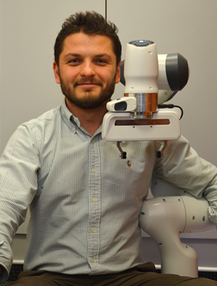
Instructor and contact
Barış Akgün
baakgun@ku.edu.tr
Eng 273
Office hours by appointment, online or in person
You can also stop by when my door is open, especially after lectures
Teaching assistants: TBA
Notes:
Suggested delivery: 0:45
Invite questions during and after lectures. Refer students to the syllabus for current contact information.
Source: course/syllabus/syllabusFall26.docx (instructor-frozen September 29, 2026). Course policies remain governed by that syllabus.
Image retained from the instructor-supplied 0 - NutsAndBolts.pptx.

Slide 3
Your background and interests
What brings you to reinforcement learning?
How comfortable are you with Python, probability and linear algebra?
What have you studied in AI, machine learning or deep learning?
You are welcome to discuss concerns privately
Notes:
Suggested delivery: 1:30
Use a quick show of hands and one or two brief responses. Avoid a full-class round of introductions within this short briefing. Invite students to introduce themselves in later conversations.
Source: course/syllabus/syllabusFall26.docx (instructor-frozen September 29, 2026). Course policies remain governed by that syllabus.

Slide 4
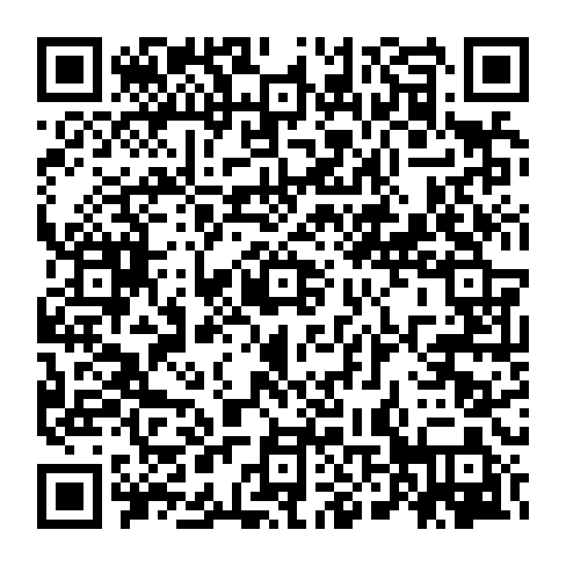
Class and syllabus
Tuesdays and Thursdays, 14:30–15:40
CASEZ27
The syllabus contains the full course policies
These slides highlight the main points
Notes:
Suggested delivery: 0:45
Point students to the current syllabus in the course space. Use the Hub landing-page link until a direct link to the current syllabus is available.
Source: course/syllabus/syllabusFall26.docx (instructor-frozen September 29, 2026). Course policies remain governed by that syllabus.

Slide 5

Course overview
Formulating sequential decisions and understanding returns and values
Learning with tabular methods and function approximation
Deep value learning and policy optimization
Exploration, planning and learned models
Offline RL and RL for LLM post-training
Notes:
Suggested delivery: 1:00
The goal is to understand the ideas shared by RL methods and to design and evaluate learning agents. The course moves from foundations toward modern methods. Use the map for orientation without explaining the algorithms yet.
Source: course/syllabus/syllabusFall26.docx (instructor-frozen September 29, 2026). Course policies remain governed by that syllabus.
Image retained from the instructor-supplied 0 - NutsAndBolts.pptx.

Slide 6
Preparation
AI background: agents, decisions, utility, states, actions and rewards
ML background: regression, stochastic gradient descent and neural networks
Working knowledge of probability, statistics and linear algebra
Python programming, including translating equations into code
Prior deep learning coursework is helpful but not required
Notes:
Suggested delivery: 1:15
Refer to the syllabus for the COMP341 and COMP421/521 prerequisites and the distinctions between formal prerequisites and expected background. Encourage students to assess gaps early and discuss concerns before add/drop. Assignments involve substantial programming and mathematical reasoning.
Source: course/syllabus/syllabusFall26.docx (instructor-frozen September 29, 2026). Course policies remain governed by that syllabus.

Slide 7
Course communication
Course materials and announcements on KU Hub
Assignment and report submissions through KU Hub
Check your university email regularly
Contact the instructor when you need clarification
Notes:
Suggested delivery: 0:45
Students are responsible for checking university email. Submission rules appear later in this briefing and in the syllabus.
Source: course/syllabus/syllabusFall26.docx (instructor-frozen September 29, 2026). Course policies remain governed by that syllabus.

Slide 8
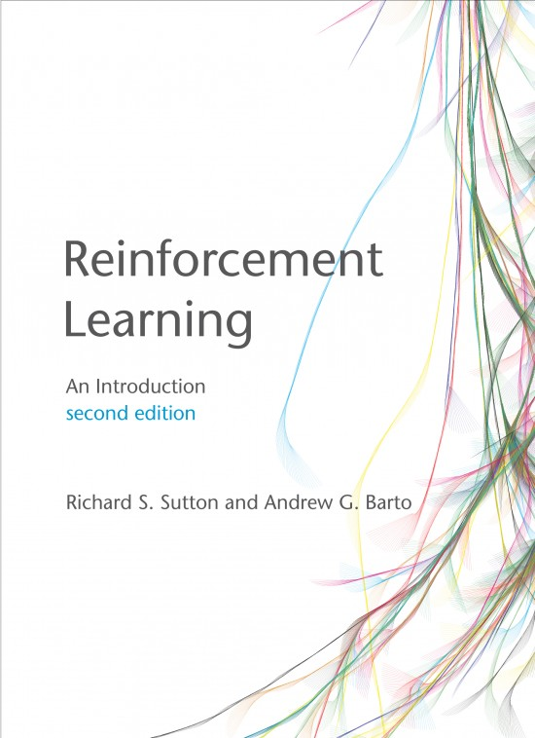
Textbook and resources
Sutton and Barto
Reinforcement Learning: An Introduction, 2nd edition
Book website
A reference for foundational RL concepts
No assigned readings this semester
Teaching mainly through lectures, with videos as needed
Notes:
Suggested delivery: 0:30
Students may use the book to revisit explanations. The textbook listing does not introduce required reading or reading-only exam material.
Source: course/syllabus/syllabusFall26.docx (instructor-frozen September 29, 2026). Course policies remain governed by that syllabus.
Reading policy: decisions/reading_decisions.md. Book cover retained from the instructor-supplied deck.

Slide 9
Lectures and participation
Attendance is not tracked
Questions and discussion are encouraged
Videos will supplement lectures as needed
Notes:
Suggested delivery: 0:30
Invite students to ask for clarification. Avoid promising a fixed break schedule or a number of additional videos.
Source: course/syllabus/syllabusFall26.docx (instructor-frozen September 29, 2026). Course policies remain governed by that syllabus.

Slide 10
Assessment
Component | Course grade
Individual programming assignments | 20%
Three midterms, 15% each | 45%
Semester project | 35%
Four assignments planned, with the lowest dropped. The count may change. If more than three are offered, the lowest is dropped
Each midterm covers a different set of topics
No final exam
Notes:
Suggested delivery: 1:45
Assignments provide practice in implementation and experimental reasoning. Exams assess understanding of the taught material. Exact dates and instructions will follow through course communication. Do not turn internal week targets into announced dates.
Source: course/syllabus/syllabusFall26.docx (instructor-frozen September 29, 2026). Course policies remain governed by that syllabus.

Slide 11
Semester project
Formulate an RL problem, build a solution, compare with a meaningful baseline and evaluate the results.
Milestone | Course grade
Proposal | 5%
Formulation and design | 5%
Progress and evaluation | 7.5%
Presentation | 7.5%
Final report | 10%
Teams of 2–3 encouraged. Individual and four-person teams considered case by case.
Notes:
Suggested delivery: 2:00
Project expectations scale with team size. A well-supported negative result can succeed. Novelty and benchmark superiority are not required. Communicate limitations as well as results. Further project details will follow during the semester.
Source: course/syllabus/syllabusFall26.docx (instructor-frozen September 29, 2026). Course policies remain governed by that syllabus.

Slide 12
LLM use in coursework
LLMs may help with coding and reports, with disclosure
Failure to disclose use is treated as plagiarism
You must understand, check and explain submitted work
You remain responsible for errors
An LLM-use report is required for every assignment and report
One-shot or few-shot delegation of an assignment solution receives no credit
Notes:
Suggested delivery: 2:00
The report requirements will be provided before the first assignment/report. The assignment no-credit rule applies specifically to assignment solutions. Do not extend it to project coding or introduce a prompt-count threshold as a grading rubric. Understanding and verification remain the student's responsibility.
Source: course/syllabus/syllabusFall26.docx (instructor-frozen September 29, 2026). Course policies remain governed by that syllabus.

Slide 13
Writing and exams
Project reports should be clear, focused and concise
Verbose, repetitive, unnecessarily detailed, unfocused, vague or obvious AI writing loses marks
LLMs are not permitted in online or take-home midterms
University rules on plagiarism and academic conduct apply
Notes:
Suggested delivery: 1:00
The project writing policy applies to the submitted writing, including writing produced with AI tools. Online or take-home midterms assess students' knowledge of the material. Refer to the syllabus and exam instructions for the applicable rules.
Source: course/syllabus/syllabusFall26.docx (instructor-frozen September 29, 2026). Course policies remain governed by that syllabus.

Slide 14
Submissions and late policy
Submit through KU Hub. Email submissions are not accepted
Download and check your uploaded files. Only the latest submission is graded
Ten late days in total, at most three per submission except the final report
Remaining late days may be used for the final report, with a possible Incomplete grade
Exceeding the late-day limits incurs grade penalties
Full make-up and early-exam policies appear in the syllabus.
Notes:
Suggested delivery: 2:00
The server timestamp determines submission time. An appropriate extension will be granted if the system is down. Do not invent a numerical late penalty.
Source: course/syllabus/syllabusFall26.docx (instructor-frozen September 29, 2026). Course policies remain governed by that syllabus.

Slide 15
Additional Textbooks and Other Resources
David Silver’s Lecture Notes and Videos (Classical)
  https://www.davidsilver.uk/teaching/
Shiyu Zhao’s Notes and Videos (Classical)
  https://github.com/MathFoundationRL/Book-Mathematical-Foundation-of-Reinforcement-Learning
Sergey Levine’s Course
  https://rail.eecs.berkeley.edu/deeprlcourse/
Emma Brunskill’s Course
  https://web.stanford.edu/class/cs234/
Chelsea Finn’s Course
  https://cs224r.stanford.edu/
Kevin Murphy’s Book (Both Classical and Deep)
  https://arxiv.org/abs/2412.05265

