Slide 1
Introduction
Chapter 1
Tanenbaum & Bo, Modern Operating Systems:4th ed., (c) 2013 Prentice-Hall, Inc. All rights reserved.

Slide 2
Components of a Modern Computer (1)
  One or more processors
  Main memory
  Disks
  Printers
  Keyboard
  Mouse
  Display
  Network interfaces
  I/O devices
Tanenbaum & Bo, Modern Operating Systems:4th ed., (c) 2013 Prentice-Hall, Inc. All rights reserved.

Slide 3
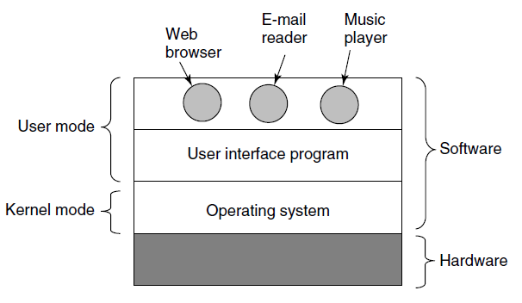
Components of a Modern Computer (2)
Figure 1-1. Where the operating system fits in.
Tanenbaum & Bo, Modern Operating Systems:4th ed., (c) 2013 Prentice-Hall, Inc. All rights reserved.

Slide 4
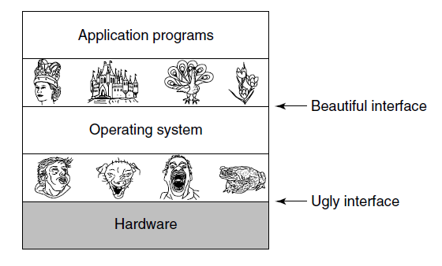
The Operating System as an Extended Machine
Figure 1-2. Operating systems turn ugly hardware into beautiful abstractions.
Tanenbaum & Bo, Modern Operating Systems:4th ed., (c) 2013 Prentice-Hall, Inc. All rights reserved.

Slide 5
The Operating System as a Resource Manager
Top down view
  Provide abstractions to application programs
Bottom up view
  Manage pieces of complex system
Alternative view
  Provide orderly, controlled allocation of resources
Tanenbaum & Bo, Modern Operating Systems:4th ed., (c) 2013 Prentice-Hall, Inc. All rights reserved.

Slide 6
History of Operating Systems
The first generation (1945–55) vacuum tubes
The second generation (1955–65) transistors and batch systems
The third generation (1965–1980) ICs and multiprogramming
The fourth generation (1980–present) personal computers
The fifth generation (1990–present) mobile computers
Tanenbaum & Bo, Modern Operating Systems:4th ed., (c) 2013 Prentice-Hall, Inc. All rights reserved.

Slide 7
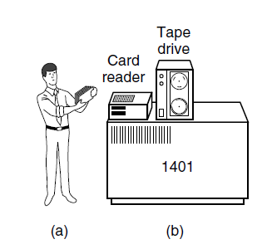
Transistors and Batch Systems (1)
Figure 1-3. An early batch system. (a) Programmers bring cards to 1401. (b) 1401 reads batch of jobs onto tape.
Tanenbaum & Bo, Modern Operating Systems:4th ed., (c) 2013 Prentice-Hall, Inc. All rights reserved.

Slide 8
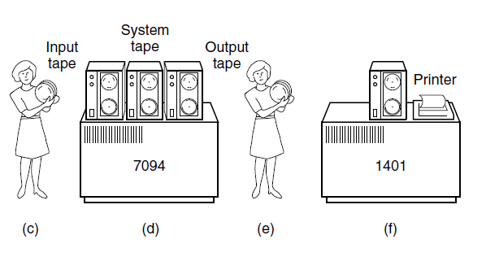
Transistors and Batch Systems (2)
Figure 1-3. An early batch system. (c) Operator carries input tape to 7094. (d)7094 does computing. (e) Operator carries output tape to 1401. (f) 1401 prints output.
Tanenbaum & Bo, Modern Operating Systems:4th ed., (c) 2013 Prentice-Hall, Inc. All rights reserved.

Slide 9
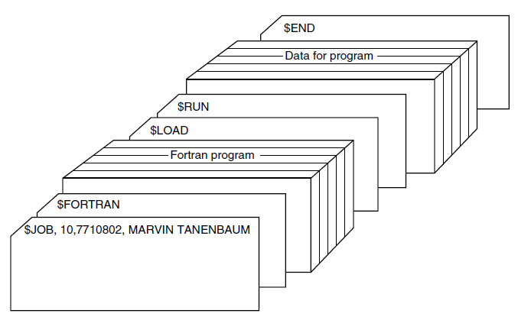
Transistors and Batch Systems (3)
Figure 1-4. Structure of a typical FMS job.
Tanenbaum & Bo, Modern Operating Systems:4th ed., (c) 2013 Prentice-Hall, Inc. All rights reserved.

Slide 10
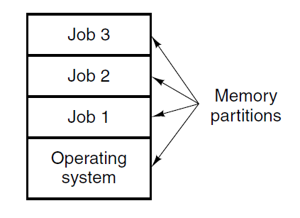
ICs and Multiprogramming
Figure 1-5. A multiprogramming system with
three jobs in memory.
Tanenbaum & Bo, Modern Operating Systems:4th ed., (c) 2013 Prentice-Hall, Inc. All rights reserved.

Slide 11
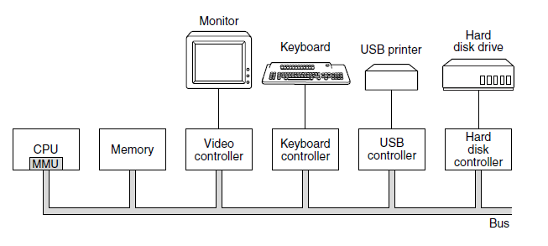
Processors (1)
Figure 1-6. Some of the components of a
simple personal computer.
Tanenbaum & Bo, Modern Operating Systems:4th ed., (c) 2013 Prentice-Hall, Inc. All rights reserved.

Slide 12
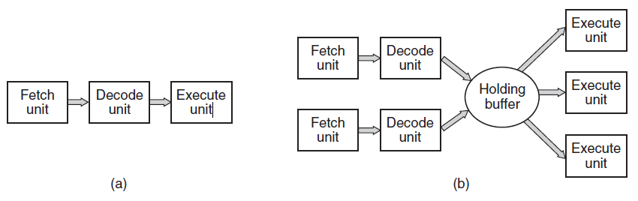
Processors (2)
Figure 1-7. (a) A three-stage pipeline. (b) A superscalar CPU.
Tanenbaum & Bo, Modern Operating Systems:4th ed., (c) 2013 Prentice-Hall, Inc. All rights reserved.

Slide 13
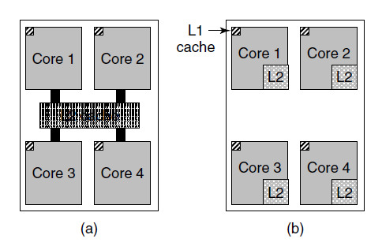
Memory (1)
Figure 1-8. (a) A quad-core chip with a shared L2 cache.
(b) A quad-core chip with separate L2 caches.
Tanenbaum & Bo, Modern Operating Systems:4th ed., (c) 2013 Prentice-Hall, Inc. All rights reserved.

Slide 14
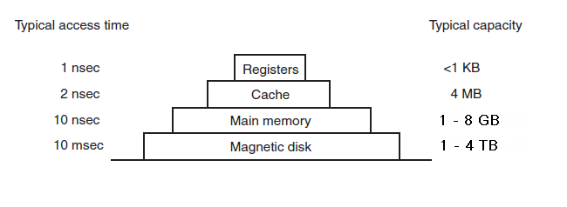
Memory (2)
Figure 1-9. A typical memory hierarchy. The numbers are very rough approximations.
Tanenbaum & Bo, Modern Operating Systems:4th ed., (c) 2013 Prentice-Hall, Inc. All rights reserved.

Slide 15
Memory (3)
Caching system issues:
When to put a new item into the cache.
Which cache line to put the new item in.
Which item to remove from the cache when a slot is needed.
Where to put a newly evicted item in the larger memory.
Tanenbaum & Bo, Modern Operating Systems:4th ed., (c) 2013 Prentice-Hall, Inc. All rights reserved.

Slide 16
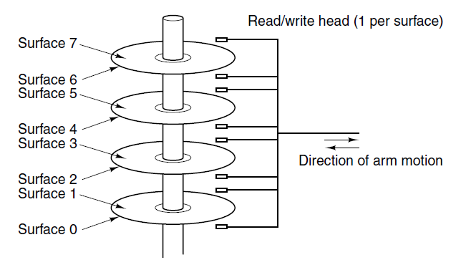
Disks
Figure 1-10. Structure of a disk drive.
Tanenbaum & Bo, Modern Operating Systems:4th ed., (c) 2013 Prentice-Hall, Inc. All rights reserved.

Slide 17
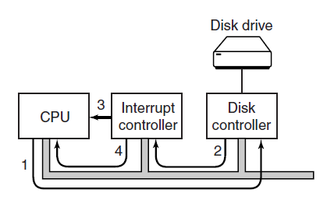
I/O Devices
Figure 1-11. (a) The steps in starting an I/O device
and getting an interrupt.
Tanenbaum & Bo, Modern Operating Systems:4th ed., (c) 2013 Prentice-Hall, Inc. All rights reserved.

Slide 18
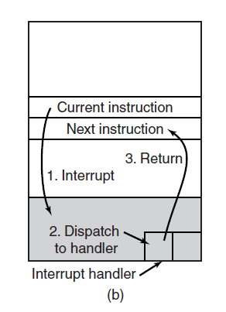
I/O Devices
Figure 1-11. (b) Interrupt processing involves taking the interrupt, running the interrupt handler, and returning to the user program.
Tanenbaum & Bo, Modern Operating Systems:4th ed., (c) 2013 Prentice-Hall, Inc. All rights reserved.

Slide 19
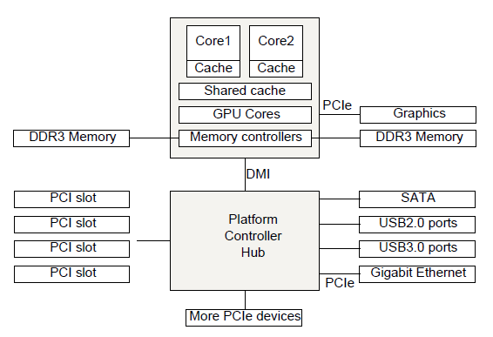
Buses
Figure 1-12. The structure of a large x86 system
Tanenbaum & Bo, Modern Operating Systems:4th ed., (c) 2013 Prentice-Hall, Inc. All rights reserved.

Slide 20
The Operating System Zoo
Mainframe Operating Systems
Server Operating Systems
Multiprocessor Operating Systems
Personal Computer Operating Systems
Handheld Computer Operating Systems
Embedded Operating Systems
Sensor Node Operating Systems
Real-Time Operating Systems
Smart Card Operating Systems
Tanenbaum & Bo, Modern Operating Systems:4th ed., (c) 2013 Prentice-Hall, Inc. All rights reserved.

Slide 21
Processes (1)
Key concept in all operating systems
Definition: a program in execution
Process is associated with an address space
Also associated with set of resources
Process can be thought of as a container
  Holds all information needed to run program
Tanenbaum & Bo, Modern Operating Systems:4th ed., (c) 2013 Prentice-Hall, Inc. All rights reserved.

Slide 22
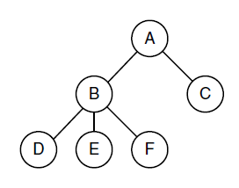
Processes (2)
Figure 1-13. A process tree. Process A created two child processes, B and C. Process B created three child processes, D, E, and F.
Tanenbaum & Bo, Modern Operating Systems:4th ed., (c) 2013 Prentice-Hall, Inc. All rights reserved.

Slide 23
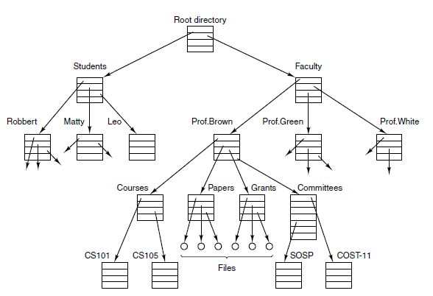
Files (1)
Figure 1-14. A file system for a university department.
Tanenbaum & Bo, Modern Operating Systems:4th ed., (c) 2013 Prentice-Hall, Inc. All rights reserved.

Slide 24
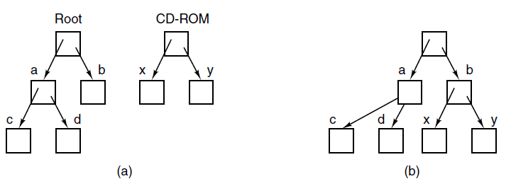
Files (2)
Figure 1-15. (a) Before mounting, the files on the CD-ROM are not accessible. (b) After mounting, they are part of the file hierarchy.
Tanenbaum & Bo, Modern Operating Systems:4th ed., (c) 2013 Prentice-Hall, Inc. All rights reserved.

Slide 25
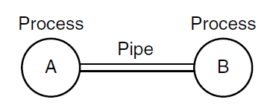
Files (3)
Figure 1-16. Two processes connected by a pipe.
Tanenbaum & Bo, Modern Operating Systems:4th ed., (c) 2013 Prentice-Hall, Inc. All rights reserved.

Slide 26
Ontogeny Recapitulates Phylogeny
Each new “species” of computer
  Goes through same development as “ancestors”
Consequence of impermanence
  Text often looks at “obsolete” concepts
  Changes in technology may bring them back
Happens with large memory, protection hardware, disks, virtual memory
Tanenbaum & Bo, Modern Operating Systems:4th ed., (c) 2013 Prentice-Hall, Inc. All rights reserved.

Slide 27
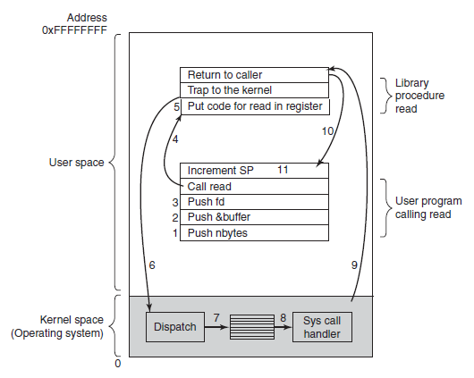
System Calls (1)
Figure 1-17. The 11 steps in making the system call
read(fd, buffer, nbytes).
Tanenbaum & Bo, Modern Operating Systems:4th ed., (c) 2013 Prentice-Hall, Inc. All rights reserved.

Slide 28
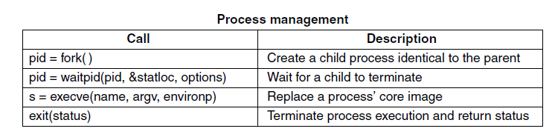
System Calls (2)
Figure 1-18. Some of the major POSIX system calls. The return code s is −1 if an error has occurred. The return codes are as follows: pid is a process id, fd is a file descriptor, n is a byte count, position is an offset within the file, and seconds is the elapsed time.
Tanenbaum & Bo, Modern Operating Systems:4th ed., (c) 2013 Prentice-Hall, Inc. All rights reserved.

Slide 29
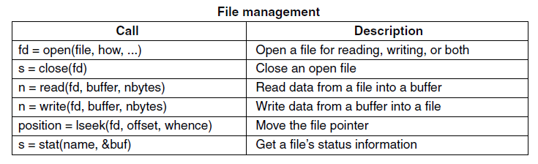
System Calls (3)
Figure 1-18. Some of the major POSIX system calls. The return code s is −1 if an error has occurred. The return codes are as follows: pid is a process id, fd is a file descriptor, n is a byte count, position is an offset within the file, and seconds is the elapsed time.
Tanenbaum & Bo, Modern Operating Systems:4th ed., (c) 2013 Prentice-Hall, Inc. All rights reserved.

Slide 30
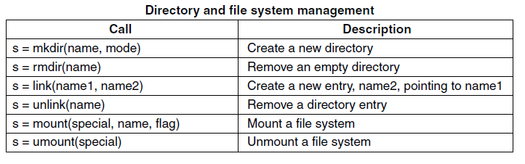
System Calls (4)
Figure 1-18. Some of the major POSIX system calls. The return code s is −1 if an error has occurred. The return codes are as follows: pid is a process id, fd is a file descriptor, n is a byte count, position is an offset within the file, and seconds is the elapsed time.
Tanenbaum & Bo, Modern Operating Systems:4th ed., (c) 2013 Prentice-Hall, Inc. All rights reserved.

Slide 31
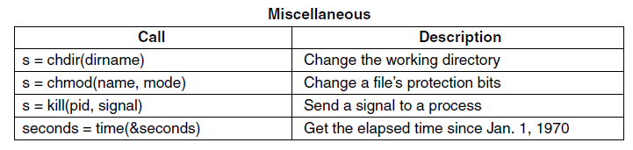
System Calls (5)
Figure 1-18. Some of the major POSIX system calls. The return code s is −1 if an error has occurred. The return codes are as follows: pid is a process id, fd is a file descriptor, n is a byte count, position is an offset within the file, and seconds is the elapsed time.
Tanenbaum & Bo, Modern Operating Systems:4th ed., (c) 2013 Prentice-Hall, Inc. All rights reserved.

Slide 32
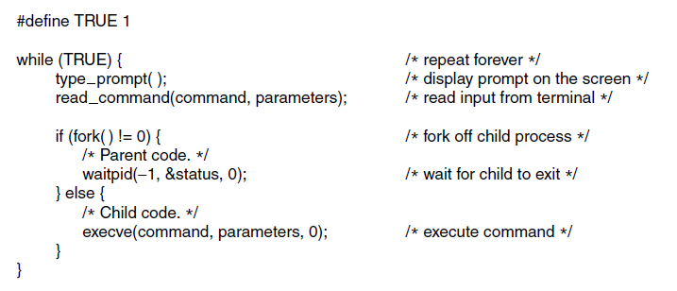
System Calls for Process Management
Figure 1-19. A stripped-down shell. Throughout this book, TRUE is assumed to be defined as 1.
Tanenbaum & Bo, Modern Operating Systems:4th ed., (c) 2013 Prentice-Hall, Inc. All rights reserved.

Slide 33
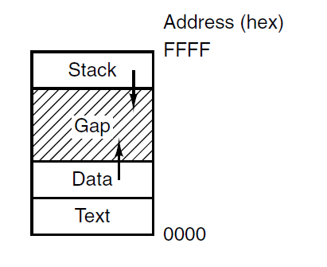
System Calls for File Management
Figure 1-20. Processes have three segments:
text, data, and stack
Tanenbaum & Bo, Modern Operating Systems:4th ed., (c) 2013 Prentice-Hall, Inc. All rights reserved.

Slide 34
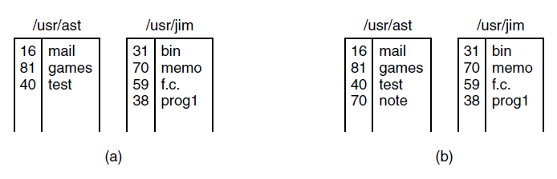
System Calls for Directory Management (1)
Figure 1-21. (a) Two directories before linking usr/jim/memo to ast’s directory. (b) The same directories after linking.
Tanenbaum & Bo, Modern Operating Systems:4th ed., (c) 2013 Prentice-Hall, Inc. All rights reserved.

Slide 35
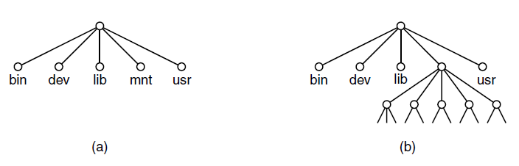
System Calls for Directory Management (2)
Figure 1-22. (a) File system before the mount.
(b) File system after the mount.
Tanenbaum & Bo, Modern Operating Systems:4th ed., (c) 2013 Prentice-Hall, Inc. All rights reserved.

Slide 36
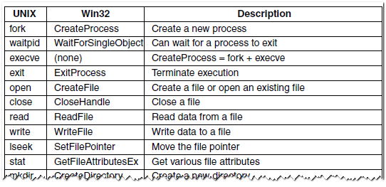
The Windows Win32 API (1)
Figure 1-23. The Win32 API calls that roughly correspond to the UNIX calls of Fig. 1-18.
Tanenbaum & Bo, Modern Operating Systems:4th ed., (c) 2013 Prentice-Hall, Inc. All rights reserved.

Slide 37
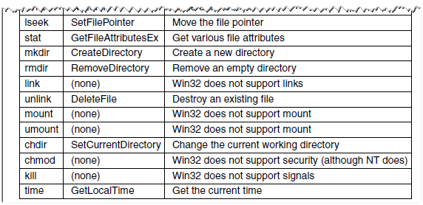
The Windows Win32 API (2)
Figure 1-23. The Win32 API calls that roughly correspond to the UNIX calls of Fig. 1-18.
Tanenbaum & Bo, Modern Operating Systems:4th ed., (c) 2013 Prentice-Hall, Inc. All rights reserved.

Slide 38
Monolithic Systems (1)
Basic structure of OS
A main program that invokes the requested service procedure.
A set of service procedures that carry out the system calls.
A set of utility procedures that help the service procedures.
Tanenbaum & Bo, Modern Operating Systems:4th ed., (c) 2013 Prentice-Hall, Inc. All rights reserved.

Slide 39
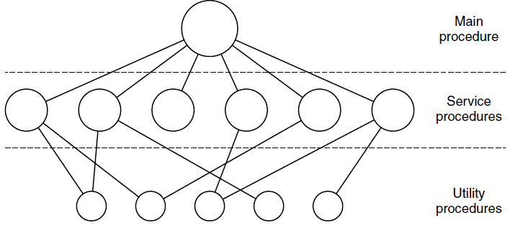
Monolithic Systems (2)
Figure 1-24. A simple structuring model
for a monolithic system.
Tanenbaum & Bo, Modern Operating Systems:4th ed., (c) 2013 Prentice-Hall, Inc. All rights reserved.

Slide 40
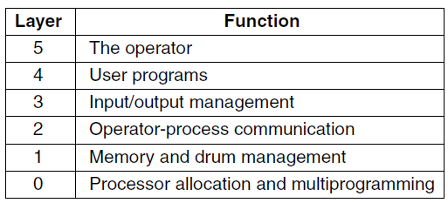
Layered Systems
Figure 1-25. Structure of the THE operating system.
Tanenbaum & Bo, Modern Operating Systems:4th ed., (c) 2013 Prentice-Hall, Inc. All rights reserved.

Slide 41
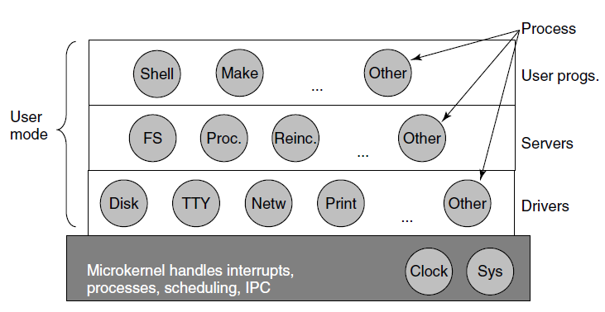
Microkernels
Figure 1-26. Simplified structure of the
MINIX 3 system.
Tanenbaum & Bo, Modern Operating Systems:4th ed., (c) 2013 Prentice-Hall, Inc. All rights reserved.

Slide 42
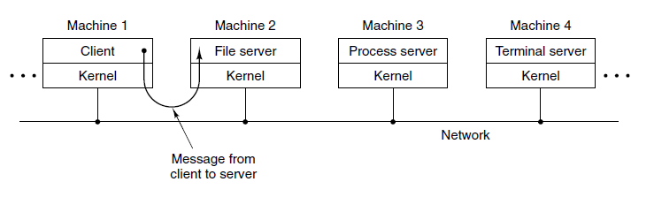
Client-Server Model
Figure 1-27. The client-server model over a network.
Tanenbaum & Bo, Modern Operating Systems:4th ed., (c) 2013 Prentice-Hall, Inc. All rights reserved.

Slide 43
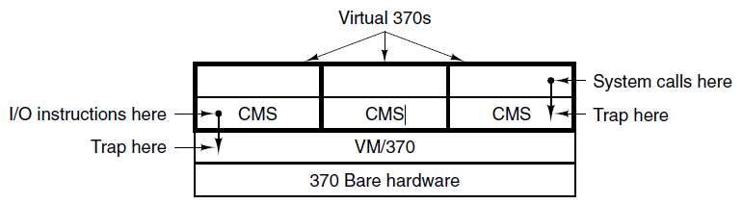
Virtual Machines
Figure 1-28. The structure of VM/370 with CMS.
Tanenbaum & Bo, Modern Operating Systems:4th ed., (c) 2013 Prentice-Hall, Inc. All rights reserved.

Slide 44
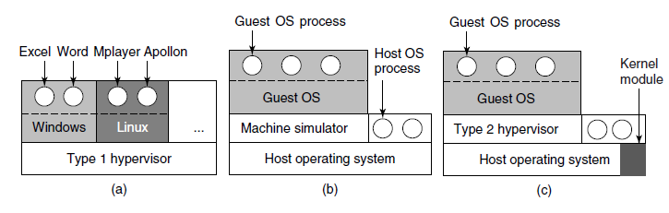
Virtual Machines Rediscovered
Figure 1-29. (a) A type 1 hypervisor. (b) A pure type 2 hypervisor. (c) A practical type 2 hypervisor.
Tanenbaum & Bo, Modern Operating Systems:4th ed., (c) 2013 Prentice-Hall, Inc. All rights reserved.

Slide 45
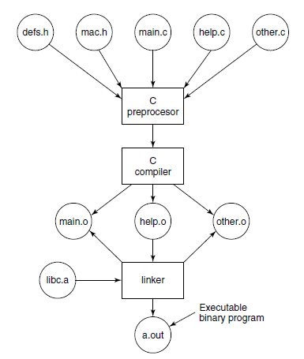
Large Programming Projects
Figure 1-30. The process of compiling C and header
files to make an executable.
Tanenbaum & Bo, Modern Operating Systems:4th ed., (c) 2013 Prentice-Hall, Inc. All rights reserved.

Slide 46
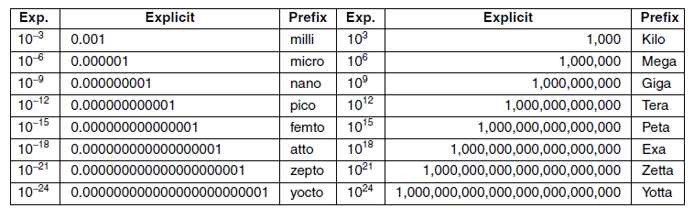
Metric Units
Figure 1-31. The principal metric prefixes.
Tanenbaum & Bo, Modern Operating Systems:4th ed., (c) 2013 Prentice-Hall, Inc. All rights reserved.

Slide 47
End
Chapter 1
Tanenbaum & Bo, Modern Operating Systems:4th ed., (c) 2013 Prentice-Hall, Inc. All rights reserved.

