Slide 1
File Systems
Chapter 4
Tanenbaum & Bo, Modern Operating Systems:4th ed., (c) 2013 Prentice-Hall, Inc. All rights reserved.

Slide 2
File Systems (1)
Essential requirements for long-term information storage:
It must be possible to store a very large amount of information.
Information must survive termination of process using it.
Multiple processes must be able to access information concurrently.
Tanenbaum & Bo, Modern Operating Systems:4th ed., (c) 2013 Prentice-Hall, Inc. All rights reserved.

Slide 3
File Systems (2)
Think of a disk as a linear sequence of fixed-size blocks and supporting two operations:
Read block k.
Write block k
Tanenbaum & Bo, Modern Operating Systems:4th ed., (c) 2013 Prentice-Hall, Inc. All rights reserved.

Slide 4
File Systems (3)
Questions that quickly arise:
How do you find information?
How do you keep one user from reading another user’s data?
How do you know which blocks are free?
Tanenbaum & Bo, Modern Operating Systems:4th ed., (c) 2013 Prentice-Hall, Inc. All rights reserved.

Slide 5
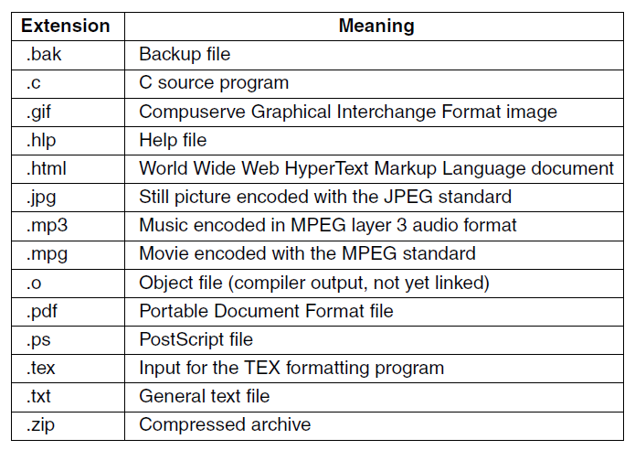
File Naming
Figure 4-1. Some typical file extensions.
Tanenbaum & Bo, Modern Operating Systems:4th ed., (c) 2013 Prentice-Hall, Inc. All rights reserved.

Slide 6
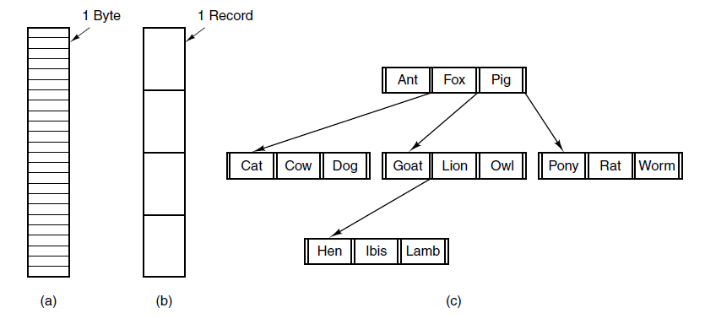
File Structure
Figure 4-2. Three kinds of files. (a) Byte sequence.
(b) Record sequence. (c) Tree.
Tanenbaum & Bo, Modern Operating Systems:4th ed., (c) 2013 Prentice-Hall, Inc. All rights reserved.

Slide 7
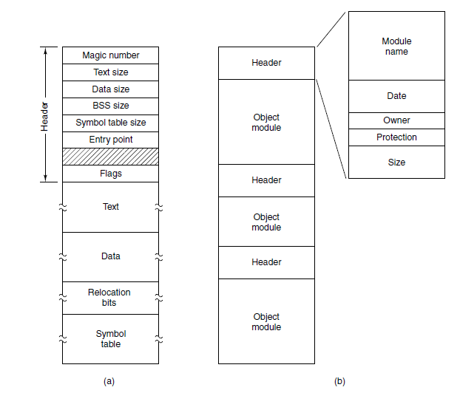
File Types
Figure 4-3. (a) An executable file. (b) An archive
Tanenbaum & Bo, Modern Operating Systems:4th ed., (c) 2013 Prentice-Hall, Inc. All rights reserved.

Slide 8
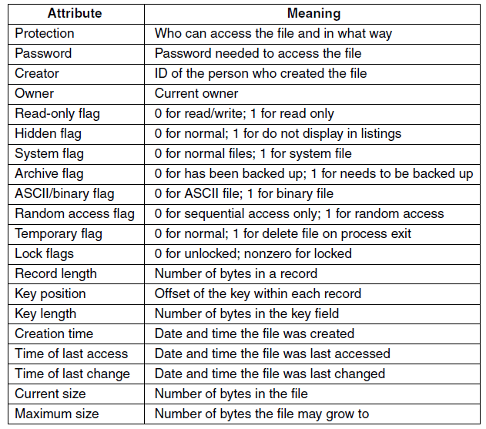
File Attributes
Figure 4-4. Some possible file attributes.
Tanenbaum & Bo, Modern Operating Systems:4th ed., (c) 2013 Prentice-Hall, Inc. All rights reserved.

Slide 9
File Operations
Create
Delete
Open
Close
Read
Write
Append
Seek
Get attributes
Set attributes
Rename
Tanenbaum & Bo, Modern Operating Systems:4th ed., (c) 2013 Prentice-Hall, Inc. All rights reserved.

Slide 10
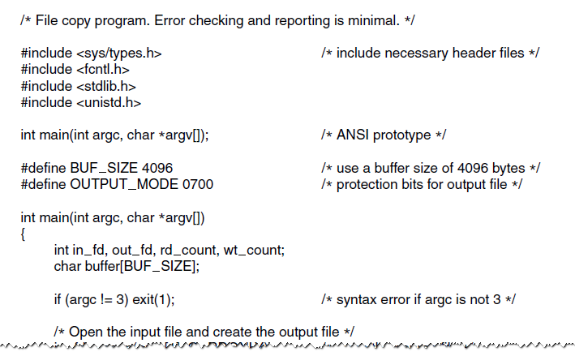
Example Program Using File System Calls (1)
Figure 4-5. A simple program to copy a file.
Tanenbaum & Bo, Modern Operating Systems:4th ed., (c) 2013 Prentice-Hall, Inc. All rights reserved.

Slide 11
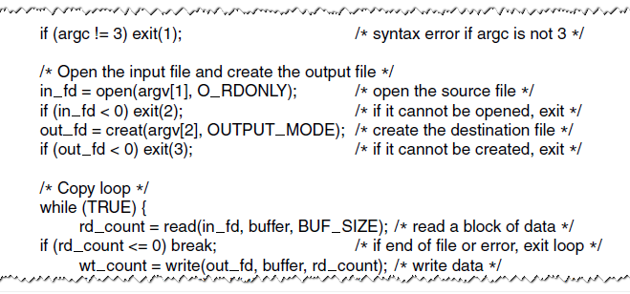
Example Program Using File System Calls (2)
Figure 4-5. A simple program to copy a file.
Tanenbaum & Bo, Modern Operating Systems:4th ed., (c) 2013 Prentice-Hall, Inc. All rights reserved.

Slide 12
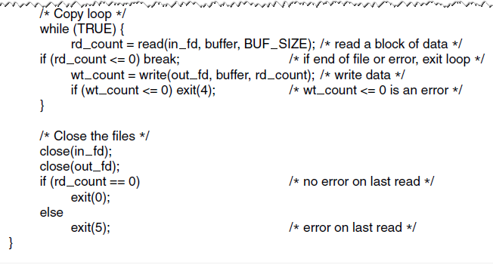
Example Program Using File System Calls (3)
Figure 4-5. A simple program to copy a file.
Tanenbaum & Bo, Modern Operating Systems:4th ed., (c) 2013 Prentice-Hall, Inc. All rights reserved.

Slide 13
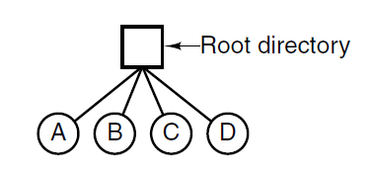
Single-Level Directory Systems
Figure 4-6. A single-level directory system containing four files.
Tanenbaum & Bo, Modern Operating Systems:4th ed., (c) 2013 Prentice-Hall, Inc. All rights reserved.

Slide 14
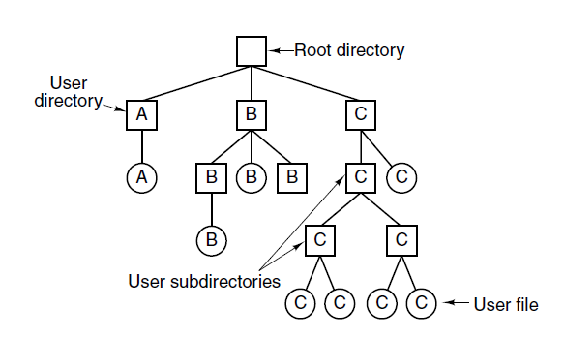
Hierarchical Directory Systems
Figure 4-7. A hierarchical directory system.
Tanenbaum & Bo, Modern Operating Systems:4th ed., (c) 2013 Prentice-Hall, Inc. All rights reserved.

Slide 15
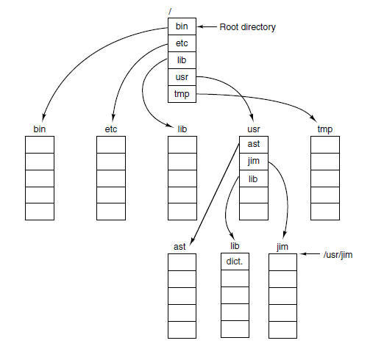
Path Names
Figure 4-8. A UNIX directory tree.
Tanenbaum & Bo, Modern Operating Systems:4th ed., (c) 2013 Prentice-Hall, Inc. All rights reserved.

Slide 16
Directory Operations
Create
Delete
Opendir
Closedir
Readdir
Rename
Link
Unlink
Tanenbaum & Bo, Modern Operating Systems:4th ed., (c) 2013 Prentice-Hall, Inc. All rights reserved.

Slide 17
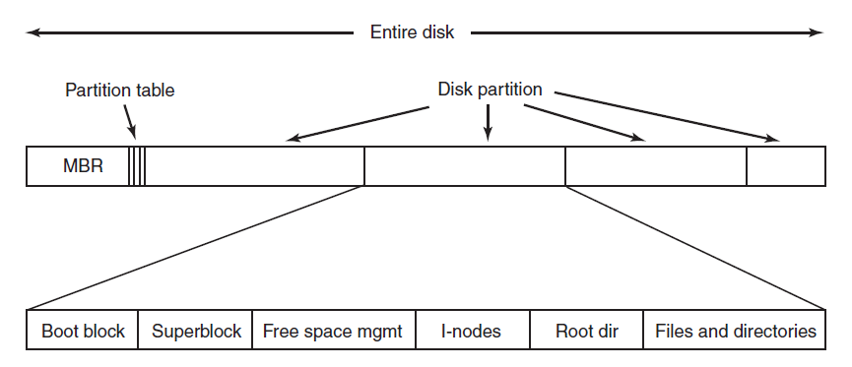
File System Layout
Figure 4-9. A possible file system layout.
Tanenbaum & Bo, Modern Operating Systems:4th ed., (c) 2013 Prentice-Hall, Inc. All rights reserved.

Slide 18
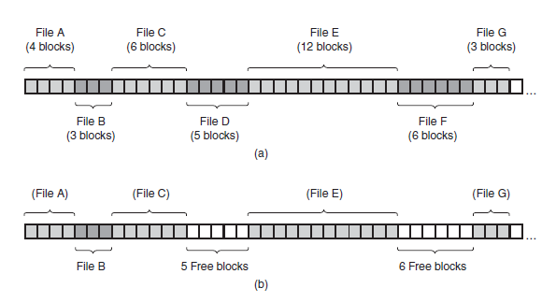
Implementing Files
Contiguous Layout
Figure 4-10. (a) Contiguous allocation of disk
space for seven files. (b) The state of the
disk after files D and F have been removed.
Tanenbaum & Bo, Modern Operating Systems:4th ed., (c) 2013 Prentice-Hall, Inc. All rights reserved.

Slide 19
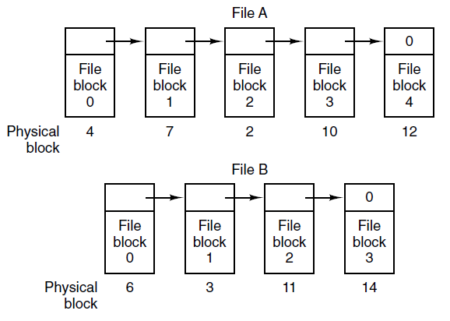
Implementing Files
Linked List Allocation
Figure 4-11. Storing a file as a linked list of disk blocks.
Tanenbaum & Bo, Modern Operating Systems:4th ed., (c) 2013 Prentice-Hall, Inc. All rights reserved.

Slide 20
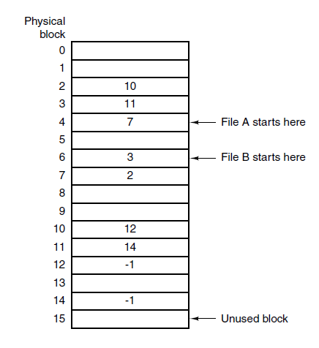
Implementing Files
Linked List – Table in Memory
Figure 4-12. Linked list allocation using a file
allocation table in main memory.
Tanenbaum & Bo, Modern Operating Systems:4th ed., (c) 2013 Prentice-Hall, Inc. All rights reserved.

Slide 21
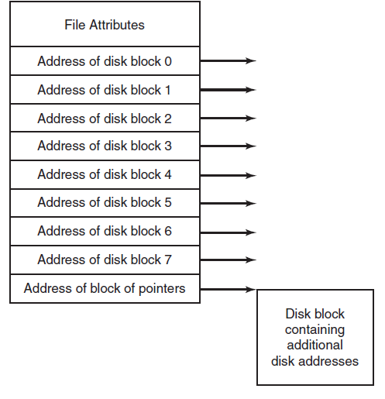
Implementing Files
I-nodes
Figure 4-13. An
example i-node.
Tanenbaum & Bo, Modern Operating Systems:4th ed., (c) 2013 Prentice-Hall, Inc. All rights reserved.

Slide 22
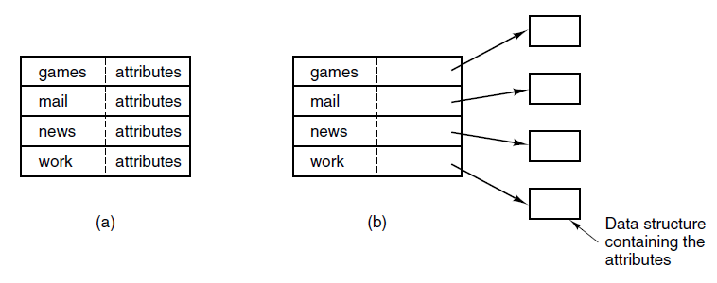
Implementing Directories (1)
Figure 4-14. (a) A simple directory containing fixed-size entries with the disk addresses and attributes in the directory entry. (b) A directory in which each
entry just refers to an i-node.
Tanenbaum & Bo, Modern Operating Systems:4th ed., (c) 2013 Prentice-Hall, Inc. All rights reserved.

Slide 23
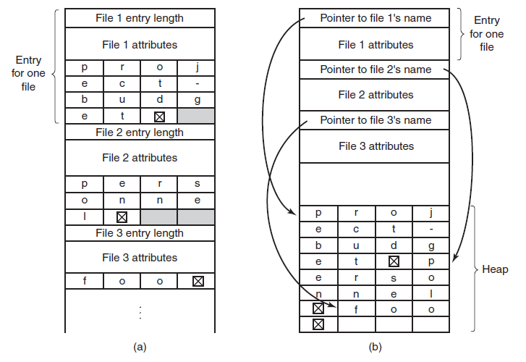
Implementing Directories (2)
Figure 4-15. Tw o ways of handling long file names in a directory. (a) In-line. (b) In a heap.
Tanenbaum & Bo, Modern Operating Systems:4th ed., (c) 2013 Prentice-Hall, Inc. All rights reserved.

Slide 24
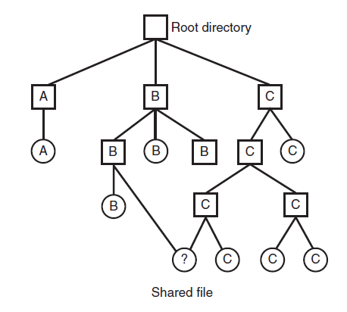
Shared Files (1)
Figure 4-16. File system containing a shared file.
Tanenbaum & Bo, Modern Operating Systems:4th ed., (c) 2013 Prentice-Hall, Inc. All rights reserved.

Slide 25
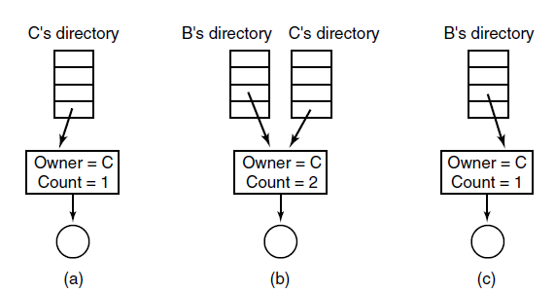
Shared Files (2)
Figure 4-17. (a) Situation prior to linking. (b) After the link is created. (c) After the original owner removes the file.
Tanenbaum & Bo, Modern Operating Systems:4th ed., (c) 2013 Prentice-Hall, Inc. All rights reserved.

Slide 26
Journaling File Systems
Steps to remove a file in UNIX:
Remove file from its directory.
Release i-node to the pool of free i-nodes.
Return all disk blocks to pool of free disk blocks.
Tanenbaum & Bo, Modern Operating Systems:4th ed., (c) 2013 Prentice-Hall, Inc. All rights reserved.

Slide 27
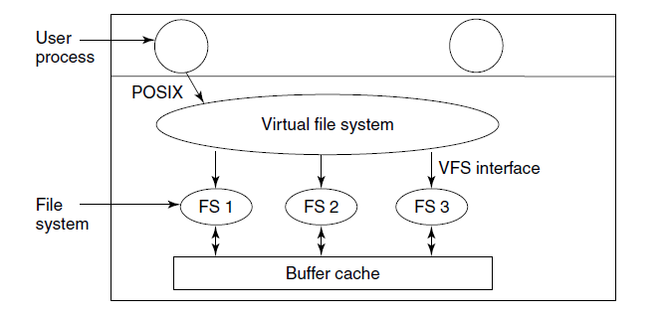
Virtual File Systems (1)
Figure 4-18. Position of the virtual file system.
Tanenbaum & Bo, Modern Operating Systems:4th ed., (c) 2013 Prentice-Hall, Inc. All rights reserved.

Slide 28
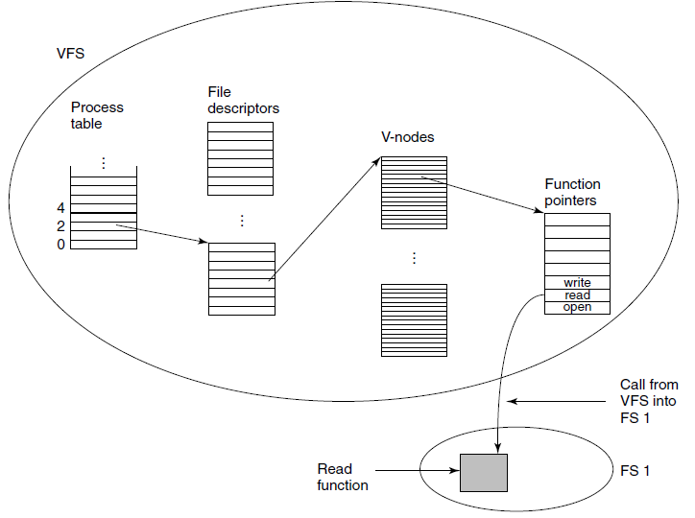
Virtual File Systems (2)
Figure 4-19. A simplified view of the data structures and code used by the VFS and concrete file system
to do a read.
Tanenbaum & Bo, Modern Operating Systems:4th ed., (c) 2013 Prentice-Hall, Inc. All rights reserved.

Slide 29
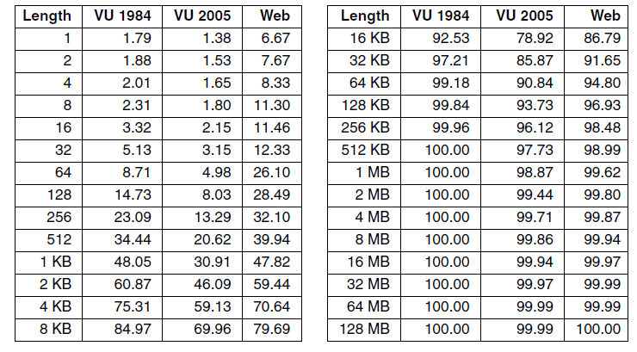
Disk Space Management (1)
Figure 4-20. Percentage of files smaller than a
given size (in bytes).
Tanenbaum & Bo, Modern Operating Systems:4th ed., (c) 2013 Prentice-Hall, Inc. All rights reserved.

Slide 30
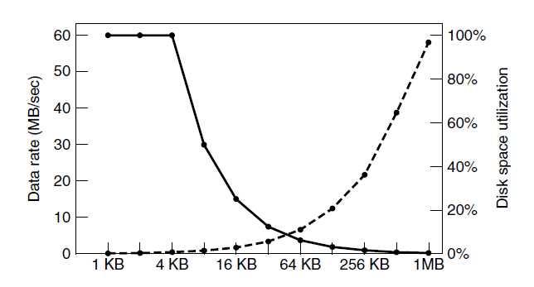
Disk Space Management (2)
Figure 4-21. The dashed curve (left-hand scale) gives the data rate of a disk. The solid curve (right-hand scale) gives the disk space efficiency. All files are 4 KB.
Tanenbaum & Bo, Modern Operating Systems:4th ed., (c) 2013 Prentice-Hall, Inc. All rights reserved.

Slide 31
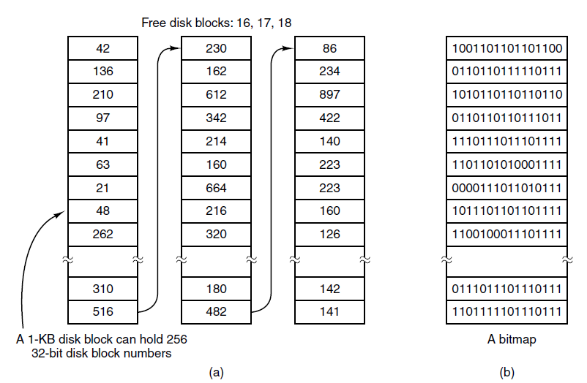
Keeping Track of Free Blocks (1)
Figure 4-22. (a) Storing the free list on a
linked list. (b) A bitmap.
Tanenbaum & Bo, Modern Operating Systems:4th ed., (c) 2013 Prentice-Hall, Inc. All rights reserved.

Slide 32
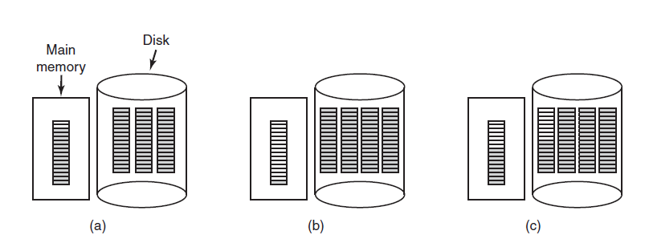
Keeping Track of Free Blocks (2)
Figure 4-23. (a) An almost-full block of pointers to free disk blocks in memory and three blocks of pointers on disk. (b) Result of freeing a three-block file. (c) An alternative strategy for handling the three free blocks. The shaded entries represent pointers to free disk blocks.
Tanenbaum & Bo, Modern Operating Systems:4th ed., (c) 2013 Prentice-Hall, Inc. All rights reserved.

Slide 33
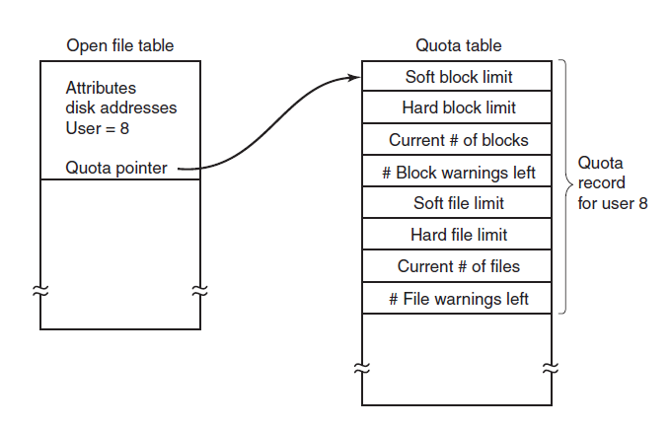
Disk Quotas
Figure 4-24. Quotas are kept track of on a
per-user basis in a quota table.
Tanenbaum & Bo, Modern Operating Systems:4th ed., (c) 2013 Prentice-Hall, Inc. All rights reserved.

Slide 34
File System Backups (1)
Backups to tape are generally made to handle one of two potential problems:
Recover from disaster.
Recover from stupidity.
Tanenbaum & Bo, Modern Operating Systems:4th ed., (c) 2013 Prentice-Hall, Inc. All rights reserved.

Slide 35
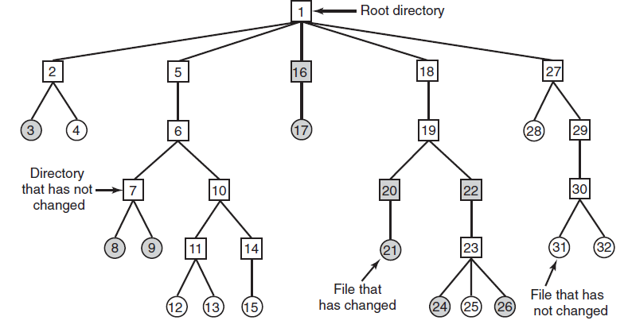
File System Backups (2)
Figure 4-25. A file system to be dumped. The squares are directories and the circles are files. The shaded items have been modified since the last dump. Each directory and file is labeled by its i-node number.
Tanenbaum & Bo, Modern Operating Systems:4th ed., (c) 2013 Prentice-Hall, Inc. All rights reserved.

Slide 36
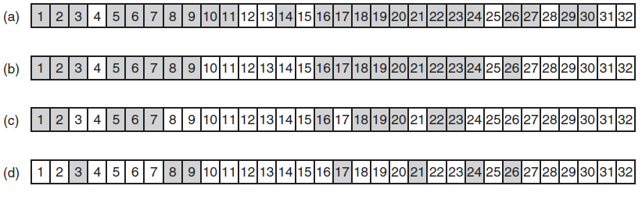
File System Backups (3)
Figure 4-26. Bitmaps used by the logical dumping algorithm.
Tanenbaum & Bo, Modern Operating Systems:4th ed., (c) 2013 Prentice-Hall, Inc. All rights reserved.

Slide 37
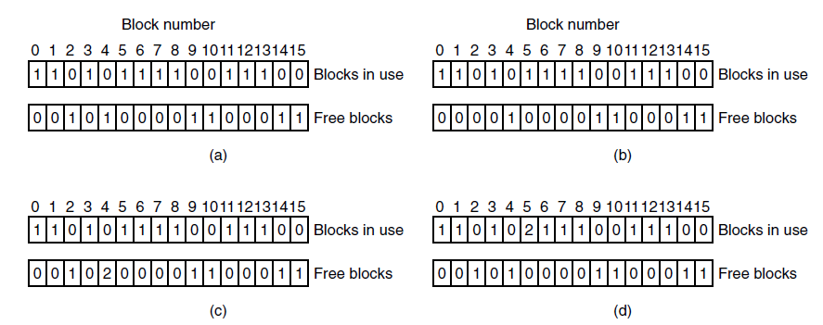
File System Consistency
Figure 4-27. File system states. (a) Consistent. (b) Missing block. (c) Duplicate block in free list. (d) Duplicate data block.
Tanenbaum & Bo, Modern Operating Systems:4th ed., (c) 2013 Prentice-Hall, Inc. All rights reserved.

Slide 38
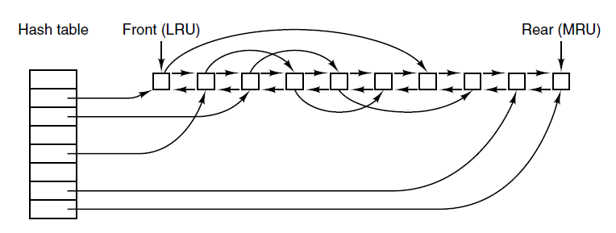
File System Performance (1)
Figure 4-28. The buffer cache data structures.
Tanenbaum & Bo, Modern Operating Systems:4th ed., (c) 2013 Prentice-Hall, Inc. All rights reserved.

Slide 39
File System Performance (2)
Some blocks rarely referenced two times within a short interval.
Leads to a modified LRU scheme, taking two factors into account:
  Is the block likely to be needed again soon?
  Is the block essential to the consistency of the file system?
Tanenbaum & Bo, Modern Operating Systems:4th ed., (c) 2013 Prentice-Hall, Inc. All rights reserved.

Slide 40
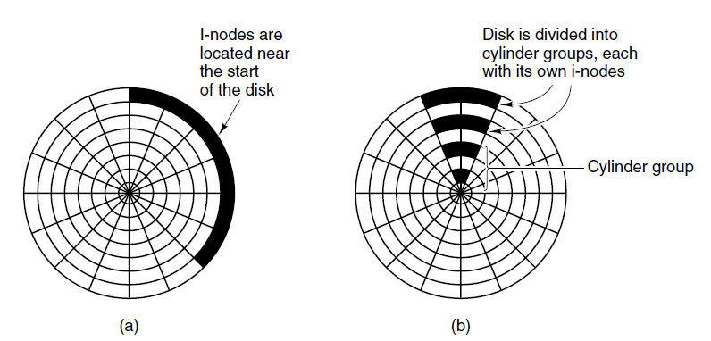
Reducing Disk Arm Motion
Figure 4-29. (a) I-nodes placed at the start of the
disk. (b) Disk divided into cylinder groups, each
with its own blocks and i-nodes.
Tanenbaum & Bo, Modern Operating Systems:4th ed., (c) 2013 Prentice-Hall, Inc. All rights reserved.

Slide 41
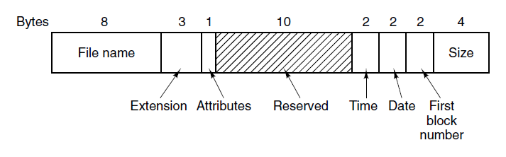
The MS-DOS File System (1)
Figure 4-30. The MS-DOS directory entry.
Tanenbaum & Bo, Modern Operating Systems:4th ed., (c) 2013 Prentice-Hall, Inc. All rights reserved.

Slide 42
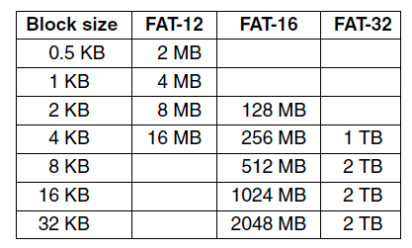
The MS-DOS File System (2)
Figure 4-31. Maximum partition size for different block sizes. The empty boxes represent forbidden combinations.
Tanenbaum & Bo, Modern Operating Systems:4th ed., (c) 2013 Prentice-Hall, Inc. All rights reserved.

Slide 43
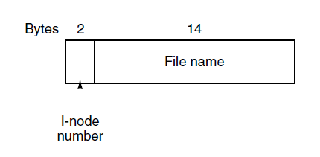
The UNIX V7 File System (1)
Figure 4-32. A UNIX V7 directory entry.
Tanenbaum & Bo, Modern Operating Systems:4th ed., (c) 2013 Prentice-Hall, Inc. All rights reserved.

Slide 44
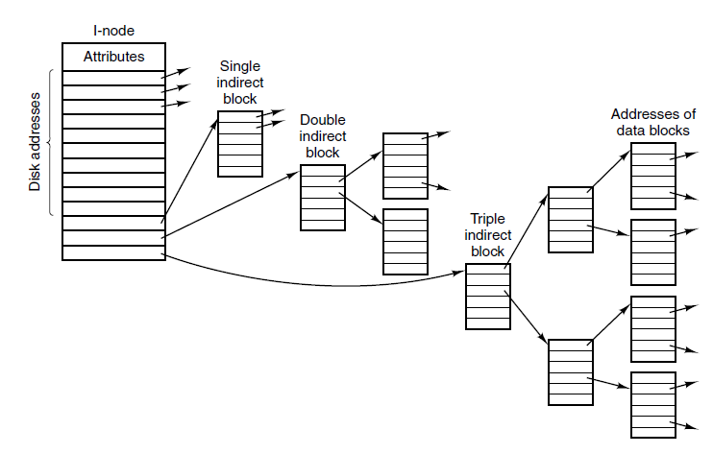
The UNIX V7 File System (2)
Figure 4-33. A UNIX i-node
Tanenbaum & Bo, Modern Operating Systems:4th ed., (c) 2013 Prentice-Hall, Inc. All rights reserved.

Slide 45
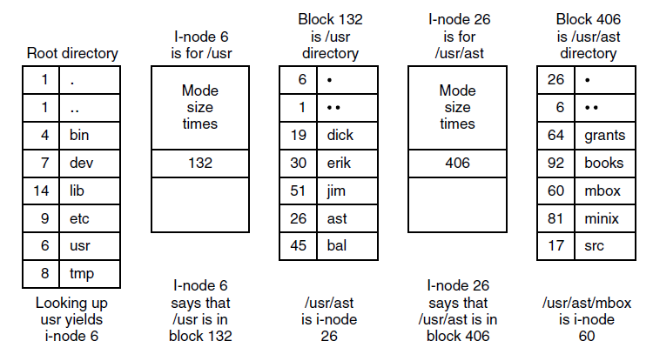
The UNIX V7 File System (3)
Figure 4-34. The steps in looking up /usr/ast/mbox.
Tanenbaum & Bo, Modern Operating Systems:4th ed., (c) 2013 Prentice-Hall, Inc. All rights reserved.

Slide 46
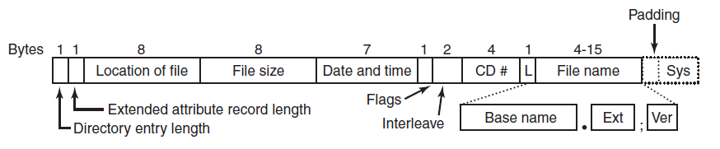
The ISO 9660 File System
Figure 4-35. The ISO 9660 directory entry.
Tanenbaum & Bo, Modern Operating Systems:4th ed., (c) 2013 Prentice-Hall, Inc. All rights reserved.

Slide 47
Rock Ridge Extensions
PX - POSIX attributes.
PN - Major and minor device numbers.
SL - Symbolic link.
NM - Alternative name.
CL - Child location.
PL - Parent location.
RE - Relocation.
TF - Time stamps.
Tanenbaum & Bo, Modern Operating Systems:4th ed., (c) 2013 Prentice-Hall, Inc. All rights reserved.

Slide 48
Joliet Extensions
Long file names.
Unicode character set.
Directory nesting deeper than eight levels.
Directory names with extensions
Tanenbaum & Bo, Modern Operating Systems:4th ed., (c) 2013 Prentice-Hall, Inc. All rights reserved.

Slide 49
End
Chapter 4
Tanenbaum & Bo, Modern Operating Systems:4th ed., (c) 2013 Prentice-Hall, Inc. All rights reserved.

