Slide 1
Deadlocks
Chapter 6
Tanenbaum & Bo, Modern Operating Systems:4th ed., (c) 2013 Prentice-Hall, Inc. All rights reserved.

Slide 2
Preemptable and Nonpreemptable Resources
Sequence of events required to use a resource
Request the resource.
Use the resource.
Release the resource.
Tanenbaum & Bo, Modern Operating Systems:4th ed., (c) 2013 Prentice-Hall, Inc. All rights reserved.

Slide 3
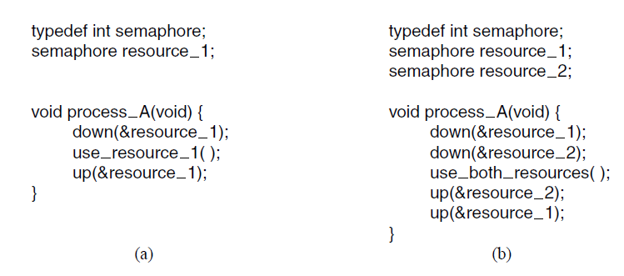
Resource Acquisition (1)
Figure 6-1. Using a semaphore to protect resources.
(a) One resource. (b) Two resources.
Tanenbaum & Bo, Modern Operating Systems:4th ed., (c) 2013 Prentice-Hall, Inc. All rights reserved.

Slide 4
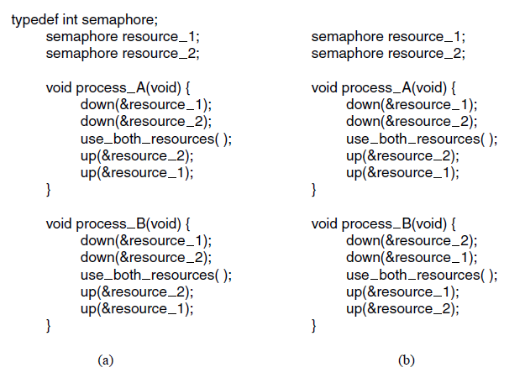
Resource Acquisition (2)
Figure 6-2. (a) Deadlock-free code.
(b) Code with a potential deadlock.
Tanenbaum & Bo, Modern Operating Systems:4th ed., (c) 2013 Prentice-Hall, Inc. All rights reserved.

Slide 5
Deadlock Definition
A set of processes is deadlocked if …
Each process in the set waiting for an event
That event can be caused only by another process
Tanenbaum & Bo, Modern Operating Systems:4th ed., (c) 2013 Prentice-Hall, Inc. All rights reserved.

Slide 6
Conditions for Resource Deadlocks
Four conditions that must hold:
Mutual exclusion
Hold and wait
No preemption
Circular wait condition
Tanenbaum & Bo, Modern Operating Systems:4th ed., (c) 2013 Prentice-Hall, Inc. All rights reserved.

Slide 7
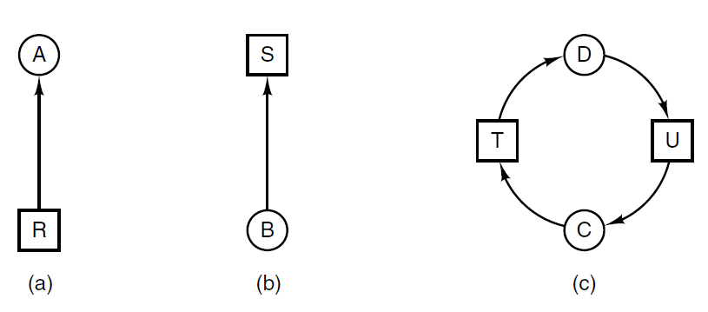
Deadlock Modeling (1)
Figure 6-3. Resource allocation graphs. (a) Holding a resource. (b) Requesting a resource. (c) Deadlock.
Tanenbaum & Bo, Modern Operating Systems:4th ed., (c) 2013 Prentice-Hall, Inc. All rights reserved.

Slide 8
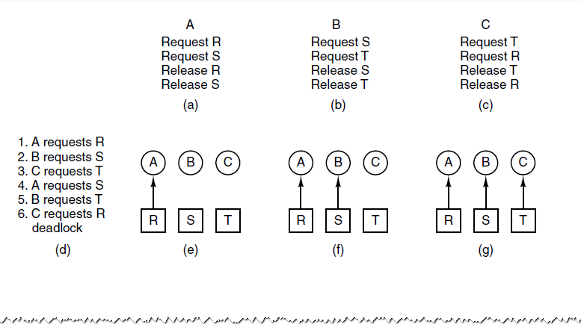
Deadlock Modeling (2)
Figure 6-4. An example of how deadlock occurs
and how it can be avoided.
Tanenbaum & Bo, Modern Operating Systems:4th ed., (c) 2013 Prentice-Hall, Inc. All rights reserved.

Slide 9
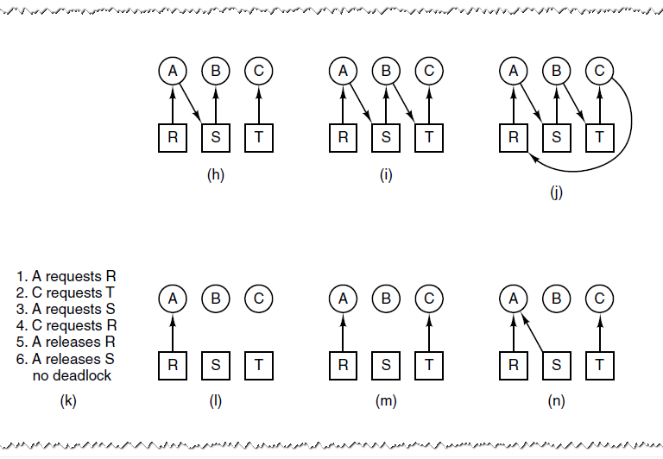
Deadlock Modeling (3)
Figure 6-4. An example of how deadlock occurs
and how it can be avoided.
Tanenbaum & Bo, Modern Operating Systems:4th ed., (c) 2013 Prentice-Hall, Inc. All rights reserved.

Slide 10
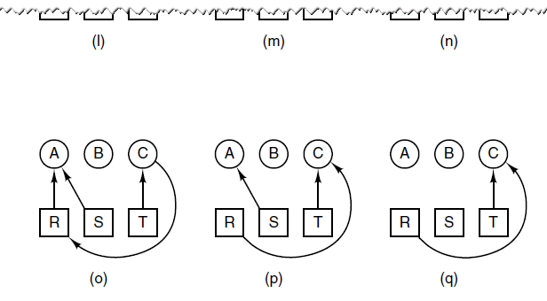
Deadlock Modeling (4)
Figure 6-4. An example of how deadlock occurs
and how it can be avoided.
Tanenbaum & Bo, Modern Operating Systems:4th ed., (c) 2013 Prentice-Hall, Inc. All rights reserved.

Slide 11
Deadlock Modeling (5)
Strategies are used for dealing with deadlocks:
Ignore the problem, maybe it will go away.
Detection and recovery. Let deadlocks occur, detect them, and take action.
Dynamic avoidance by careful resource allocation.
Prevention, by structurally negating one of the four required conditions.
Tanenbaum & Bo, Modern Operating Systems:4th ed., (c) 2013 Prentice-Hall, Inc. All rights reserved.

Slide 12
Deadlock Detection with One Resource of Each Type (1)
Example of a system – is it deadlocked?
Process A holds R, wants S
Process B holds nothing, wants T
Process C holds nothing, wants S
Process D holds U, wants S and T
Process E holds T, wants V
Process F holds W, wants S
Process G holds V, wants U
Tanenbaum & Bo, Modern Operating Systems:4th ed., (c) 2013 Prentice-Hall, Inc. All rights reserved.

Slide 13
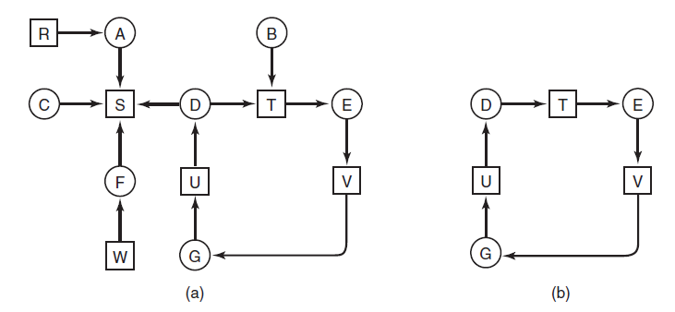
Deadlock Detection with One Resource of Each Type (2)
Figure 6-5. (a) A resource graph. (b) A cycle extracted from (a).
Tanenbaum & Bo, Modern Operating Systems:4th ed., (c) 2013 Prentice-Hall, Inc. All rights reserved.

Slide 14
Algorithm to Detect Deadlocks (1)
For each node, N in the graph, perform following five steps with N as starting node.
Initialize L to empty list, and designate all arcs as unmarked.
Add current node to end of L, check to see if node now appears in L two times. If so, graph contains a cycle (listed in L) and algorithm terminates
Tanenbaum & Bo, Modern Operating Systems:4th ed., (c) 2013 Prentice-Hall, Inc. All rights reserved.

Slide 15
Algorithm to Detect Deadlocks (2)
From given node, see if there are any unmarked outgoing arcs. If so, go to step 5; if not, go to step 6.
Pick unmarked outgoing arc at random, mark it. Then follow to new current node and go to step 3.
If this is initial node, graph does not contain cycles, algorithm terminates. Otherwise, dead end. Remove it and go back to the previous node.
Tanenbaum & Bo, Modern Operating Systems:4th ed., (c) 2013 Prentice-Hall, Inc. All rights reserved.

Slide 16
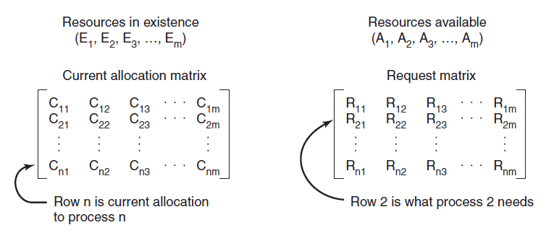
Deadlock Detection with Multiple Resources of Each Type (1)
Figure 6-6. The four data structures needed
by the deadlock detection algorithm.
Tanenbaum & Bo, Modern Operating Systems:4th ed., (c) 2013 Prentice-Hall, Inc. All rights reserved.

Slide 17
Deadlock Detection with Multiple Resources of Each Type (2)
Deadlock detection algorithm:
Look for unmarked process, P_{i} , for which the i-th row of R is less than or equal to A.
If such a process is found, add the i-th row of C to A, mark the process, go back to step 1.
If no such process exists, algorithm terminates.
Tanenbaum & Bo, Modern Operating Systems:4th ed., (c) 2013 Prentice-Hall, Inc. All rights reserved.

Slide 18
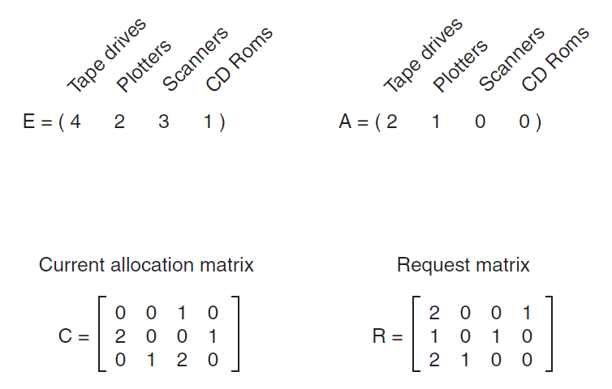
Deadlock Detection with Multiple Resources of Each Type (3)
Figure 6-7. An example for the deadlock detection algorithm.
Tanenbaum & Bo, Modern Operating Systems:4th ed., (c) 2013 Prentice-Hall, Inc. All rights reserved.

Slide 19
Recovery from Deadlock
Possible Methods of recovery (though none are “attractive”):
Preemption
Rollback
Killing processes
Tanenbaum & Bo, Modern Operating Systems:4th ed., (c) 2013 Prentice-Hall, Inc. All rights reserved.

Slide 20
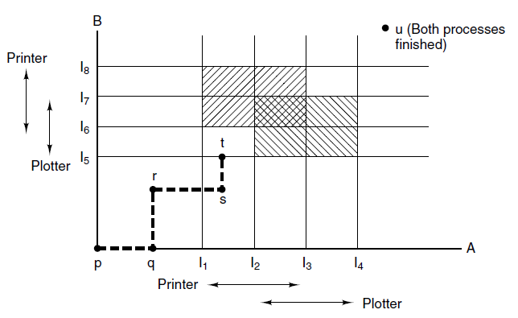
Deadlock Avoidance
Resource Trajectories
Figure 6-8. Two process resource trajectories.
Tanenbaum & Bo, Modern Operating Systems:4th ed., (c) 2013 Prentice-Hall, Inc. All rights reserved.

Slide 21
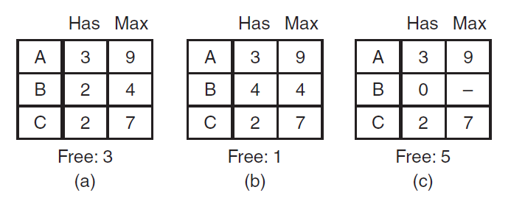
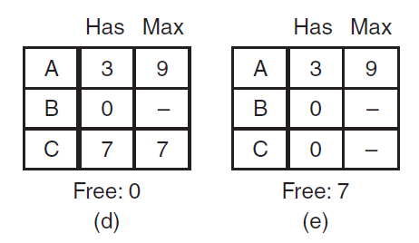
Safe and Unsafe States (1)
Figure 6-9. Demonstration that the state in (a) is safe.
Tanenbaum & Bo, Modern Operating Systems:4th ed., (c) 2013 Prentice-Hall, Inc. All rights reserved.

Slide 22
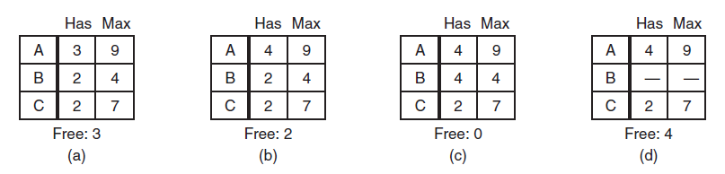
Safe and Unsafe States (2)
Figure 6-10. Demonstration that the state in (b) is not safe.
Tanenbaum & Bo, Modern Operating Systems:4th ed., (c) 2013 Prentice-Hall, Inc. All rights reserved.

Slide 23
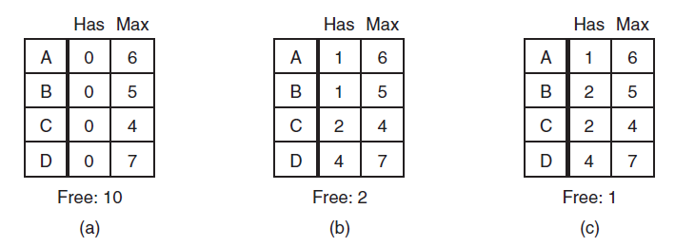
Banker’s Algorithm for
Single Resource
Figure 6-11. Three resource allocation states:
(a) Safe. (b) Safe. (c) Unsafe.
Tanenbaum & Bo, Modern Operating Systems:4th ed., (c) 2013 Prentice-Hall, Inc. All rights reserved.

Slide 24
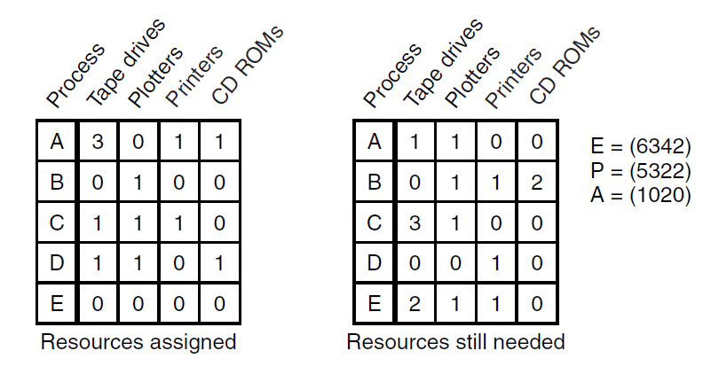
Banker’s Algorithm for
Multiple Resources (1)
Figure 6-12. The banker’s algorithm with multiple resources.
Tanenbaum & Bo, Modern Operating Systems:4th ed., (c) 2013 Prentice-Hall, Inc. All rights reserved.

Slide 25
Banker’s Algorithm for
Multiple Resources (2)
Look for a row, R, whose unmet resource needs are all smaller than or equal to A. If no such row exists, system will eventually deadlock.
Assume the process of row chosen requests all resources needed and finishes. Mark that process as terminated, add its resources to the A vector.
Repeat steps 1 and 2 until either all processes are marked terminated (safe state) or no process is left whose resource needs can be met (deadlock)
Tanenbaum & Bo, Modern Operating Systems:4th ed., (c) 2013 Prentice-Hall, Inc. All rights reserved.

Slide 26
Deadlock Prevention
Assure that at least one of conditions is never satisfied
Mutual exclusion
Hold and wait
No Preemption
Circular wait
Tanenbaum & Bo, Modern Operating Systems:4th ed., (c) 2013 Prentice-Hall, Inc. All rights reserved.

Slide 27
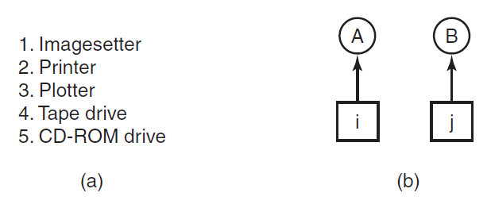
Attacking Circular Wait Condition (1)
Figure 6-13. (a) Numerically ordered resources.
(b) A resource graph
Tanenbaum & Bo, Modern Operating Systems:4th ed., (c) 2013 Prentice-Hall, Inc. All rights reserved.

Slide 28
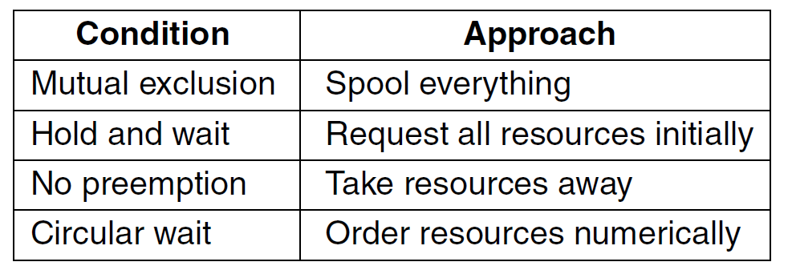
Attacking Circular Wait Condition (2)
Figure 6-14. Summary of approaches to deadlock prevention.
Tanenbaum & Bo, Modern Operating Systems:4th ed., (c) 2013 Prentice-Hall, Inc. All rights reserved.

Slide 29
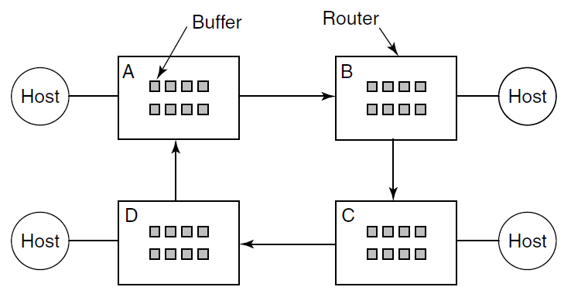
Communication Deadlocks
Figure 6-15. A resource deadlock in a network.
Tanenbaum & Bo, Modern Operating Systems:4th ed., (c) 2013 Prentice-Hall, Inc. All rights reserved.

Slide 30
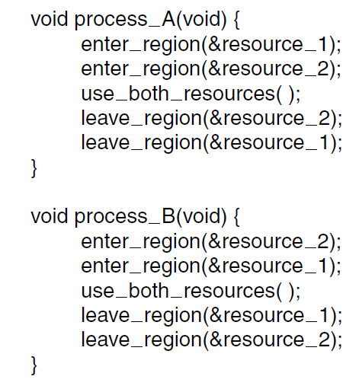
Livelock
Figure 6-16. Busy waiting that can lead to livelock.
Tanenbaum & Bo, Modern Operating Systems:4th ed., (c) 2013 Prentice-Hall, Inc. All rights reserved.

Slide 31
End
Chapter 6
Tanenbaum & Bo, Modern Operating Systems:4th ed., (c) 2013 Prentice-Hall, Inc. All rights reserved.

