Slide 1
cALorie
Teaching a computer to name your exercise from a workout video
Pose-based exercise recognition · final project · 2026
Notes:
cALorie watches a workout video and says which exercise you are doing, minute by minute. This talk covers how it works, what we measured, and where it still fails.

Slide 2
From video to an exercise timeline
Video
Pose
Gate
Classifier
Timeline
a workout, 20–45 min
17 body joints found in every frame (MediaPipe)
is this a known exercise, or rest or something else?
which of 14 exercises is it?
“0:45–1:30 squats …”
Two small neural networks read how the body moves over about 4 seconds. Rests, warm-ups, and moves we don’t support should come out as “unknown”.
Notes:
The model never looks at pixels. MediaPipe turns each frame into 17 body points. A gate decides if a moment is a supported exercise. A classifier names it. A smoothing step turns the flickering predictions into clean segments.

Slide 3
Short clips looked great. Real workouts did not
82%
33%
55%
score on short, trimmed clips (the usual test)
score on full, real workouts it had never seen
of real exercise time thrown away as “unknown”
Real sessions have rests, timers, intros, camera changes, and exercises the model barely knew: sit-up, row, lunge, shoulder press, and triceps all scored 0%.
Notes:
Macro F1 averages the score over exercises so rare ones count equally. 82 percent was the old internal test of short clips. On eight full follow-along workouts, the same model scored 33 percent, and more than half of the real exercise time was rejected.

Slide 4
The fix: label real workouts, second by second
34 h
19 h
100%
of video turned into pose data, from about 2,900 clips and videos
of it real follow-along workouts: 38 videos labeled second by second
of 210 random segments spot-checked by hand were correct
Every second of these 38 workouts is rest, warm-up, a supported exercise, or “unknown”. Together with about 2,850 shorter clips, that is roughly 34 hours of video turned into body-pose data. Two video sets were locked away and never used to train or tune.
Notes:
In total about 34 hours of video was processed: roughly 1,800 short training clips (7.7 h), 1,040 RepCount clips (7.3 h), and 38 long workouts (18.8 h). We collected the 38 follow-along videos from creators we had not used before, screened out vlogs and montages, and labeled every second using a 23-rule annotation guide. The spot checks were 44 of 44, 95 of 95, and 71 of 71 correct. Two test sets were locked with file fingerprints before any model was scored.

Slide 5
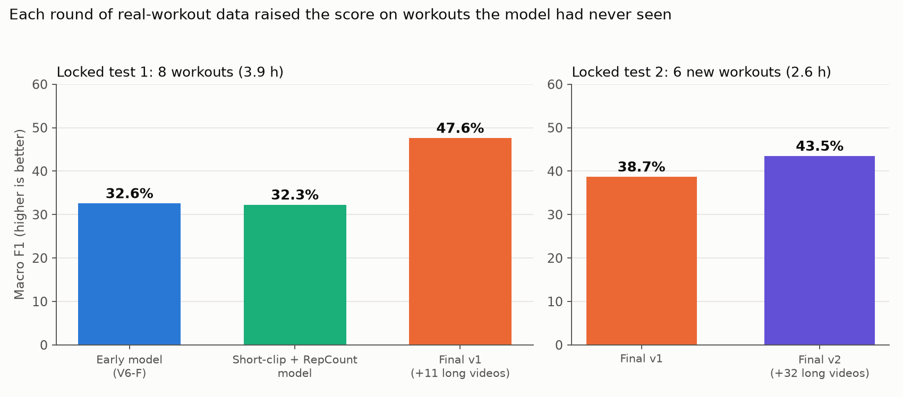
More real workouts raised the score every time
Notes:
Left: eight unseen workouts. The early model and the short-clip model scored about 32 percent. Adding eleven long videos gave 47.6 percent. Right: six brand-new workouts from new creators. Final v1 scored 38.7 percent; adding more data gave 43.5 percent, with all four pre-set criteria met. The two tests are different videos, so compare bars within a panel.

Slide 6
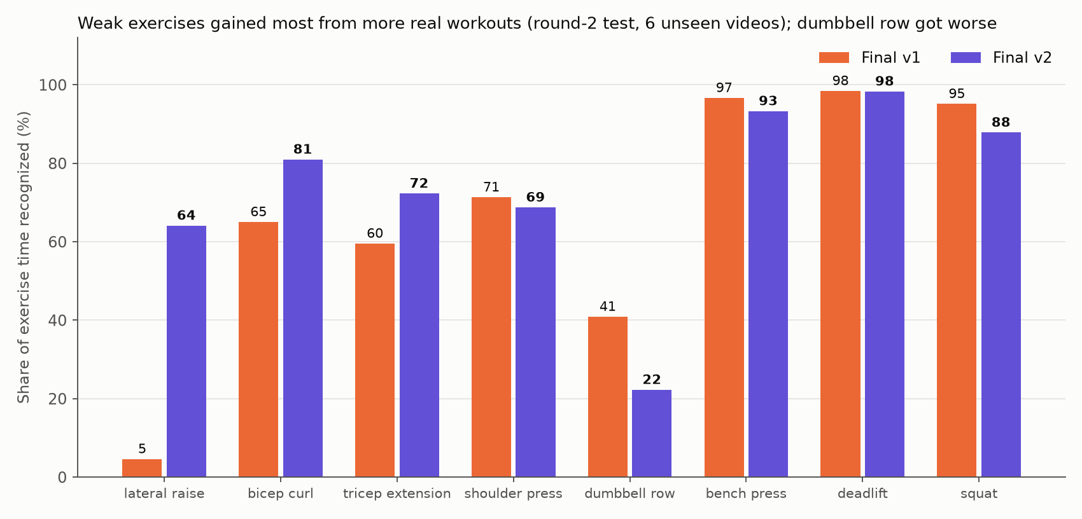
Weak exercises improved; row slipped
Notes:
Lateral raise went from 5 to 64 percent, curls 65 to 81, triceps 60 to 72. Dumbbell row dropped from 41 to 22, and squat from 95 to 88. We report that honestly: more data is not better for every exercise at once.

Slide 7
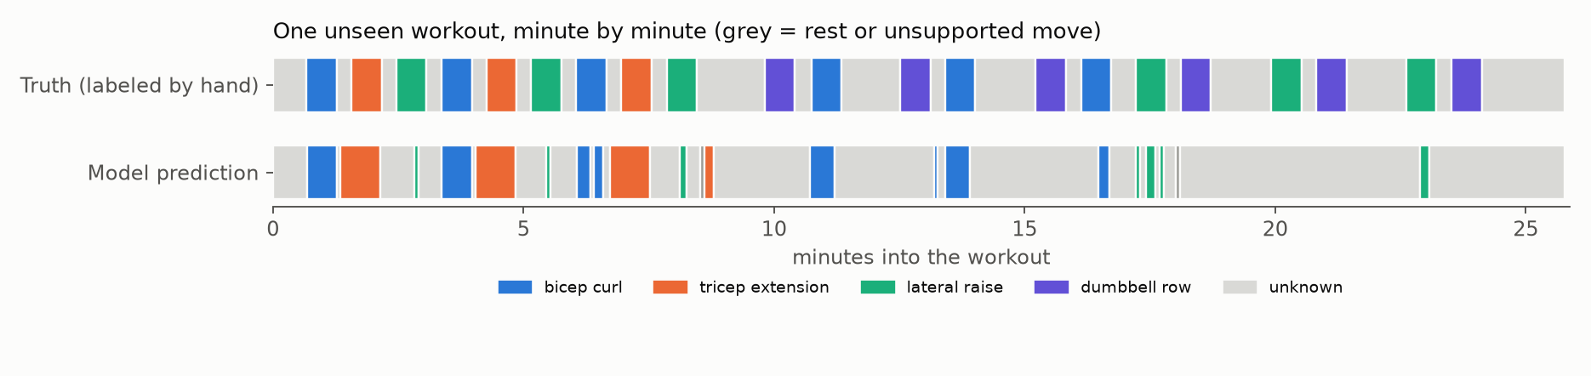
What the model sees, minute by minute
Gets right
Most curl and triceps blocks are found in the right place.
Rests and timer screens mostly stay “unknown”.
Still gets wrong
About 30% of real exercise time is still missed.
Many rows and lateral raises become “unknown”.
Notes:
This is one real unseen workout from the second test. Top row is what a human labeled; bottom row is the model. The match is imperfect, which is why we also report the numbers, not just pictures.

Slide 8
How we kept the results honest
1
Rules before results
Every experiment’s pass rule was written and pushed before it ran.
2
Locked tests
Test videos were fingerprinted and never used for training or tuning.
3
Failures kept
Experiments that missed a bar are reported as failures, not hidden.
4
Humans in the loop
Labels follow a written guide; I checked random samples by eye.
Notes:
Two earlier experiments missed their pass rule and were reported as failures. The first full retraining failed on the gate; the rebalanced one came close but also missed the bar by five points. We froze it anyway, labeled as not passing, and scored it once on the locked test.

Slide 9
A small local app: upload a video, get the timeline
Runs on your own computer. One command starts it; long videos (up to 4 GB) are fine.
Shows the exercise timeline and time per exercise.
Counts reps for 5 exercises and estimates calories with a ±35% range.
Your video is never uploaded anywhere.
68%
of unseen clips counted within one rep of a human (sealed test)
Calories use one fixed MET value per exercise and could not be validated.
Notes:
The web page is a Streamlit script. Reps come from a simple peak counter tuned on dev clips and scored once on a sealed test: 68 percent within one rep, 39 percent exact. Calories use the standard formula with a fixed MET per exercise and a plus or minus 35 percent range, because we have no ground truth for them.

Slide 10
Limits, and what comes next
Limits
Tested on only 6 (and 8) unseen workouts.
About 30% of real exercise time is still missed.
Dumbbell row and squat got worse in round 2.
Reps and calories are approximate.
Next
More workouts from more people for the weak exercises.
A fresh locked test, since these are now spent.
Better rep counting and a real calorie check.
A friendlier app on top.
Notes:
The honest summary: each round of real workout data helped, the model is still research-grade, and the next step is more varied data and a fresh test set.

