Slide 1
What factors affect information spreading with Gossip?
Ali, Tao, Jeremy

Slide 2
Overview
Gossip protocols - also known as epidemic protocols.
Spreading of information like a gossip/rumour/infection.
Used because it’s robust, efficient, and a simple idea.

Slide 3
Use cases
Disseminate information - from a single node to a network.
Determine aggregate information of nodes in a network.
Meta-gossip: using gossip to facilitate routing.
Lots of good examples here.
Costa, Paolo, et al. "Exploring the interdisciplinary connections of gossip-based systems." ACM SIGOPS Operating Systems Review 41.5 (2007): 51-60.

Slide 4
Tradeoffs
Fooding
Fast and robust
Tree
Fast and efficient
Gossip
Efficient and robust
random.sample([efficient, fast, robust], 2)

Slide 5
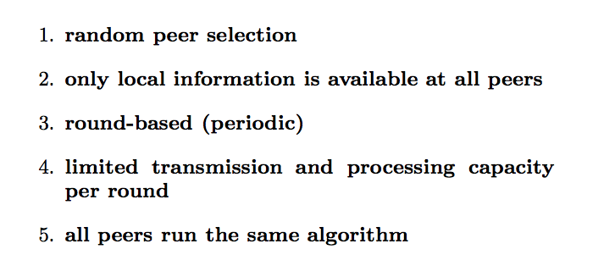
More Precisely
Costa, Paolo, et al. "Exploring the interdisciplinary connections of gossip-based systems." ACM SIGOPS Operating Systems Review 41.5 (2007): 51-60.

Slide 6
Data Aggregation in Gossip Algorithm
The goal is to have every node compute the average of all node’s values in the system.
Some common computations: Averaging, Sum, Min, Max.
Kempe, David, Alin Dobra, and Johannes Gehrke. "Gossip-based computation of aggregate information." Foundations of Computer Science, 2003. Proceedings. 44th Annual IEEE Symposium on. IEEE, 2003.

Slide 7
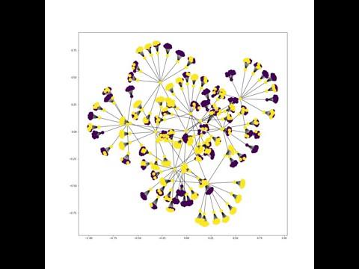
Message Dissemination in Balanced Tree (initiated at a leaf)
Gossip-Push protocol

Slide 8
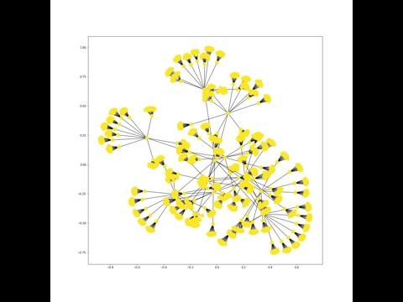
Message Dissemination in Balanced Tree
(initiated at the center)

Slide 9
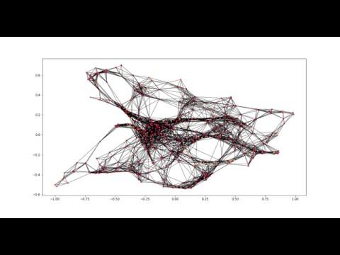

Slide 10
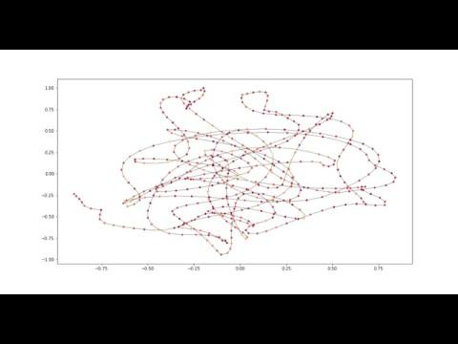

Slide 11
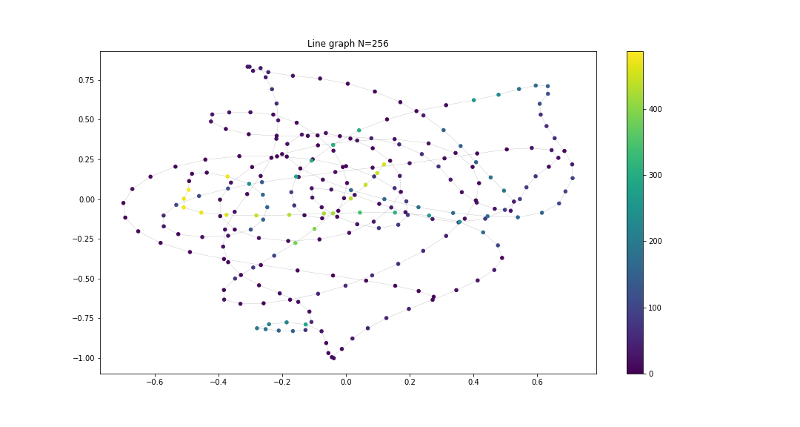
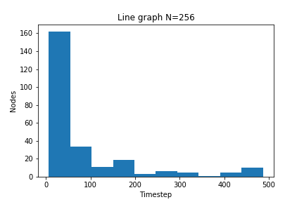

Slide 12
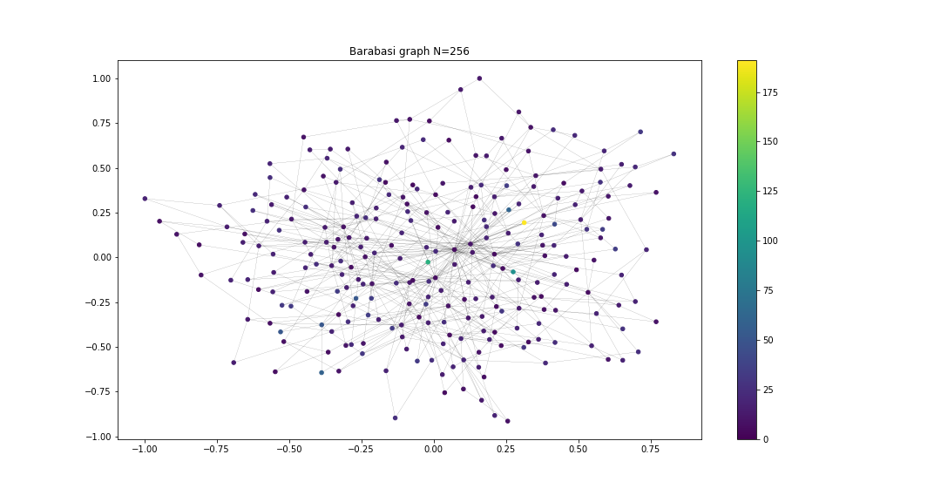
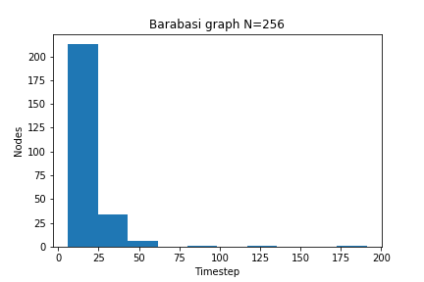

Slide 13
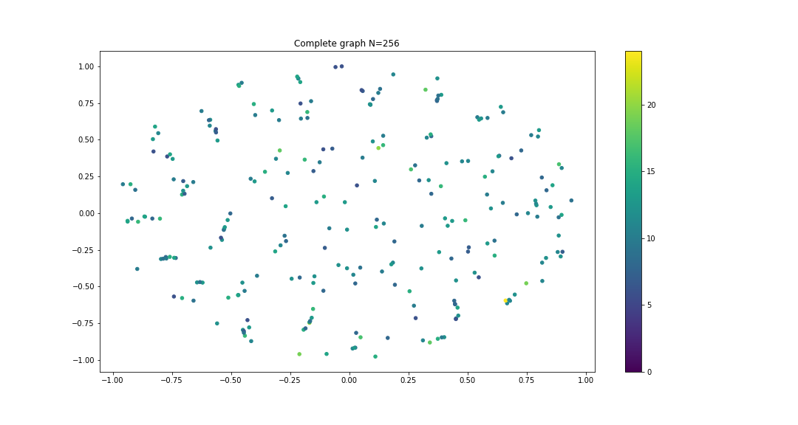
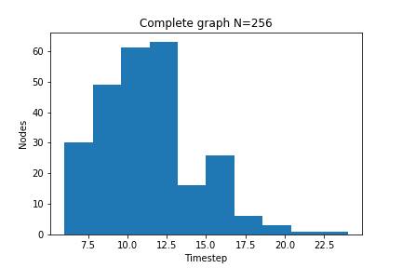

Slide 14
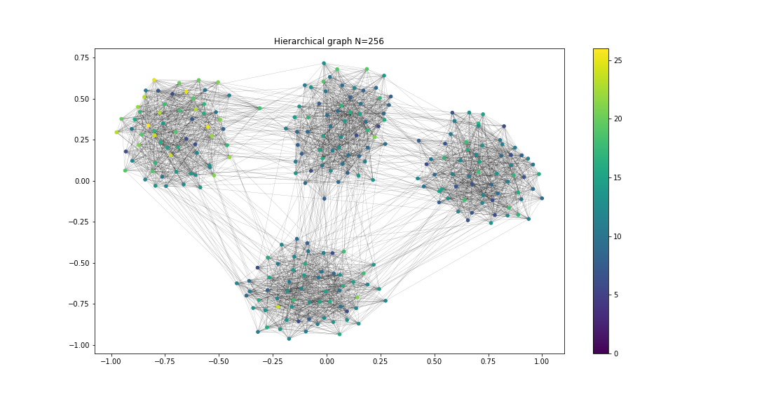
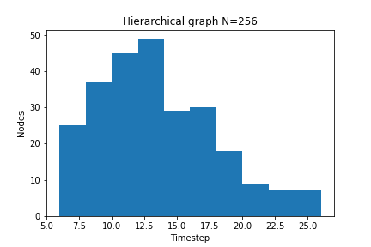

Slide 15
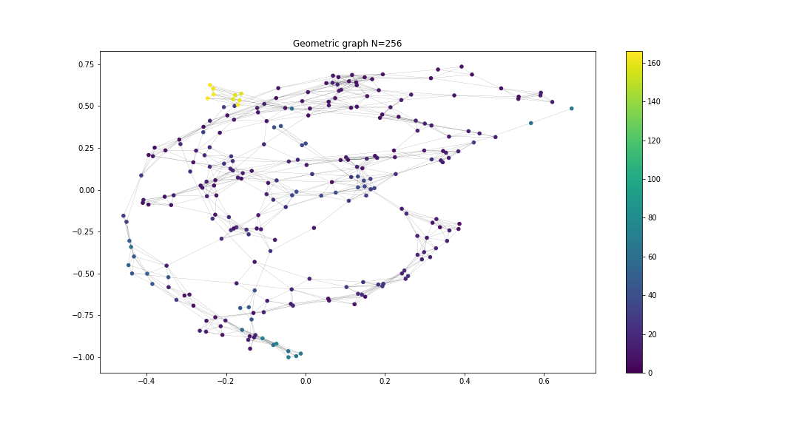
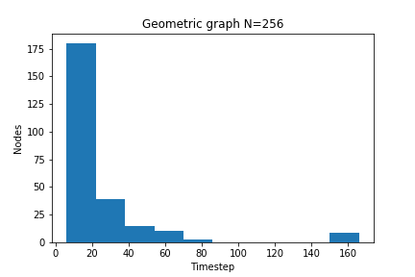

Slide 16
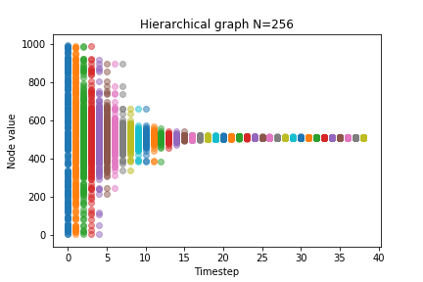
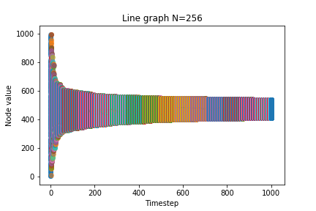
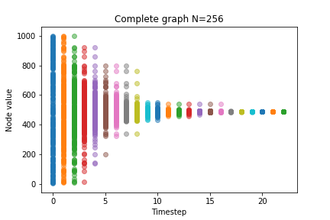
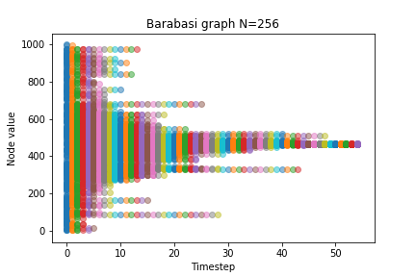
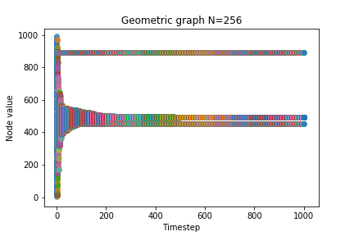

Slide 17
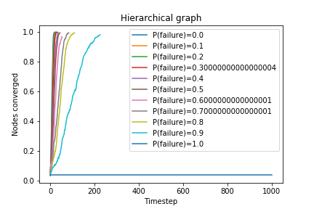
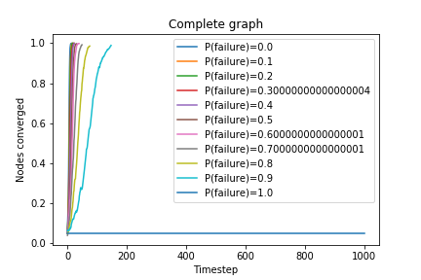
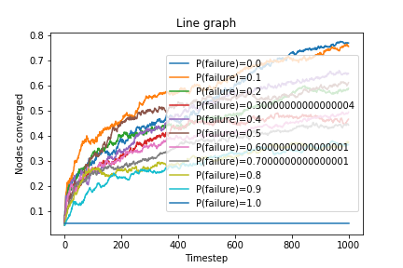
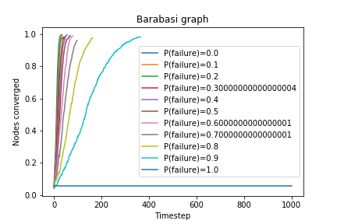
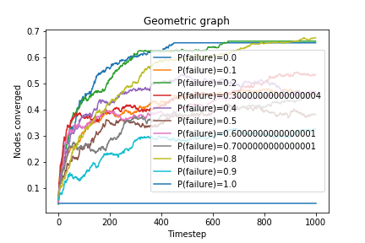

Slide 18
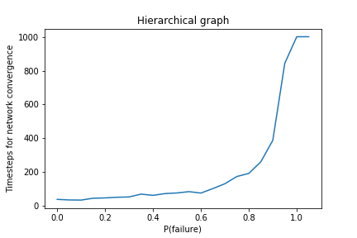
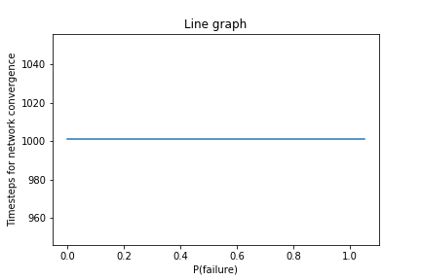
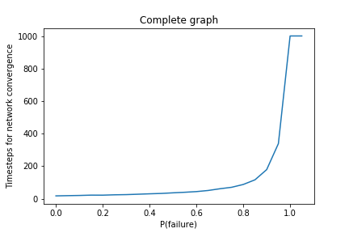
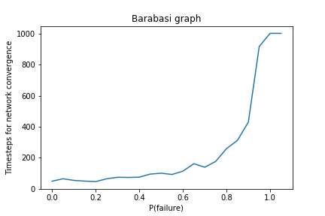
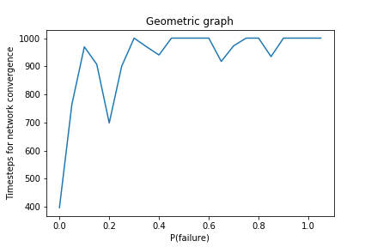

Slide 19
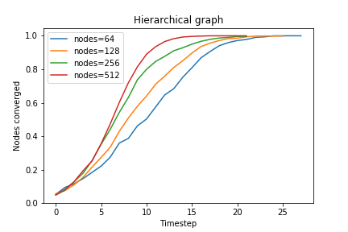
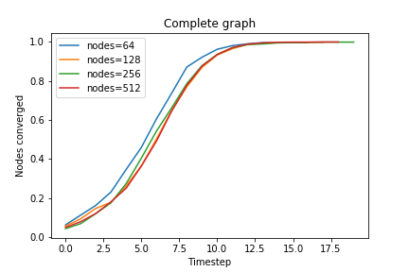
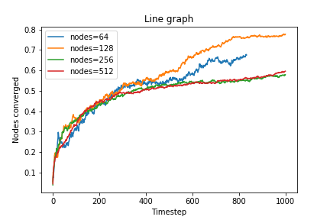
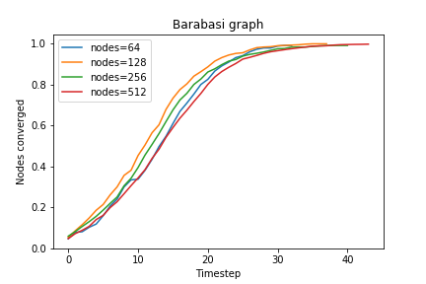
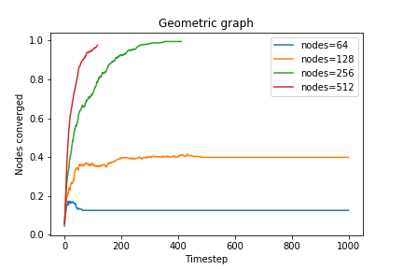

Slide 20
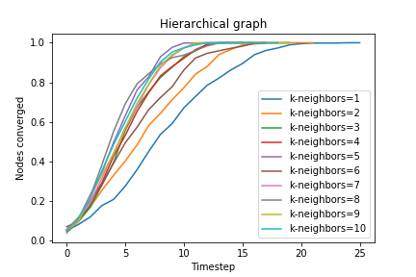
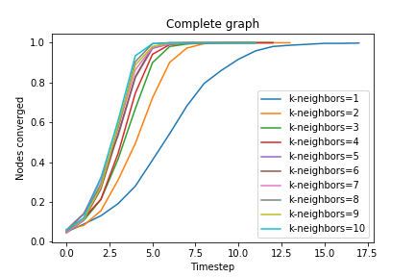
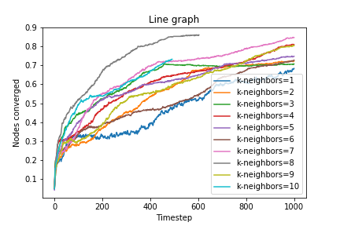
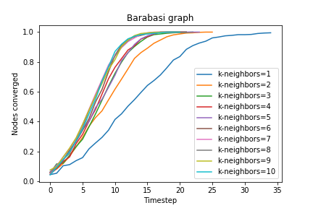
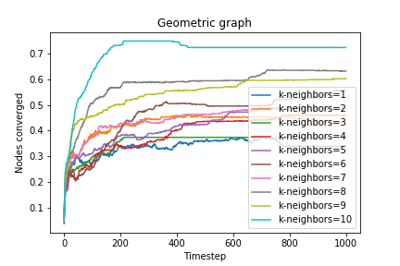

Slide 21
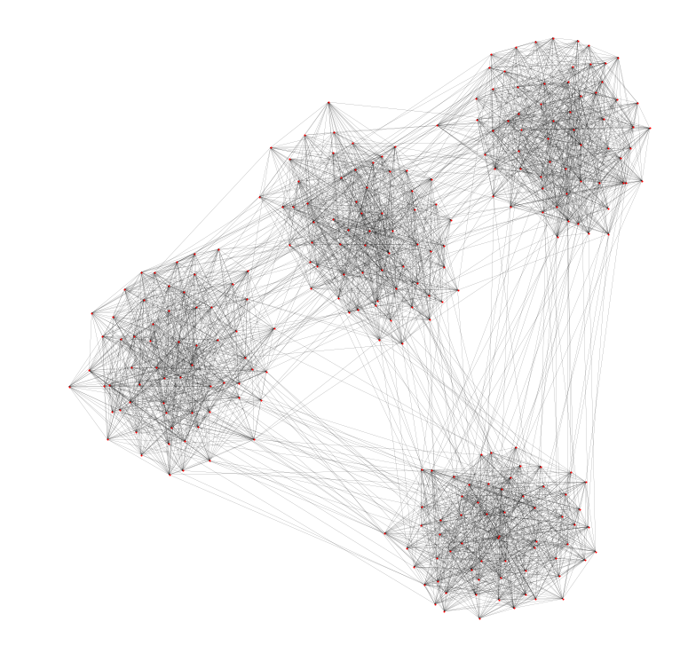
Package Delivery Model on Hierarchical Gossip Network
Hierarchical Network
256 nodes
First level: 16 communities(z1=12)
Second level: 4 communities in a
group (z2=5)
Third level: All individual nodes(z3=1)

Slide 22
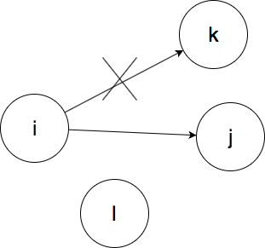
Two Kinds of Noise
Topology Noise p:
Partially false knowledge of network topology (rewiring)
Dynamic Noise q:
Package path does not follow
from deterministic rules

Slide 23
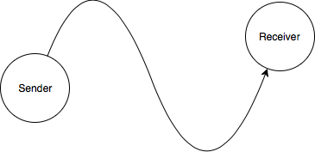

Procedure
Set Constant Time deadline T, topology noise p, dynamic noise q. Randomly choose sender node s and receiver node r.
If t<T, continue dynamics, go to Step 3. Otherwise considered as undelivered.
If receiver node r is the neighbor of sender node s, package move from s to r with probability 1-q, otherwise go to Step 4.

Slide 24
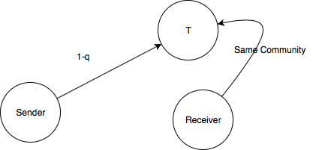
Procedure (Continued)
4. If there is a node t that belongs to the same community as the receiver r among the neighbors of node s, package move from s to t with probability 1-q. otherwise go to Step 5.
5. Randomly choose one of the nearest neighbors node X of the node s and send the packet from node s to X.
6. If the package reaches it destination, end loop. Otherwise, t=t+1, continue iteration from step 2.

Slide 25
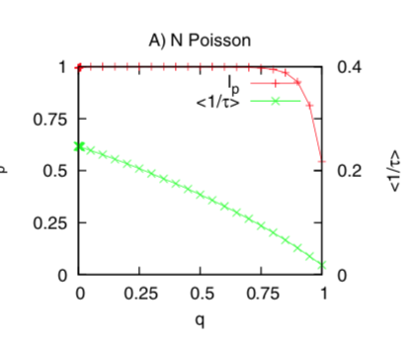
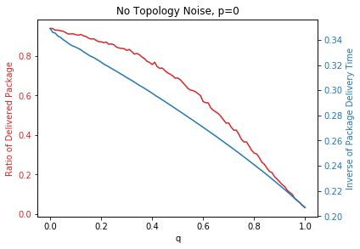
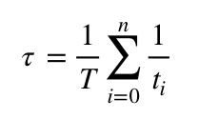
Simulation (p=0)
Agnieszka Czaplicka, Janusz A. Ho􏰀lyst, and Peter M.A. Sloot
Stochastic resonance for information flows on hierarchical networks
Inverse of Package Delivery Time:

Slide 26
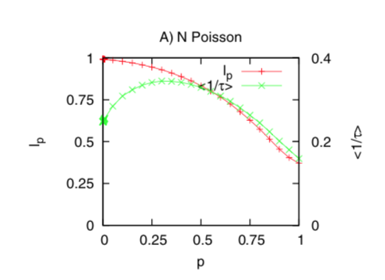
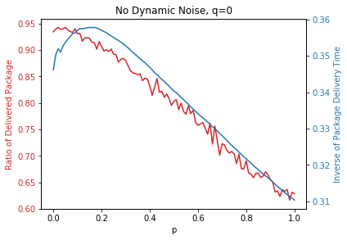
Simulation (q=0)
Agnieszka Czaplicka, Janusz A. Ho􏰀lyst, and Peter M.A. Sloot
Stochastic resonance for information flows on hierarchical networks
The average time of package delivery is minimal
when the inverse of package delivery time is maximize.
P is approximately 0.2.
Probably a result of an increasing clustering
coefficient due to random rewiring.

Slide 27
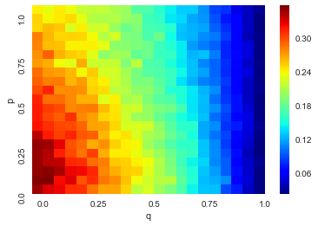

Heatmap with both noise
Inverse of Package Delivery Time:
Agnieszka Czaplicka, Janusz A. Ho􏰀lyst, and Peter M.A. Sloot
Stochastic resonance for information flows on hierarchical networks

Slide 28


Heatmap with both noise
Success Delivery Rate(T=10)
Agnieszka Czaplicka, Janusz A. Ho􏰀lyst, and Peter M.A. Sloot
Stochastic resonance for information flows on hierarchical networks

Slide 29

Future Work
Gossip network with Tree structure
Multiple Identical Network connect together
Agnieszka Czaplicka, Janusz A. Ho􏰀lyst, and Peter M.A. Sloot
Stochastic resonance for information flows on hierarchical networks

