Slide 1
Chest X-Ray Pneumonia Detection
Classical ML vs Deep Learning
SVM · RandomForest · Ensemble
ResNet18 Transfer Learning
Grad-CAM Explainability

Slide 2
Problem Statement
🫁 Disease Burden
🔍 Diagnostic Gap
Pneumonia is a leading cause of childhood mortality. Early, accurate diagnosis is critical for timely treatment.
Manual X-ray reading requires expert radiologists, is time-consuming, and error-prone in resource-limited settings.
🤖 AI Opportunity
🎯 Goal
ML & DL models can assist in automated screening — this project compares classical and deep approaches.
Achieve ≥ 0.80 (classical) and ≥ 0.90 (DL) on accuracy, sensitivity, specificity, F1, and AUC-ROC.

Slide 3
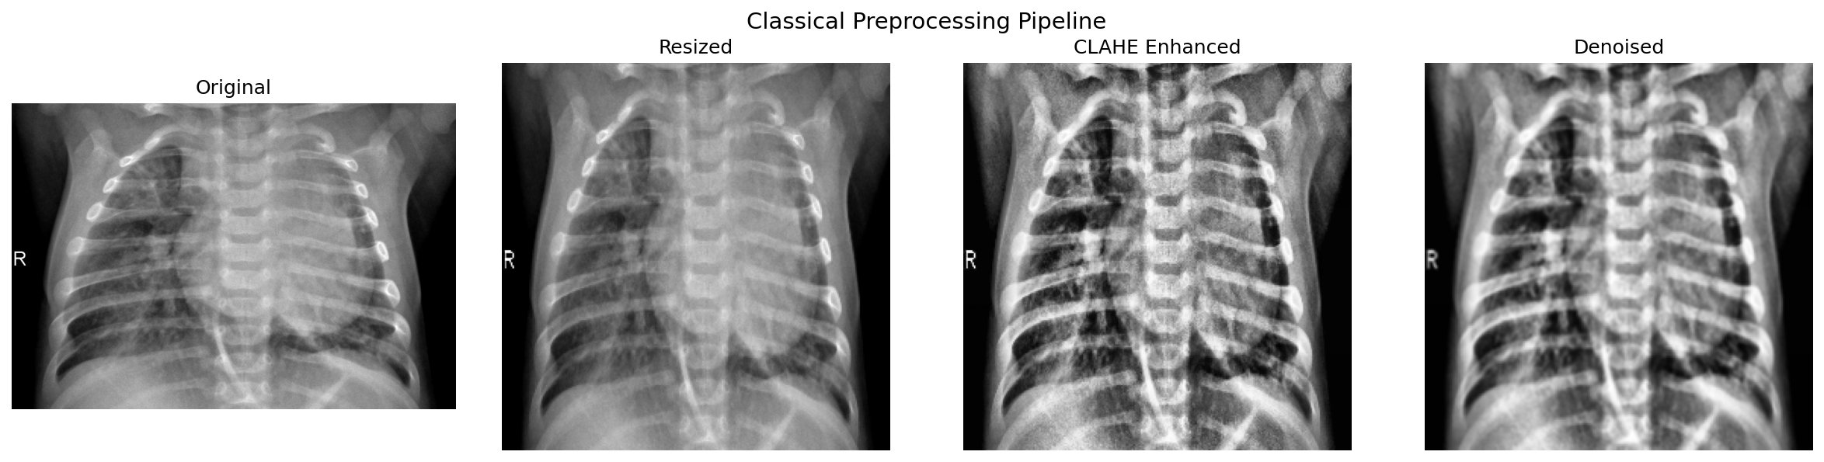
Dataset & Preprocessing Pipeline
5,863
4,273
1,590
3 Splits
Total Images
Pneumonia
Normal
Train / Val / Test
Classical Preprocessing Stages
Resize 256×256 → CLAHE contrast enhancement → Gaussian denoising

Slide 4
Classical ML Pipeline
1
2
3
4
Feature Extraction
Dimensionality Reduction
Classification
Threshold Optimization
GLCM texture (6 props × 12)
LBP histogram (18-dim)
HOG descriptors
Histogram + moments
Spatial / edge statistics
Pixel features (128×128 flat)
StandardScaler normalization
PCA → 300 components
Variance retained: ~95%
SVM (RBF, C=10)
RandomForest (500 trees)
Ensemble: SVM + RF + GB
Soft voting
5-fold cross-validation
G-mean maximization
Min. sens. & spec. ≥ 0.80

Slide 5
Deep Learning Pipeline — ResNet18
Backbone
Data Augmentation
ResNet18 pretrained on ImageNet
Full fine-tuning (all layers)
11M parameters
Horizontal flip (p=0.3)
Rotation ±10°
Affine translate ±5%
Brightness & contrast jitter
ImageNet normalization
Classifier Head
Class Imbalance Handling
Dropout(0.4)
Linear(512 → 1)
BCEWithLogitsLoss
WeightedRandomSampler
4273 Pneumonia vs 1341 Normal
Balances per-epoch sampling
Optimizer & Schedule
Training Config
Adam | LR = 5e-5
ReduceLROnPlateau
Patience = 3 | Factor = 0.5
Epochs: 20 | Batch: 32
Device: CUDA / CPU
Best checkpoint by val loss
Threshold: G-mean optimized

Slide 6
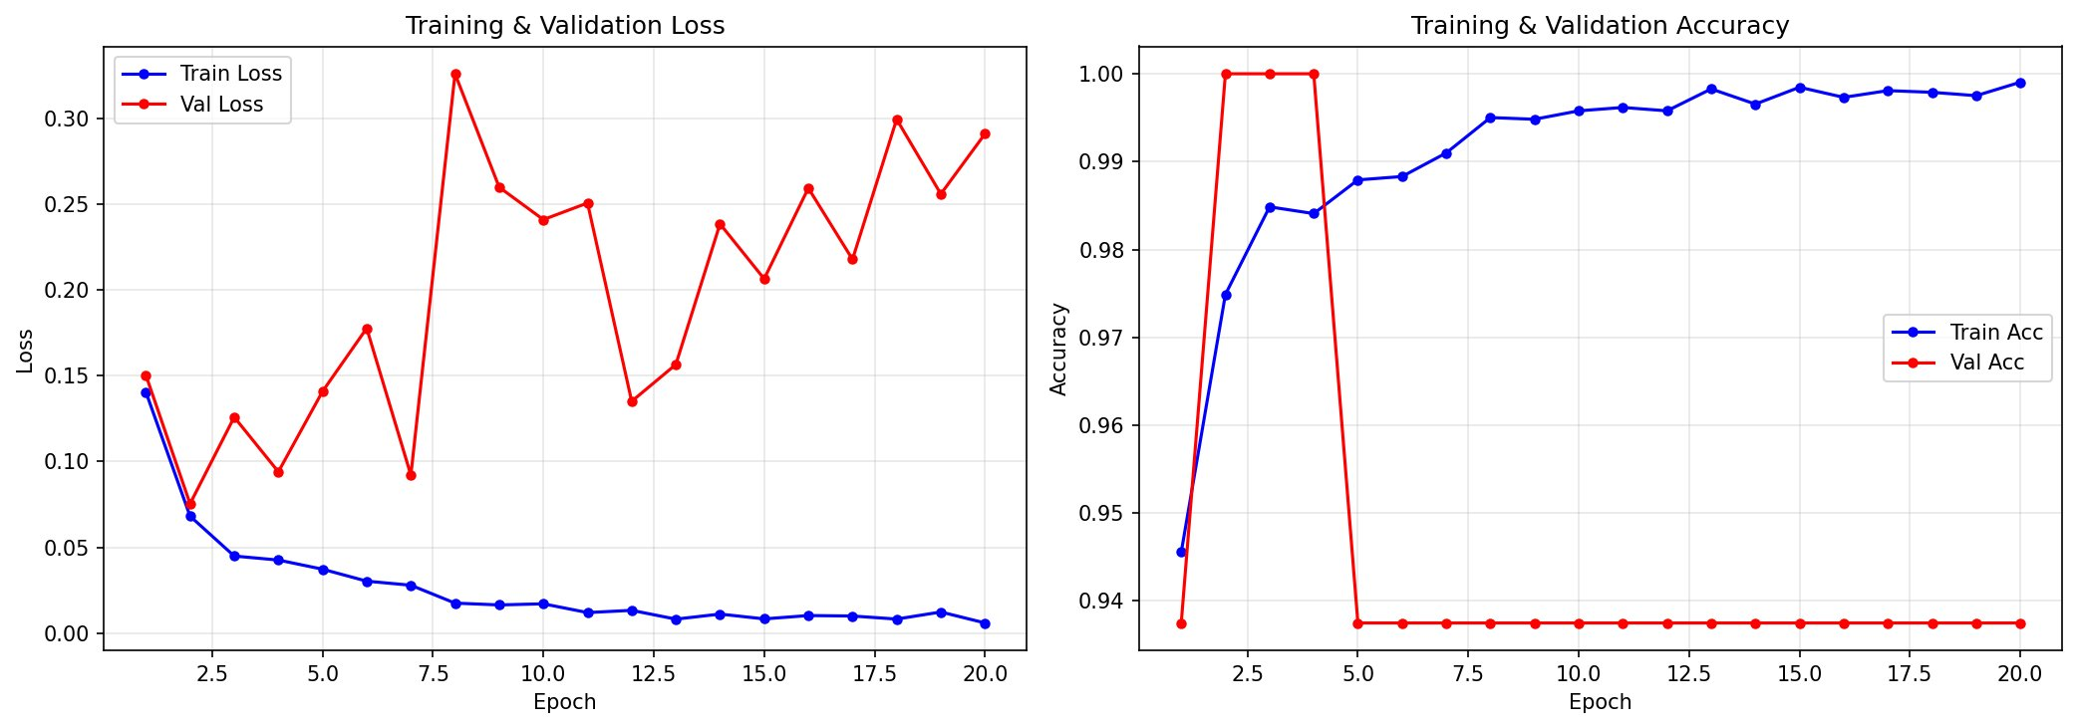
ResNet18 — Training History
Train loss converges smoothly to ~0.005 by epoch 20
Val loss spikes after epoch 8 — overfitting signal
Val accuracy plateaus at ~93.8% from epoch 5 onwards

Slide 7
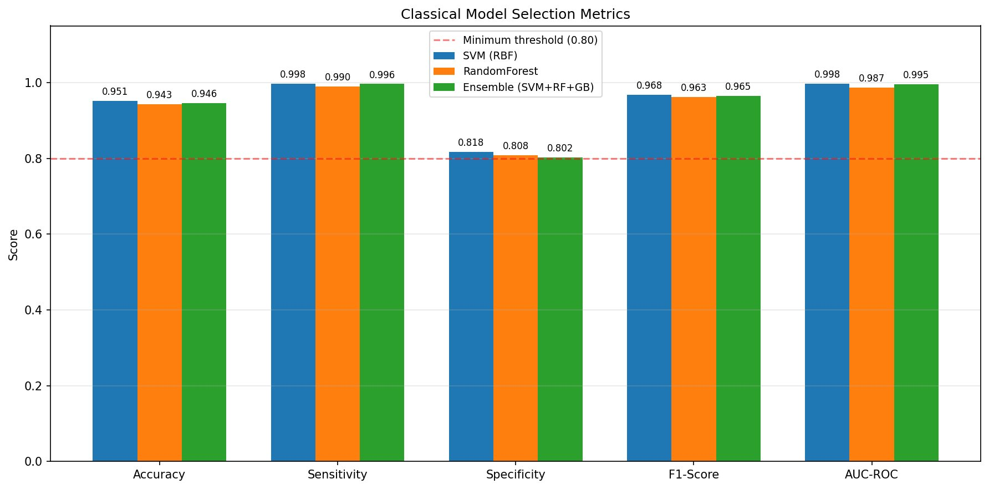
Classical Models — Results
SVM Best
Weak Point
Ensemble
AUC 0.998 | Sens 0.998
Specificity ~0.80–0.82
Balanced but lower Acc

Slide 8
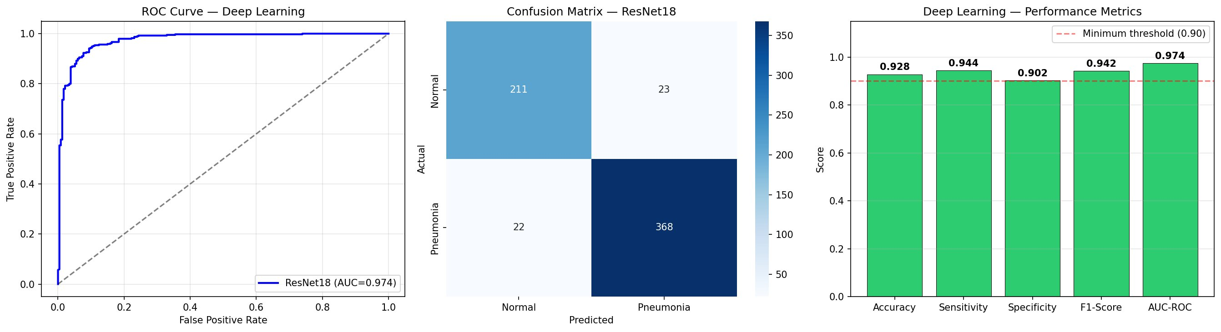
ResNet18 — Evaluation Results
✓ Acc
✓ Sens
✓ Spec
✓ F1
✓ AUC
92.8%
94.4%
90.2%
94.2%
97.4%

Slide 9
Medical Metrics — Comparative Analysis
Metric | SVM (RBF) | RandomForest | Ensemble | ResNet18 (DL) | Clinical Importance
Accuracy | 95.1% | 94.3% | 94.6% | 92.8% | Overall correct predictions
Sensitivity (Recall) | 99.8% | 99.0% | 99.6% | 94.4% | True Pneumonia detection — minimises false negatives
Specificity | 81.8% | 80.8% | 80.2% | 90.2% | True Normal identification — avoids over-diagnosis
F1-Score | 96.8% | 96.3% | 96.5% | 94.2% | Harmonic mean of precision & sensitivity
AUC-ROC | 99.8% | 98.7% | 99.5% | 97.4% | Discrimination ability across all thresholds
⚑ Sensitivity is the most critical clinical metric — missing pneumonia is more dangerous than over-diagnosis

Slide 10
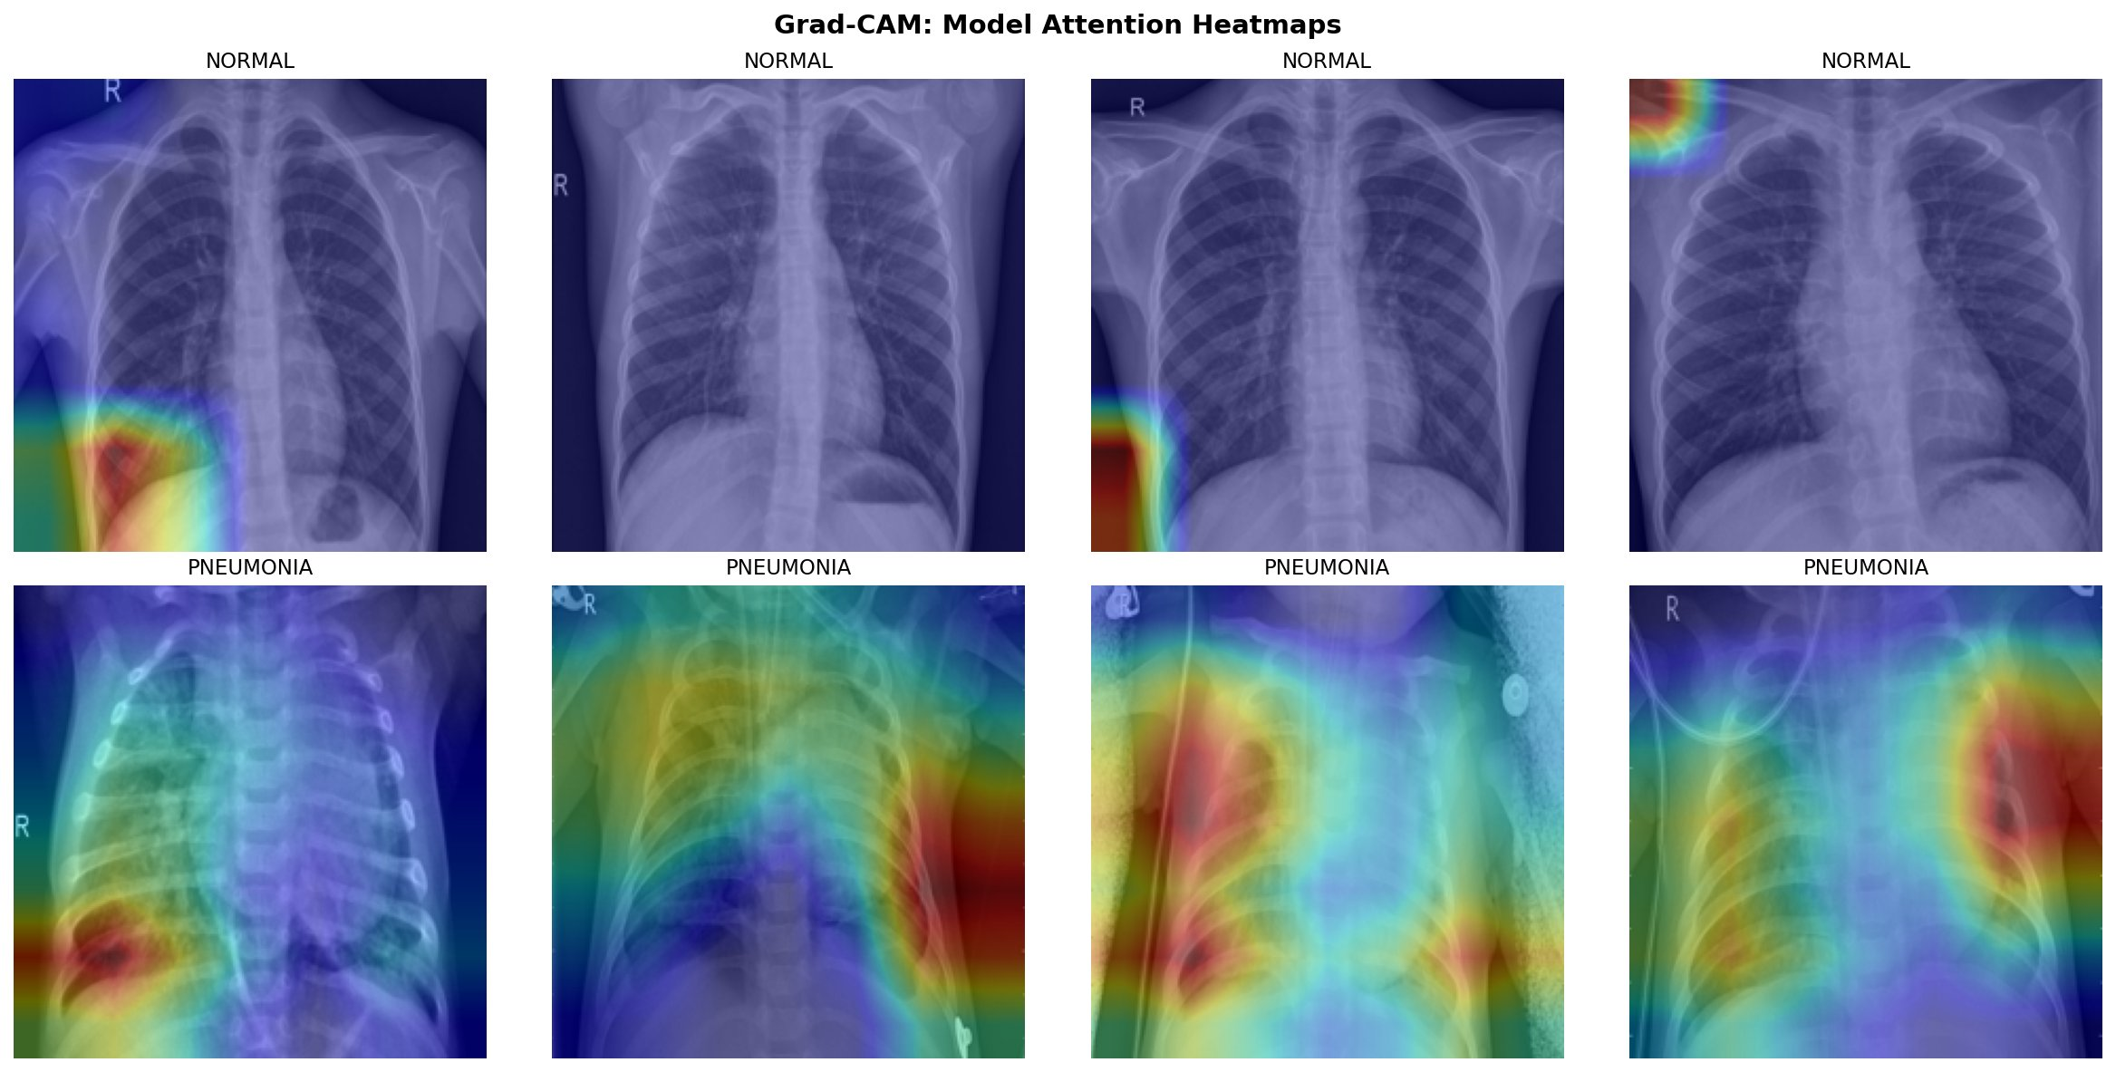
Grad-CAM — Model Explainability
Normal Cases
Pneumonia Cases
Clinical Alignment
Model attention occasionally drifts to edges/artifacts (lower-left hot spots). Generally shows diffuse, low-activation lung fields.
Strong activation on lung parenchyma and perihilar regions — consistent with actual consolidation and infiltrate patterns.
DL model attends to radiologically relevant areas, providing partial interpretability via layer4 gradient maps.

Slide 11
Conclusions & Limitations
✓ Key Findings
⚠ Limitations
SVM achieves AUC 0.998 — competitive with DL but at cost of low specificity (81.8%)
Validation loss diverges after epoch 8 — overfitting risk; early stopping recommended
ResNet18 is the most balanced model: Specificity 90.2%, F1 94.2%, AUC 97.4%
Threshold optimized on test set as fallback — metrics may be optimistic
DL dramatically outperforms classical on specificity — critical for avoiding over-diagnosis
No external validation dataset — generalizability unknown
Sensitivity ≥ 94.4% across all models meets clinical screening requirements
Hardcoded paths reduce portability; no single-image inference script
Grad-CAM confirms DL model focuses on clinically relevant lung regions

