Slide 1
New Directions in Cryptography
By WHITFIELD DIFFIE AND MARTIN E. HELLMAN,
Alper Sayan
Ertan Ayanlar
Barış Karaer

Slide 2
Table of Contents
Introduction
Conventional Cryptography
Public Key Cryptography
One Way Authentication
Trap Door
Computational Complexity
Conclusion

Slide 3
Introduction
The best known cryptographic problem is that of privacy: preventing the unauthorized extraction of information from communications over an insecure channel

Slide 4
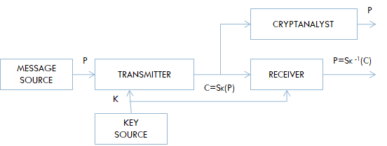
Conventional Cryptography
Basic problem: Secure communication over an insecure channel
Symmetric-key algorithms
Computationally secure
Computationally infeasible
Threats
  Ciphertext Only Attack
  Known Plaintext Attack
  Chosen Plaintext Attack (IFF attack)

Slide 5
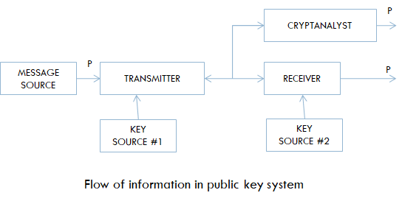
Public Key Cryptography (Asymmetric Cryptography)
Uses pairs of keys: public and private keys.
Let M be a message and let C be the encrypted message (ciphertext). A public key cryptosystem has a separate method E() for encrypting and D() decrypting.
Encrypts messages using the receiver's public key (E), that can only be decrypted with the receiver's private key (D).
D(E(M)) = M
Both E() and D() are easy to compute
Publicly revealing E() does not make it easy to determine D()
E(D(M)) = M - needed for signatures
The collection of E()’s are made publicly available but the D()’s remain secret.
Called a one-way trap-door function (hard to invert, but easy if you have the secret information)

Slide 6
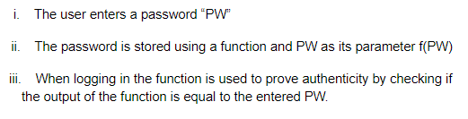
One Way Authentication
It must be easy for anyone to recognize the signature as authentic, but impossible for anyone other than the legitimate signer to produce it
One-way function
Public key cryptosystem can be used to produce a true one-way authentication system
Public key cryptosystem is used to produce a true one way authentication system

Slide 7
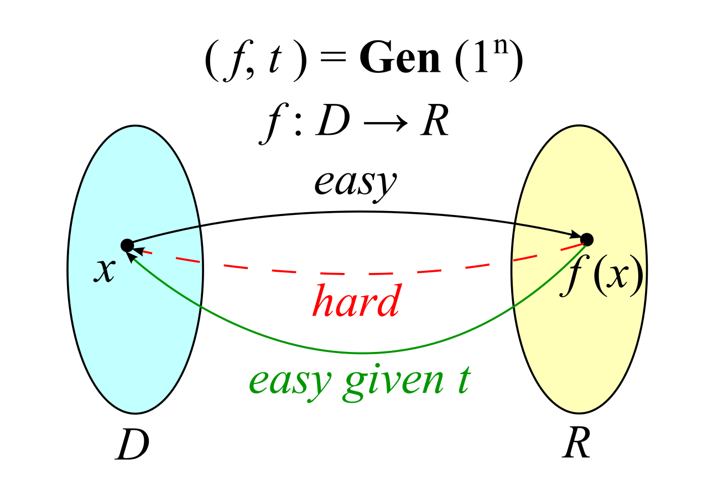
Trap Door
Without information about deciphering key, by knowing only the enciphering key and the message A it is computationally infeasible to find message M.
A trap door cryptosystem can be used to produce a public key cryptosystem.

Slide 8
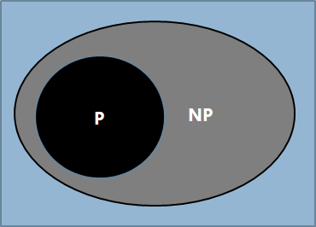
Computational Complexity
The cryptanalytic difficulty of a system whose encryption and decryption operations can be done in P time can not be greater than NP
Focuses on classifying computational problems according to their inherent difficulty and relating these classes to each other.

Slide 9
Conclusion
This paper basically introduces a new away to encrypt/decrypt message
Previous way a one key is used both for encryption and decryption.
New way a used different key for encryption and decryption
There are two things suggested:
  Public key system
  One-way authentication system based on public key

Slide 10
Thank you for listening.

