Slide 1
Market-Consistent Option Pricing: Weighted Monte Carlo for BSM & Heston
Baris Karadas
MSc Economics & Finance — Université Lumière Lyon 2
Under the supervision of Bertrand Tavin

Slide 2
Motivation
Market option prices show volatility smiles & skews
BSM assumes constant volatility → fails to fit the full implied volatility surface
Heston captures smiles/skews but can still leave residual mispricing after calibration
Research Question
How effectively can Weighted Monte Carlo (WMC), via entropy reweighting of simulation paths, reduce pricing error and variance to match observed market quotes when the base models (BSM, Heston) are mis-calibrated?
Key Contributions
Stability (Kullback–Leibler divergence, effective number of paths)
Accuracy (mean & median absolute errors)
Computation speed.

Slide 3
Dataset
Risk-free rate: U.S. Treasury yields (matched maturities, constant if missing)
Options: European call options — 18 July 2025 snapshot
Underlying: S&P 500 index (ticker: ^GSPC)
Size: 361 options, maturities < 1 year.
Prices: mid-point (bid/ask)
Calibration / Evaluation Split
30 options & 6 forwards for weights calibration (WMC-BSM & WMC-Heston)
78 options for parameter calibration (BSM, Heston parameters)
Full 361-option set for out-of-sample evaluation
Implementation Details
Language: Python 3.11.9 (Visual Studio Code, Windows 11)
Optimization: L-BFGS-B, gradient tolerance 1e−12 (WMC)
Simulation: 50,000 Monte Carlo paths

Slide 4
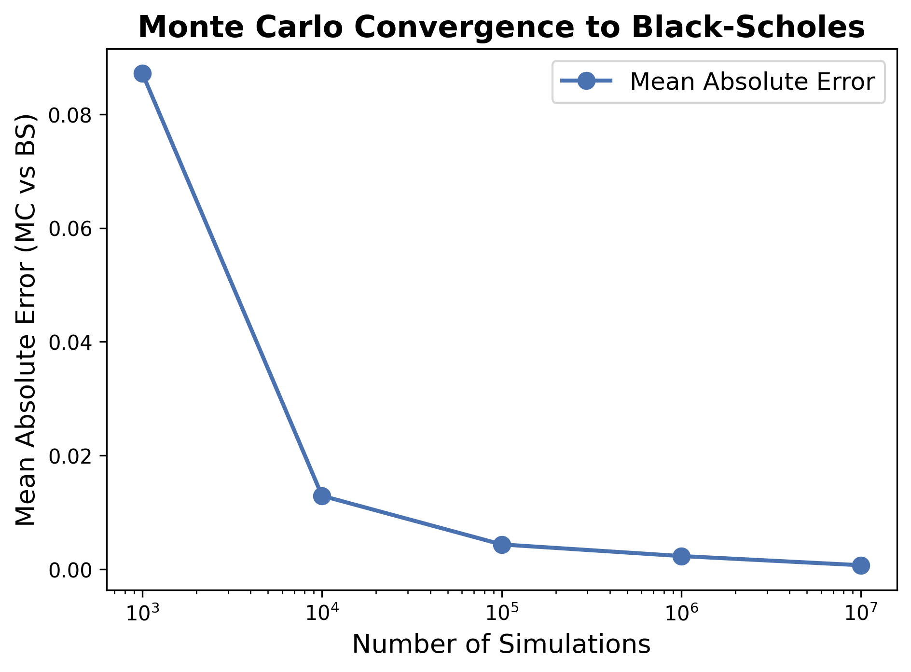


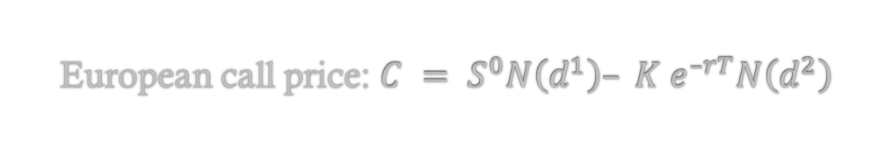
BSM Model (constant volatility)
Closed Form of BSM Model
European call price: $C = S^{0}N\left(d^{1}\right)– K e^{–rT}N\left(d^{2}\right)$

Slide 5


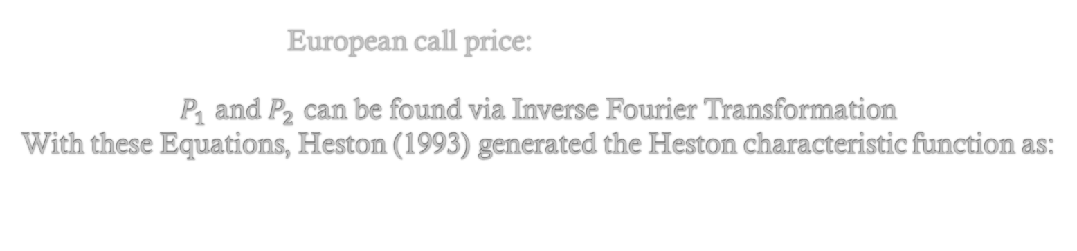
Heston Model (stochastic volatility)
Closed Form of Heston Model
European call price:
$P_{1}$ and $P_{2}$ can be found via Inverse Fourier Transformation
With these Equations, Heston (1993) generated the Heston characteristic function as:

Slide 6
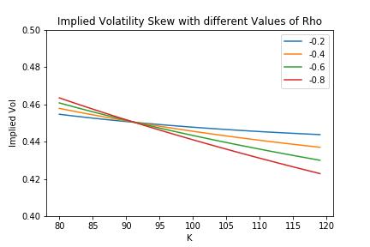
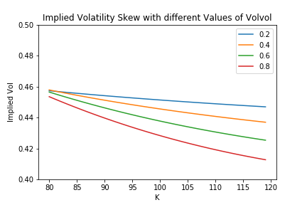
Data and Parameters

Slide 7
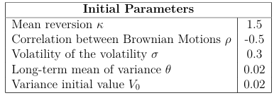
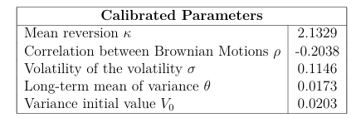
Calibration Standard Model
BSM
Dataset: 78 S&P 500 European call options (maturity < 1 year) for calibration, 361 for testing
Calibration method: L-BFGS-B numerical optimisation
Pricing method: Black–Scholes–Merton closed-form formula
Performance: Converged in <1 second; σ ≈ 0.147
Heston
Dataset: 78 S&P 500 European call options (maturity < 1 year) for calibration, 361 for testing
Calibration method: L-BFGS-B numerical optimisation
Pricing method: Heston closed-form formula
Performance: Converged ≈ in 250 seconds

Slide 8


WMC Approach
Key Principle
Minimise relative entropy (Kullback–Leibler divergence) between original and re-weighted probability distributions
Steps
Simulate asset price paths under chosen model (e.g., BSM, Heston)
Compute discounted payoffs for calibration instruments (vanilla options)
Solve optimisation problem to find new path weights satisfying pricing constraints
Use re-weighted paths to price other derivatives
WMC - Dual Optimisation

Slide 9
Calibration of WMC
WMC-BSM
Dataset: 30 S&P 500 European call options (maturity < 1 year) & 6 forwards for calibration, 361 for testing
Calibration method: L-BFGS-B numerical optimisation (entropy minimisation)
Pricing method: Black–Scholes–Merton Monte Carlo simulation (50,000 paths)
Performance: Converged in ~3 seconds (~125 iterations)
Initial setup: Equal path weights, σ from average market IV (0.1416)
WMC-Heston
Dataset: Same as WMC-BSM calibration
Calibration method: L-BFGS-B numerical optimisation (entropy minimisation)
Pricing method: Heston Monte Carlo simulation (50,000 paths)
Performance: Converged in ~6 seconds (~100 iterations)

Slide 10
Mean Absolute Error – By Maturity
Model | Maturity < 0.3 | 0.3 >= Maturity < 0.6 | Maturity => 0.6
BSM | 14.17 | 19.7 | 23.52
Heston | 6.73 | 6.26 | 6.21
WMC-BSM | 4.64 | 4.96 | 7.26
WMC-Heston | 3.3 | 4.84 | 7.33

Slide 11
Mean Absolute Error – By Strike
Model | Strike < 100 | 100 >= Strike < 105 | Strike > 100
BSM | 19.39 | 12.38 | 24.57
Heston | 9.28 | 5.66 | 3.58
WMC-BSM | 8.8 | 4.08 | 2.15
WMC-Heston | 8.27 | 3.48 | 1.48

Slide 12
Mean Absolute Error – Surface
Model | Mean Error | Median Error
BSM | 18.17 | 17.7
Heston | 6.45 | 5.11
WMC-BSM | 5.31 | 2.78
WMC-Heston | 4.72 | 2.02

Slide 13
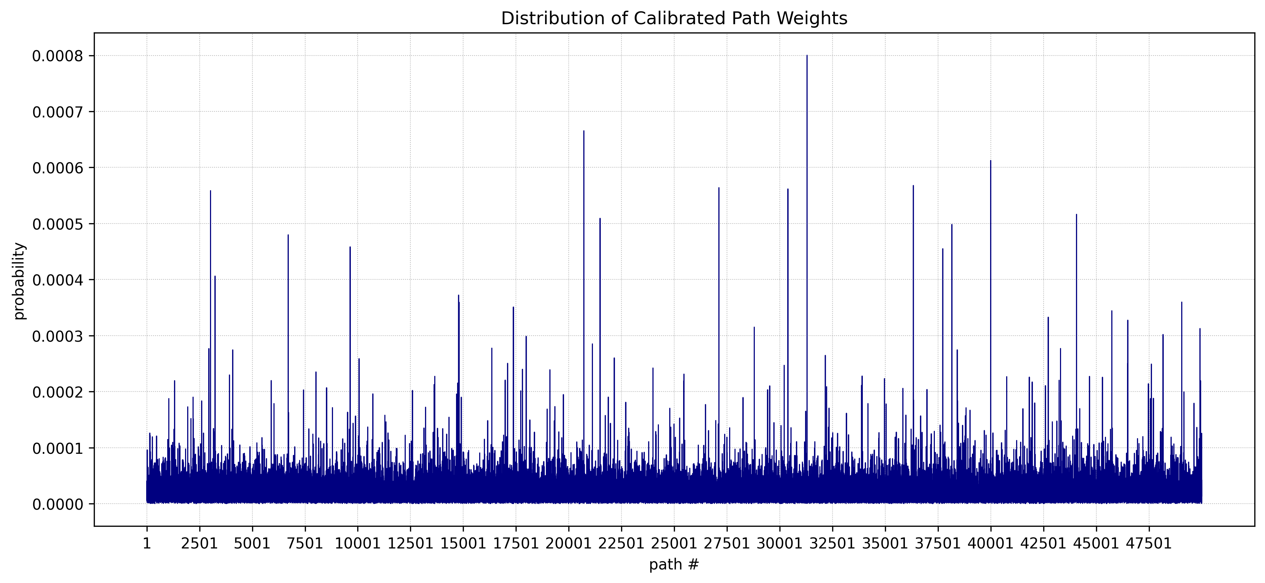
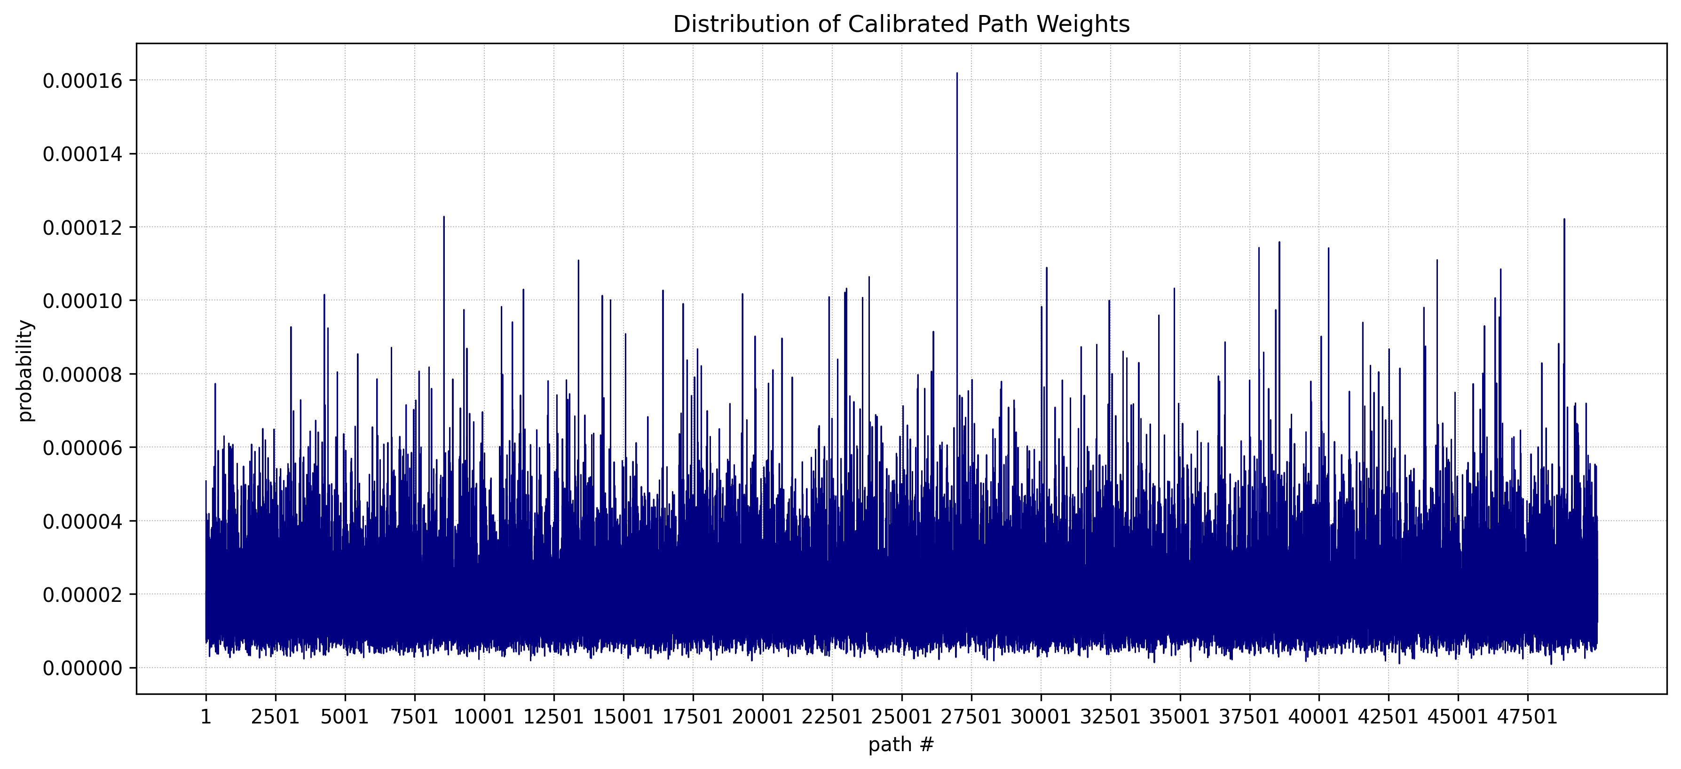
Comparison of WMC-BSM vs WMC-Heston
Metrics | WMC-BSM | WMC-Heston
KL Divergence | 0.38 | 0.108
Kurtosis | 145.13 | 11.8
Skewness | 7.33 | 1.87
Range | 0.0008 | 0.00016
Median | 0.000014 | 0.0000191
Effective number of paths | 34 186 | 44 869

Slide 14
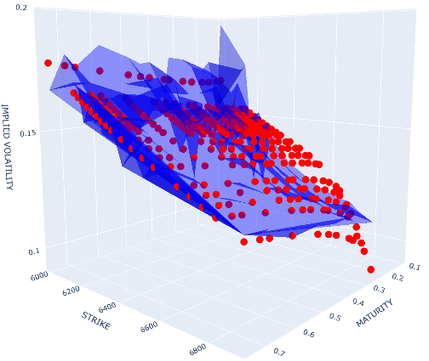
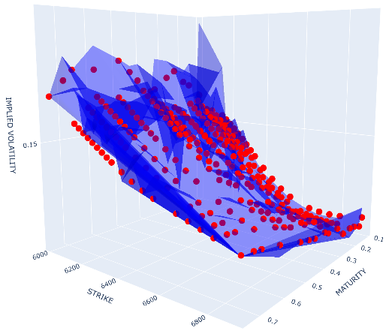
Implied Volatility of Heston vs WMC-Heston

Slide 15
CONCLUSION
WMC significantly improves calibration accuracy for both BSM and Heston, reducing mean & median absolute errors across the volatility surface, maturities, and strikes.
Heston under WMC achieves the best overall fit, capturing smile/skew more effectively while maintaining stability (low KL divergence)
WMC-BSM shows higher KL divergence and lower effective number of paths than WMC-Heston (more aggressive reweighting)
Computation speed for WMC-BSM calibration (~3s) which is faster than WMC-Heston (~6s), but both are practical for real-world usage
WMC provides a flexible and model-agnostic enhancement for market-consistent pricing without altering base model dynamics.

Slide 16
THANK YOU FOR LISTENING ANY QUESTIONS ?

