Slide 1
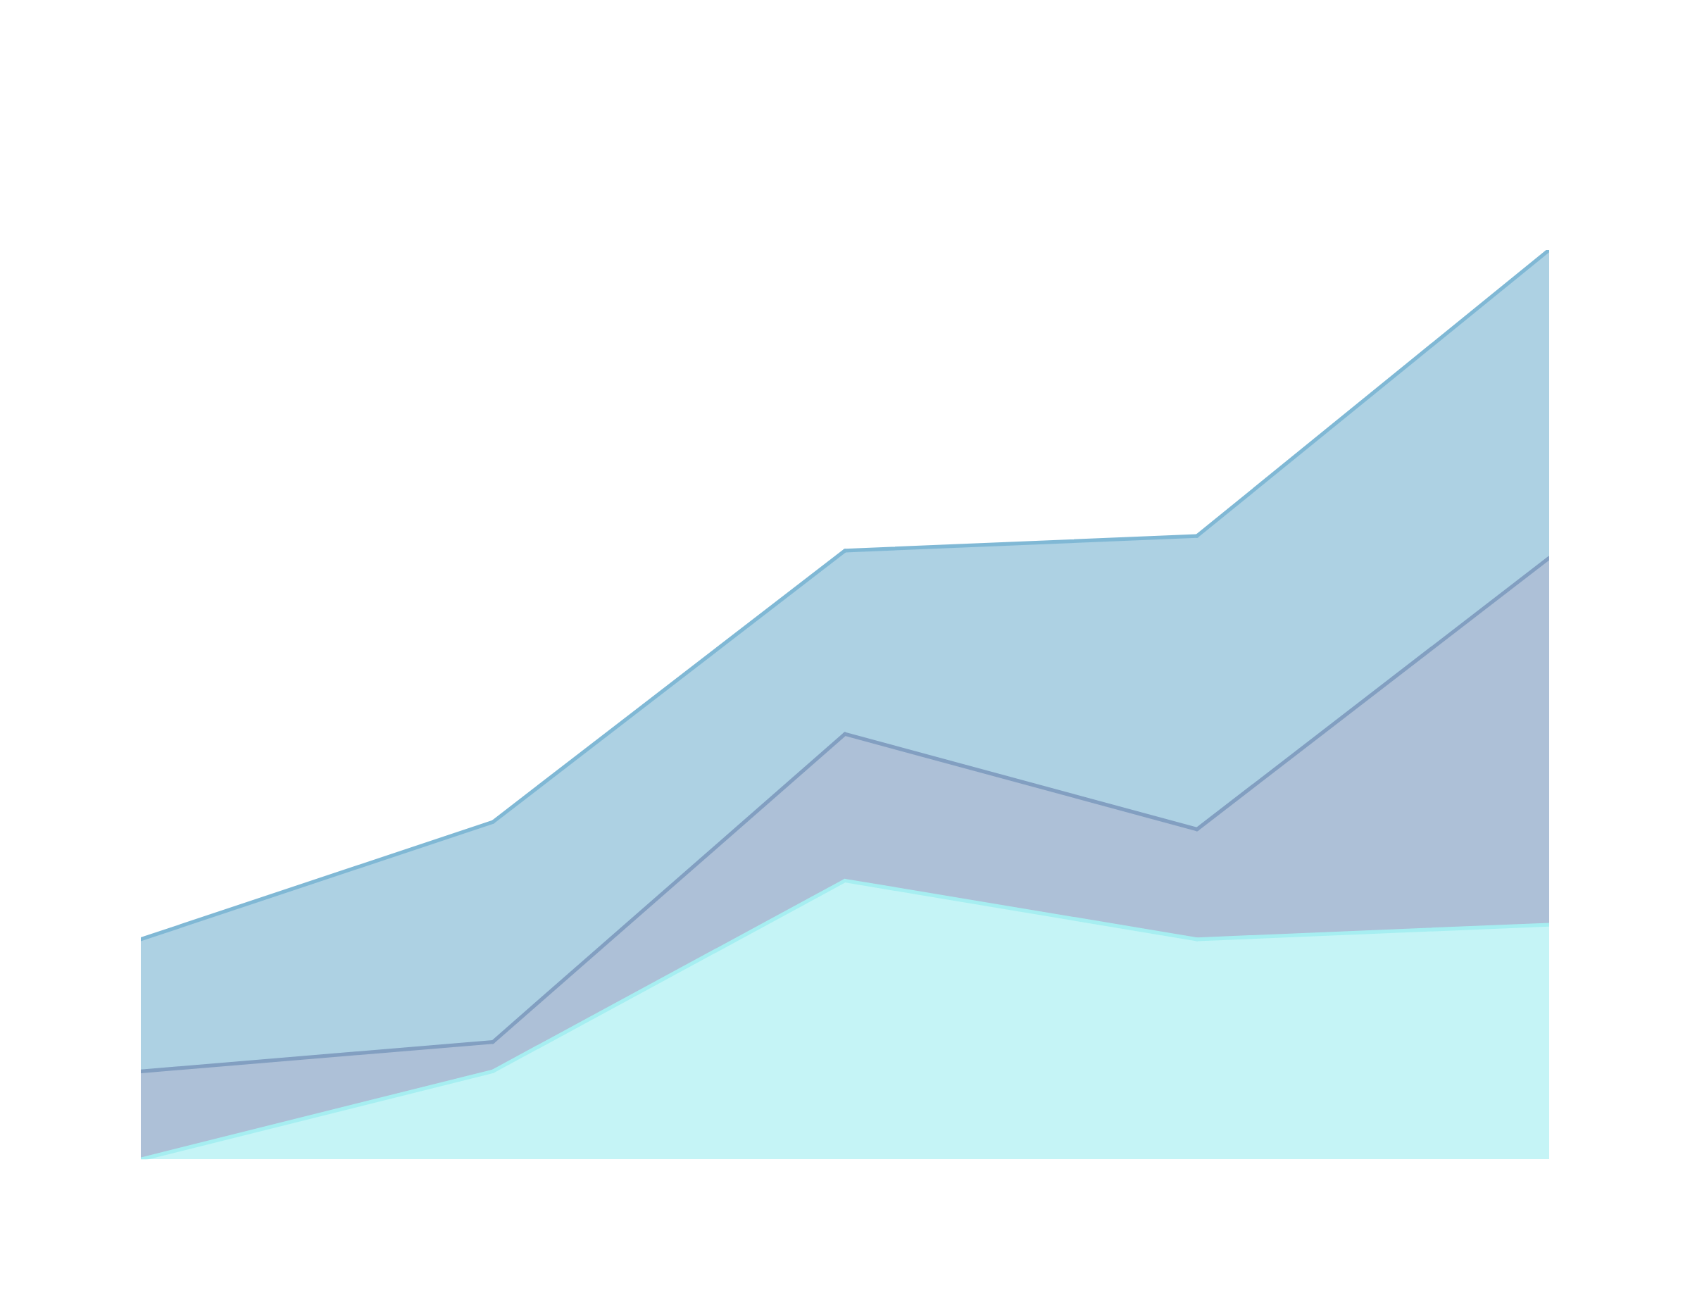
CLASSIFICATION METHOD
WITH A RESEARCH PAPER ON:
COMPARISON OF MULTIPLE CLASSIFICATION METHODS FOR DIAGNOSIS OF PARKINSON DISEASE

Slide 2

WHAT IS THE CLASSIFICATION METHOD?
A task that involves assigning a class label to each instance in a dataset based on its features.
The goal of classification is to build a model that accurately predicts the class labels of new instances based on their features.

Slide 3
RATIONALE / BACKGROUND OF THE RESEARCH PAPER
Parkinson’s disease is challenging to diagnose with high accuracy due to symptom overlap with other conditions, leading to misdiagnosis rates as high as 25%. This study focuses on automating the diagnostic process by analyzing voice measurements, as dysphonia (vocal impairment) is common among Parkinson’s patients. This approach aims to enable quicker and more reliable detection, especially useful for patients with limited access to clinical settings.

Slide 4
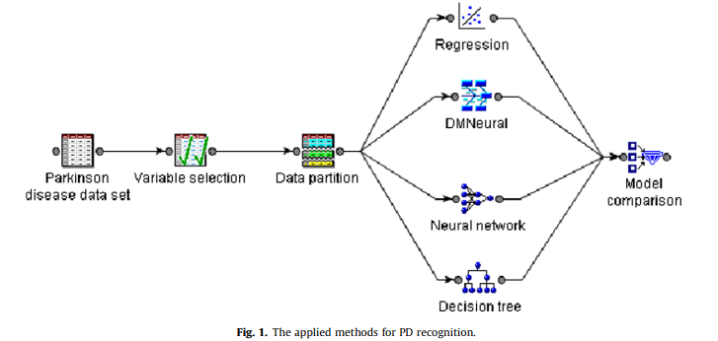
PROCEDURE / PROCESS FOR DATA HANDLING
Biomedical Voice Data Utilization
Utilized SAS Enterprise Guide for data preprocessing.
Employed the SAS variable selection for Key features.
Partitioned the dataset into training (65%) and testing (35%) subsets to validate model performance.
Implemented four classification models
Used SAS model comparison tools to evaluate classifiers based on accuracy, ROC curve, and cumulative lift scores.
Notes:
Data Handling Process:
1. Data Collection:
a. Used a dataset of biomedical voice measurements from 31 people, with 23 diagnosed with Parkinson's disease and 8 healthy individuals.
b. Each row in the dataset represents one of 195 voice recordings, containing 23 voice-related features.
2. Data Preprocessing:
a. Utilized SAS Enterprise Guide for data preprocessing.
b. The voice measurements were standardized to ensure consistency across samples.
3. Feature Selection:
a. Employed the SAS variable selection component to identify the most relevant features for classification.
b. Unrelated variables were set as "rejected," removing them from the model inputs, though they remained in the dataset for reference.
4. Data Partitioning:
a. Partitioned the dataset into training (65%) and testing (35%) subsets to validate model performance.
b. Ensured the training and testing sets were mutually exclusive, reducing bias and enhancing generalizability.
5. Model Training and Tuning:
a. Implemented four classification models (Neural Networks, DMNeural, Regression, and Decision Trees) using SAS Enterprise Miner.
b. Tuned each model’s parameters to optimize performance (e.g., adjusting the number of neurons in the Neural Network).
6. Model Evaluation:
a. Used SAS model comparison tools to evaluate classifiers based on accuracy, ROC curve, and cumulative lift scores.
b. Analyzed model performance in both the training and testing phases to assess generalizability.

Slide 5

Data Mining Algorithms

Slide 6
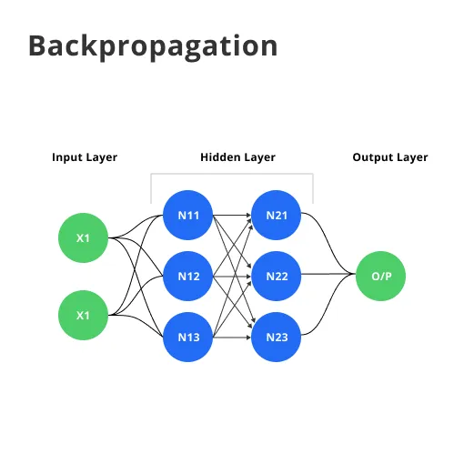
Backpropagation (BP) Learning Algorithm
a supervised learning algorithm used to train neural networks by adjusting weights based on the error between the predicted output and the actual target output.

Slide 7
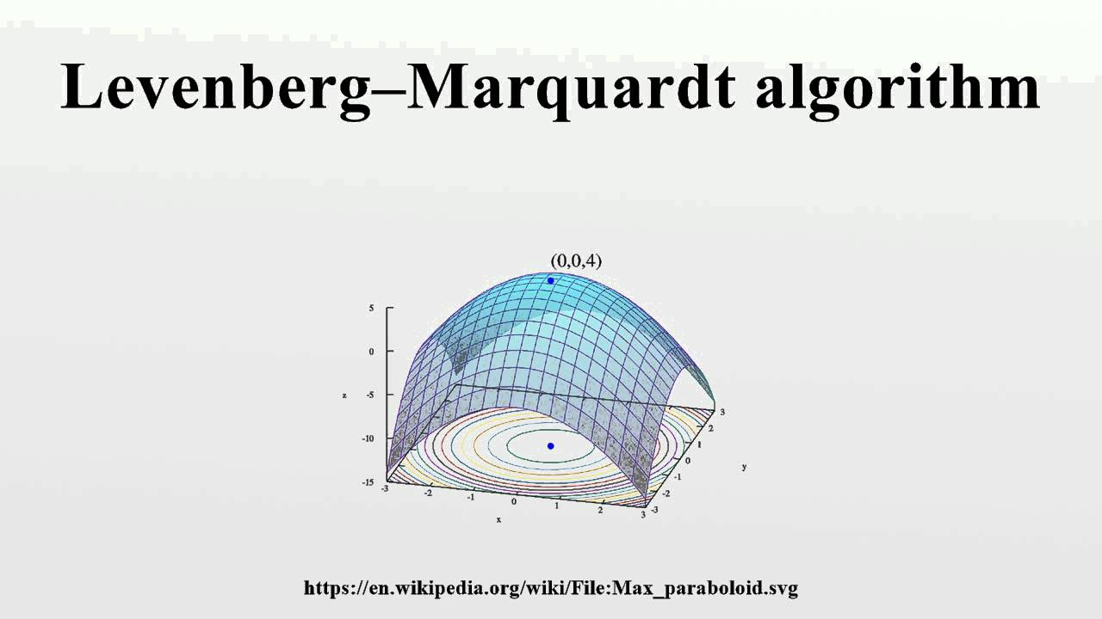
Levenberg-Marquadt (LM) Algorithm
an optimization algorithm used to train neural networks by combining the benefits of gradient descent and the Gauss-Newton method.

Slide 8
Scaled Conjugate Gradient (SCG)
a first-order optimization technique used to train neural networks. It is designed to optimize the conjugate gradient method while using a scaling factor for better convergence.
Pola–Ribiere Conjugate Gradient (CGP)
another first-order optimization method used for training neural networks. It is a variant of the conjugate gradient method and is based on updating the weight using conjugate directions.

Slide 9
Summary
In the study, a feedforward neural network with a hidden layer was trained using backpropagation and optimized with Levenberg-Marquardt, Scaled Conjugate Gradient, and Pola-Ribiere Conjugate Gradient algorithms, utilizing a tangent sigmoid activation function, to classify Parkinson’s disease, with the goal of determining the most effective optimization method for accurate prediction.

Slide 10
APPLICATION RESULTS

Slide 11
4 MODELS
NEURAL NETWORK
LOGISTICS REGRESSION
A yes-or-no prediction tool that estimates the likelihood of someone having Parkinson’s based on voice patterns.
DECISION TREE
Think of this as a model that mimics how our brain works, learning from data to recognize patterns.
DMNEURAL
Simplifies the data first by focusing only on the most important parts, then uses a neural network to learn from this simplified data.
Imagine a flowchart with yes-or-no questions that lead to different outcomes.

Slide 12
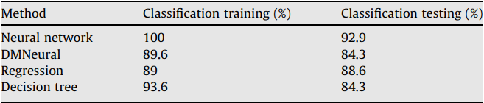
Neutral Network: Exceptional Performance in identifying Parkinson’s disease.
DMNeutral & Decision Tree: Lowest amongst methods but still performed
reasonably.
Regression: Slightly Less effective compared to the network model.

Slide 13
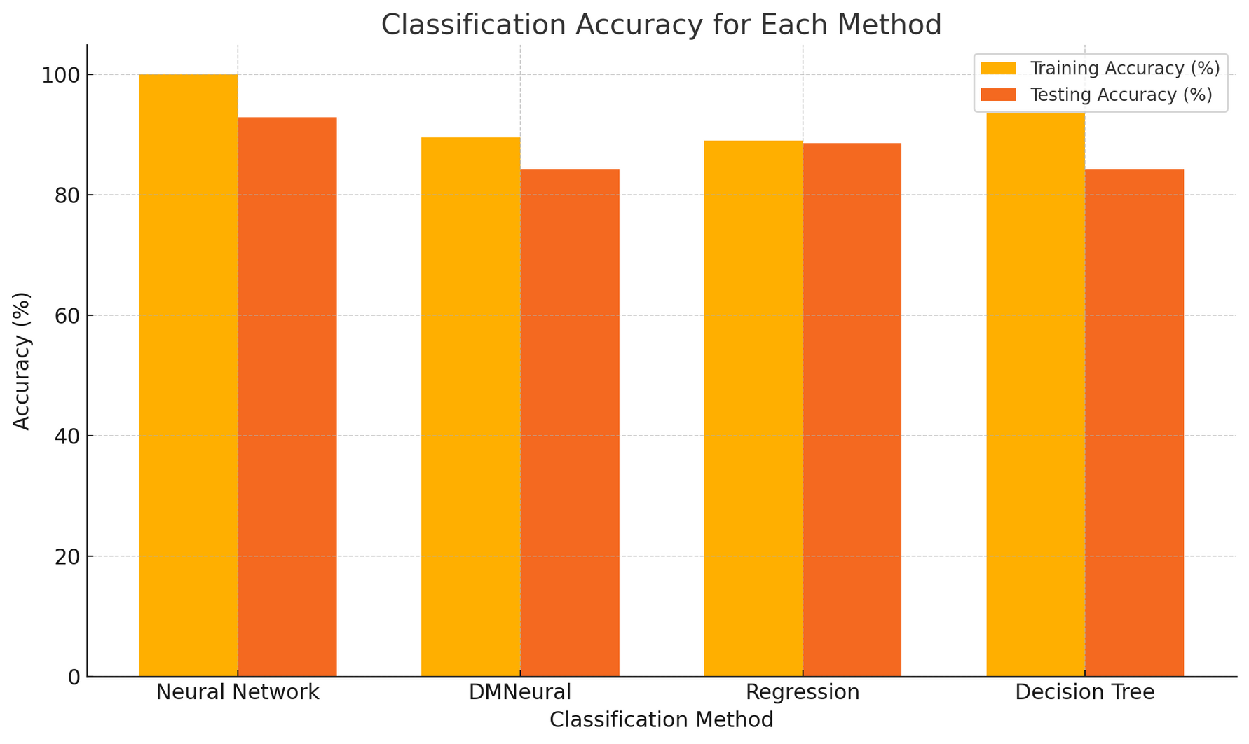

Slide 14
End

