Slide 1
Capstone: Find the best neighborhood in Toronto to open a Restaurant Supply Store
Applied Data Science Capstone
IBM Data Science Professional Certificate

Slide 2
Data:
1. Load all the Data from all the various sources.
1.1 Toronto neighborhoods broken down by postal code
https://en.wikipedia.org/wiki/List_of_postal_codes_of_Canada:_M Here I used BeautifulSoup to scrape the wiki page to extract a working list of Toronto Neighborhoods sorted by postal code.
1.1.1 Load Toronto geospatial coordinates and merge to Toronto Postal Code Data
http://cocl.us/Geospatial_data Next, I joined geo spatial to the Toronto Data.
1.2 Toronto neighborhoods populations broken down by postal code
https://www12.statcan.gc.ca/census-recensement/2016/dp-pd/hlt-fst/pd-pl/Tables/File.cfm?T=1201&SR=1&RPP=9999&PR=0&CMA=0&CSD=0&S=22&O=A&Lang=Eng&OFT=CSV Use Pandas to grab the csv
1.2.1 Merge Toronto Neighbourhood populations data with Toronto Postal Code data
Next, I joined population data to the Toronto Data.
1.3 Toronto neighborhoods average after tax income broken down by postal code
Here we must manually download these from Stats Canada and load them. https://www12.statcan.gc.ca/census-recensement/2016/dp-pd/prof/search-recherche/change-geo.cfm?Lang=E&Geo1=FSA See: to_geo_space.csv
1.3.1 Merge Toronto Neighbourhood income data with Toronto Postal Code data
Next, I joined income data to the Toronto Data. At this time I also saved a copy of the data set as my friend had asked for it in his list of requirements. See: TO_Affluence.csv

Slide 3
1.4 What is the Canadian National Average After Tax Income
Here I must also manually download this from Stats Canada and load them. https://www150.statcan.gc.ca/n1/daily-quotidien/180313/dq180313a-eng.htm Canadian families and unattached individuals had a median after-tax income of $57,000 in 2016.
Key Observation: Of the 103 Toronto Neighborhoods gathered only 55.3% or 57 Neighborhoods are above the median after-tax income. 37.8% or 39 Neighborhoods are below he median after-tax income. 6.7% or 7 neighborhoods did not register as it appears their populations are too low. It appears that the greatest concentration of affluence is near central Toronto. We decided to keep all neighborhoods in the dataset regardless of income of population as the majority were close enough. *
1.5 Toronto list of Restaurants or Venues that could potentially use Restaurant Equipment
4SQUARE API https://api.foursquare.com
1.5.1 Get all the Venues in Toronto.
1.5.2 Only add Restaurants as Venue Categories
Use this list to Extract Restaurants and only include Restaurants in our Data Set.
1.5.3 OneHot encode and count restaurants
Prepare the data for clustering
* Combine all of those into a working Data Set to cluster and geo spatial map of the results showing the best neighborhood to open a Restaurant Supply Store *
Combining all of these disparate data sets will clearly demonstrate the following:
which neighborhoods in Toronto have clusters of like Restaurants
how populated each neighborhoods is
the average after tax income is all of these neighborhoods
which neighborhood should he target to open his new store.

Slide 4
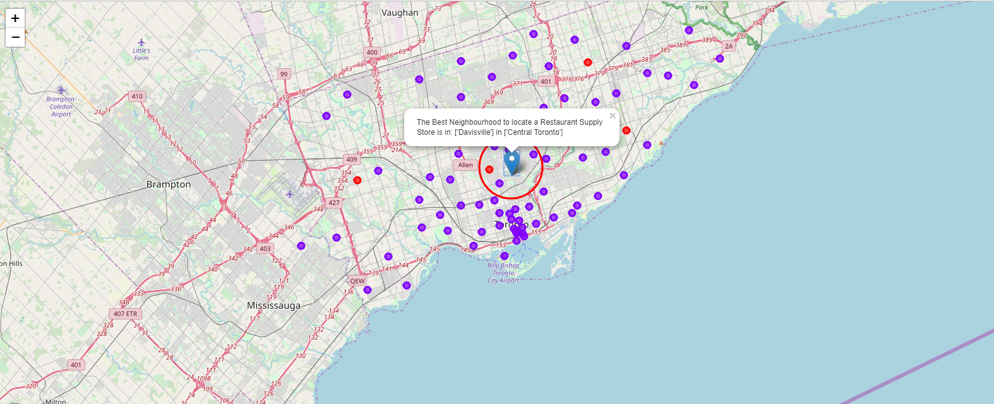
Results:
4.1 Plot the clusters on a Map of the Toronto and Super Impose the best location of a Store

Slide 5
Results Cont’d:
4.2 Exact Address of desired Location
Based on a reverse Lookup The exact Address to locate would be: 268 Balliol Street, ON M4S 1C2, Canada or lat: 43.6991598, lng: -79.3878871

