Slide 1
Enforcing Sparse Measurements in Kolmogorov Flow
Baris Turan

Slide 2
Outline
Introduction
Open Issues from Last Meeting
  Two-Point Correlation at Different Reynolds Numbers
  Controlling the Uncertainty in Enforcement
JAX-Fluids

Slide 3
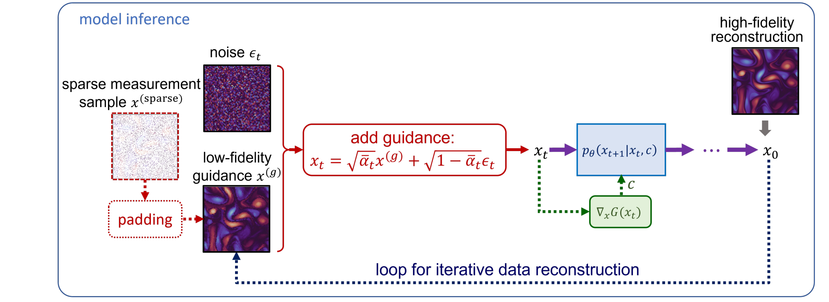
Introduction
Normally, the input of reverse diffusion would be sampled from a Gaussian distribution
In this method, we first apply forward diffusion to the low-fidelity guidance
This becomes the input of the reverse diffusion process
The reconstruction is iteratively refined
During training, we only use high fidelity data
Dule Shu, Zĳie Li, & Amir Barati Farimani (2023). A physics-informed diffusion
model for high-fidelity flow field reconstruction.
Journal of Computational Physics, 478, 111972.

Slide 4
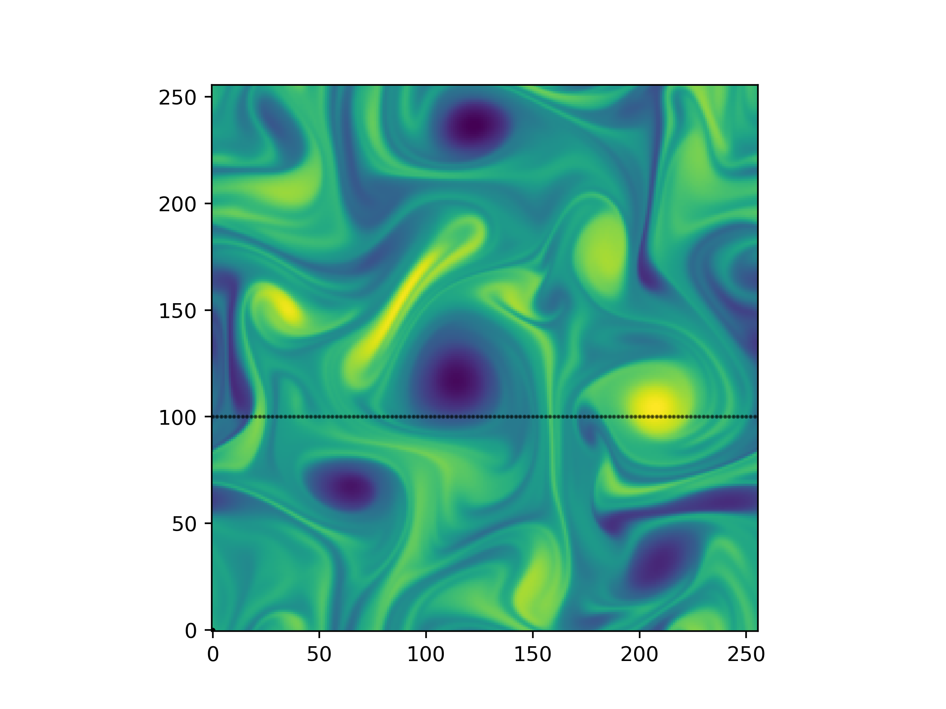
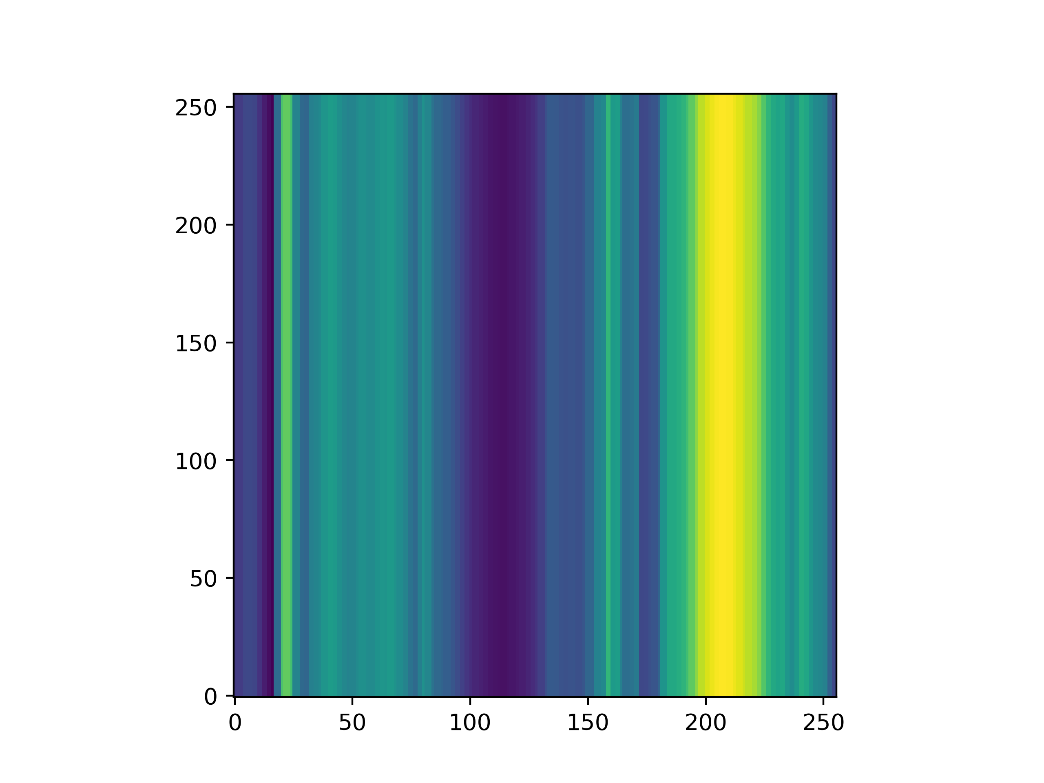
Controlling Enforcement Uncertainty

Slide 5
Controlling Enforcement Uncertainty
We blend guidance with noise so that the model receives some information from the low-fidelity input
is the number of reverse diffusion steps we take.
As , input approaches pure noise, and guidance information becomes lost
Hence, can be used to control how closely the generated result resembles the guidance
Smaller leads to less variation.
Dule Shu, Zĳie Li, & Amir Barati Farimani (2023). A physics-informed diffusion
model for high-fidelity flow field reconstruction.
Journal of Computational Physics, 478, 111972.

Slide 6
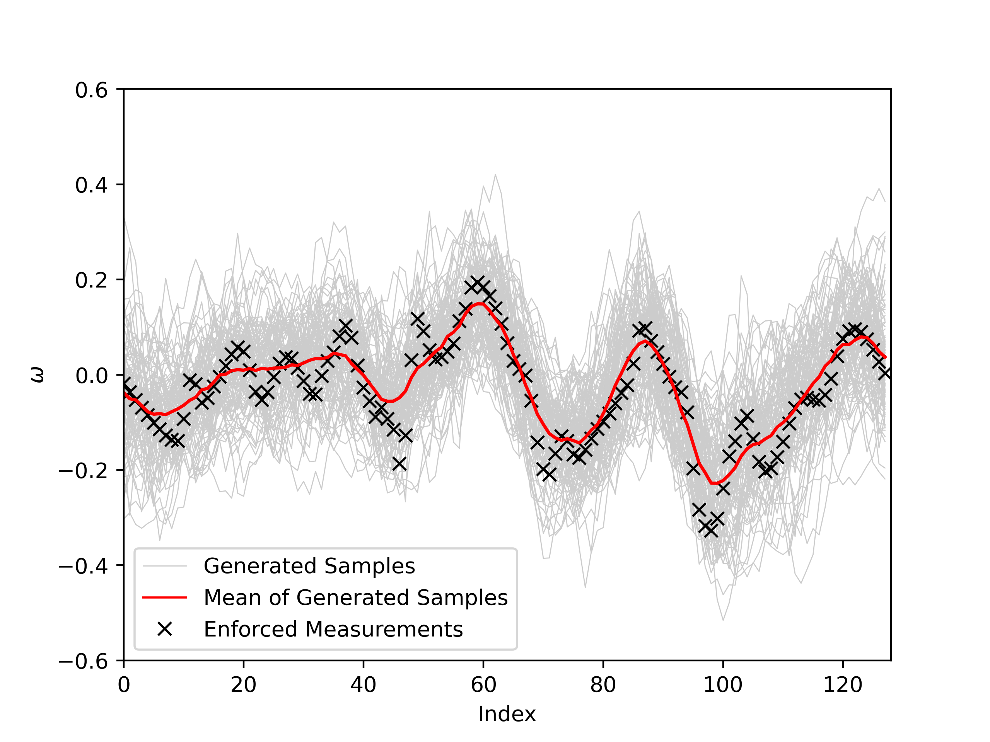
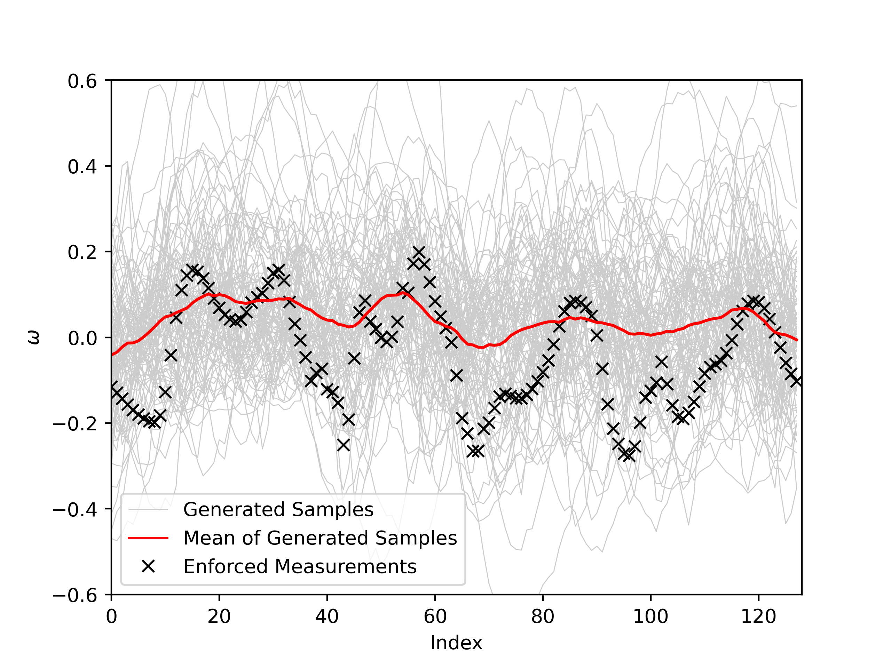
Controlling Enforcement Uncertainty
βmax=0.02, t=100
βmax=0.02, t=400

Slide 7
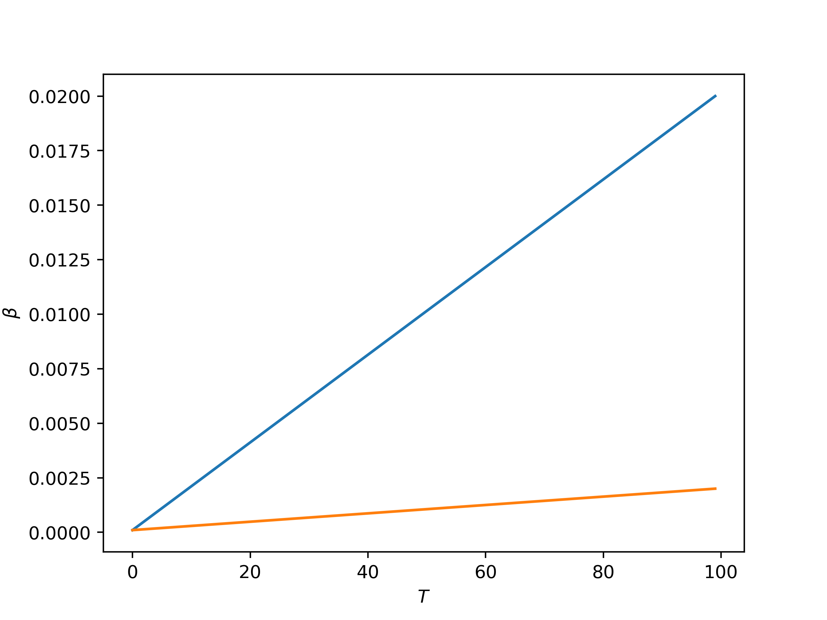
Controlling Enforcement Uncertainty
I also tried manually adjusting the noise schedule by changing the noise schedule at inference
Has a similar effect to adjusting number of time steps, but not very “sound”

Slide 8
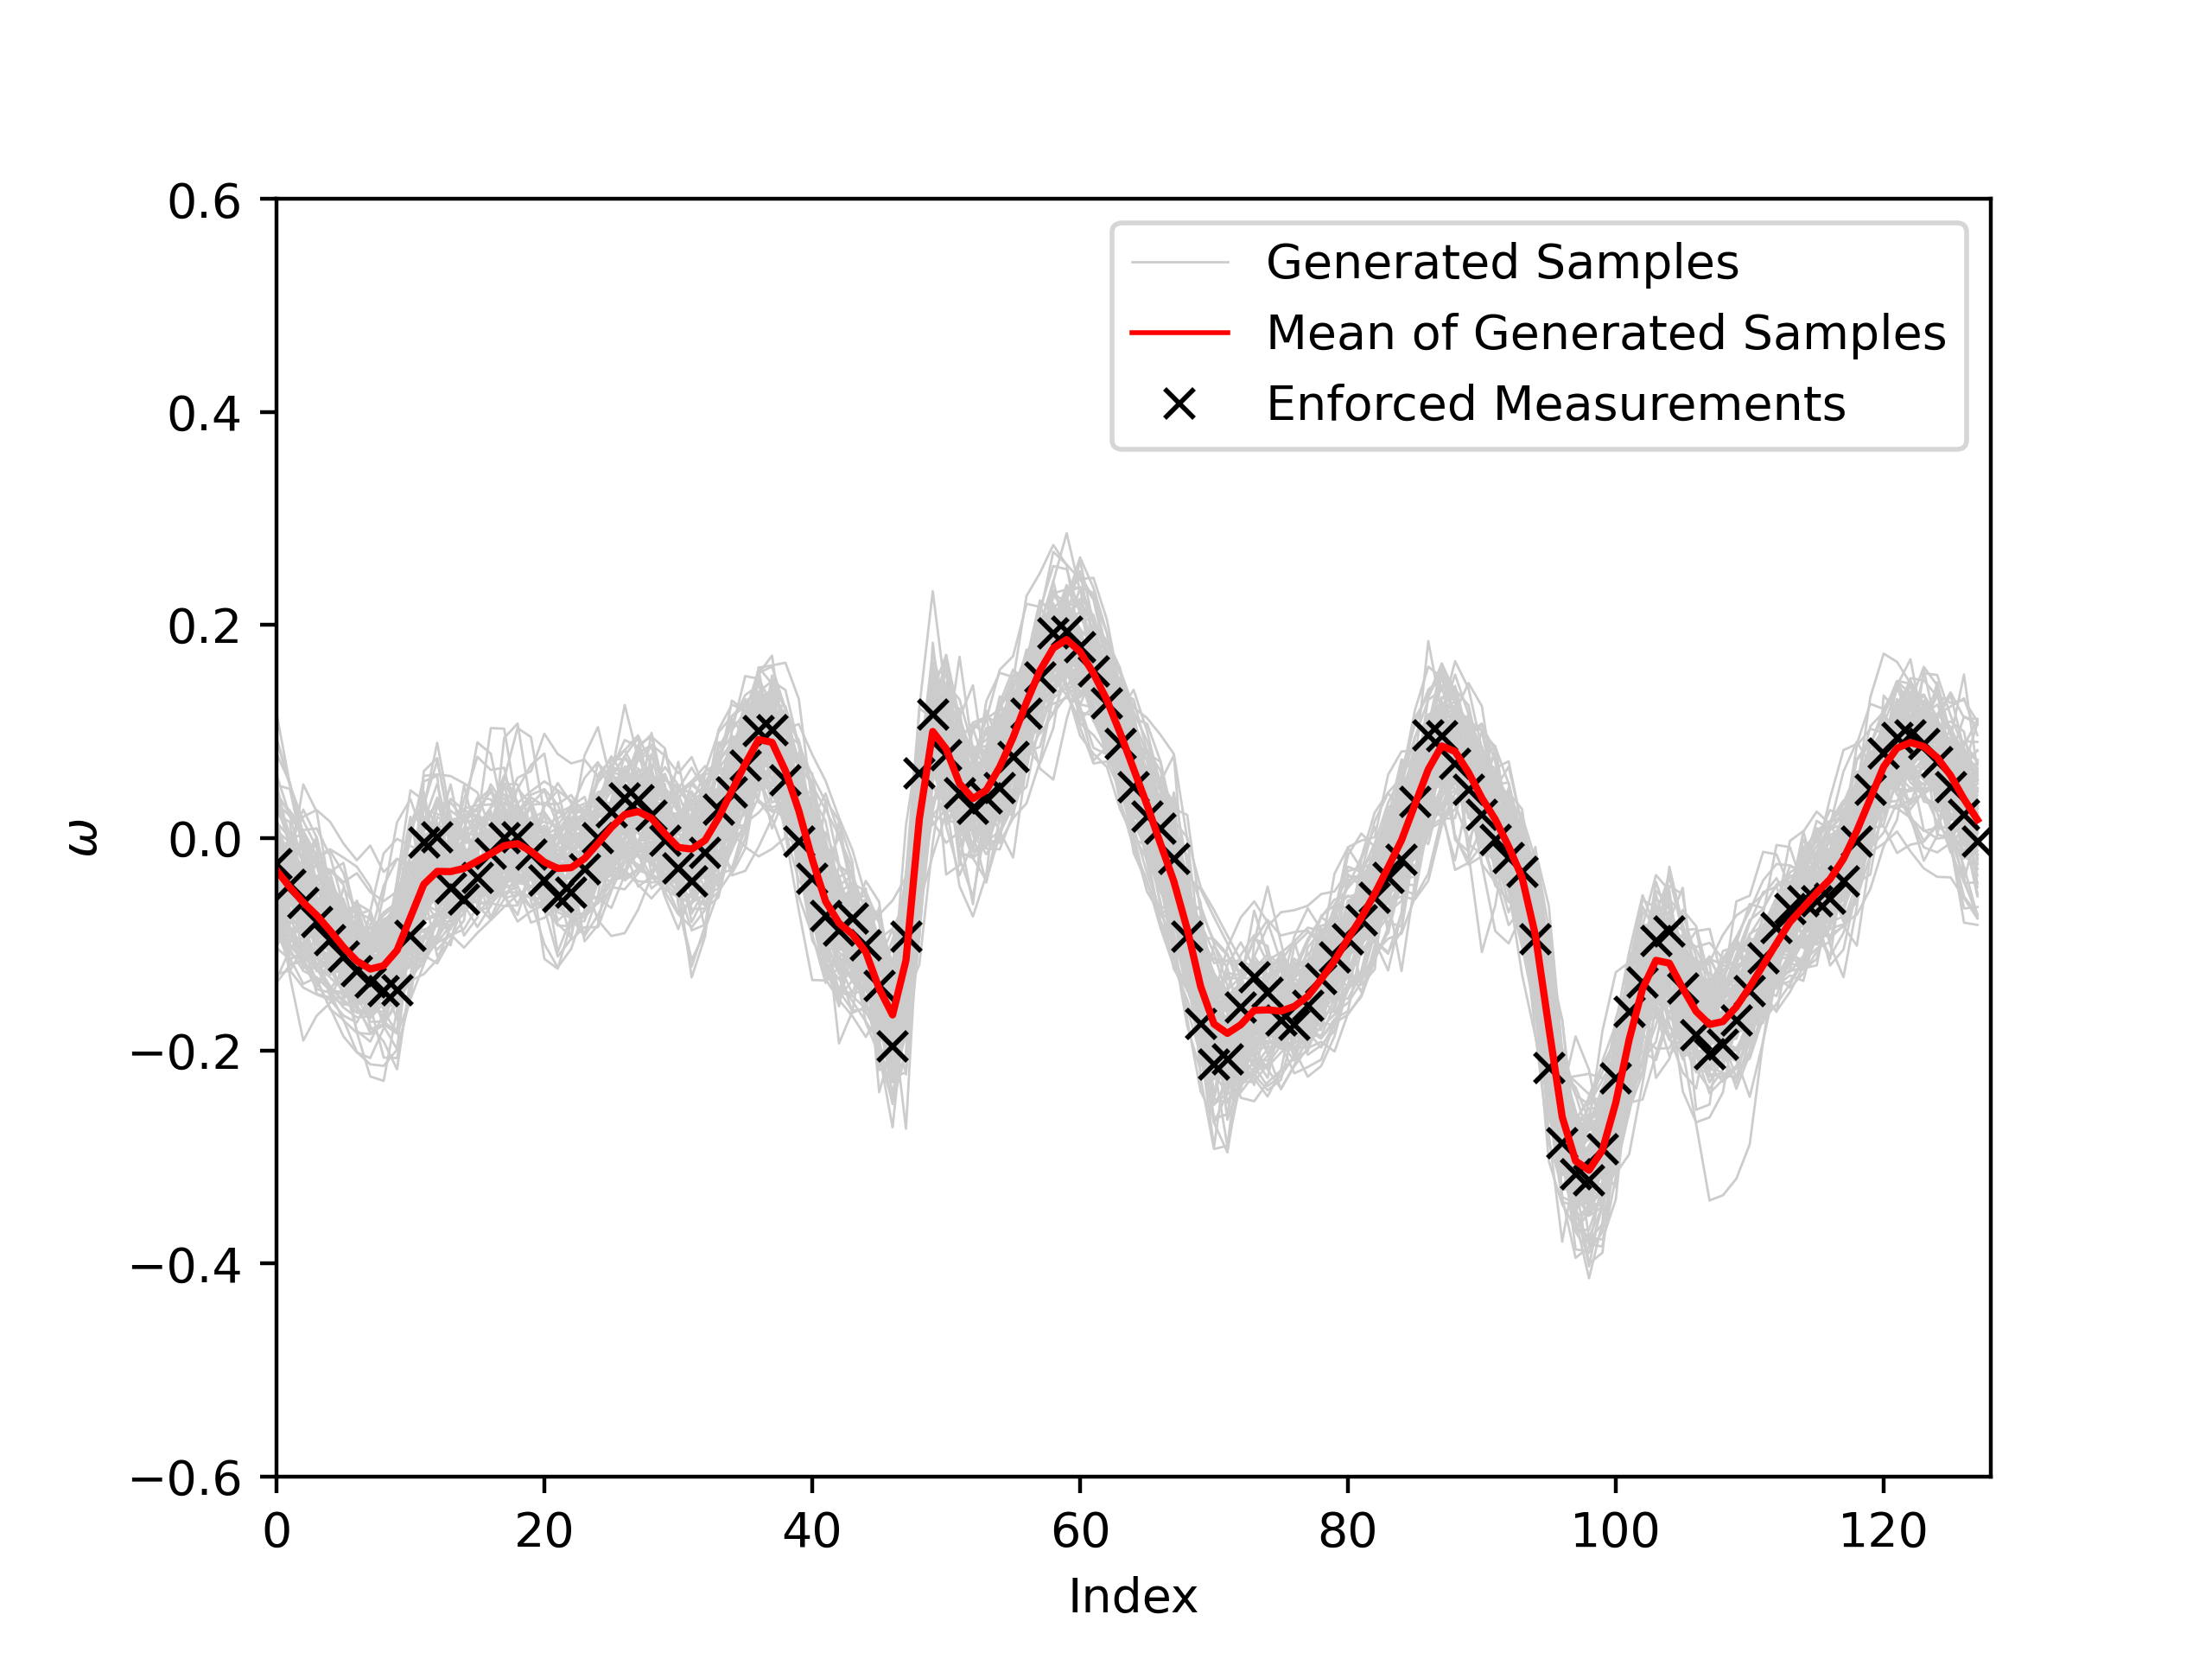
Controlling Enforcement Uncertainty
βmax=0.002, t=100
βmax=0.02, t=100

Slide 9
Two-Point Correlations at Different Reynolds Numbers

Slide 10
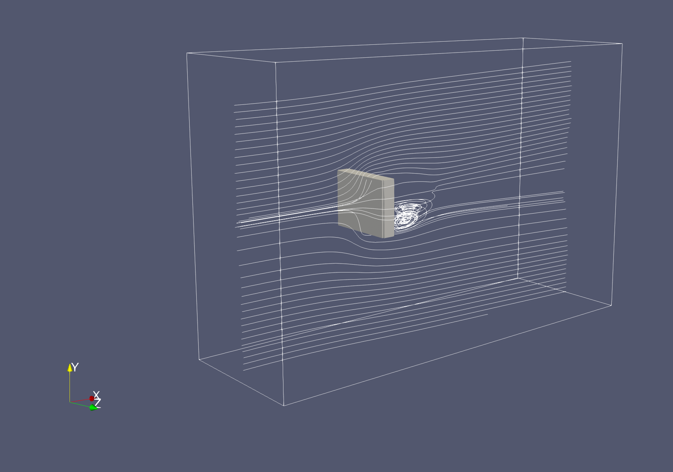
JAX-Fluids
I tried running a 3D case simulation of a rectangular plate wake at Re=40 and Ma=0.3 with around 2 million cells
Took around 2 hours to reach steady state.

Slide 11
JAX-Fluids

