Slide 1
Enforcing Sparse Measurements in Diffusion Models
Baris Turan

Slide 2
Outline
Introduction
Implementation
Results
Plan for Next Week

Slide 3
Introduction
Diffusion models predict unconditional distribution
In simulations, we want to condition the results, on boundary conditions, information on governing equations etc.
Leveraging sparse measurements for data assimilation

Slide 4
Introduction
Conditoining vs. Guidance
  Conditioning
    Samples from conditional pdf
    Might need to retrain unconditional model
  Guidance

Slide 5
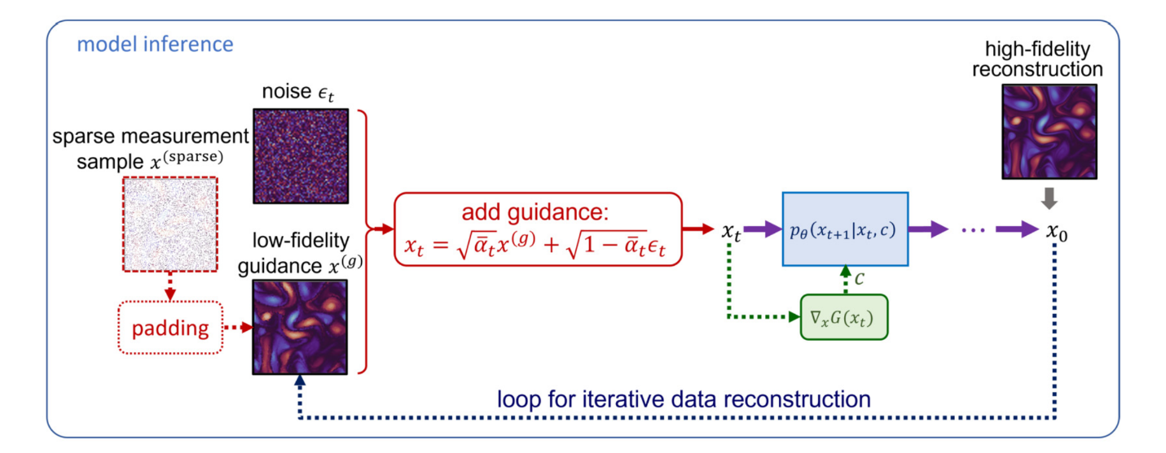
Guidance Using Sparse Data
Shu et al. (2023)
  Kolmogorov flow
  Use sparse/low fidelity data as guidance
  Mix guidance with noise, then feed the result to diffusion model
  Model trained only with high fidelity data.

Slide 6
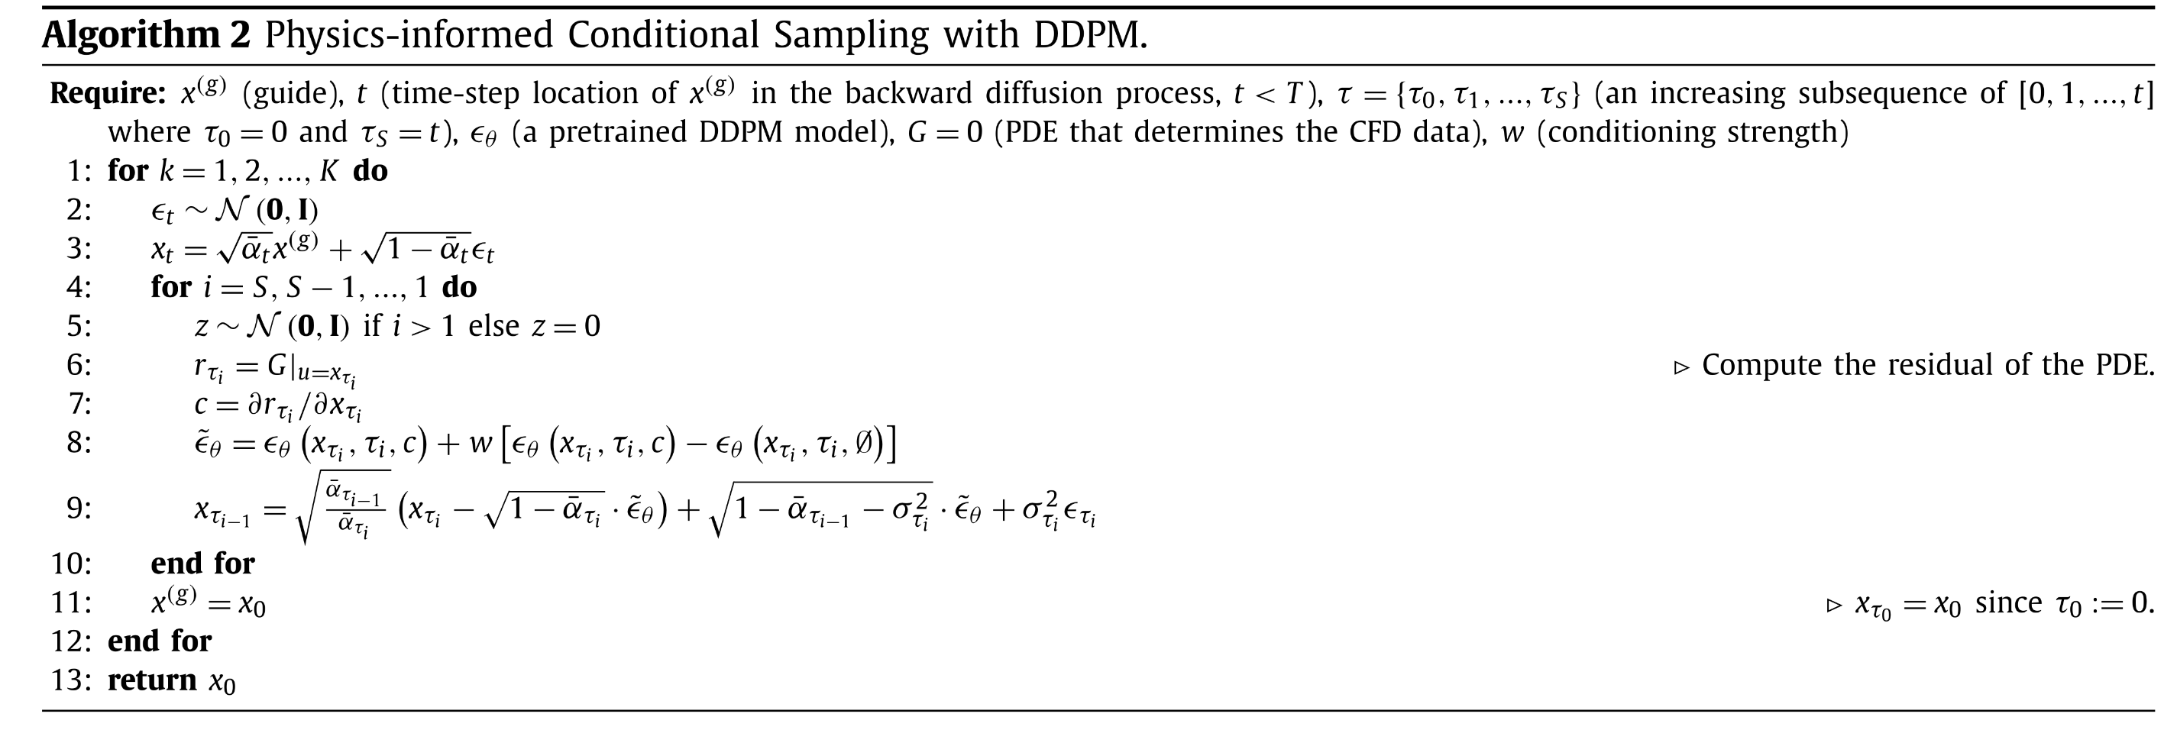
Implementation
Implemented the method of Shu et al. (2023)
Used the pre-trained unconditional U-net for Kolmogorov Flow
Had to change variance schedule

Slide 7
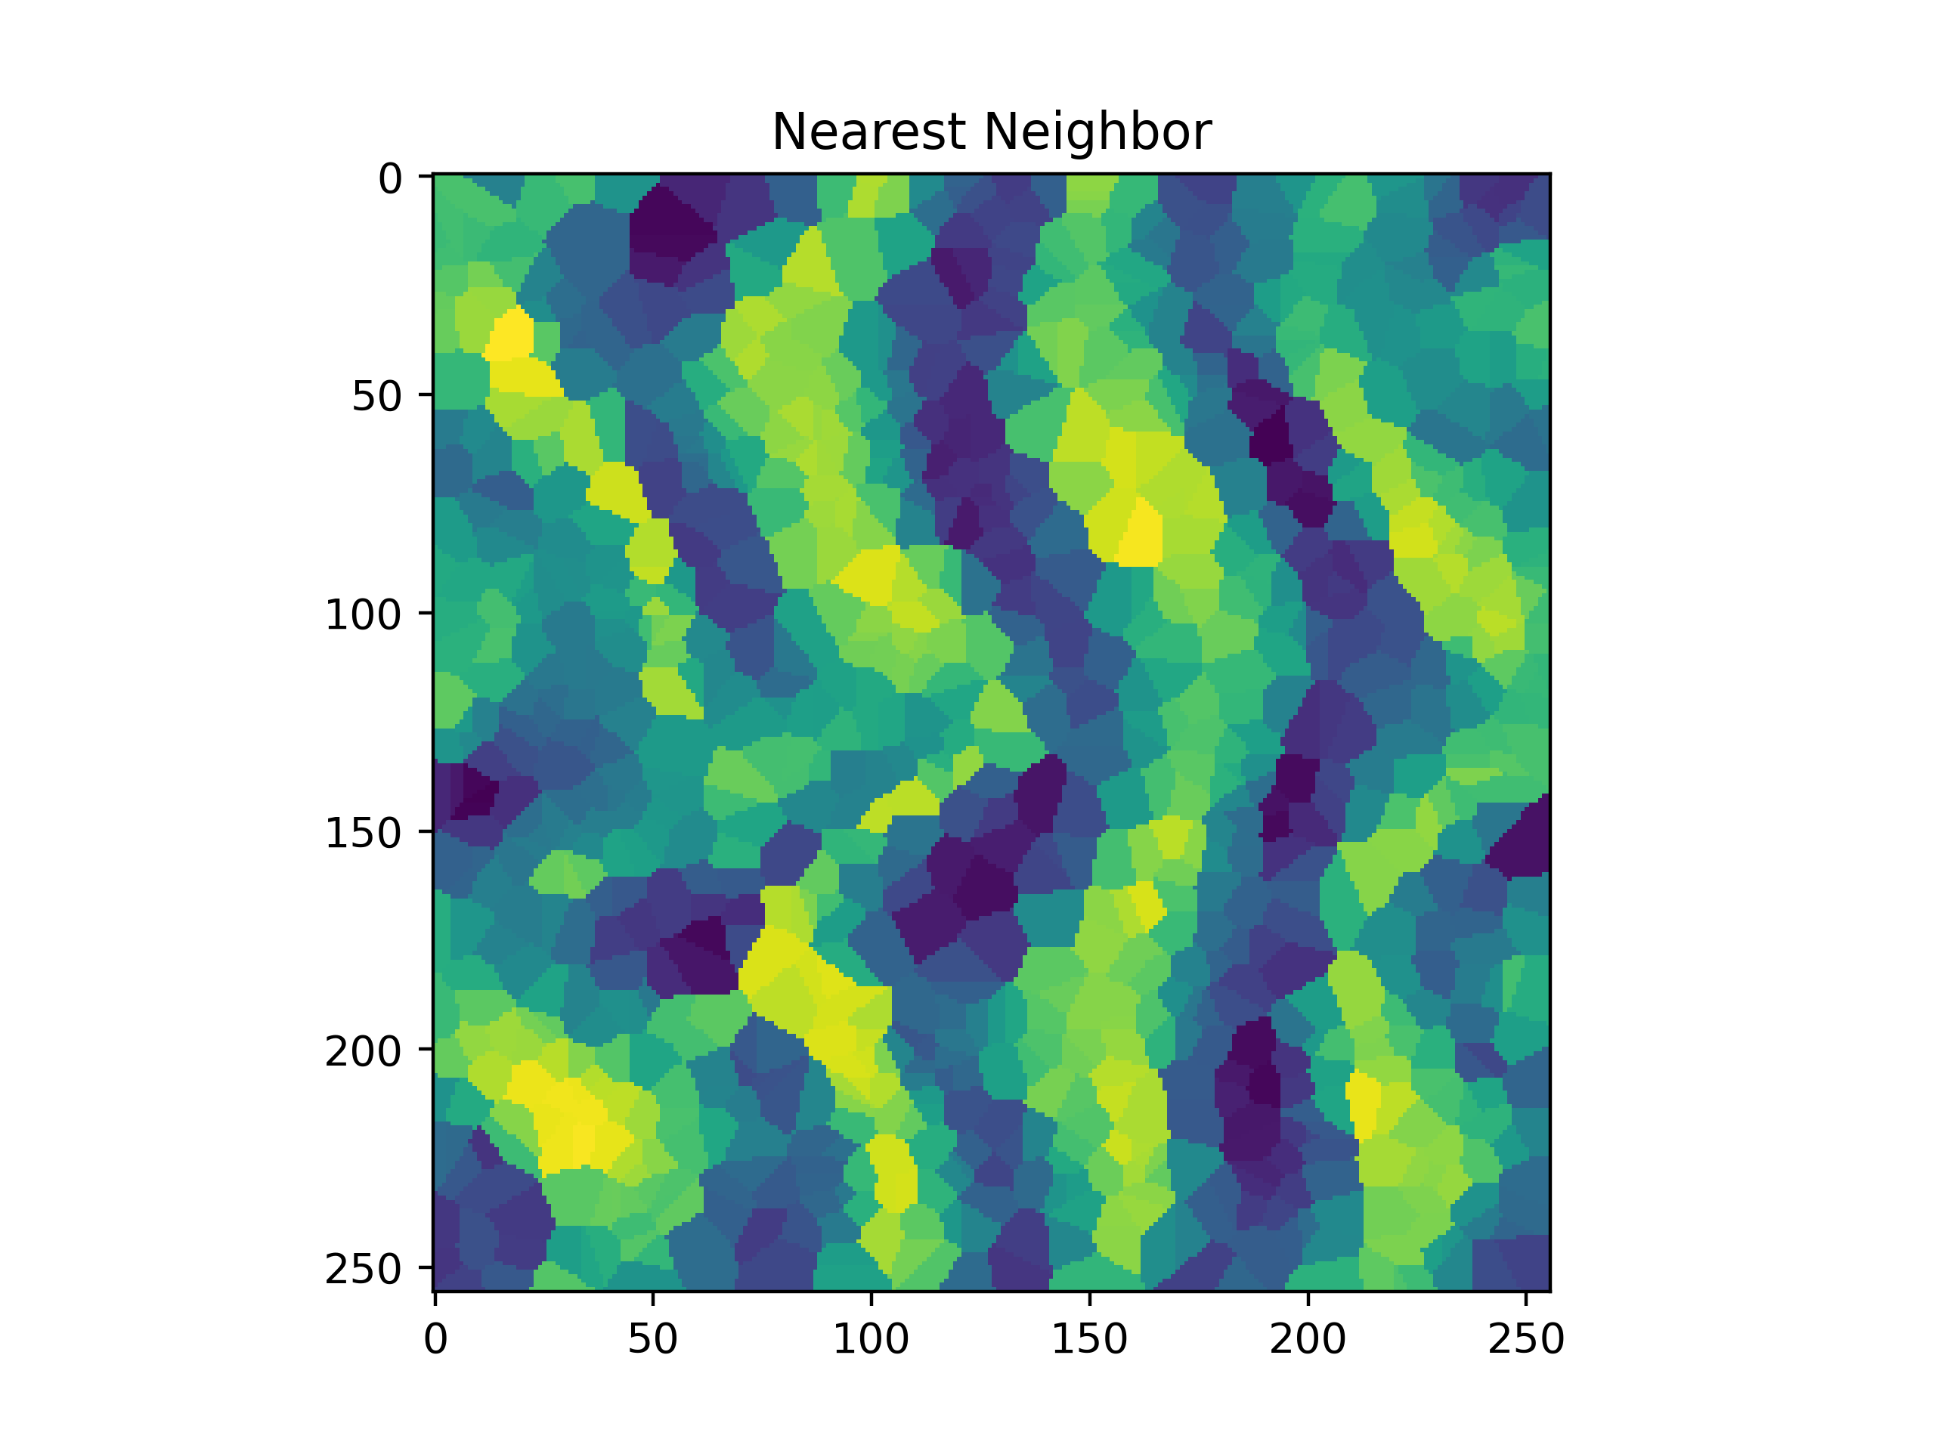
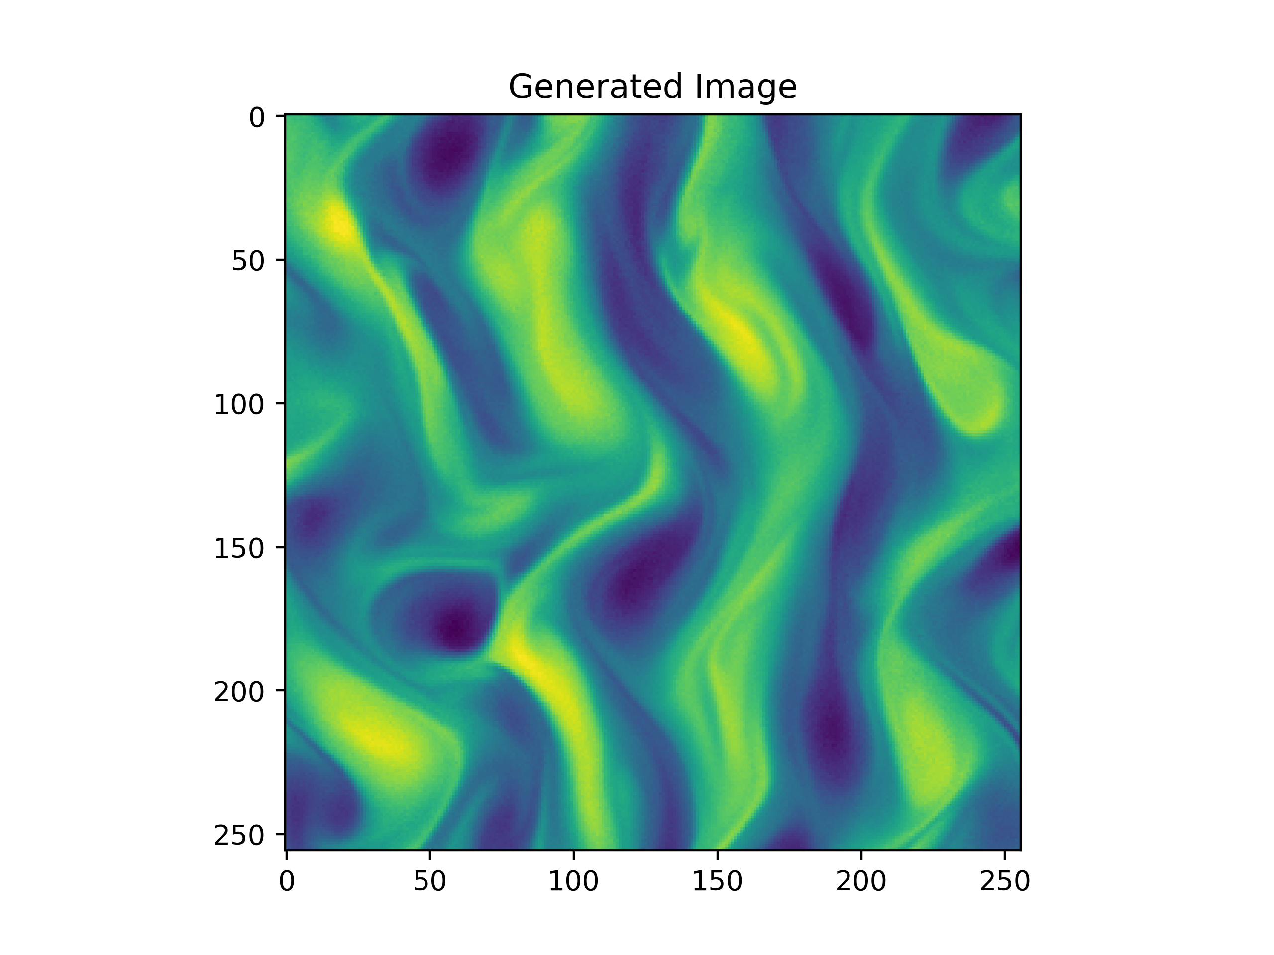
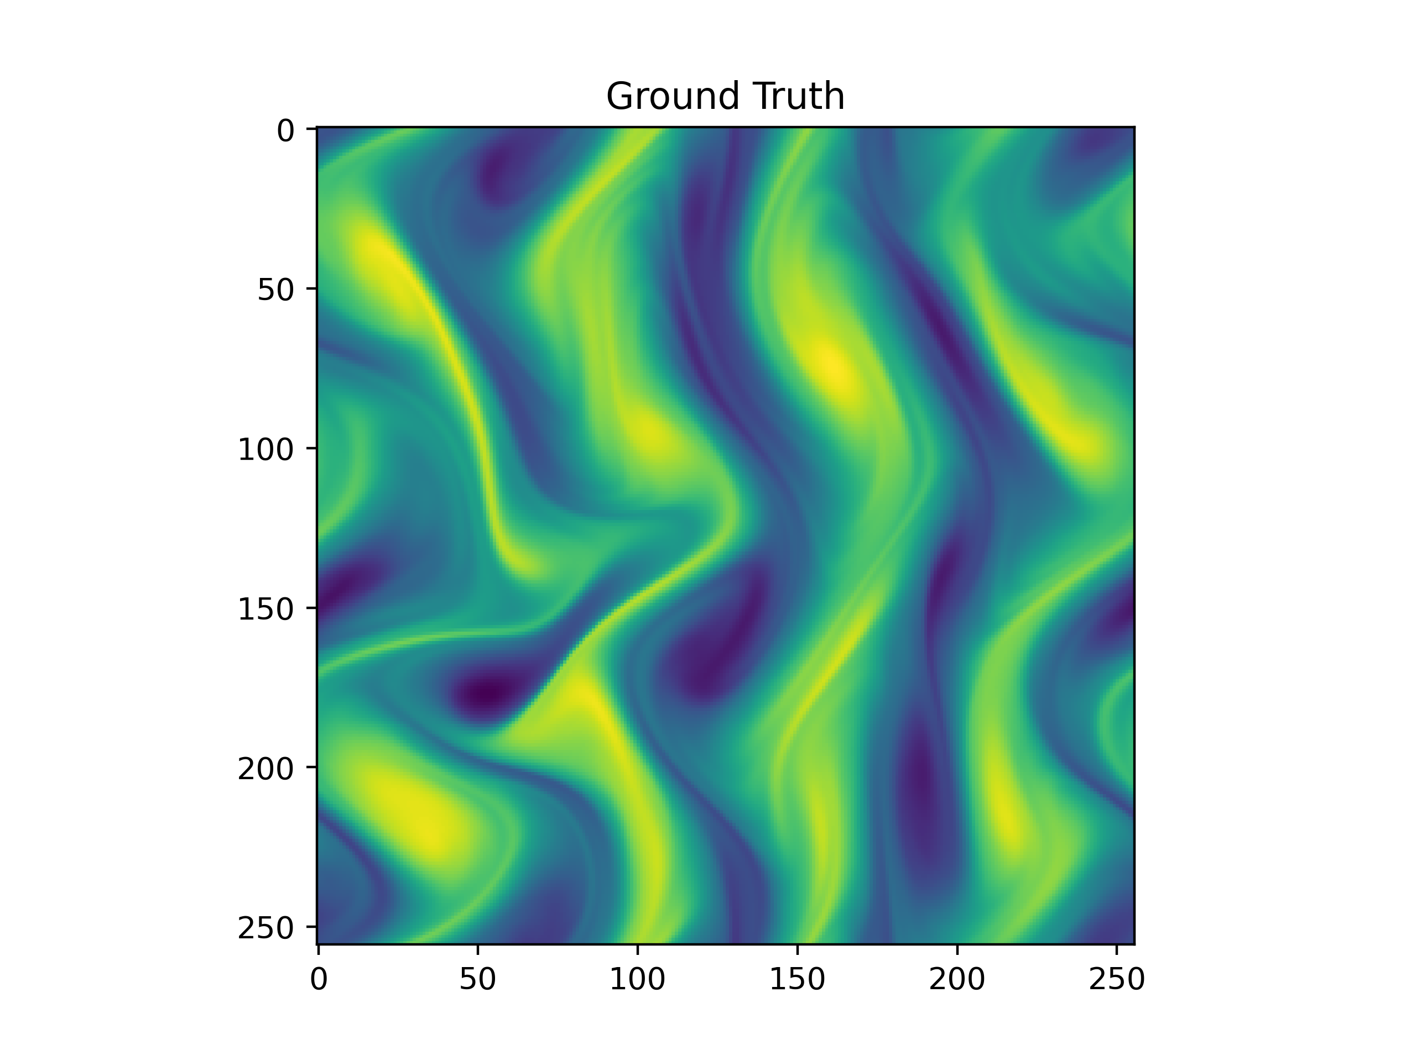
Results
1.5625% sparsity, K=1, t=100, beta_max = 0.002

Slide 8
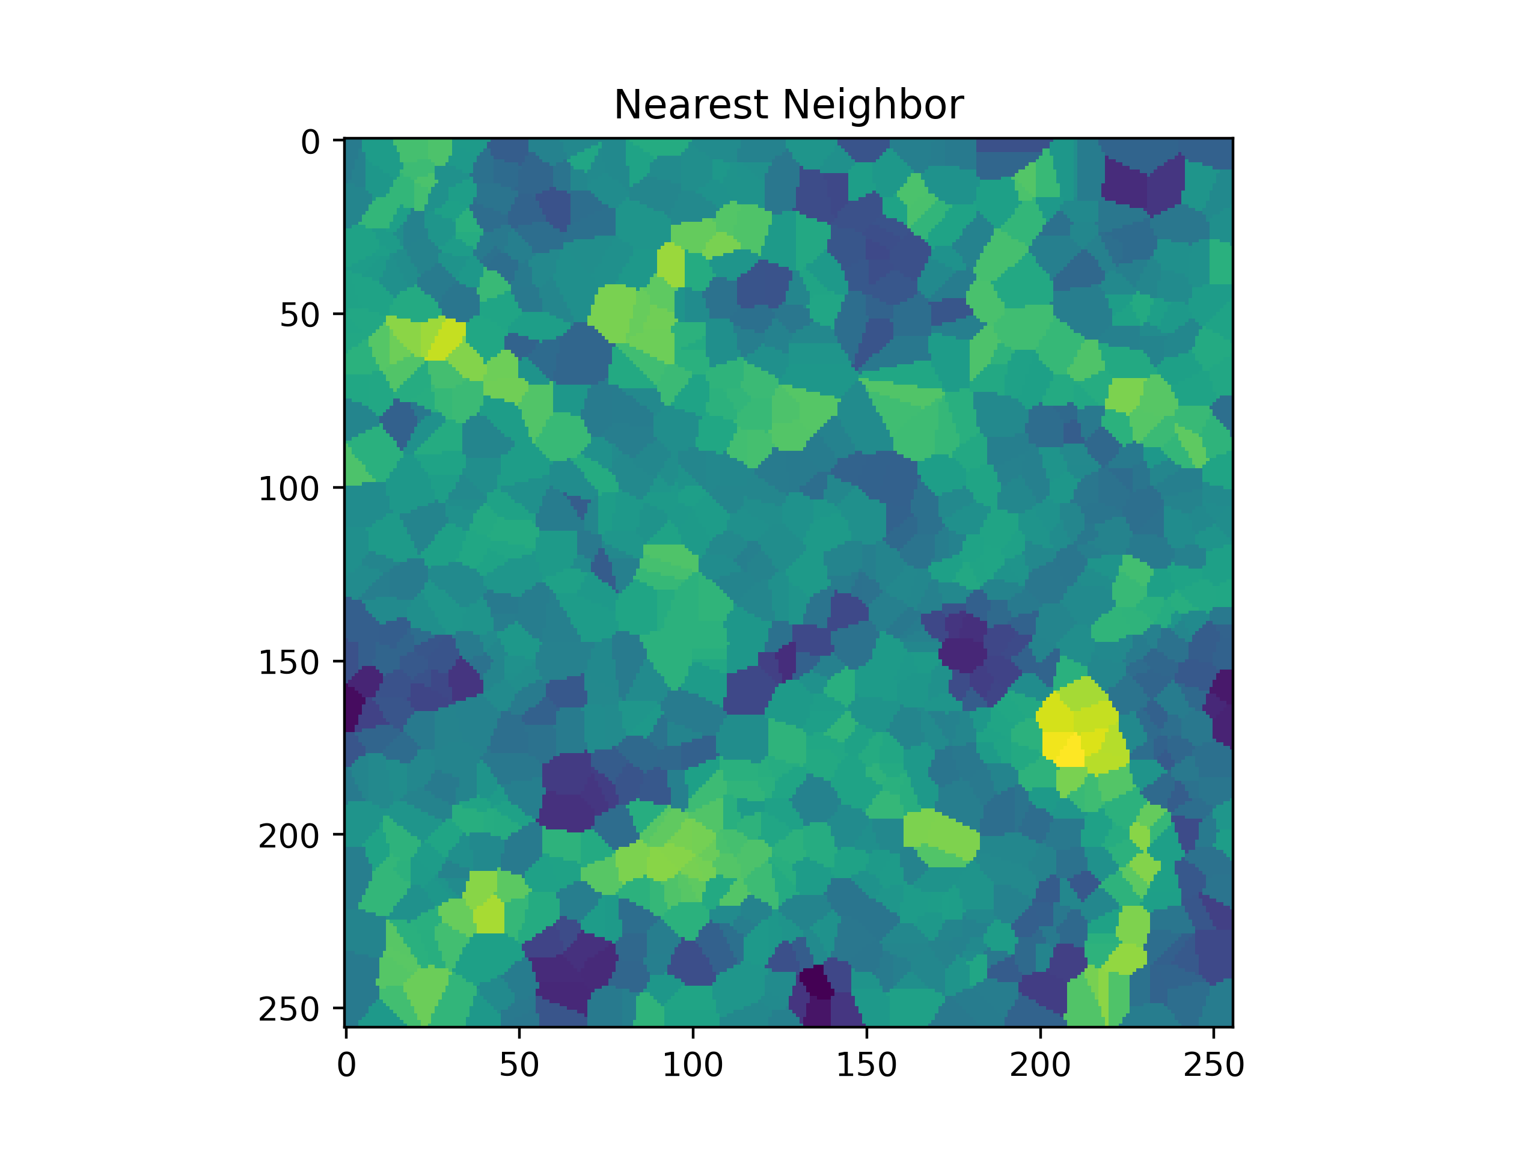
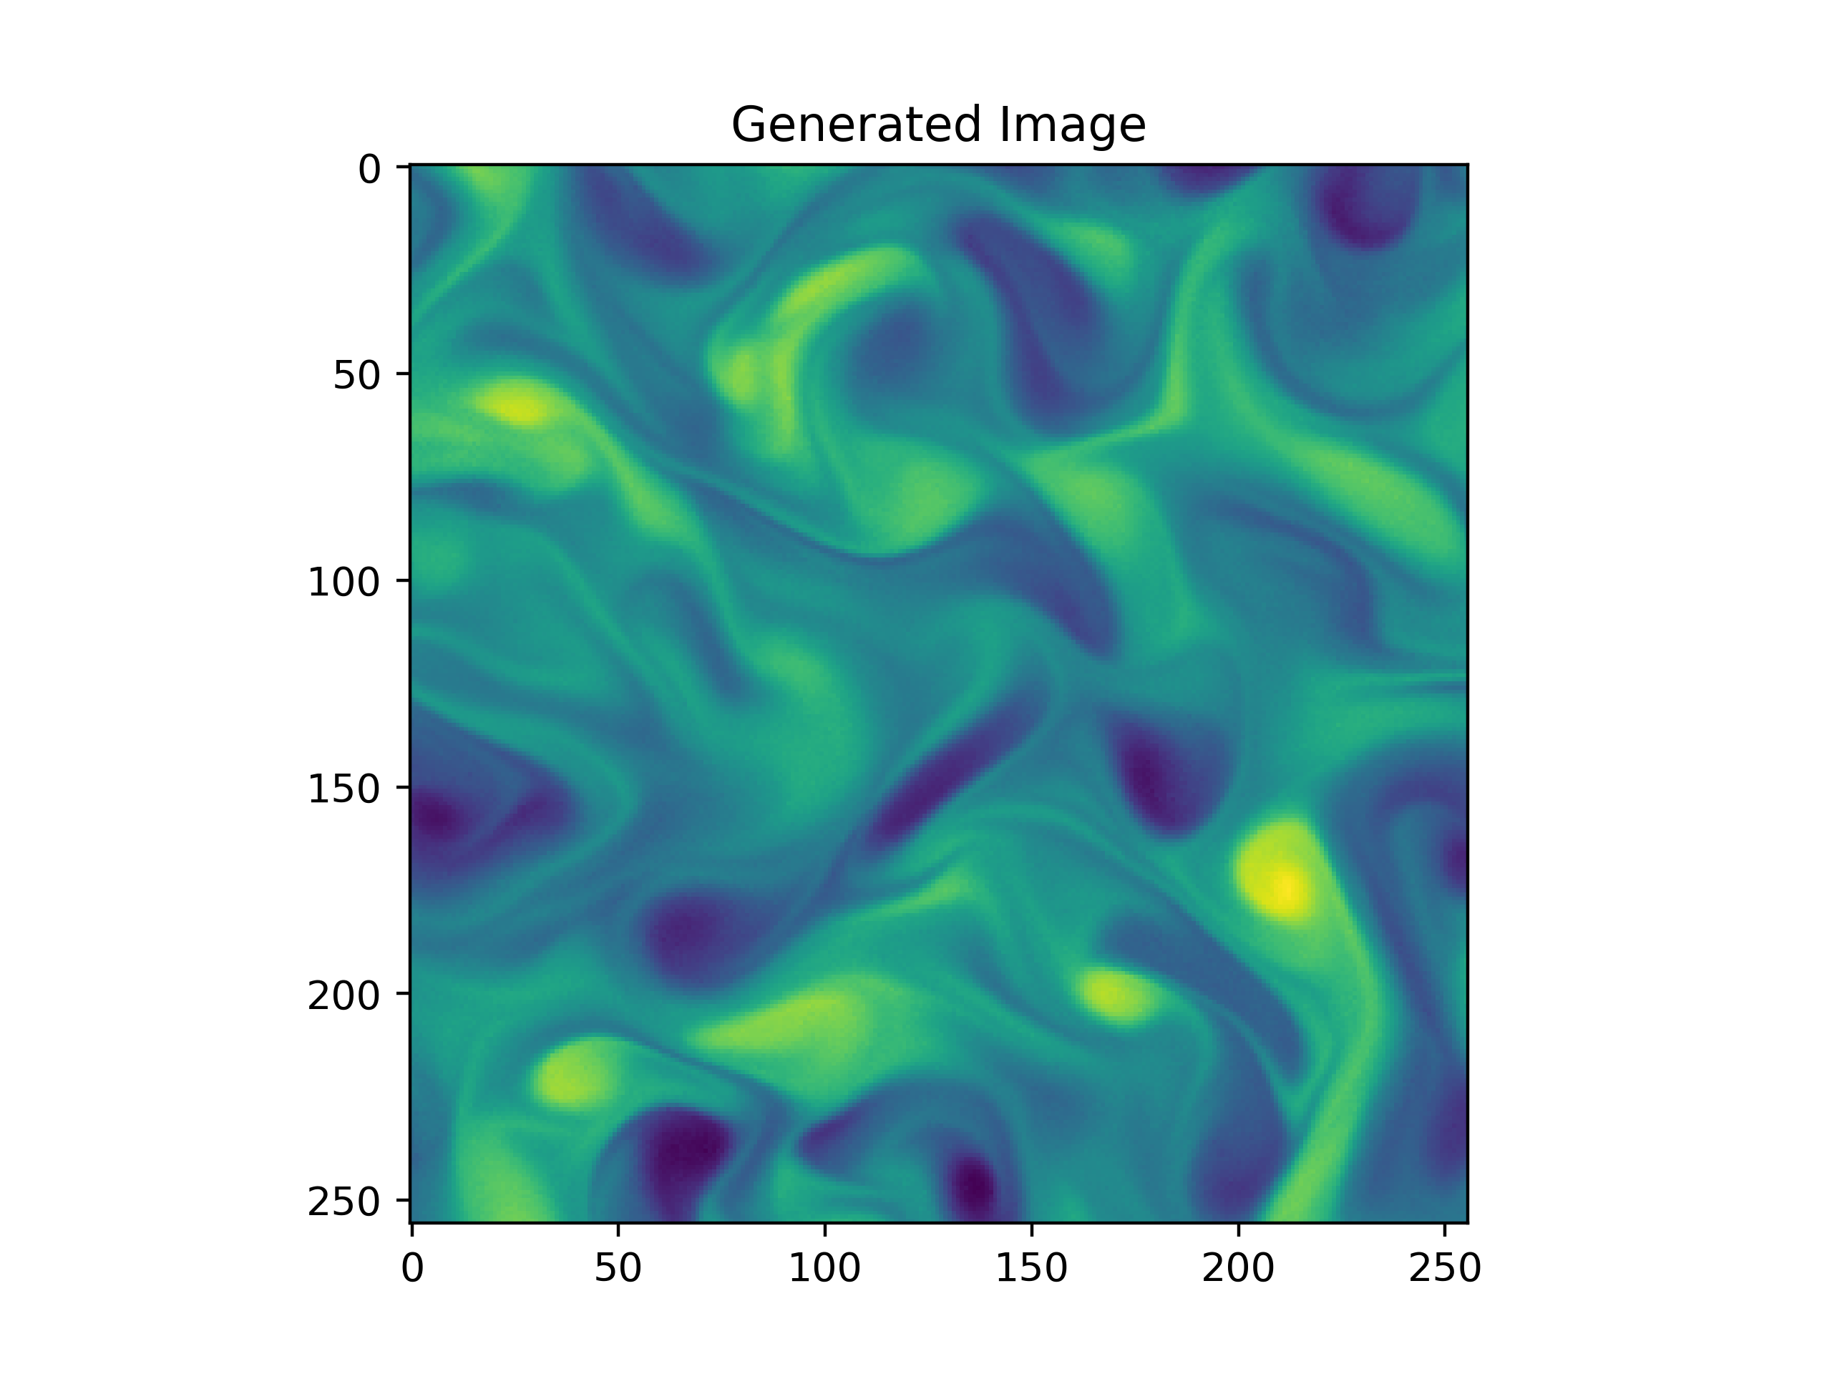
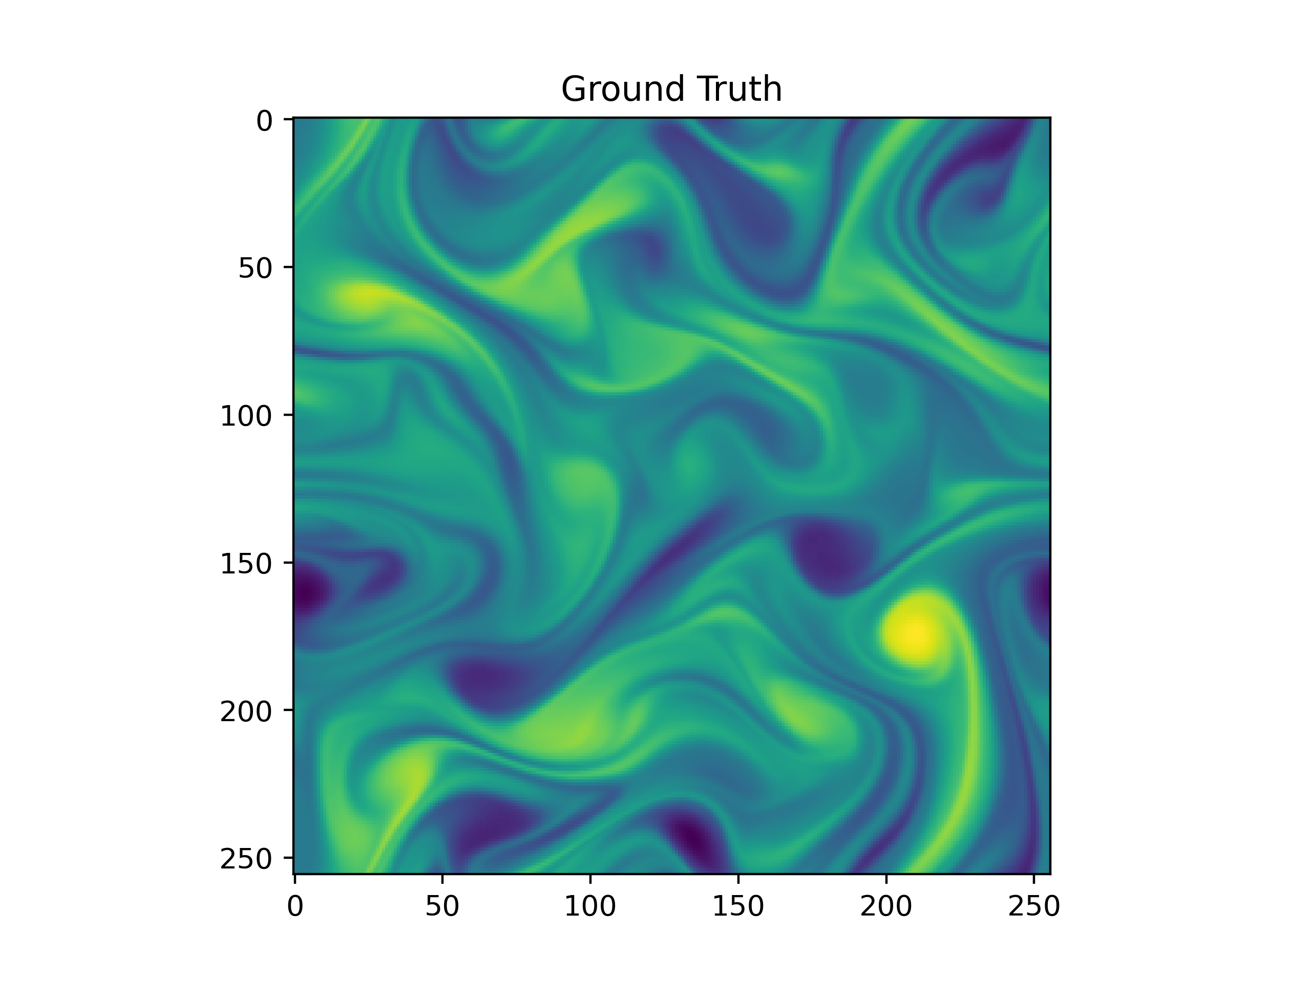
Results
1.5625% sparsity, K=1, t=100

Slide 9
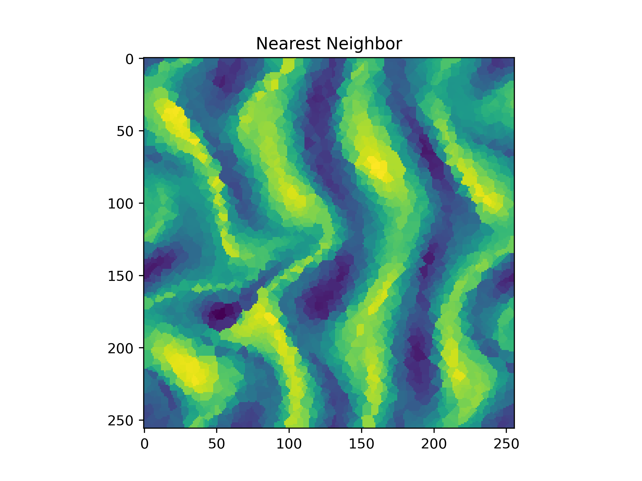
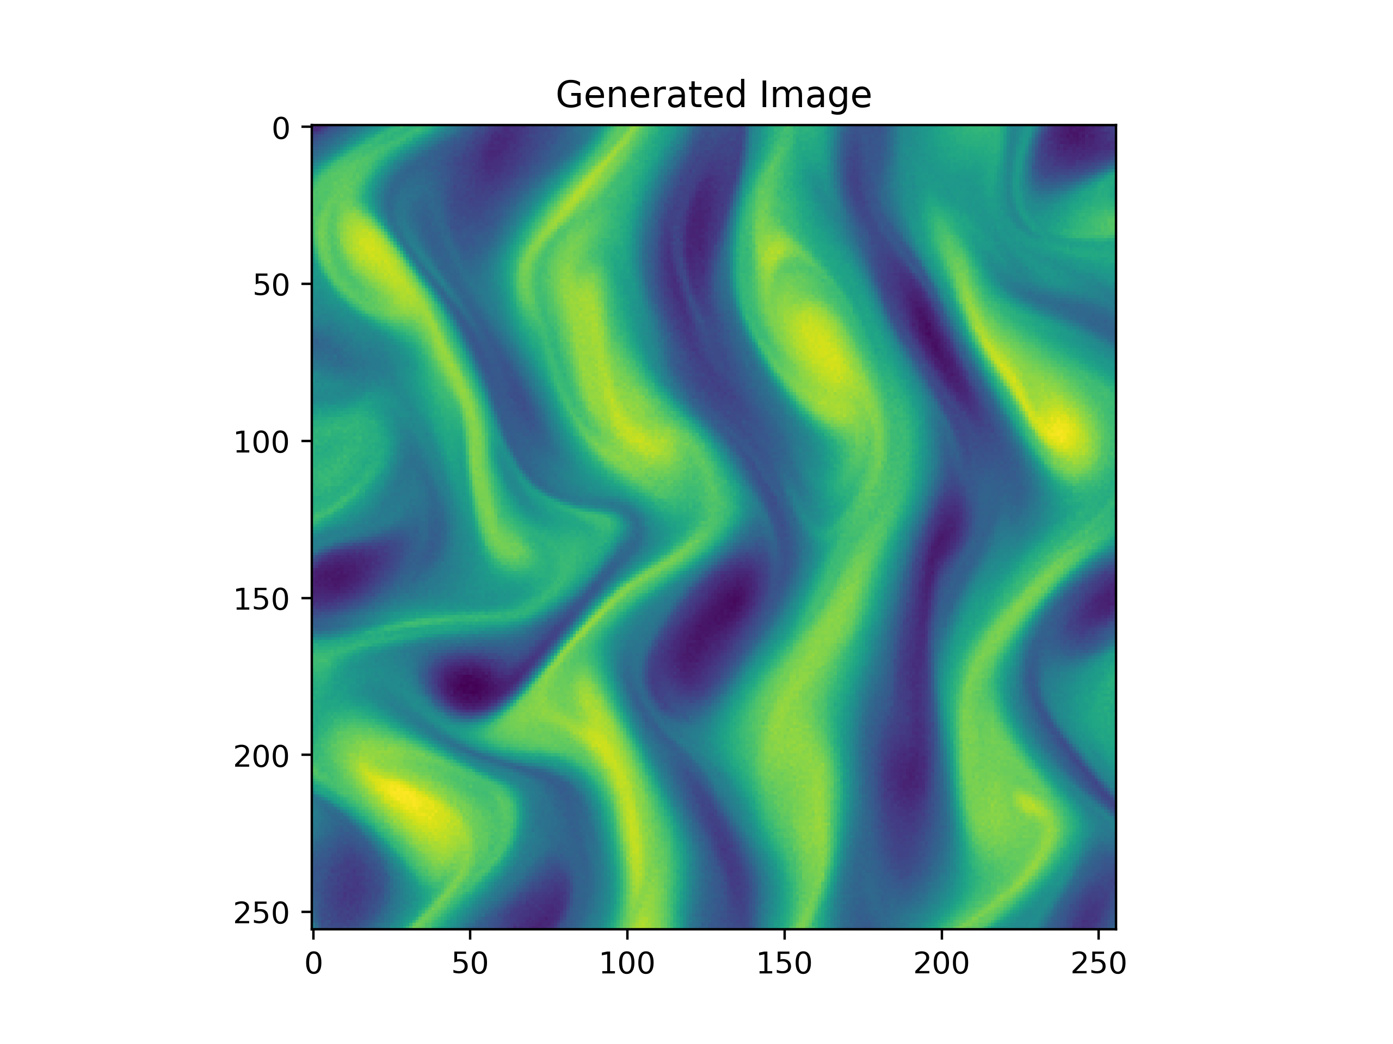
Results
5% sparsity, K=1, t=100, beta_max = 0.002

Slide 10
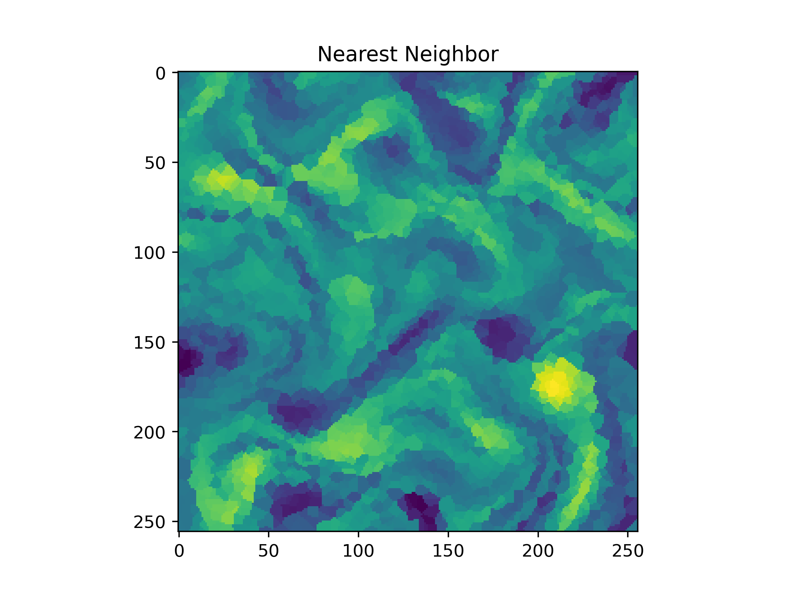

Results
5% sparsity, K=1, t=100, beta_max = 0.002

Slide 11
Results
Accuracy at measurement locations

Slide 12
Results
Effect of Beta_max

Slide 13
Results
Effect of t

Slide 14
Results
Effect of K

