Slide 1
Enforcing Sparse Measurements in Diffusion Models
Baris Turan

Slide 2
Outline
Previous Meeting
Statistical Quantities
Running the Code from the Paper
Using JAX-Fluids

Slide 3
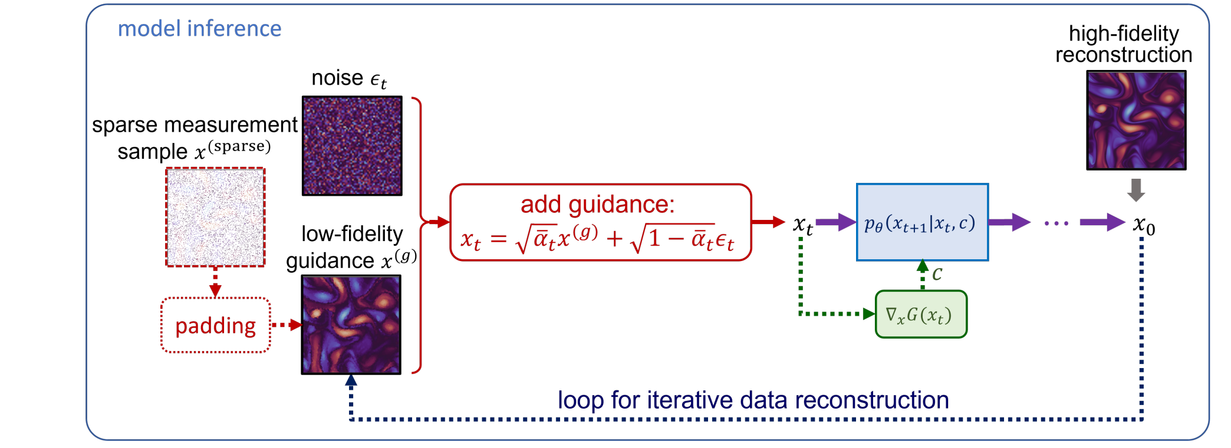
Previous Meeting
Nearest neighbor interpolation + noise to generate high fidelity flow
Need more physical metrics to evaluate results
Run the code from the Shu et al. (2023)
Dule Shu, Zĳie Li, & Amir Barati Farimani (2023). A physics-informed diffusion model for high-fidelity flow field reconstruction. Journal of Computational Physics, 478, 111972.

Slide 4
Our model: 1861697 parameters
Their model: 3468739 parameters

Slide 5
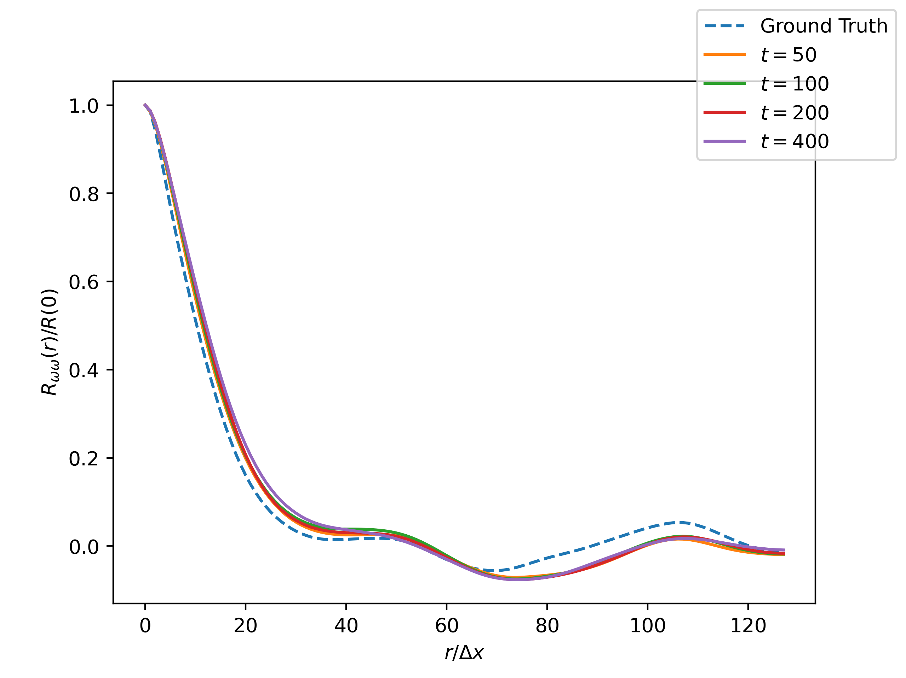
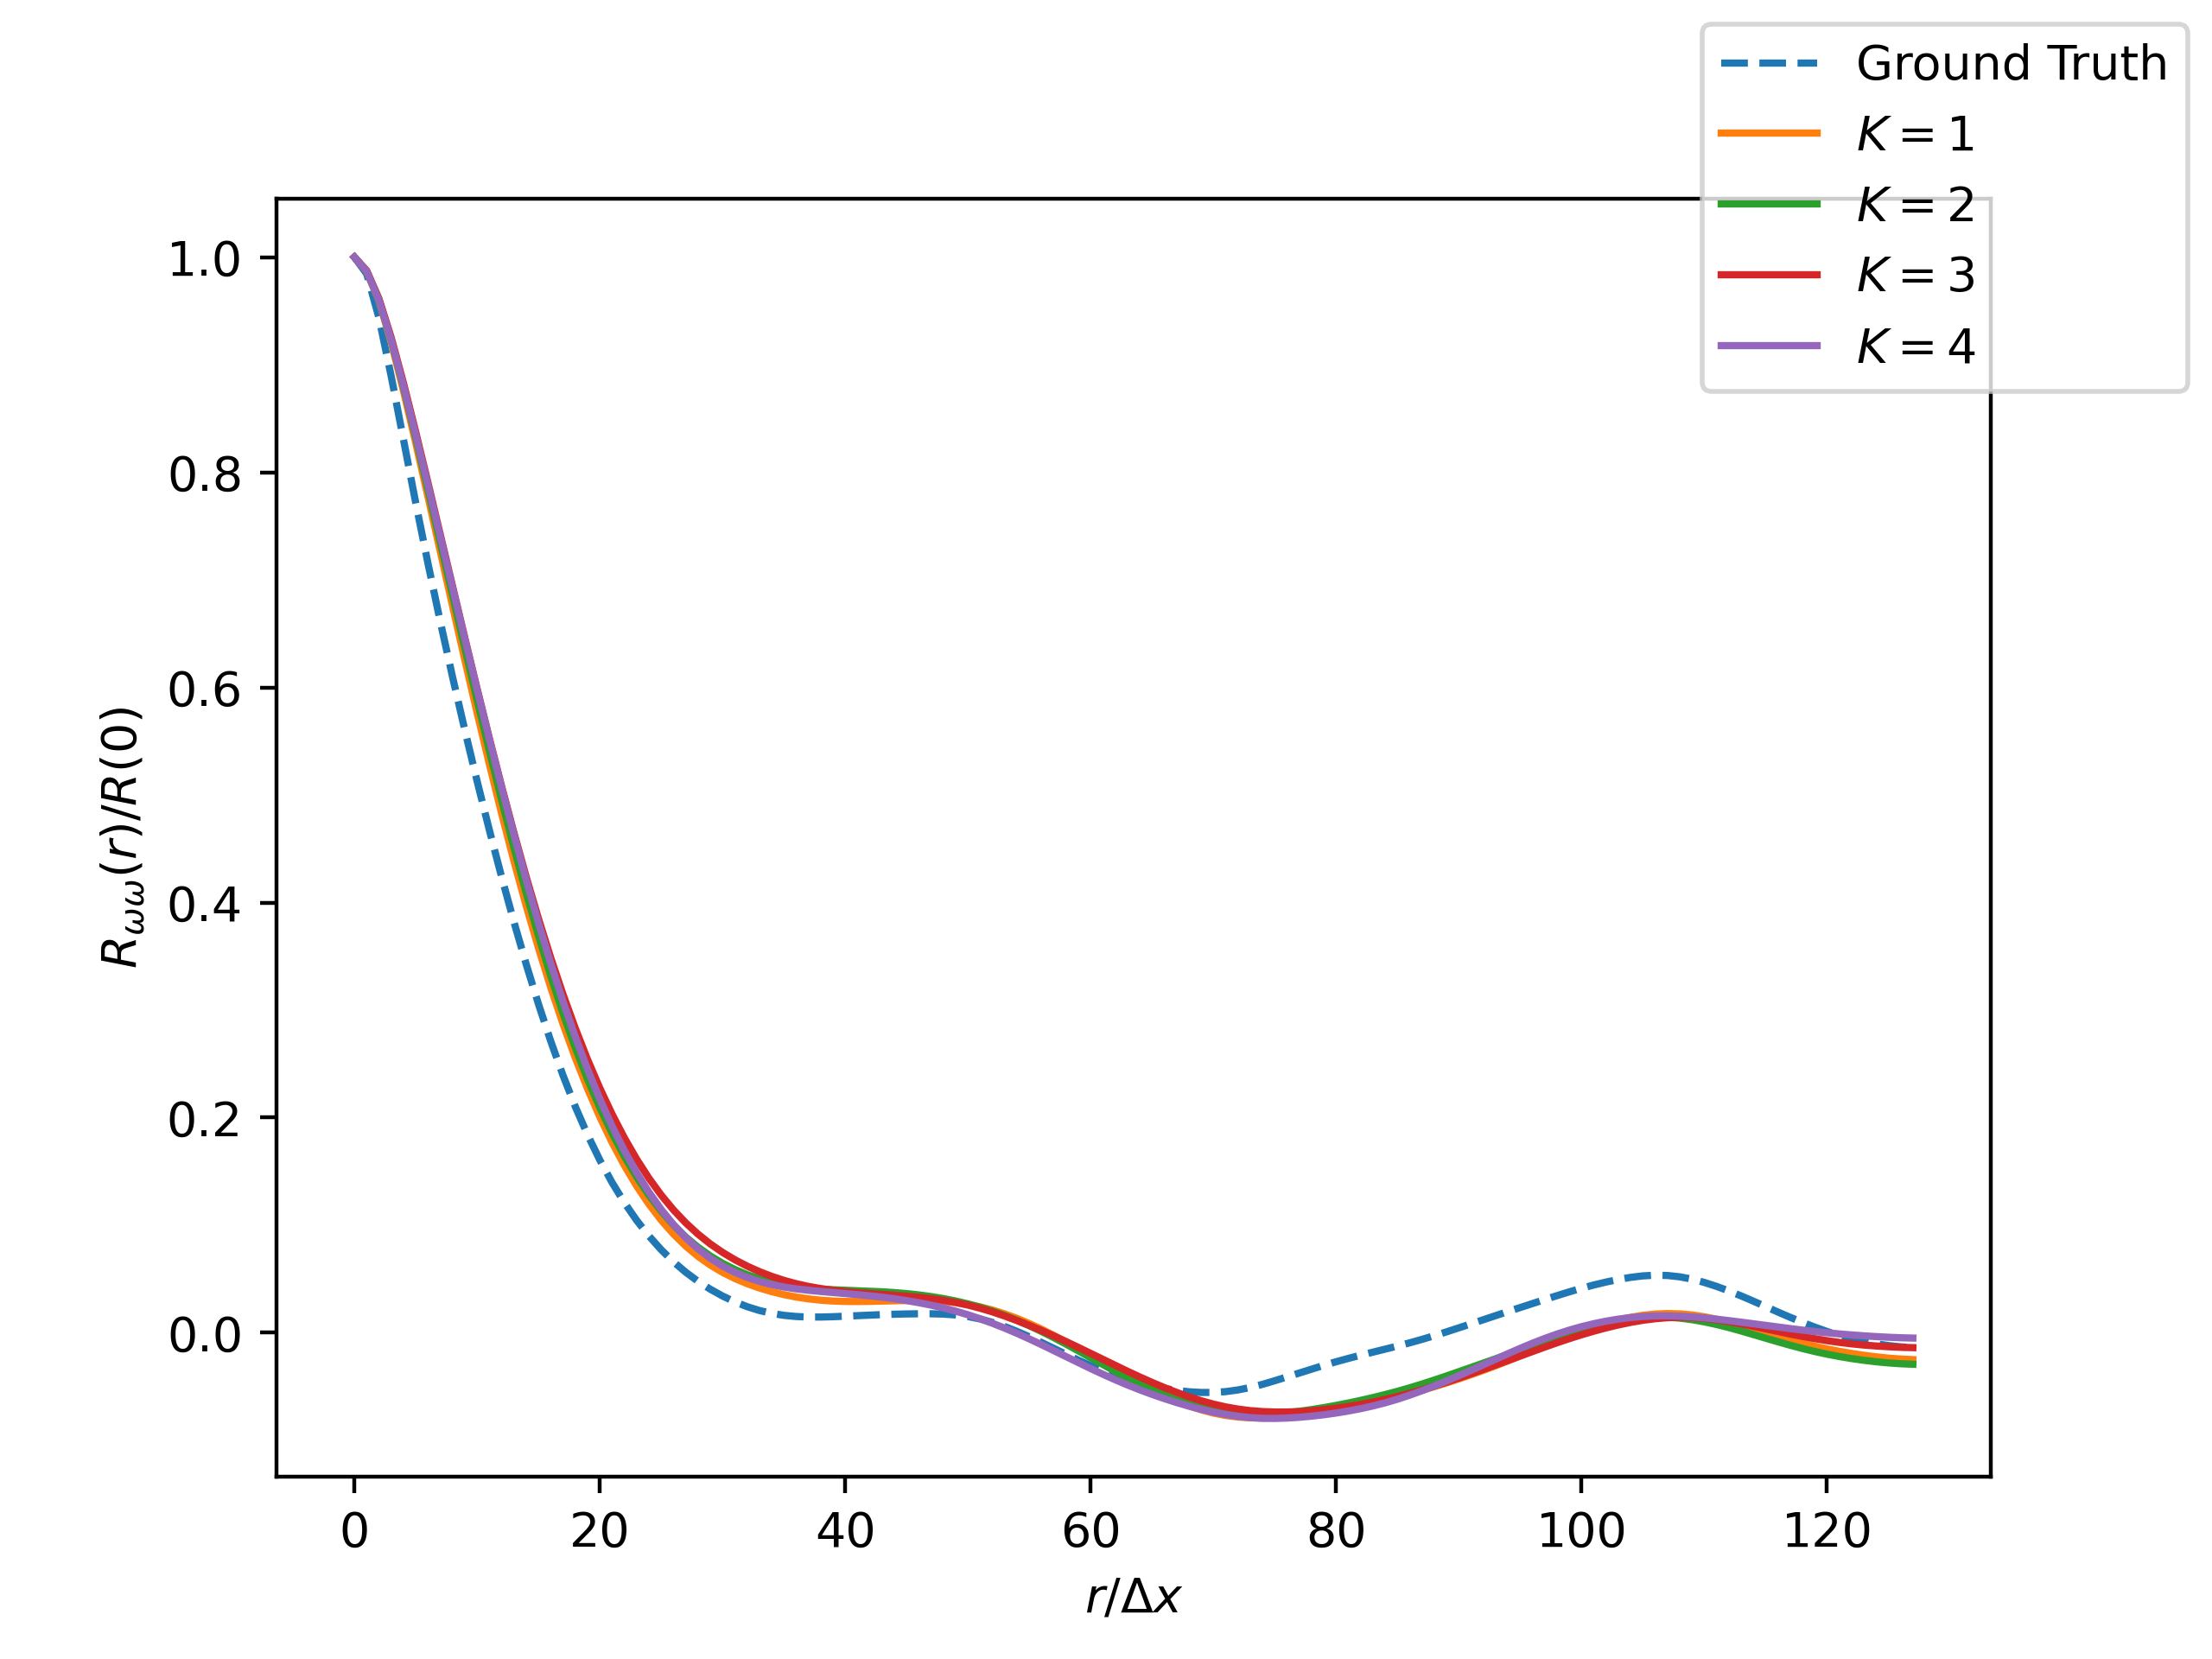
Two-Point Correlation of Vorticity

Slide 6
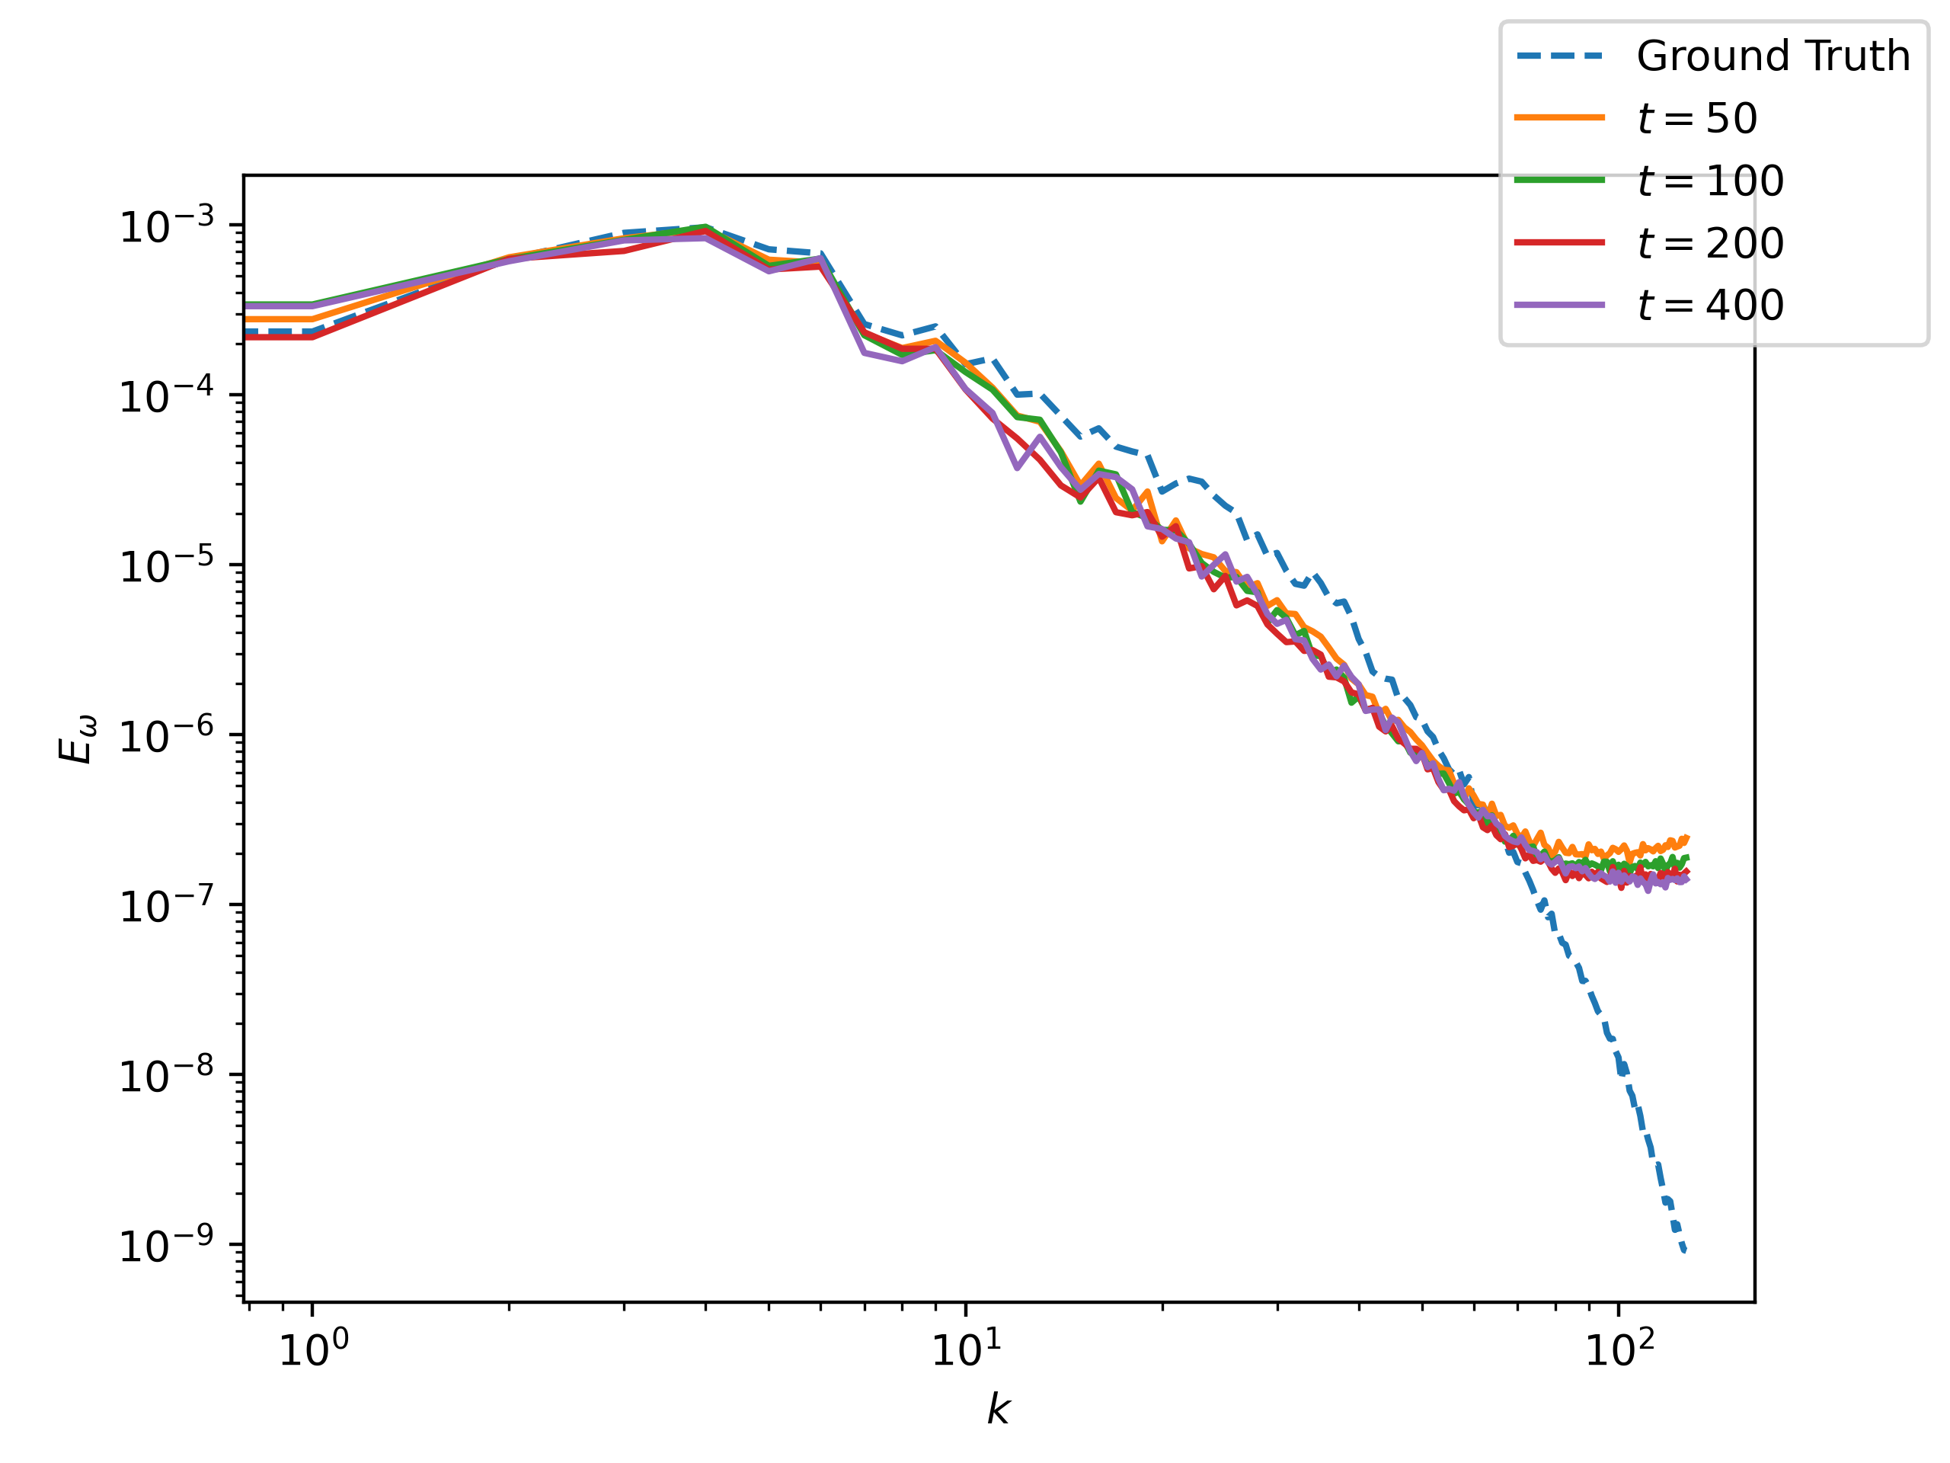
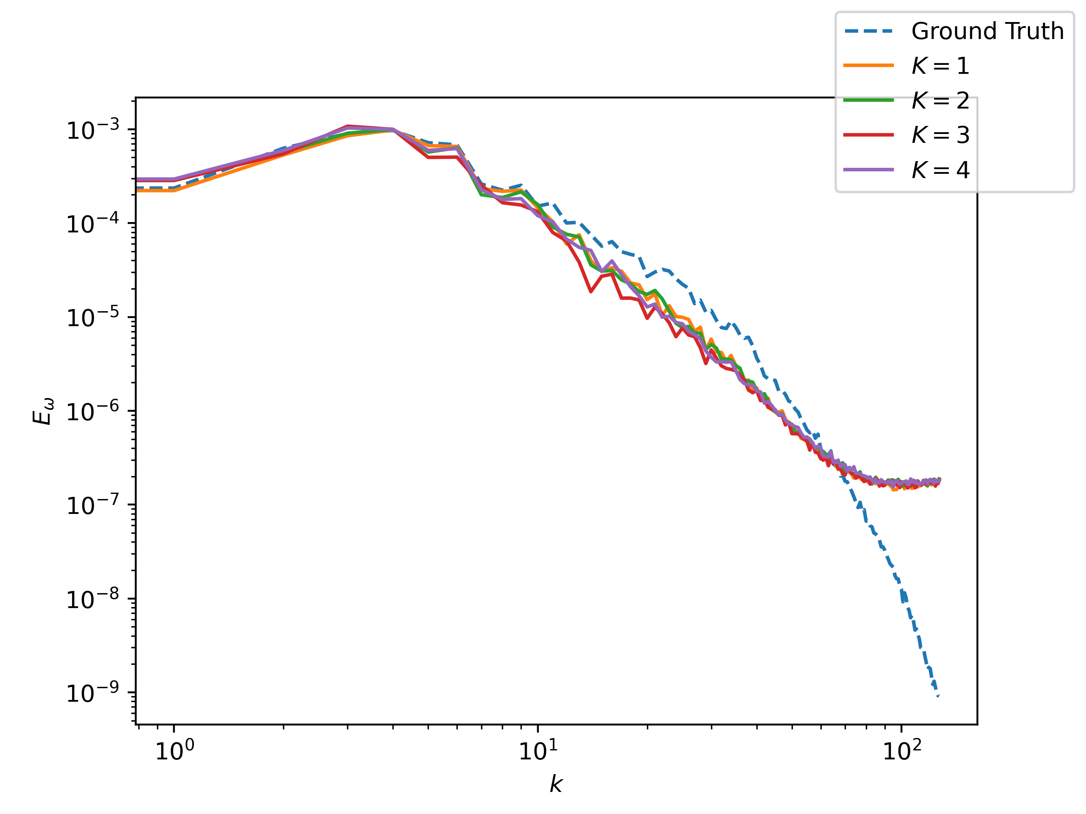
Vorticity Spectrum

Slide 7
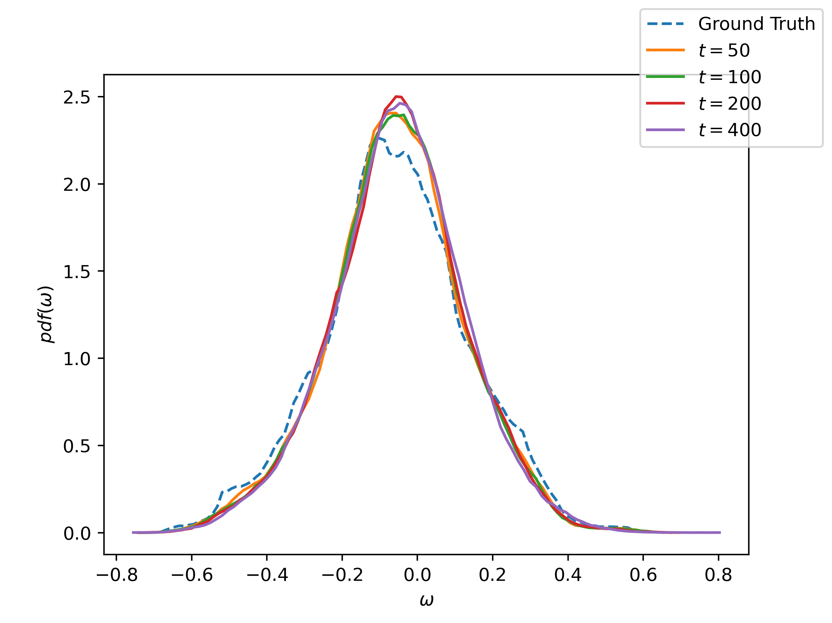
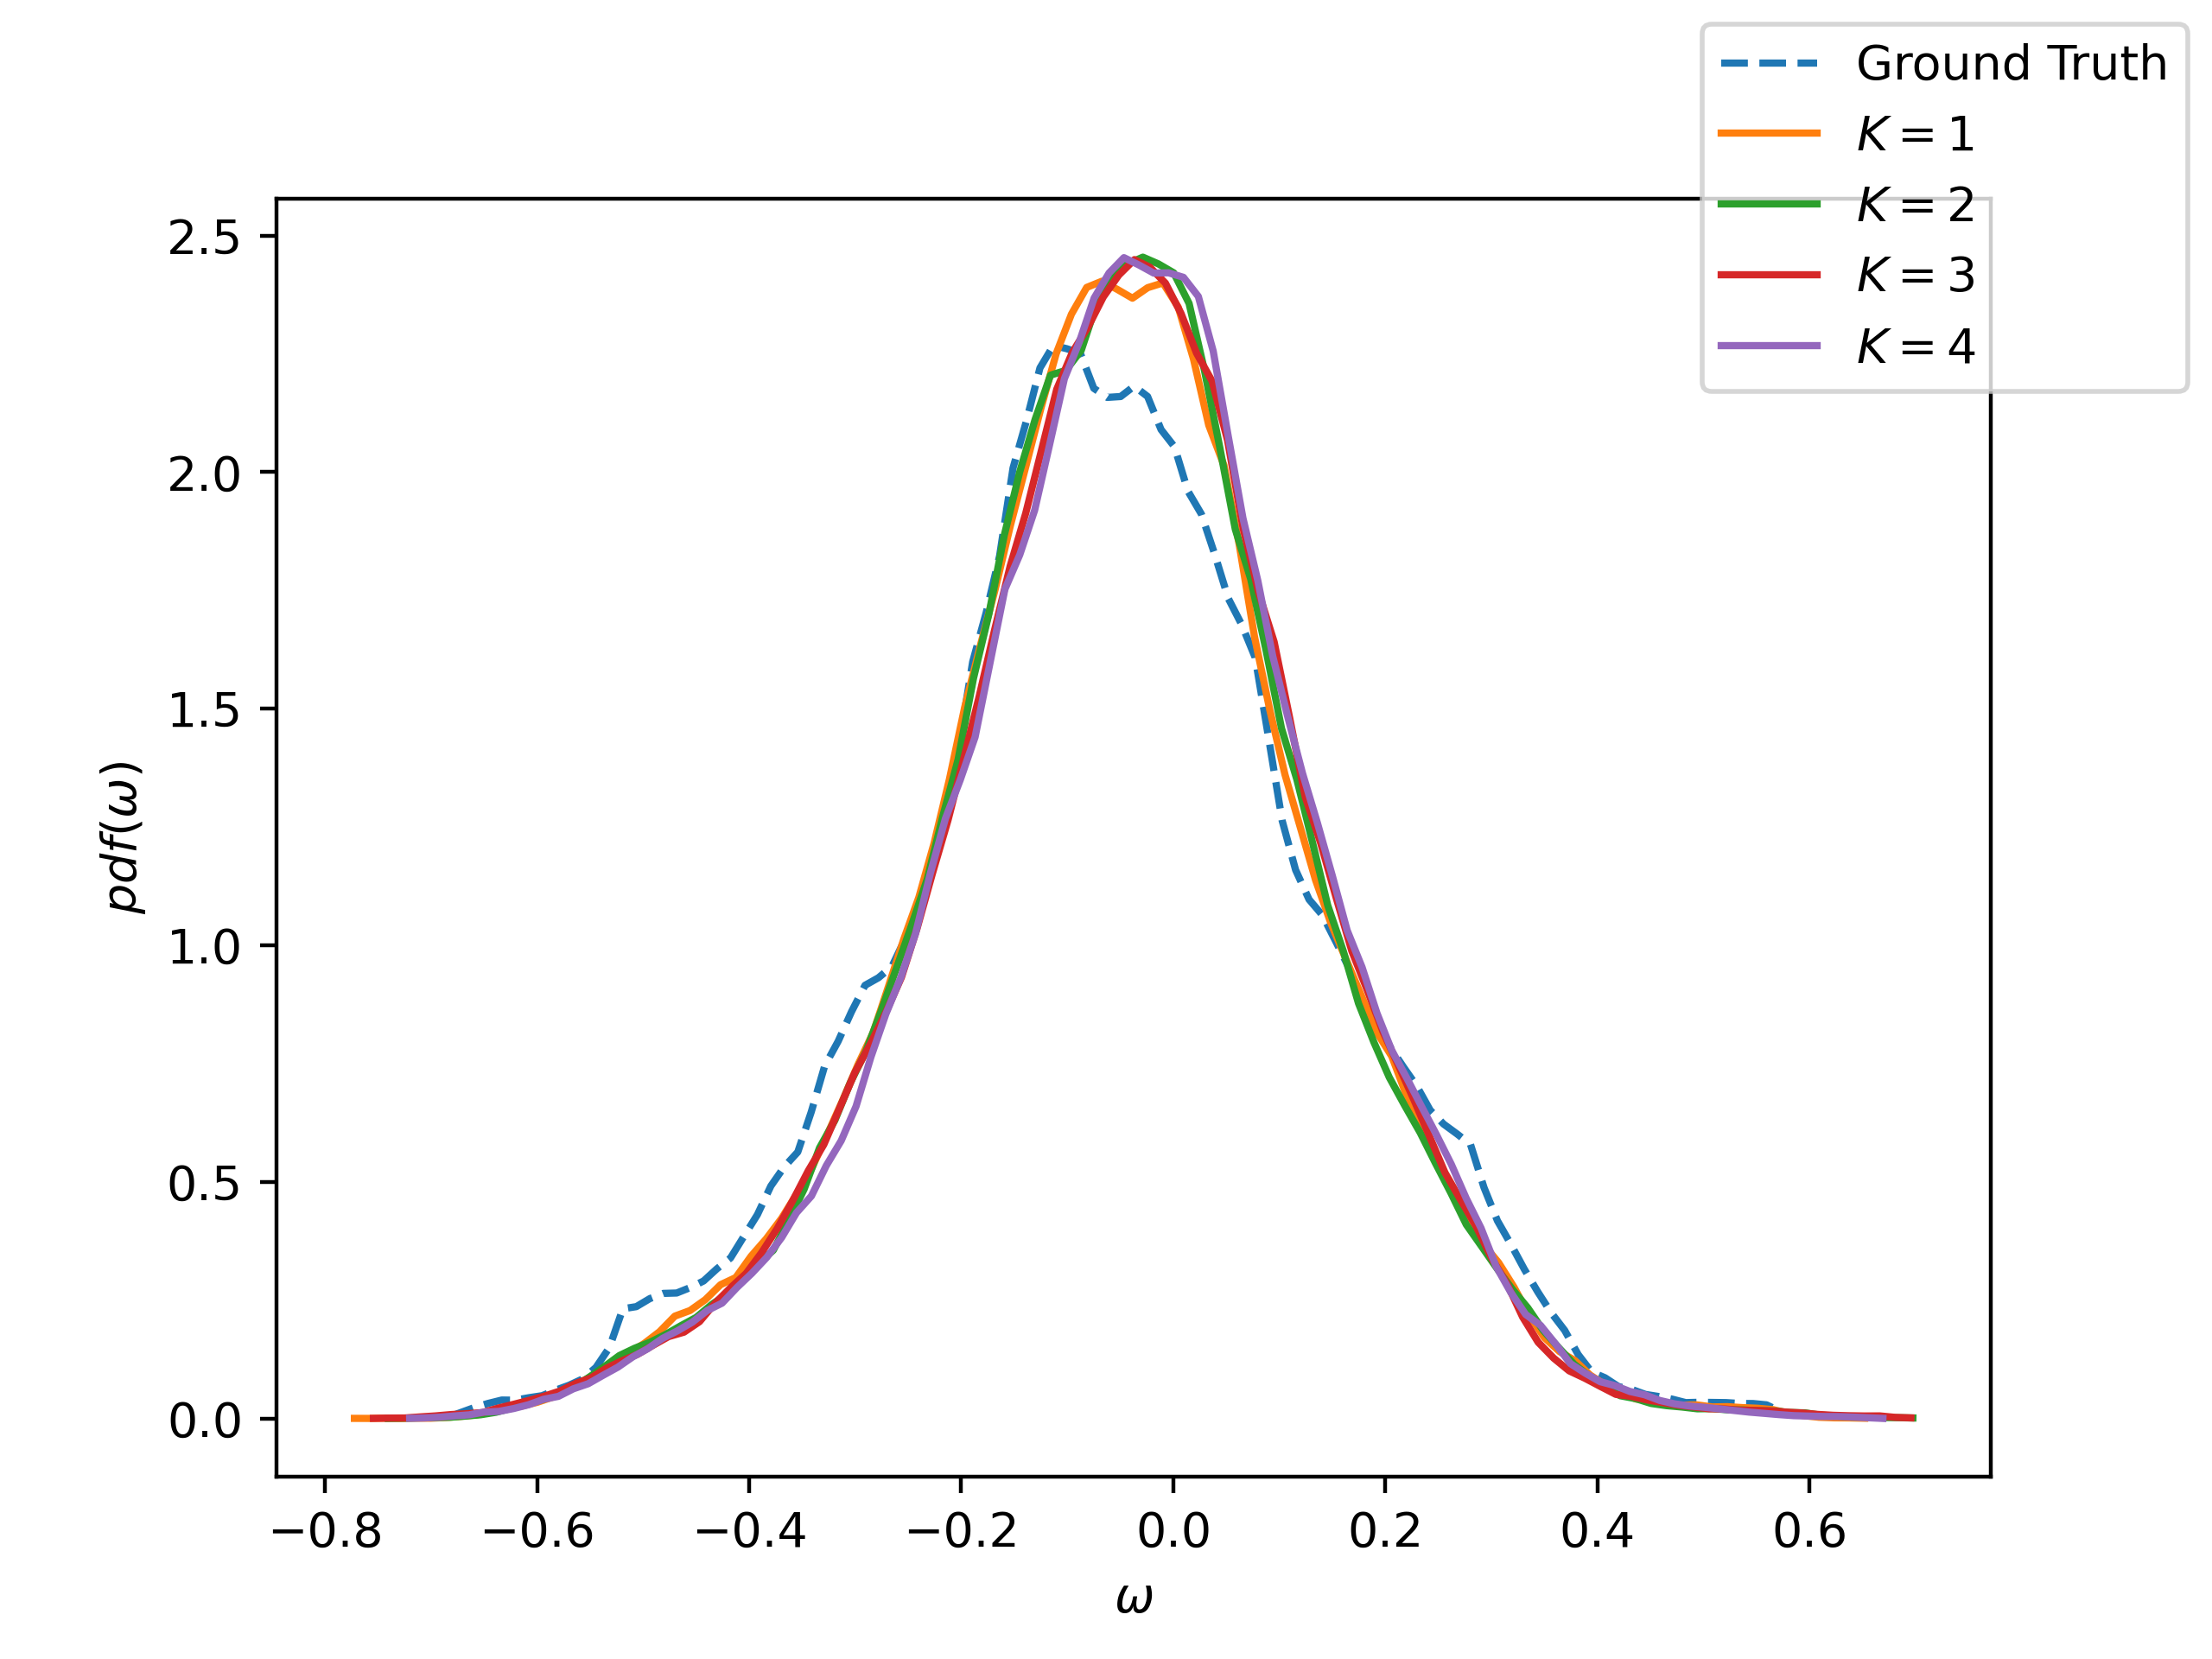
Probability Density Function

Slide 8
Enforcement Accuracy

Slide 9
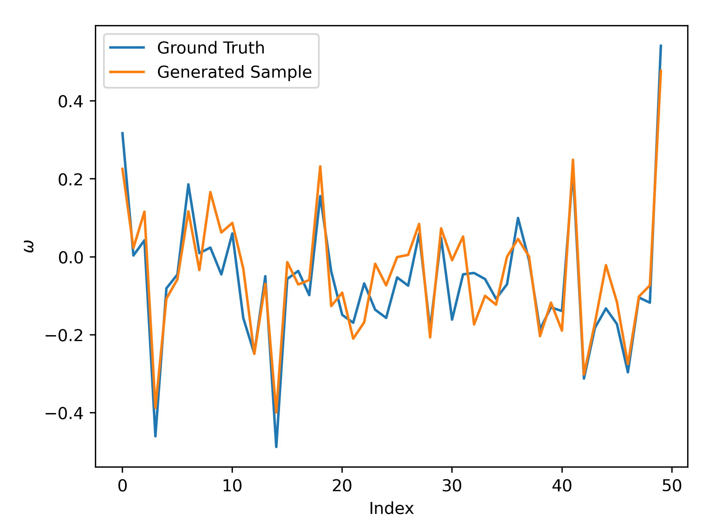
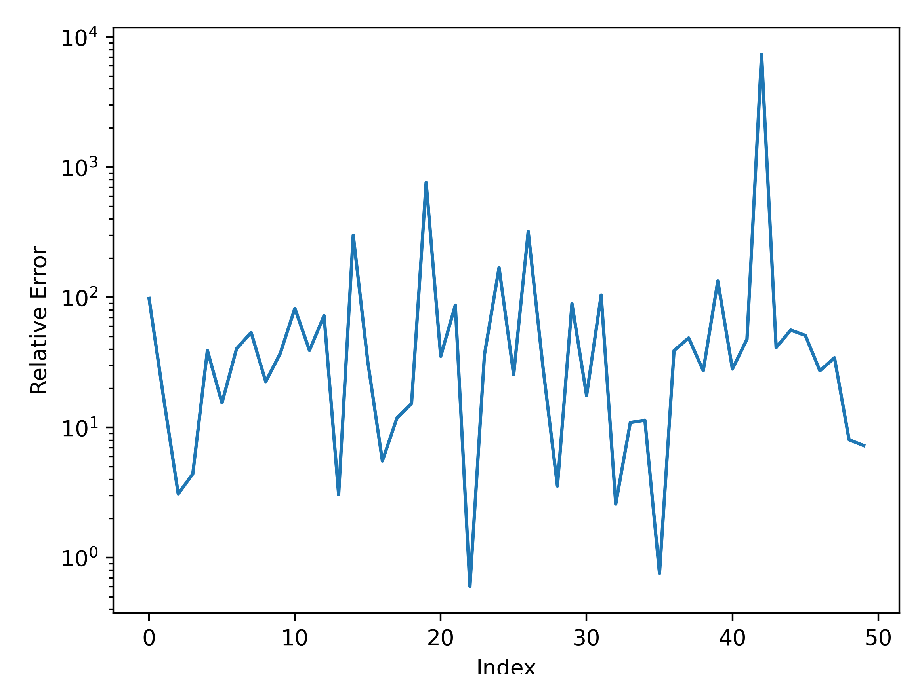
Enforcement Accuracy

Slide 10
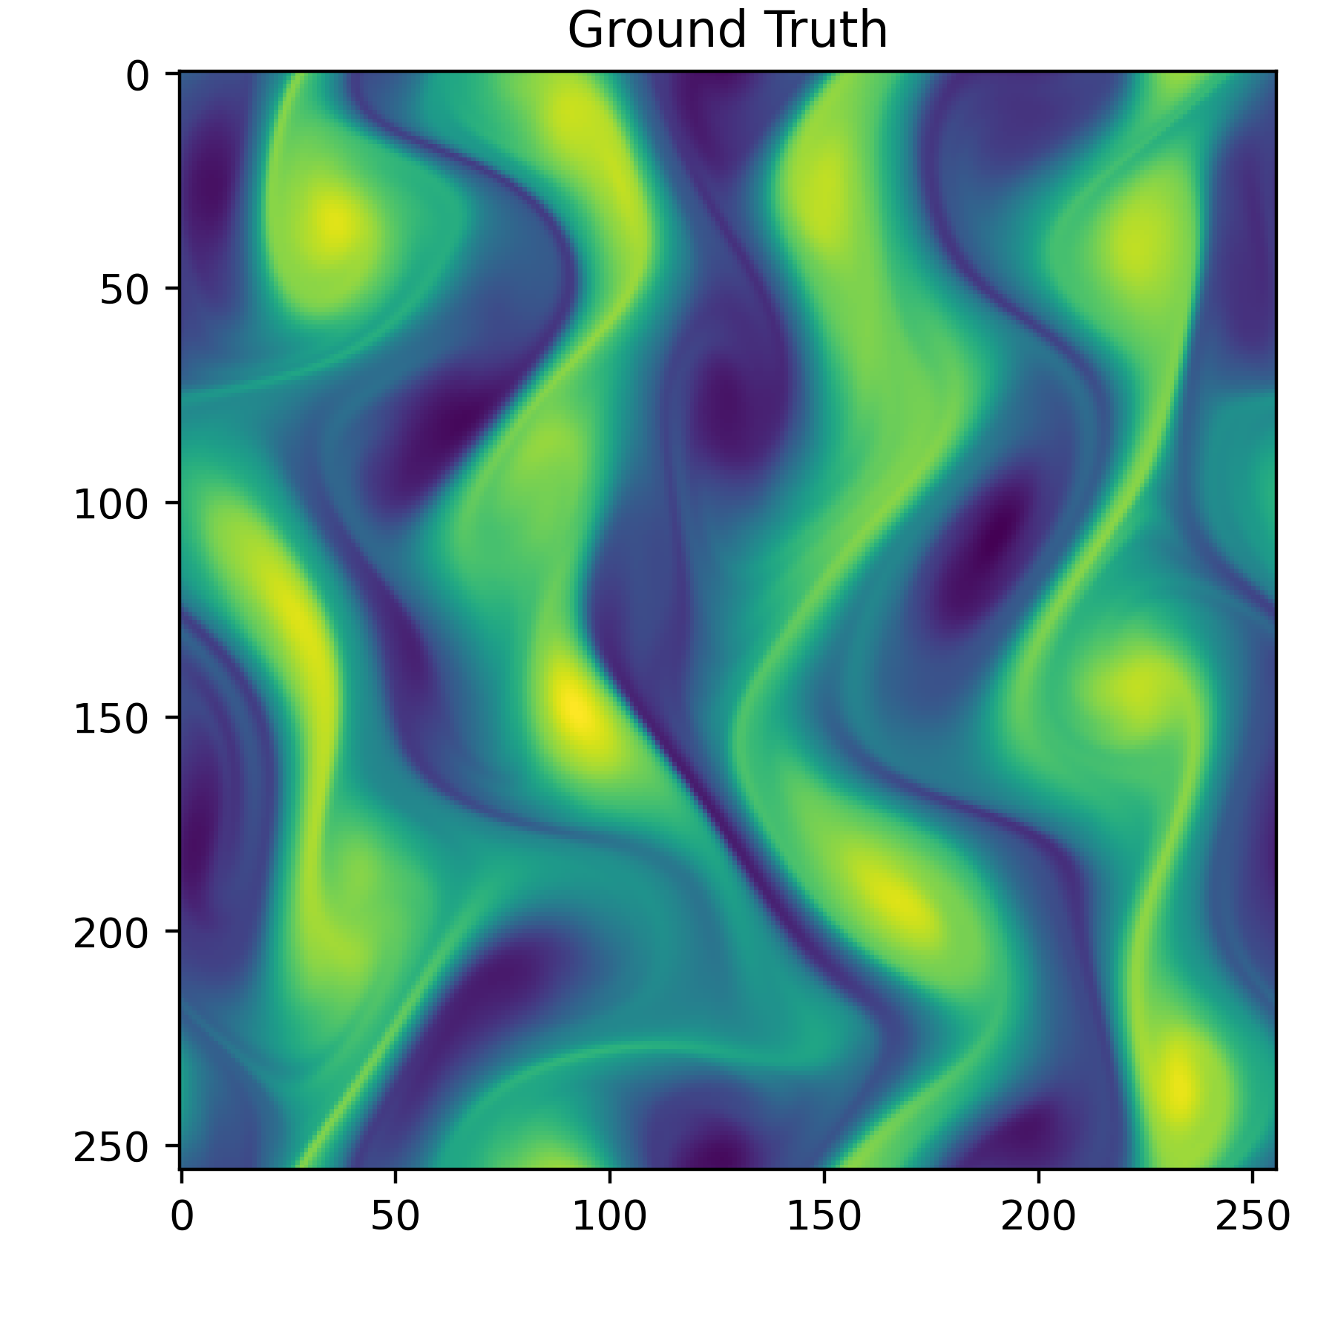
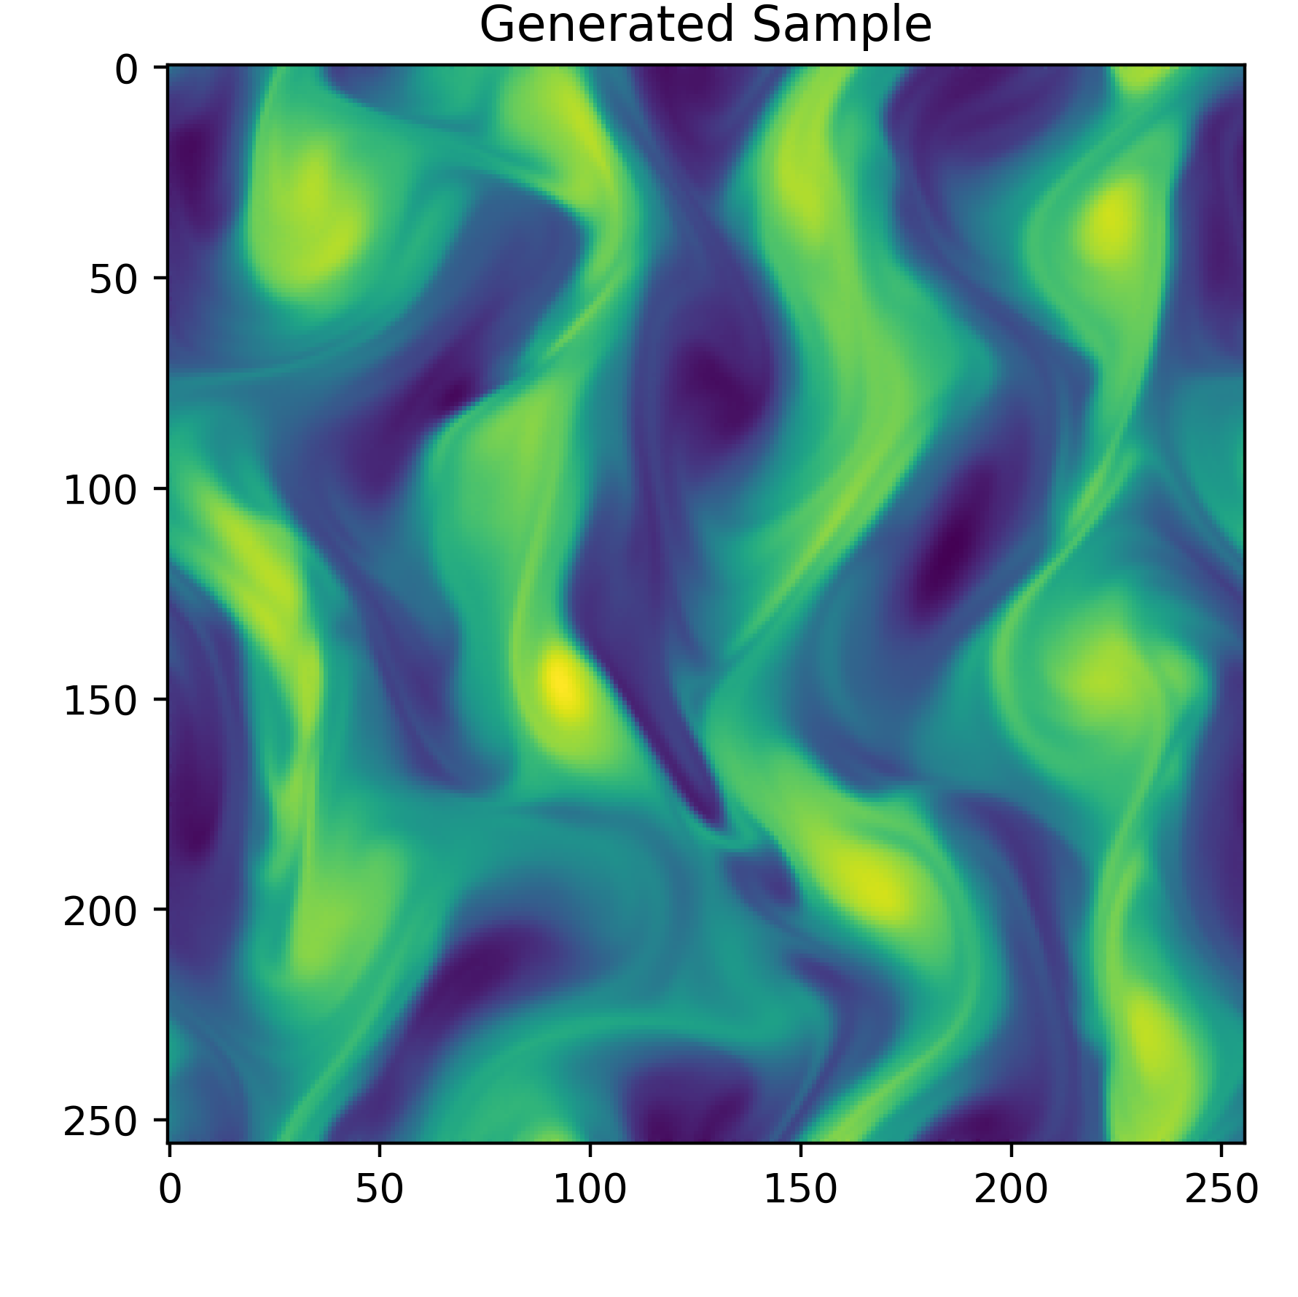
The Results from the Code of Shu et al. (2022)

Slide 11
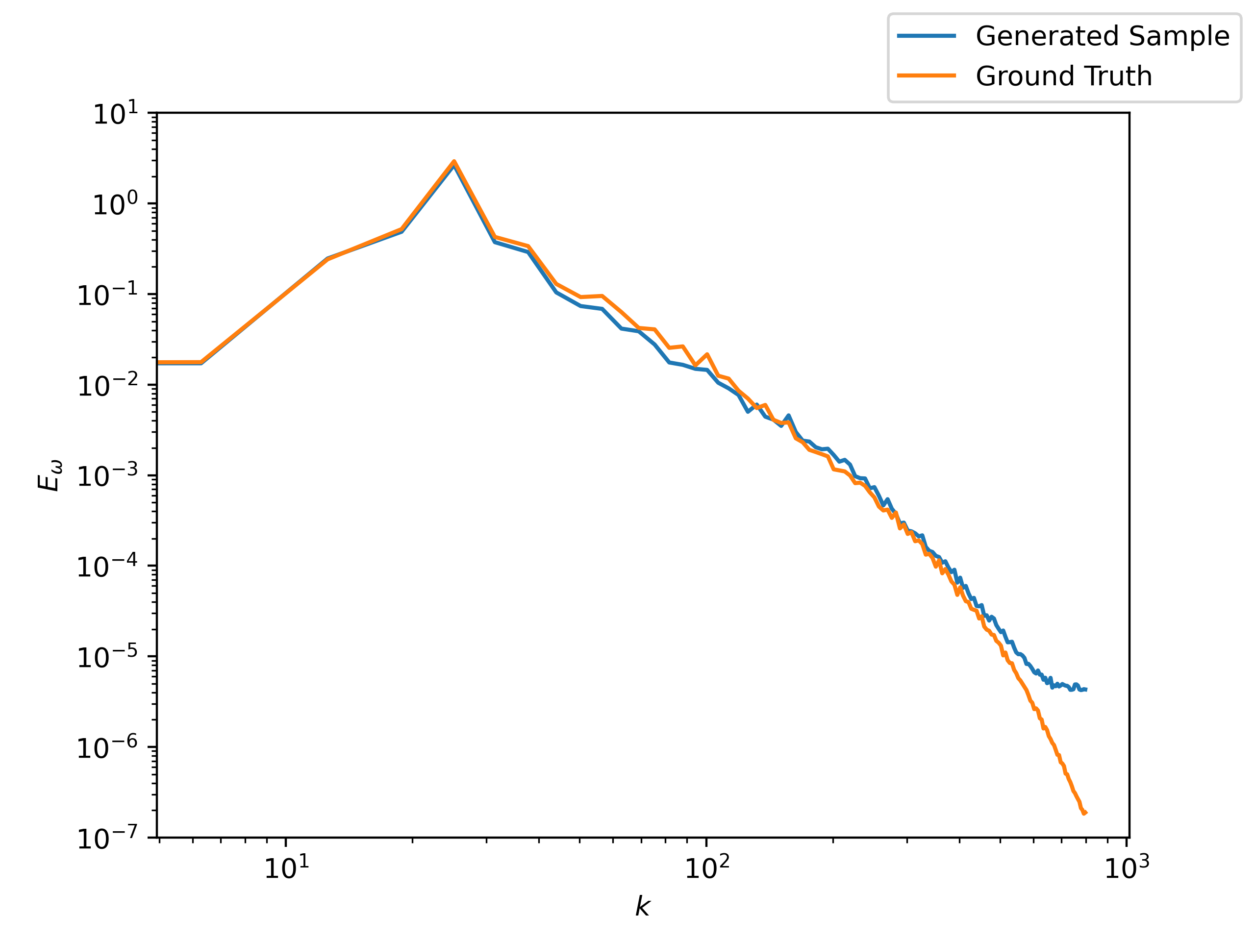
The Results from the Code of Shu et al. (2022)

