Slide 1
Message Queue

Slide 2
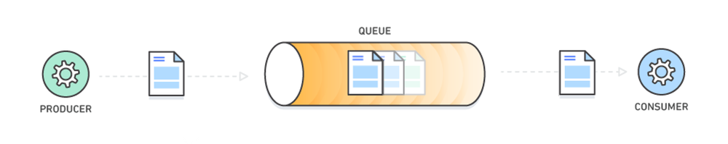
What is Message Queue
Message queues allow different parts of a system to communicate and process operations asynchronously. A message queue provides a lightweight buffer which temporarily stores messages, and endpoints that allow software components to connect to the queue in order to send and receive messages. The messages are usually small, and can be things like requests, replies, error messages, or just plain information. To send a message, a component called a producer adds a message to the queue. The message is stored on the queue until another component called a consumer retrieves the message and does something with it

Slide 3
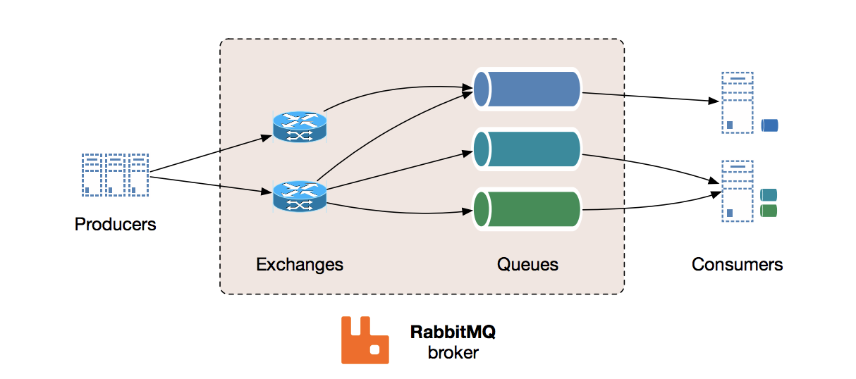

Slide 4
RabbitMQ Installation
https://www.rabbitmq.com/download.html
docker run -it --rm --name rabbitmq -p 5672:5672 -p 15672:15672 rabbitmq:3.8-management
Advanced Message Queuing Protocol (AMQP)
Portal
for docker installation must define services in your docker-compose.yml file.
Then rebuild the project for it’s work (docker-compose up -d)

Slide 5
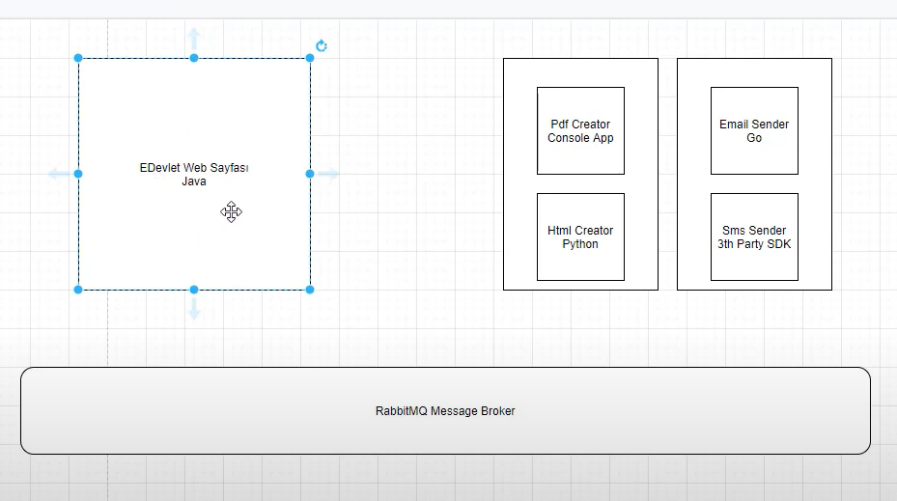
.Net core Example
This example taken from TechBuddy youtube channel.

Slide 6
Necessary Packages from Nuget
RabbitMQ.Client
Newtonsoft.Json

Slide 7
