Slide 1

oneM2M Access Control System Discussion
Group Name: WG4 SEC
Source: Wei Zhou, CATT, zhouwei@catt.cn
Meeting Date: 2013-12-05
Agenda Item:

Slide 2
Introduction
This contribution uses a simple example to show oneM2M system should support multiple authentication mechanisms and use Attribute Based Access Control (ABAC).

Slide 3
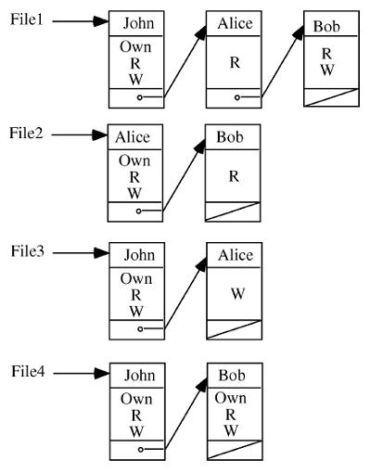
Limitation of the ACL
Principle: In an Access Control List (ACL) system each object is associated with a ACL, indicating each subject has what privilege on the object.
Advantage: can provide fine grained access control.
Disadvantage: When there are huge amount of objects, the ACL management becomes a nightmare

Slide 4
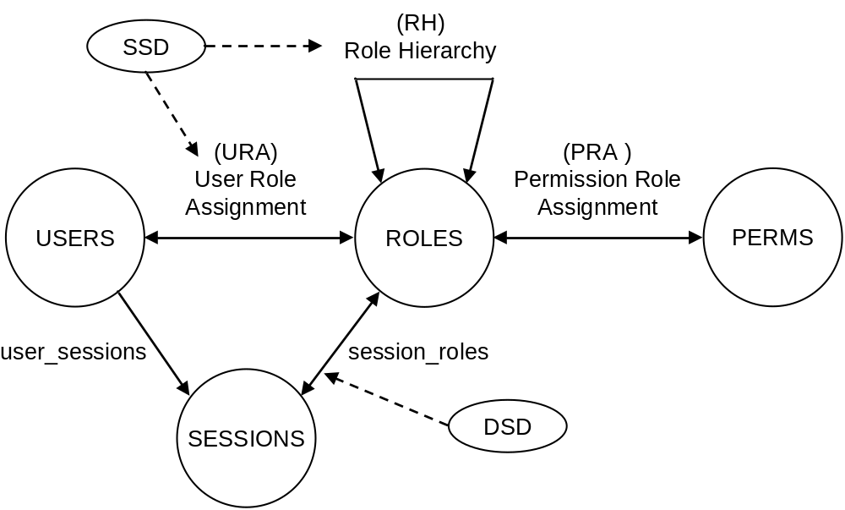
Limitation of RBAC
Principle: RBAC is that permissions are assigned to roles rather than to individual users.
Advantage: RBAC is more scalable than user-based security specifications and greatly reduces the cost and administrative overhead.
Disadvantage: RBAC lacks the ability to specify a fine-grained control on individual users in certain roles and on individual object instances.

Slide 5
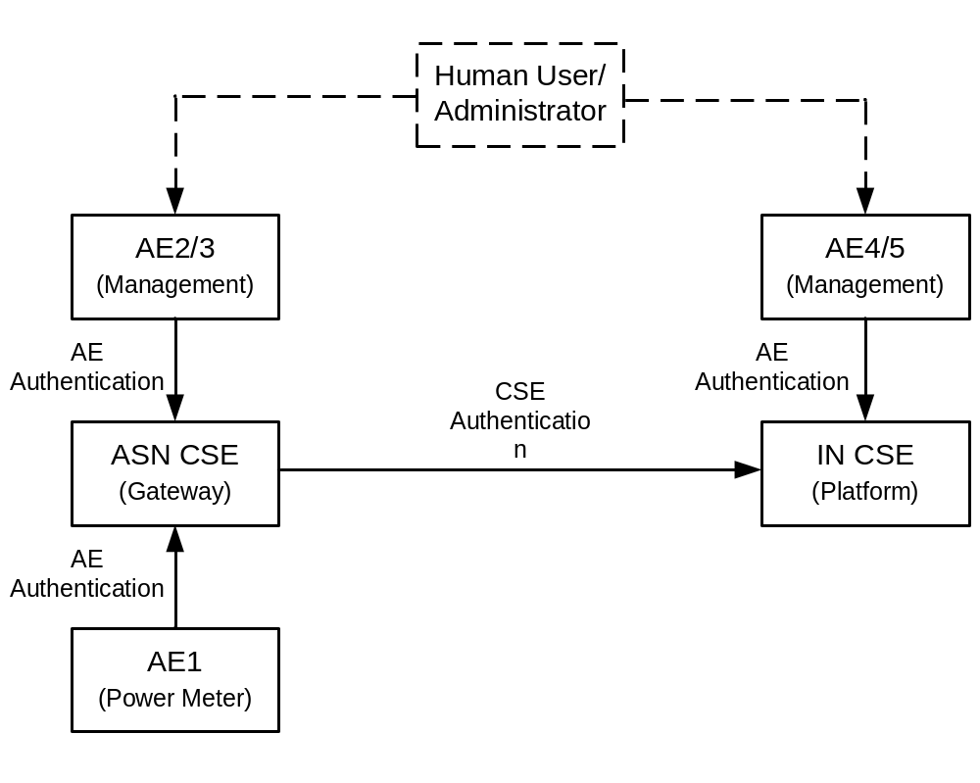
Authentication Model
From the view of system: there only exist AEs or CSEs, no human being;
A person is authenticated through an AE.
Authentication and Authorization:
AE1: Power meter, username/password, ACL.
AE2: Local administrator, username/password, RBAC.
AE3: System administrator, hardware-token-based, RBAC.
AE4: House owner, username/password, RBAC.
AE5: System administrator, hardware-token-based, RBAC.

Slide 6
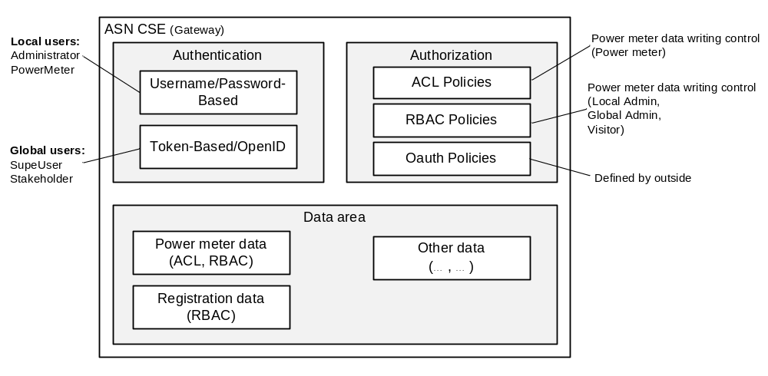
Example of ASN CSE Authentication and Authorization

Slide 7
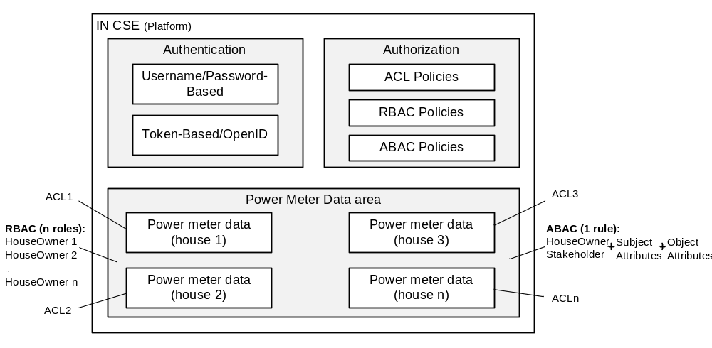
Example of IN CSE Authentication and Authorization

Slide 8
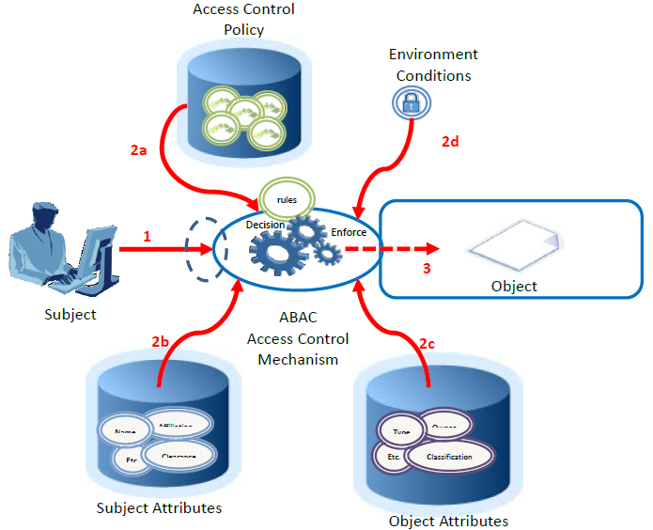
Attribute Based Access Control (ABAC)
DRAFT NIST Special Publication 800-162:
Guide to Attribute Based Access Control (ABAC) Definition and Considerations
An ABAC Rule:
A User who has the “role of HouseOwner” and the user is the “owner of house x” can read the “data belongs to house x”.

Slide 9
Conclusions
oneM2M shall support multiple authentication mechanisms.
oneM2M shall design an authorization framework that support ACL, RBAC and ABAC.
The design of accessRight should consider these requirements.

