Slide 1
SecurBoot:
Below is the link from Swissbit.
https://www.swissbit.com/en/products/security-technology/security-products/secure-boot/
1. Could we know background or why “Raspberry Pi” need secure boot?
2. Swissbit mentioned they had many IP on security features, include this application. Could we find method to avoid this?
SecureOS (may this similar as SecurBoot?)
Unique ID (Each uSD is traceable)
SecureEncrypt + SecurAccess
1. Can partition drive with encryption;
2. Log-in/Log-out Secure Partitions;
3. Can setup Privilege by different level, who can access, who can read only
WORM (Write one time, Read many)

Slide 2
Flow Chart Content
Secure User Configuration
Partiton Secure Configuration
Secure boot/os lock
Secure boot/os unlock
Unique ID
SecureEncrypt Configuration
SecureEncrypt
SecurAccess
WORM
Secure Erase (?)

Slide 3
API management area
初步規劃兩種資料結構
Partition Secure struct
User Information struct

Slide 4
Partition Secure struct(建構中)
typedef struct PartitionSecureInfo
{
char PtnEnable; // 1 byte : Partition Enable
char Ptn_SecureMode; // 1 byte : Secure mode of Partition (Normal,
Read only, Protect)
char IsLogIn; // 1 byte : Is User Log In (TRUE/FALSE)
char Ptn_UserLogInMode; // 1 byte : Secure mode of Current User
unsigned int Ptn_StartSector; // 4 bytes : Start of the sector
unsigned int Ptn_EndSector; // 4 bytes : End of the sector
} PtnSecInfoTab;
User Information struct(建構中)
typedef struct UserInfo
{
unsigned short InternalID; // 2 bytes : internal used
char UserID[10]; // 10 bytes : User ID
char PWD[10]; // 10 bytes : Password
char Authority[4]; // 4 bytes : HIGH(Read/Write), MID(Read only),
// LOW(Protect) of each partition
} UserInfoTable;

Slide 5
新增administrator登入設定

Slide 6
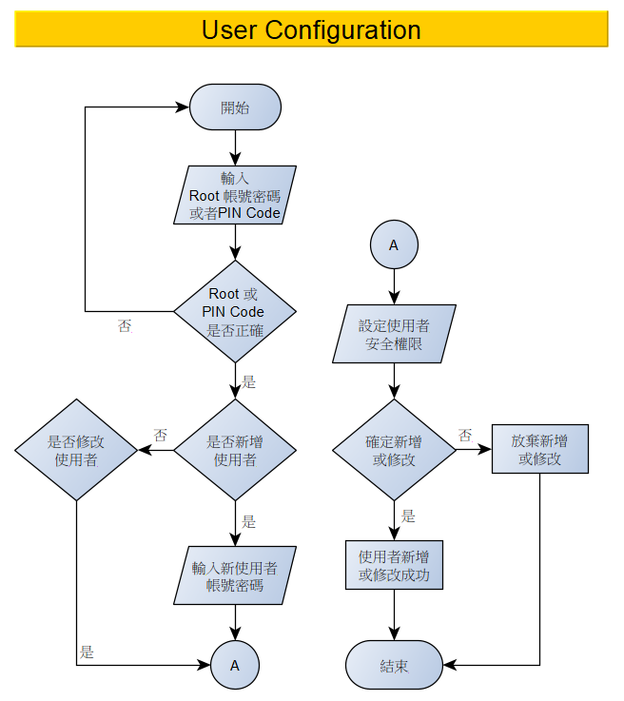
使用者帳號密碼設定:
SD command number – 56
Command argument – CS=128, CC=1, R/W=0
Input – char UserID : 10 Bytes char PWD : 10 Bytes char Authority : 4 Bytes
Returns – n/a
可透過 Read Status CMD (未定) 取得該使用者是否
有設定成功
全限設定: Normal, read only , Protect(考慮中)

Slide 7
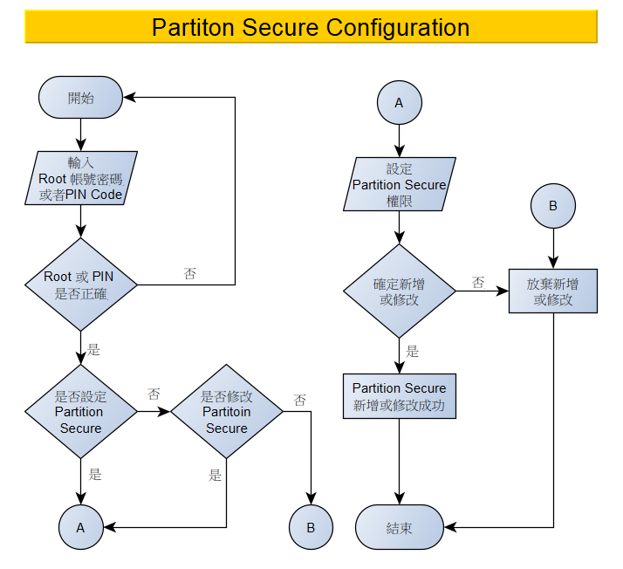
Secure Partition 設定:
SD command number – 56
Command argument – CS=128, CC=2, R/W=0
Input – char PtnEnable : 1 Byte char Ptn_SecureMode : 1 Bytes unsinged int Ptn_StartSector : 4 Byes
unsigned int Ptn_EndSector : 4 Byes
Returns – n/a
可透過 Read Status CMD (未定) 取得該使用者是否
有設定成功
全限設定: Normal, read only , Protect(考慮中)

Slide 8
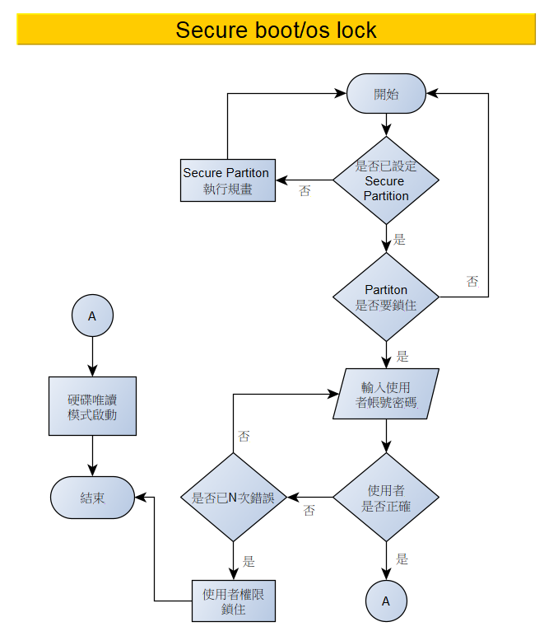
Secure boot/os lock 設定:
SD command number – 56
Command argument – CS=128, CC=3, R/W=0
Input – char PtnID : 1 Byte
char PtnAuthority : 1 Byte char UserID : 10 Bytes char PWD : 10 Byes
Returns – n/a
可透過 Read Status CMD (未定) 取得該使用者是否
有設定成功

Slide 9
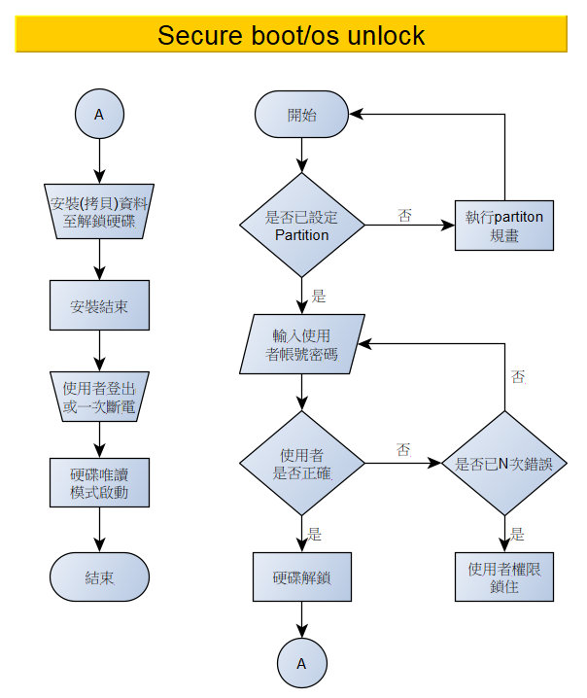
Secure boot/os unlock 設定:
SD command number – 56
Command argument – CS=128, CC=4, R/W=0
Input – char PtnID : 1 Byte
char PtnAuthority : 1 Byte char UserID : 10 Bytes char PWD : 10 Byes
Returns – n/a
可透過 Read Status CMD (未定) 取得該使用者是否
有設定成功

Slide 10
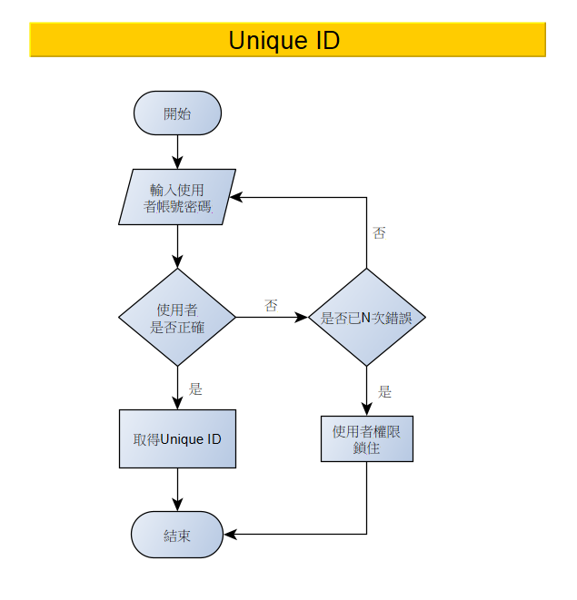
取得 Unique ID 設定:
SD command number – 56
Command argument – CS=128, CC=5, R/W=0
Input – char UserID : 10 Bytes char PWD : 10 Byes
Returns – One 512 byte sector included unique ID
可透過 Read Status CMD (未定) 取得該使用者是否
成功

Slide 11
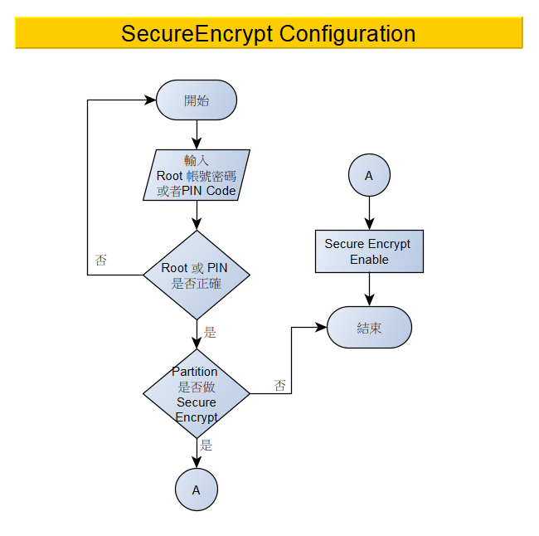

Slide 12
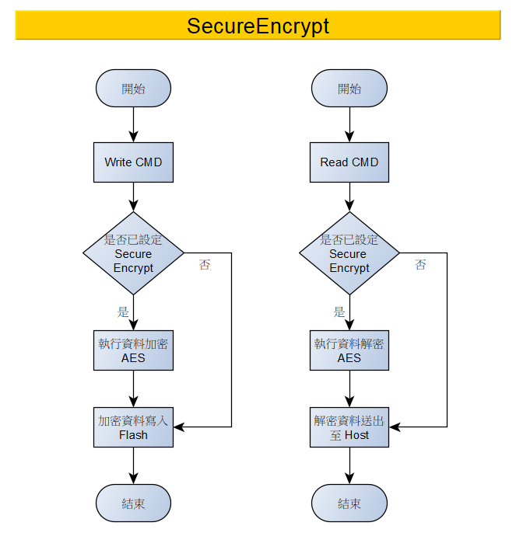
Secure Encrypt 設定:
SD command number – 56
Command argument – CS=128, CC=6, R/W=0
Input – char PtnID : 1 Byte // char RootID ?? : 10 Bytes char PWD : 10 Byes
Returns – n/a
可透過 Read Status CMD (未定) 取得該使用者是否
有設定成功
確定OS是否可以支援 CMD56
推產品確定客戶是否了解
AES 加解密會因為 Block swap 會去自動加解密????

Slide 13
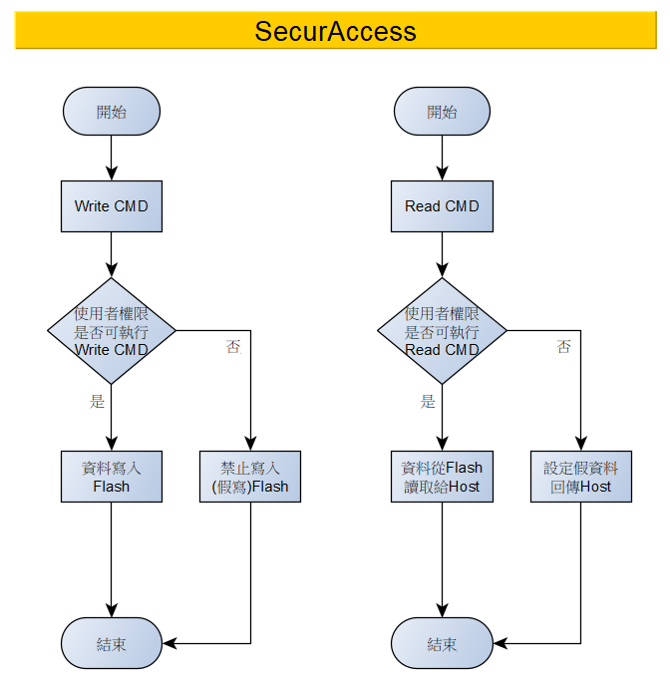

Slide 14
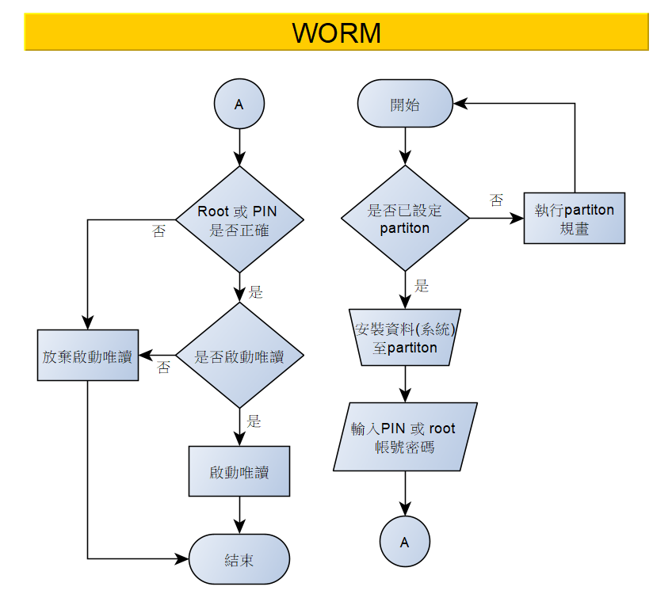

Slide 15
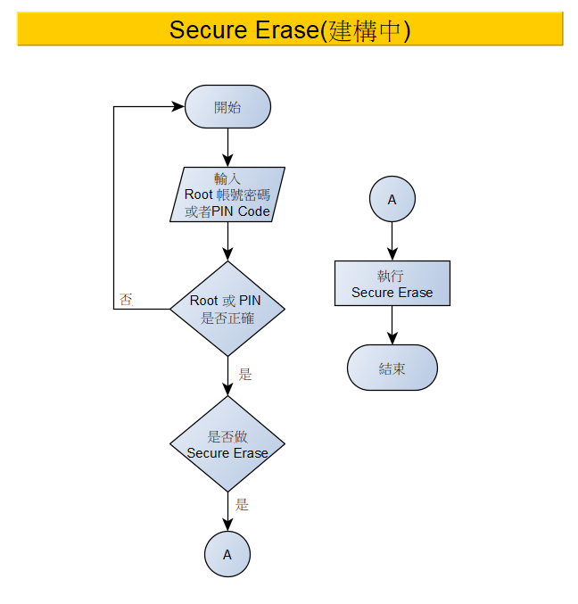

Slide 16
WORM DEMO

Slide 17
Next:
API Coding

Slide 18
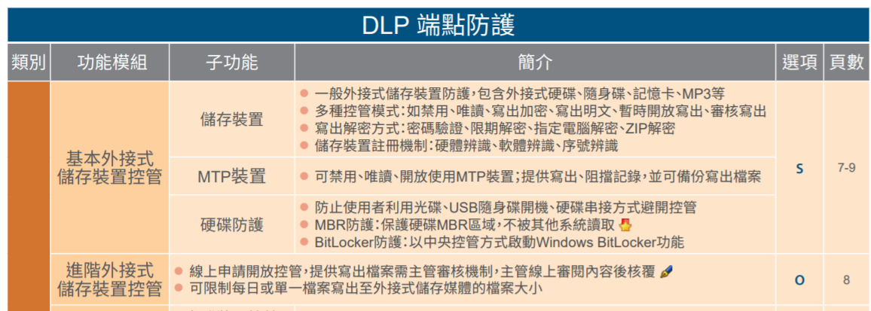

Slide 19
如果輸入過程中 SD 被拔起來，是否會有錯誤
MBR 亂碼需解決
輸入的帳號密碼跟Partition須用簡單加密傳到Client端
AES的Key要放在哪? Management Storge?
Hsfmt (開卡，VC)程式碼修改，MinGW編譯環境建立

