Slide 1
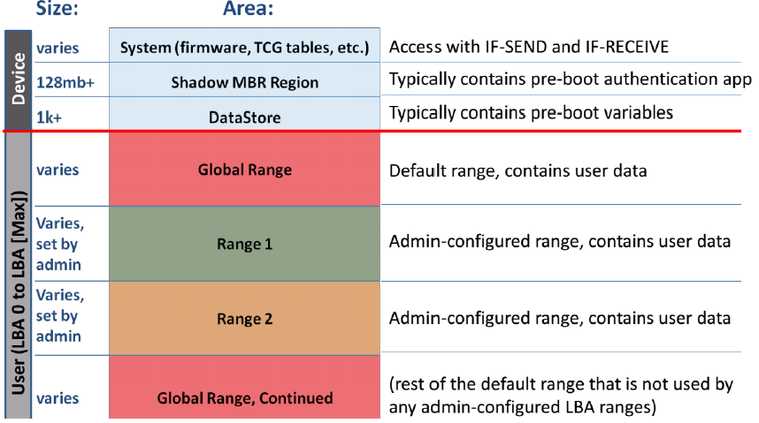
Opal Device Layout

Slide 2
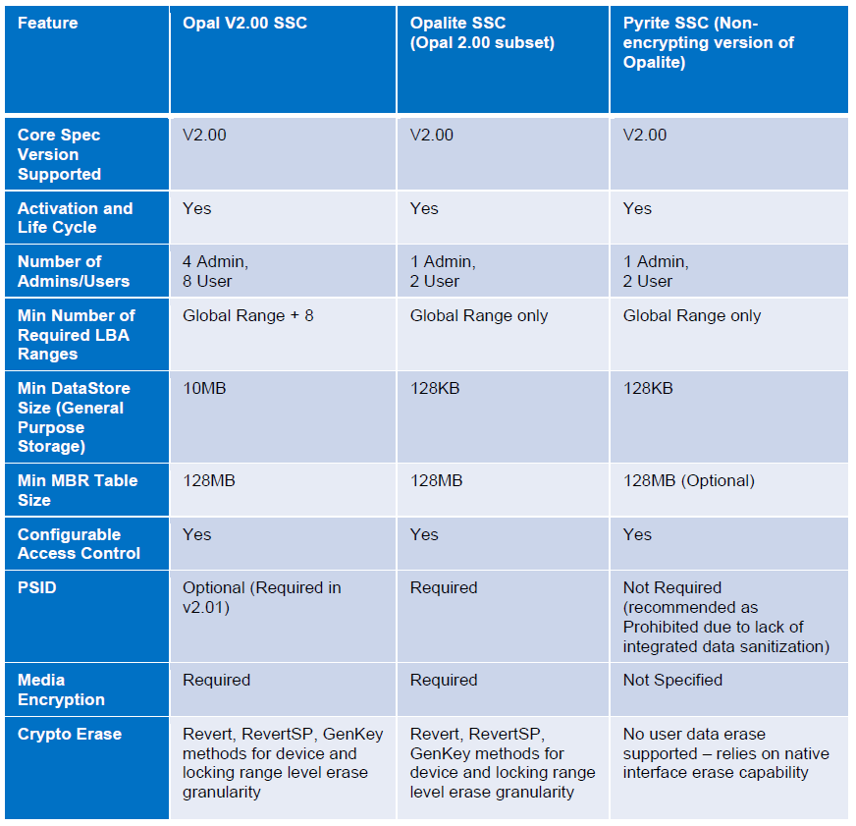
TCG SSC comparison: Opal, Opalite and Pyrite
The primary difference between Opal SSC and Opalite SSC is that Opalite defines only a single, “Global” Locking Range, whereas Opal requires support for several configurable Locking Ranges. In addition, Opalite limits the number of supported Users to 2.
Pyrite is almost identical to Opalite, with one primary difference: Pyrite does not specify capabilities for cryptographic protection of data at rest. As such, references to and support for capabilities related to encryption, cryptographic erase, etc. are absent from Pyrite.
Opalite and Pyrite provide Storage Device vendors the ability to provide different levels of solution, depending on market need, internal roadmaps, and other business and technical considerations.
Other than these differences, the Opal, Opalite, and Pyrite SSCs are very similar. They all rely on the same communications protocol, on a common set of data structures, and on a common set of commands. Because the management interface is common, it is straightforward to design and implement software to manage Storage Devices based on the Opal Family.

Slide 3
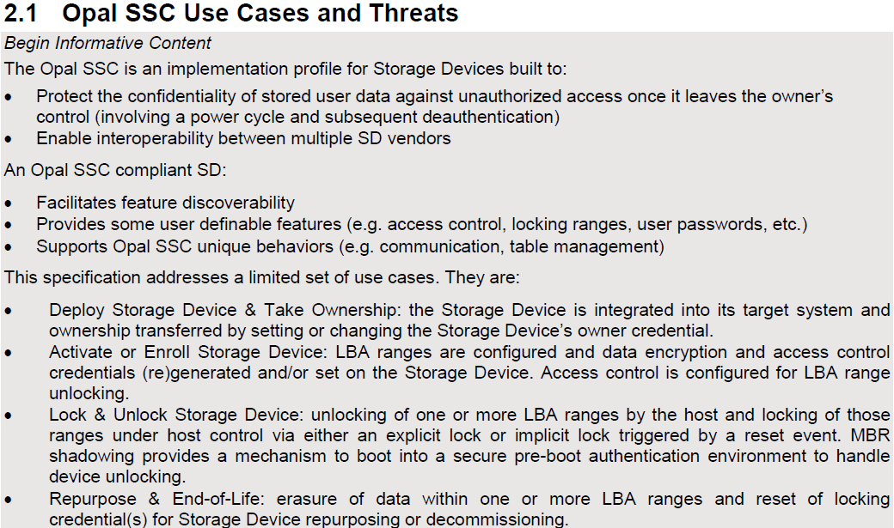
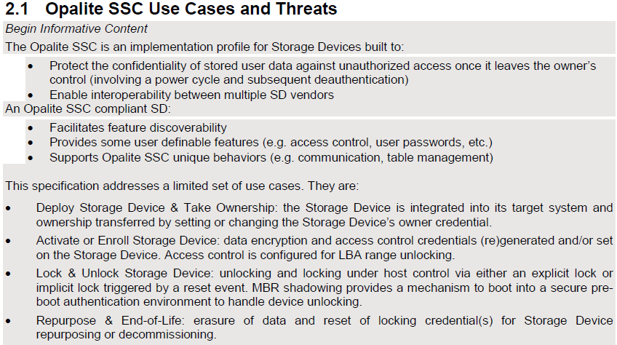
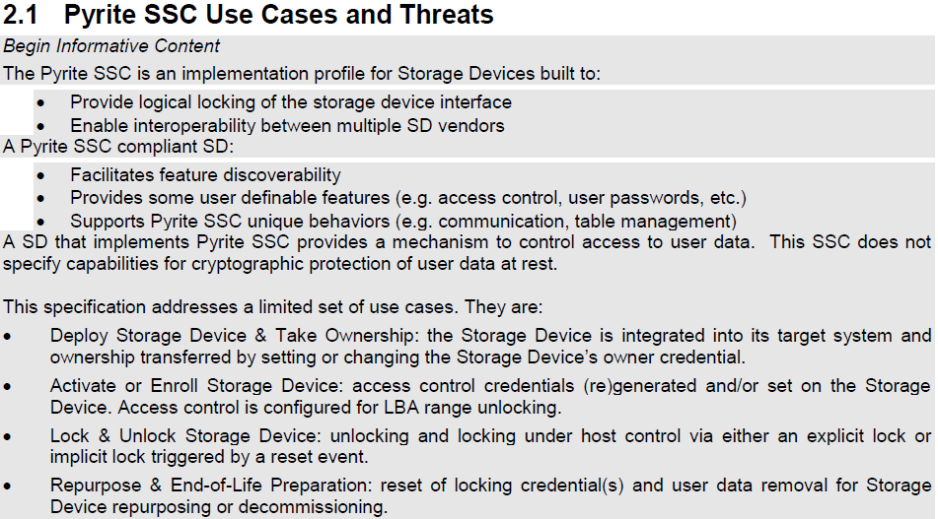
Comparison of Overview in Spec: Opal, Opalite and Pyrite

