Slide 1
COMP419-Distributed Systems
A simple implementation of an online distributed game system build with microservice architecture.
COMP419
BARKAS THEODOROS

Slide 2
ARCHITECTURE
Web Browser
User Interface
AUTHENTICATION
GAME_MASTER
GAME_PLAY
PostgreSQL
MongoDB

Slide 3
My Backend Tech Stack
Node.js /express
Single threaded yet not blocking IOs.
Natively made for async await calls thanks to the event loop.
Easy,dynamically typed,fast.
PostgreSQL
ACID compliance.
That means we are less afraid of critical sections because my transactions are either completed or not.

Slide 4
My Backend Tech Stack
MongoDB
Best suitable for unstractured data.
Not good if we want to run a lot of queries.
Key Value Store.
It’s a good option for describing the match
state.
Docker
To containerize everything.
To run everything on any system.
Kubernetes (Upcomming)

Slide 5
Authentication
Written with Node.js with PostgreSQL integration.
“bcrypt” for hashing the password and store it to my database.
“Pg” supports connection pooling and has not an ORM (object relational mapping).
“jsonwebtoken” to sign JWT with RS256 asymmetric encryption and respond to the client passing it down.
I used JWT so that databases and each microservice don’t stress to validate all requests.
JWT of course has an expirational date of 1 hour.

Slide 6
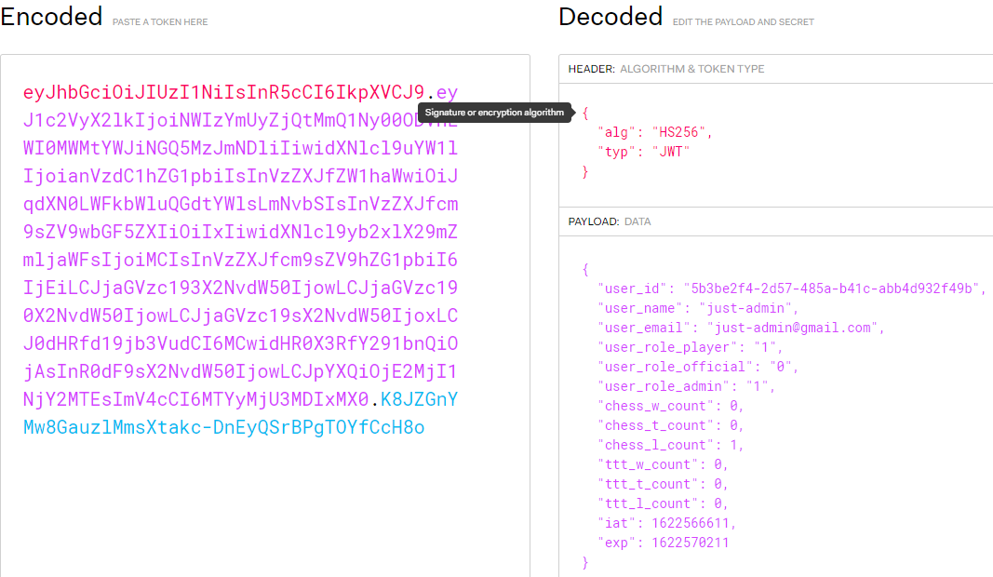
Authentication

Slide 7
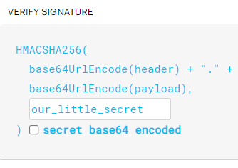

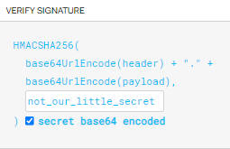

Authentication

Slide 8
Frontend
Svelte and SvelteKit
SvelteKit is an application framework powered by svelte still in beta.
Svelte is a radical new approach to building user interfaces. Whereas traditional frameworks like React and Vue do the bulk of their work in the browser, Svelte shifts that work into a compile step that happens when you build your app.
That’s why svelte apps are smaller,faster(it doesn’t have a virtual DOM) and have smaller bundle size.
Svelte is growing on popularity and has a very good development experience.
A lot of potential in embedded systems (smart TVs ,POS etc.).

Slide 9
Frontend
Technical decisions I made:
I used “stores” to keep the state in a svelte application.
I used “setInterval()” to check for changes on the server during game play(polling method).
I used svelteKit for Routing and Code Splitting.

Slide 10
Chess (and a little game_play)
I used an external library for chessboard UI called “cm-chessboard” and “chess.js” for move validation.
Both on them are implemented both on the front and the backend as well.
Functionalities:
When a user has already lost the pawns cannot move.
A user cannot play any move that’s not possible by the rule of chess and the current state of the game.
All the details are kept on the database.
Due to the interval polling the “game_play microservice” remains stateless.
In case of failure in a websocket implementation it would be difficult to connect with the user again.

Slide 11
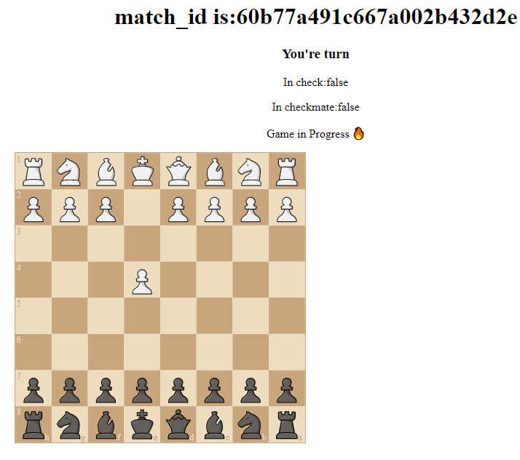
Chess UI

Slide 12
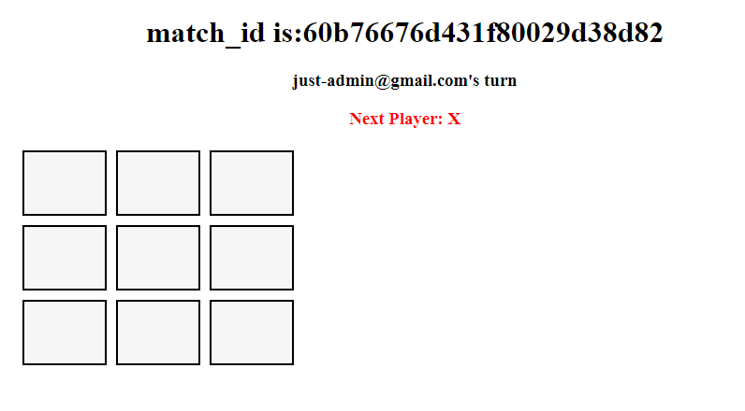
Tic-Tac-Toe
Tic-Tac-Toe UI has been made from scratch.

Slide 13
game_master
Implemented with Node.js with PostgreSQL and mongoDb integration (via “mongoose” library).
Responsibilities:
Authenticate and check if client is an Official.
Tournament Management (PostgreSQL):
Tournament Creation and match making (PostgreSQL).
Match making for Tournament and practice plays (MongoDB).
Create Tuples and Create Matches.
Send the transaction to the Database.
Other Important Libraries:
“uuidv4” was important for my implementation to know whats the uuid is before I send my query(it’s important for tournament features).

Slide 14
game_master: Tournaments
Check if the client is an Official
The official can choose the tournament participants.
checks the game type:chess or tic-tac-toe
He names the tournament.
The users whose game has started can see it on navigation bar: “My Matches” and can play their match.
When the match has ended the “gameplay microservice” must check if the match that ended is in tournament.
If it has, it checks if is an endgame or not.
If it hasn’t, it means that there’s another game waiting.
The winner from the previous game passes on the next tournament game as one of the two players.

Slide 15
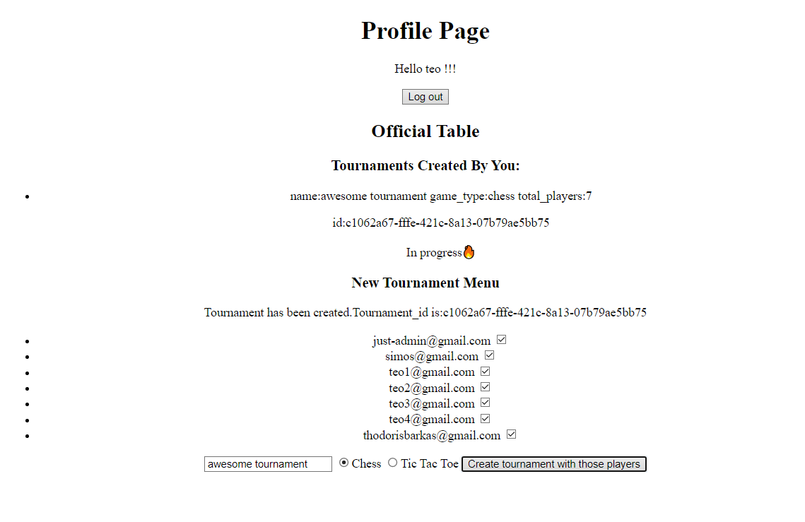
Profile Page for an official

Slide 16
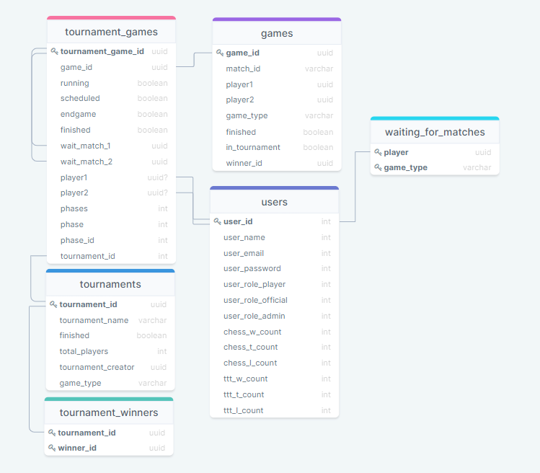
PostgreSQL structure

Slide 17
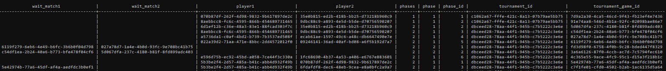
Example

Slide 18
game_master-Running Matches
When a player wants to get all his running matches he communicates with this service:
The game_master signs a new token to the client that can then be send to game_play and the game_play would know if the user has access to play those games or not.
This is very efficient for our databases because this way we don’t stress it a lot.
And at the same time we don’t degrade our system’s security.

Slide 19
Algorithm for Creating the Tournament Graph
We calculate the phases of the tournament players: floor(log2(gameBacket.length);)
We put all players to a gameBacket(List) pop them out 2 by 2.
Create the values that gonna be inserted to tournament_games table tuple by tuple.
Store to a waitingForBacket(List).
When there’s less than 2 list items in the gameBacket we push all items from waitingForBacket to gameBacket and we repeat.
Special handle if (phase ==phases AND gameBacket.length!=8).
That’s because we want to have 4 winners so we may end up playing less than 4 games at the last phase of the tournament.

Slide 20
game_play
Implemented with Node.js with PostgreSQL and mongoDb integration.
Responsibilities:
Authenticate and check if client can play the specific game.
Check if it is client’s turn to play.
Check if move is valid.
Check for winner and update databases accordingly.
If game result is a tie and the game is in a tournament:the game has to be repeated
If game result is a win and the game is in a tournament:the game has to be updated and the state of the tournament must be updated.
In this cases the game_play updates the state of the tournament by just sending a query to the PostgreSQL.

Slide 21
game_play(technical choises)
game_play is accessed by the front-end via a “setInterval()”.
The original idea was to create a websocket implementation of game_play to communicate with the client.
But to keep everything stateless the “setIntervral()” option.

Slide 22
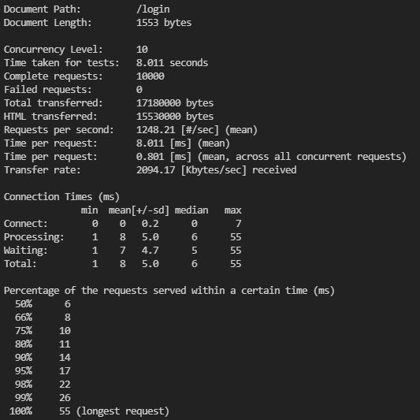
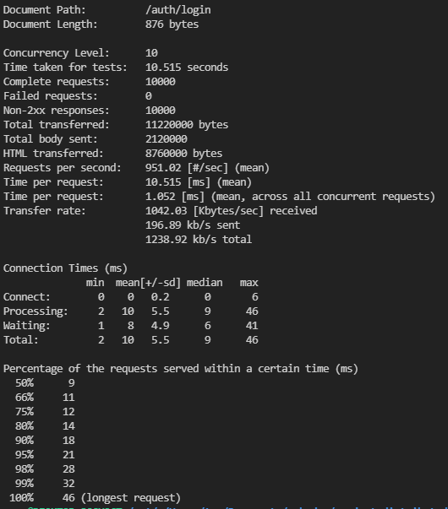
Bench tests

Slide 23
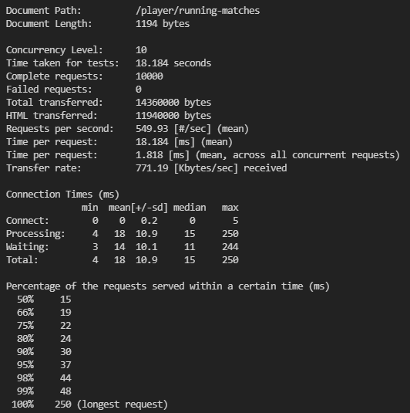
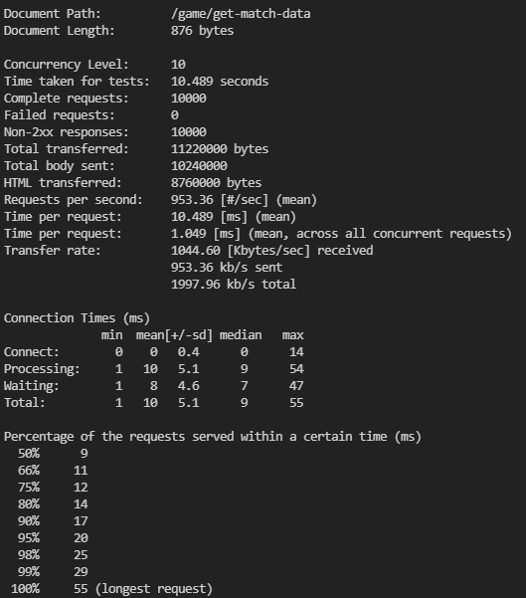
Bench Test

