Slide 1

( The XT Community Social Hub)
Group 1
Mentor: Mohammad Shais Sheikh
Group Members
Anant Jain
Antony Jeban A
Barkat Ali
Bhagya R
Hardik Sinha
Jaswant Khati
Jayesh Pawar
Kummara Manoj

Slide 2
Table of Contents
Application Overview
Content & Interactions
Blog Post Specifications
App Access Specifications
Application Architecture and Workflow Overview
Application Architecture (Node.js and Express.js)
Application Workflow Routes
Application Events Flow
Application Remote Procedure Call (RPC)

Slide 3
Application Overview

Slide 4
”XT Socials,” The XT Community Social Hub, is a web application that simplifies and streamlines communicating with the XT community.
Future XT dialogues about ideas, experiences, growth, vision, and personal opinions will all take place on this one platform.

Slide 5
Content & Interactions

Slide 6
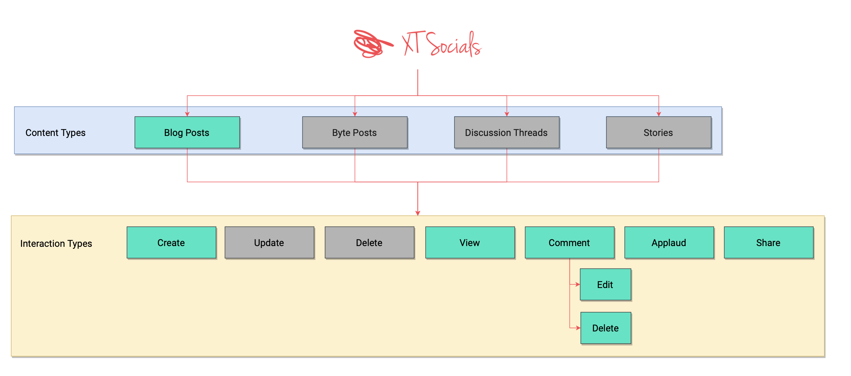
The author should be allowed to enable/disable “comment”, “applaud” and “share” interactions at the time of creation

Slide 7
Blog Post Specifications

Slide 8
Blog Post Specification
Publishing can be instant or scheduled (future only)
Combination of images, text and links
Image Specifications – types can be .png, .jpg , .jpeg or .gif. Max size – 2 MB
Should show the approximate reading time
In view mode,
Author details to show – Full name & Career Stage
Also show – publishing time & interactions count
Basic auditing to be implemented in the comments section
Comments should support text and emojis
If comment has link, it should be automatically highlighted
Comments should show the author and the timestamp as per the viewer’s local time

Slide 9
App Access Specifications

Slide 10
App Access Specification
Currently, the app is to be kept private
In future, it will have public and protected routes
Public routes will be visible to all
Protected routes will be only for XT community members
Login to be implemented using Email and OTP combination
User onboarding to be done using a backend job i.e., No UI

Slide 11
Application Architecture and Workflow Overview

Slide 12
Application Architecture and Workflow Overview
We create a diagram of application architecture.
We are having five Microservices (Node.js for each service)
Users Microservice
Blog Microservice
Comments
Applaud
Share
Query
Each service will connect with Query Service using RabbitMQ (Message Broker)
We will use Express Framework for exposing apis.
We will use MOJO-AUTH for sending E-mail to the user mail id.
We will use JWT (Json Web Token to authenticate user.)
We will use MongoDB for storing data.
We will use NGINX for load balancing and reverse proxy
We will use Remote Procedure Call (RPC) to retrieve dependent data from other service.
We will use Docker to containerized your services.

Slide 13
Application Design Pattern (Using Node.js and Express.js – Microservices CQRS)

Slide 14
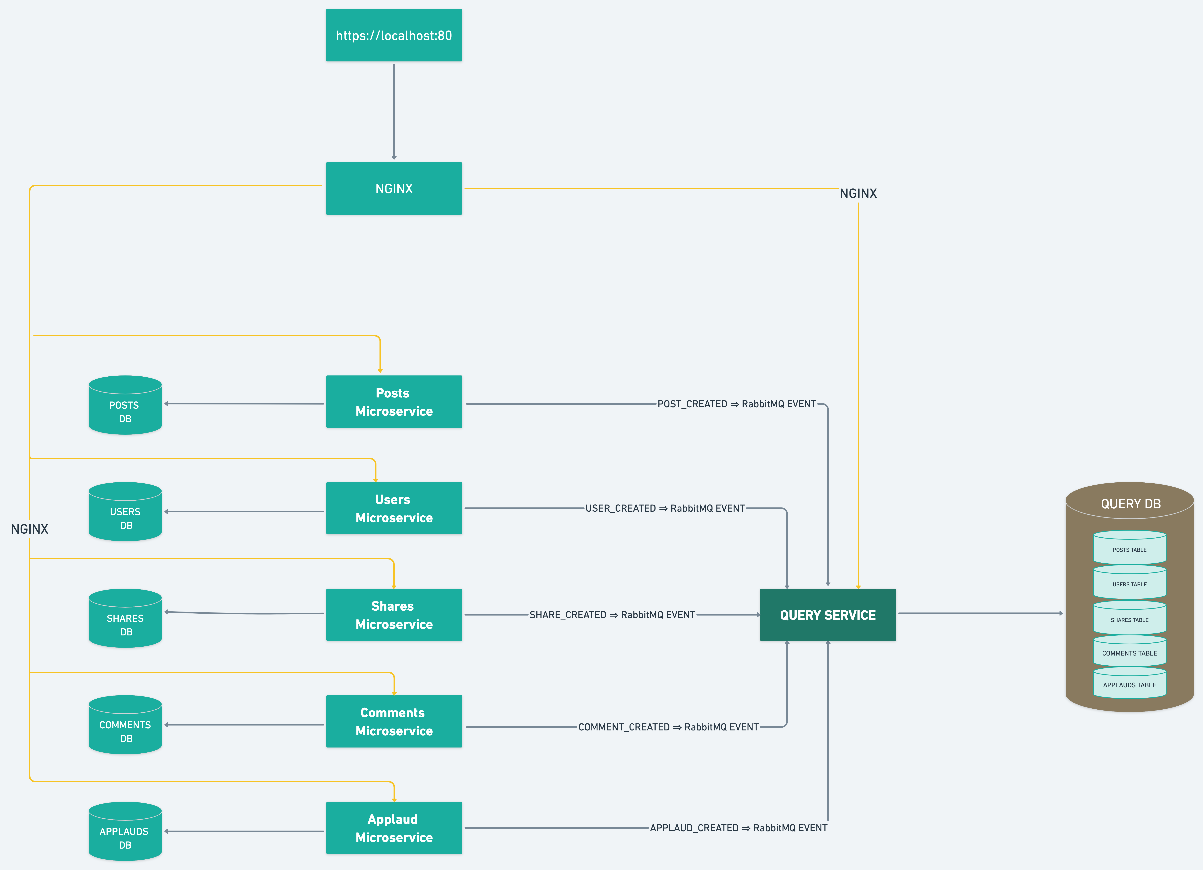

Slide 15
Application Workflow Routes

Slide 16
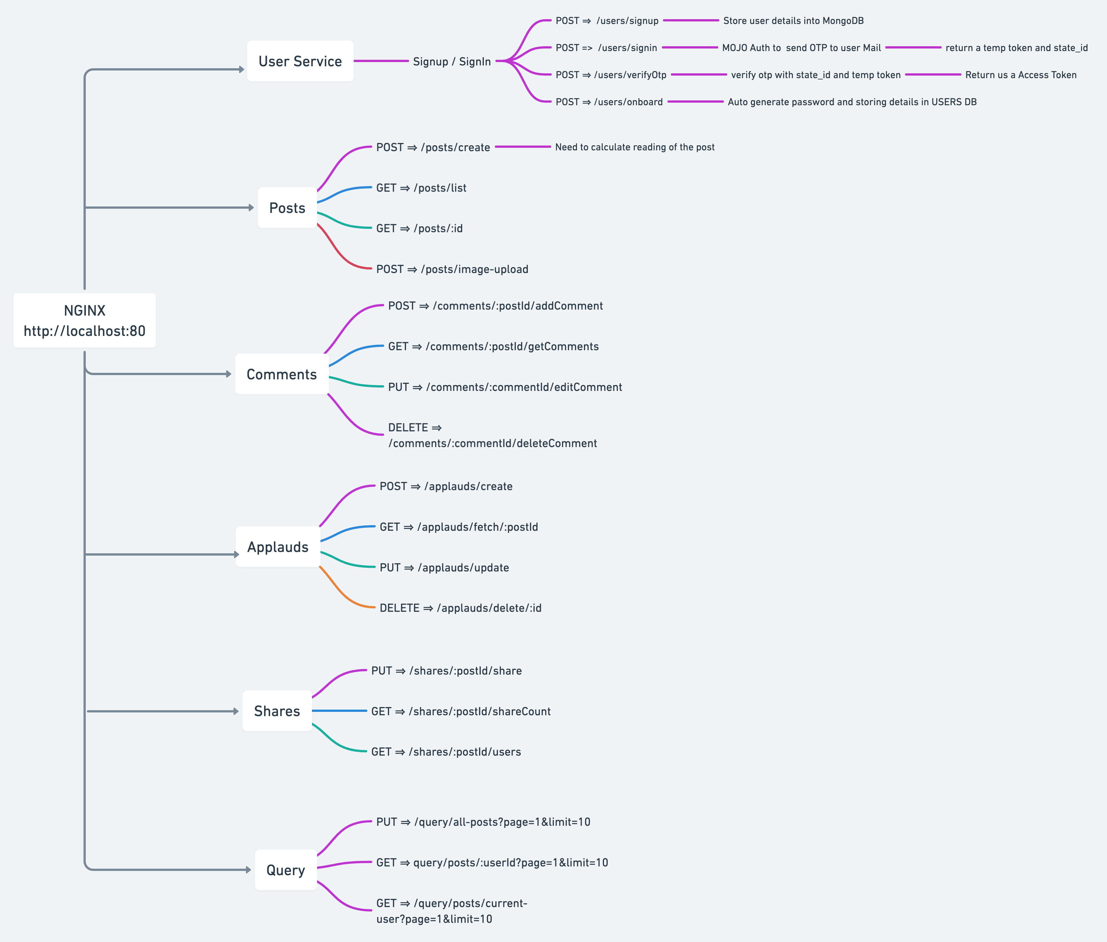

Slide 17
Application Events Flow

Slide 18
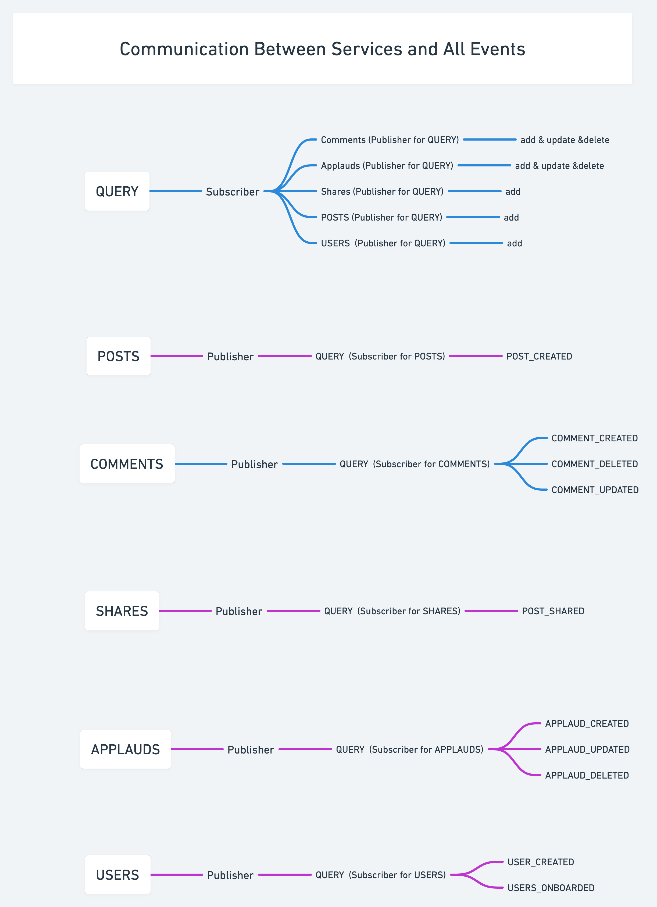

Slide 19
Application Remote Procedure Call (RPC)

Slide 20
