Slide 1
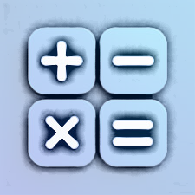
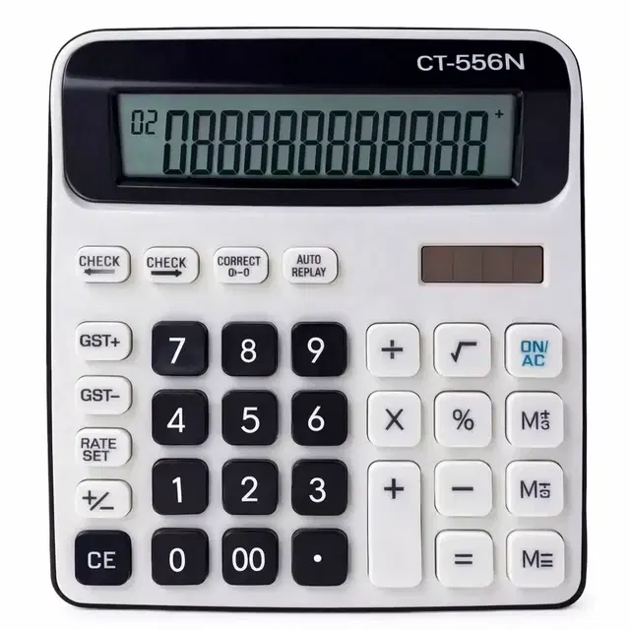
SMART CALCULATOR
[Basic, Advanced, Unit Conversion, Graph Plotter, BMI, GST ]
NextHikes It Solution
Presented by : Barkha Jaiswal

Slide 2
Project overview
This calculator is built with Python, Tkinter and Matplotlib.
This project is a desktop calculator with six sections:
  1 – Basic calculation
  2 – Advanced math functions
  3 – Unit conversion
  4 – Graph plotting
  5 – BMI calculation
  6 – GST calculation
The interface is built with Tkinter and its themed widgets.
The invalid input produces an error message.
A history box in Basic and Advanced section.

Slide 3
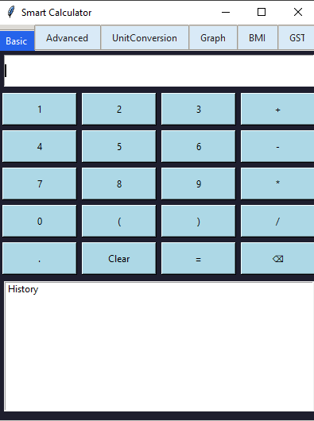
Basic calculator
The Basic Tab supports:
Numbers and decimal input
Addition, subtraction, multiplication and division
Parentheses
Clear and backspace
A calculation history
Keyboard entry

Slide 4
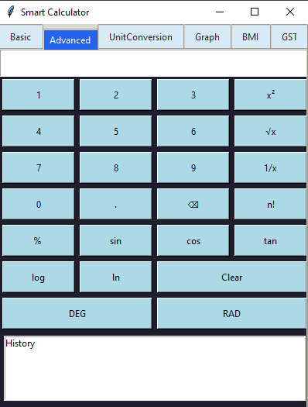
Advanced Calculator
The advanced tab includes:
Square, square root and reciprocal
Factorial and percent
sin, cos and tan
Log and ln
Separate DEG and RAD buttons for trigonometric angle
The math functions use Python’s math library.

Slide 5
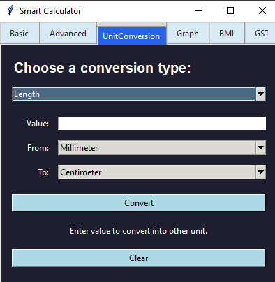
Unit conversion
The Unit Conversion tab converts:
Length : Millimeters, Centimeters, Meters, Kilometers, Inches, Feet and Miles
Weight : Milligrams, Grams, Kilograms, Ounces and Pounds
Temperature : Celsius, Fahrenheit and Kelvin
The available units change when the user selects a category.

Slide 6
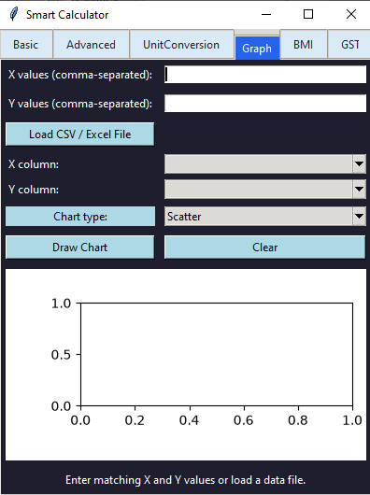
Graph plotter
The Graph tab accepts comma-separated X and Y values or load CSV / Excel file and can draw:
Line chart
Bar chart
Horizontal Bar chart
Scatter chart
Pie chart
It uses Matplotlib to display the chart inside the Tkinter window.
It uses csv and pathlib for importing csv / excel file and its path.

Slide 7
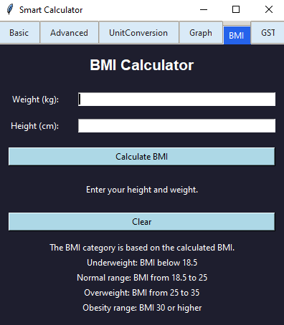
BMI Calculator
(Body Mass Index)
The BMI tab calculates BMI using your height and weight.
Enter your measurements to see your BMI result and category.
Category shows: Underweight, Normal range, Overweight and Obesity range.
BMI = Weight(kg) / Height(m)**2

Slide 8
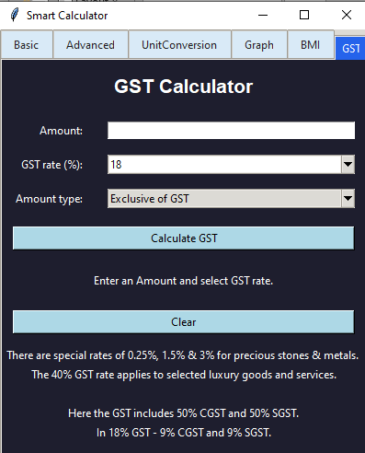
GST Calculator
(Goods and Service Tax)
This tab calculates GST based on the amount entered and selected GST rate.
You can select Exclusive of GST and Inclusive of GST.
Shows the total price and the tax amount, including GST.
Helps users quickly estimate the final cost of a product or service.

Slide 9
Conclusion
My calculator brings together basic and advanced calculations, unit conversion, graphs, BMI, and GST in one project.
It helps users perform calculations and view results quickly.
Building it helped me practice input handling, calculations, and testing.
I can improve it further by adding more features and refining the interface.
The project gave me practical experience applying programming concepts to useful tasks.

Slide 10
Challenges Faced
Designing a clear, easy-to-use interface
Handling operator precedence and chained calculations
Preventing errors from invalid input, such as dividing by zero
Making the calculator respond correctly to button presses
Testing different calculations and edge case
Reading CSV/excel files and handling missing or invalid data
Turning imported data into the correct graph
Appling the correct GST rate and calculating the total

Slide 11
Thank You

