Slide 1
Ch. 18/Mod. 7
Spanning Tree Protocol
CCNA 3 version 3.0

Slide 2
Overview
Define redundancy and its importance in networking
Describe the key elements of a redundant networking topology
Define broadcast storms and describe their impact on switched networks
Define multiple frame transmissions and describe their impact on switched networks
Identify causes and results of MAC address database instability
Identify the benefits and risks of a redundant topology
Describe the role of spanning tree in a redundant-path switched network
Identify the key elements of spanning tree operation
Describe the process for root bridge election
List the spanning-tree states in order
Compare Spanning-Tree Protocol and Rapid Spanning-Tree Protocol

Slide 3
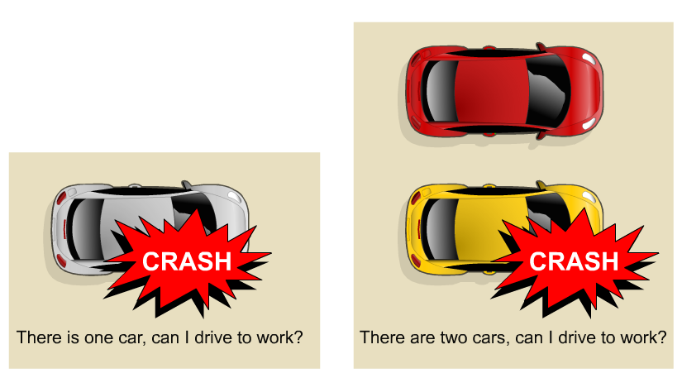
Redundancy
Achieving such a goal requires extremely reliable networks.
Reliability in networks is achieved by reliable equipment and by designing networks that are tolerant to failures and faults.
The network is designed to reconverge rapidly so that the fault is bypassed.
Fault tolerance is achieved by redundancy.
Redundancy means to be in excess or exceeding what is usual and natural.

Slide 4
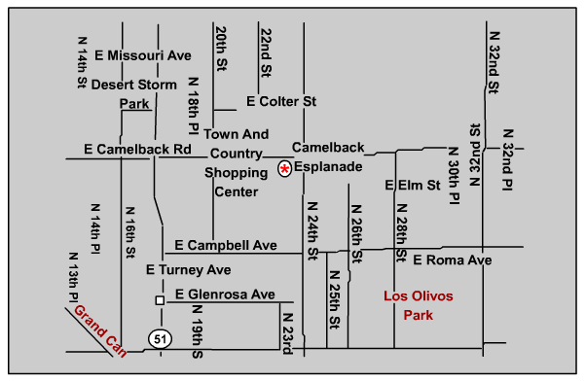
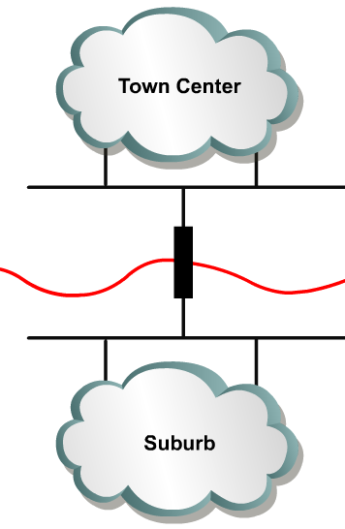
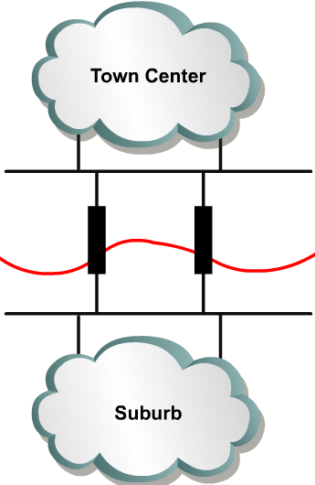
Redundant topologies
One Bridge
Redundant Bridges
A network of roads is a global example of a redundant topology.
If one road is closed for repair there is likely an alternate route to the destination

Slide 5
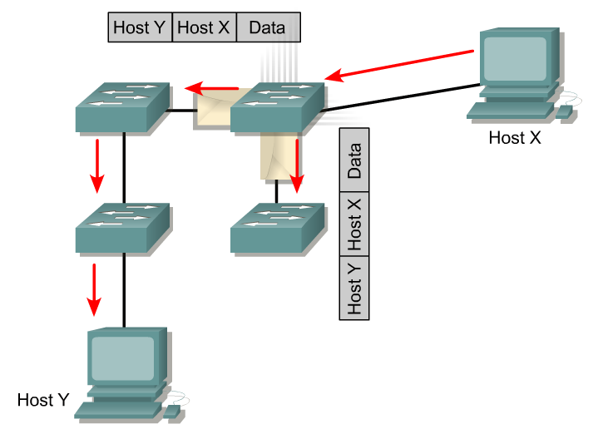
Types of Traffic
Unknown Unicast
Types of traffic (Layer 2 perspective)
Known Unicast: Destination addresses are in Switch Tables
Unknown Unicast: Destination addresses are not in Switch Tables
Multicast: Traffic sent to a group of addresses
Broadcast: Traffic forwarded out all interfaces except incoming interface.

Slide 6
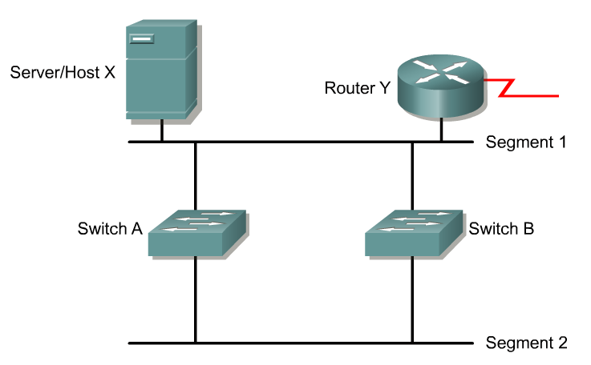
Redundant switched topologies
Switches learn the MAC addresses of devices on their ports so that data can be properly forwarded to the destination.
Remember: switches use the Source MAC address to learn where the devices are, and enters this information into their MAC address tables.
Switches will flood frames for unknown destinations until they learn the MAC addresses of the devices.
Broadcasts and multicasts are also flooded. (Unless switch is doing Multicast Snooping or IGMP)
A redundant switched topology may (STP disabled) cause broadcast storms, multiple frame copies, and MAC address table instability problems.

Slide 7
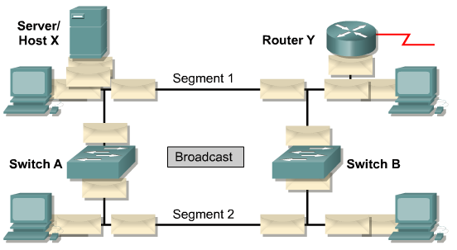
Broadcast Storm
Broadcast storm: “A state in which a message that has been broadcast across a network results in even more responses, and each response results in still more responses in a snowball effect.” www.webopedia.com
A broadcast storm because Spanning Tree Protocol is not enabled:
Broadcasts and multicasts can cause problems in a switched network.
If Host X sends a broadcast, like an ARP request for the Layer 2 address of the router, then Switch A will forward the broadcast out all ports.
Switch B, being on the same segment, also forwards all broadcasts.
Switch B sees all the broadcasts that Switch A forwarded and Switch A sees all the broadcasts that Switch B forwarded.
Switch A sees the broadcasts and forwards them.
Switch B sees the broadcasts and forwards them.
The switches continue to propagate broadcast traffic over and over.
This is called a broadcast storm.

Slide 8
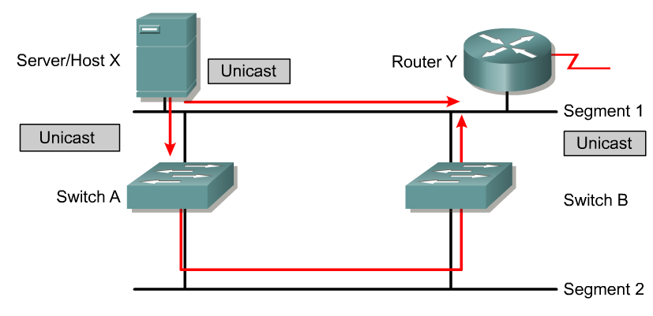
Multiple frame transmissions
In a redundant switched network it is possible for an end device to receive multiple frames.
Assumptions:
  Spanning Tree Protocol is not enabled
  MAC address of Router Y has been timed out by both switches.
  Host X still has the MAC address of Router Y in its ARP cache
Host X sends a unicast frame to Router Y.

Slide 9

Let’s try it
We will connect two switches with two paths
Connect multiple computers
Disable Spanning Tree

Slide 10
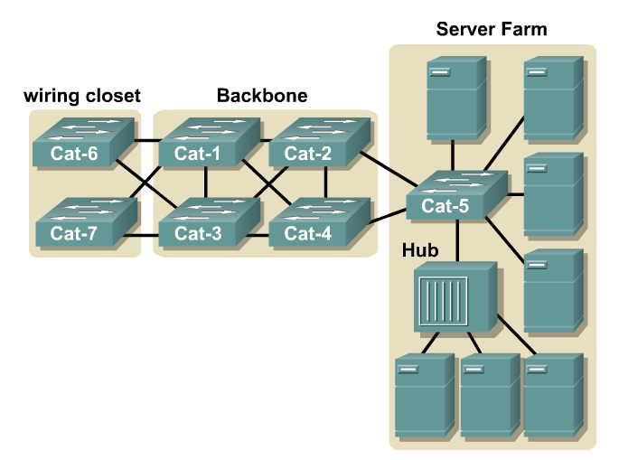
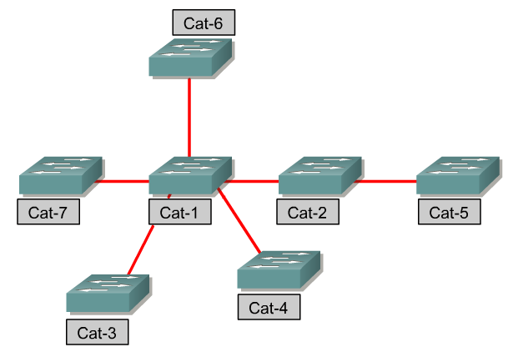
Redundant topology and spanning tree
Unlike IP, in the Layer 2 header there is no Time To Live (TTL).
The solution is to allow physical loops (redundant physical connections) but create a loop free logical topology.
The loop free logical topology created is called a tree.
This topology is a star or extended star logical topology, the spanning tree of the network.

Slide 11
Redundant topology and spanning tree
It is a spanning tree because all devices in the network are reachable or spanned.
The algorithm used to create this loop free logical topology is the spanning-tree algorithm.
This algorithm can take a “relatively” long time to converge.
A new algorithm called the rapid spanning-tree algorithm is being introduced to reduce the time for a network to compute a loop free logical topology. (later)

Slide 12
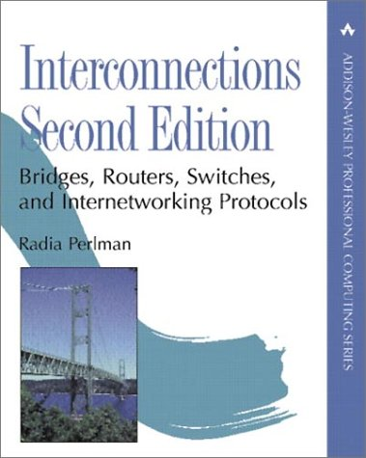

Radia Perlman
Spanning-Tree Protocol (STP)
Ethernet bridges and switches can implement the IEEE 802.1D Spanning-Tree Protocol and use the spanning-tree algorithm to construct a loop free shortest path network.
Radia Perlman “is the inventor of the spanning tree algorithm used by bridges (switches), and the mechanisms that make link state routing protocols such as IS-IS (which she designed) and OSPF (which adopted many of the ideas) stable and efficient. Her thesis on sabotage-proof networks is well-known in the security community.”
http://www.equipecom.com/radia.html

Slide 13
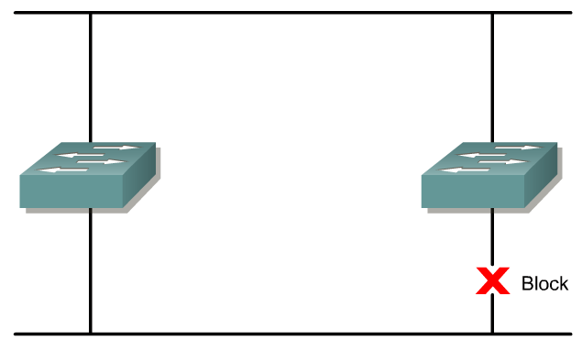
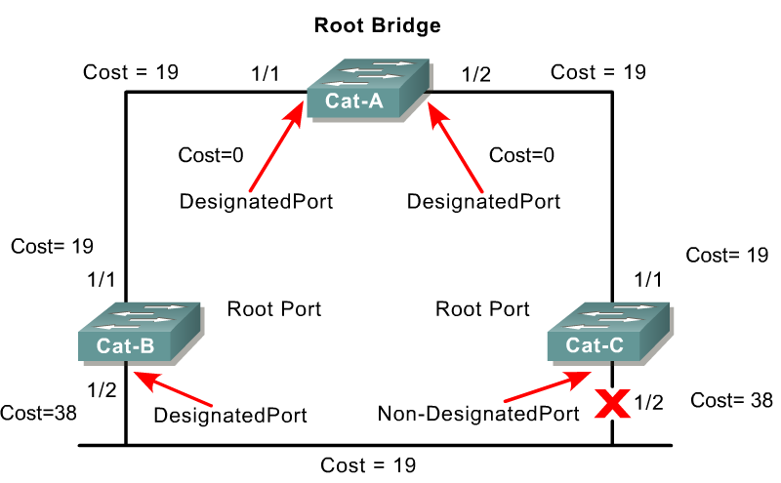
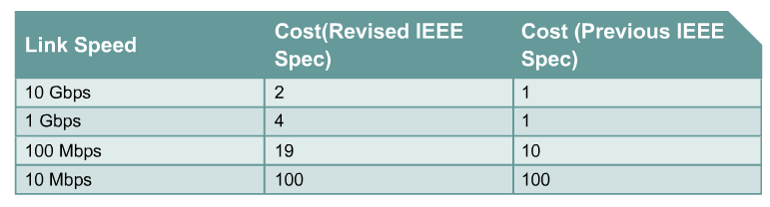
Spanning-Tree Protocol (STP)
We will see how this works in a moment.
Shortest path is based on cumulative link costs.
Link costs are based on the speed of the link.
The Spanning-Tree Protocol establishes a root node, called the root bridge.
The Spanning-Tree Protocol constructs a topology that has one path for reaching every network node.
The resulting tree originates from the root bridge.
Redundant links that are not part of the shortest path tree are blocked.

Slide 14
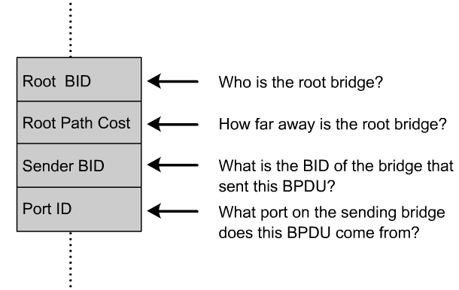
Spanning-Tree Protocol (STP)
BPDU
It is because certain paths are blocked that a loop free topology is possible.
Data frames received on blocked links are dropped.
The Spanning-Tree Protocol requires network devices to exchange messages to prevent bridging loops, called Bridge Protocol Data Unit (BPDU). .
Links that will cause a loop are put into a blocking state.
BPDUs continue to be received on blocked ports.
This ensures that if an active path or device fails, a new spanning tree can be calculated.

Slide 15
Spanning-Tree Protocol (STP)
BPDUs contain enough information so that all switches can do the following:
Select a single switch that will act as the root of the spanning tree
Calculate the shortest path from itself to the root switch
Designate one of the switches as the closest one to the root, for each LAN segment. This bridge is called the “designated switch”.
  The designated switch handles all communication from that LAN towards the root bridge.
Choose one of its ports as its root port, for each non-root switch.
  This is the interface that gives the best path to the root switch.
Select ports that are part of the spanning tree, the designated ports. Non-designated ports are blocked.

Slide 16
Let’s see how this is done!
Some of this is extra information or information explained that is not explained fully in the curriculum.

Slide 17
Two Key Concepts: BID and Path Cost
STP executes an algorithm called Spanning Tree Algorithm (STA).
STA chooses a reference point, called a root bridge, and then determines the available paths to that reference point.
  If more than two paths exists, STA picks the best path and blocks the rest
STP calculations make extensive use of two key concepts in creating a loop-free topology:
  Bridge ID
  Path Cost

Slide 18
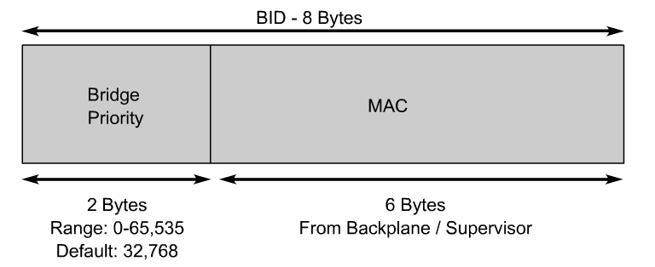
Bridge ID (BID)
Bridge ID (BID) is used to identify each bridge/switch.
The BID is used in determining the center of the network, in respect to STP, known as the root bridge.
Consists of two components:
  A 2-byte Bridge Priority: Cisco switch defaults to 32,768 or 0x8000.
  A 6-byte MAC address

Slide 19
Bridge ID (BID)
Bridge Priority is usually expressed in decimal format and the MAC address in the BID is usually expressed in hexadecimal format.
BID is used to elect a root bridge (coming)
Lowest Bridge ID is the root.
If all devices have the same priority, the bridge with the lowest MAC address becomes the root bridge. (Yikes!)

Slide 20
Bridge ID (BID)
ALSwitch#show spanning-tree
VLAN0001
Spanning tree enabled protocol ieee
Root ID Priority 32768
Address 0003.e334.6640
Cost 19
Port 23 (FastEthernet0/23)
Hello Time 2 sec Max Age 20 sec Forward Delay 15 sec
Bridge ID Priority 32769 (priority 32768 sys-id-ext 1)
Address 000b.fc28.d400
Hello Time 2 sec Max Age 20 sec Forward Delay 15 sec
Aging Time 300
Interface Port ID Designated Port ID
Name Prio.Nbr Cost Sts Cost Bridge ID Prio.Nbr
---------------- -------- --------- --- --------- -------------------- --------
Fa0/23 128.23 19 FWD 0 32768 0003.e334.6640 128.25
ALSwitch#

Slide 21
Path Cost
Bridges use the concept of cost to evaluate how close they are to other bridges.
This will be used in the STP development of a loop-free topology .
Originally, 802.1d defined cost as 1000/bandwidth of the link in Mbps.
  Cost of 10Mbps link = 100 or 1000/10
  Cost of 100Mbps link = 10 or 1000/100
  Cost of 1Gbps link = 1 or 1000/1000
Running out of room for faster switches including 10 Gbps Ethernet.

Slide 22
Path Cost
IEEE modified the most to use a non-linear scale with the new values of:
  4 Mbps 250 (cost)
  10 Mbps 100 (cost)
  16 Mbps 62 (cost)
  45 Mbps 39 (cost)
  100 Mbps 19 (cost)
  155 Mbps 14 (cost)
  622 Mbps 6 (cost)
  1 Gbps 4 (cost)
  10 Gbps 2 (cost)

Slide 23
Path Cost
You can modify the path cost by modifying the cost of a port.
  Switch(config-if)# spanning-tree cost value
  Exercise caution when you do this!
BID and Path Cost are used to develop a loop-free topology .
Coming very soon!
But first the Four-Step STP Decision Sequence

Slide 24
Four-Step STP Decision Sequence
When creating a loop-free topology, STP always uses the same four-step decision sequence:
Four-Step decision Sequence
Step 1 - Lowest BID
Step 2 - Lowest Path Cost to Root Bridge
Step 3 - Lowest Sender BID
Step 4 - Lowest Port ID
Bridges use Configuration BPDUs during this four-step process.
  There is another type of BPDU known as Topology Change Notification (TCN) BPDU (later)

Slide 25
Three Steps of Initial STP Convergence
The STP algorithm uses three simple steps to converge on a loop-free topology.
Switches go through three steps for their initial convergence:
STP Convergence
Step 1 Elect one Root Bridge
Step 2 Elect Root Ports
Step 3 Elect Designated Ports
All STP decisions are based on a the following predetermined sequence:
Four-Step decision Sequence
Step 1 - Lowest BID
Step 2 - Lowest Path Cost to Root Bridge
Step 3 - Lowest Sender BID
Step 4 - Lowest Port ID

Slide 26
Three Steps of Initial STP Convergence
STP Convergence
Step 1 Elect one Root Bridge
Step 2 Elect Root Ports
Step 3 Elect Designated Ports

Slide 27
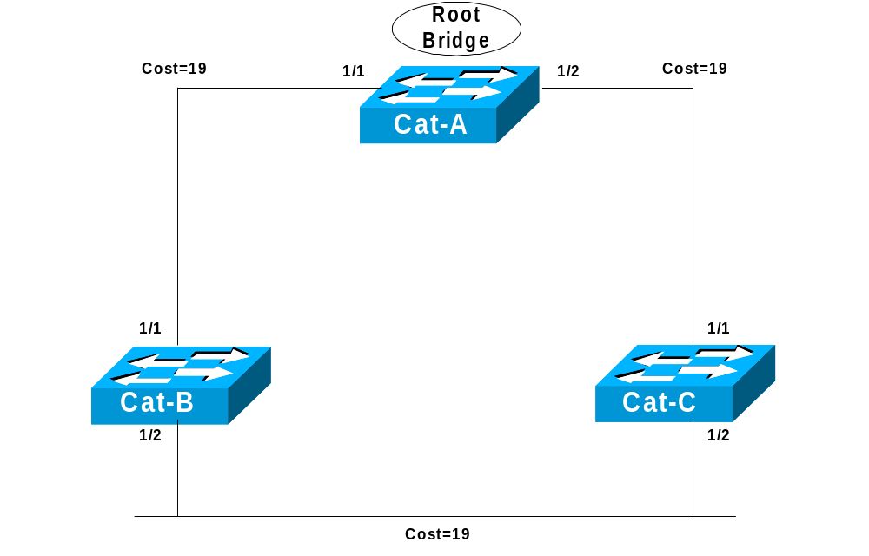
Step 1 Elect one Root Bridge

Slide 28
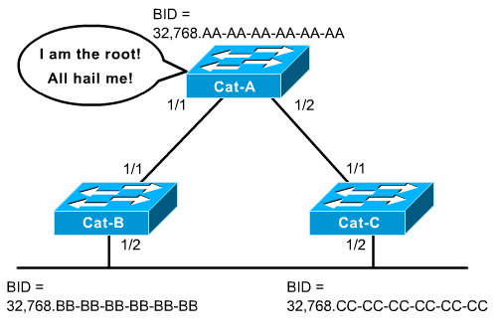
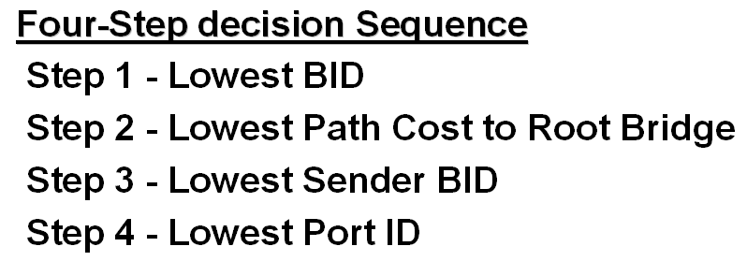
Step 1 Elect one Root Bridge
When the network first starts, all bridges are announcing a chaotic mix of BPDUs.
All bridges immediately begin applying the four-step sequence decision process.
Switches need to elect a single Root Bridge.
Switch with the lowest BID wins!
Note: Many texts refer to the term “highest priority” which is the “lowest” BID value.
This is known as the “Root War.”

Slide 29
Step 1 Elect one Root Bridge
Cat-A has the lowest Bridge MAC Address, so it wins the Root War!
All 3 switches have the same default Bridge Priority value of 32,768

Slide 30
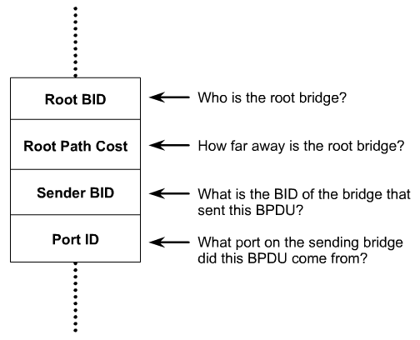
Its all done with BPDUs!
Step 1 Elect one Root Bridge
BPDU
802.3 Header
Destination: 01:80:C2:00:00:00 Mcast 802.1d Bridge group
Source: 00:D0:C0:F5:18:D1
LLC Length: 38
802.2 Logical Link Control (LLC) Header
Dest. SAP: 0x42 802.1 Bridge Spanning Tree
Source SAP: 0x42 802.1 Bridge Spanning Tree
Command: 0x03 Unnumbered Information
802.1 - Bridge Spanning Tree
Protocol Identifier: 0
Protocol Version ID: 0
Message Type: 0 Configuration Message
Flags: %00000000
Root Priority/ID: 0x8000/ 00:D0:C0:F5:18:C0
Cost Of Path To Root: 0x00000000 (0)
Bridge Priority/ID: 0x8000/ 00:D0:C0:F5:18:C0
Port Priority/ID: 0x80/ 0x1D
Message Age: 0/256 seconds (exactly 0 seconds)
Maximum Age: 5120/256 seconds (exactly 20 seconds)
Hello Time: 512/256 seconds (exactly 2 seconds)
Forward Delay: 3840/256 seconds (exactly 15 seconds)
Configuration BPDUs are sent every 2 seconds by default.

Slide 31
Step 1 Elect one Root Bridge
In a real network, you do not want the placement of the root bridge to rely on the random placement of the switch with the lowest MAC address.
A misplaced root bridge can have significant effects on your network including less than optimum paths within the network.
It is better to configure a switch to be the root bridge:
Switch(config)# spanning-tree [vlan vlan-list] priority priority *
Priority
  Default = 32,768
  Range 0=65,535
  Lowest wins

Slide 32
Step 1 Elect one Root Bridge
2950#show spanning-tree
VLAN0001
Spanning tree enabled protocol ieee
Root ID Priority 32768
Address 0003.e334.6640
Cost 19
Port 23 (FastEthernet0/23)
Hello Time 2 sec Max Age 20 sec Forward Delay 15 sec
Bridge ID Priority 32769 (priority 32768 sys-id-ext 1)
Address 000b.fc28.d400
Hello Time 2 sec Max Age 20 sec Forward Delay 15 sec
Aging Time 300
Interface Port ID Designated Port ID
Name Prio.Nbr Cost Sts Cost Bridge ID Prio.Nbr
---------------- -------- --------- --- --------- -------------------- --------
Fa0/23 128.23 19 FWD 0 32768 0003.e334.6640 128.25
ALSwitch#

Slide 33
Step 1 Elect one Root Bridge
2900#show spanning-tree
Spanning tree 1 is executing the IEEE compatible Spanning Tree protocol
Bridge Identifier has priority 32768, address 0003.e334.6640
Configured hello time 2, max age 20, forward delay 15
We are the root of the spanning tree
Topology change flag not set, detected flag not set, changes 1
Times: hold 1, topology change 35, notification 2
hello 2, max age 20, forward delay 15
Timers: hello 0, topology change 0, notification 0
Interface Fa0/1 (port 13) in Spanning tree 1 is down
Port path cost 19, Port priority 128
Designated root has priority 32768, address 0003.e334.6640
Designated bridge has priority 32768, address 0003.e334.6640
Designated port is 13, path cost 0
Timers: message age 0, forward delay 0, hold 0
BPDU: sent 1, received 0

Slide 34
Three Steps of Initial STP Convergence
STP Convergence
Step 1 Elect one Root Bridge
Step 2 Elect Root Ports
Step 3 Elect Designated Ports

Slide 35
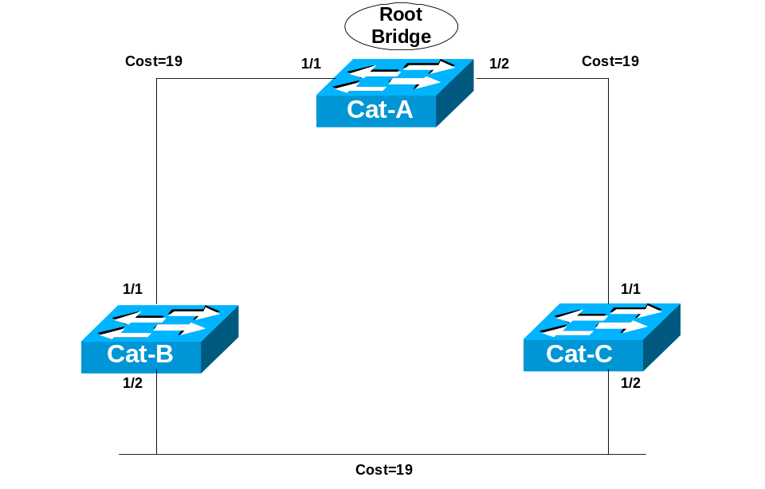
Step 2 Elect Root Ports
Now that the Root War has been won, switches move on to selecting Root Ports.
A bridge’s Root Port is the port closest to the Root Bridge.
Bridges use the cost to determine closeness.
Every non-Root Bridge will select one Root Port!
Specifically, bridges track the Root Path Cost, the cumulative cost of all links to the Root Bridge.

Slide 36
Step 2 Elect Root Ports
Our Sample Topology

Slide 37
Step 2 Elect Root Ports
BPDU
Cost=0
BPDU
Cost=0
BPDU
Cost=0+19=19
BPDU
Cost=0+19=19
Step 1
Cat-A sends out BPDUs, containing a Root Path Cost of 0.
Cat-B receives these BPDUs and adds the Path Cost of Port 1/1 to the Root Path Cost contained in the BPDU.
Step 2
Cat-B adds Root Path Cost 0 PLUS its Port 1/1 cost of 19 = 19

Slide 38
Step 2 Elect Root Ports
BPDU
Cost=0
BPDU
Cost=0
BPDU
Cost=19
BPDU
Cost=19
BPDU
Cost=19
BPDU
Cost=19
BPDU
Cost=38 (19=19)
BPDU
Cost=38 (19=19)
Step 3
Cat-B uses this value of 19 internally and sends BPDUs with a Root Path Cost of 19 out Port 1/2.
Step 4
Cat-C receives the BPDU from Cat-B, and increased the Root Path Cost to 38 (19+19). (Same with Cat-C sending to Cat-B.)

Slide 39
Step 2 Elect Root Ports
BPDU
Cost=0
BPDU
Cost=0
BPDU
Cost=19
BPDU
Cost=19
Root Port
Root Port
BPDU
Cost=38 (19=19)
BPDU
Cost=38 (19=19)
Step 5
Cat-B calculates that it can reach the Root Bridge at a cost of 19 via Port 1/1 as opposed to a cost of 38 via Port 1/2.
Port 1/1 becomes the Root Port for Cat-B, the port closest to the Root Bridge.
Cat-C goes through a similar calculation. Note: Both Cat-B:1/2 and Cat-C:1/2 save the best BPDU of 19 (its own).

Slide 40
Step 2 Elect Root Ports
2950#show spanning-tree
VLAN0001
Spanning tree enabled protocol ieee
Root ID Priority 32768
Address 0003.e334.6640
Cost 19
Port 23 (FastEthernet0/23)
Hello Time 2 sec Max Age 20 sec Forward Delay 15 sec
Bridge ID Priority 32769 (priority 32768 sys-id-ext 1)
Address 000b.fc28.d400
Hello Time 2 sec Max Age 20 sec Forward Delay 15 sec
Aging Time 300
Interface Port ID Designated Port ID
Name Prio.Nbr Cost Sts Cost Bridge ID Prio.Nbr
---------------- -------- --------- --- --------- -------------------- --------
Fa0/23 128.23 19 FWD 0 32768 0003.e334.6640 128.25
ALSwitch#

Slide 41
Three Steps of Initial STP Convergence
STP Convergence
Step 1 Elect one Root Bridge
Step 2 Elect Root Ports
Step 3 Elect Designated Ports

Slide 42
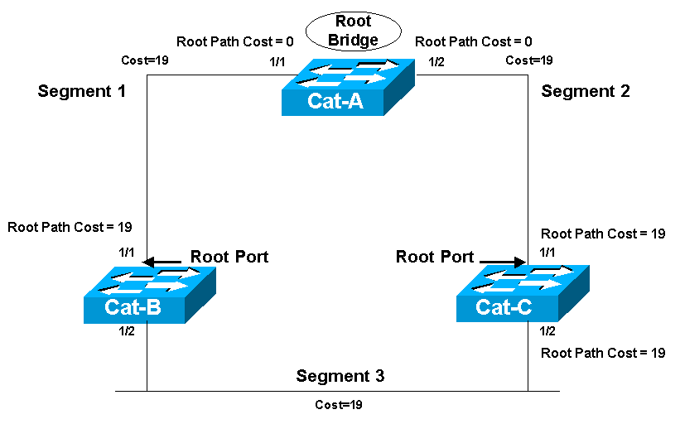
Step 3 Elect Designated Ports
The loop prevention part of STP becomes evident during this step, electing designated ports.
A Designated Port functions as the single bridge port that both sends and receives traffic to and from that segment and the Root Bridge.
Each segment in a bridged network has one Designated Port, chosen based on cumulative Root Path Cost to the Root Bridge.
The switch containing the Designated Port is referred to as the Designated Bridge for that segment.
To locate Designated Ports, lets take a look at each segment.
Root Path Cost, the cumulative cost of all links to the Root Bridge.

Slide 43
Step 3 Elect Designated Ports
Root Path Cost = 0
Root Path Cost = 0
Segment 1
Segment 2
Root Path Cost = 19
Root Path Cost = 19
Root Port
Root Port
Root Path Cost = 19
Root Path Cost = 19
Segment 3
Segment 1: Cat-A:1/1 has a Root Path Cost = 0 (after all it has the Root Bridge) and Cat-B:1/1 has a Root Path Cost = 19.
Segment 2: Cat-A:1/2 has a Root Path Cost = 0 (after all it has the Root Bridge) and Cat-C:1/1 has a Root Path Cost = 19.
Segment 3: Cat-B:1/2 has a Root Path Cost = 19 and Cat-C:1/2 has a Root Path Cost = 19. It’s a tie!

Slide 44
Step 3 Elect Designated Ports
Root Path Cost = 0
Root Path Cost = 0
Segment 1
Segment 2
Designated Port
Designated Port
Root Path Cost = 19
Root Path Cost = 19
Root Port
Root Port
Root Path Cost = 19
Root Path Cost = 19
Segment 3
Segment 1
Because Cat-A:1/1 has the lower Root Path Cost it becomes the Designate Port for Segment 1.
Segment 2
Because Cat-A:1/2 has the lower Root Path Cost it becomes the Designate Port for Segment 2.

Slide 45
Root Path Cost = 0
Root Path Cost = 0
Segment 1
Segment 2
Designated Port
Designated Port
Root Path Cost = 19
Root Path Cost = 19
Root Port
Root Port
Root Path Cost = 19
Root Path Cost = 19
Segment 3
Segment 3
Both Cat-B and Cat-C have a Root Path Cost of 19, a tie!
When faced with a tie (or any other determination) STP always uses the four-step decision process:

Slide 46
Root Path Cost = 0
Root Path Cost = 0
Segment 1
Segment 2
Designated Port
Designated Port
Root Path Cost = 19
Root Path Cost = 19
Root Port
Root Port
32,768.CC-CC-CC-CC-CC-CC
32,768.BB-BB-BB-BB-BB-BB
Root Path Cost = 19
Root Path Cost = 19
Designated Port
Segment 3
Non-Designated Port
Segment 3 (continued)
1) All three switches agree that Cat-A is the Root Bridge, so this is a tie.
2) Root Path Cost for both is 19, also a tie.
3) The sender’s BID is lower on Cat-B, than Cat-C, so Cat-B:1/2 becomes the Designated Port for Segment 3.
Cat-C:1/2 therefore becomes the non-Designated Port for Segment 3.

Slide 47
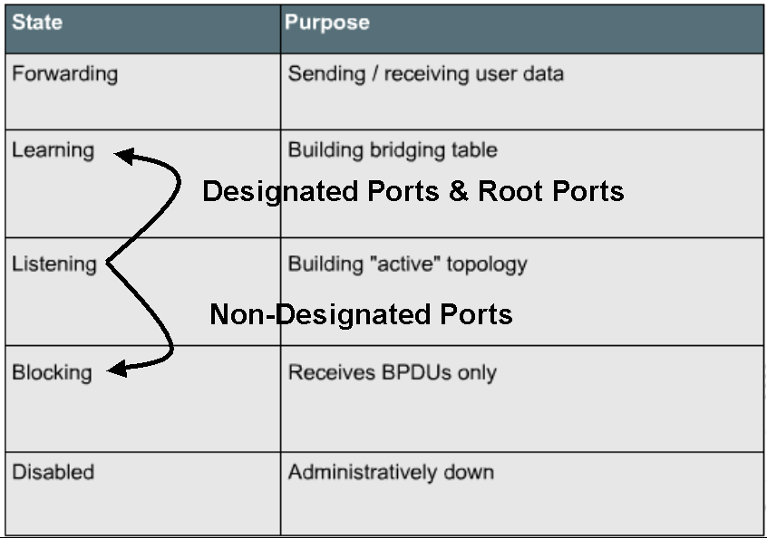
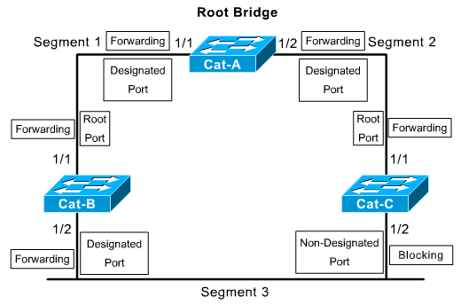
We will first only look at switch ports that have connections to other switches.

Slide 48

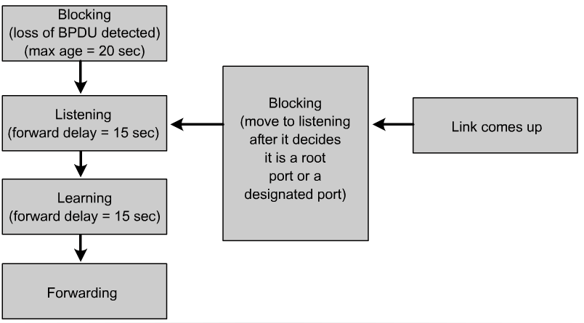
Stages of spanning-tree port states

Slide 49
Stages of spanning-tree port states
Time is required for (BPDU) protocol information to propagate throughout a switched network.
Topology changes in one part of a network are not instantly known in other parts of the network.
There is propagation delay.
A switch should not change a port state from inactive (Blocking) to active (Forwarding) immediately, as this may cause data loops.
Each port on a switch that is using the Spanning-Tree Protocol has one of five states,

Slide 50
STP Port States
In the blocking state, ports can only receive BPDUs.
  Data frames are discarded and no addresses can be learned.
  It may take up to 20 seconds to change from this state.
Ports go from the blocked state to the listening state.
  Switch determines if there are any other paths to the root bridge.
  The path that is not the least cost path to the root bridge goes back to the blocked state.
  The listening period is called the forward delay and lasts for 15 seconds.
  In the listening state, user data is not being forwarded and MAC addresses are not being learned.
  BPDUs are still processed.

Slide 51
STP Port States
Ports transition from the listening to the learning state.
  In this state user data is not forwarded, but MAC addresses are learned from any traffic that is seen.
  The learning state lasts for 15 seconds and is also called the forward delay.
  BPDUs are still processed.

Slide 52
STP Port States
A port goes from the learning state to the forwarding state.
  In this state user data is forwarded and MAC addresses continue to be learned.
  BPDUs are still processed.
Remember – A switch port is allowed to transition to the Forwarding state only if no redundant links (loops) are detected and if the port has the best path to the Root Bridge as the Root Port or Designated Port.

Slide 53
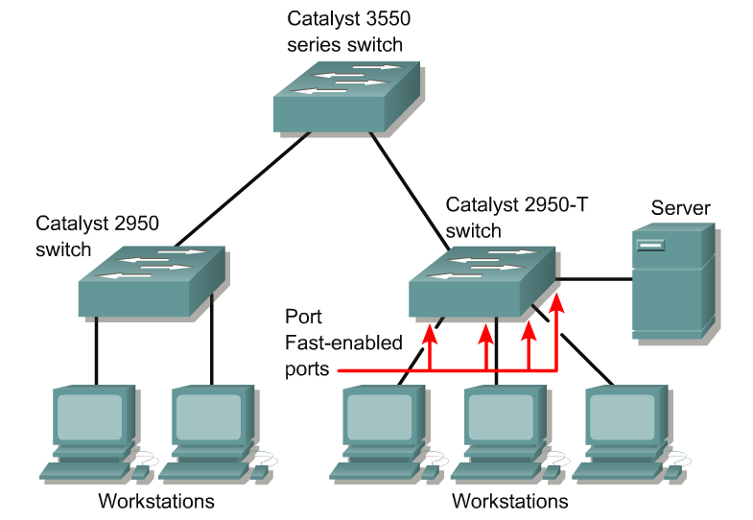
Access ports
When a device is connected to a port, the port normally moves from Blocking State to Listening state, for 15 seconds.
When the Forward Delay timer expires, the port enters the Learning state, for 15 seconds.
When the Forward Delay timer expires a second time, the port is transitioned to the Forwarding or Blocking state.
This 30 seconds delay can cause a problem with computers asking for an IP address (DHCP) before the switch port has transitioned to Forwarding State.
This causes the DHCP to fail, and the host to configure a default IP address.

Slide 54
Access ports
When PortFast is enabled on a switch or trunk port, the port is immediately transitioned to the Forwarding state.
As soon as the switch detects the link, the port is transitioned to the Forwarding state (less than 2 seconds after the cable is plugged in).
This should only be enabled on switch ports where there are only hosts and not any switches.
Switch(config-if)# spanning-tree portfast

Slide 55
ALSwitch#show spanning-tree (Connecting a host without Portfast on)
VLAN0001
Spanning tree enabled protocol ieee
Root ID Priority 32768
Address 0003.e334.6640
Cost 19
Port 23 (FastEthernet0/23)
Hello Time 2 sec Max Age 20 sec Forward Delay 15 sec
Bridge ID Priority 32769 (priority 32768 sys-id-ext 1)
Address 000b.fc28.d400
Hello Time 2 sec Max Age 20 sec Forward Delay 15 sec
Aging Time 15
Interface Port ID Designated Port ID
Name Prio.Nbr Cost Sts Cost Bridge ID Prio.Nbr
---------------- -------- --------- --- --------- -------------------- -------
Fa0/8 128.8 19 LIS 19 32769 000b.fc28.d400 128.8
Fa0/23 128.23 19 FWD 0 32768 0003.e334.6640 128.25
---------------- -------- --------- --- --------- -------------------- -------
Fa0/8 128.8 19 LRN 19 32769 000b.fc28.d400 128.8
Fa0/23 128.23 19 FWD 0 32768 0003.e334.6640 128.25
---------------- -------- --------- --- --------- -------------------- -------
Fa0/8 128.8 19 FWD 19 32769 000b.fc28.d400 128.8
Fa0/23 128.23 19 FWD 0 32768 0003.e334.6640 128.25
ALSwitch#

Slide 56
Example of redundant links

Slide 57
Not seeing BPDU from Cat-B
Ages out BPDU and goes into Listening mode
X Fails
Hub
Cat-B:1/2 fails.
Cat-C has no immediate notification because it’s still receiving a link from the hub.
Cat-C notices it is not receiving BPDUs from Cat-B.
20 seconds (max age) after the failure, Cat-C ages out the BPDU that lists Cat-B as having the DP for segment 3.
This causes Cat-C:1/2 to transition into the Listing state (15 seconds) in an effort to become the DP.
Hub

Slide 58
X Fails
Forwarding Mode
Listening Mode
Hub
Because Cat-C:1/2 now offers the most attractive access from the Root Bridge to this link, it eventually transitions to Learning State (15 seconds), then all the way into Forwarding mode.
In practice this will take 50 seconds (20 max age + 15 Listening + 15 Learning) for Cat-C:1/2 to take over after the failure of Cat-B:1/2.
Hub

Slide 59

Port Cost/Port ID
Blocking
0/2
X
0/1
Forwarding
Assume path cost and port priorities are default (32). Port ID used in this case. Port 0/1 would forward because it’s the lower than Port 0/2.
If the path cost and bridge IDs are equal (as in the case of parallel links), the switch goes to the port priority as a tiebreaker.
Lowest port priority wins (all ports set to 32).
You can set the priority from 0 – 63.
If all ports have the same priority, the port with the lowest port number forwards frames.

Slide 60
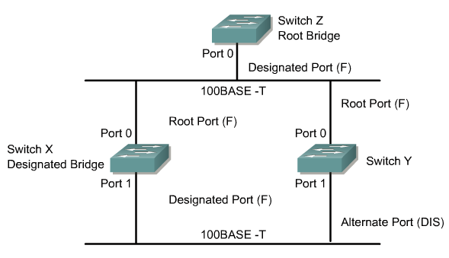
Rapid Spanning Tree Protocol (RSTP)
It is difficult to explain RSTP in just a few slides. RSTP is discussed in detail in CCNP 3.

Slide 61
Rapid Spanning Tree Protocol (RSTP)
The Rapid Spanning-Tree Protocol is defined in the IEEE 802.1w LAN standard.
The standard and protocol introduce the following:
  Clarification of port states and roles
  Definition of a set of link types that can go to forwarding state rapidly
  Concept of allowing switches, in a converged network, to generate their own BPDUs rather than relaying root bridge BPDUs
The “blocked” state of a port has been renamed as the “discarding” state.

Slide 62
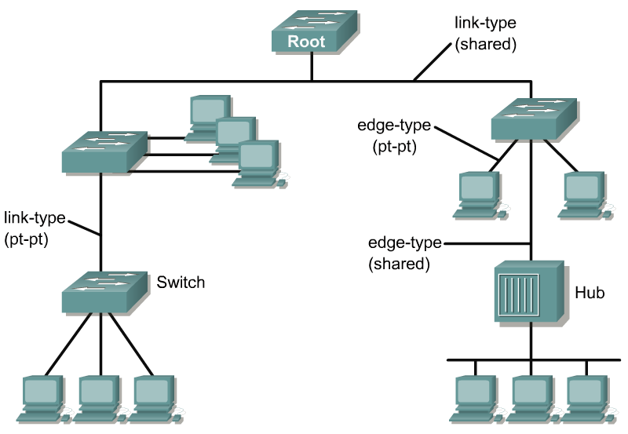
RSTP Link Types
Link types have been defined as point-to-point, edge-type, and shared.
These changes allow failure of links in switched network to be learned rapidly.
Point-to-point links and edge-type links can go to the forwarding state immediately.
Network convergence does not need to be any longer than 15 seconds with these changes.
The Rapid Spanning-Tree Protocol, IEEE 802.1w, will eventually replace the Spanning-Tree Protocol, IEEE 802.1D

Slide 63
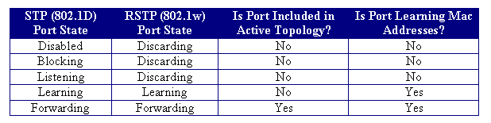
RSTP Port States

