Slide 1
Predicting Smartphone Prices from Hardware Specifications
Predictive Analytics project · Random Forest vs Gradient Boosting
Budget
Mid-Range
Premium
Barkha Sahu · Symbiosis Institute of Technology, Nagpur

Slide 2
What this presentation covers
AGENDA
Problem statement
Dataset
1
2
Data understanding and preprocessing
Predictive modelling approach
3
4
Model development
Evaluation of the model
5
6
Results and interpretation
Conclusion
7
8

Slide 3



Can hardware specs predict a phone’s price?
1 · PROBLEM STATEMENT
Phone prices vary hugely: from ₹5,700 to ₹260,000.
CLASSIFICATION
Which price tier?
Buyers and makers want to know how much of the price comes from hardware alone.
Budget, Mid-Range or Premium
REGRESSION
Goal: predict a phone’s price tier and its actual price from its specifications.
What is the price?
A predicted amount in rupees

Slide 4
Three datasets, 2,822 phones
2 · DATASET
STUDY 1
STUDY 2
STUDY 3
Mobiles Dataset 2025
Final Mobile Dataset
Smartphones v4
915
1,049
858
unique phones
clean phones
phones
Prices in USD
Target: 3 price tiers
Prices in INR
Target: 3 price tiers
Prices in INR
Target: the price itself
Features: RAM, storage, battery, display, cameras, processor and brand. Price is never used as a feature.

Slide 5
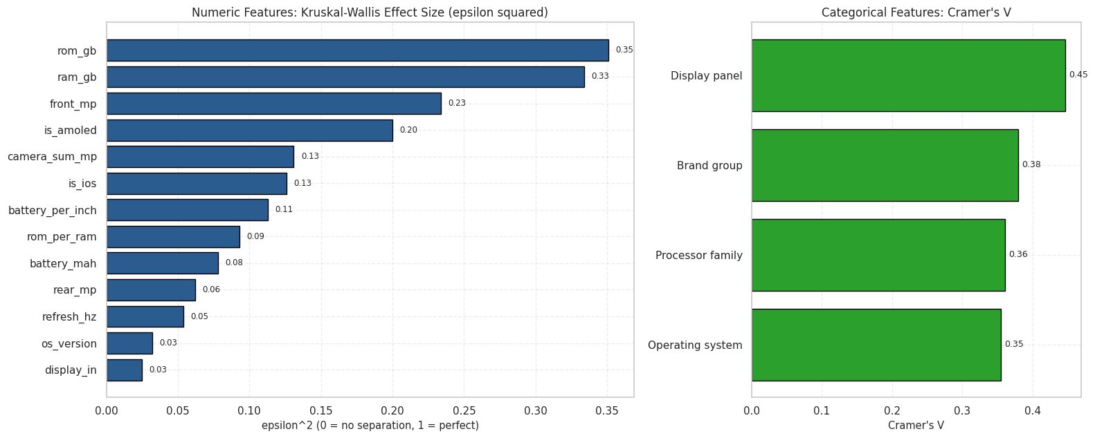
What the data tells us
3 · DATA UNDERSTANDING
0.63
Storage vs price correlation
0.60
RAM vs price correlation
Longer bar = stronger link with price (Study 2)
100%
Bigger batteries mean cheaper phones. Refresh rate and OS version barely matter.
of Apple phones are Premium

Slide 6
Cleaning the data before modelling
3 · PREPROCESSING
1
2
3
4
Remove duplicates
Fix labels and codes
Fill missing values
Create new features
7 duplicate phones removed in Study 2 and 15 in Study 1.
30 brand labels merged to 27. 267 wrong RAM codes recoded to 12 GB.
9 missing camera values filled using training data only.
Camera total, battery per inch and storage per RAM.
Targets: three equal-sized price tiers (Studies 1 and 2) and log(price) for regression (Study 3).

Slide 7
A step-by-step KDD workflow
4 · PREDICTIVE MODELLING APPROACH
Select data
Clean
Engineer features
Explore
Train and tune
Test
Safeguards against cheating
Two prediction tasks
Price columns never enter the features
80/20 train–test split with a fixed seed (42)
Missing values filled using training data only
Settings tuned with 5-fold cross-validation
Classification: Budget, Mid-Range or Premium
Regression: the price in ₹

Slide 8


Random Forest vs Gradient Boosting
5 · MODEL DEVELOPMENT
Random Forest
Gradient Boosting
Many deep trees vote in parallel. Averaging their answers cuts errors.
Small trees are built one after another. Each one fixes the previous mistakes.
Best settings: 200 trees, depth 10
Best settings: 200 trees, learning rate 0.1, depth 2
Both models were tuned with 5-fold cross-validation on the 80% training set.

Slide 9
How we judge the models
6 · EVALUATION OF THE MODEL
Classification (price tier)
Regression (price in ₹)
Accuracy
share of phones placed in the right tier
MAE
average error in rupees
Macro-F1
accuracy balanced across all tiers
MAPE
average error as a percentage
ROC-AUC
how well the tiers are separated
R²
share of price variation explained
Tested on a held-out 20% of phones (172 to 210) the models never saw. Chance level for 3 tiers is 33%.

Slide 10
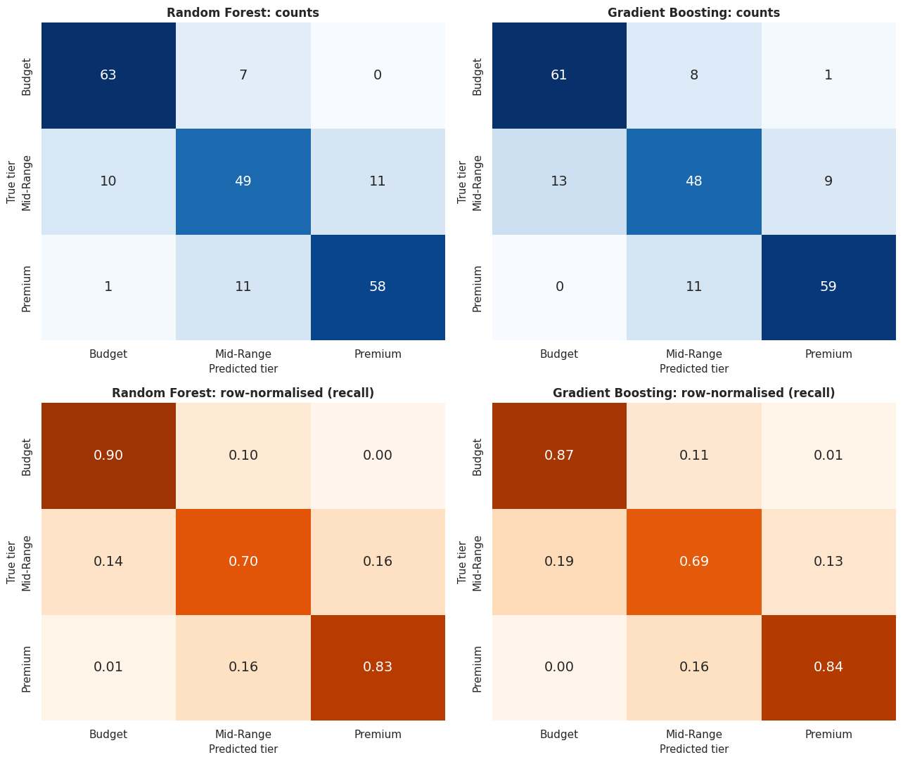
Tier prediction is 80–84% accurate
7 · RESULTS AND INTERPRETATION
Study 2 confusion matrices: darker diagonal = correct
About 98% of mistakes are only one tier away. Mid-Range is the hardest tier.

Slide 11
Price prediction: Gradient Boosting wins
7 · RESULTS AND INTERPRETATION
₹3,887
average error (MAE) of tuned Gradient Boosting
0.941
R²: share of price variation explained
10.8%
average percentage error (MAPE)
Random Forest tuned: MAE ₹5,537, R² 0.879

Slide 12
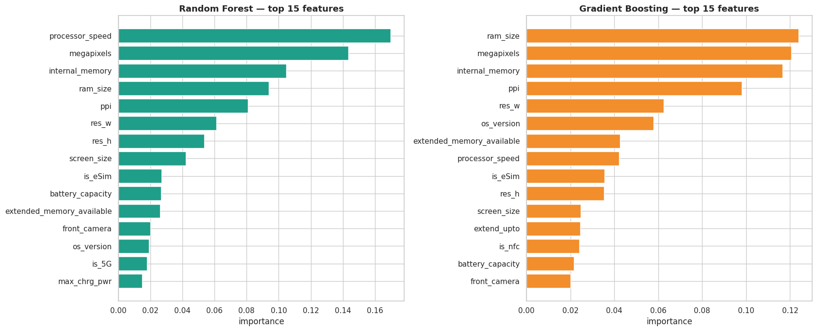
What drives a phone’s price
7 · RESULTS AND INTERPRETATION
Key takeaways
RAM and storage are the strongest price signals
Screen quality and processor speed come next
New feature battery per inch added useful signal
Brand and marketing are not in the specs
Longer bar = feature matters more (Study 3)
Both models agree on the main drivers, so the result is consistent.

Slide 13
Conclusion: specs predict price well
8 · CONCLUSION
1
2
3
4
Specs predict the tier
Both models are equal on tiers
Gradient Boosting wins on price
Errors are near-misses
81 to 84% accuracy vs 33% by chance
Only about 1 point apart (McNemar p = 0.82)
MAE ₹3,887 and R² 0.941, vs ₹5,537 and 0.879
Almost all are one tier away, near the cut-offs
Best choice: Random Forest for tier labels, tuned Gradient Boosting for price estimates.

Slide 14
Limitations and next steps
8 · CONCLUSION
Limitations
Next steps
Launch prices only, not adjusted for inflation or currency
Small samples: 858 to 1,049 phones per dataset
Brand, marketing and launch timing are not in the specs
Models need testing on new data before real use
Add launch date, brand tier and reviews as features
Try XGBoost, LightGBM and ordinal models
Flag low-confidence predictions for manual review
Deploy the saved models in a small price-check app

