Slide 1

Noida institute of Engineering & Technology
Department of CSE (Data Science)
Session (2025-26)
Capstone Project (ACSE0859)
Presentation on
“Sales Data Analysis & Forecasting Dashboard"
Project Guide: Ms. Garima Dhawan Submitted To: Member:Barkha Jha

Slide 2

Presentation Outline
Topic of Project
Problem Statement
Literature Review
Introduction (In detail)
Model (Diagram/ Design)
Implementation
- Frontend technologies Used
- Backend Technologies Used
AI-tech (How AI will benefit this project , if any)
Monetization Policy (if any)
Future Scope

Slide 3
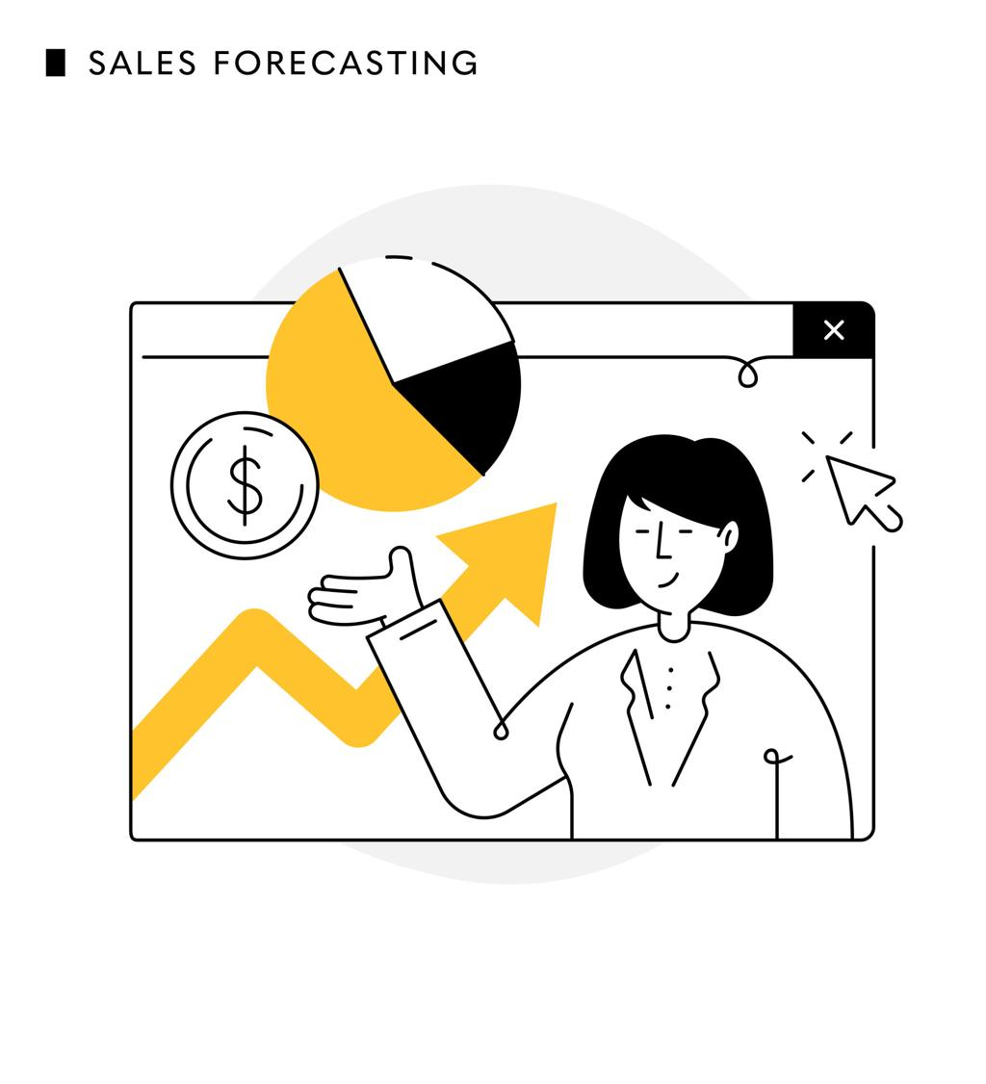
Problem Statement
Retail businesses generate huge amounts of sales data every day. However, many companies struggle to extract useful insights from this data.
Some common problems include:
• Difficulty analyzing sales trends • Identifying best-performing products • Understanding customer purchasing behavior • Predicting future sales demand

Slide 4
Literature Review
Sr. No. | Author / Year | Technique Used | Key Contribution
1 | Smith et al. (2020) | ARIMA Model | Used time series forecasting to predict retail sales trends.
2 | Brown et al. (2021) | Linear Regression | Applied machine learning for demand prediction in retail datasets.
3 | Lee et al. (2022) | Data Analytics & Dashboards | Developed visualization dashboards to analyze retail sales performance.
4 | Kumar et al. (2023) | Machine Learning Models | Used predictive analytics to improve inventory and sales planning.

Slide 5

Introduction
Retail businesses generate a large amount of transactional data from daily sales activities. Analyzing this data helps organizations understand sales patterns, customer preferences, and product demand.
With the advancement of data analytics and machine learning, businesses can extract valuable insights from raw data and make informed decisions.
This project focuses on analyzing the Walmart retail sales dataset to identify trends in sales performance, customer behavior, and product demand.
In addition, machine learning techniques are applied to forecast future sales, which helps businesses improve inventory management, marketing strategies, and revenue planning.

Slide 6
MODEL DESIGN
The proposed system analyzes Walmart sales data using data analytics and machine learning techniques. The system processes raw sales data, performs analysis, applies forecasting models, and visualizes results using dashboards. Walmart Sales Dataset
Data Cleaning & Preprocessing
Feature Engineering
Exploratory Data Analysis
Machine Learning Models
Forecast Results
Power BI Dashboard
Streamlit Web Application

Slide 7
MODEL DESIGN
1️⃣ Data Collection The Walmart sales dataset containing transaction details such as product line, quantity, payment method, and sales value was used.
2️⃣ Data Preprocessing The dataset was cleaned by checking for missing values, removing duplicates, and converting date and time fields into appropriate formats.
3️⃣ Feature Engineering Additional features such as Month, Day, and Hour were created from the date and time columns to analyze time-based sales patterns.
4️⃣ Exploratory Data Analysis (EDA) Statistical analysis and visualizations were performed to understand sales trends, customer behavior, and product performance.
5️⃣ Machine Learning Forecasting Forecasting models such as ARIMA and Linear Regression were implemented to predict future sales trends.
6️⃣ Dashboard Development An interactive Power BI dashboard was created to visualize key insights and performance metrics.
7️⃣ Web Application Deployment The analytics system was deployed using a Streamlit web application for easy access and presentation.

Slide 8
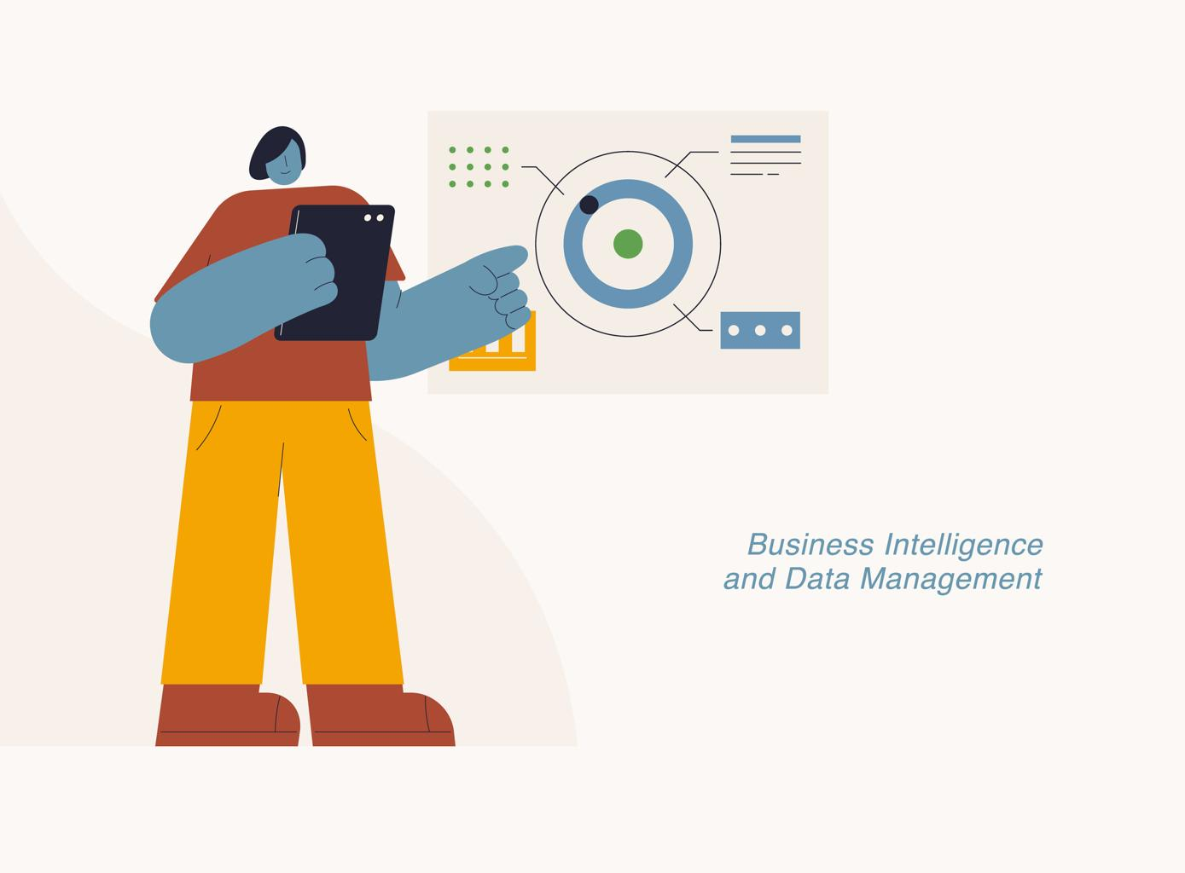
Frontend Technology Used
Data Visualization Charts
Streamlit
Power BI
Used to create interactive dashboards for visualizing sales trends, branch performance, product analysis and forecasting results.
Used to develop a web based interface that allows users to explore analytics system easily
Charts such as bar charts, line charts, and pie charts were used to present insights clearly

Slide 9
Backend Technology Used
Python
Used as the primary programming language for data processing and machine learning implementation
Pandas
Used for data manipulation, cleaning and preprocessing of Walmart sales dataset.
Matplotlib
Charts such as bar charts, line charts, and pie charts were used to present insights clearly

Slide 10


Slide 11
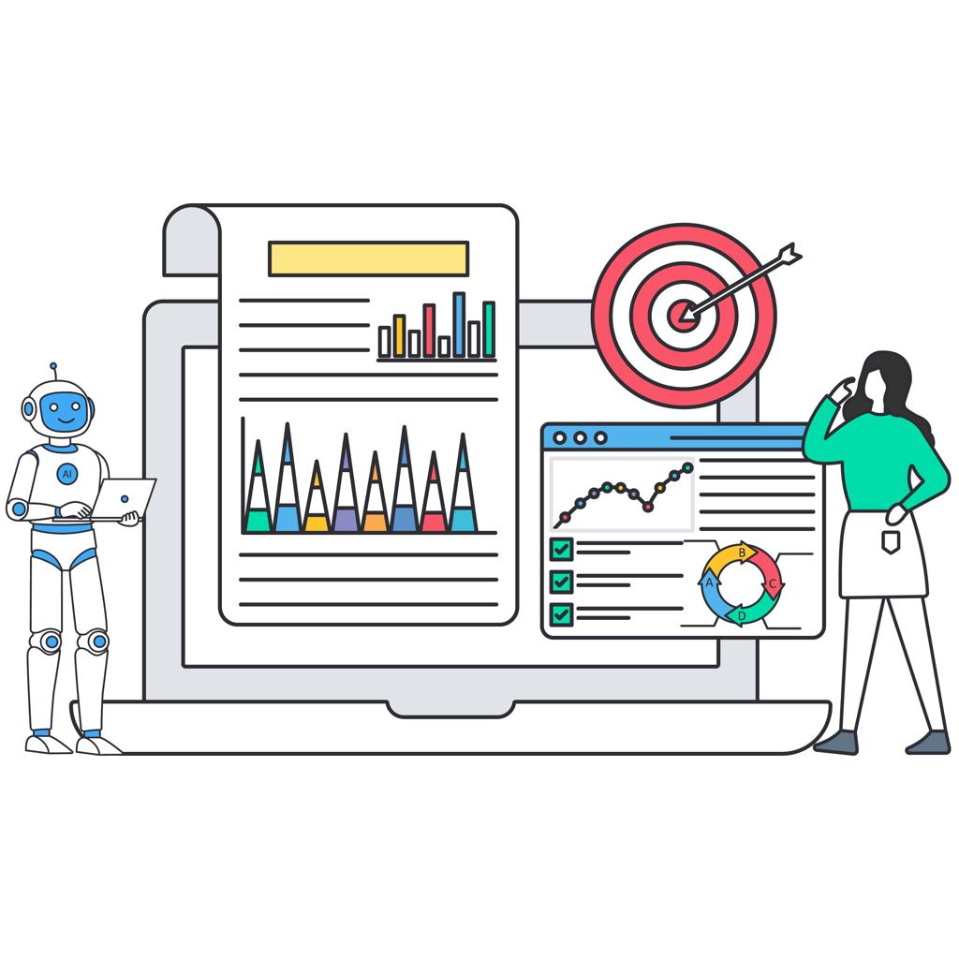
AI Technology Used
In this project, machine learning techniques are used to analyze historical sales data and forecast future revenue.
AI techniques used in the project include:
• ARIMA Model (Time Series Forecasting) Used to analyze historical sales data and predict future sales trends.
• Linear Regression Model Used as a baseline machine learning model for predicting sales values

Slide 12

Monetization Policy
The proposed sales analytics system can generate revenue through several business models.
Possible monetization strategies include:
• Retail Analytics Service Providing sales analytics and forecasting solutions to retail companies.
• Subscription-Based Dashboard Businesses can subscribe to the analytics dashboard for continuous monitoring of sales performance.
• Inventory Optimization Solutions Companies can use forecasting results to optimize inventory management and reduce operational costs.

Slide 13
Future Scope
The proposed system can be further improved in several ways:
• Larger Datasets Future work can include analyzing larger and real-time retail datasets to improve forecasting accuracy.
• Advanced Machine Learning Models Deep learning models such as LSTM (Long Short-Term Memory) can be implemented for more accurate time-series forecasting.
• Real-Time Data Integration Integration with live sales databases can enable real-time analytics and monitoring.
• Cloud-Based Deployment The system can be deployed on cloud platforms to allow scalable and remote access.
• Mobile Dashboard Applications Developing mobile applications will allow business managers to monitor sales insights anytime and anywhere.

Slide 14
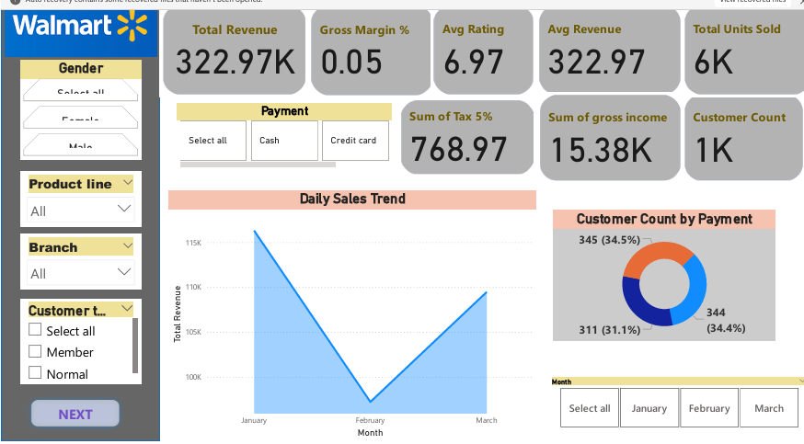
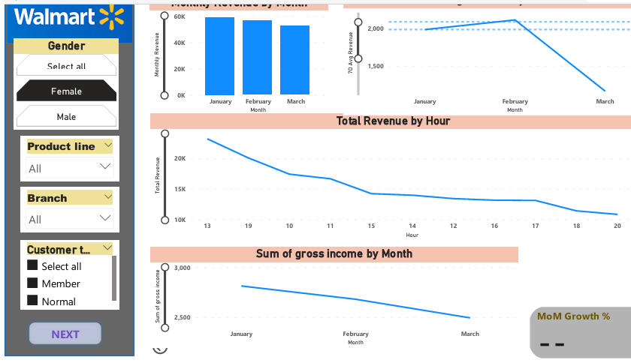
PROJECT

Slide 15
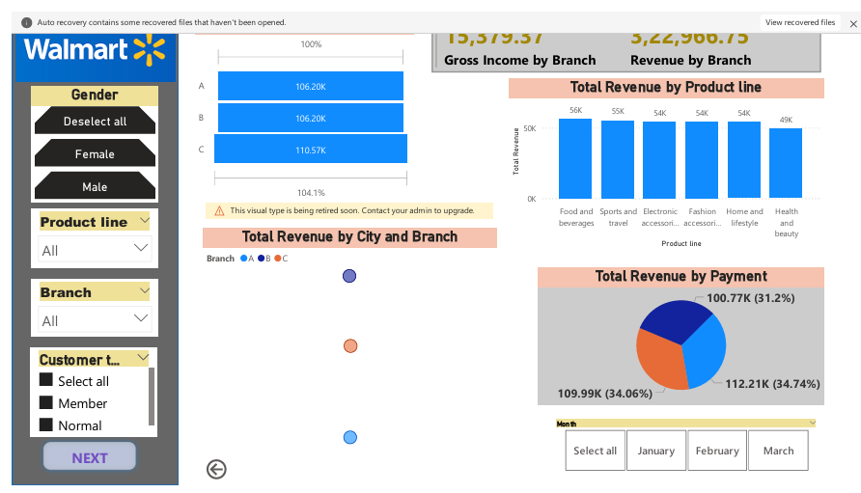
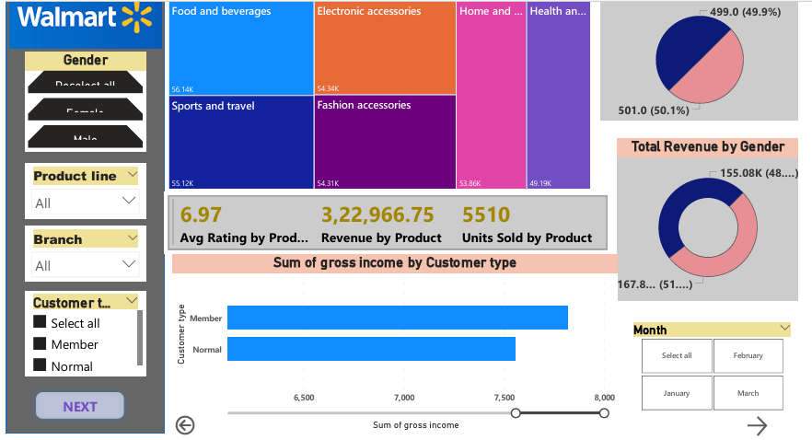
PROJECT

Slide 16
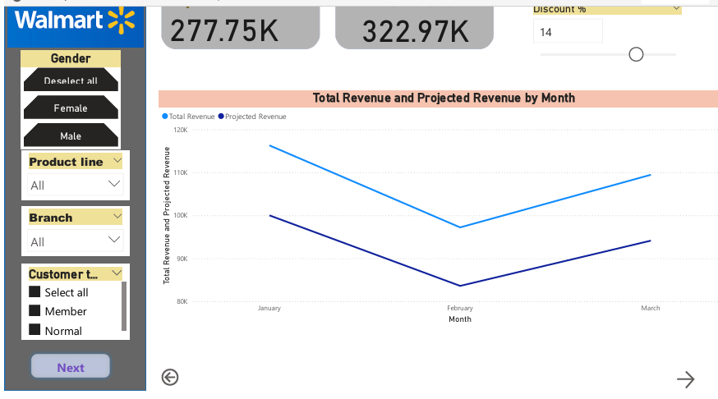
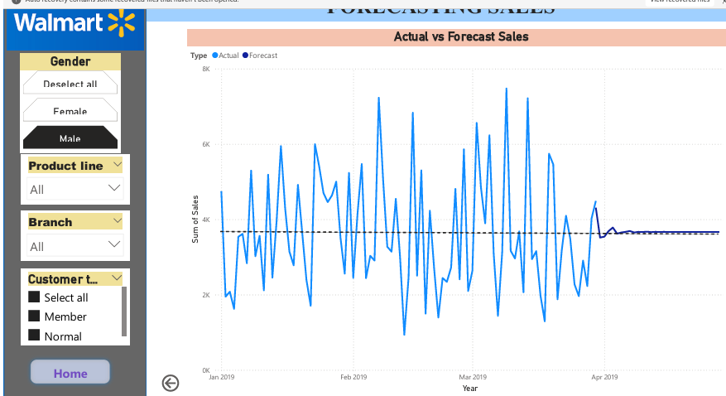
PROJECT

Slide 17
Noida institute of Engineering & Technology
Thank you

