Slide 1
IBM University Engagement Project Submission
“Exploring the Power of Agentic AI with IBM Granite and LangFlow”

Slide 2
Project Tile – AI Agent for Smart Farming Advice
Domain of Project – Agriculture
Faculty Name | Recent Passport Photo | Email ID | Mobile number [WhatsApp]
Dr. Barkha Joshi |  | barkhajoshi.comp@svitvasad.ac.in barkhadesai21@gmail.com | 9909002598

Slide 3
Problem Statement -
Problem Statement : AI Agent for Smart Farming Advice
The Challenge
Farmers often struggle with low crop yield, unpredictable weather, pest infestations, and limited access to timely expert advice. Traditional farming advisory services are fragmented, slow, and not personalized to the farmer’s specific land, crop, or climate conditions. With the rise of climate change, data-driven smart farming solutions are needed to empower farmers with actionable insights.
The Objective
Develop an AI-powered Smart Farming Agent that provides personalized, real-time, and sustainable agricultural advice. The solution should:
1. Agricultural Knowledge Retrieval (RAG) – Use Retrieval-Augmented Generation to fetch best practices, crop-specific guidelines, and government advisory updates.
2. Weather & Soil Insights – Integrate real-time weather forecasts, soil health data, and irrigation needs to optimize farm planning.
3. Pest & Disease Detection – Enable multimodal support where farmers upload crop images for early pest/disease identification and get instant recommendations.
4. Personalized Advisory Agent – Suggest seeds, fertilizers, irrigation schedules, and harvesting timelines based on farmer profile and land conditions.
5. Market & Cost Optimization – Forecast demand, suggest market prices, and recommend cost-efficient practices for better income.
6. Multi-Agent Collaboration –
Crop Advisory Agent
Weather & Irrigation Agent
Pest/Disease Detection Agent
Market Insights Agent

Slide 4
Technology Used
Tech Stack
LangFlow + IBM watsonx.ai + Granite Models

Slide 5
Proposed Solution -
Proposed Solution: AI Agent for Smart Farming Advice
The proposed solution is a multi-agent AI-powered Smart Farming Advisory System built using LangFlow, IBM watsonx.ai, and Granite Models to provide personalized, real-time agricultural guidance to farmers. The system addresses critical farming challenges related to crop selection, crop vulnerabilities, soil and site preparation, cultural practices, irrigation management, pest and disease control, and market intelligence.
At its core, the solution leverages a Retrieval-Augmented Generation (RAG) pipeline to retrieve accurate and up-to-date agricultural knowledge, including crop-specific best practices, government advisories, weather information, and soil management recommendations. The platform integrates real-time weather forecasts, soil health data, and irrigation requirements to support informed decision-making and optimize farm productivity.
The system consists of multiple specialized AI agents:
Crop Advisory Agent – Recommends suitable crops, cultivation practices, sowing schedules, and nutrient management strategies.
Weather & Irrigation Agent – Provides weather-based irrigation planning, rainfall forecasts, and water management recommendations.
Pest & Disease Detection Agent – Enables farmers to upload crop images for early pest and disease identification and receives actionable treatment recommendations.
Market Insights Agent – Forecasts crop demand, provides market price trends, and suggests profitable selling strategies.
Input Recommendation Agent – Suggests suitable seeds, fertilizers, pesticides, and harvesting timelines based on crop type, soil conditions, and farmer preferences.
The solution includes a user-friendly dashboard (built with Streamlit or React) that presents crop health status, weather alerts, irrigation schedules, disease detection results, and market insights through interactive visualizations.
LangFlow orchestrates the multi-agent workflows and integrates external data sources, while IBM watsonx.ai provides scalable model deployment, embeddings, vector search, and AI governance capabilities. Granite Models power reasoning, question answering, summarization, and personalized recommendations.

Slide 6
Langflow component Used -
1) Chat Input – Interface where users enter their queries, preferences, or meal details (text/voice/image).
2) IBM watsonx AI Agent - Processes user input using Granite models to generate personalized nutrition insights and recommendations.
3) Name of IBM Granite model - Granite-4.0-8B-Instruct → Fast, efficient for real-time diet recommendations
4) Chat output -Displays AI-generated responses such as diet plans, nutritional analysis, and health suggestions.
5) File component - Stores and retrieves user data, agriculture advisories, Soil management guides, Pest and disease management documents, Fertilizer recommendation, Weather-related agricultural guidelines, Market and pricing reports

Slide 7
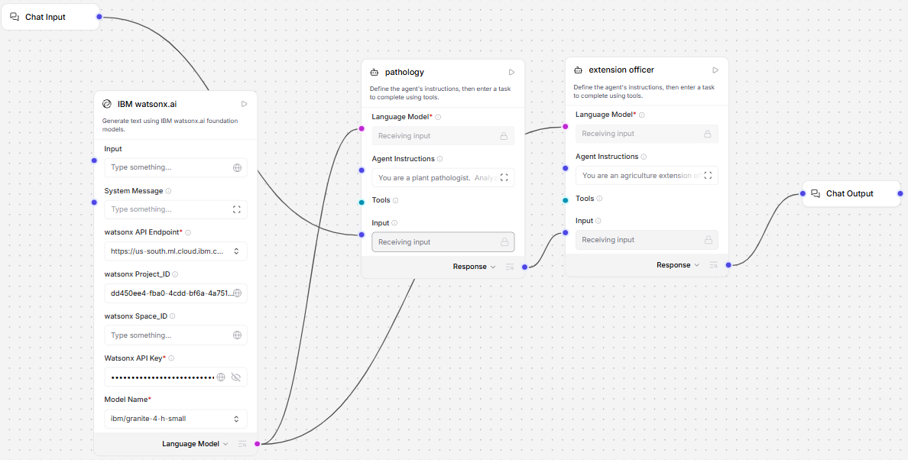
Langflow workflow -

Slide 8
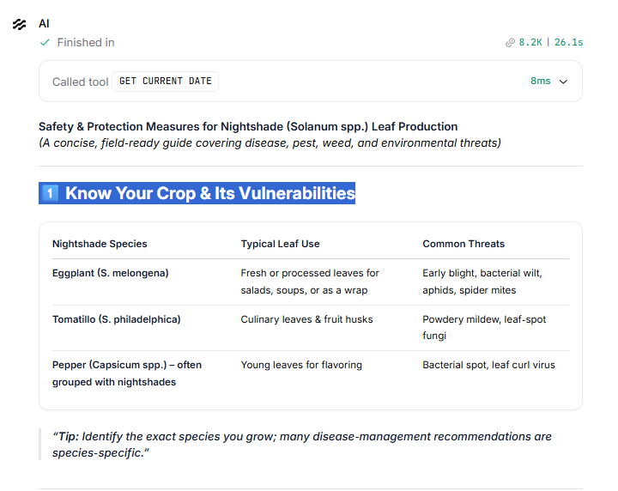
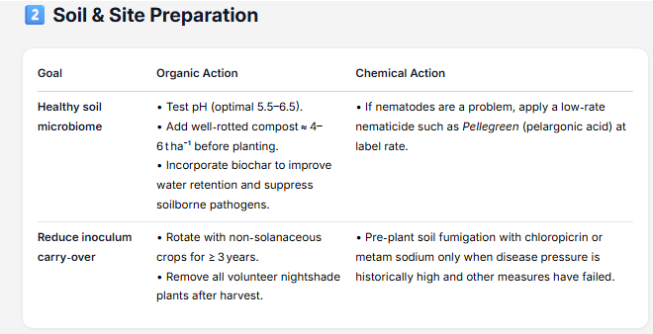
Output

Slide 9
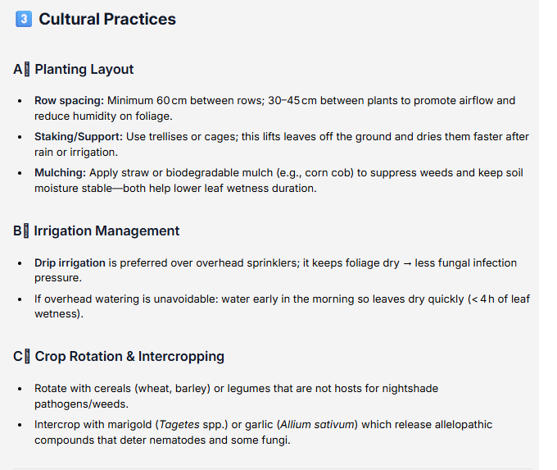
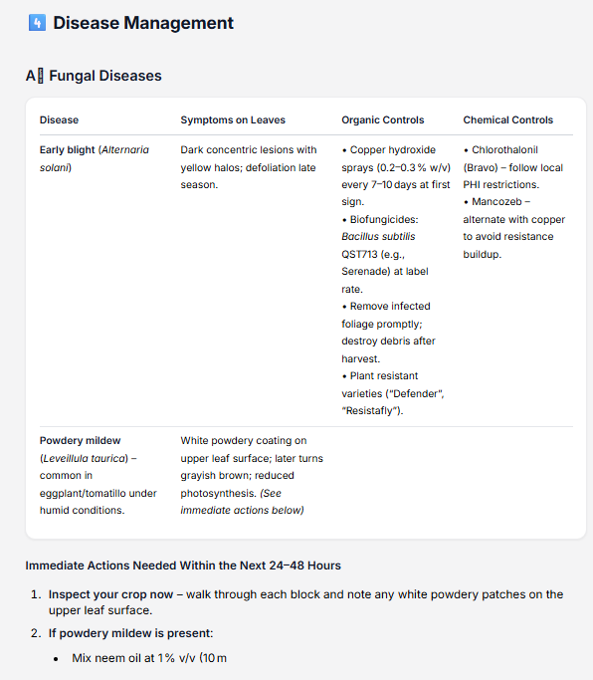

Slide 10
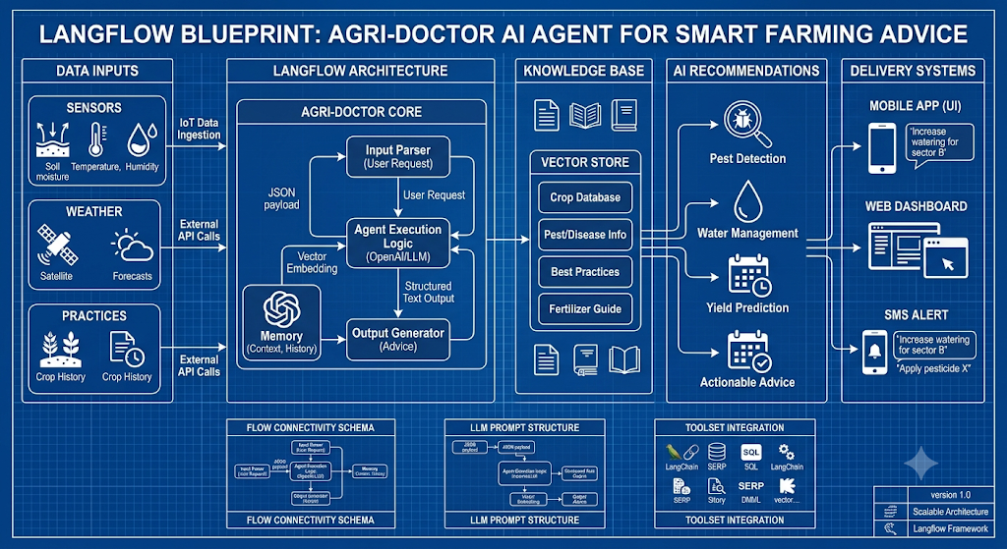
Architecture blueprint

Slide 11

Role of Agentic AI in the solution
Agentic AI enables the Farming advice to function as an intelligent, autonomous system rather than a simple chatbot. Using IBM watsonx.ai and IBM Granite models, it coordinates multiple specialized agents to deliver personalized nutrition guidance.
Agent 1(pathology):When a farmer inputs a query (e.g., "My tomato leaves have dark brown spots with yellow rings"), this agent assumes the role of a laboratory expert. It focuses purely on biological precision: identifying the exact pathogen, defining the botanical symptoms, and providing a rigorous list of organic and chemical treatments.
Agent 2(extension officer):This agent accepts the complex, highly technical output generated by the Plant Pathologist. Rather than showing that dense jargon directly to the farmer, it acts as a human translator. It rewrites the instructions into simple, localized language, maps out step-by-step instructions, and explicitly details what the farmer must do in the next 24 to 48 hours to salvage their crop.
This multi-agent approach ensures efficient task execution and accurate results.
Overall, Agentic AI makes the system proactive, personalized, and goal-driven, acting like a smart farming that helps farmers.

Slide 12
Technology Used
Langflow platform -For designing and orchestrating multi-agent workflows visually
IBM Grainte model - for eg – ibm-granite-3-2-8b – For natural language understanding, reasoning, and personalization
IBM Cloud – It provides the infrastructure to build, deploy, and scale the Nutrition Agent efficiently. IBM Cloud enables a reliable, secure, and scalable environment for deploying the Nutrition Agent.
RAG– RAG to fetch real data first, then generate intelligent answers, making the Nutrition Agent more trustworthy and effective.
IBM Watsonx.ai - For model deployment, embeddings, and AI governance
Vector Database (FAISS/Chroma) – For RAG-based nutritional data retrieval

Slide 13
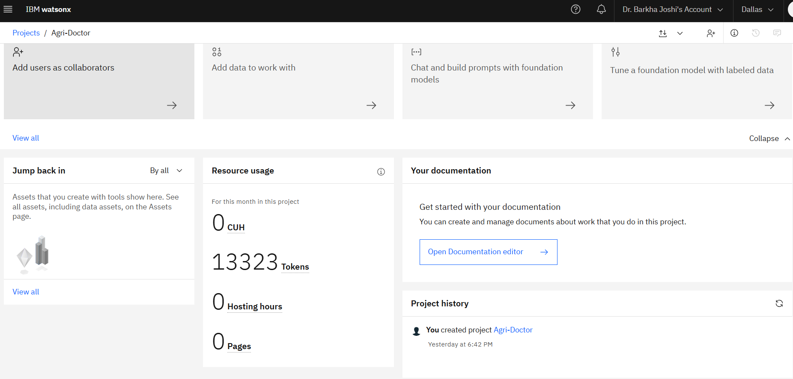
Token Usage
13323 token are used
·
·
·

Slide 14
Novelty and Uniqueness
1. Agentic AI-Based Agricultural Decision Making
Unlike traditional agricultural chatbots that rely on a single AI model, the proposed system employs an Agentic AI architecture where multiple specialized agents collaborate autonomously to solve complex farming problems. Crop Advisory Agent ,Weather & Irrigation Agent ,Pest & Disease Detection Agent.
This enables dynamic planning, reasoning, and task delegation rather than simple question answering.
2. Multi-Agent Collaboration with Intelligent Routing
The system automatically determines which agents are required based on the farmer's query and coordinates them in parallel.
3. RAG-Powered Agricultural Knowledge Engine
The solution combines IBM Granite Models with Retrieval-Augmented Generation (RAG) to provide accurate, explainable recommendations.Agricultural research documents ,Crop cultivation manuals Pest and disease databases.This reduces hallucinations and ensures reliable recommendations.
This makes the solution a smart, adaptive, and proactive digital nutritionist, not just a static diet recommendation tool.

Slide 15
Git Hub Link
https://github.com/barkhasvit/Smart-Farming
·
·
·

Slide 16
Future Scope
1.AI Agent for Smart Farming Advice can be extended into a comprehensive digital agriculture ecosystem by incorporating advanced AI, IoT, remote sensing, and predictive analytics capabilities.
1. IoT-Based Smart Farm Monitoring
Integrate IoT sensors to collect real-time data on:Soil moisture ,Soil pH ,Temperature ,Humidity ,Nutrient levels This will enable automated and data-driven irrigation and nutrient management.
2. Drone and Satellite-Based Crop Monitoring
Leverage drones and satellite imagery to:Detect crop stress ,Monitor crop growth stages ,Identify pest infestations early ,Estimate crop health at field scale ,This would improve precision agriculture practices.
3. Predictive Disease and Pest Outbreak Forecasting
Use historical weather, soil, and disease data to predict:Disease outbreaks ,Pest infestations ,Yield losses ,allowing farmers to take preventive measures before damage occurs.
4. AI-Powered Yield Prediction
Develop machine learning models that estimate crop yield based on:Weather conditions ,Soil health ,Crop variety ,Cultivation practices
·
·
·

Slide 17


